Slide 1
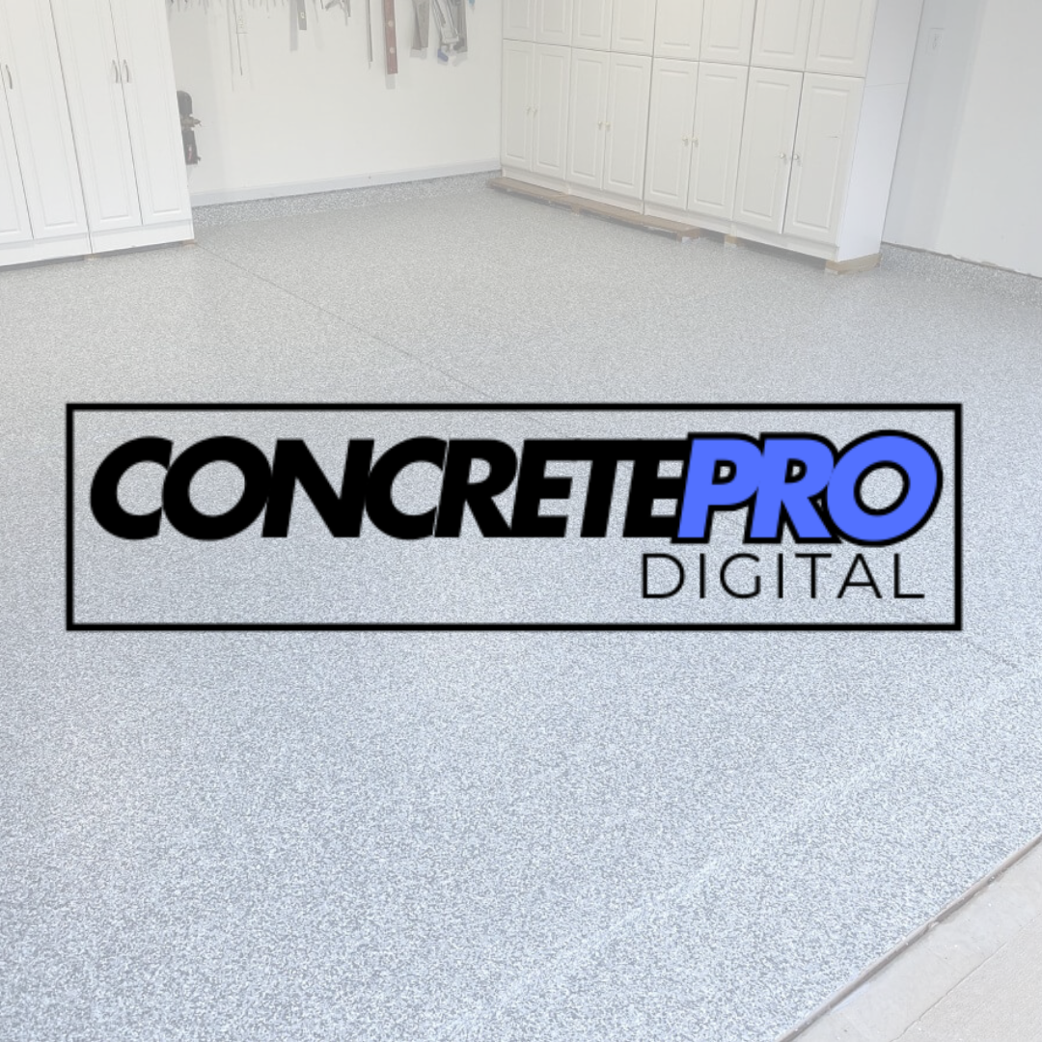
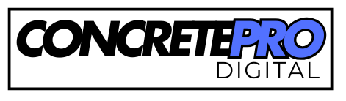
ConcretePro Digital
Specialized Marketing Solutions for Concrete Coating Companies
Who We Are:
A dedicated digital marketing agency focused exclusively on elevating concrete coating businesses.
Proven track record with over $5 million in client revenue generated and management of more than $1 million in ad spend.
Our Results:
Thousands of high-quality Leads Generated
Over $5 Million in Client Revenue
$1M+ Managed Ad Spend
Average 7:1 ROI

Slide 2
All 100% Done-For-You System
(You Just Cover Ad Spend)
Proven by Concrete Coating Pros All Over The U.S.
✔️ Technical Setup
✔️ Ad Graphic & Video Design
✔️ Copywriting
✔️ Campaign Buildout
✔️ Dedicated Landing Page (included)
✔️ Launch & Optimized

Slide 3
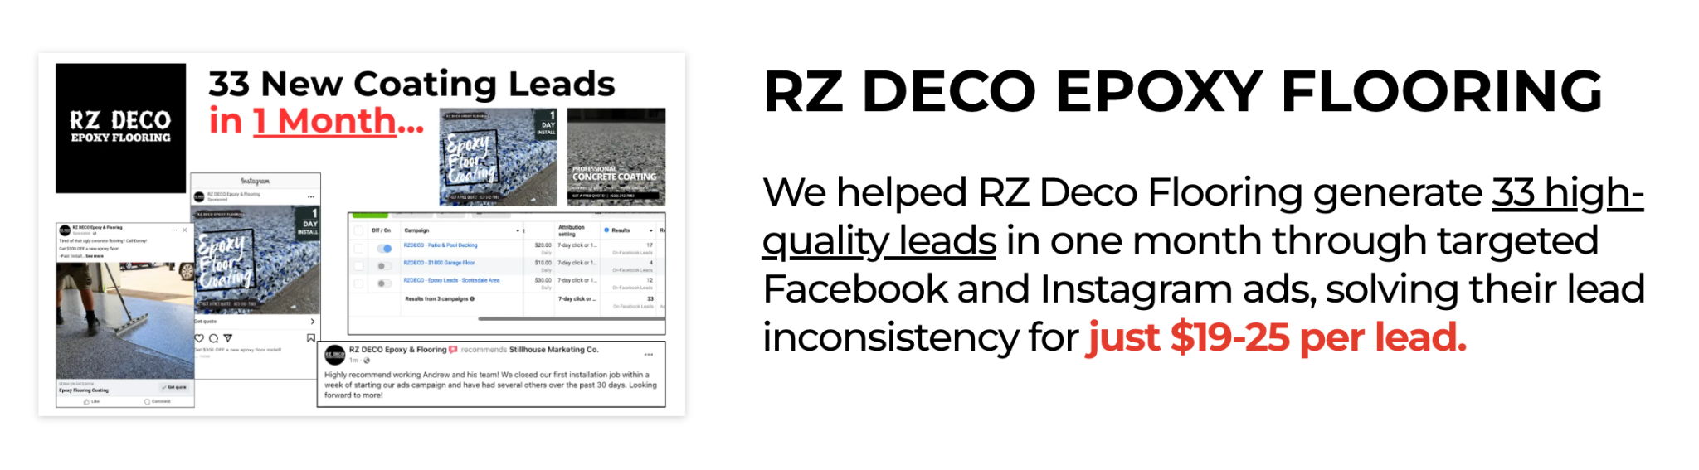
What This Is
PROVEN System to fill your business with High Quality Coating Customers That Actually Close!
(Without Risk to you)

Slide 4
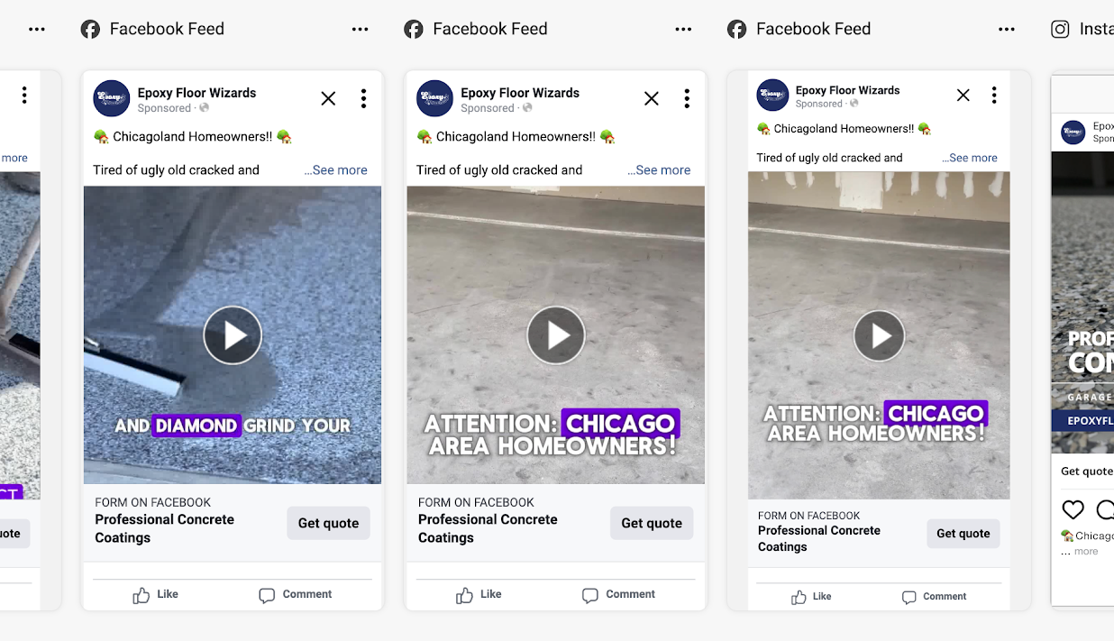
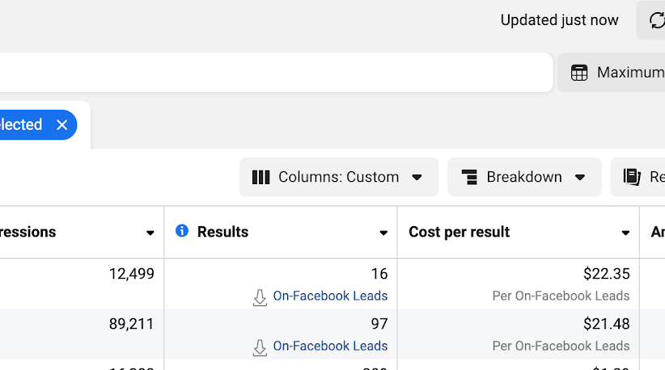
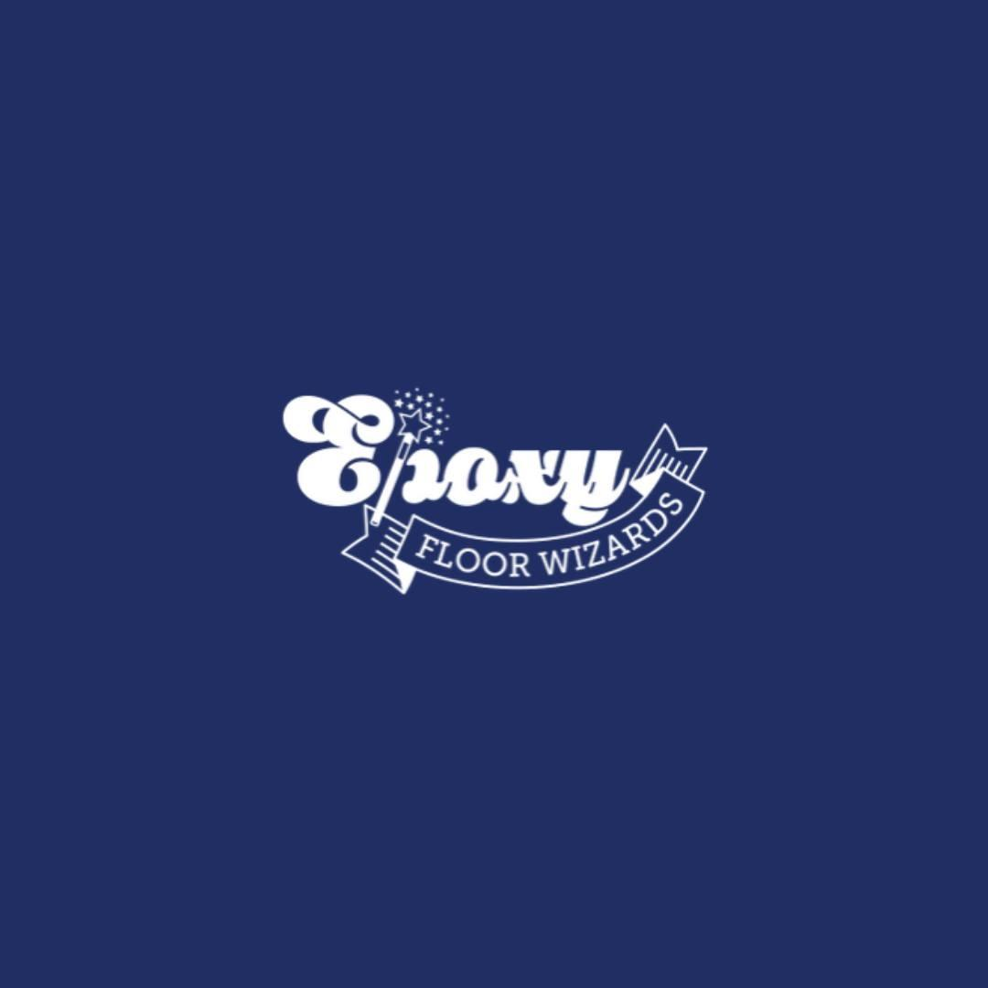
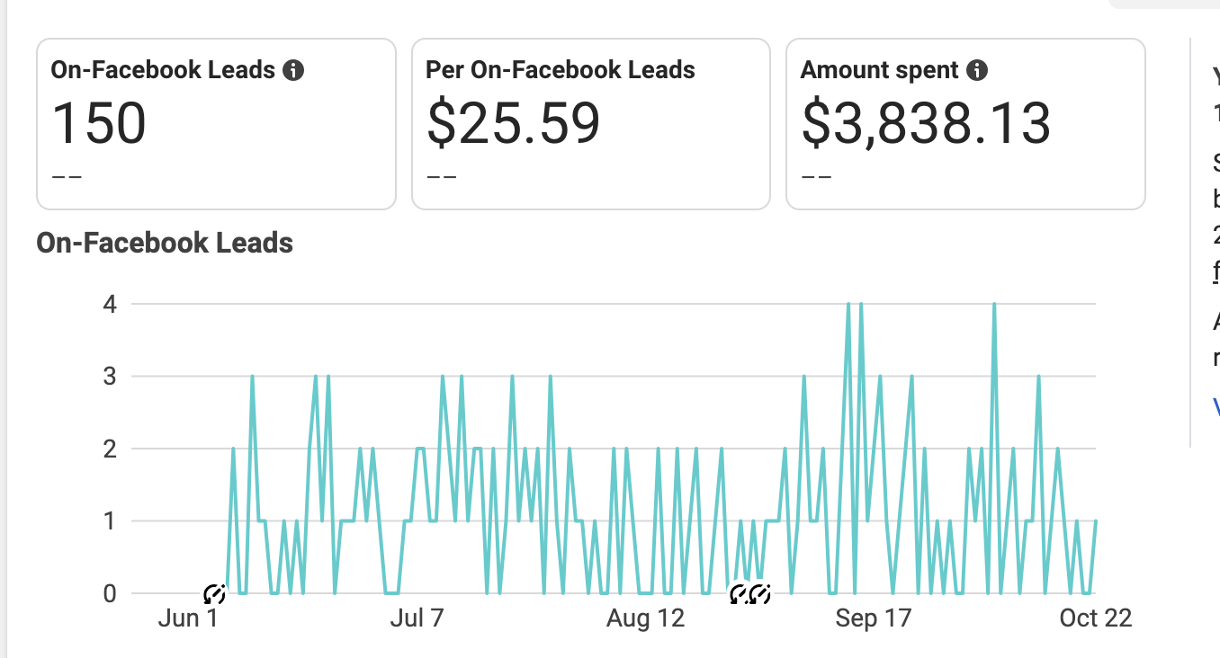
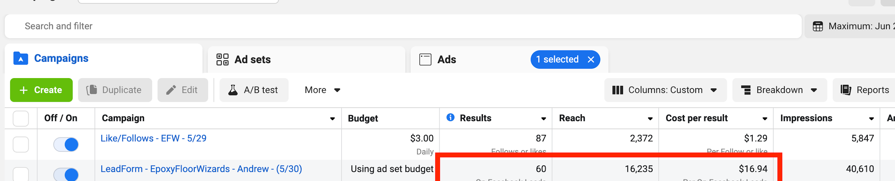
Epoxy Floor Wizards
By partnering with us, Epoxy Floor Wizards transformed their inconsistent lead generation into a steady stream of high-quality leads, achieving a 6:1 ROI.
Generated 91 new leads at $14-19 per lead
Achieved a 7:1 return on ad spend (ROAS)
Set up automated follow-ups and a CRM to boost lead conversion

Slide 5
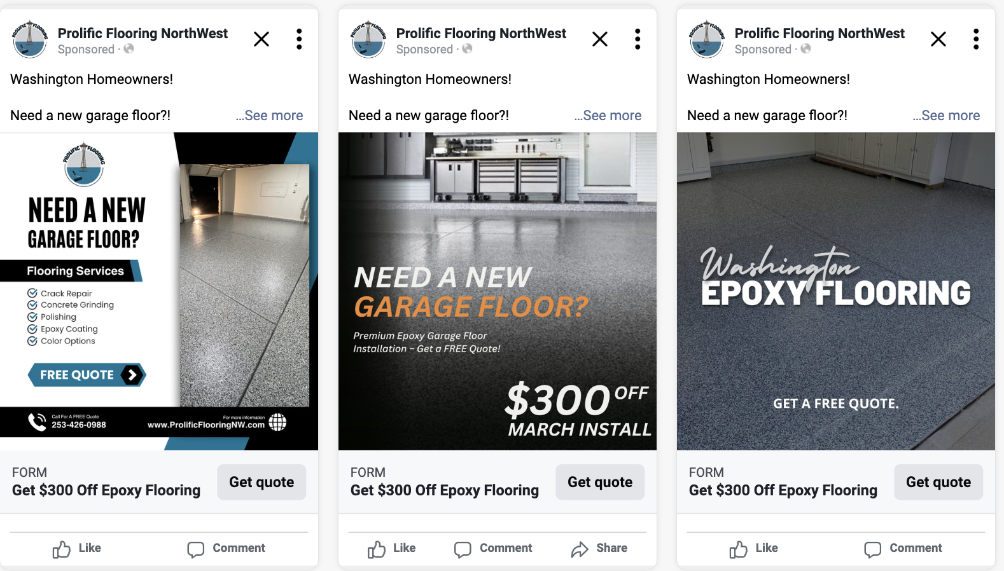
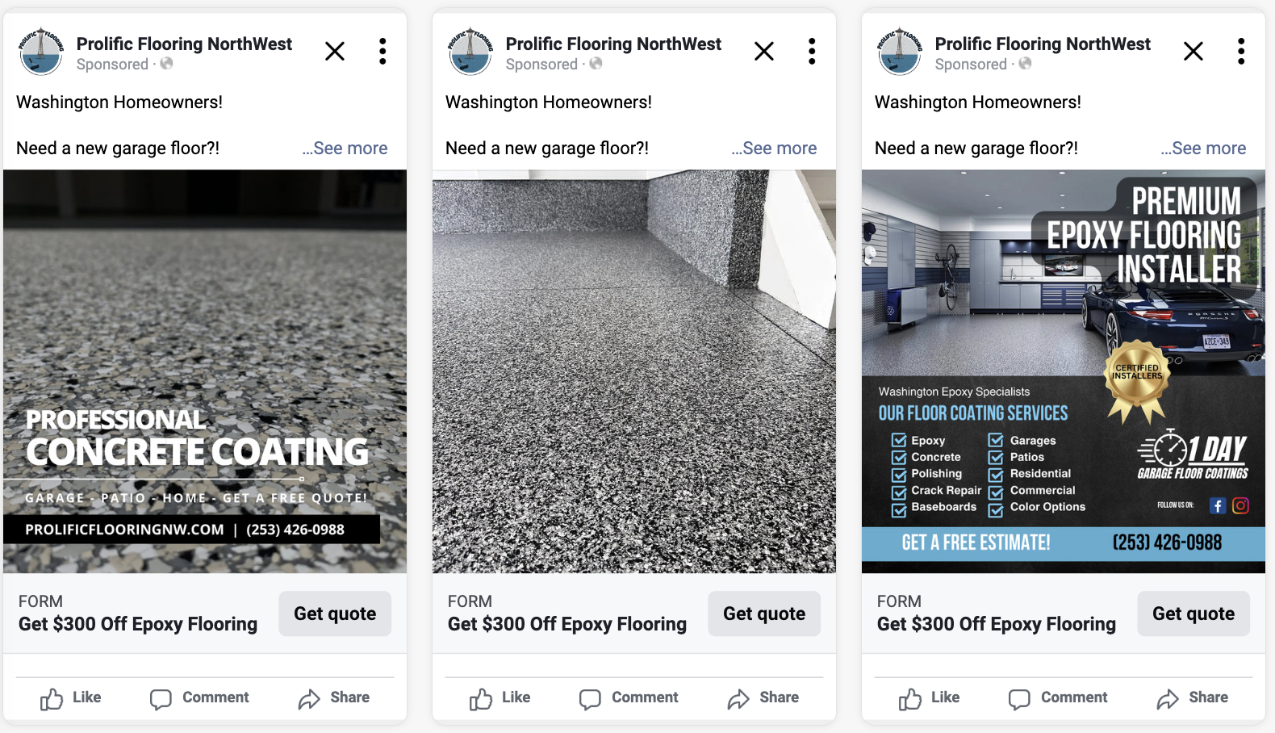
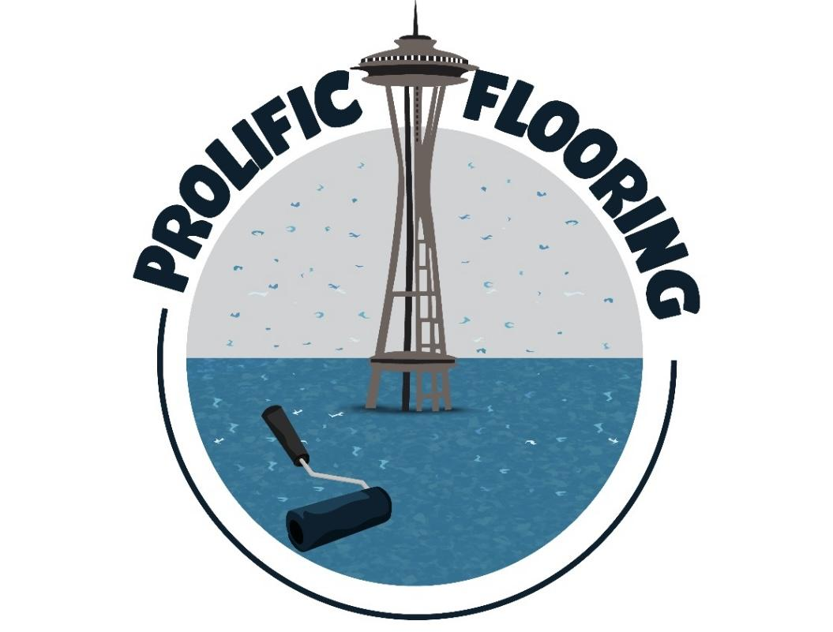
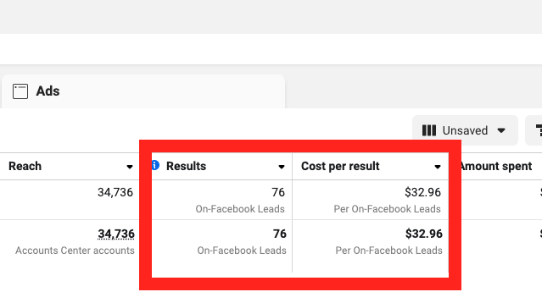
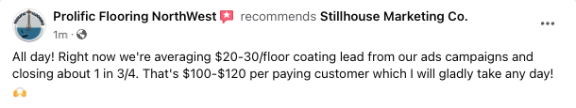
Prolific Flooring
In just two months, Prolific Flooring transitioned from relying on referrals to generating a steady stream of exclusive, high-quality leads through targeted Facebook and Instagram ads, resulting in higher profits and consistent business growth.
Over 70 exclusive leads generated at just over $30 per lead.
Implemented CRM automation for consistent follow-up and improved conversions.
Shifted from subcontracting to closing higher-margin direct jobs.

Slide 6
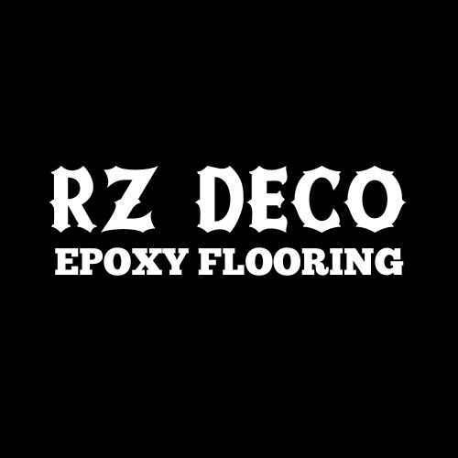
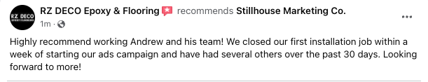
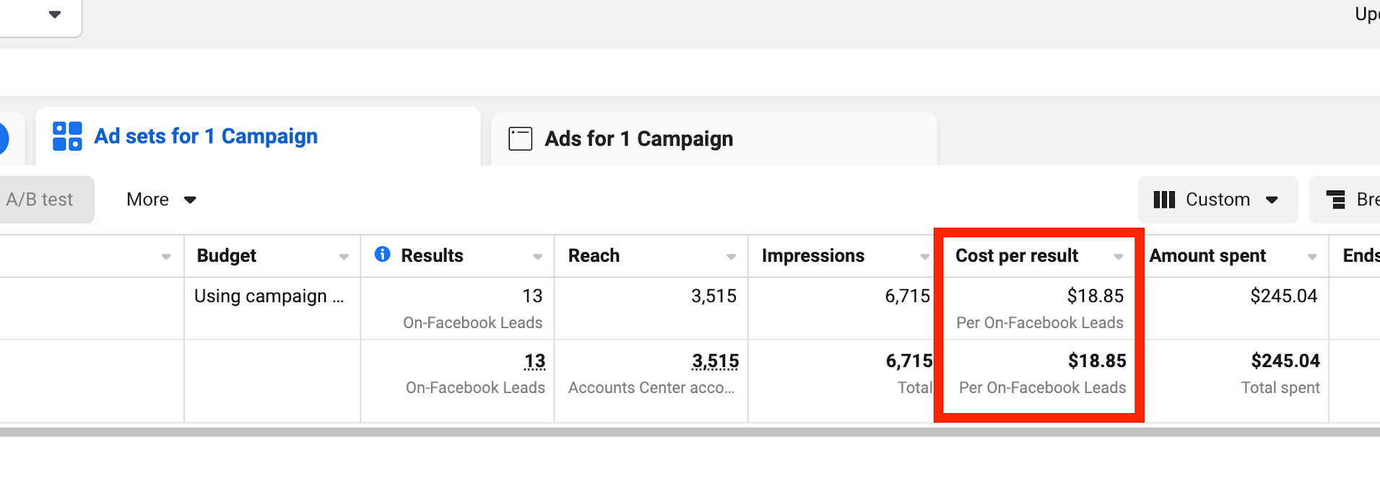
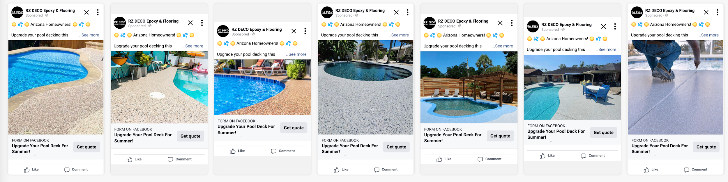
RZ Deco Epoxy Flooring
By focusing on targeted Facebook and Instagram ads, we helped RZ Deco Flooring generate 33 new, high-quality leads in just 30 days at $19-25 per lead, ending their struggle with inconsistent lead flow.
33 leads generated in one month
Cost per lead: $19-25
Leads sent directly for immediate follow-up, improving conversion

Slide 7
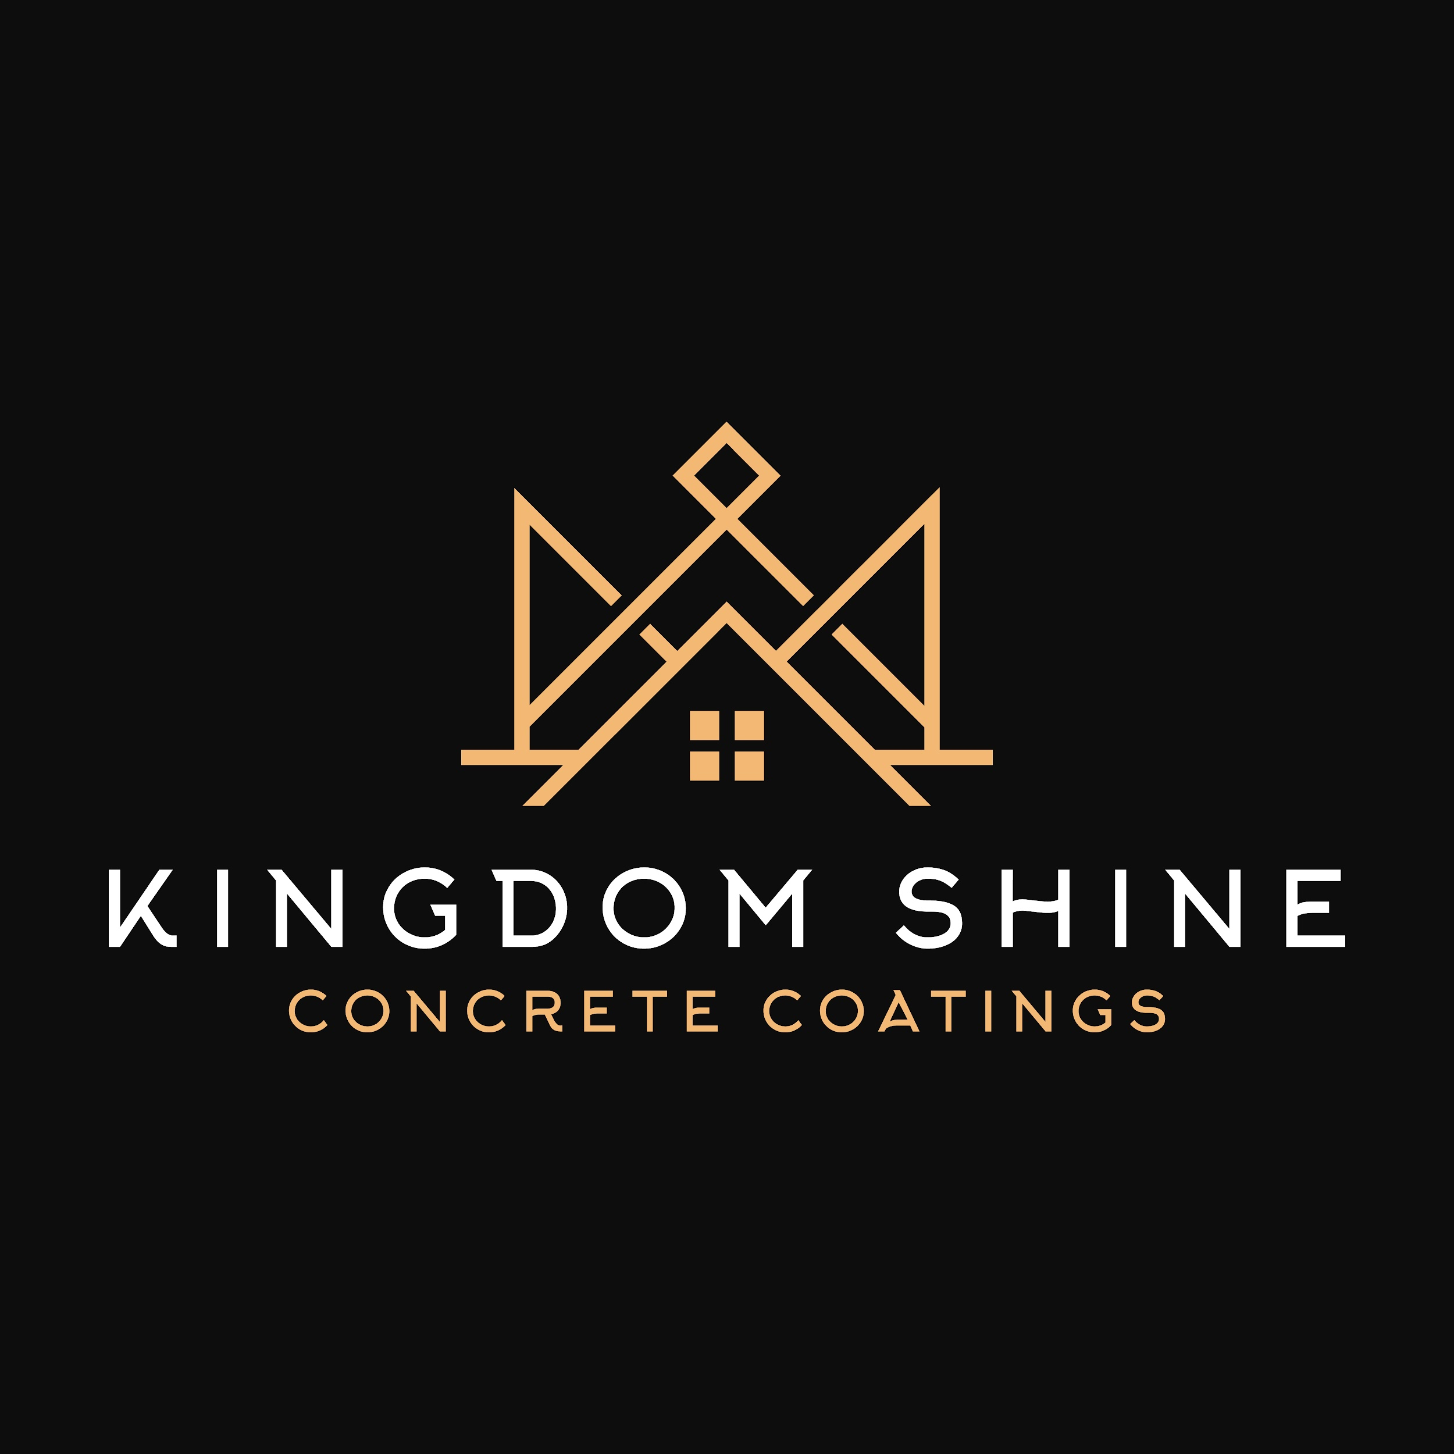
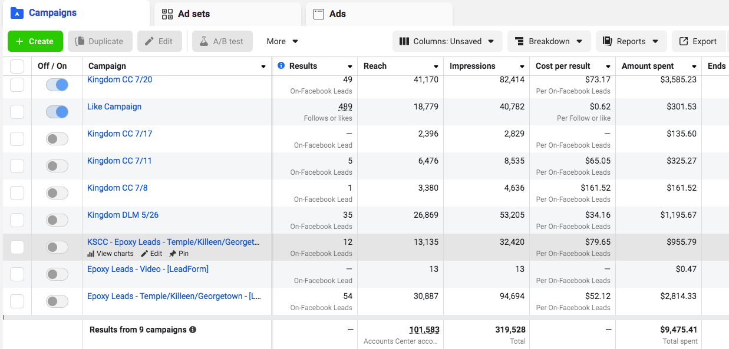
Kingdom Shine Concrete Coatings
In just one year, Kingdom Shine Concrete Coatings transformed from a startup to a six-figure revenue business under the leadership of owner Joel, thanks to a comprehensive marketing strategy that laid a solid foundation for growth.
Generated 66 leads in the initial push, fueling business launch and growth.
Reinvested nearly 100% of revenue into acquiring equipment, vehicles, and building a team.
Achieved over six figures in revenue within the first year, positioning for continued success.

Slide 8
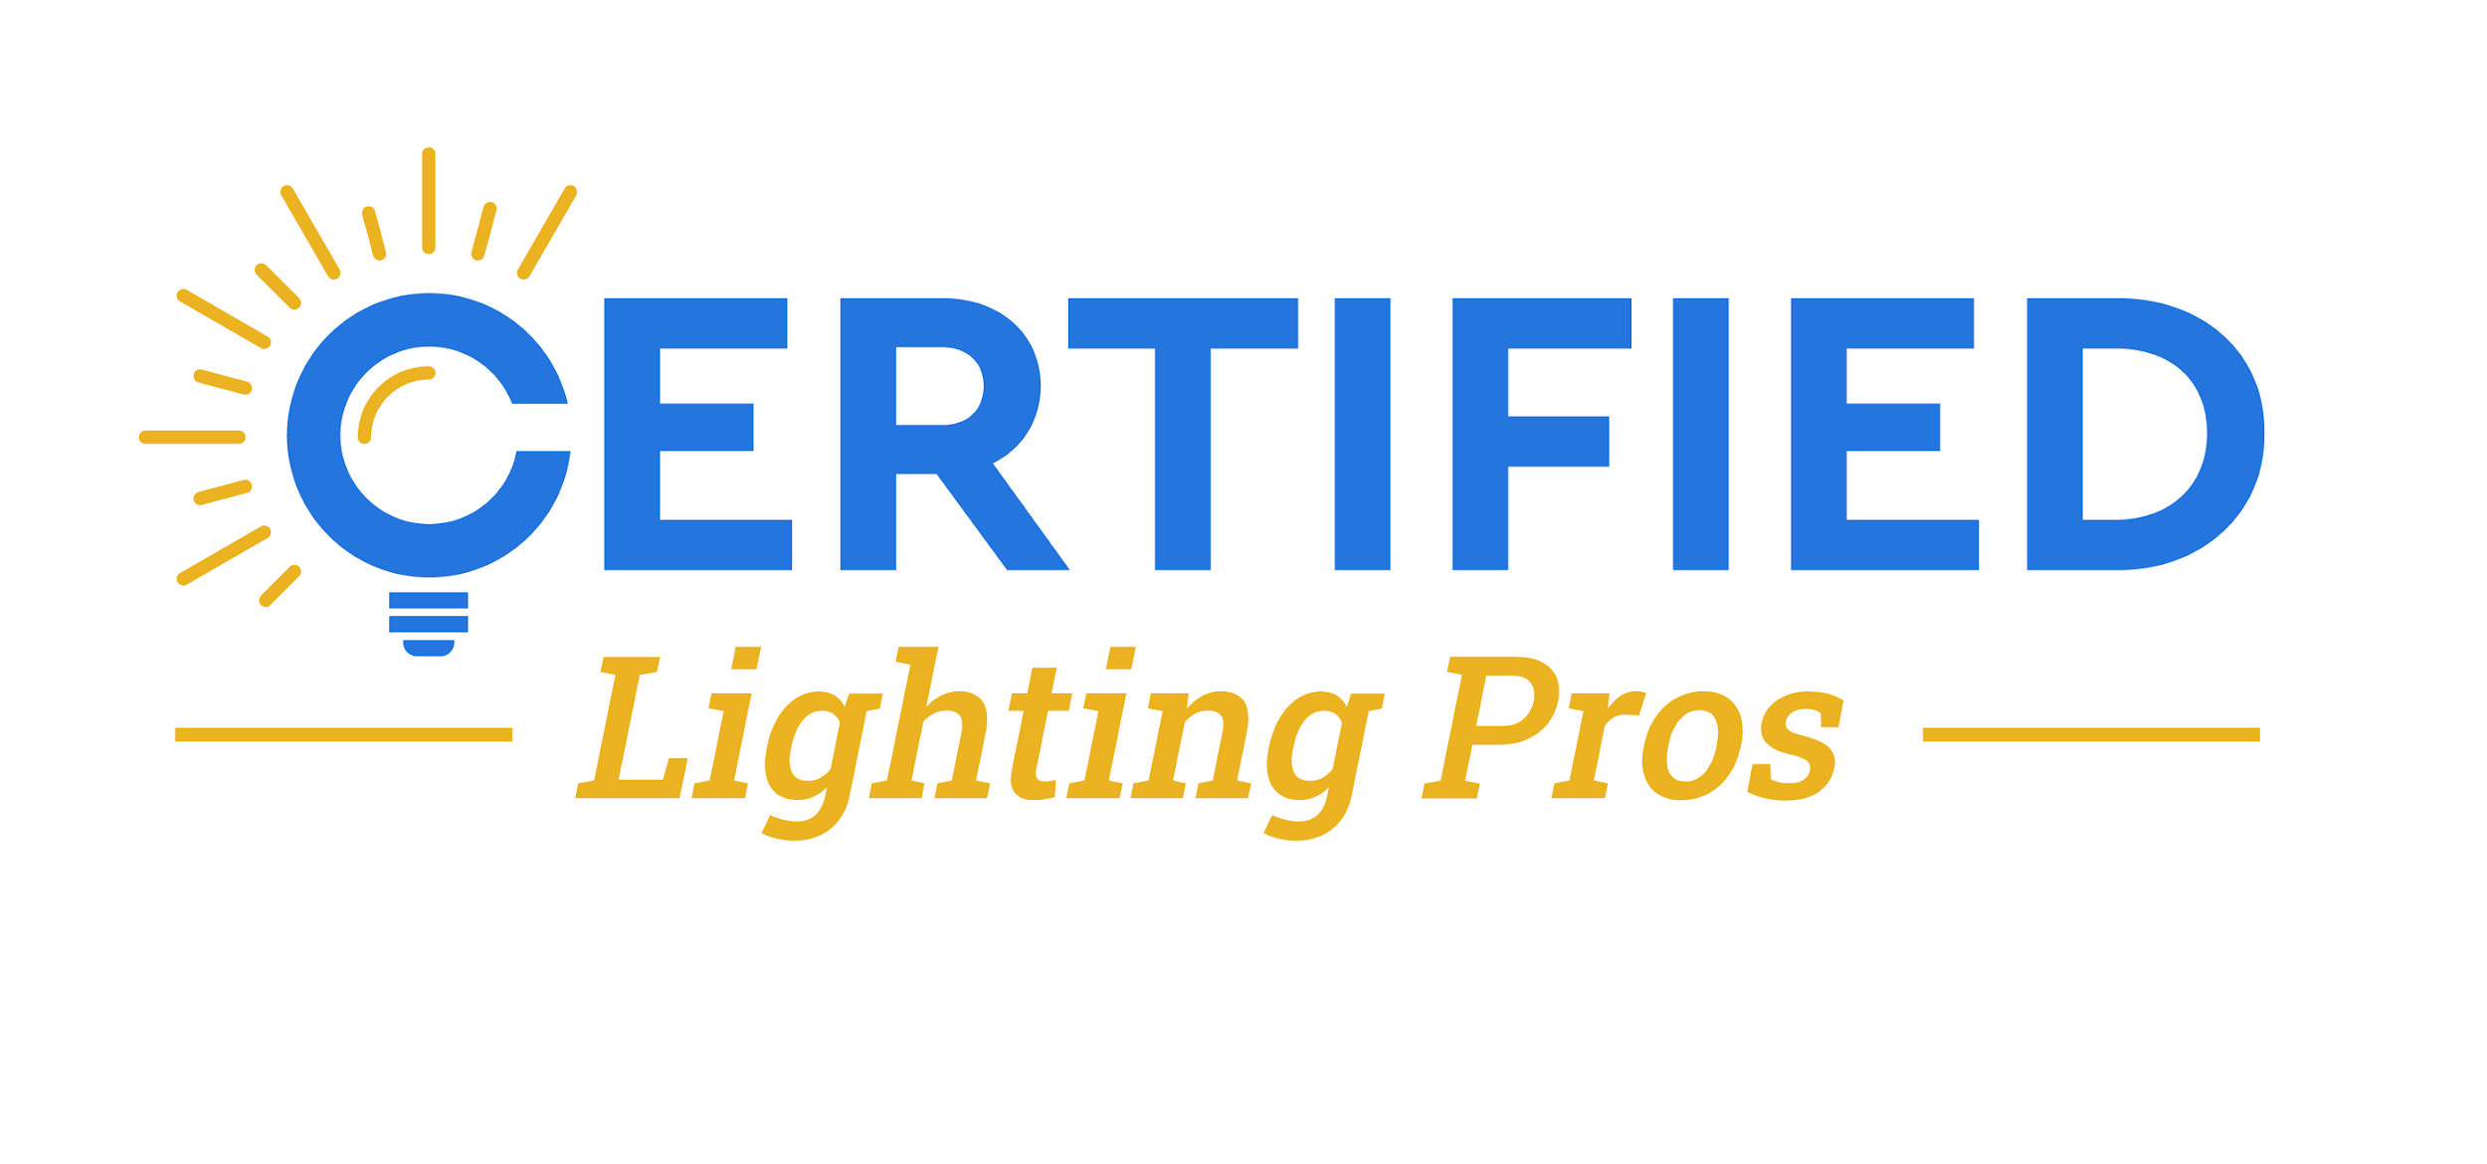
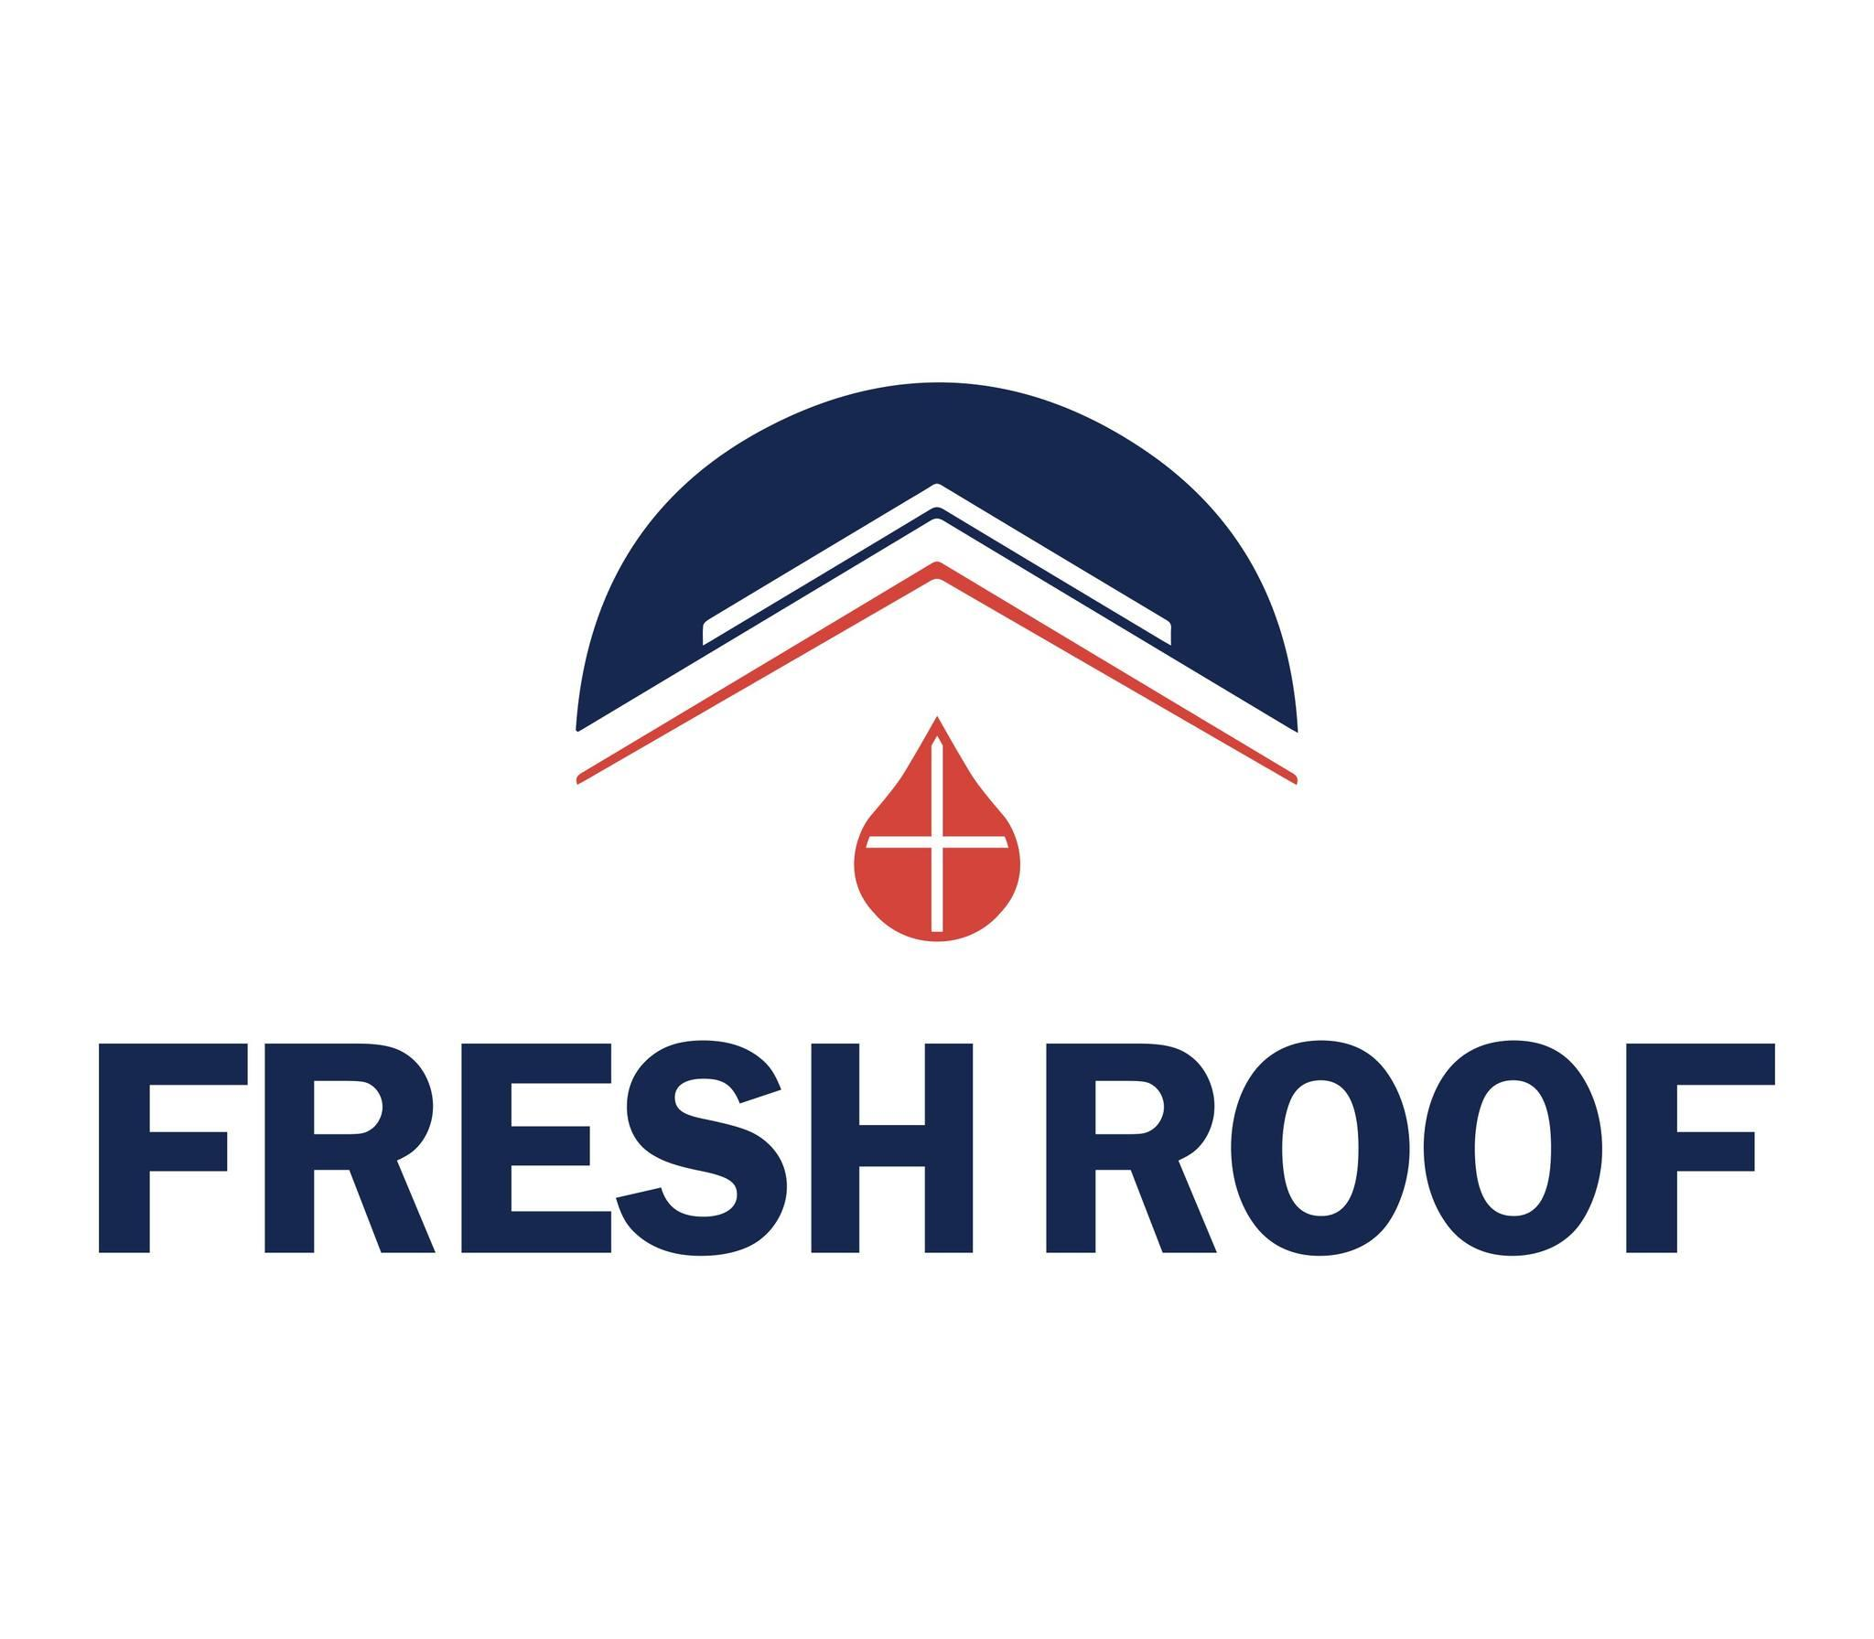
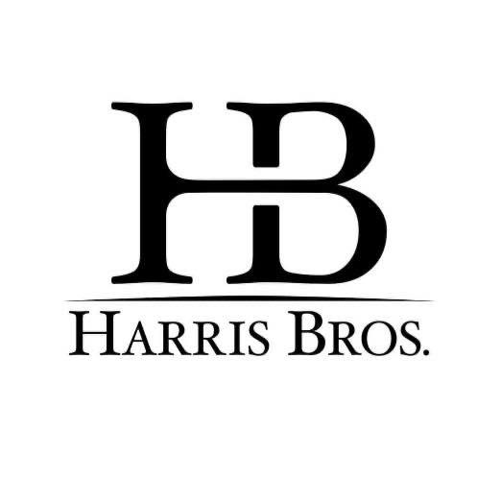

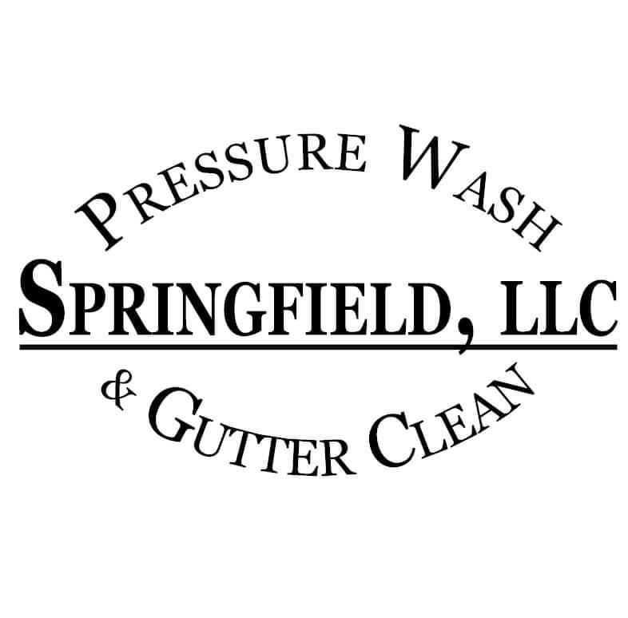
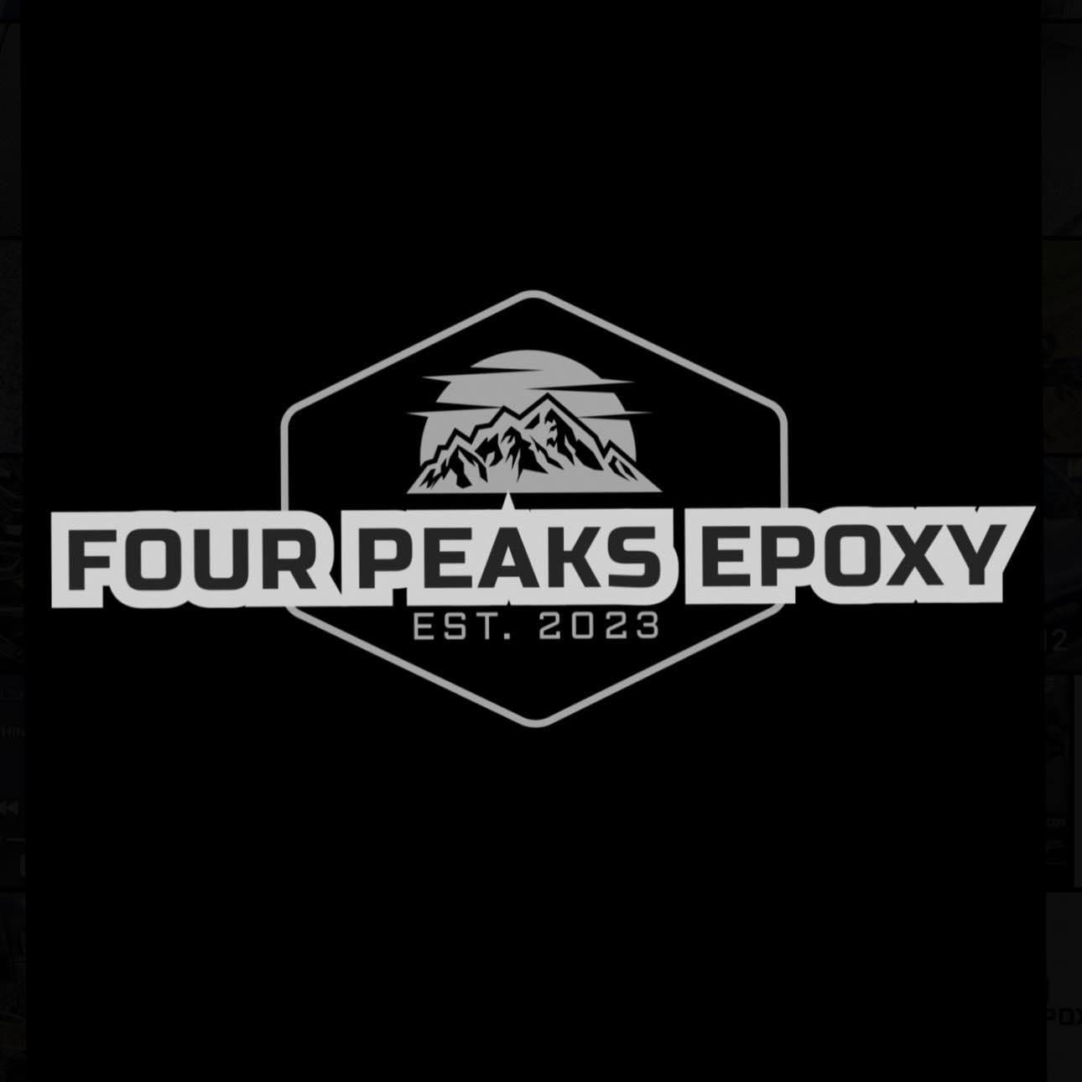
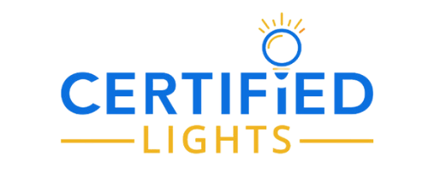
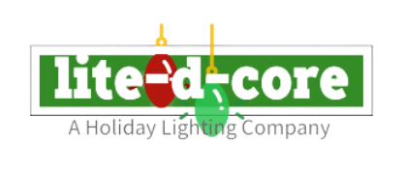
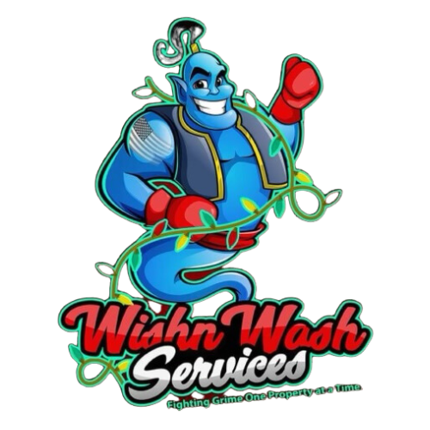
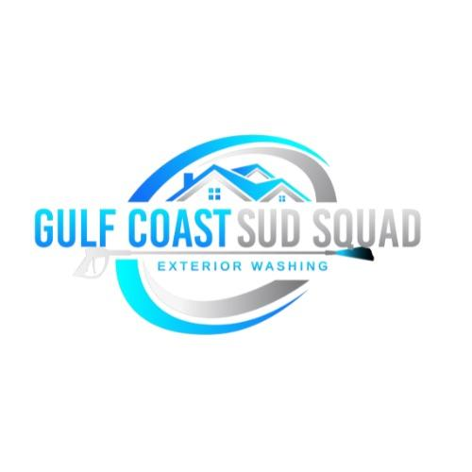

Some others we’ve worked with...

Slide 9
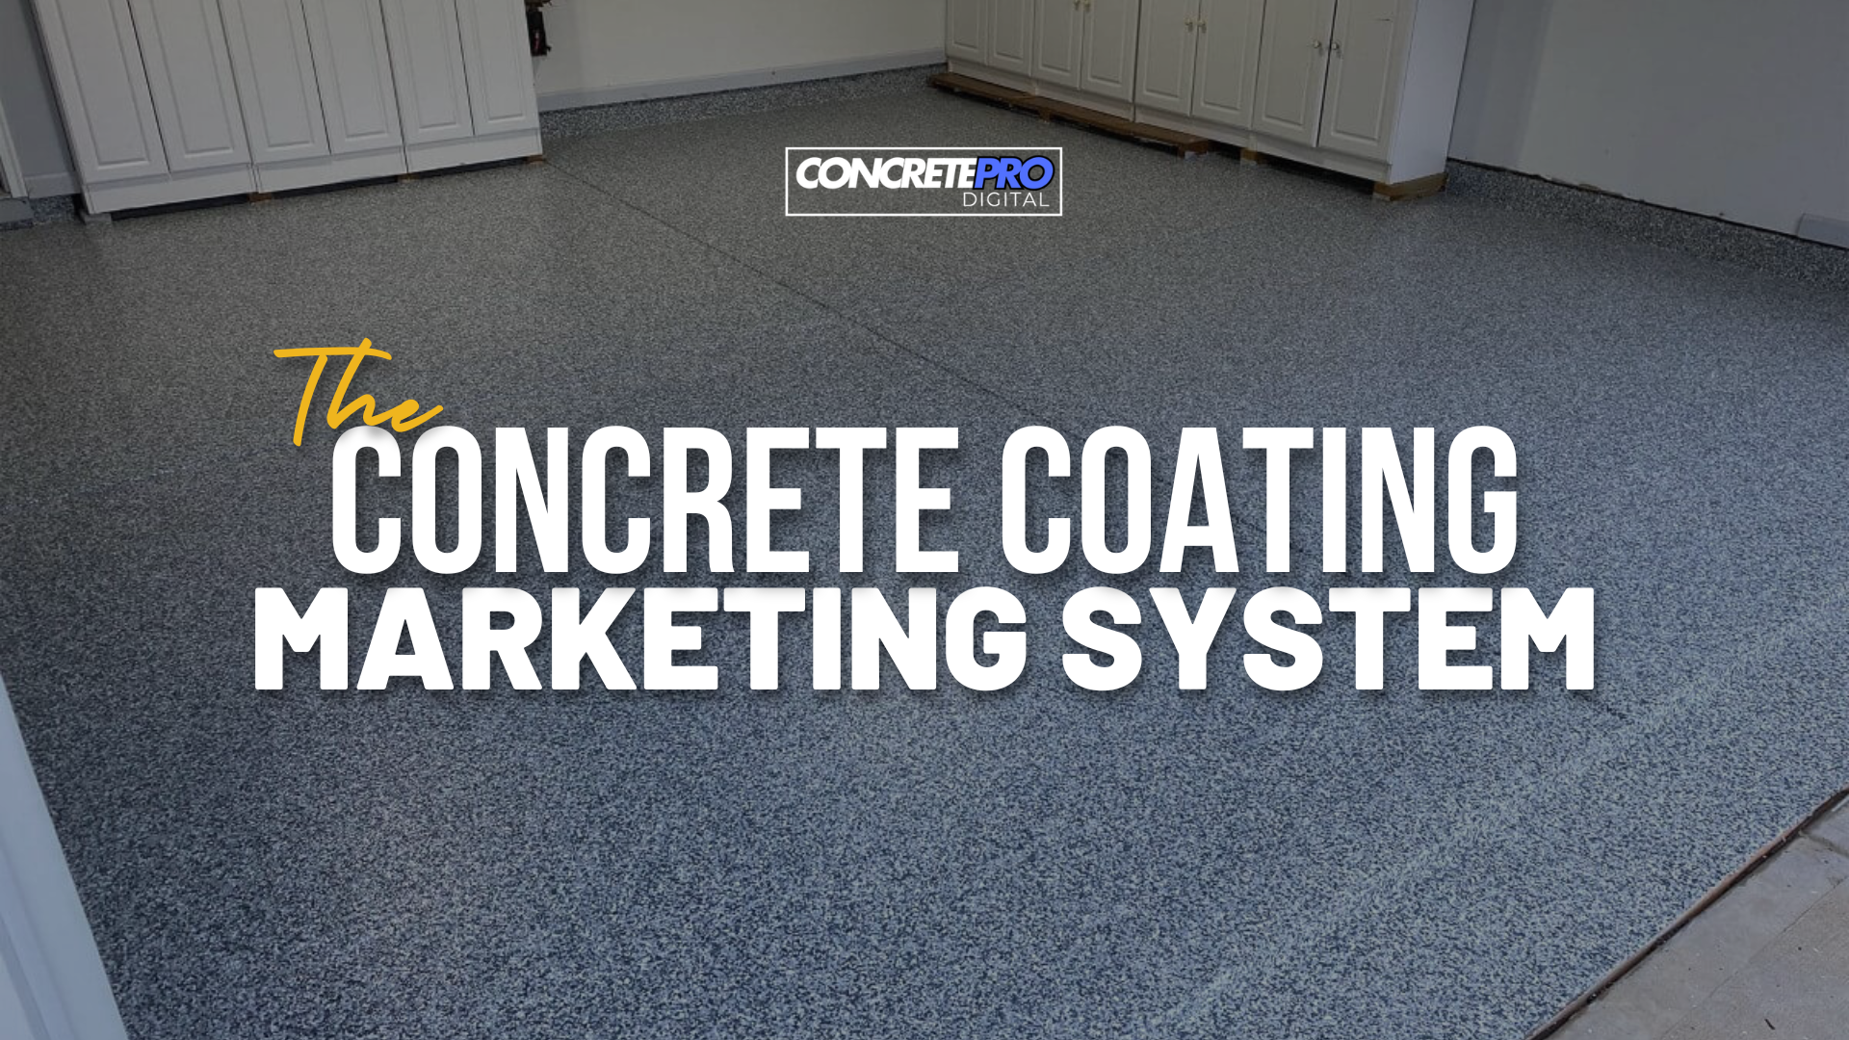

Slide 10
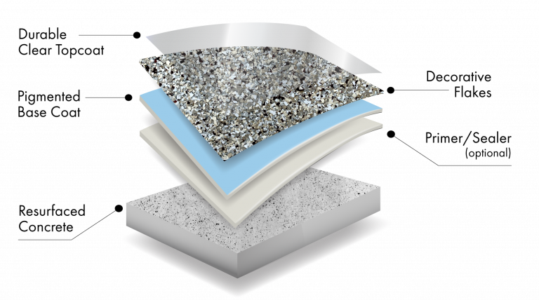
Think Of It Like…

Slide 11
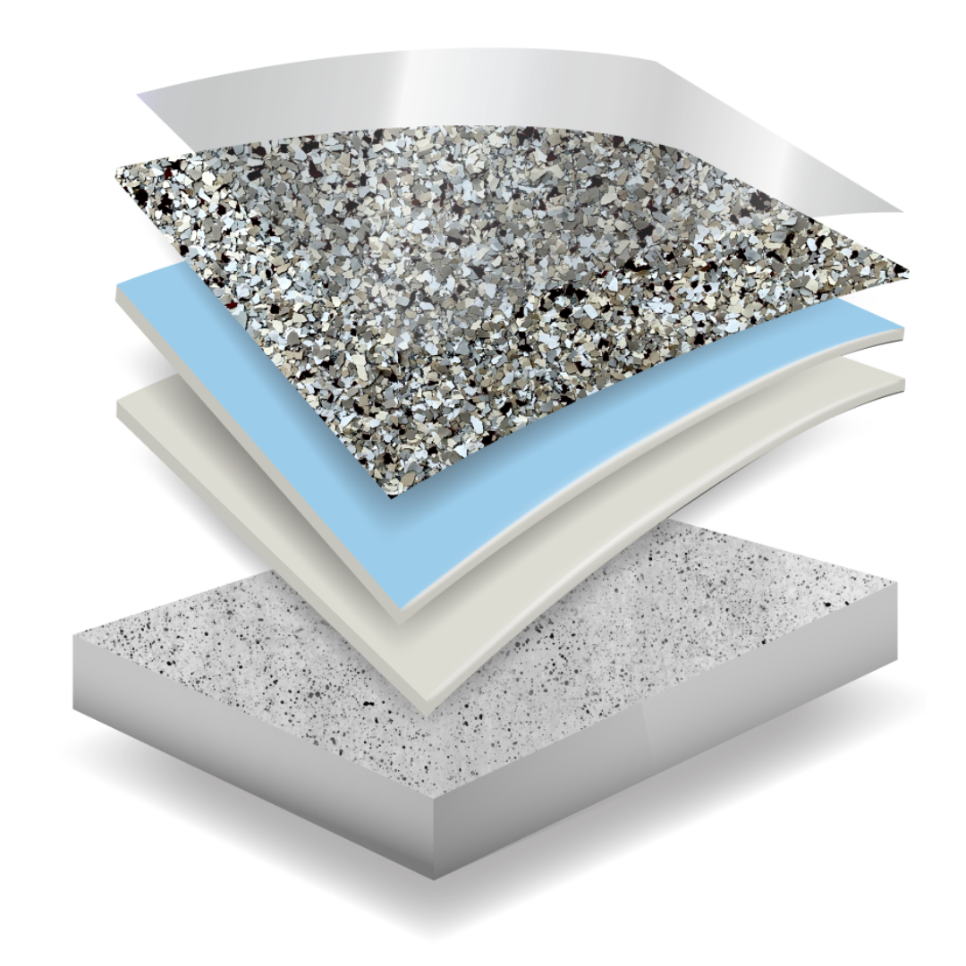
The ConcretePro System…
Foundation & Infrastructure
LeadFlow Ads System
Pipeline, Follow-Up, & Conversion System
Scaling: Reputation, Referrals, & Growth
Notes:
Our Epoxy Ads System works the same way…
The foundation & prep work is your ads strategy and framework
Then getting your offer and targeting is like your base coating that causes everything to stick
The your lead generation ads that everyone sees and wants…
The your retargeting and positioning ads to seal the deal and making your company stand out and shine…

Slide 12
Step 1: Foundation & Infrastructure

Slide 13
Foundation & Infrastructure
Every Great System Starts with Strong Prep Work…
Before we launch your marketing system, we lay the groundwork to ensure everything runs seamlessly:
Strategic Planning:
  Crafting high-converting offers tailored to your audience
  Developing precise targeting to reach your ideal customers
System Setup:
  Building custom lead forms to capture and track data
  Setting up campaign tracking and analytics to monitor performance

Slide 14
Integrations & Compliance
Connecting the Dots…
Building a Scalable System That’s Built To Last
3. Integration:
Linking ad accounts, websites, and CRMs
Enabling SMS automation to deliver leads instantly via text
4. Compliance & Optimization:
Adding or updating policy pages on your website for ad platform compliance
Ensuring ad accounts are properly configured and ready to go

Slide 15
Step 2: LeadFlow
(Your Ads System & Lead Generation…)

Slide 16
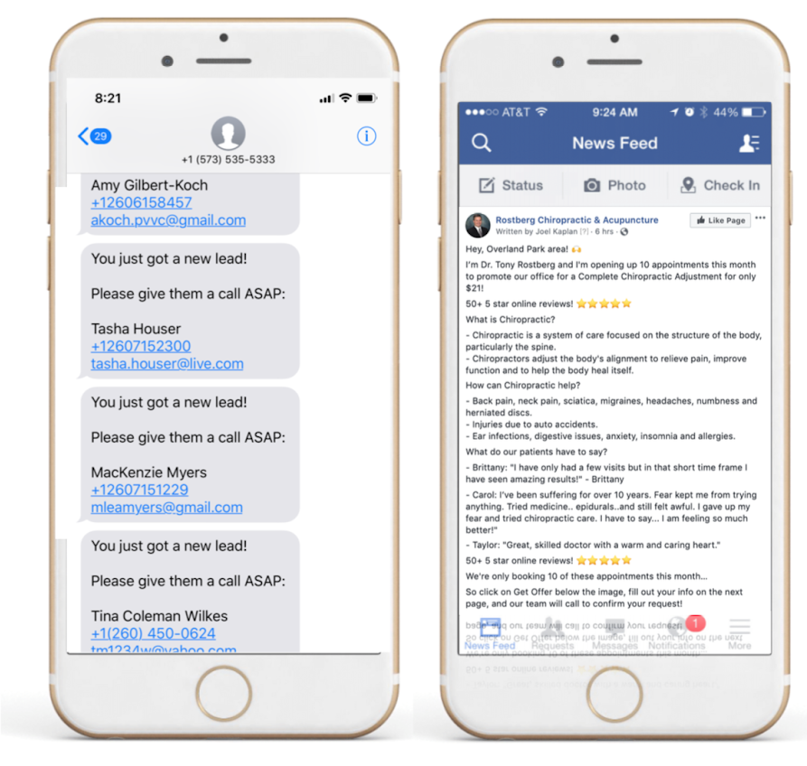
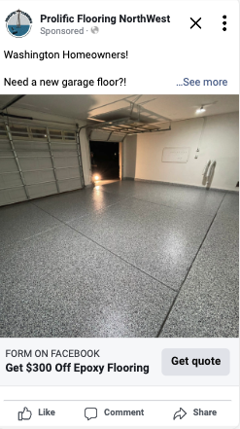
The ConcretePro Ads System
Pillar #2: Capturing Attention and Driving Leads
It all starts out with our battle tested advertising system, which is the proven method we use to to generate all of the opportunities for you, every day:
Targeted Ad Campaigns:
Facebook & Instagram ads tailored for your ideal customers.
Hyper-focused targeting to reach the people most likely to convert.
Compelling Creative:
Eye-catching visuals designed to stop scrolling.
Offers and ad copy that drive clicks and conversions.

Slide 17
The ConcretePro
Ads System
It all starts out with our battle tested advertising system, which is the proven method we use to to generate all of the opportunities for you, every day:
Targeted Ad Campaigns:
Facebook & Instagram ads tailored for your ideal customers.
Hyper-focused targeting to reach the people most likely to convert.
Compelling Creative:
Eye-catching visuals designed to stop scrolling.
Offers and ad copy that drive clicks and conversions.
Notes:
This is where your new leads are actually generated… as they request quotes and estimates and more information.
In this step, we gather information like:
Type of project
Timeline they’re looking to have it done by
Size of space
Additional notes and descriptions
Along with their address and contact information
And then all of that information is immediately sent over to you by phone and in email.

Slide 18
Proven Offer + Copy + Design
Not all ads are created equal.
We create and utilize PROVEN ads that we know convert to new customers.
Hence why we offer
GUARANTEED RESULTS!
Notes:
For this step - we start with a proven framework of ad designs, offers, and copy that we already know converts from working with floor coating businesses all over the US… and then we take that and further customize it all with your specific images, logo, and contect to fit your company’s brand, look, and style…
Which we end up with a campaign strategy that’s built on a proven framework and that’s custom tailored to your company and market…
And then - we multiply that by 10

Slide 19
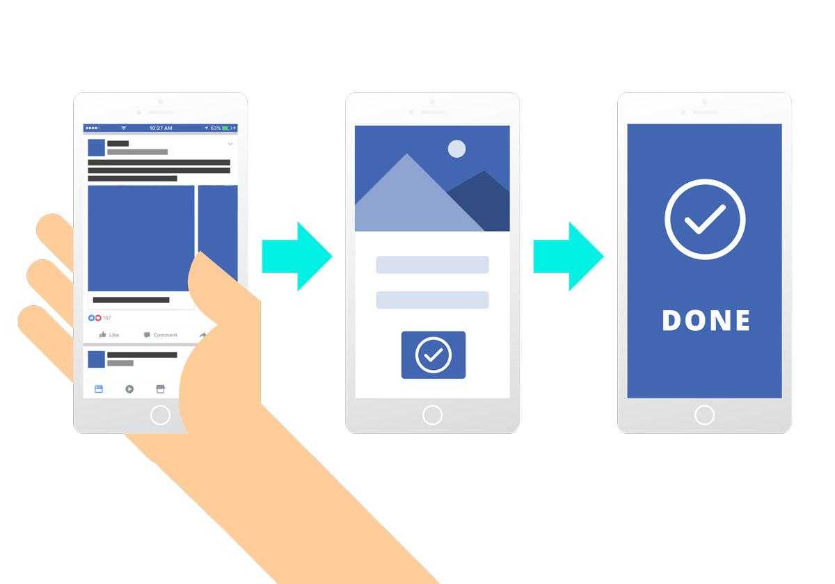
Leadflow - Ads System & Lead Generation
Capturing Attention and Driving Leads…
Optimized Lead Forms:
Streamlined, user-friendly forms for high-quality lead capture.
Built-in tracking to measure ad performance and lead flow.
Data-Driven Adjustments:
Regular reviews to refine targeting and messaging.
Ongoing optimizations to improve cost per lead and overall ROI.
Visuals: A Simple flowhart: “Ad” → “Lead Form” → “Lead Delivered”

Slide 20
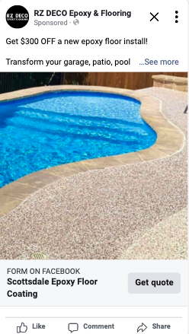

Case Studies
Notes:
And so we’re not running a single ad image or video - but multiple ads - within the proven framework so people are not getting pounded with the same thing over and over again… where your ads eventually fatigue and results drop off over time.
Instead we use, what’s called a “dynamic” ad approach - where we’re…

Slide 21
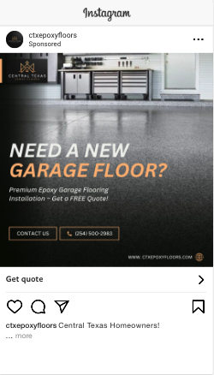
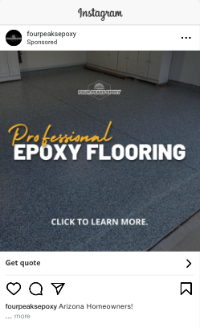
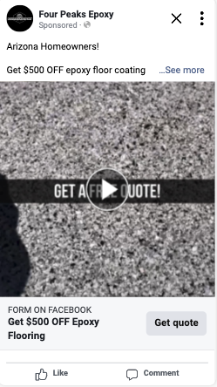
Case Studies
Notes:
Building awareness of your company in your market - and people are seeing a variety of ads instead of annoying them with the same thing over and over again.

Slide 22
RETARGETING & BRANDING “Authority” CAMPAIGNS
We want to position your business as the leading epoxy specialist within your community
Because thousands of customers will see your campaigns - You will create a omnipresence and an engaging brand awareness
Direct access coupled with a long term play. Customers now is the goal. But our goal is to create a “authority ” behind the business with long term branding strategies.
More calls and increase brand perception ORGANICALLY
You’re building a MASSIVE database of IDEAL customers
Notes:
So to get the best out of lead generation ads campaigns - we also need to position ourselves as an authority and leading floor specialist in your community. Thousands of people will see your ads and company. They’ll also see some of your competitors as well. We want to set are selves apart from them to be seen as the go-to company for concrete coating.
And we do this by adding an authority building layer to our ads system - to position you above other options in your market
And then a Retargeting layer to complete the system.

Slide 23

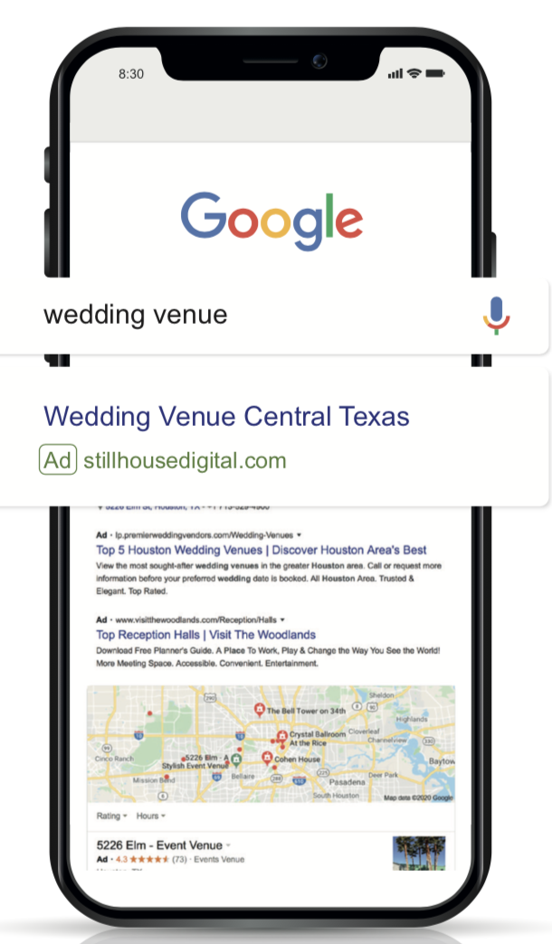



Where most people FAIL...
Over a few days or weeks...
Your
Ad
Your
Ad
Your
Ad
Your
Ad
Your
Ad
Your
Ad
Your
Ad
Your
Ad

Slide 24
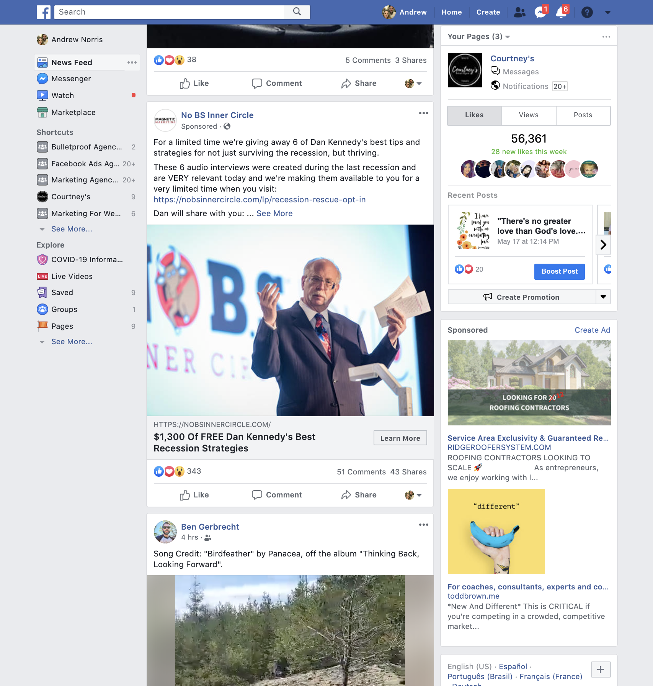
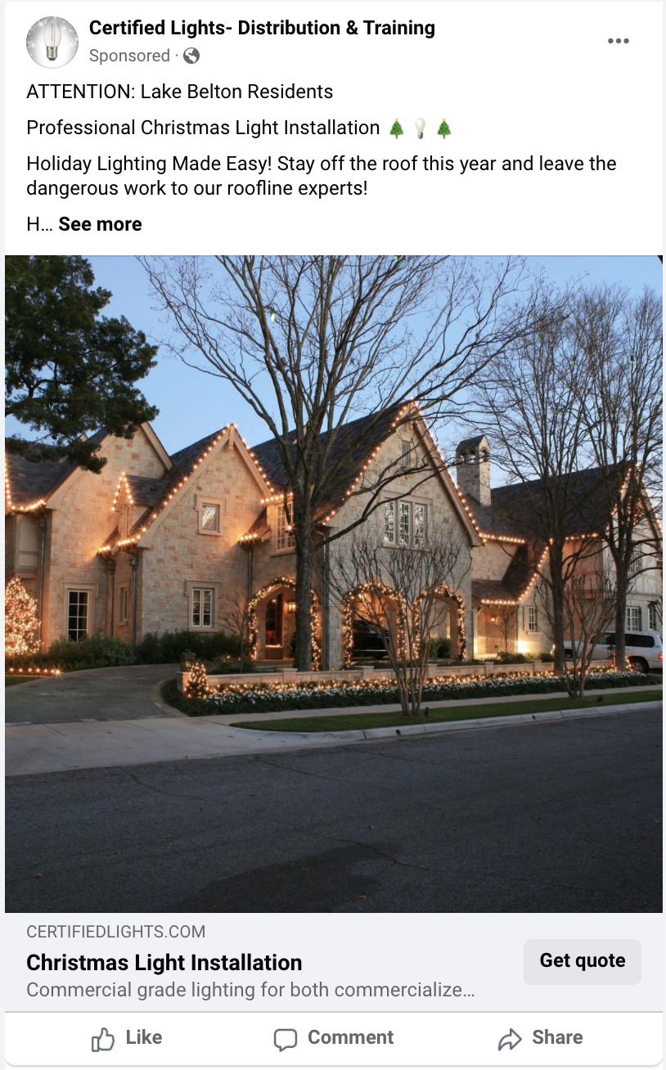
Retargeting...

Slide 25
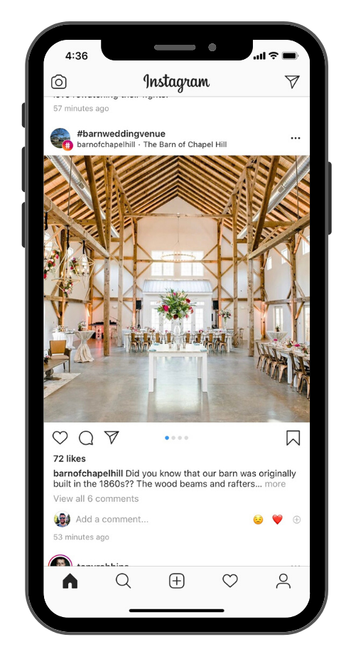
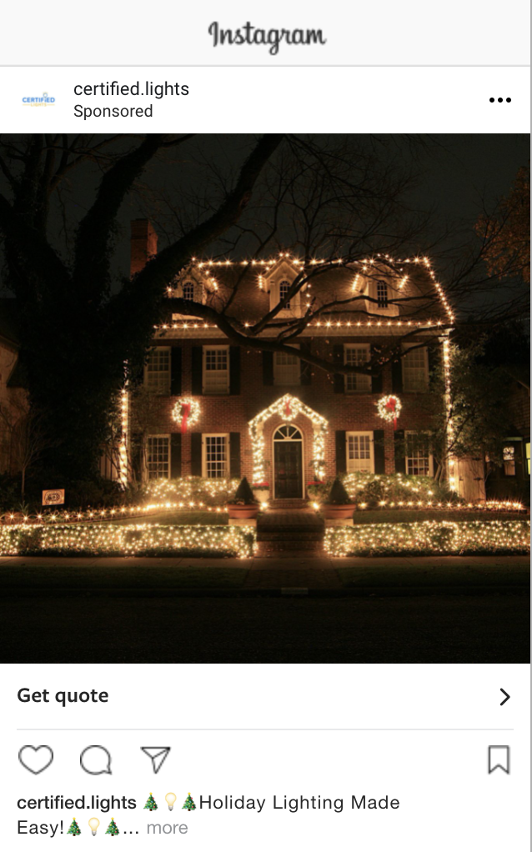
Retargeting...

Slide 26
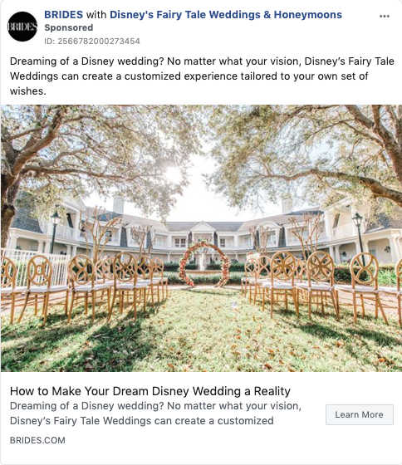
Like Your Own Internet Sales Rep...

Slide 27

HIGH LEVERAGE APPROACH
Retargeting is the most powerful way to completely take over your market like the big brands…
…but with a smaller ad budget!

Slide 28
Conversion: Pipeline & Follow-Up
Pillar #3: Turning Leads Into Customers

Slide 29
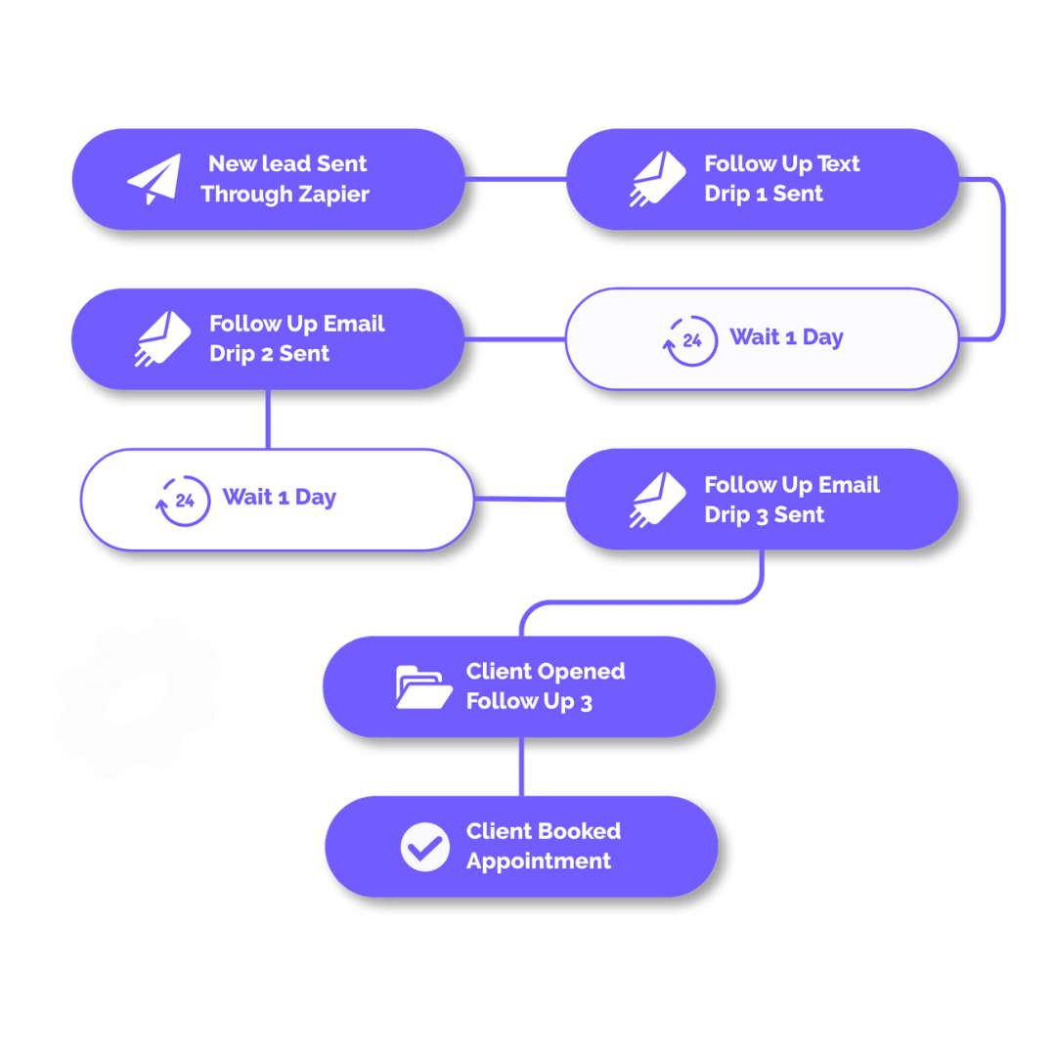
Conversion - Pipeline & Follow-Up
Pillar 3: Streamlining Follow-Up…
CRM Integration:
All leads in one place for seamless management.
Automated tools to track and manage each lead’s journey.
Instant Follow-Up:
Leads receive immediate texts and emails after form submission.
Faster responses mean better chances of closing.

Slide 30
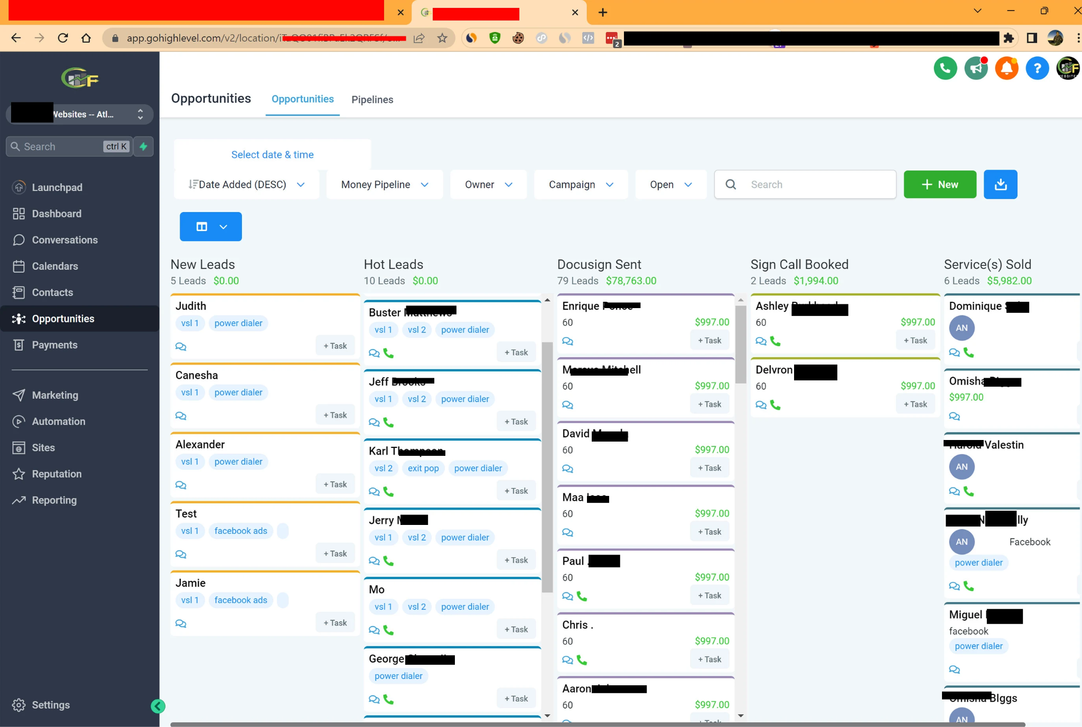
Conversion - Pipeline & Follow-Up
Pillar #3: Turning Leads Into Customers…
Lead Nurturing Pipeline:
Track progress from lead to customer. Organized stages to ensure no lead falls through the cracks.
Tools to prioritize the hottest leads for faster closes.
Analytics for Improvement:
Insights into what’s working and where to improve.
Tweaking systems to maximize conversion rates over time.

Slide 31
Scaling - Reputation, Referrals & Growth
(Leveraging Customer Satisfaction & Building a System That Grows With You…)

Slide 32
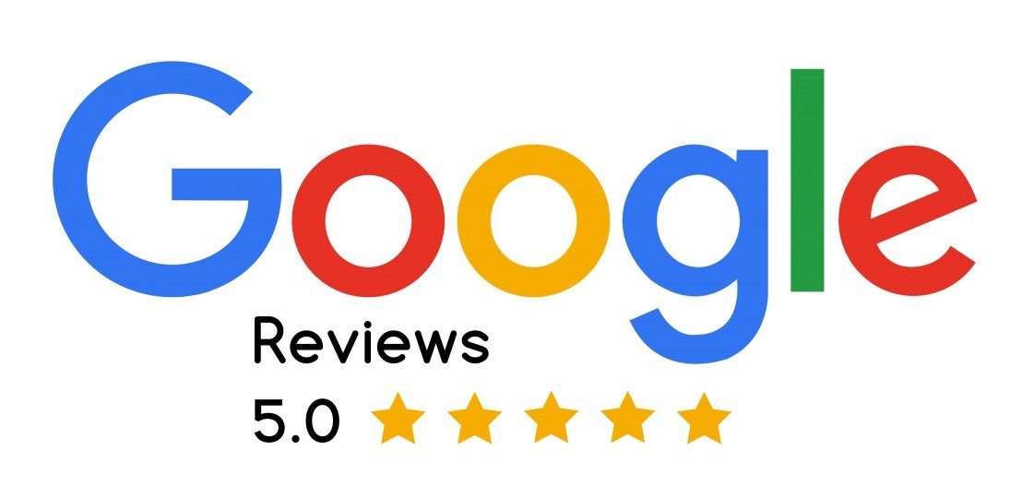
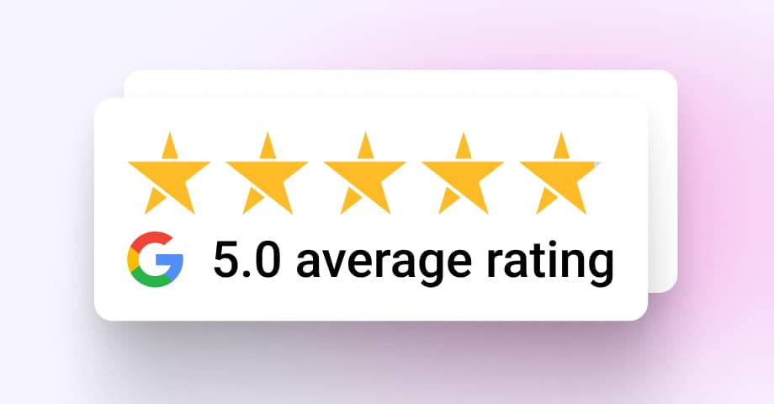
Scaling – Building Trust & Momentum
Pillar #4: Reputation, Referrals & Growth…
Long-Term Nurture:
We deploy PROVEN Email/Text campaigns to your prospects who don’t close. Maximizing every single lead you get!
Automated Google Review Campaign:
Systems to ensure every customer has a great experience.
Tools to follow up and encourage reviews to build a trusted online reputation.
Reputation Management:
Proactively monitoring and improving online reviews to boost organic leads through a stellar reputation.

Slide 33
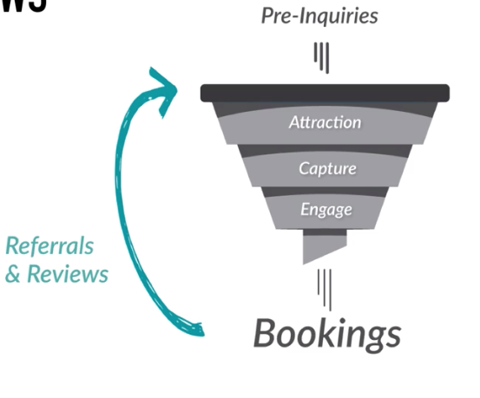
Scaling Campaigns & Expanding Reach
Pillar 4: Scaling – Growing Beyond Ads…
Referrals:
We also set you up with a Done For You referral program. We automate the process of asking for referrals from your customers who do close!
Happy customers recommending your services to others.
Scaling Ad Campaigns:
Expanding budgets and targeting new markets and audiences.
Testing new offers, targeting, and platforms for even greater results.

Slide 34
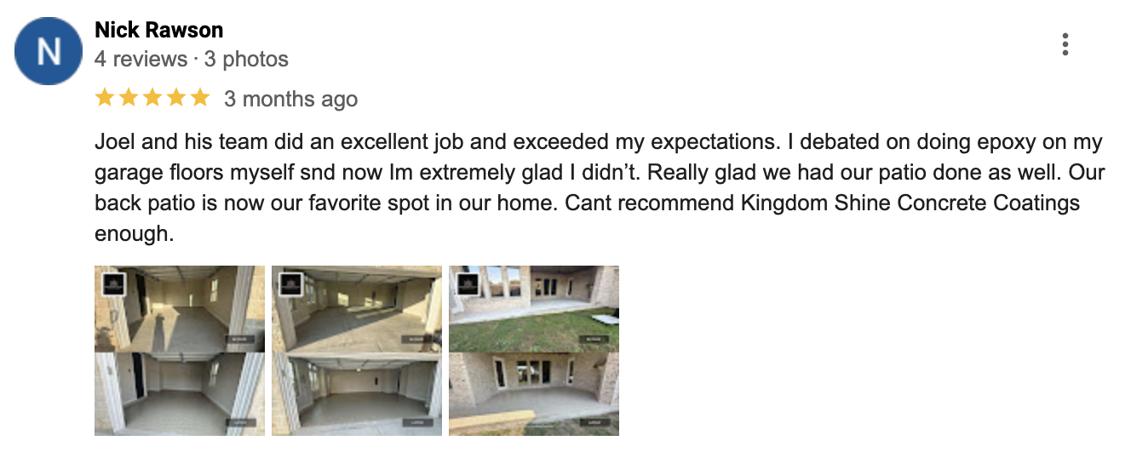


Get Testimonials, Pictures, & Referrals...

Slide 35
Overview…
The ConcretePro System:
Foundation & Infrastructure: Strategic targeting, lead forms, CRM setup, and compliance – all built before launch.
LeadFlow Ads System: Hyper-targeted Facebook & Instagram ads that drive leads with optimized forms and creative.
Conversion - Pipeline & Follow-Up: Instant follow-ups and a nurturing system that turns leads into loyal customers.
Scaling - Reputation & Growth: Building trust through 5-star reviews, referrals, and expanding reach with optimized campaigns.
Notes:
Our Epoxy Ads System works the same way…
The foundation & prep work is your ads strategy and framework
Then getting your offer and targeting is like your base coating that causes everything to stick
The your lead generation ads that everyone sees and wants…
The your retargeting and positioning ads to seal the deal and making your company stand out and shine…

