Slide 1
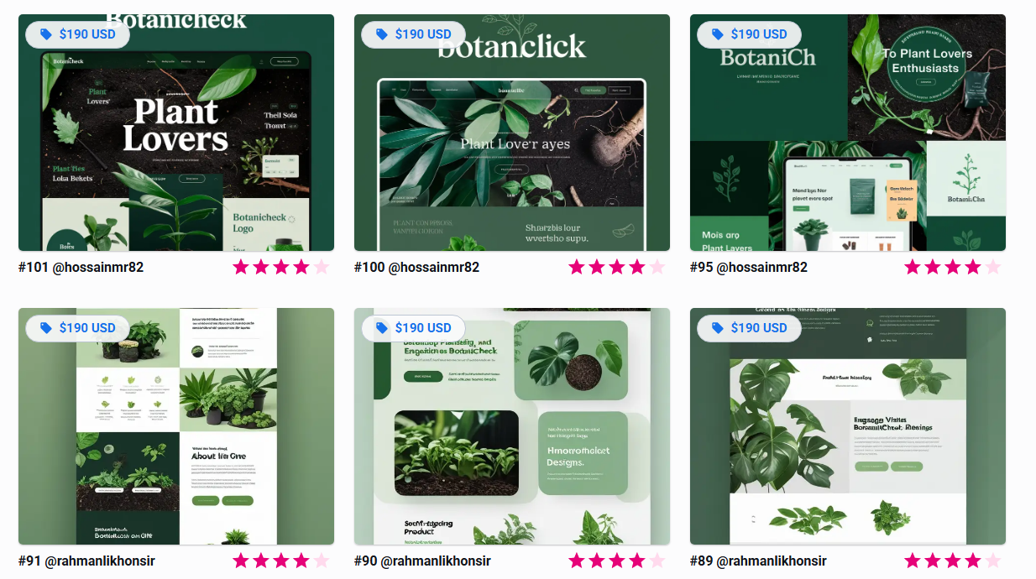
Overall Site Mood Board
Rich Greens shades & Black soil – Vitality

Slide 2

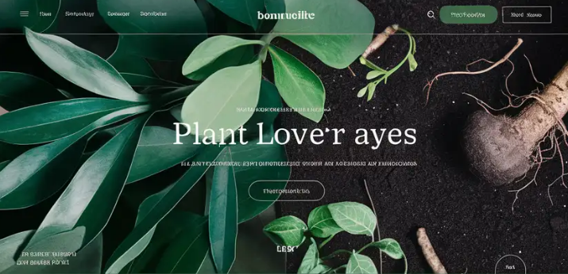



Slide 3



Green shades color contrasting

Slide 4
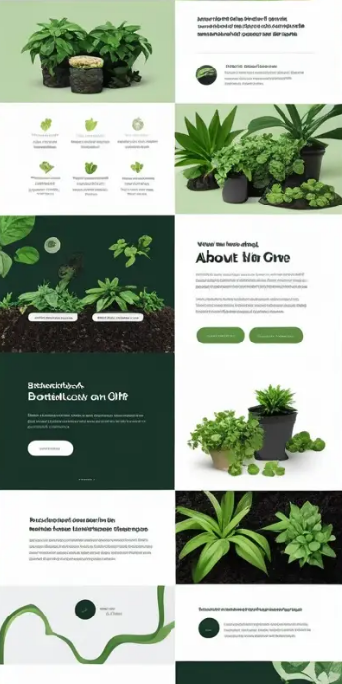


Slide 5

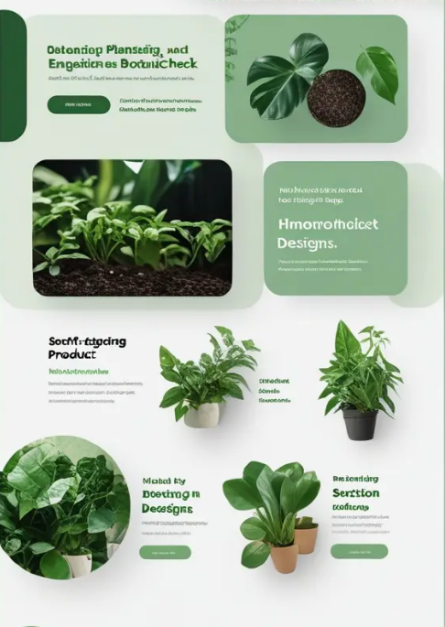


Slide 6



