Slide 1
Home
Shop
Our Logo
Free Garden Presentation
Contact Us
Welcome to The Mikrolab!
Supercharge Your Soil. Grow Stronger, Healthier Plants.
Our premium compost is packed with powerful microbes and rich nutrients to transform your soil—naturally.
Get a FREE compost or soil test —First 10 this month!
Not sure why your plants are struggling? A quick compost or soil test can reveal what’s missing
Claim Yours Now

Slide 2


The Heart of a Plant is in the Ground
The secret to lush, thriving plants isn’t in the leaves—it’s in the soil. Strong roots, rich microbial life, and balanced nutrients make all the difference.
At The Mikrolab, we take a science-backed approach to soil and compost health, helping gardeners grow stronger, more resilient plants—naturally.
Curious about what’s happening beneath the surface?
Get a free compost or soil test and start growing healthier plants today!
Example Visuals we love!

Slide 3
Shop – Premium Organic Compost
High-quality, sterilized compost for strong, thriving plants
At The Mikrolab, we provide nutrient-rich, sterilized compost designed to improve soil health and plant growth. Choose between our standard Sterilized Compost for general use or the Sterilized Compost with Plant Growth-Promoting Microorganisms to supercharge your soil with beneficial microbes. Both options ensure your plants get the best foundation for growth.

Slide 4
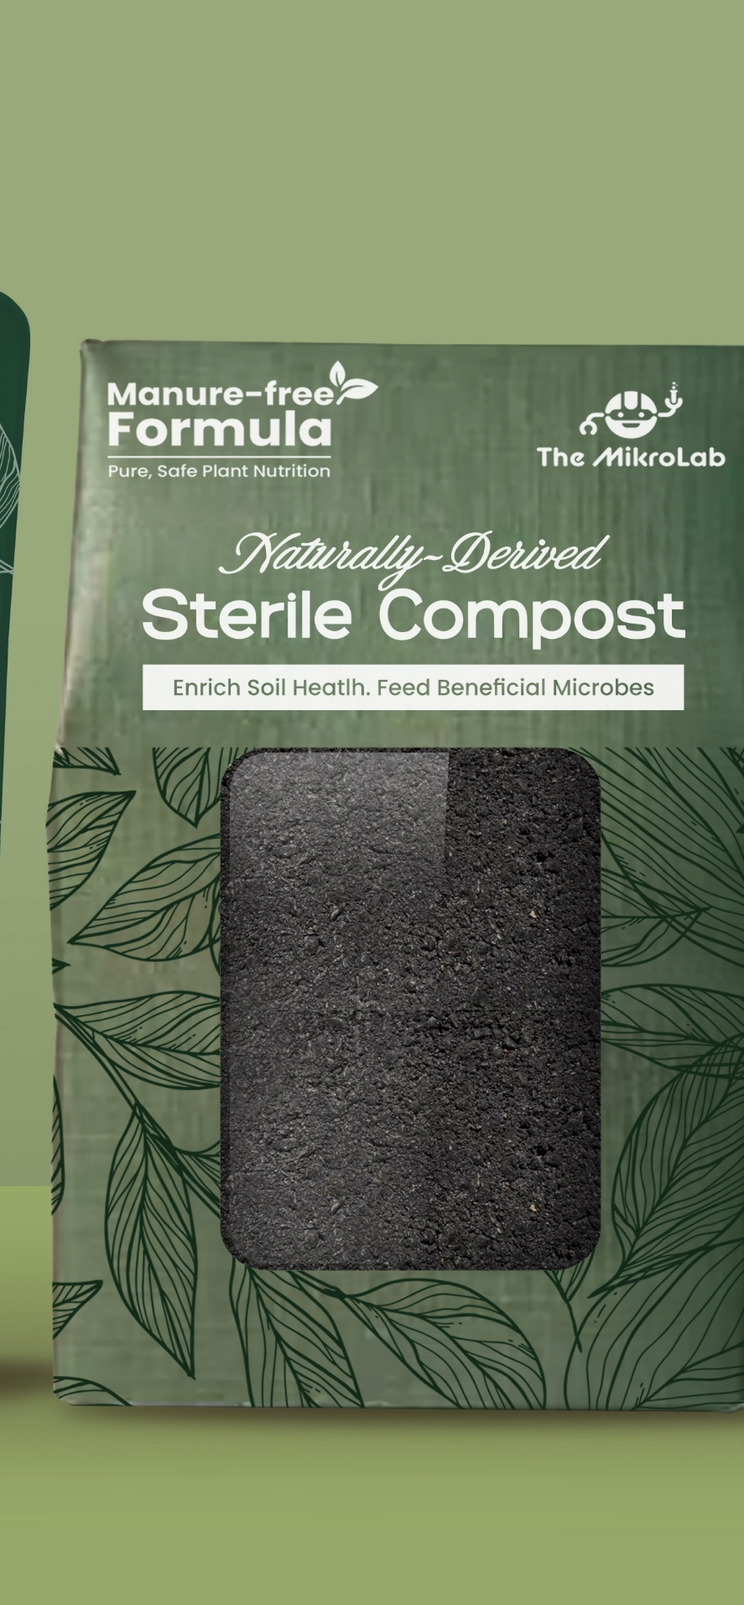
Protect & Revitalize Your Plants
Sterilized Compost
Harmful mold spores and bacteria- Removed.
$39.99 per cubic yard
Our Sterilized Compost is made from 100% organic materials and is perfect for general gardening and soil improvement.
Features:
✔️ 100% organic material
✔️ Manure-free formula
✔️ Sterilized to eliminate pathogens
✔️ Improves soil structure and moisture retention
✔️ Available for pickup or local delivery within 120 miles of Stow, OH
Perfect for:
✅ Vegetable gardens, flower beds, and lawns
✅ Improving general soil health and fertility
✅ All-around garden soil enrichment
Improves soil structure
Allow the beneficial microbes already in your soil to thrive
Cleaner growing environment. The best conditions for stronger, healthier, and more resilient plants.
Order Sterilized Compost Now
Don’t let contaminated compost put your plants at risk—refresh your soil the right way with Sterilized Compost.

Slide 5
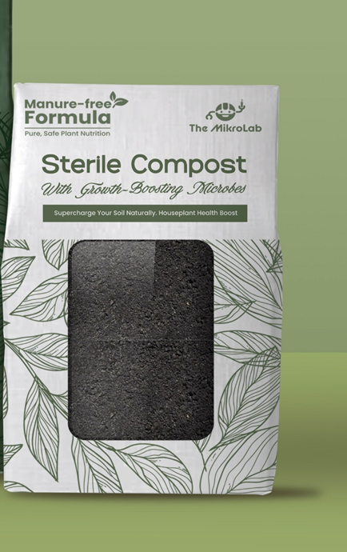
A Clean, Microbe-Boosted Refresh for Your Plants
Sterilized Compost with Plant Growth-Promoting Microorganisms
Faster Nutrient Absorption – Beneficial microbes help break down organic matter, delivering nutrients right where your plants need them.
$49.99 per cubic yard
Our Sterilized Compost with Plant Growth-Promoting Microorganisms takes soil improvement a step further. In addition to sterilized, nutrient-rich compost, it’s inoculated with beneficial microorganisms that promote plant growth, enhance resilience, and help fight off diseases naturally.
Features:
✔️ Sterilized compost with added plant growth-promoting microorganisms
✔️ Manure-free formula
✔️ Rich in beneficial microbes that improve soil health
✔️ Supports natural disease resistance and plant vigor
✔️ Available for pickup or local delivery within 120 miles of Stow,
OH
Perfect for:
✅ Gardeners seeking stronger, more resilient plants
✅ Improving soil health with beneficial microbes
✅ Increasing disease resistance and promoting faster plant growth
Supports root health and resilience, even in potted environments.
Encourages faster growth with carefully selected beneficial microbes.
Order Sterilized Compost with Microorganisms Now
Mold-Free & Safe – No unwanted pathogens, just a clean and balanced compost blend.

Slide 6
Compost Pickup & Local Delivery
Pickup:
Pick up your compost directly from our location in Stow, OH. Our team will have it ready for you.
Local Delivery:
We offer local delivery to locations within 120-mile radius of Stow, OH.
Free Delivery Offer
Free Delivery on Orders Over 2 Cubic Yards!
Order 2+ cubic yards of our premium compost and enjoy free delivery within a 120-mile radius of Stow, OH. No extra fees!
Whether you’re planting your garden or enriching your soil, we make it easy with free delivery on larger orders.
Limited Time Only! Order today to take advantage of this offer and get your compost delivered right to your door!
[Order Now]
Within 20 miles: Free
21–30 miles: $15
31–60 miles: $40
61–120 miles: $60
Free delivery for orders within 20 miles of Stow, OH!

Slide 7
FAQs
Q: Do you offer shipping?
Currently, we only offer local delivery and pickup from our Stow location. Shipping is not available due to the weight of compost.
Q: How are local delivery fees calculated?
Local delivery fees are based on the distance from our Stow location. The exact fee will be calculated and displayed during checkout.
Q: How long does local delivery take?
Local deliveries typically take 3–5 business days, depending on your location.

Slide 8
Free Garden Presentation
Beneficial Microbes for Your Garden
Grow stronger, healthier plants—from the ground up.
What You'll Learn
Discover how beneficial microbes power plant growth, protect roots, and supercharge compost. In this fun, science-based session, you’ll learn:
How microbes boost soil health and plant resilience
What healthy compost really looks like
Simple tips to improve your garden, naturally
Presented By
Led by Mope, microbiologist and founder of The Mikrolab, a lab dedicated to soil health and sustainable gardening. You’ll also receive a free compost or soil test for your group!
Perfect For:
Garden clubs
Master Gardener groups
Community gardens
Plant societies or green clubs
Presentation Format:
Length: 40–45 minutes
Cost: Free!
Location: Available in-person near Akron, OH or virtually anywhere
Includes: Group Q&A and optional compost test follow-up
Request a Free Presentation
Fill out the form below:
Group Name:
Contact Name:
Email Address:
Location (City/State):
Virtual or In-Person Preference:
Preferred Date(s):
Estimated Group Size:
[Submit Button – “Request My Free Presentation”]
FAQs
Is this really free?
Yes! It’s part of our outreach to promote soil health and sustainable gardening.
Can small groups request a talk?
Absolutely—whether 5 or 50, we’re happy to connect.
What’s in the compost test?
We test for microbial activity and visual health indicators to give you actionable feedback.

