Slide 1
MithraX A disruptive transcatheter repair technology targeting complex structural mitral regurgitation
March 2025

Slide 2
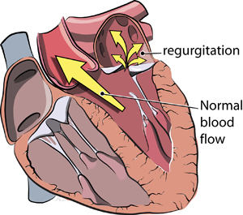
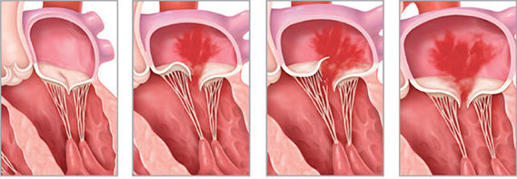
The disease, mitral regurgitation (MR). Millions of patients, only few being treated today.
MR is a heart valve disease in which the valve between the left heart chambers doesn't close completely, allowing blood to leak backward across the valve > Shortness of breath, palpitations, arrythmia, mortality risk.
Healthy valve
Structural MR
Functional MR
3-4M in need of treatment (US/EU)
Approx. 150K procedures per year
Prevalence of 2%
https://www.heart-valve-surgery.com/

Slide 3
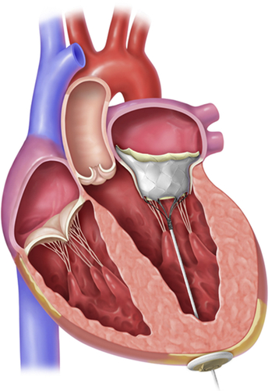
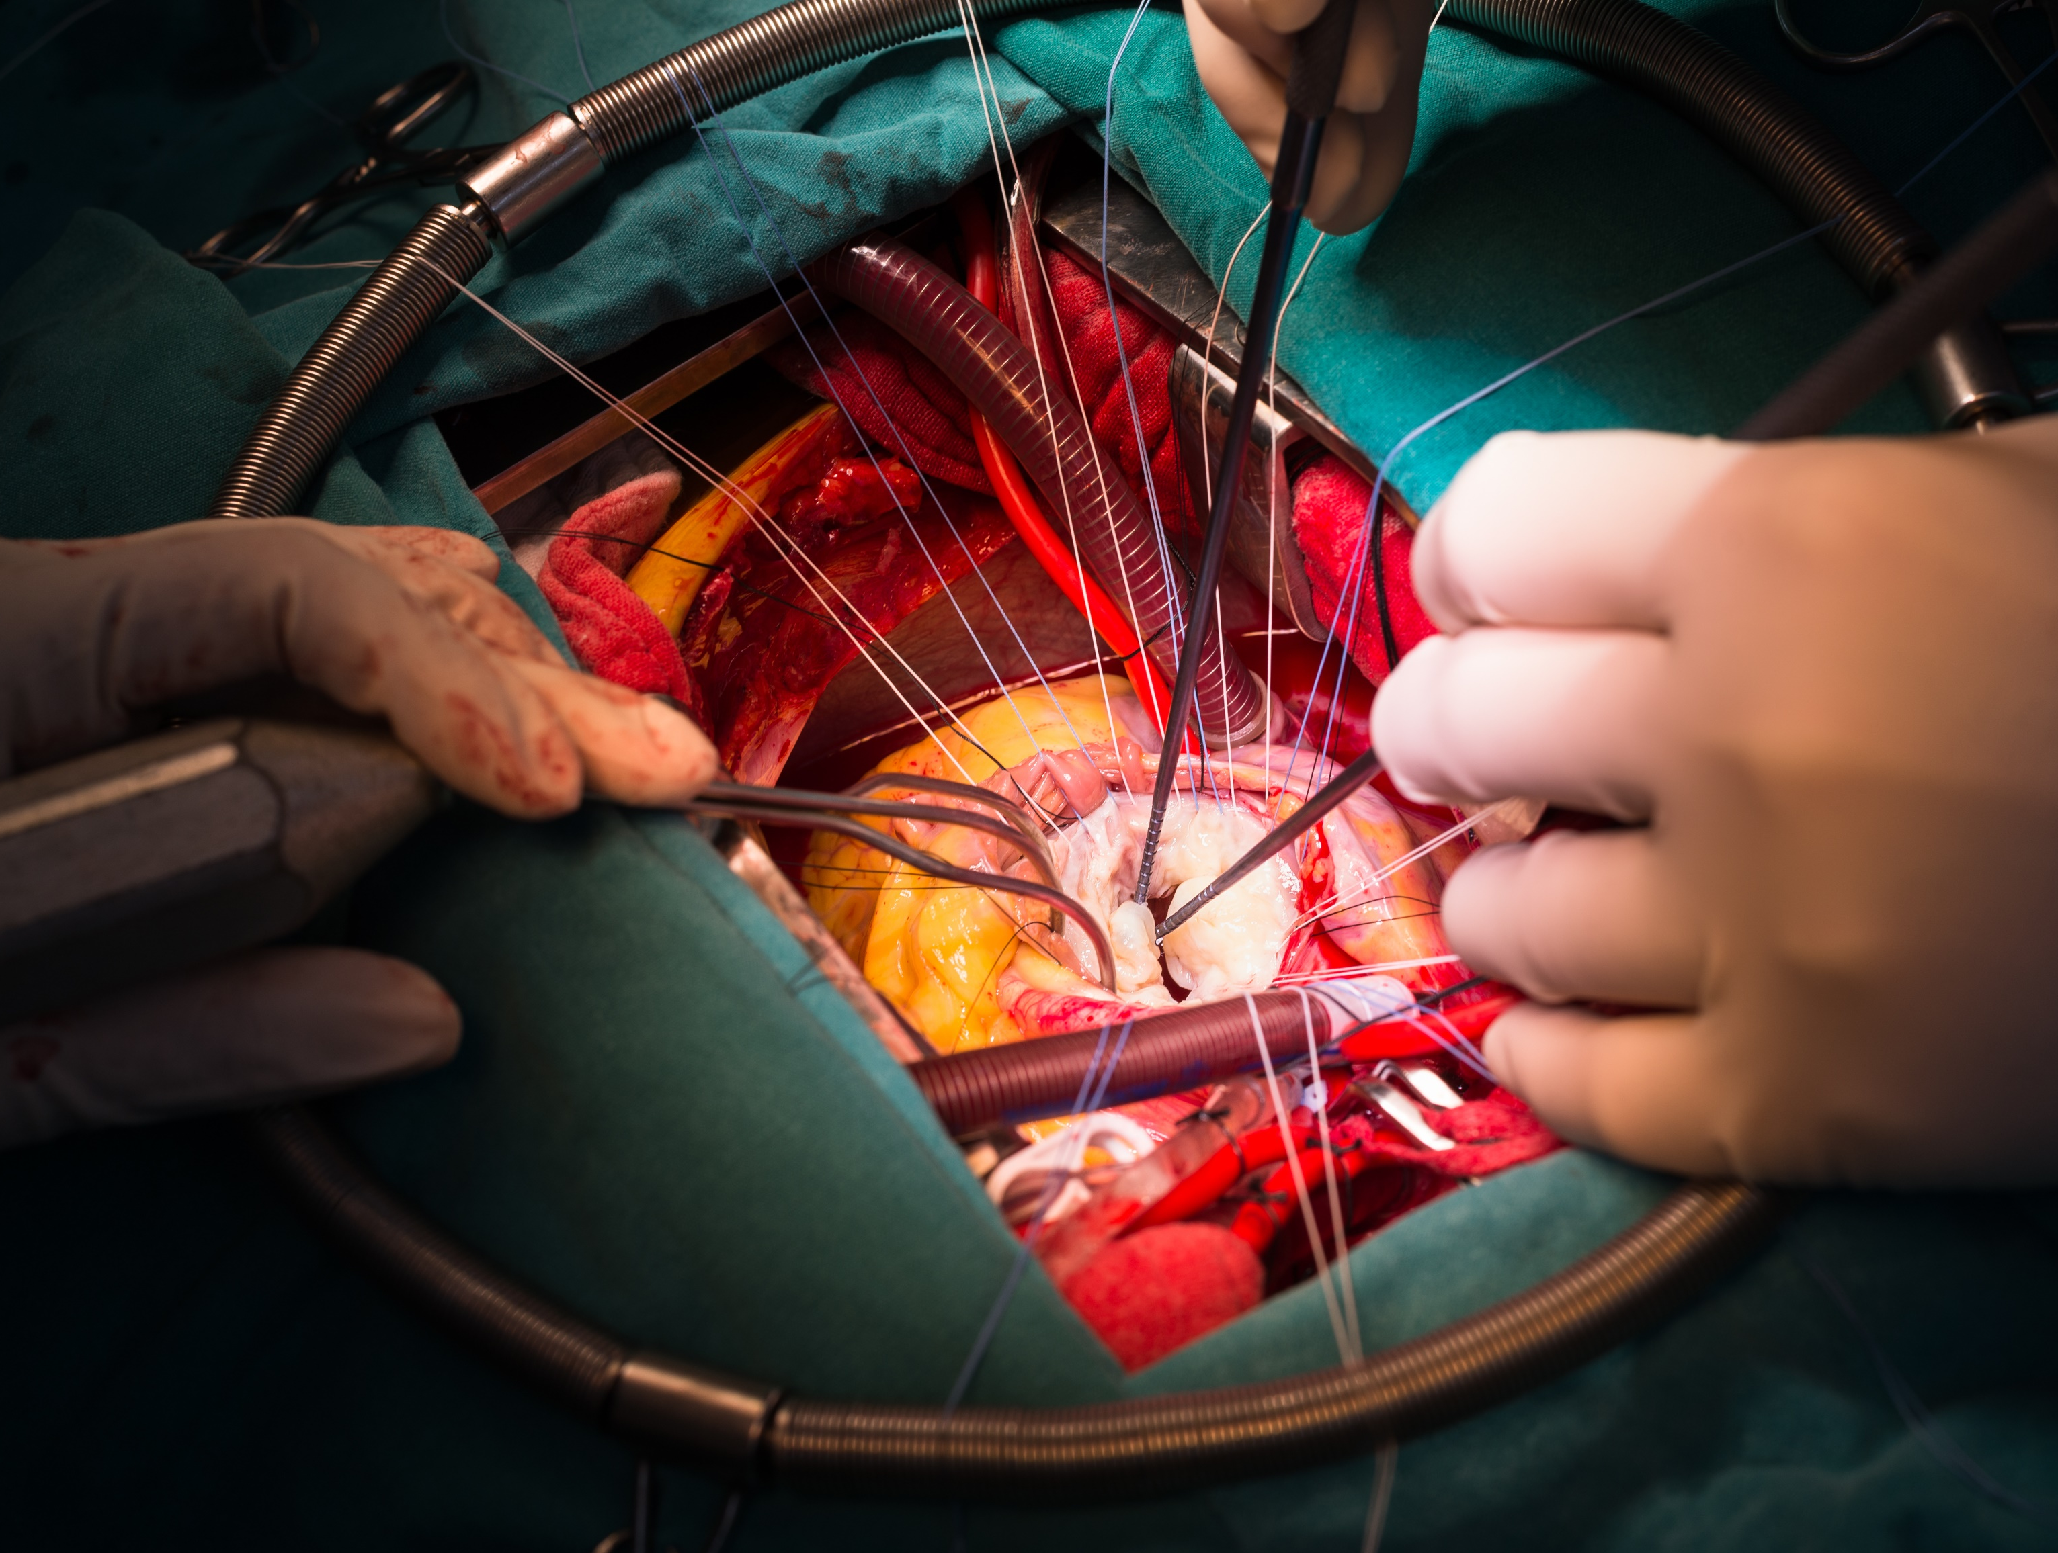
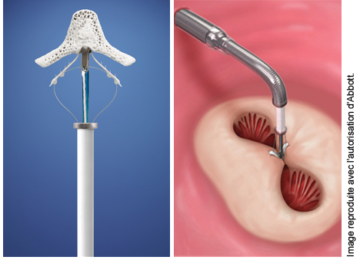
Current practice! Open heart surgery is invasive and traumatic. TEER often delivers suboptimal results and excludes patients.
Open heart surgery
Transcatheter edge-to-edge repair
Transcatheter mitral replacement
Standard of care
Invasive procedure
Many patients are old, frail and not eligible for surgery
2 commercially available products (MitraClip and Pascal)
Reduce MR, but what about residual MR?
Specific patients' selection, and many not eligible
Very few available options, some in clinical trials
Tangible challenge with obstruction of the left ventricle outflow tract

Slide 4
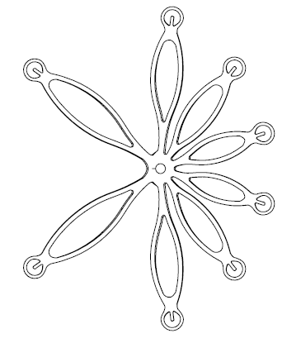
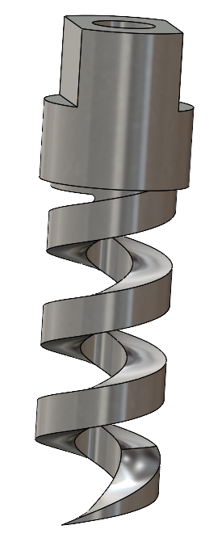
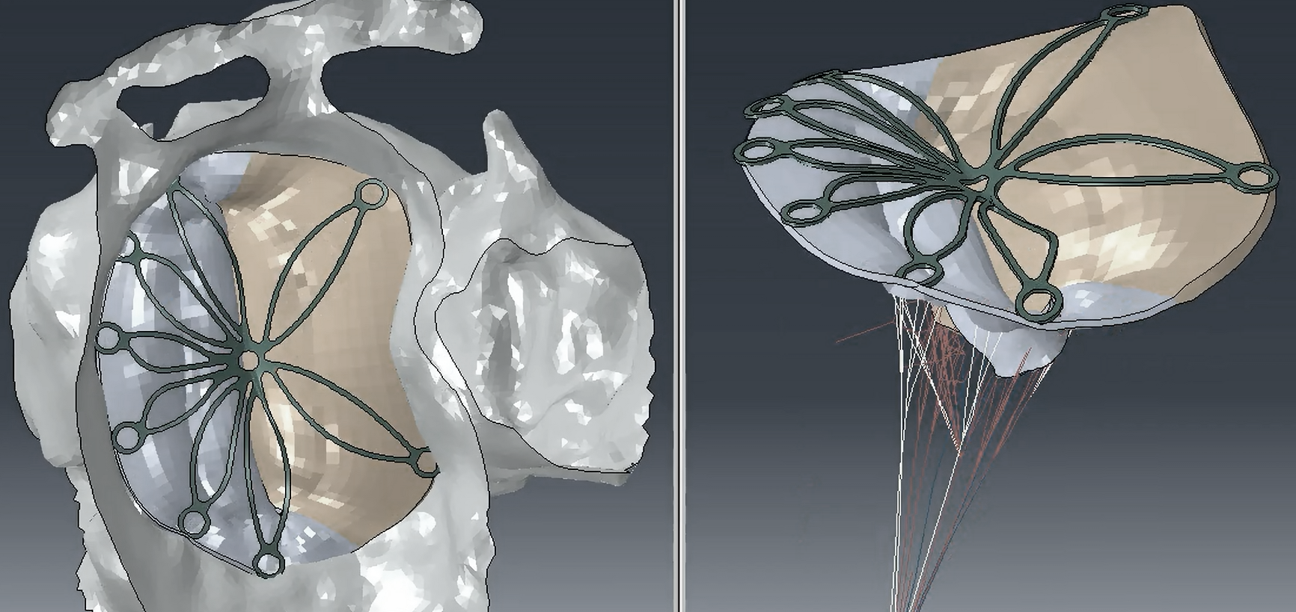
MithraX, a transcatheter mitral grid for structural mitral regurgitation
The solution
What does MithraX do?
MithraX is a polished nitinol grid,
anchored on the mitral annulus with specifically designed anchors
and delivered thanks to an intuitive catheter solution.
Treats structural mitral regurgitation by eliminating mitral prolapses,
Prevents annulus dilatation, reducing the risk of functional mitral regurgitation.

Slide 5
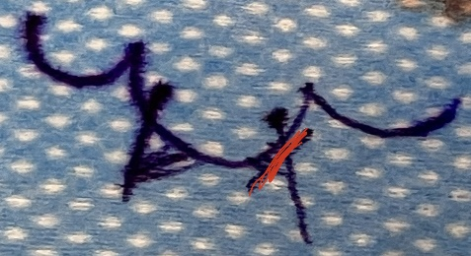
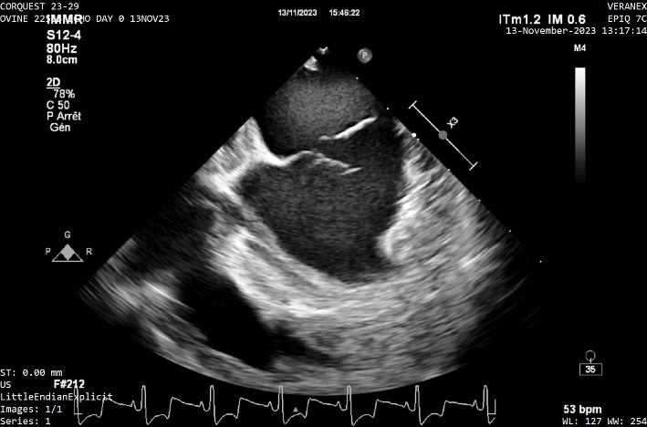
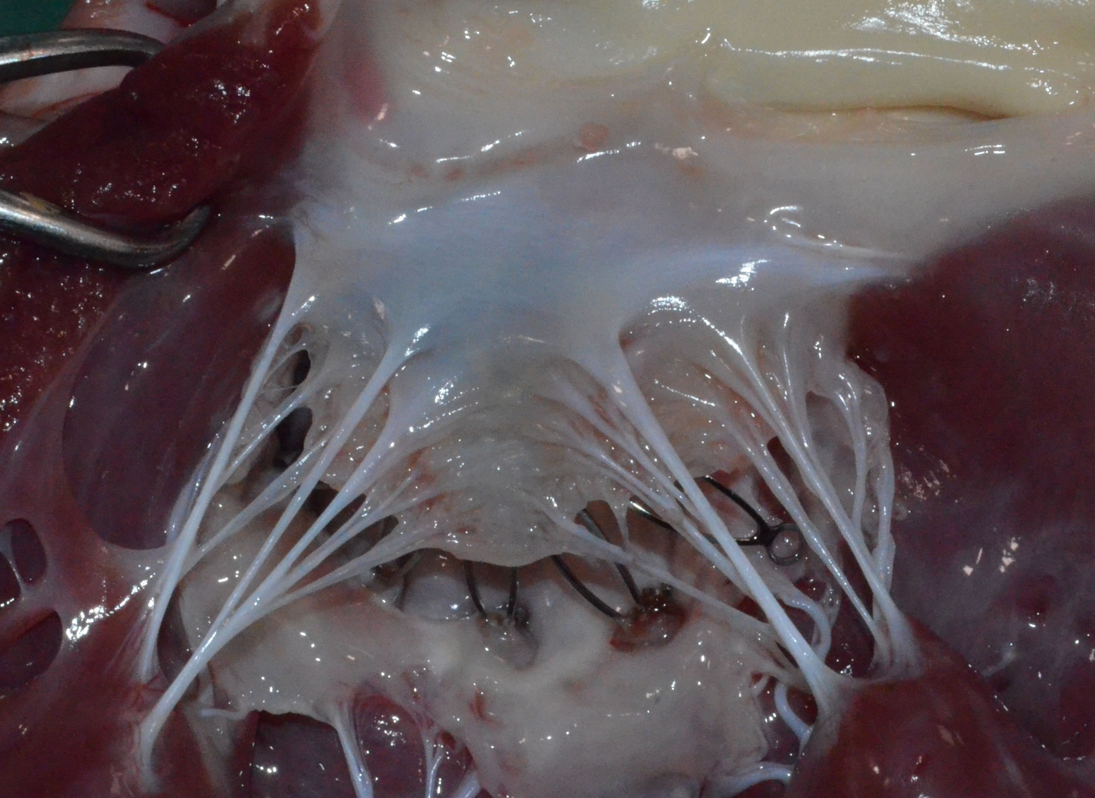
MithraX, development so far!
Ex-vivo testing, ovine model (n=9)
Ex-vivo testing, human model (n=2)
In-vivo testing, ovine model (n=10, 4 acute & 6 chronic [7-90 days])
Results
Efficacy in reducing MR
Anatomical fit
No tissue damage (leaflet, atrial, ventricular)
No thrombus or infection sign at necropsy

Slide 6

Competitive landscape at launch, MithraX will be used for patients with more complex MR, complex anatomies, patients with Barlow disease.
 | Simple < Anatomy / Mitral regurgitation > Complex
Surgery | Standard of care?
TEER | Safe, feasible but residual MR, stenosis, anatomic limitations
T-Chordal repair | Single central prolapse?
T-Hemi-replacement | Posterior prolapse only?
T-Leaflet enhancer | Single central prolapse?
TMV-Replacement | How big will TMVR be? For structural MR, repair is preferred!
MithraX to help with
Leaflet billowing / thickened leaflets / dilated annulus / multiple chordal rupture(s) / wide prolapse / bi-leaflet prolapses / multi prolapses / Barlow
And many more.

Slide 7
MithraX initially targeting 24,000 complex patients, with the potential to treat many more.
Severe primary MR not treated
1,4M patients
Barlow type, complex, not treated
230K patients
Barlow type, complex but treated
24K patients annually
500 M$
MithraX
is a versatile solution for complex cases and challenging anatomies.
Expands treatment access and improves outcomes for underserved patients.
Targeting, in US and EU
About 24K patients treated every year
About 1,6M patients untreated
Adams DH, Rosenhek R, Falk V. Degenerative mitral valve regurgitation: best practice revolution. Eur Heart J. 2010;31(16):1958-1966.
Enriquez-Sarano M, Akins CW, Vahanian A. Mitral regurgitation. Lancet. 2009;373:1382–1394
Transcatheter Mitral Valve Technologies: The Heart of Cardiovascular Device Innovation. BackBay Lifescience Advisors, 2018
https://www.heart.org/en/health-topics/heart-valve-problems-and-disease/heart-valve-problems-and-causes/problem-mitral-valve-prolapse
https://mitraclip.com/physician/mitral-regurgitation-prevalence
Data on file.

Slide 8





Go-to-market strategy – MithraX will be used.
Patients
Benefit from a new transcatheter treatment, specifically if complex mitral regurgitation
Cardiologists
A new option for complex MR, better results
Hospitals
Toolbox for mitral regurgitation
An opportunity to treat more patients
2 options for repair, TEER and MithraX
1 technology for replacement
Payer
Leveraging existing reimbursement scheme for TEER (25 K$ per case)
Channel
Partnership with strategic players (licensing / exit)
Let’s treat many untreated patients.
(Distribution network)
CPT Code 33418 / 33419

Slide 9
Exit opportunities! Strategic players still have limited options for transcatheter structural mitral repair.
T-Mitral portfolio of strategic players
Deals & references
Players | Structural - TMVr | Functional – TMVr | T-Replacement
Abbott | MitraClip |  | Tendyne
Edwards | Pascal (Harpoon) | (Cardioband) (Mitralign) | Evoque Sapien Innovalve
Medtronic | Halfmoon |  | Intrepid
Boston Scientific |  | (Millepede)
JJMT
Gore Medical | (Pipeline)
Venus MedTech |  |  | Cardiovalve
Meril
Year | Investor | Target | Value | Stage
2024 | Edwards | Innovalve | 300 M$ ? | Clinical
2021 | Venus MedTech | Cardiovalve | 300 M$ | FiH
2020 | Medtronic | Halfmoon | Undisclosed | Pre-FiH
2019 | W.L. Gore | Pipeline | Undisclosed | FiH
2018 | Boston Sc | Millepede | 540 M$ | FiH
2017 | Edwards | Harpoon | 250 M$ | Pre-CE
2016 | Edwards | Valtech | 690 M$ | CE

Slide 10


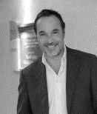

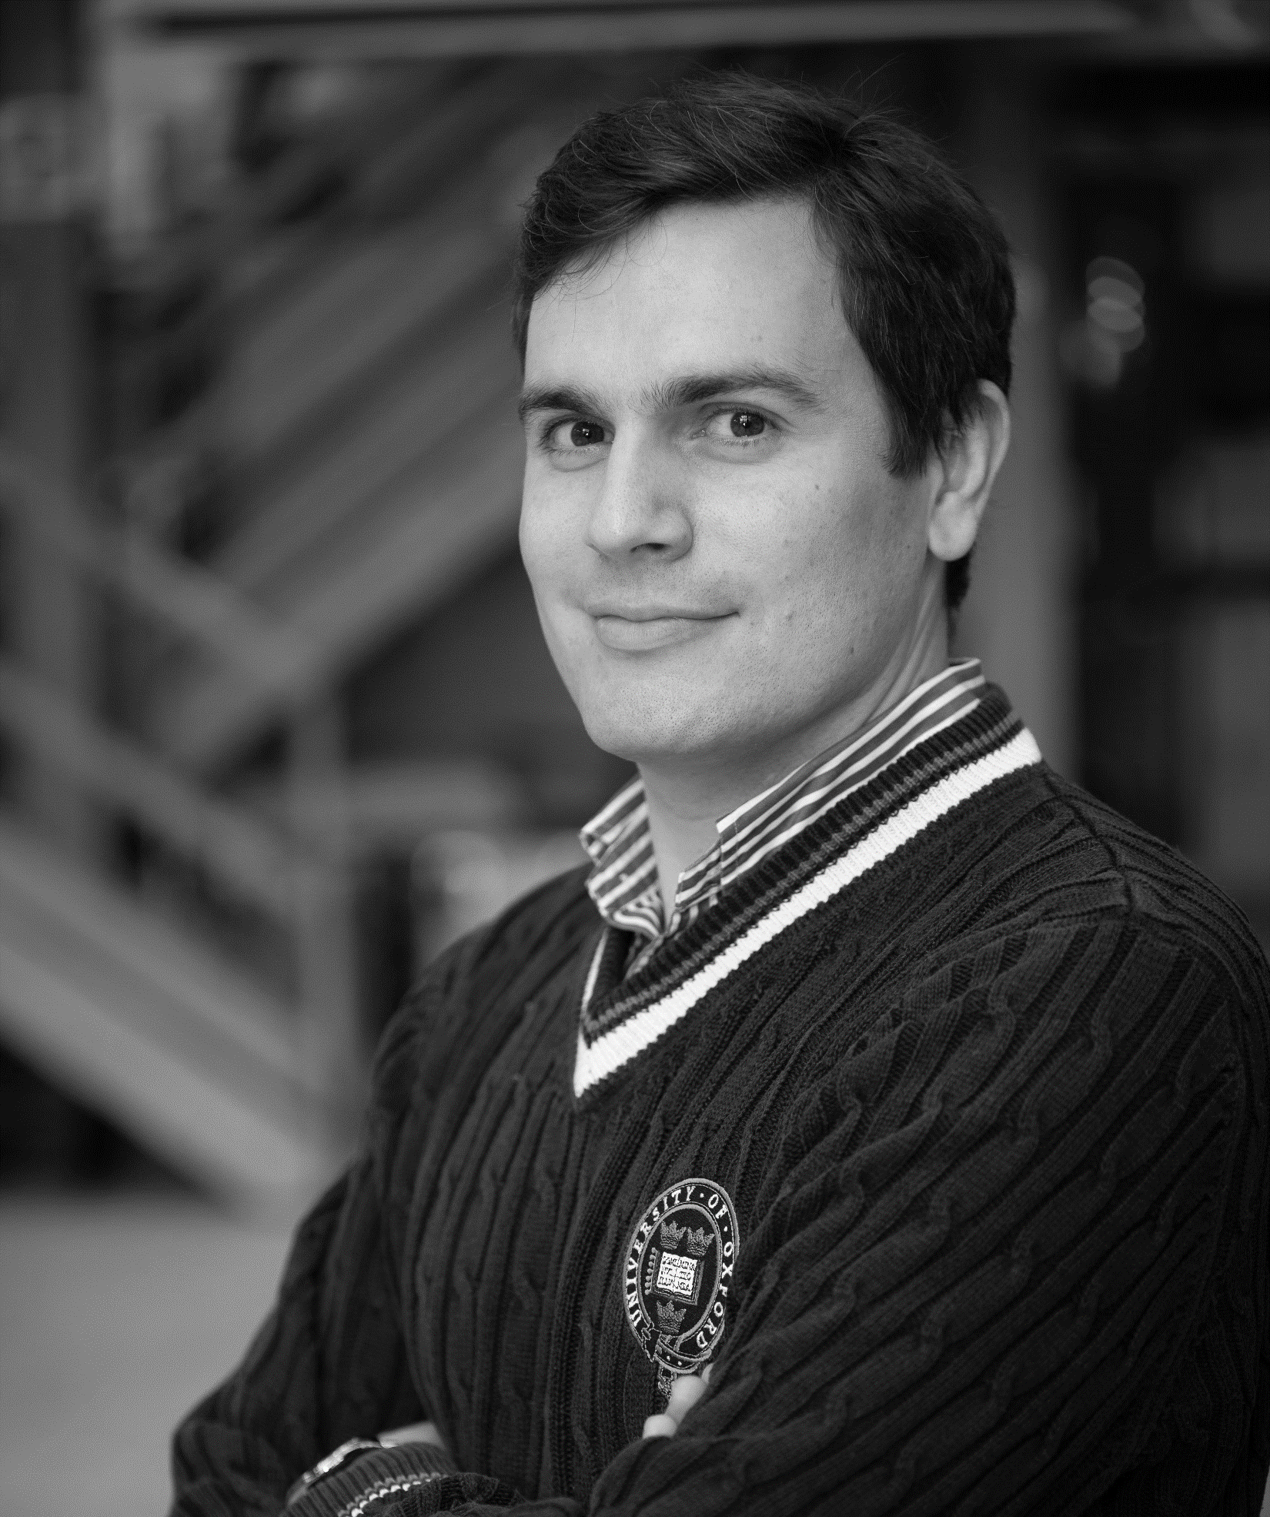
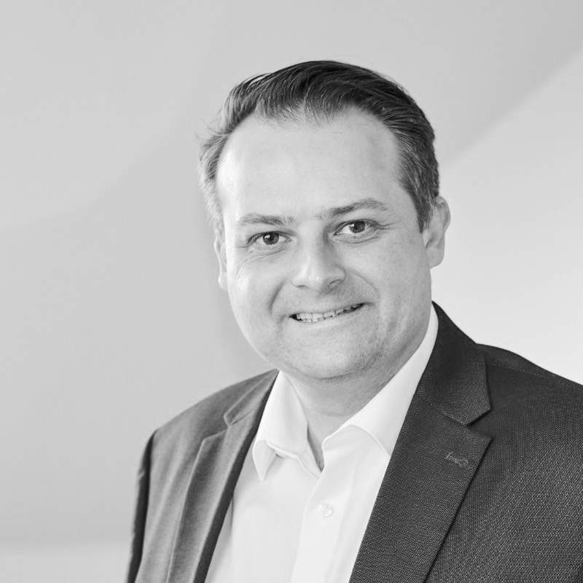

Management + Clinical + Engineering, a diverse team and solid partners to develop a new mitral repair technology.
Arnaud van Schevensteen
Co-founder
20+ years entrepreneurial experience.
Inspirational leader and aortic valve patient, Arnaud brings the ambition of CorQuest and a combination of patient knowledge and experience, strategic thinking, and ethical integrity.
Olivier Decuypere
CEO
18+ years international experience in the MedTech Industry. JJ MedTech.
Disruptive leader with proven expertise in business management, commercial strategies, regional and local marketing plan and launch of new technologies.
MBA from IESE Business School, Barcelona, Spain.
Didier de Cannière
Co-founder & CMO
Professor and Chairman
Department of Surgery &
Chief of Cardiac Surgery St. Peter Hospital, Brussels
​
Pioneer in minimal invasive surgery, speaker and moderator in more than 100 conferences, more than 50 publications in peer reviewed indexed literature. Co-founder of MedTech start-ups, sold one to St Jude
Ludovic Melly
Clinical advisor
Professor in Cardiac Surgery and serial entrepreneur.
Cardiac surgeon at CHU UCL Namur. Passionate by research and innovation, involved in different MedTech startups.
Xavier Bollen
R&D Engineer
Mechanical engineer with experience and expertise in cardiac valve innovations.
Led or participated in TAVR and other aortic development projects.
Benjamin Rieck
Strategic Advisor
MedTech expert, Angioconsult
With over 20 years in the medical device industry, played a key role in more than 20 successful transitions including Millepede, Corevalve, Claret Medical, CardioValve, CardiAQ Valve, Laminar and many more.

Slide 11
Our strategic roadmap. Looking for 3M$ in 2025, to execute a surgical FiH and finalize the delivery platform.
2024
2025
2026
2027
2028
2029
2030
2031
2032
Design & development :
Finalize delivery platform (catheter)
Catheter validated
Pre-clinical & clinical plan
Pre-industrialization > Verification & Validation
Small scale manufacturing
Pre-Sub FDA
Regulatory f-up
Regulatory f-up
EU and FDA
Surgical FiH
FiH
EFS
Pivotal
MA & Reimb deep dive
Market access & reimbursement
Prepare for commercialization
Financed
(Private & Public)
Fund raising of 3M$
Serie A

Slide 12
MithraX
by

Slide 13
Back up slides

Slide 14
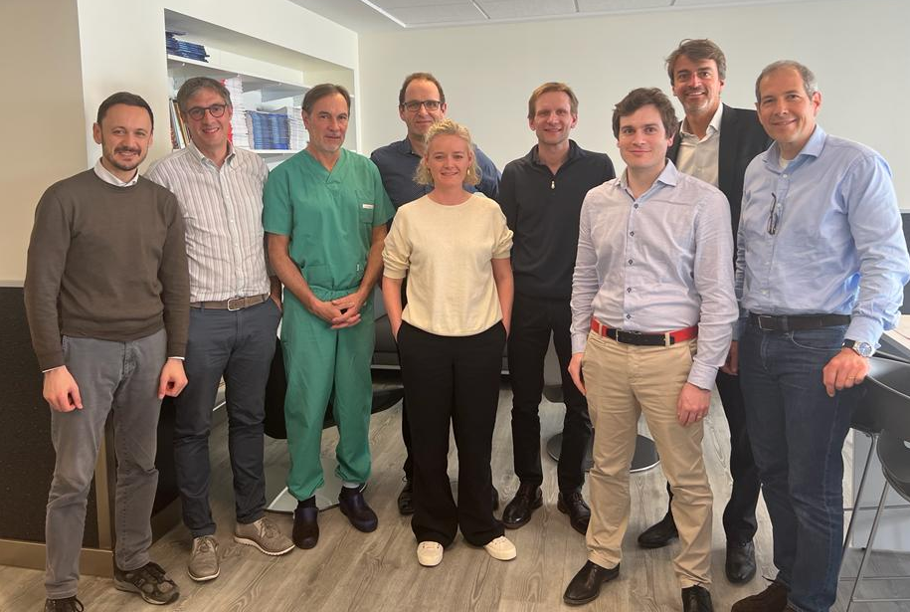
Our lean and flexible organization, leveraging expertise internally and externally. CTO and RAQA are next positions to fill!
CorQuest MedTech Medical Ad Board
Cardiologists
Prof Ole de Backer, Univ of Copenhagen
Dr Liesbeth Rosseel, A.S.Z. Aalst
Cardiac surgeons
Prof Christoph Huber, HU Geneva
Dr Maurizio Taramasso, Hirslanden Zurich
Prof G Dreyfus, HEGP Paris
Olivier Decuypere
CEO
Didier de Cannière
CMO
Xavier Bollen
R&D
Veranex
Pre-clinical
Ludovic Melly
Advisor
Cisteo Medical (3)
R&D Implants
Incite Medical (3)
R&D Catheter
Calysta
IP
Lime
Legal
TBD
RAQA
Scientific Ad Board (5)
Advisors
QbD
Clinical
Precision Life Science Partners
Strategic support
Silver Arrow
Henk Joost
Strategic support
Angioconsult
Benjamin Rieck
Strategic support

Slide 15
Competitors’ pipeline : transcatheter repair projects for structural MR
Technology name | Website | Technique | Type of MR | Dev stage
CardioMech | https://www.cardiomech.com | Chordal repair - TS | Primary | FiH stoped, redesign > new FiH soon
Neochord | https://www.neochord.com | Chordal repair - TA & TS | Primary | Commercial (TA) / clinical (TS)
ChordArt, CoreMedic | https://www.coremedic.de | Chordal repair - TS | Primary | FiH
Vesalius Cardiovascular | https://vesaliuscardio.com | Chordal repair - TS | Primary | FiH in 2024? EFS in 2024?
Butterfly - Avvie | https://www.angelvalve.com | Hemi-replacement | Primary?/Secondary | FiH in 2024?
Polares Medical | https://www.polaresmedical.com | Hemi-replacement | Primary?/Secondary | FiH in 2019, clinical?
Nyra medical | https://www.nyramed.com | Leaflet enhancer | Primary?/Secondary

