Slide 1
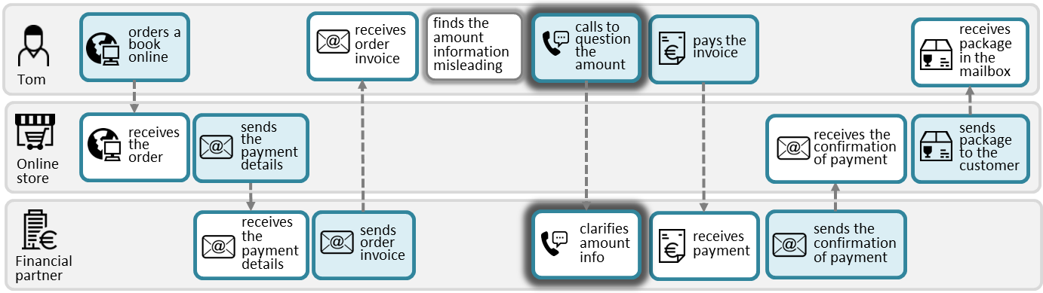
CHANNEL ICONS – finish
These “channel” icons will be used inside boxes as part of diagrams, and they are meant to fit into a visual language that has been in use for quite some time – so consistency is key.
Therefore, there is a need to standardize the design for a consistent look.

Slide 2
General comments that apply for all icons
Standardize stroke: The main stroke should be slightly bolder, to make the icons more visually balanced and readable.
Consistency – stroke: Also, please ensure consistency across all icons – same stroke weights, proportions, and style.
Aspect ratio: Icons must respect the square aspect ratio
Consistency – level of detail. Some icons have too much detail. Please simplify where possible to ensure uniformity and clarity.
A few icons may include one bold element for emphasis
Devices: Some devices, like PC (screen) is used in more icons, and should also be standard.

Slide 3








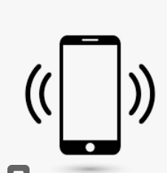























Feedback
All icons should have aspect ratio 1 : 1 (square)
Icons marked with green dot should not change too much (not completely redesigned)
Icons without a green dot should be more fundamentally changed
If you have better options, also for green ones, feel free to suggest
Old
New
Old
New
telephone conversation
Main line too thin. Please make a version with handset filled. Dots should be filled (not open).
app on PC
Outer line is good. Screen is fine. Try with the foot filled. Too much detail on the screen. (Can you try with 2x2 without it looking like MS Windows logo?)
SMS
Bolder outer line.
app on smartphone
Outer line is good. Thin horizontal line (speaker) above screen does not work. Too much detail on screen (see comment above).
Just an idea to make it square
Just an idea how to make it square.
e-mail
Aspect ratio! See general comment: Main line bolder than inner lines. Also symbol more bold.
app on tablet
Too detailed. Try to match level-of-detail in the two above. Pen must be a bit “thicker”
social media message
The devices below should match upper corresponding devices
Too much detail on humans. Make it closer to original. Keep the nice diversification of the two.
The PC above looks better. The shape looks a bit “busy” with the detailed globe. Perhaps a simpler globe inside screen?
internet via PC
message service
OK but check general comments
internet via smartphone
Check suggestion for “text”
OK but check general comments. Please try with bars (text) inside, just for fun.
internet via tablet
chat
face-to-face interaction
Too much detail on humans. Make it closer to original.
internet/globe
Try bolder outline on the globe.

Slide 4





























Later: Channels (2)
All icons should have aspect ratio 1 : 1 (square)
Icons marked with green dot should not change too much (not completely redesigned)
Icons without a green dot should be more fundamentally changed
If you have better options, also for green ones, feel free to suggest.
self-service machine
Implement standard outer and thinner lines. Perhaps even closer to the original, which has also a bold element that looks good.
payment channel Card
Card: Stick closer to original
payment channel Invoice
letter
But not sqare!
Here we include the existing invoice
This is better but too detailed. Avoid dollar, try generic currency instead
This is a generic symbol for currency
payment solution
package delivery
Perfect. Can you keep the bold glass?
Nice, but too much detail. Align card with the one above. Remove dollar.
Nice, this is “payment on handset”. Can you align with handset on previous slide? Can you remove bulb? One of these is enough.
Better than original. Keys are clearer here. Maybe copy the boldness in original (behind paper)
fax message
unknown channel
Keep to the original. At lest better boldness/balance.
shop counter
Better than original, but human is too detailed. Desk lines too close?
Health portal
New version is better! Align with “new” devices on previous slide. Fill the cross. Match level of detail.
service desk
Same as above
Medical record
Same comment here.

