Slide 1
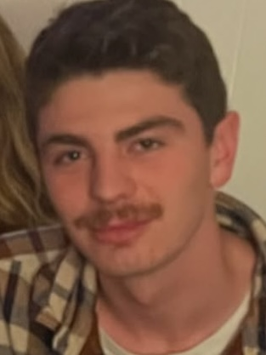
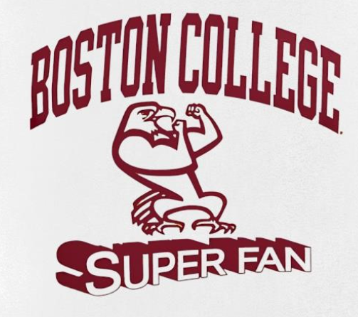

I would like the left logo to be recreated with some changes:
1. The eagle being replaced cartoon/caricature that loosely resembles the face on the right. The mustache should be exaggerated larger and the body should be exaggereated tall and skinny.
2. Replace “Super” with “Kevin” so that it reads “BOSTON COLLEGE KEVIN FAN”
3. Color scheme can stay the same (all text in marron / no others) so that this can be put onto backgrounds of various colors and it will fill through

