Slide 1

NAUTILITE LOGO
UNDERWATER LIGHTING PRODUCTS
UNDERWATER VIDEO LIGHTS - UNDERWATER TORCHES

Slide 2
PROJECT SCOPE
DEVELOP A LOG FOR A NEW LINE OF UNDERWATER LIGHTING PRODUCTS.
SPEC
BRAND WILL CONSIST IN TWO MAIN PRODUCTS:
UNDERWATER VIDEO LIGHTS: Designed specifically for underwater photography and videography. Provide consistent, wide, and even illumination to eliminate shadows and color distortion in photos and videos.
UNDERWATER TORCHES: General-purpose lights designed for navigation, signaling, or illuminating specific areas underwater.
Used primarily by scuba divers to explore underwater environments.
TARGET
-Underwater Photographers
-Scuba Divers
-Scuba Diving Companies
-Underwater Sports

Slide 3
Context
We need a modern, clean logo for Nautilite, our new line of underwater lighting for divers and photographers.
The logo should highlight the product's design elements, conveying its durability, waterproof build, and powerful light output.
The logo will be used on the packaging, user manuals, and laser-etched onto the product itself.
Please refer to slides 4 through 9 for examples of competitor logos to understand our desired aesthetic.
Note that slide 10 displays our current Hyperion logo, which should not be used as a reference for the Nautilite design.

Slide 4
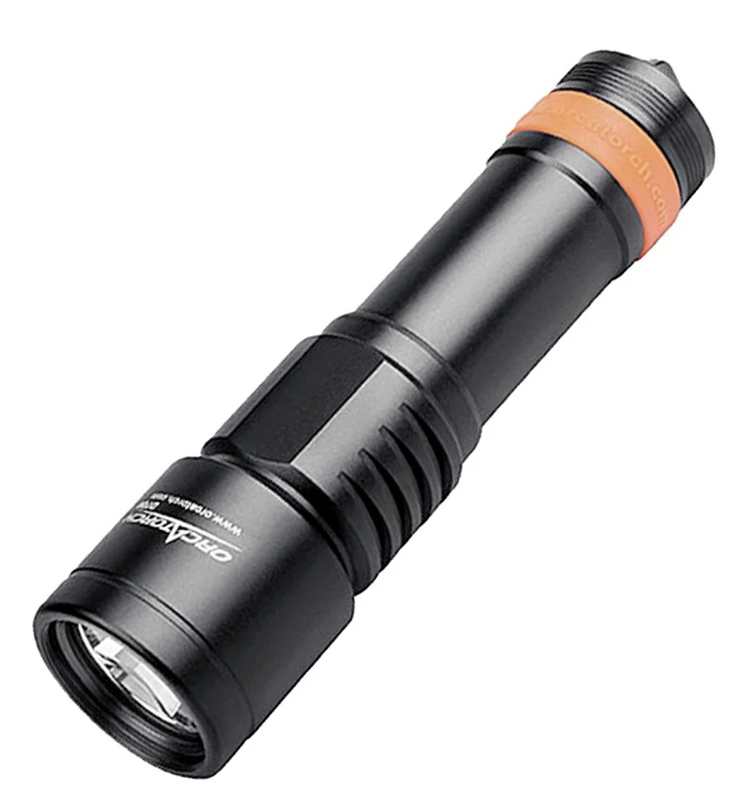

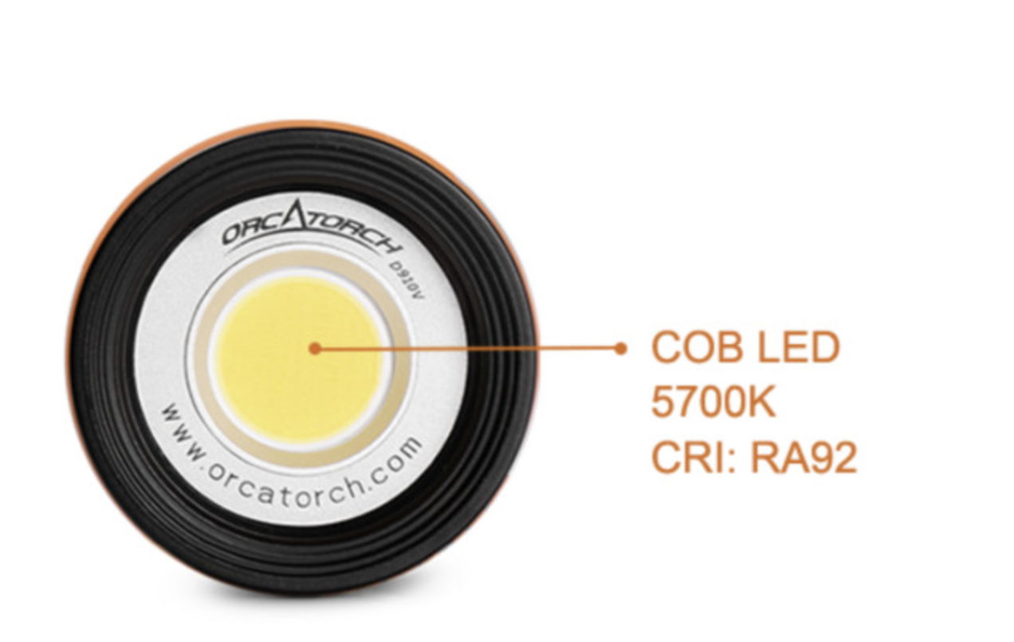
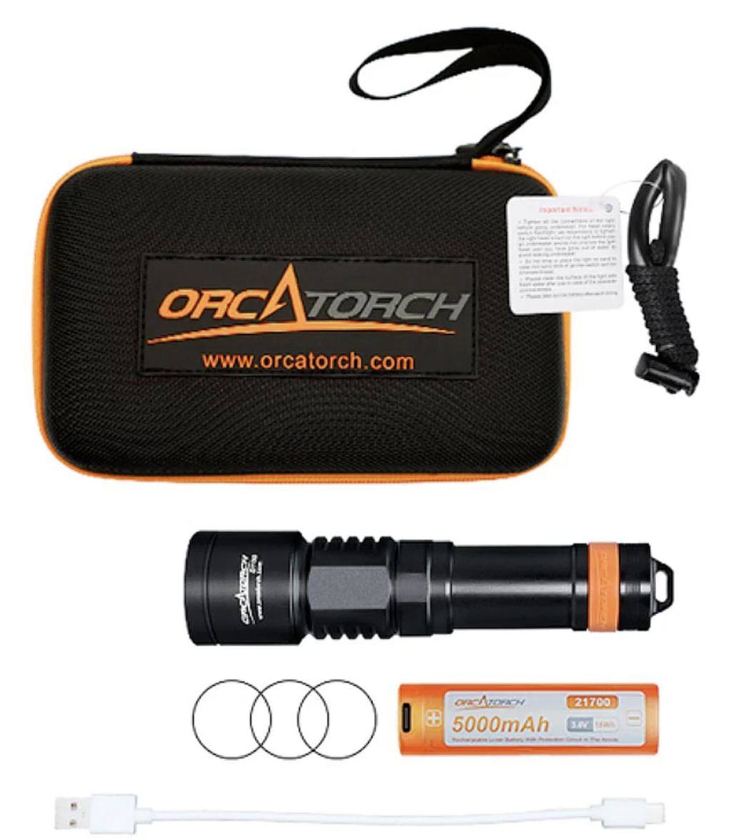
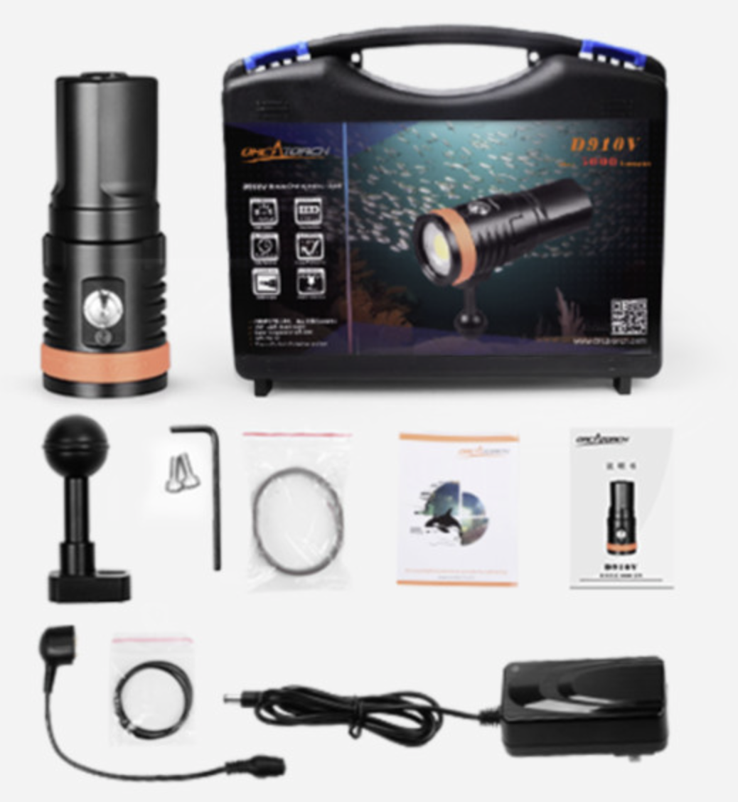
Competitors
Example underwater video light.

Slide 5
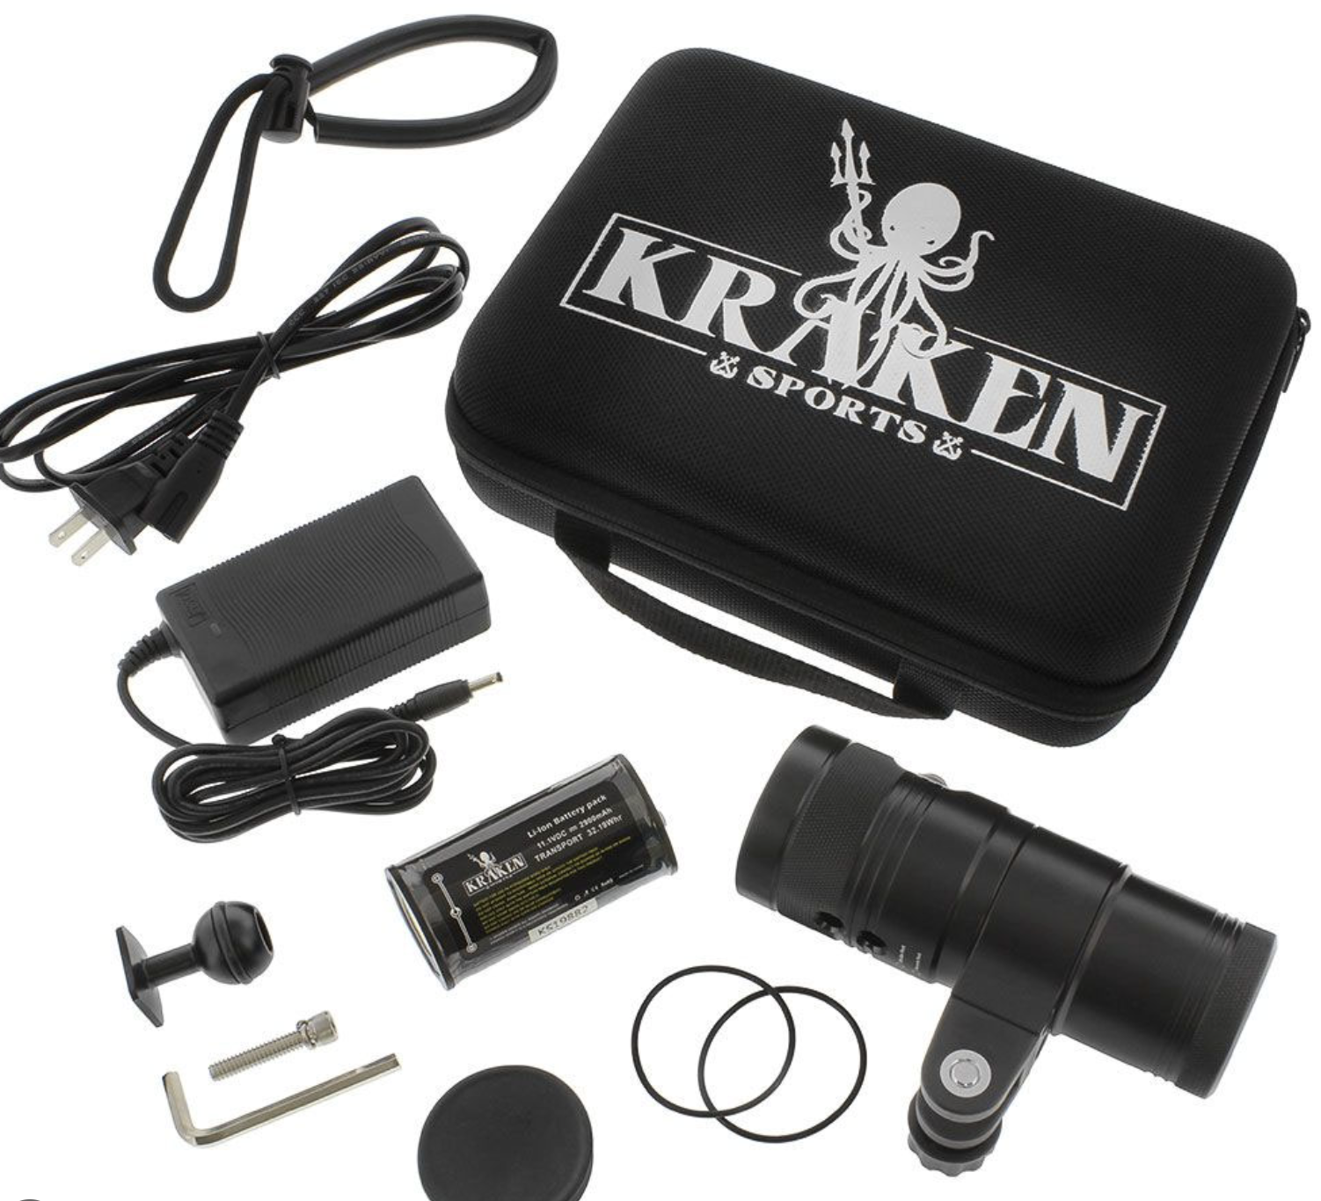
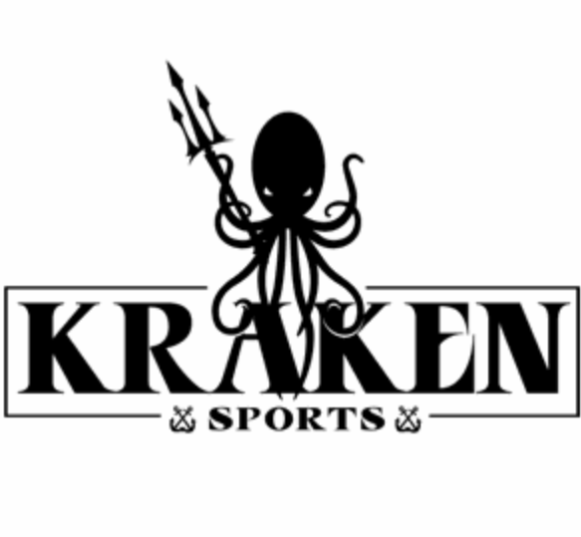
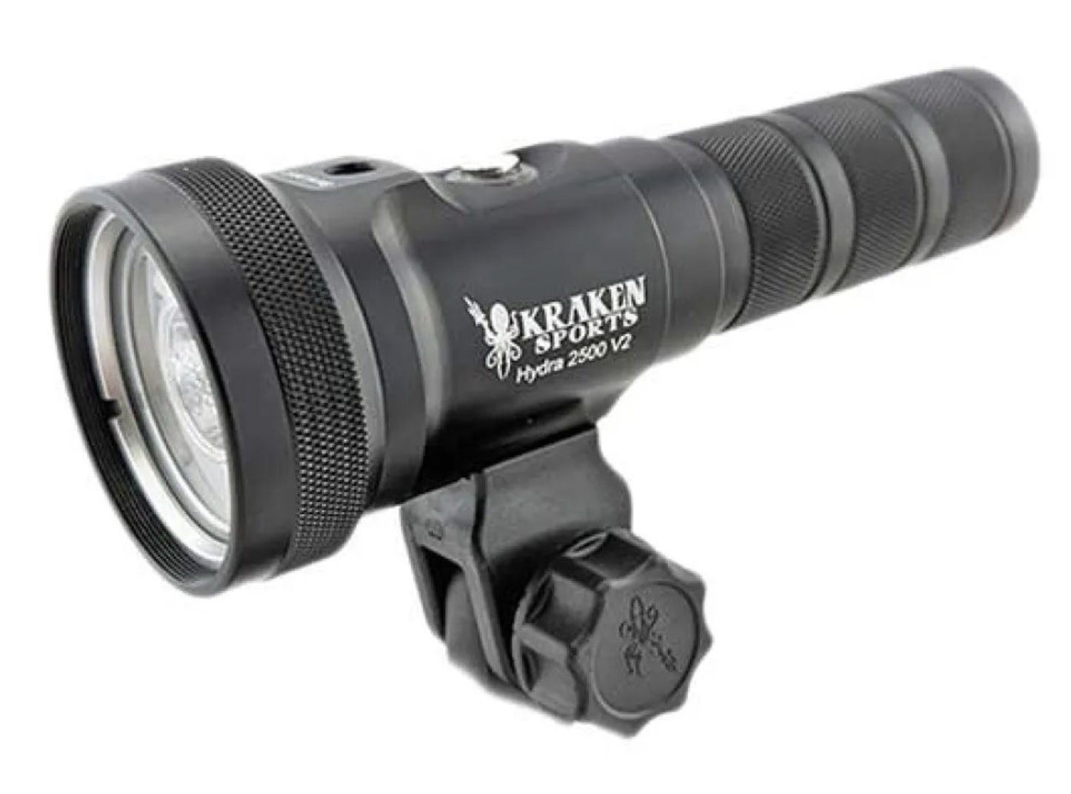
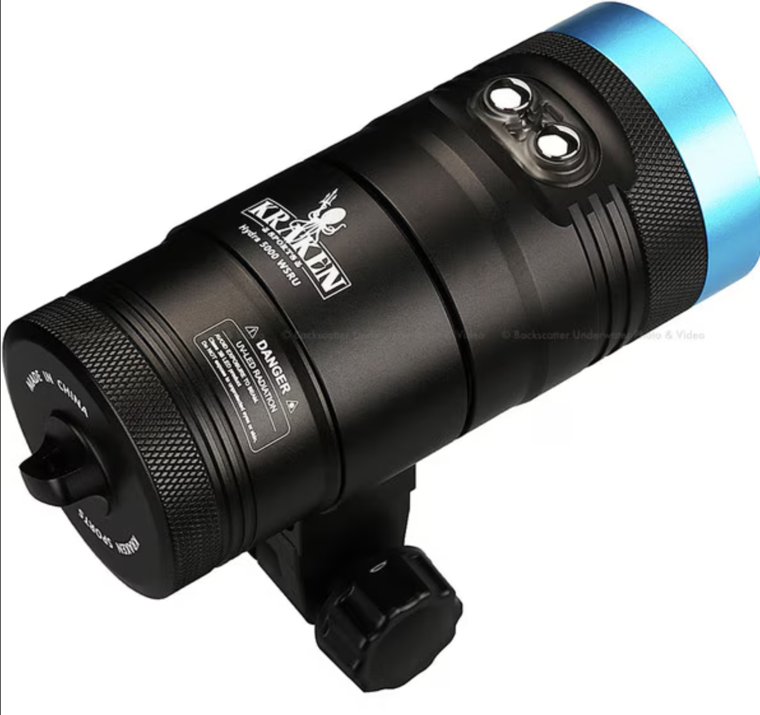
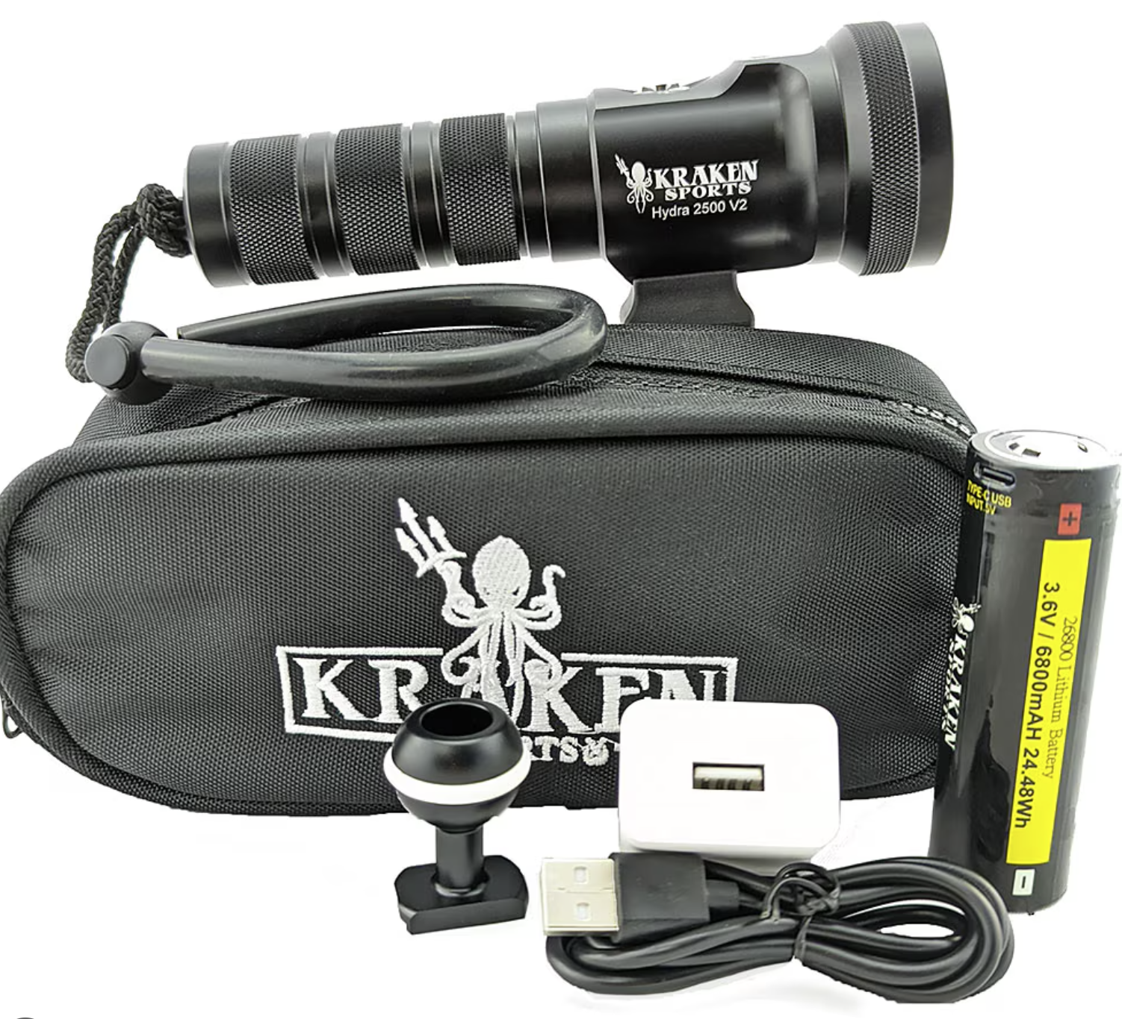
Competitors
Example underwater video light.

Slide 6
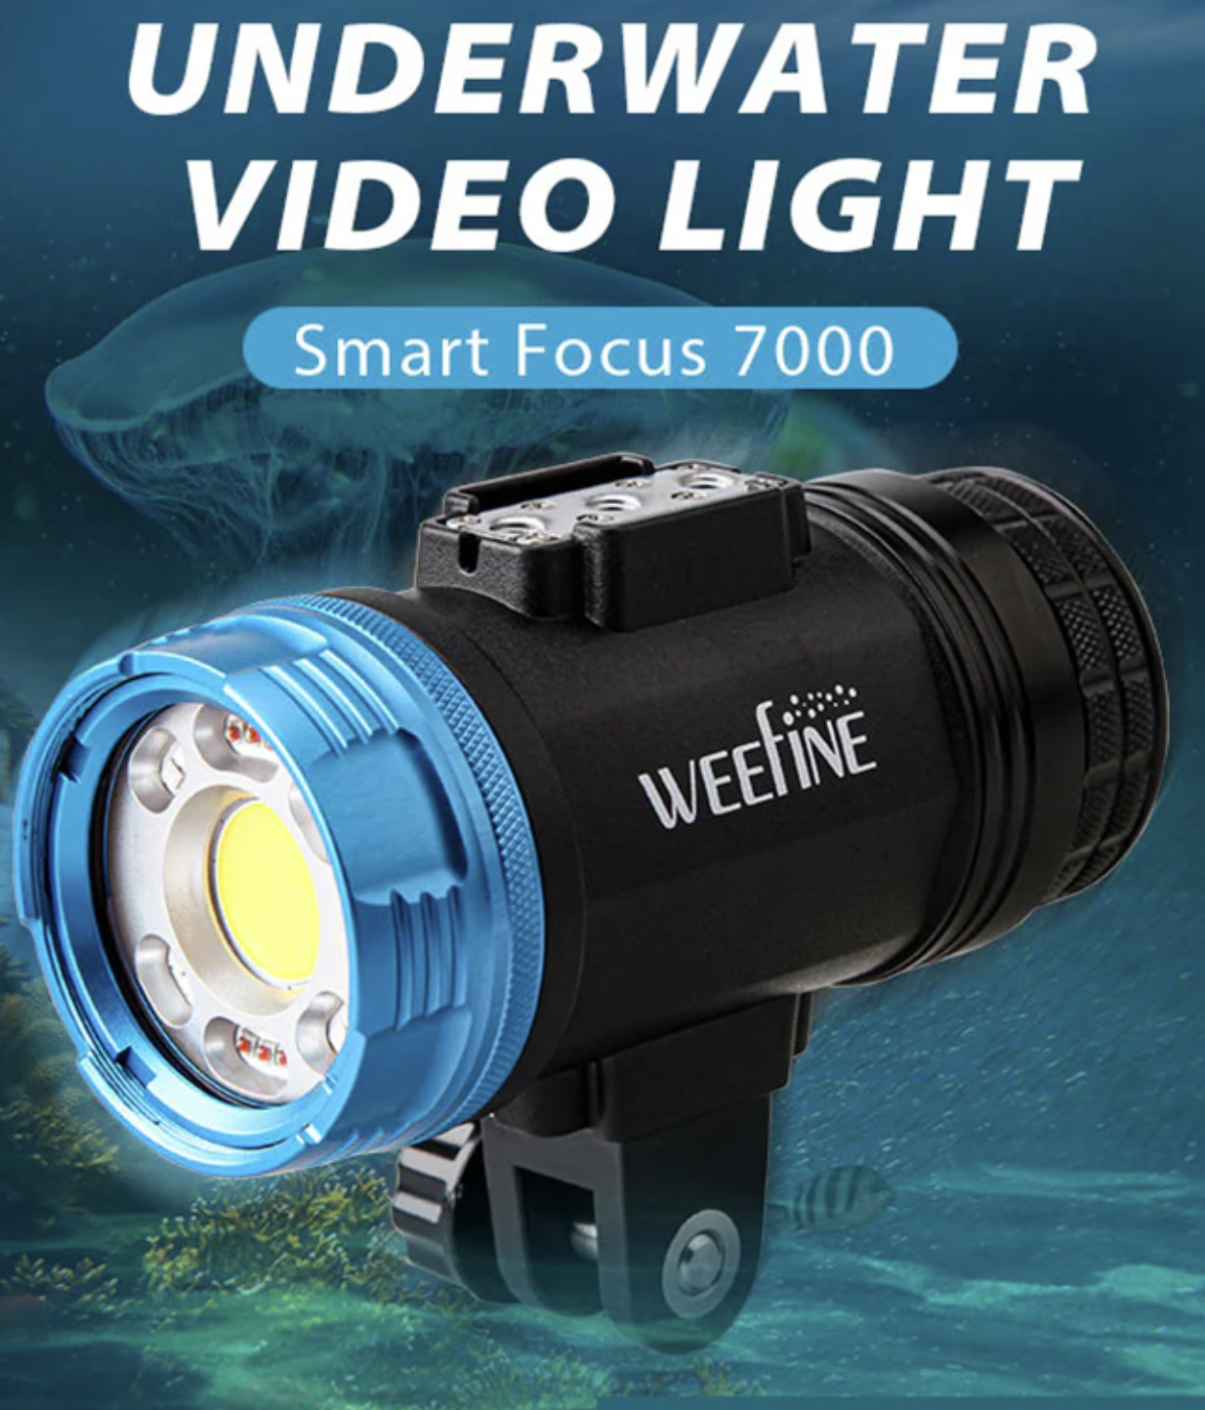
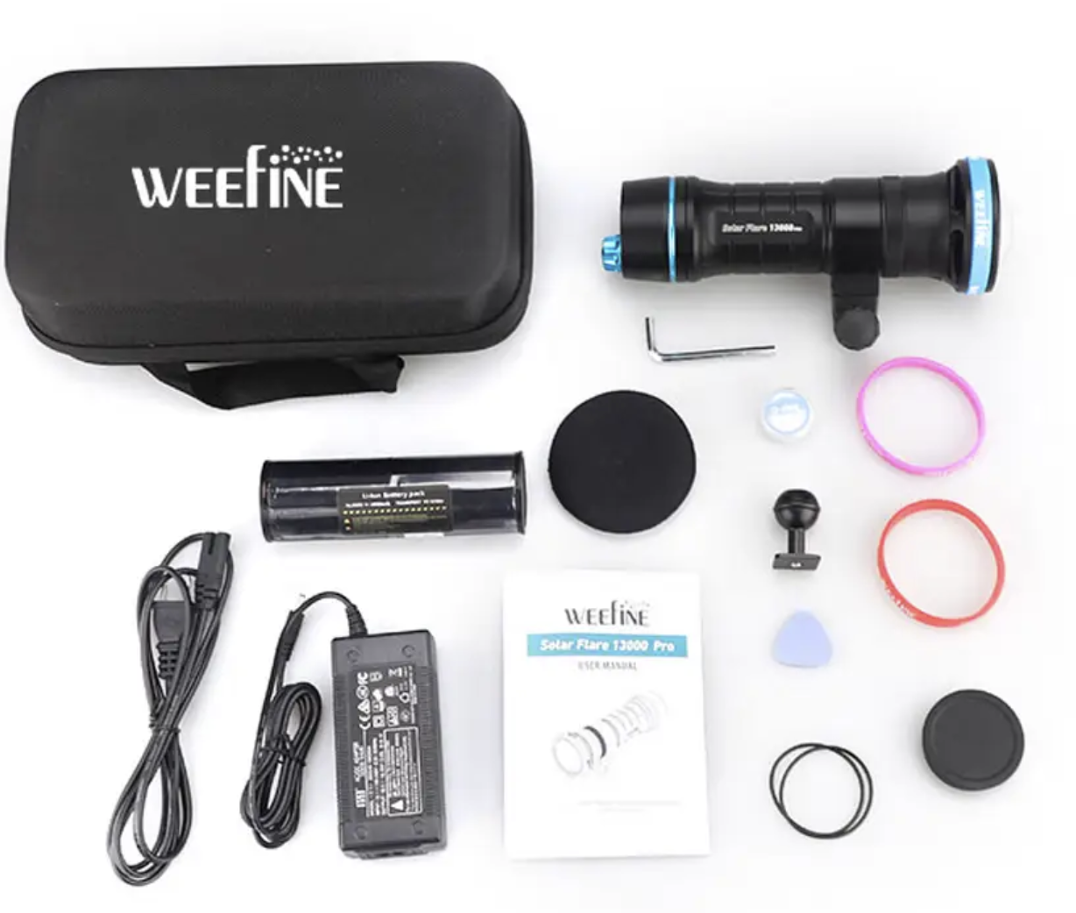
Competitors
Example underwater video light.

Slide 7
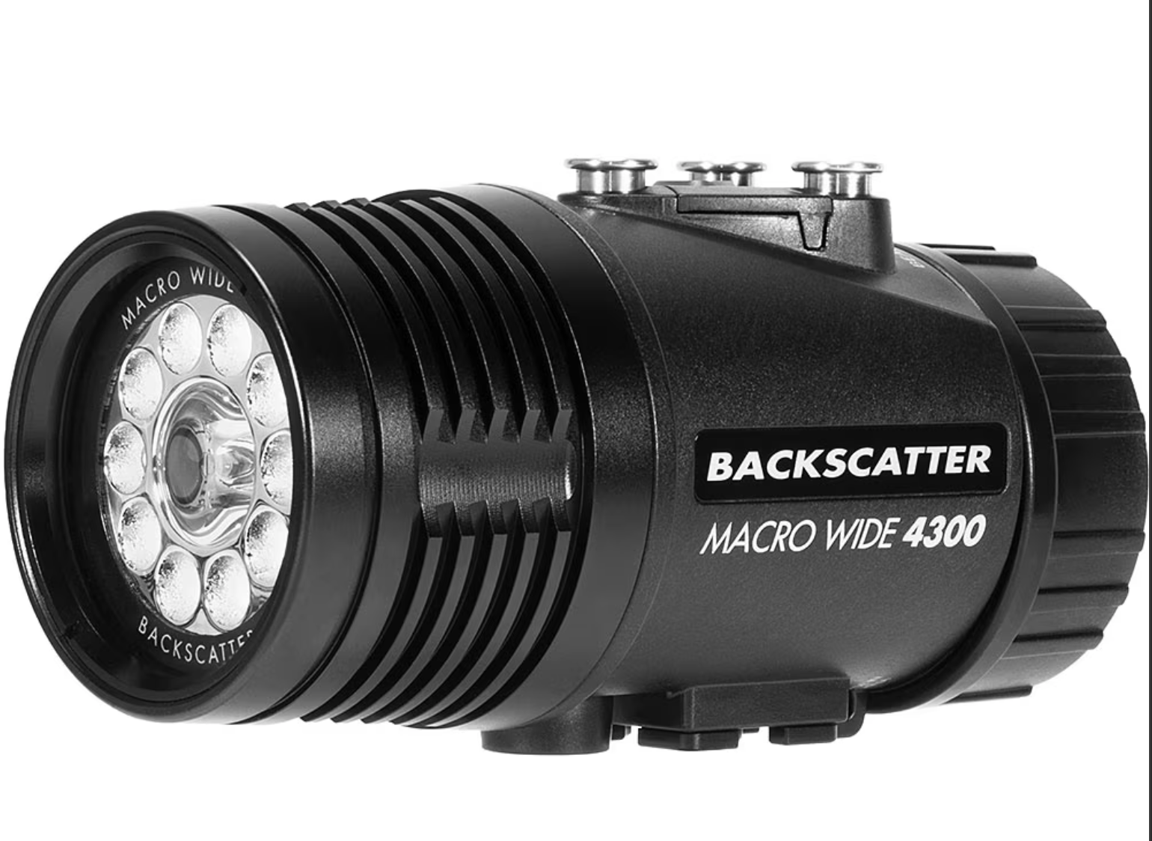
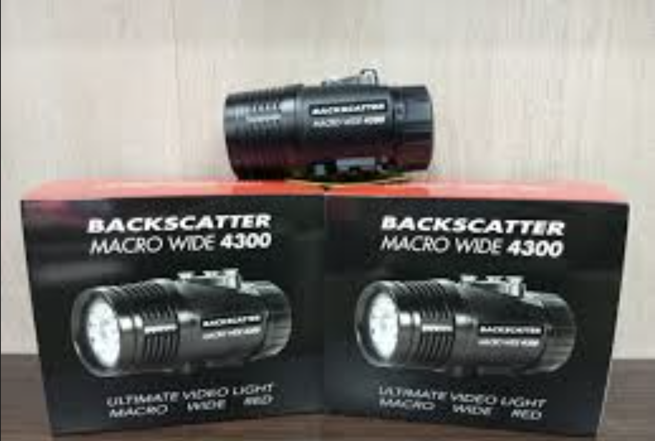
Competitors
Example underwater video light.

Slide 8
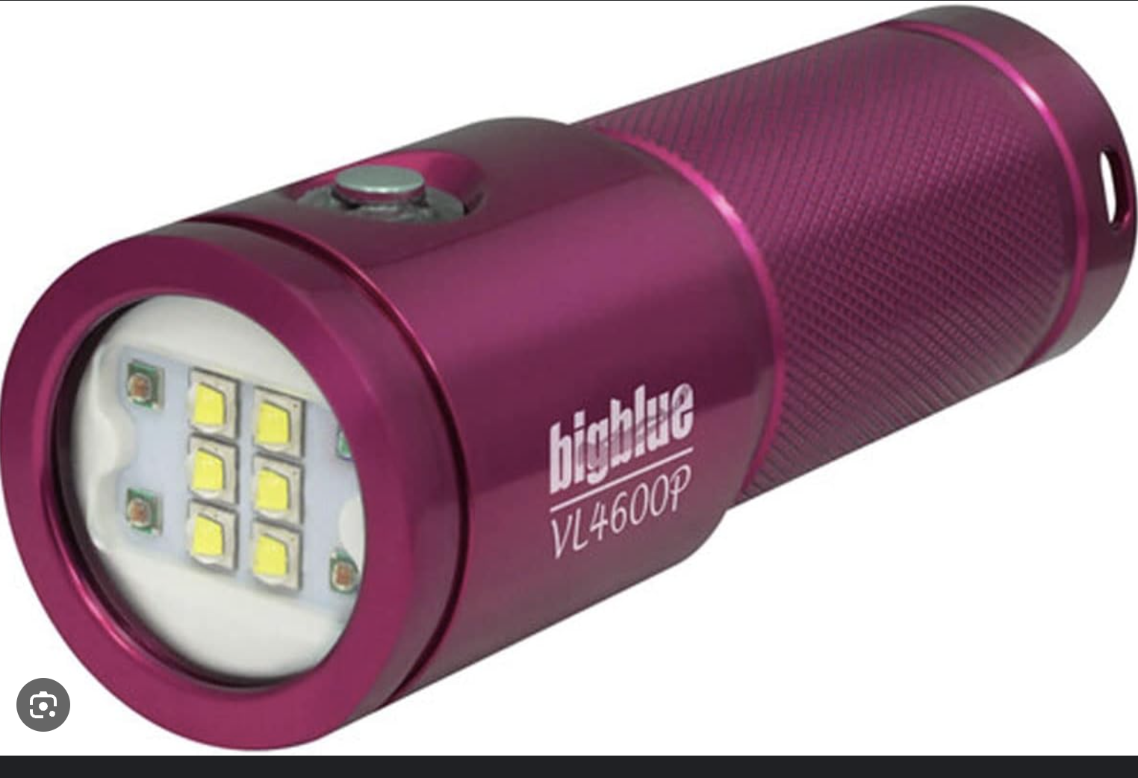
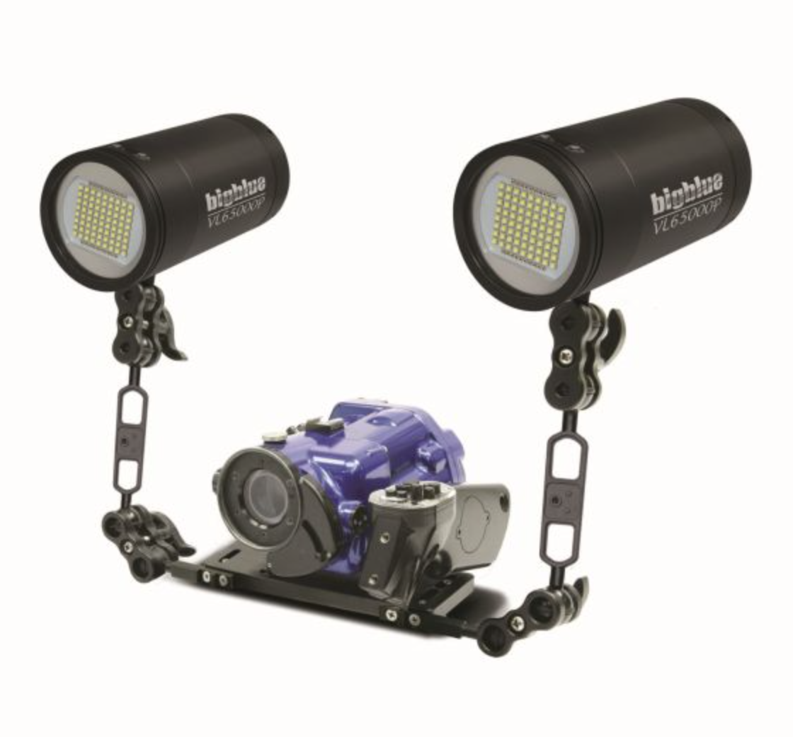
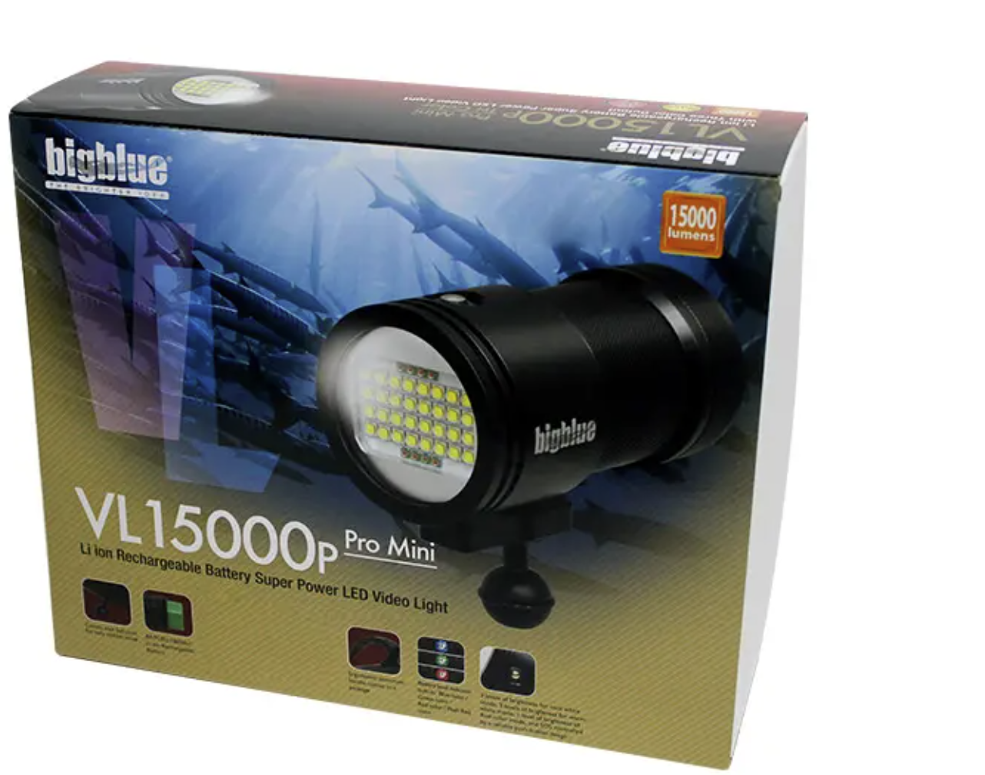
Competitors
Example underwater video light.

Slide 9
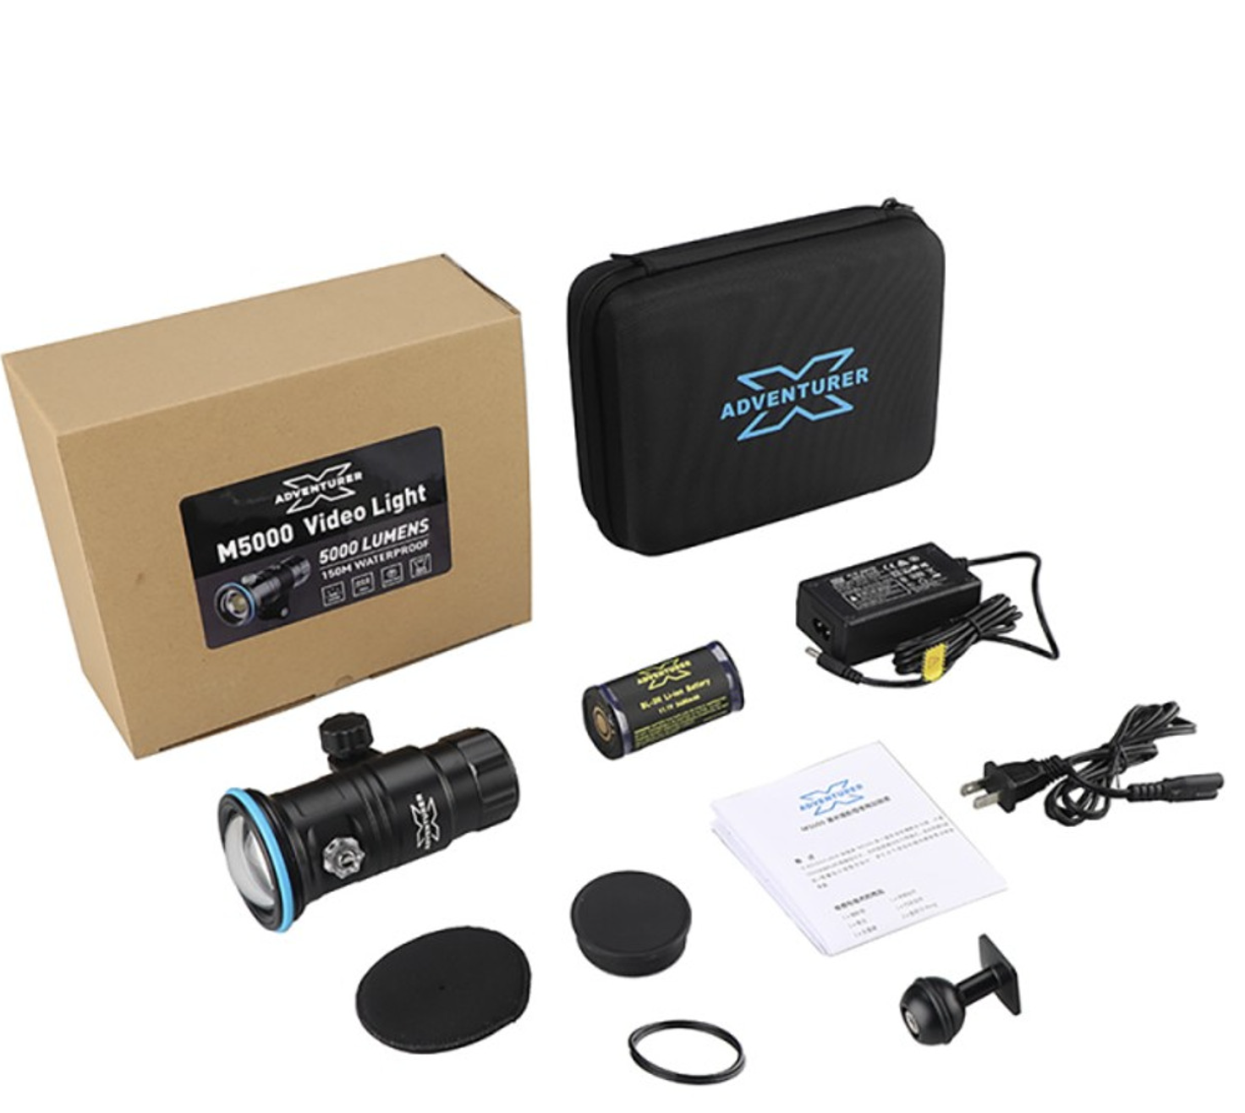
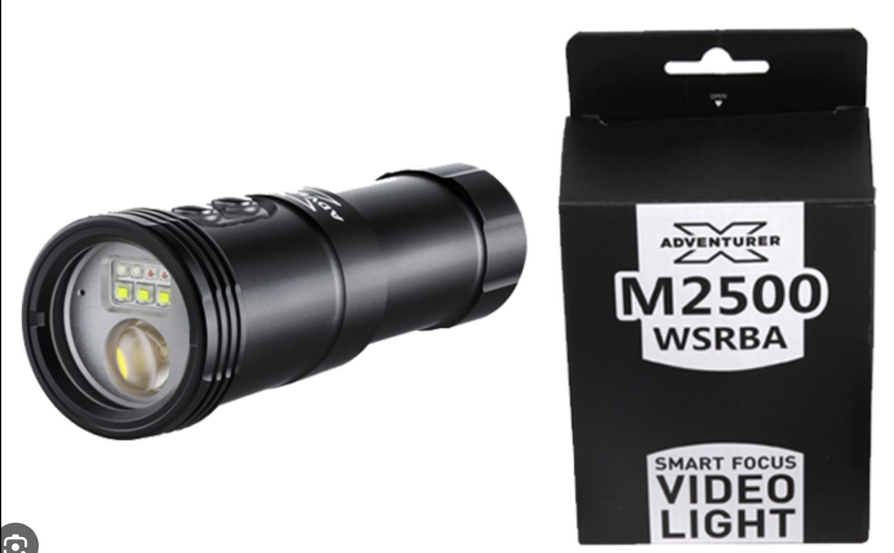
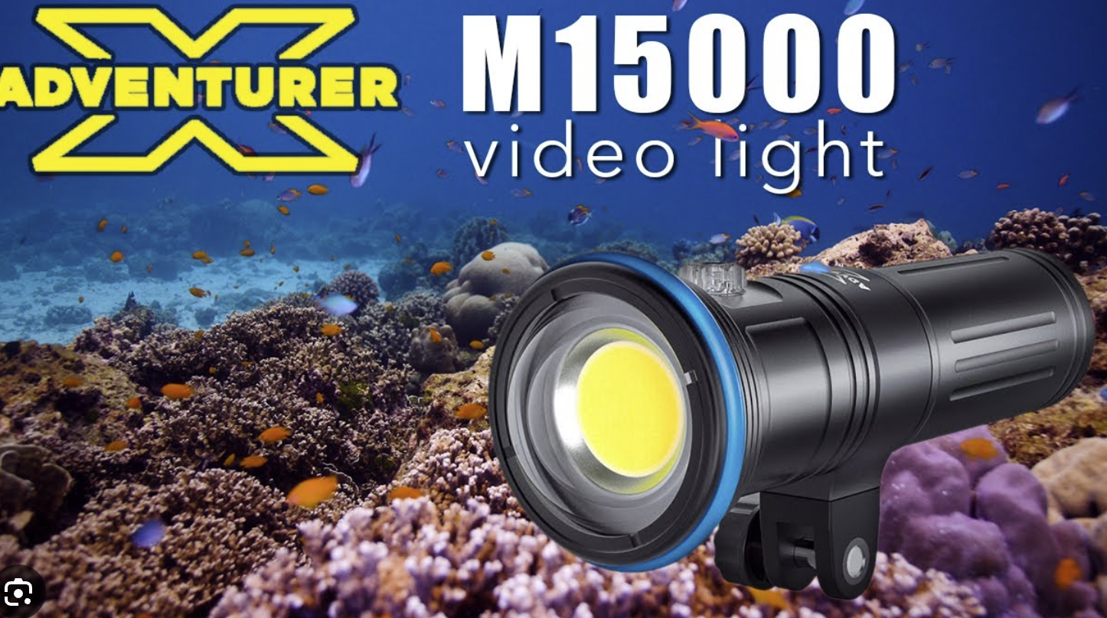
Competitors
Example underwater video light.

Slide 10
