Slide 1
Criteria
Style – Academic Journal (California Management Review) or Business Book
Clean, clear
Preferably editable

Slide 2


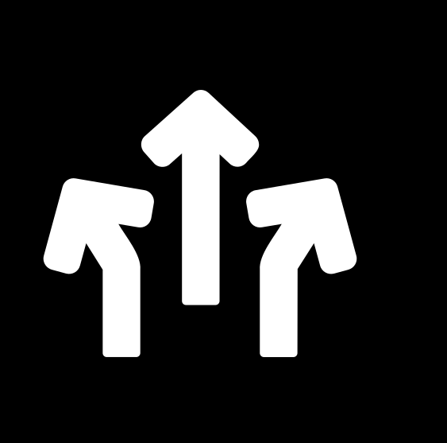

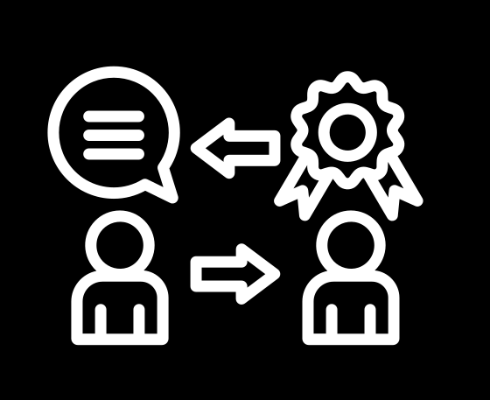
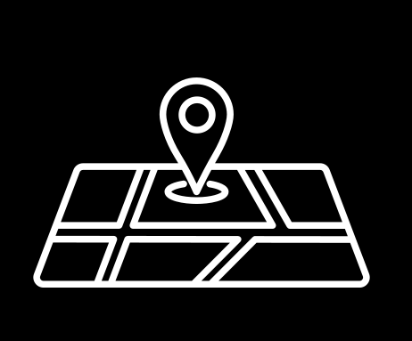
Execution of critical decision-making processes.
Conceptualization
of individual ideas
and micro strategies.
Ideas
Decisions
Provision of
guidance and
directives.
Integration into
organizational
lexicon and
behavioural
patterns, incl.
social cues
signalling the do’s
and don’ts of what
is deemed as
“acceptable” or
“normal” behaviour
Direction
Memes
Stories
Maps
Creation
of coherent
and adaptable narratives.
Development of
future state roadmaps.

Slide 3
The Ecostructure of Strategy
              E
IDEAS
IDEAS
IDEAS
IDEAS
IDEAS
IDEAS
IDEAS
MEMES
STORIES
IDEAS
IDEAS
MEMES
STORIES
IDEAS
STORIES
IDEAS
MEMES
STORIES
DECISIONS
IDEAS
MEMES
MAPS
IDEAS
MEMES
MAPS
IDEAS
DIRECTIONS
IDEAS
MAPS
DIRECTIONS
MAPS
ECOSYSTEM OF
(RE-/DE-) STRUCTURING
ECOSYSTEM OF EMERGENCE
ECOSYSTEM OF REIFICATION

Slide 4

Actors
Ideas
Decisions
Memes
Direction
Maps
Stories
Actions
Artifacts

Slide 5
Actors
Catalyzers
Ideas
Decisions
Memes
Direction
Maps
Stories
Actions
Artifacts

Slide 6



NURTURING STRATEGY
(RE-)STRUCTURING STRATEGY
DELIBERATE STRATEGY
I TERAT ION
I TERAT ION
EMERGENT STRATEGY
(DE-)STRUCTURING STRATEGY
OPENING STRATEGY

Slide 7

(RE-)STRUCTURING STRATEGY
DELIBERATE STRATEGY
NURTURING STRATEGY
I TERAT ION
I TERAT ION
EMERGENT STRATEGY
(DE-)STRUCTURING STRATEGY
OPENING STRATEGY

Slide 8
NURTURING STRATEGY
(RE-)STRUCTURING STRATEGY
DELIBERATE STRATEGY
Triggers
Synergizing
Confluencers
I TERAT ION
I TERAT ION
Manifestors
Activators
Instigating
Channels
Igniting
Breakers
Dampeners
Levers
Deploying
Cognizers
Architectures
Boosters
Cultivability
Memories
Adapting
Nurturing
Openness
Anchors
State
sensing
Fortifiers
EMERGENT STRATEGY
(DE-)STRUCTURING STRATEGY
OPENING STRATEGY

Slide 9


Strategy as an Ongoing, Evolutionary Flow of Collective Reimagining and Learning
Order
New Strategy
Old Strategy (Paradigm?)
Tipping Point
Letting go of Old
Emergence of New
Meaning
Modern biology: both competition and cooperation may coexist at different levels of organization; collaborative and symbiotic patterns and interactions are of more fundamental importance than competition as a driving force of evolution

Slide 10
