Slide 1
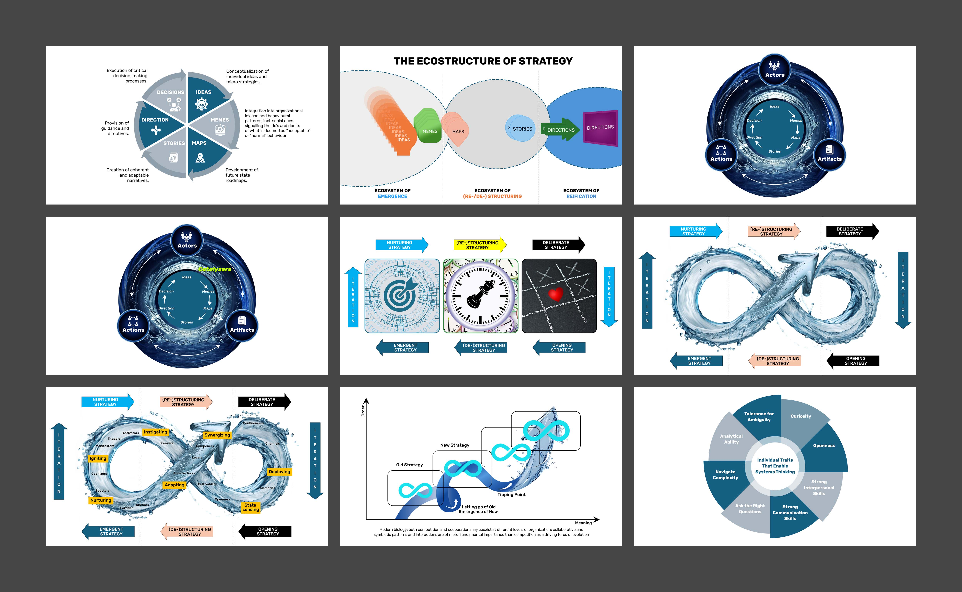
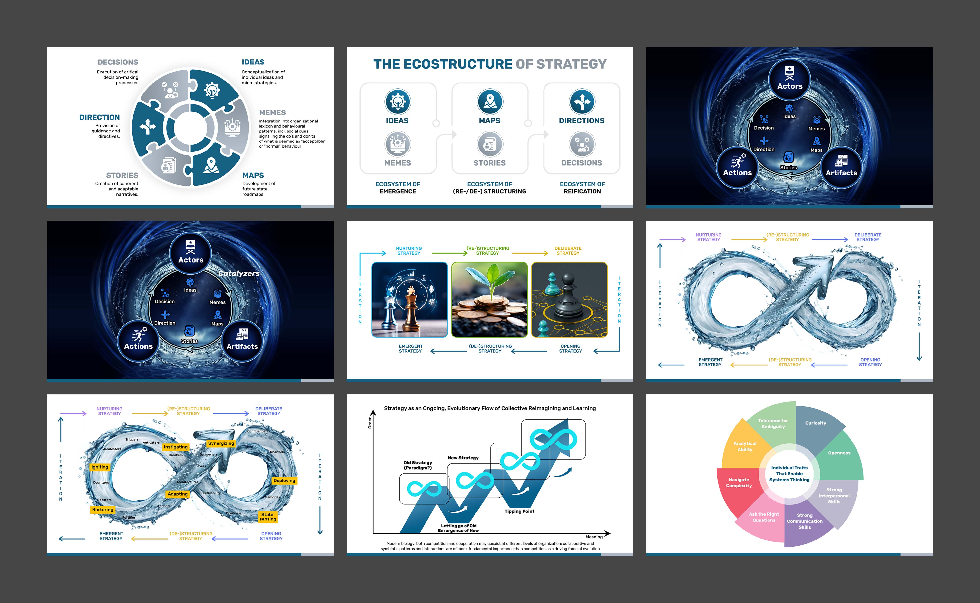
This version is best, the labels etc. are good
However there need to be arrows linking the parts vs. puzzle –like links /pieces

Slide 2
This version is better, keep the format, icons etc, however lay it out left to right like the original

Slide 3


Actors
Ideas
Decisions
Memes
Direction
Maps
Stories
Actions
Artifacts
The water-flow in my original is better, keep it, use it (take from the PPT). Insert the updated diagram in the middle from page 1. No icons needed in Actors, Actions and Artifacts

Slide 4
See comments on the last page. The word Catalyzers needs to be in a more neutral color that fits the overall briefing (not green)

Slide 5
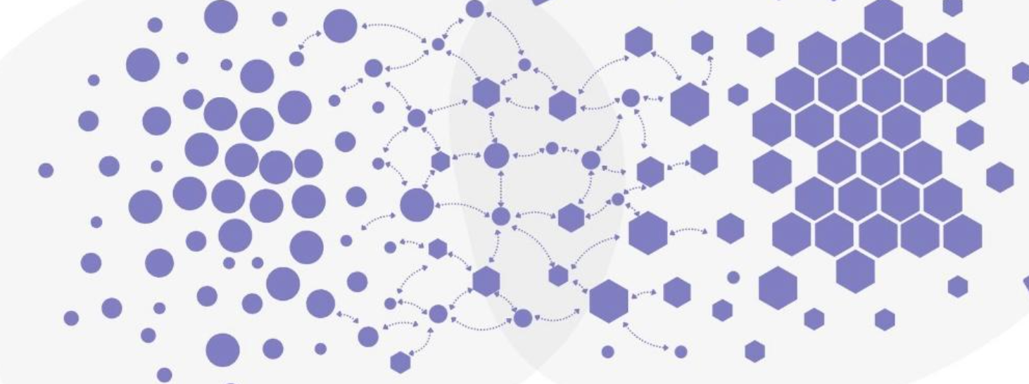
This version is better, keep the format, icons etc, change the pictures
Possibly use this as inspiration (need to be redrawn to not reuse other people’s IP):

Slide 6
This version is better, keep it, not the updated one

Slide 7
This version is better, keep it, not the updated one

Slide 8
The water arrow in the background is good. Delete the text under the chart, and replace the light-blue infinity symbols with the water-flow from the previous charts. Keep the “letting go of the old”and tipping point labels as they were in my original – between the boxes, not as part of the arrow

Slide 9
Looks good. Text in center needs to be black

