Slide 1
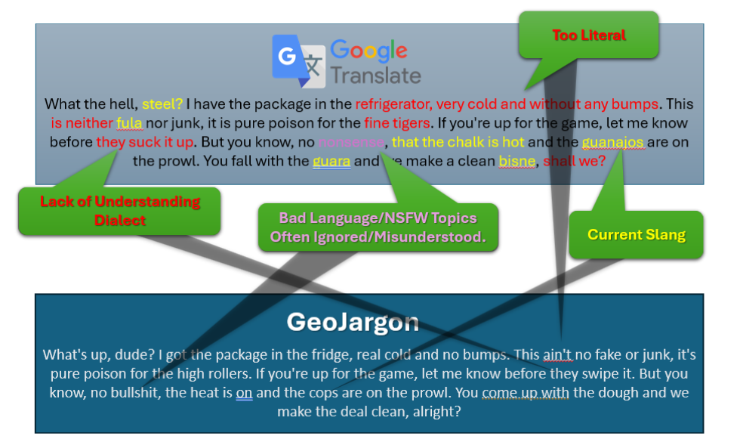
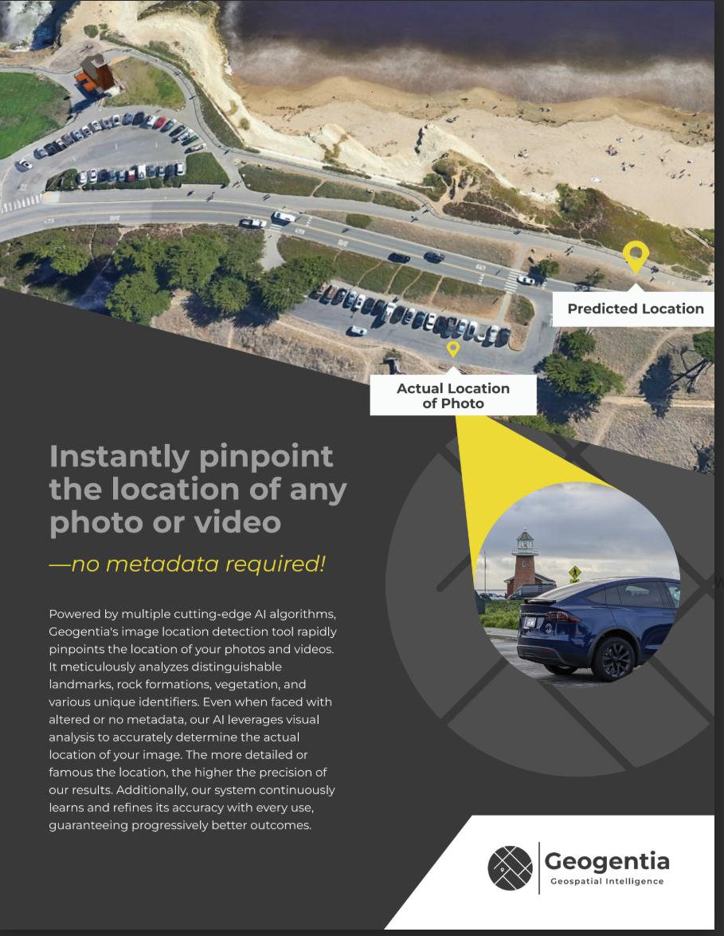
GeoJargon vs Online Translators
GeoJargon: Decode the Real Message
No More Robotic Translations—Get Down and Dirty with Real Language
Forget stiff, textbook translations. Our AI-powered system translates slang, typos, emojis, abbreviations, local dialects, and hidden meanings—so nothing gets lost in translation.
Whether it’s text messages, recorded calls, social media posts, or street slang, GeoJargon analyzes language like real people use it—raw, unfiltered, and full of nuance. We work across 78+ languages, ensuring you don’t just get the words—you get the real intent behind them.
Because in an investigation, understanding the truth can mean the difference between a lead and a dead end.

Slide 2
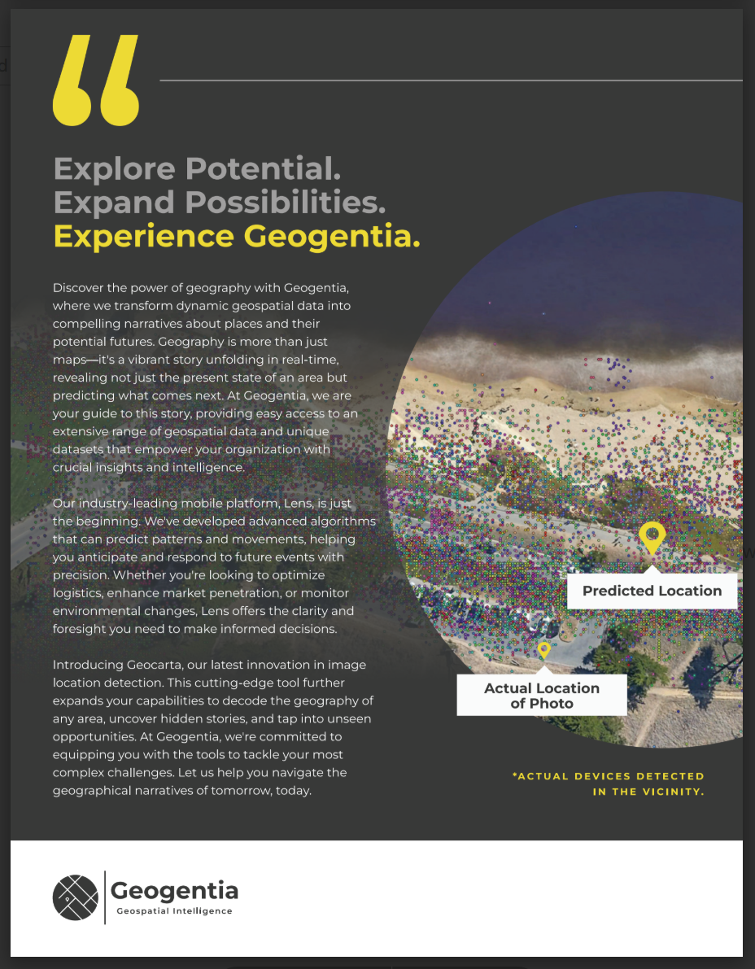
**GeoJargon: The Future of Translation**### **Break Language Barriers with Precision**Communicate effortlessly across **78 languages** with GeoJargon. Whether it’s **text, audio, or images**, our cutting-edge translation technology ensures accuracy, nuance, and cultural relevance like never before.---### **Why GeoJargon?**#### **Better Translation with Advanced AI**Traditional translation apps like Google Translate rely on **Neural Machine Translation (NMT)** and **Statistical Machine Translation (SMT)**—often resulting in literal and misleading translations.Example:- **Google Translate Interpretation**: *“That cat just kicked the bucket.”* → Assumes a feline physically kicked a bucket.- **GeoJargon Interpretation**: *Understands that ‘cat’ is slang for a cool person and ‘kicked the bucket’ means death.*GeoJargon is powered by a **custom Large Language Model (LLM)** designed to grasp **context, idioms, and cultural nuances**, making translations sound more natural and human-like.---#### **Up-to-Date Slang, Dialects & Modern Expressions**- **Google Translate**: Uses outdated language models, often derived from United Nations transcripts from the 1990s, missing modern slang and dialects.- **ChatGPT**: While advanced, its model updates are over **6 months old**, missing real-time language shifts from social media trends.- **GeoJargon**: **Slang and dialect updates in near real-time**. If a new term trends on TikTok today, GeoJargon incorporates it by **the next morning**. GeoJargon is constantly evolving, making it the perfect tool for **law enforcement, undercover investigations, and intelligence agencies** who need to stay ahead of linguistic shifts.---#### **Understands Sensitive Topics**Unlike other translation platforms, GeoJargon provides an accurate, unfiltered understanding of language—even in **sensitive or restricted** discussions.- **Google Translate**: Often misunderstands slang, censors words, or provides inaccurate translations.- **ChatGPT**: Prohibits discussion of **sex, drugs, and violence**.- **GeoJargon**: Custom LLM is trained to understand and translate **sex, drug, and violence-related conversations** with accuracy and context.---### **Customizable Communication Styles**GeoJargon goes beyond just translating words—it helps you **blend in seamlessly** by providing **multiple conversational styles** to match different scenarios. Whether you need to sound like a **teenager**, a **business executive**, or someone **in a hurry**, GeoJargon adapts accordingly.✔ **Teenager Mode** – Uses emojis, slang, and abbreviations to sound authentic to younger generations. *(“Yo fr, that’s wild!🔥”)* ✔ **Professional Mode** – Provides a polished, formal tone for business communications. *(“Thank you for your patience. We will review your request shortly.”)* ✔ **Fast & Direct Mode** – Short, to-the-point translations for quick interactions. *(“Need info now. Meet in 10.”)* ✔ **Undercover Mode** – Designed for intelligence professionals and law enforcement to **mimic local dialects, gang slang, and criminal jargon**, crucial for **narcotics, sex trafficking, and organized crime investigations**.---### **Privacy & Security First**GeoJargon is built for organizations and individuals who prioritize **data security and confidentiality**.✔ **No Third-Party Data Sharing** ✔ **No Auditing or Saving of Text, Images, or Audio** ✔ **Can Be Hosted on Classified Networks** ✔ **Compatible with Air-Gapped Systems** (Note: slang updates will be delayed by a month)---### **GeoJargon: Beyond Translation—True Communication**Whether you’re a global business, intelligence agency, or an individual needing **true-to-life translations**, GeoJargon is the **next-generation** language solution you can trust.**Experience the future of translation today.**

