Slide 1
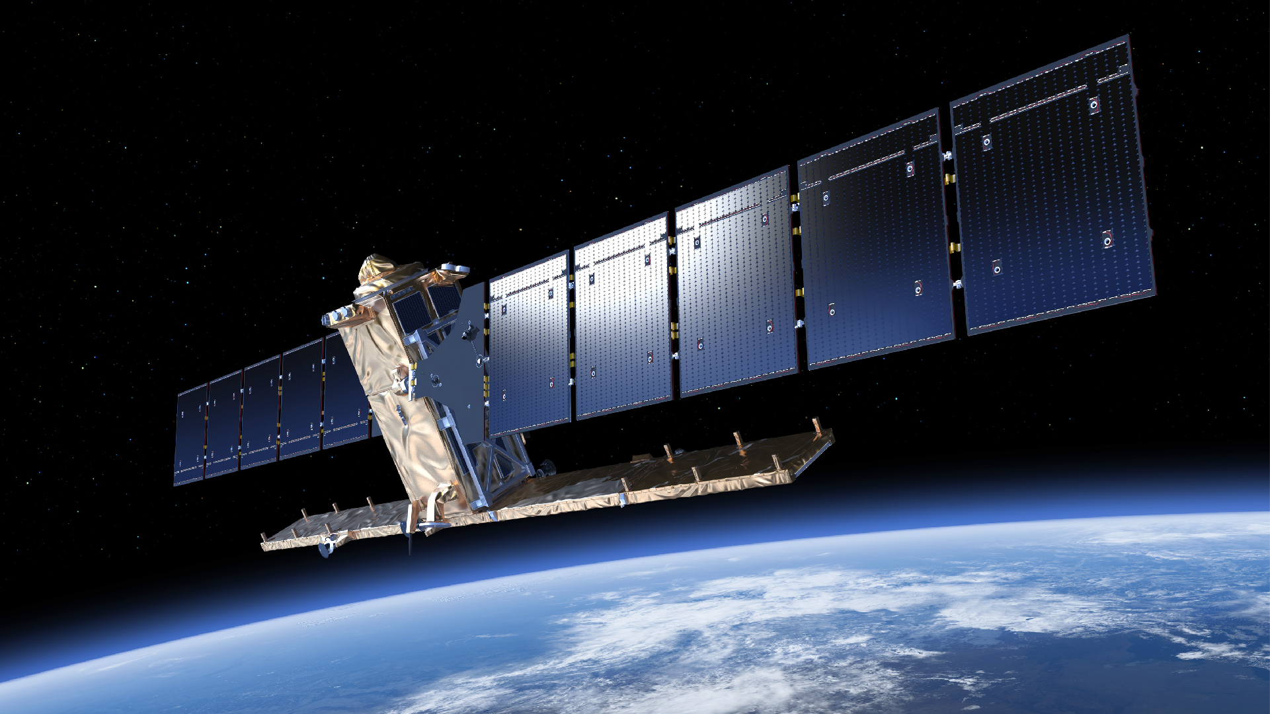

AI/ML Inference Engine Software for High-Reliability applications on Space Qualifiable Hardware
23.05.2024
DASIA 2024
pablo.ghiglino@klepsydra.com
www.klepsydra.com

Slide 2

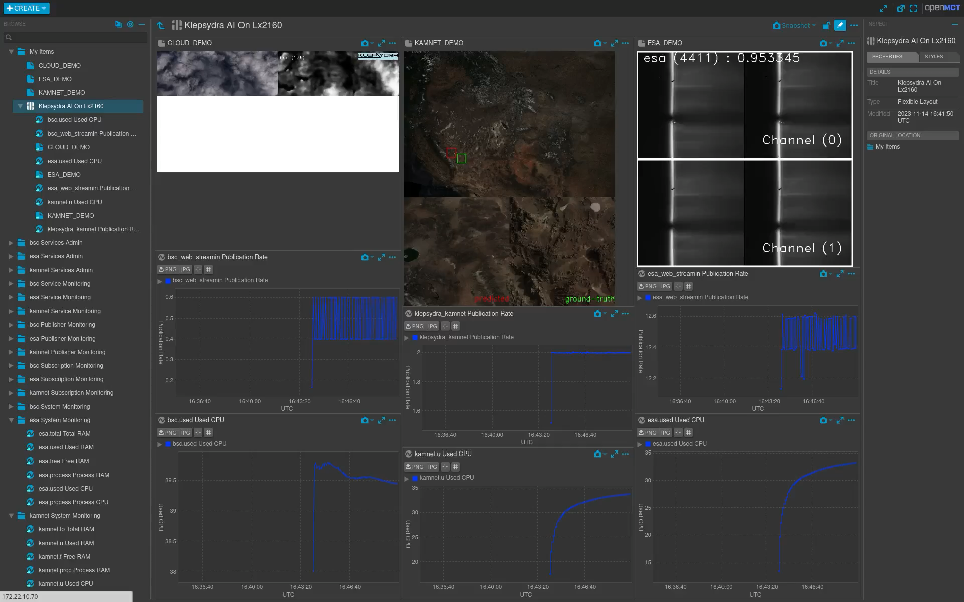
The LX2160 Space cloud Demo

Slide 3

Two main data processing approaches
Producer 1
Sensor Multiplexer
Producer 2
Producer 3
Producer 1
Consumer 1
Consumer 2
Event Loop
Consumer

Slide 4
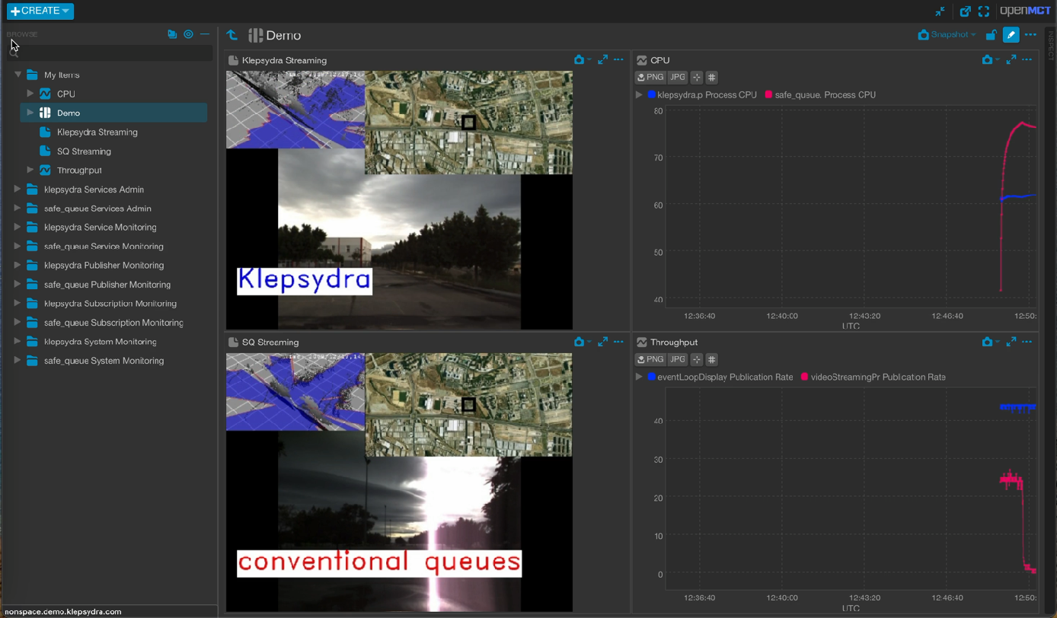
Previous Demos
Self-driving car Data Aggregation

Slide 5


Lock-free as alternative to Parallelisation
Parallelisation
Pipeline

Slide 6
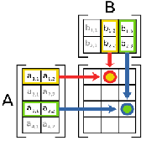
2-DIM Threading model
Threading model configuration
Core 1 | Core 2
Core 3 | Core 4
Core 1 | Core 2
Core 3 | Core 4
Core 1 | Core 2
Core 3 | Core 4
Layer
Layer
Layer
Layer
Layer
Layer
Layer
Layer
Layer
Layer
Layer
Layer
Layer
Layer
Layer
Layer
Layer
Layer
Layer
Layer
Layer
Low CPU power
Mid throughput CPU
High latency
Mid CPU
High throughput CPU
Mid latency
High CPU
Mid throughput CPU
Low latency

Slide 7
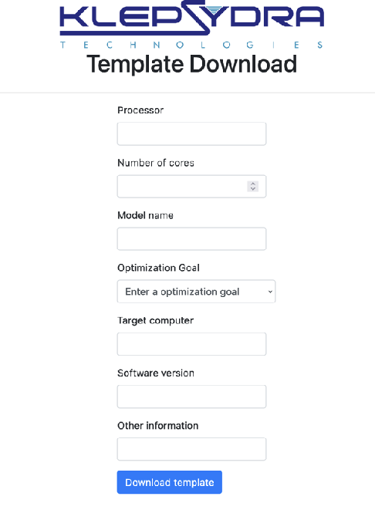
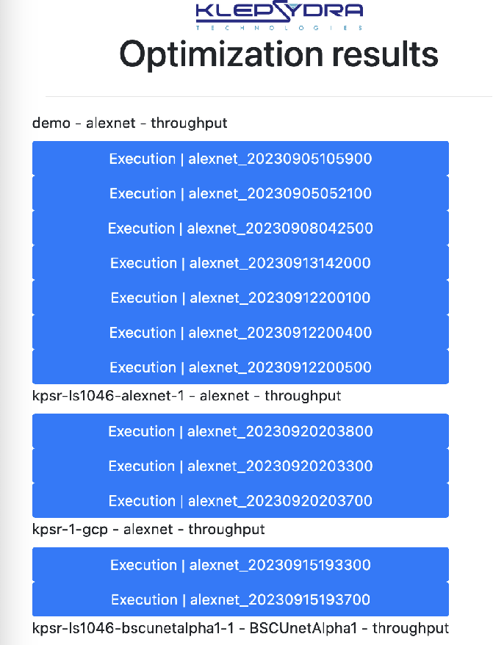
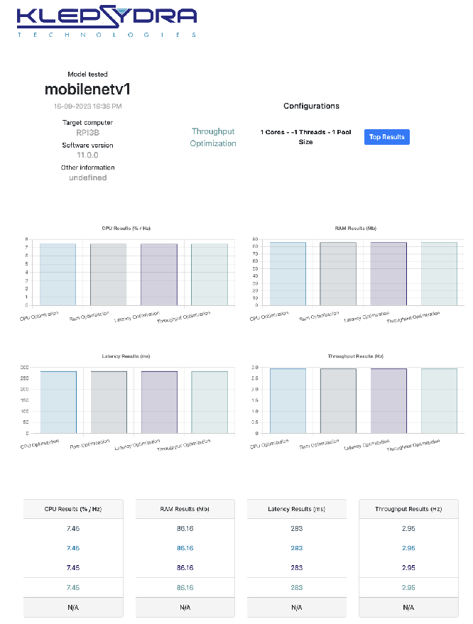
Klepsydra SDO

Slide 8
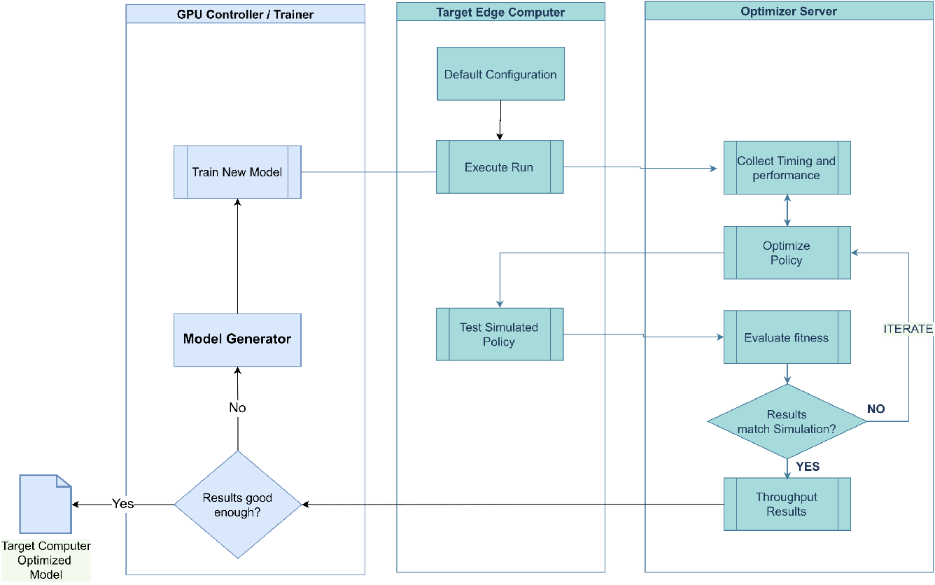
Next-SteP - Klepsydra-in-the-loop
The Next-Step Klepsydra-in-the-loop:
Architectural Search Training
Including Klepsydra SDO as part of the training target goals
Trade-off between precision and performance on the edge.
E.g.. Reduce latency in 50% for a drop in precision of 5%

Slide 9
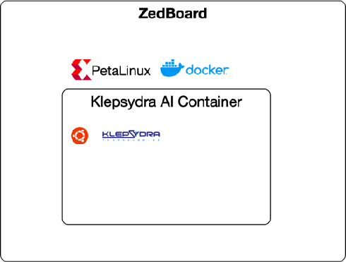
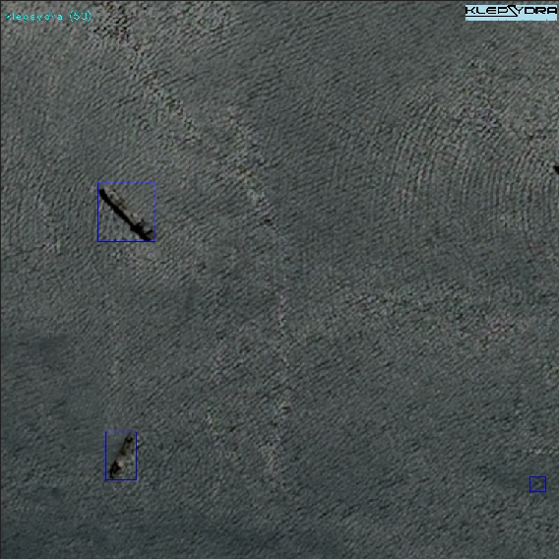
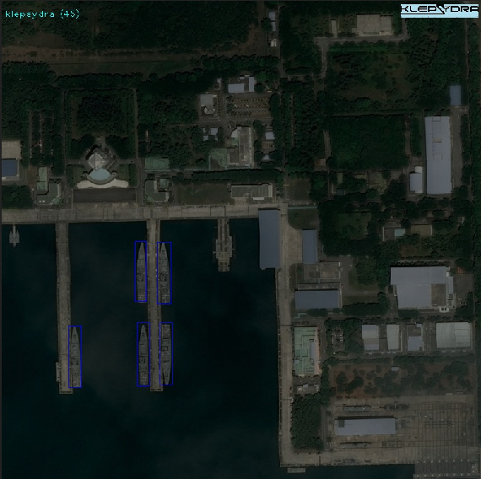
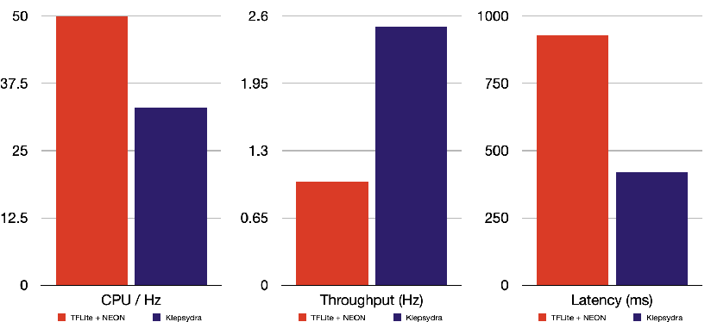
ZedBoard on Linux Support
Performance Results: CME-Q on ZedBoard

Slide 10
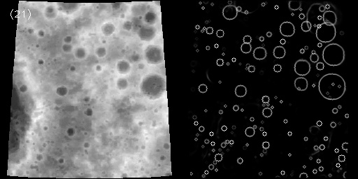
ARM64 on Linux Support
Algorithm 1: Relative navigation
Based on the paper: “Lunar Crater Identification via Deep Learning” (https://arxiv.org/abs/1803.02192)
It detects craters and their position to perform relative navigation using a single Deep Neural Network for object detection
Performance in the RPI3B+: Latency 12s
Relative navigation running the RPI3B+

Slide 11
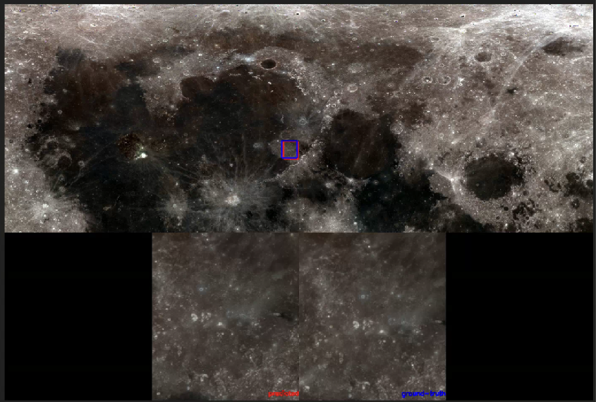
ARM64 on Linux Support
Algorithm 2: Absolute navigation and attitude determination
Based on the paper: “KAMnet – A Deep Learning Approach to Optical Navigation for a Dawn-Dusk Earth Observation Mission” (https://iafastro.directory/iac/paper/id/67964/summary/)
It is based on a single DNN that calculates position and attitude with respect to the target object.
Performance in the RPI3B+: Latency 3s
Absolute navigation running the RPI3B+

Slide 12
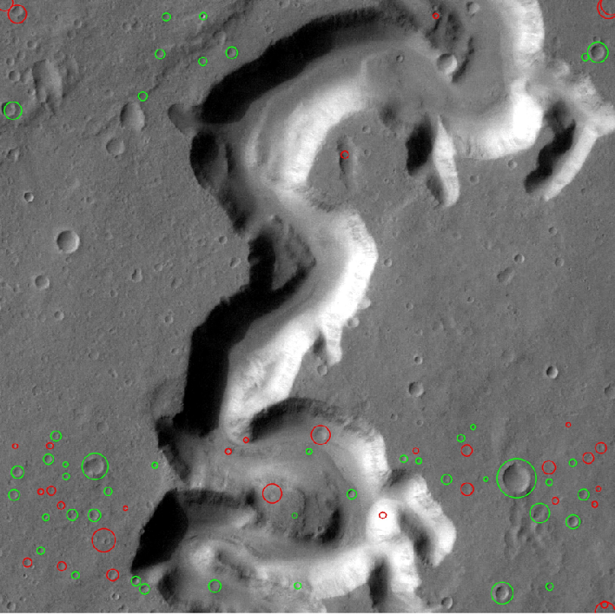
ARM64 on Linux Support
Algorithm 3: Hazardous Terrain Detection
Processing performance in the RPI3B+: Latency per tile is 1.5s, i.e., 150s per image
This network is based on unet which we have deeply studied in the FPGA and can be improved at least 100x, i.e., it can achieve a 1.5s latency
Hazardous terrain detection running the RPI3B+

Slide 13
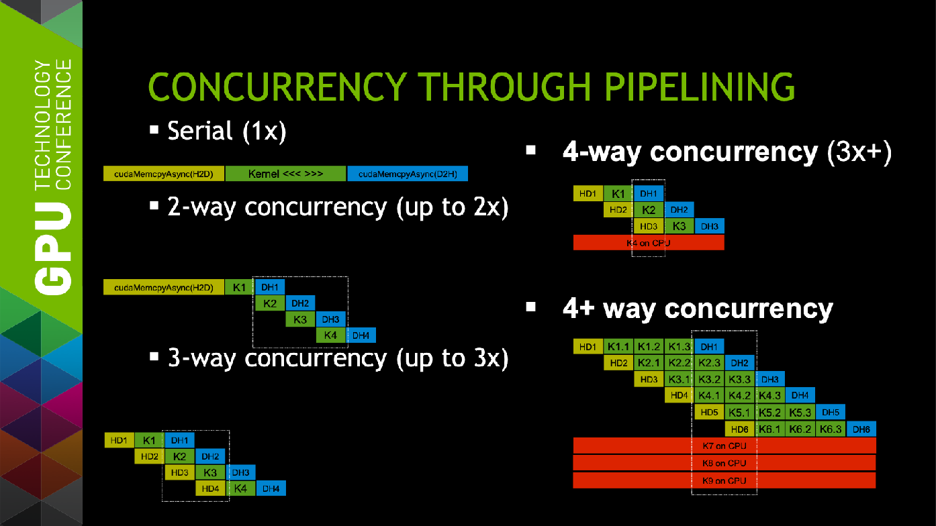
NIVIDIA GPU SUpport
The KRONOR Contract:
ARTES PIONEER Contract
Porting of Klepsydra AI to NVIDIA Tegra TX1.
Applied to AI-based AIS
IOD supported by Spire Global (scheduled for 2024)
Technical implementation currently under patent pending.
Goal is to increase GPU occupancy and therefore increase throughput (prelim results show an increase of 7x with respect to standard CuDNN programming)

Slide 14
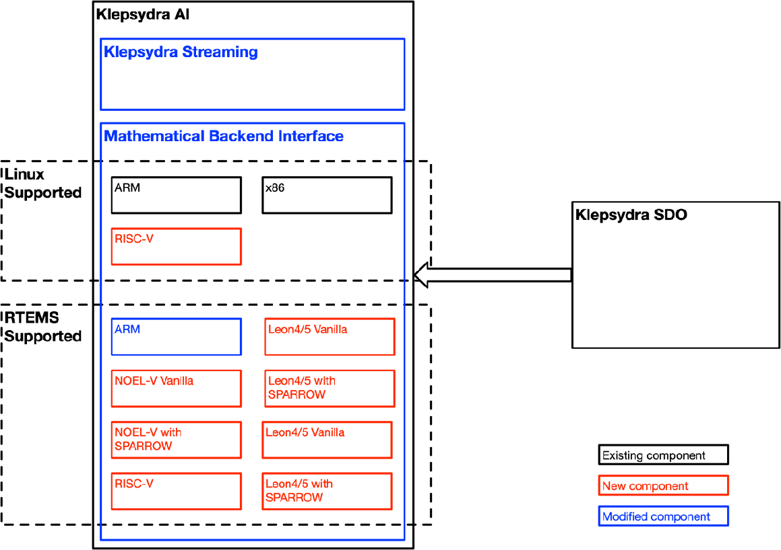
ARM, RISC-V, GR765 SUPPORT ON RTEMS
The PATTERN Contract:
GSTP Element 2 Project
Porting of Klepsydra to several CPU-only processors:
  GR740, GR765 (LEON5/NOEL-V)
  RISC-V
  ARM Cortex
On RTEMS operating system.
Adoption of Klepsydra SDO to optimise multi-core execution of AI and classical algorithms.
Start in Q4 2023

Slide 15

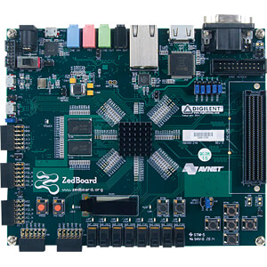
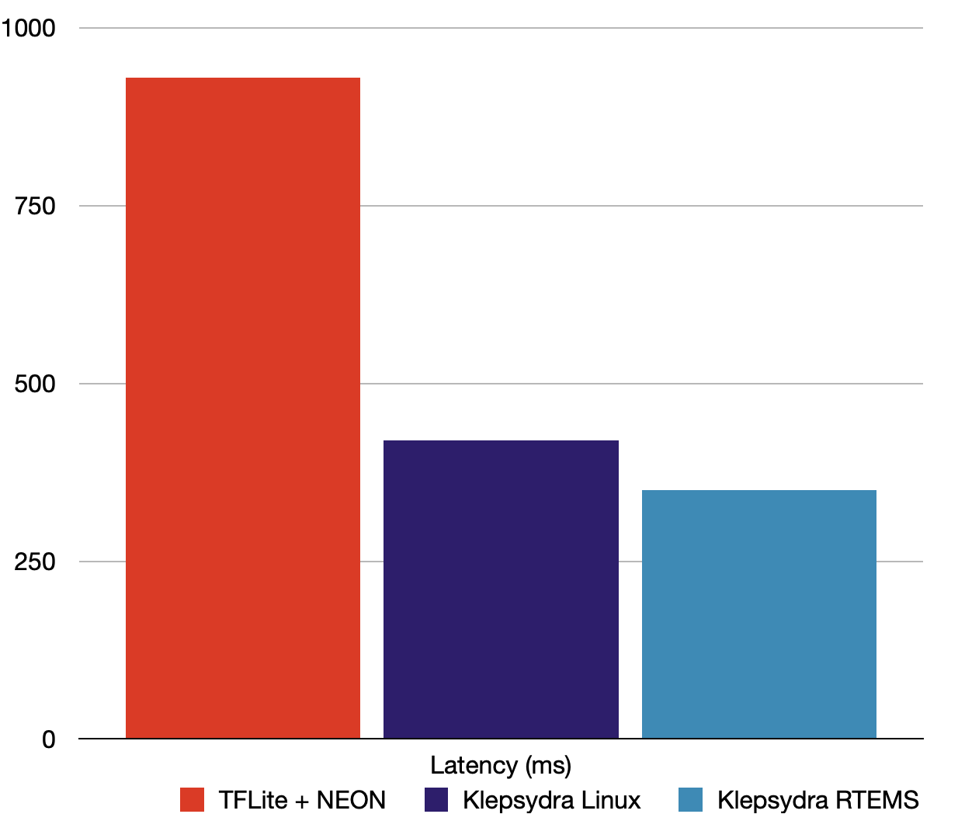
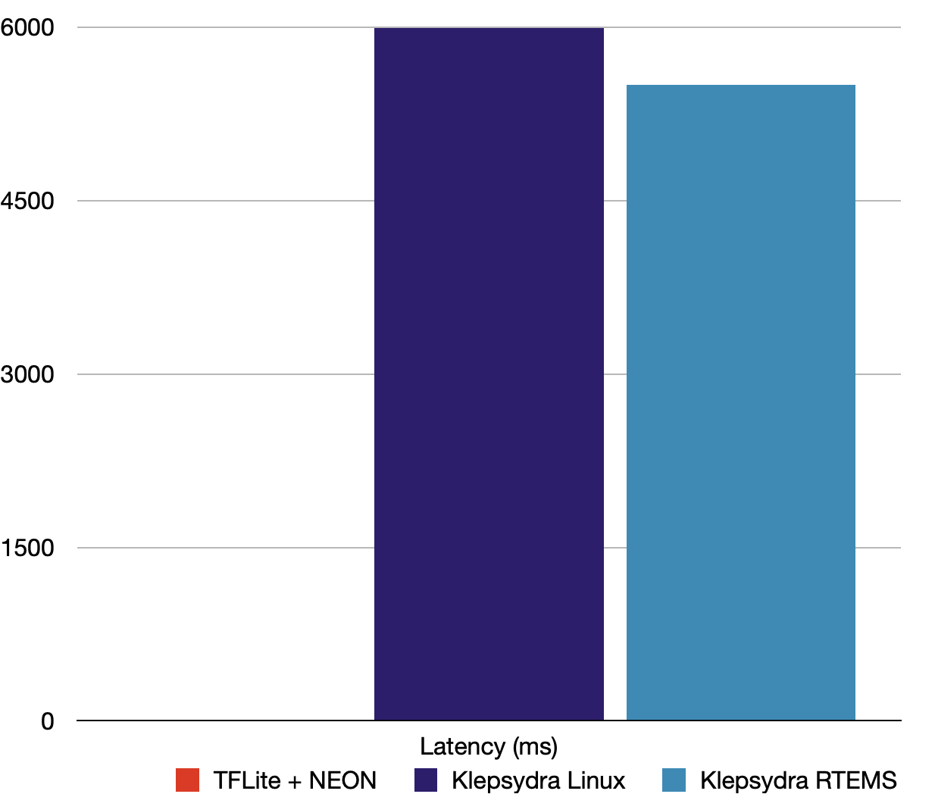

Klepsydra AI Benchmarks
PATTERN Project: ZedBoard on RTEMS
Performance comparison Klepsydra AI / TensorFlowLite (TFL)

Slide 16
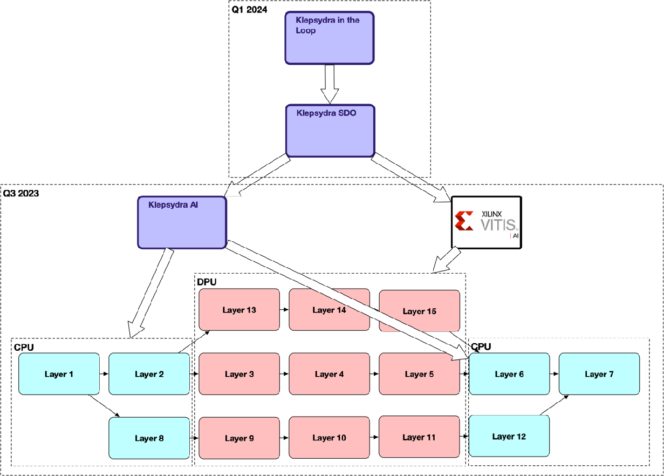
XILINX FPGA Support
Seamless integration between Klepsydra AI and VITIS AI
Optimisation of the DNN is done using SDO
  Deploys the VITIS AI part to the DPU
  Loads the non-standard parts to the AI part.
  Find the best configuration to optimise RAM, power, latency or throughput.
Klepsydra-in-the-loop performs ‘architectural search’ coupled with Klepsydra SDO to optimise the model for the target hardware.

Slide 17
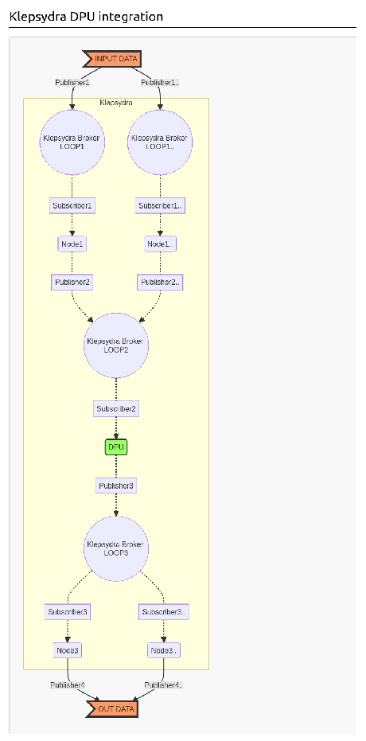
FPGA Connector
Hardware Acceleration made easy
Allows easy access / integration of FPGA HW acceleration into the Streaming Framework
We have also started work to port part of our AI Inference Engine onto FPGAs
  Approach based on Xilinx VITIS AI tool
Enables dedicated acceleration of some AI functions

Slide 18
Klepsydra AI RISC-V Benchmarks
REBECCA Project: CME Quantised
Performance comparison Klepsydra AI / TensorFlowLite (TFL)

Slide 19
Klepsydra AI RISC-V Benchmarks
REBECCA Project: MobileNetV1
Performance comparison Klepsydra AI / TensorFlowLite (TFL)

Slide 20
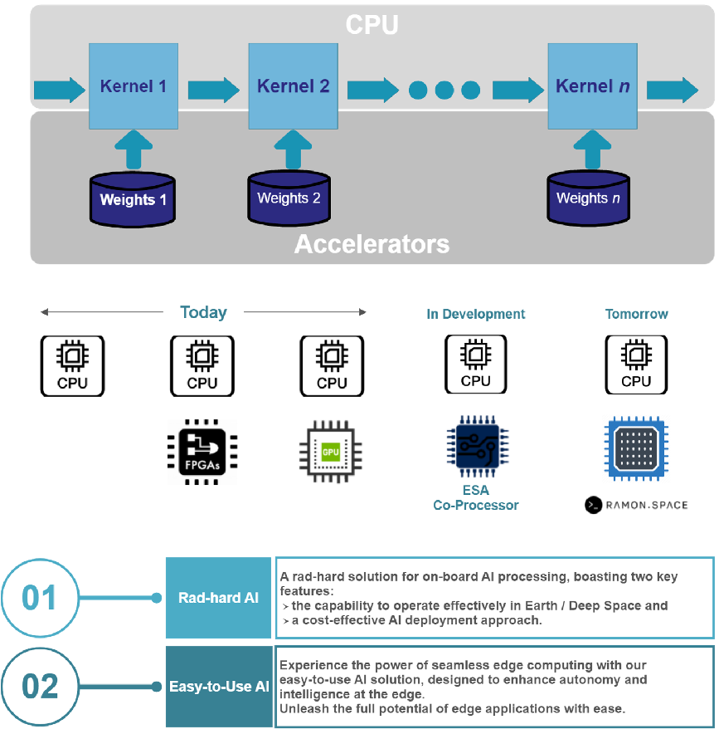

Integration of RAMON RC64
ENORMITY Contract:
Klepysdra supports HW accelerators
Extend the range of support to Ramon.Space RC64
The combination of the high-performance rad-hard space computer from Ramon.Space (UK) with the high-performance AI software from Klepsydra (CH) will result in new capabilities of satellite systems, such as on-board feature detection and cognitive instrument for Earth Observation satellites, AI based navigation and landing capabilities for planetary missions, and increased autonomy for In-Orbit Service missions.

Slide 21
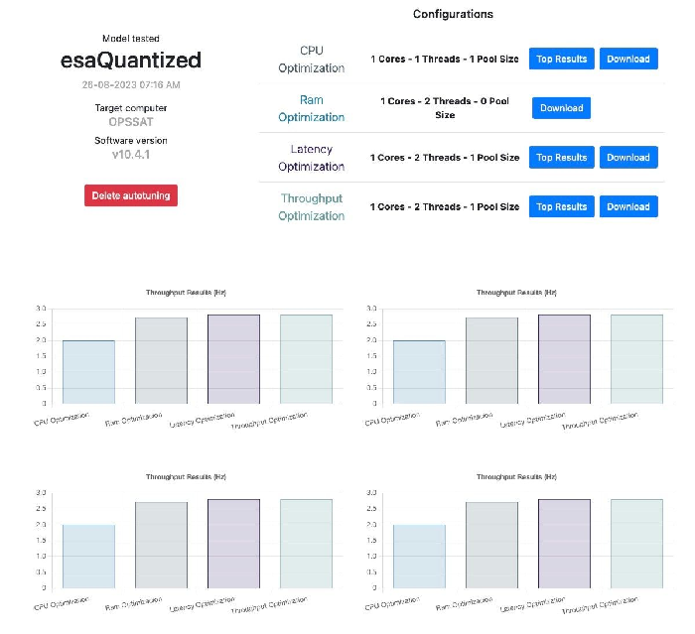
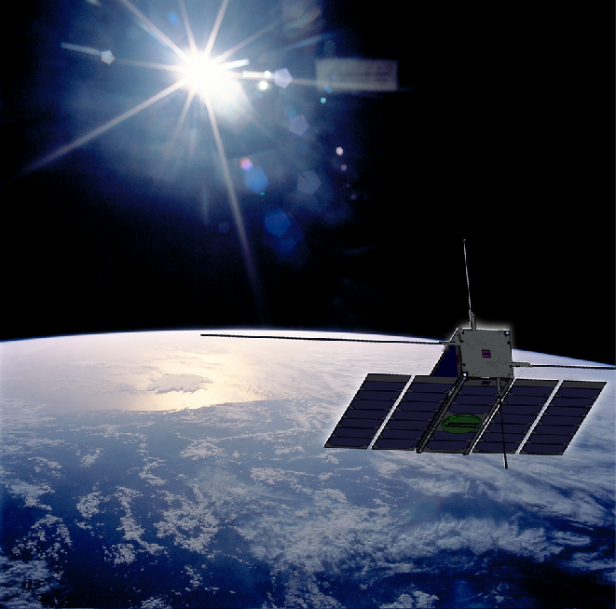
Altera Cyclone V SoC IOD
The OPSSAT Project:
Internally funded
Porting of Klepsydra to Intel Cyclone V FPGA SoC and YOCTO
Integration of Klepsydra AI to the nanosat MO framework
Preliminary performance results are excellent.
Running two AI algorithms:
  BSCAlphaUnet1 (OBPMark-ML) by the Barcelona Super Computing Center
  KAMNet (GeoLocalization) by Universidad Carlos III Madrid
Planned for Q1 2024

Slide 22
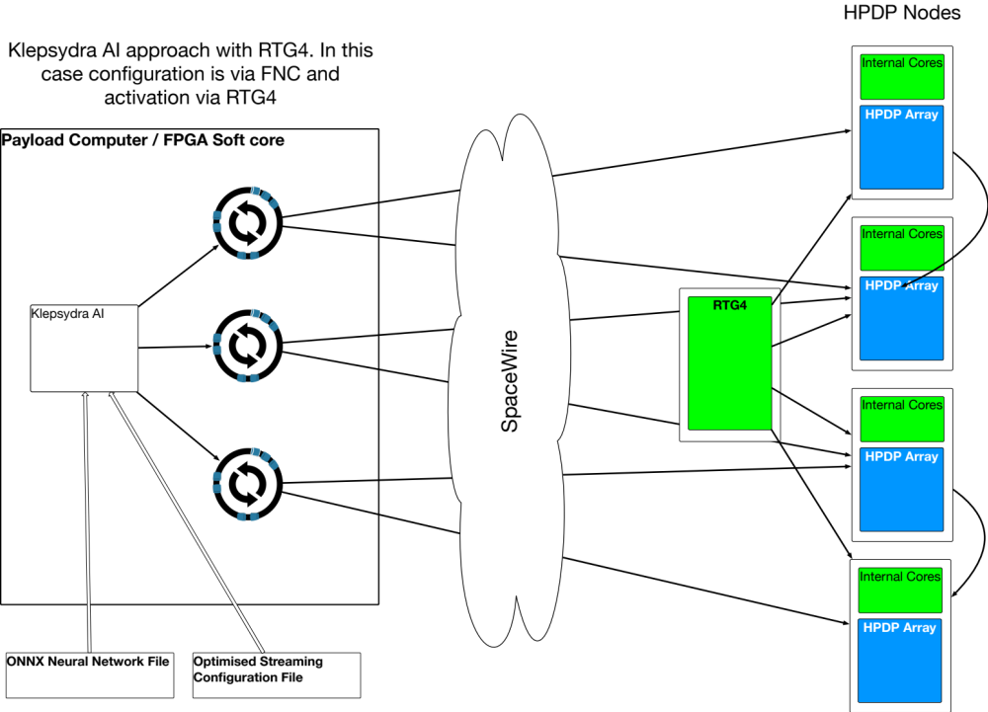
Klepsydra AI / HPDP Integration
The MANDALA Project:
The proposed idea consists of adapting Klepsydra AI and SDO for execution of AI on the HPDP40.
This new product will offer a friendly API to execute both classical and AI based algorithm on the HPDP40.

Slide 23
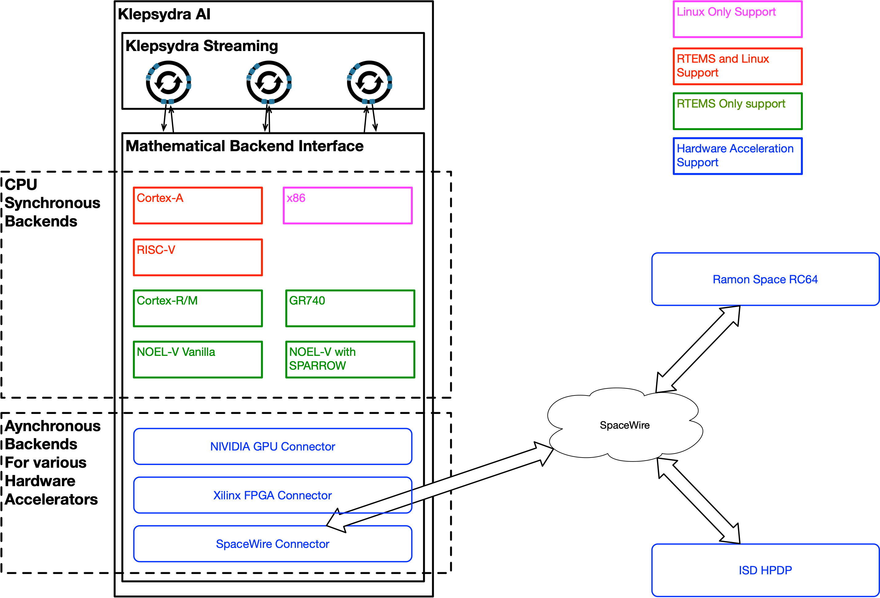
Software Support
Support to a large number of processors, operating systems and hardware accelerators:
Unified API
Unified use of SDO
Unified use of KITL
Supported by ESA and other European organisations

Slide 24

THanks and Q&A
Dr Pablo Ghiglino
pablo.ghiglino@klepsydra.com
+41786931544
www.klepsydra.com
linkedin.com/company/klepsydra-technologies

