Slide 2
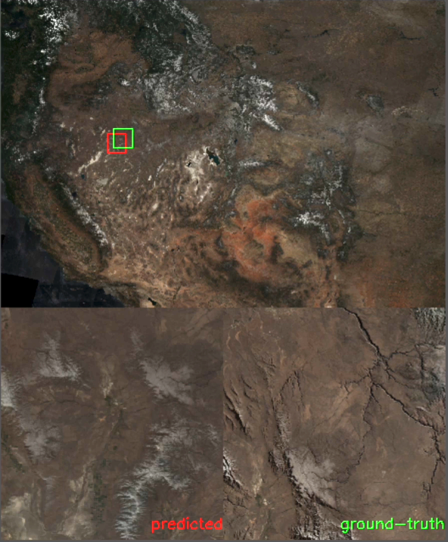
AI-based Onboard Geolocalization
Using Visual Sensors
Determine the precise location of a target on Earth using data from satellite sensors
Done by comparing the target's position in the image to known reference points (landmarks, coastlines, etc.).
Crucial Capabilities for many applications.
AI and machine learning enhance the accuracy and efficiency of these systems.

Slide 3
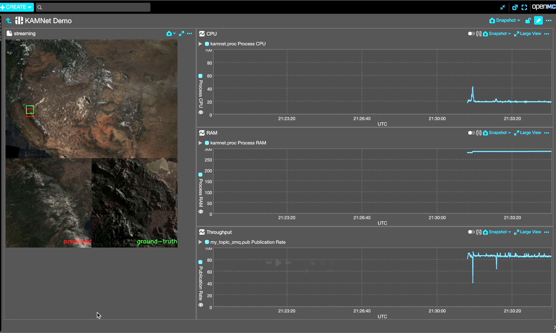
What do you see?
Visualisation tool presenting all sensor data
CPU Utilization
Low CPU utilization as some layers of the AI models are running in the FGPA DPUs
RAM Utilization
Klepsydra AI shows stable RAM usage thus leading to predicable and stable systems
CPU Throughput
Klepsydra AI enables significant throughput improvements

Slide 4
Demonstration SetUp
Enclustra Mercury+ XU1 & Klepsydra AI
AI Model: | KAMNet based on VGG19
Convolutions | 20
Gemm | 2
GlobalAveragePool | 1
Model Size | 203 MB
Number of Parameters | 53'188'930
Inference Engine | Klepsydra AI V18.3
OS | PetaLinux
Processor: | ARM® dual-/quad-core Cortex™-A53
FPAG | Zynq®UltraScale+™ FPGA, 599K+ Logic Cells
Board: | Enclustra Mercury+ XU1 - ME-XU1-9EG-3E

Slide 5
Klepsydra for Edge Computing
Your Next Step to deploy Intelligent Systems to the Edge
How does Klepsydra help you with Edge AI?
Our efficient Software Framework allows you to…
…. Process 10x more date with same space processor, same AI Model
…. Reduce power consumption by 50%, same AI Model
…. Reduce deployment and development time
Develop YOUR software and YOUR AI on our framework
Your engineers use our framework to implement their software
➡︎ we provide the acceleration framework, YOU build the System

Slide 6
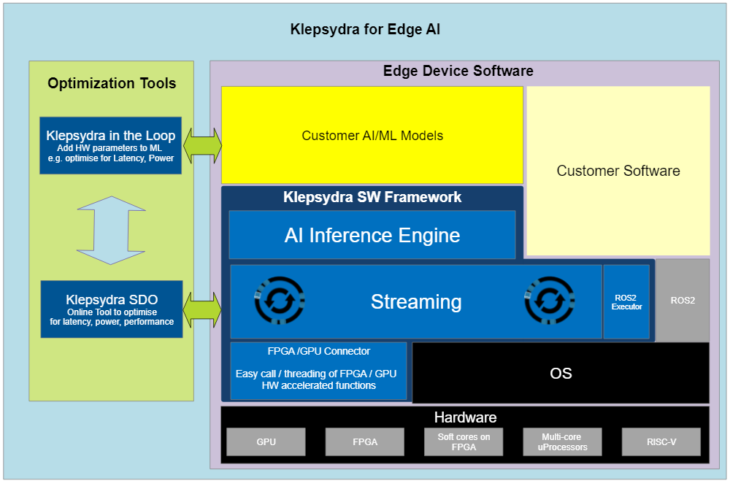
Klepsydra for Edge Computing
Lightweight, modular and compatible with most used operating systems
Performance is achieved by:
Lock-Free Algorithms
2-dim Threading Framework
2-dimensional threading framework to optimise the execution of any AI algorithm
Use of ultra-low-latency ‘lock-free’ algorithms inspired from financial trading
OS with or without Containerisation

Slide 7
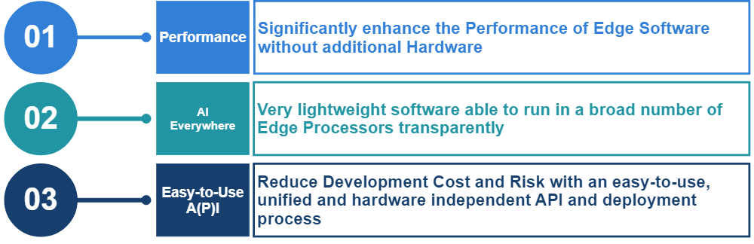
Klepsydra for Edge Computing
Unleash the full potential of edge intelligence with ease
Experience the power of seamless edge computing with our easy-to-use framework, designed to enhance autonomy and intelligence for the edge

Slide 8
Cooperation with Enclustra

Slide 9
Introduction
Klepsydra AI and FPGAs
Klepsydra AI running on Enclustra Mercury+ XU1
  Seamless integration of Klepsydra AI and Enclustra development environment
Klepsydra supports FGPA Acceleration for AI Models
  Using FPGA on Mercury+ XU1 to accelerate some layers of AI Model
Klepsydra AI and Enclustra Mercury+
Easy to use platform to implement your Edge AI applications

Slide 10
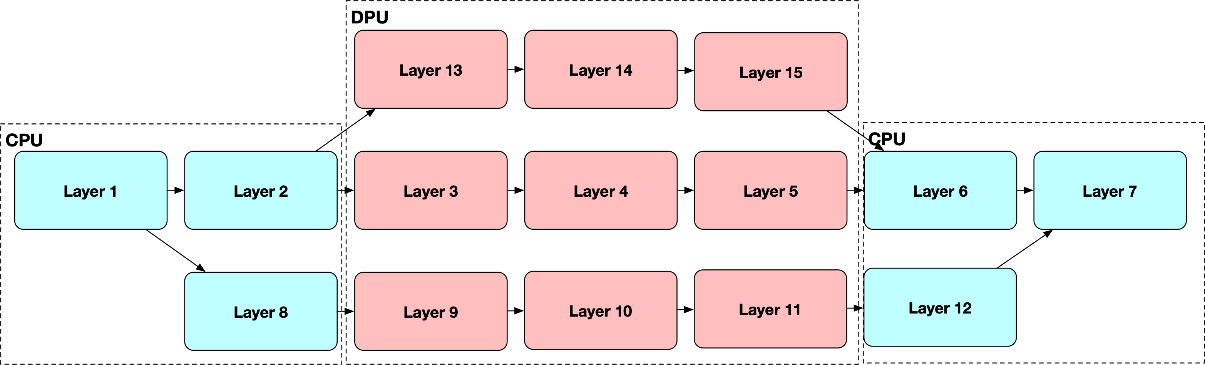
Klepsydra AI for FPGA
Combining VITIS AI and Klepsydra AI software
Enhance AI network support on Xilinx FPGAs by combining VITIS AI and Klepsydra AI software
  Xilinx-standard part of the network is implemented using VITIS AI
  Non-standard parts are implemented using Klepsydra AI on the CPU
  Single common API provided by Klepsydra AI

Slide 11
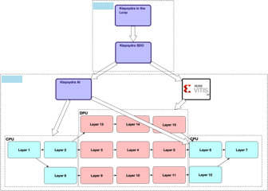
Klepsydra AI for FPGA
Seamless integration between Klepsydra AI and VITIS AI
Optimisation of the DNN is done using SDO
  Deploys the VITIS AI part to the DPU
  Loads the non-standard parts to the AI part.
  Find the best configuration to optimise RAM, power, latency or throughput.
Klepsydra-in-the-loop performs ‘architectural search’ coupled with Klepsydra SDO to optimise the model for the target hardware

Slide 12
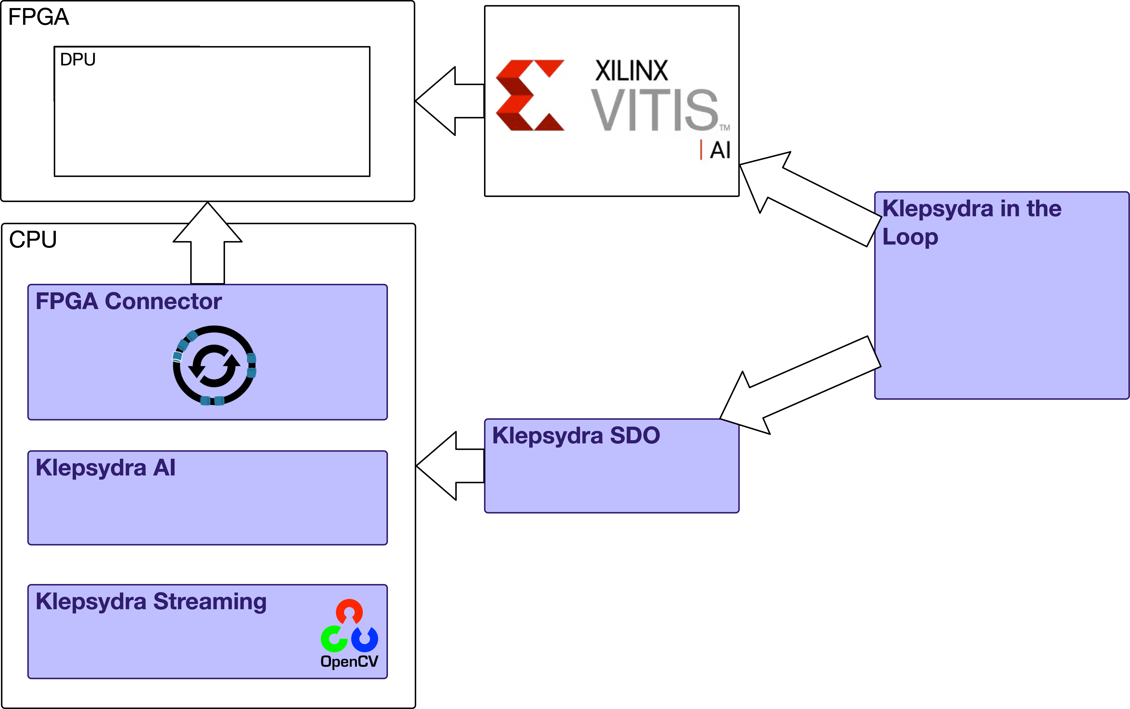
Klepsydra FPGA solution
Addressing the need of pre- and post-processing
A solution to accelerate development and build efficient data processing solution on FPGAs
Pre-processing and post-processing can be done on the CPU using OpenCV or other integrated tools, and also
The pre-processing and post-processing can also be done in the FPGA using Klepsydra FPGA connector
Klepsydra SDO can be used to optimise the complete application including the non-AI components.

