Slide 1
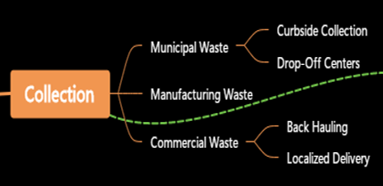

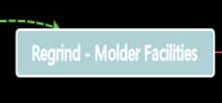
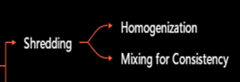






EPS Waste Sources
Recycled Content Packaging ≤15%
Expanded Polystyrene Packaging & Building Products ≤50%

