Slide 1
ReVerde
'Good for biodiversity and revenue'
'We let your farm flourish’
‘Double win, for farmers and biodiversity’

Slide 2
ReVerde
Ecowin is a Swiss-based association aimed at promoting biodiversity and sustainable agricultural practices.
Our purpose is to support farmers by developing innovative financial solutions and services ensuring that biodiversity and farm income grow together.
Anchored in agriculture, we are an interdisciplinary team, grounded in science and driven by the believe that we all live better in harmony with nature.
Who we are:
XXX
XXX
XXX
XXX
XXX

Slide 3
Reverde
Tailor-Made Solutions: We develop customized plans with measures to enhance biodiversity and economic performance, based on an integrated analysis of farm’s current operation.
Biodiversity as a Service: we focus on a 'biodiversity as a service' model, handling all organizational, financial, and administrative aspects to ensure implementation without additional burden to farmers.
Upfront Financing: We provide upfront financing for the execution of these plans, leveraging existing public biodiversity payments to create a reliable revenue stream for repayment.
Long-Term Partnership: Our goal is to be long-term partners, helping farmers achieve lasting benefits through improved biodiversity and sustainable practices.
Innovative Funding Mechanisms: In the next phase, we aim to design new mechanisms to attract private funding, enabling additional biodiversity-enhancing measures or supporting transitions to alternative farming methods.
What we do

Slide 4






Solution: biodiversity as a service
Analysis of the ecological potential
We provide ‘turn-key’ biodiversity enhancement to farmers.
We take care of all aspects related to the implementation of the measures.
No upfront costs and no extra work required
Detailed implementation plan
Implementation
Maintenance
Administration.
(Pre-)financing

Slide 5
7 Steps from first screening to long terms benefits
Step 1:
Rapid screening of potential
Step 2:
In-depth and integrated analysis of potential
Step 3:
Plan for biodiversity enhancement measures
Step 4: Service agreement between ecowin and farmer
Step 5:
Upfront financing and implementation
Step 6:
Farmer receives biodiversity payments and repayment starts.
Step 7:
Long term maintenance partnership after investment repayment
What: Remote assessment of current ecological situation and potential based on existing farm level information provided by farmer
Who: ecowin
What: Full scale analysis taking into account economic, social and ecological considerations based on (proprietary) 3V methodology
Who: ecowin and local technical partners
What: Detailed plan of all measure to be implemented based on existing payment schemes and programmes
Who: In close collaboration between the farmer and ecowin and/or local technical partner
What: Detailed contract describing services, responsibility, financing and repayments
Who: Ecowin and farmer
What: ecowin makes contracts with local providers for implementation of measures and pays for its cost.
Who: Ecowin and farmer
What: Based of proven implementation of measurs and/or ecological performance, farmer receives payments from agricultural payment scheme. Repayment to ecowin starts.
Who: Federal office for agriculture, ecowin and farmer
What: Farmer has repaid initial investment to ecowin.
Either farmer continues to maintain measures or makes new agreement with ecowin
Who: farmer and ecowin

Slide 6
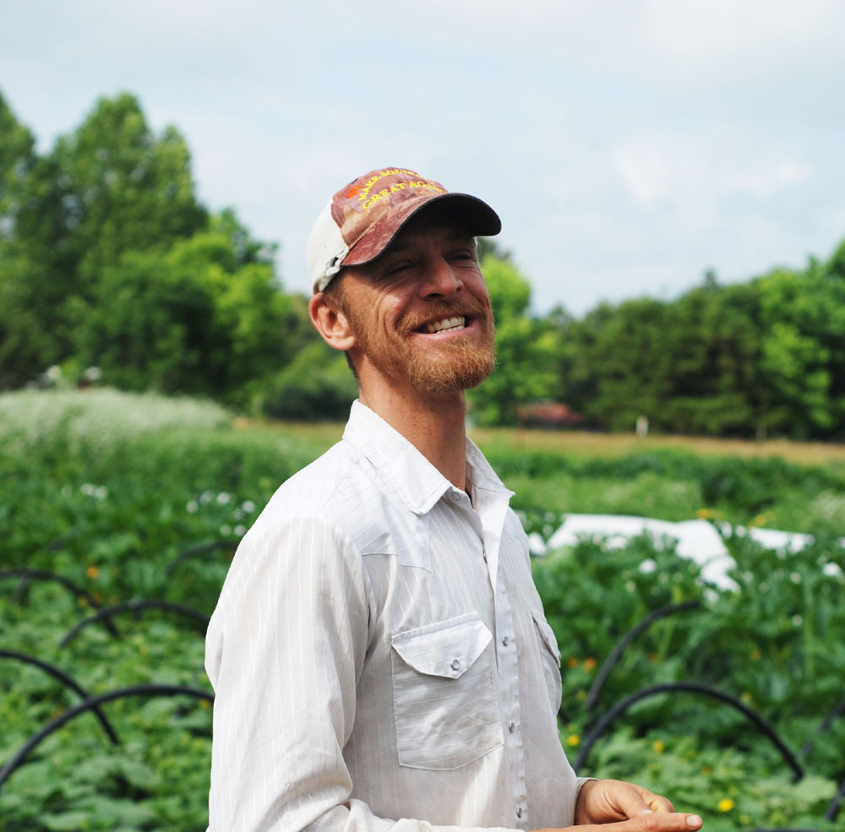
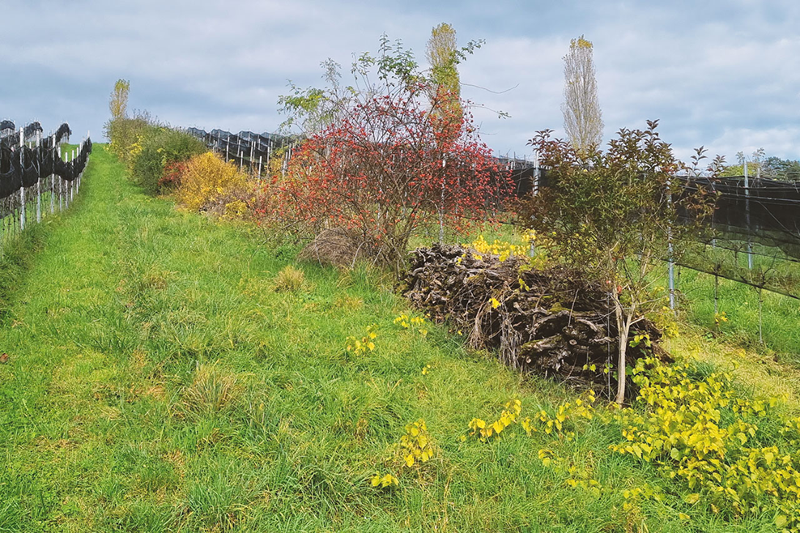
Impact objectives
Biodiversity
nx100 ha of agricultural land with increased ecological value (based on the criteria for areas promoting biodiversity).
nx1000 newly planted fruit trees (Hochstamm)
nx100 newly created ecological structures and habitats
Revitalised creeks and wetlands (mid-term)
Ecological connectivity between farms (long term)
Socio-economic
Significant income increase for farmers in the short and long term.
Reduced workload for implementation and administration of biodiversity measures.
Increased recognition of farmers’ contribution to biodiversity conservation.

Slide 7
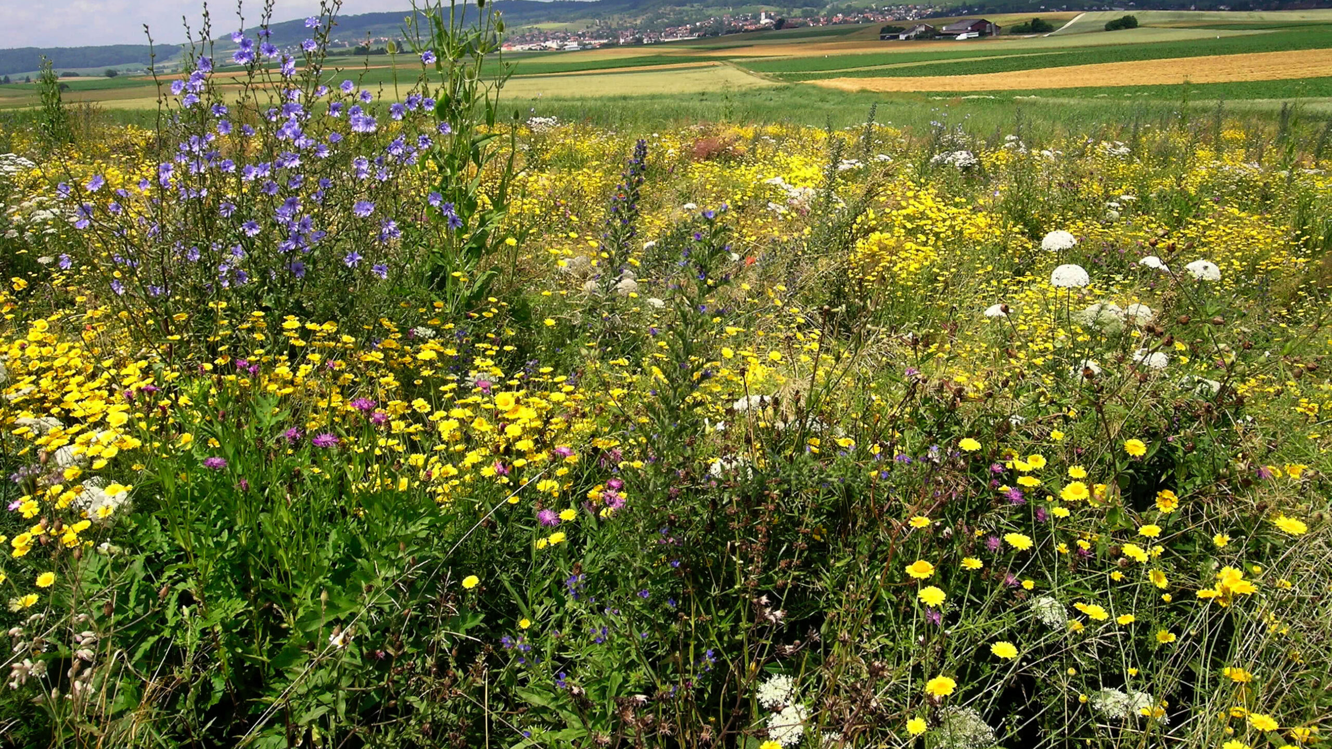
Merci
Thank you

