Slide 1

EARENDEL

Slide 2

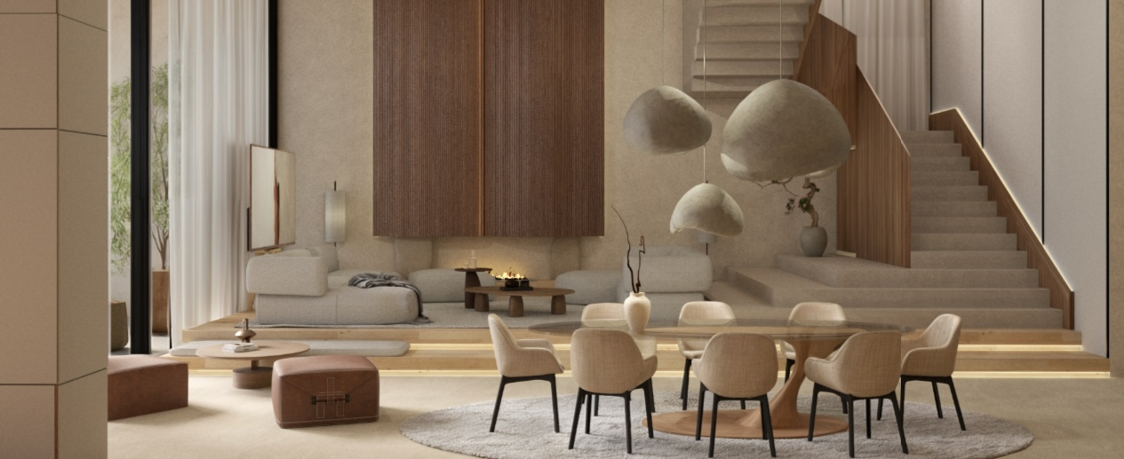
INTRO:
Welcome to Earendel, where luxury meets impeccable craftsmanship to create spaces that embody sophistication and elegance. Situated in the vibrant city of Dubai, our interior design company is dedicated to translating designers' visions into exquisite realities with painstaking attention to detail. At Earendel, we believe in curating spaces that not only reflect opulence and style but also evoke emotions and leave a lasting impression.
With a commitment to quality and a passion for perfection, we strive to ensure that every corner of your space tells a story of refined taste and timeless beauty. Join us on a journey where dreams are sculpted into reality, where creativity knows no bounds, and where luxury is not just a concept but a way of life.
Earendel - where your vision is our masterpiece.

Slide 3
ABOUT US:
Nurtured by a symphony of creative talents, our team comprises adept interior designers, innovative architects, proficient civil engineers, masterful craftsmen, and strategic project managers. We are dedicated to providing unparalleled interior fit-out services, tailoring our expertise to bring to fruition the visions of esteemed local and global designers. Renowned for our seamless collaboration with design luminaries worldwide, we adeptly elevate their unique concepts into captivating, enduring spaces that seamlessly merge functionality with timeless luxury.

Slide 4
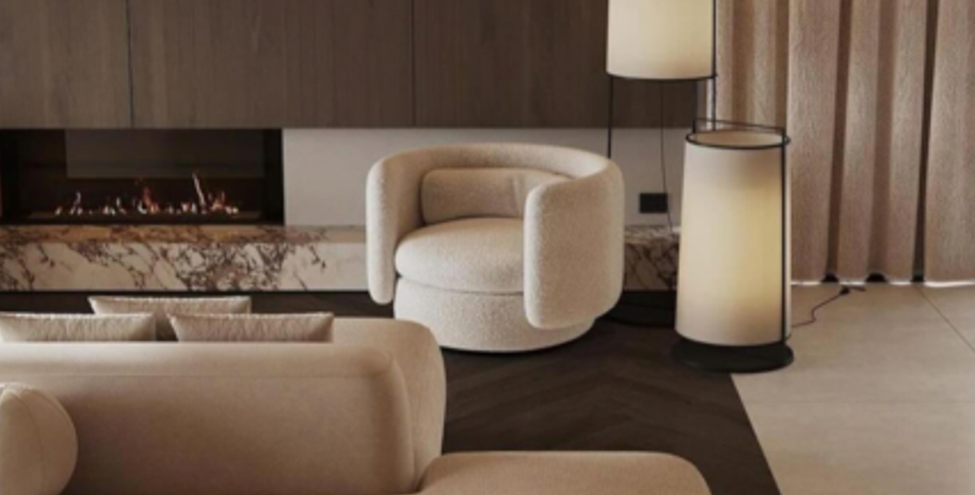
COMPANY HISTORY:
Amid shifting global dynamics, we anticipated a growing demand for finely crafted interior designs tailored for discerning International clientele. In July 2020, we embraced the opportunity to freelance, catering to this niche market. Witnessing rapid client and team growth, we took the pivotal step of establishing our company, marking an exciting milestone in our journey.

Slide 5

VISION:
To establish ourselves as the unparalleled choice for discerning clientele in search of timeless and luxurious interior design, and bespoke fit-out solutions for their residences and enterprises, setting the standard for exquisite craftsmanship and unparalleled elegance in every project we undertake.

Slide 6

MISSION: Earendel is dedicated to the art of transforming captivating designs into tangible masterpieces. With a steadfast commitment to innovation, exceptional craftsmanship, and a meticulous attention to detail ensuring that every project exudes sophistication and unparalleled quality.
Our seamless and rewarding experience from concept to completion is a testament to the dedication and passion of our team. We offer innovative solutions that push the boundaries of what is possible, setting new benchmarks for . Our global expansion strategy is driven by the desire to forge enduring partnerships with clients and partners, built on trust, excellence, and mutual success.
Join us in turning dreams into breathtaking reality, where every detail is a testament to our unwavering pursuit of perfection.

Slide 7

“Quality Is Not An Act It Is A Habit”- Aristotle

Slide 8

Our Services:
Space Planning Solutions
3D Visualization
Smart Structural Drawings
Material Selections
Joinery Works
Interior Renovation
Landscaping
Soft Furnishings
Hard Furnishings
Interior Structural Works

Slide 9

Project Milestones:
Brief Meeting & Site Visit: Understand clients vision for the space
Quotation:
Detailed cost breakdown of project
Estimation:
An Initial estimate cost
Contract:
Upon signing of the contract, a 50% down payment is made
Material Selection:
Source a range of desired materials
Implementation:
40% to be paid on job progree & 10% upon delivery

Slide 10
Projects

Slide 11
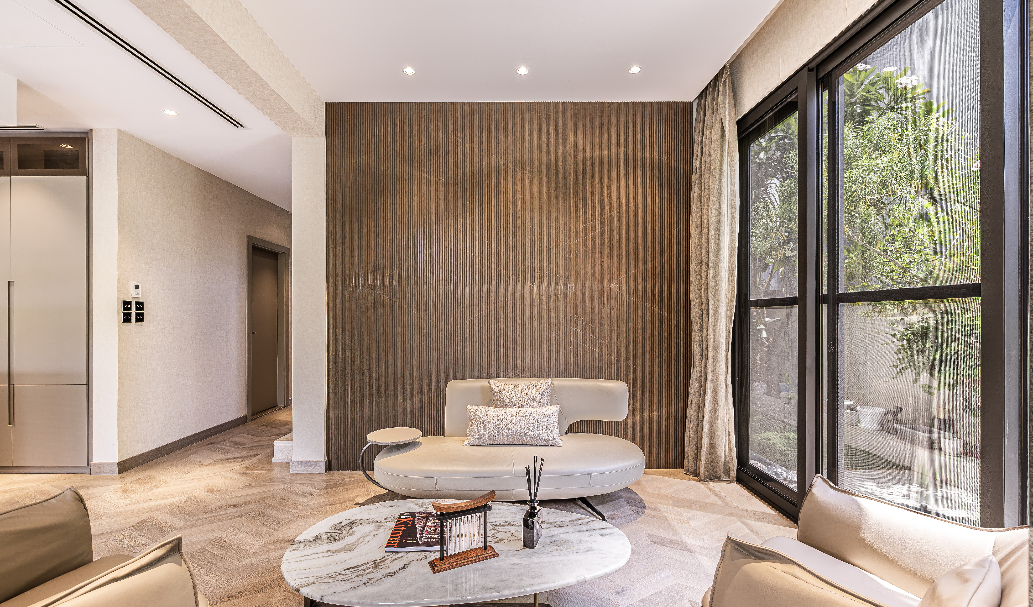
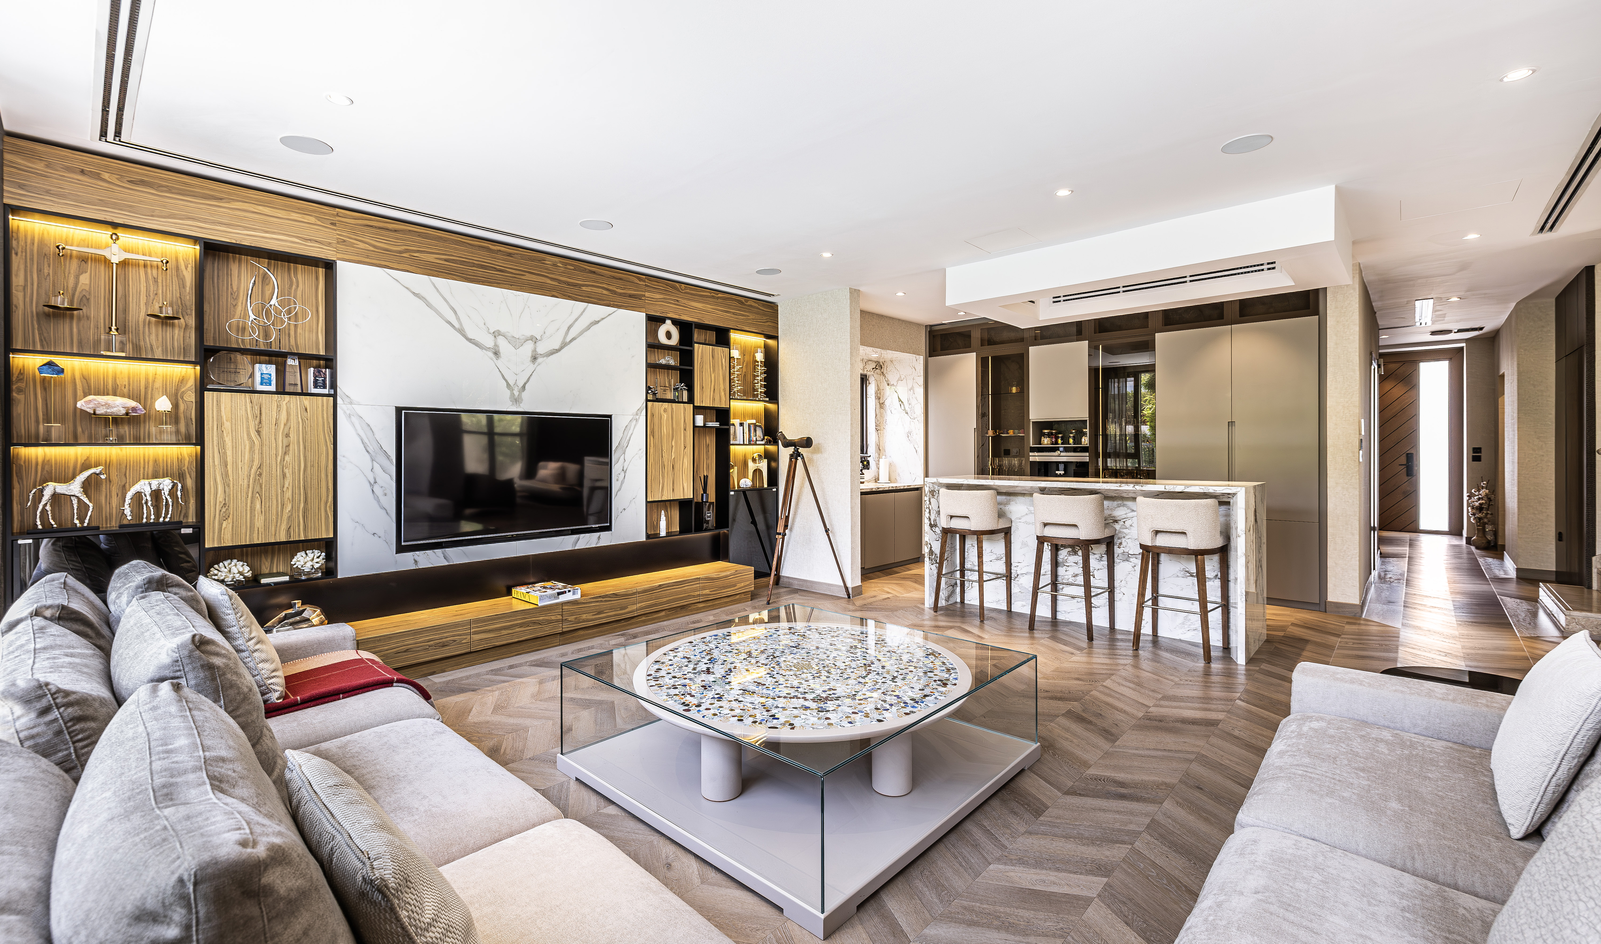
Dubai Hills Estate

Slide 12
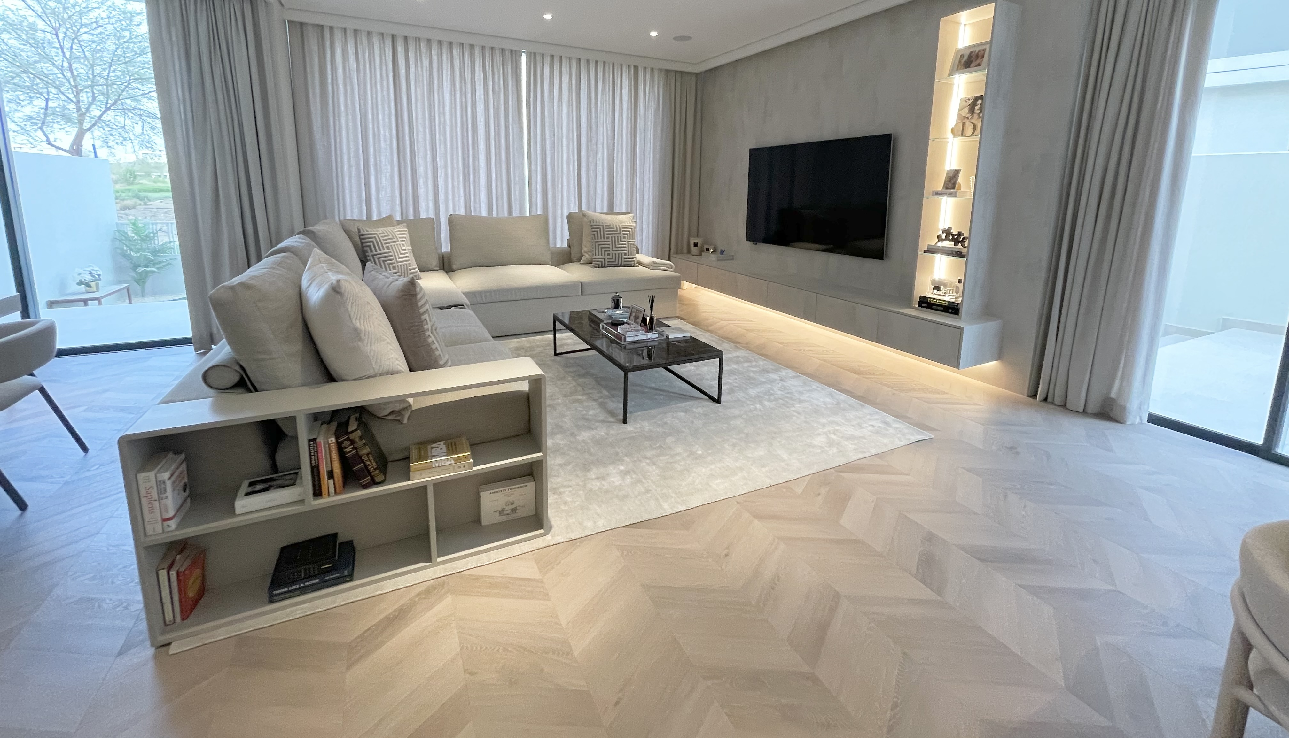
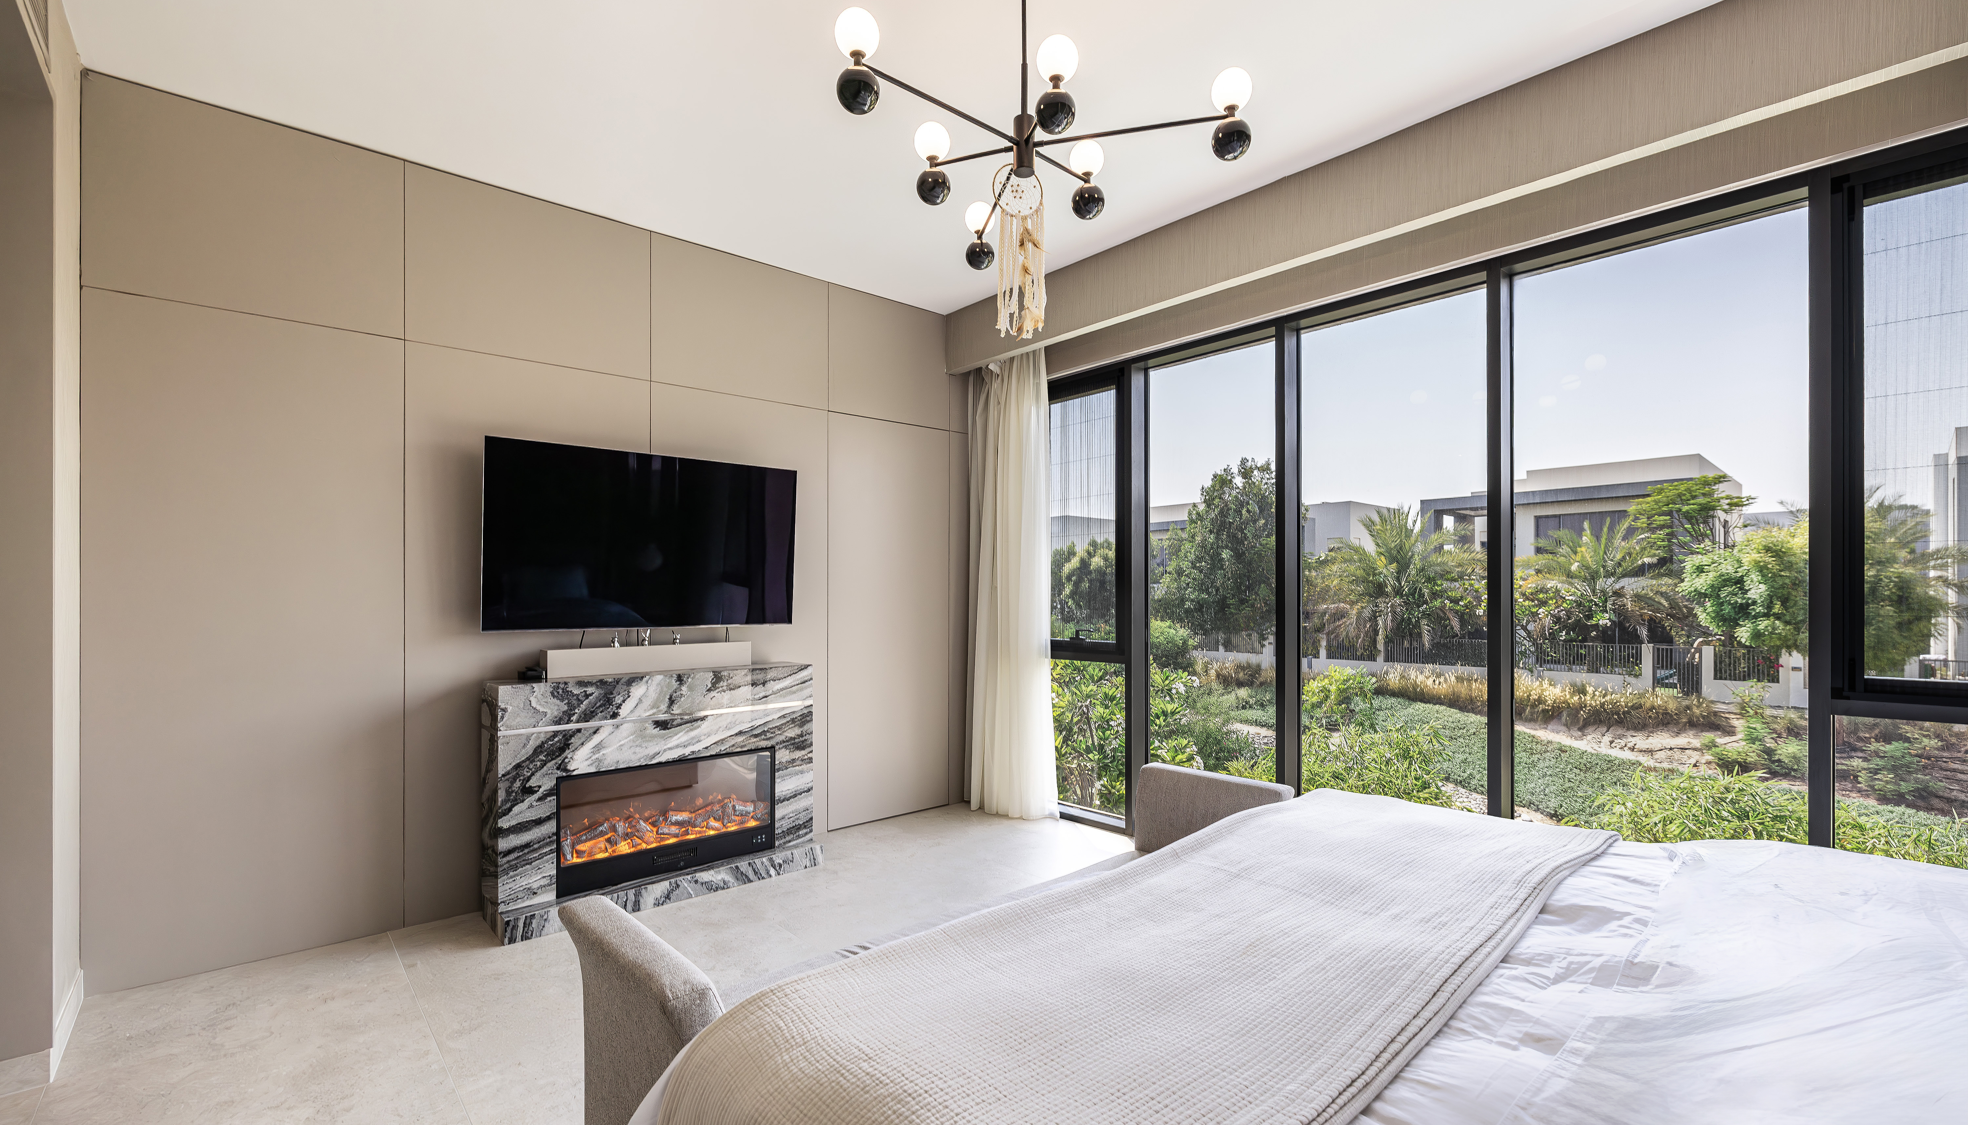
Dubai Hills
Estate

Slide 13
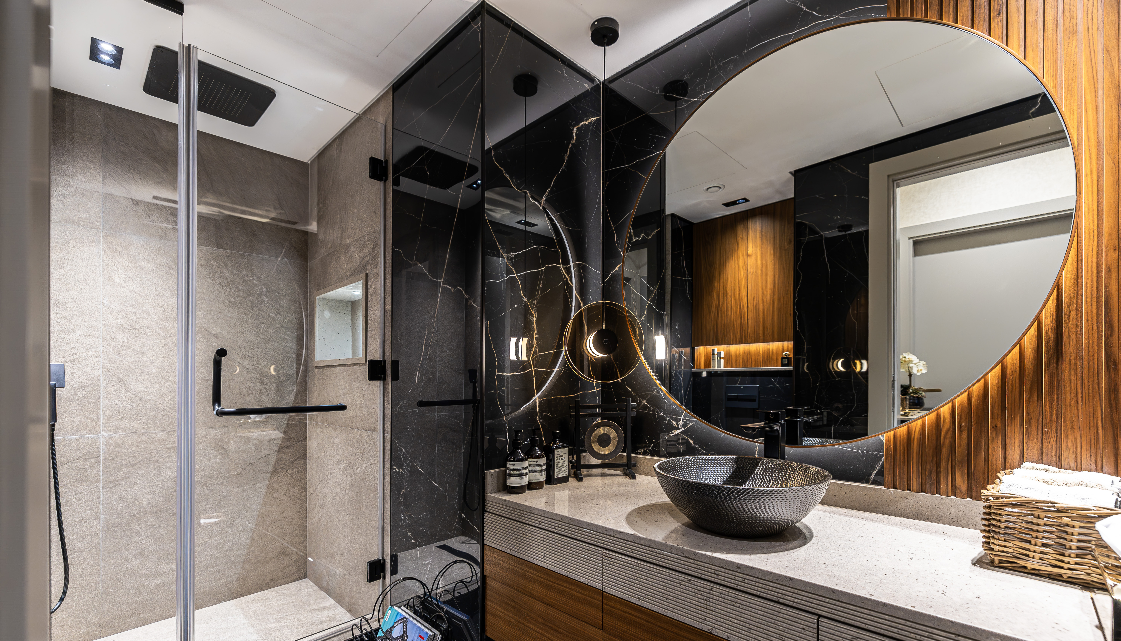
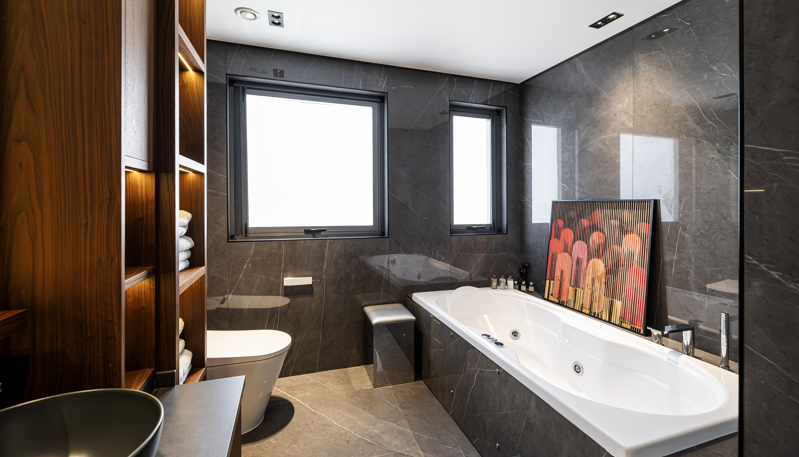
Dubai Hills
Estate

Slide 14
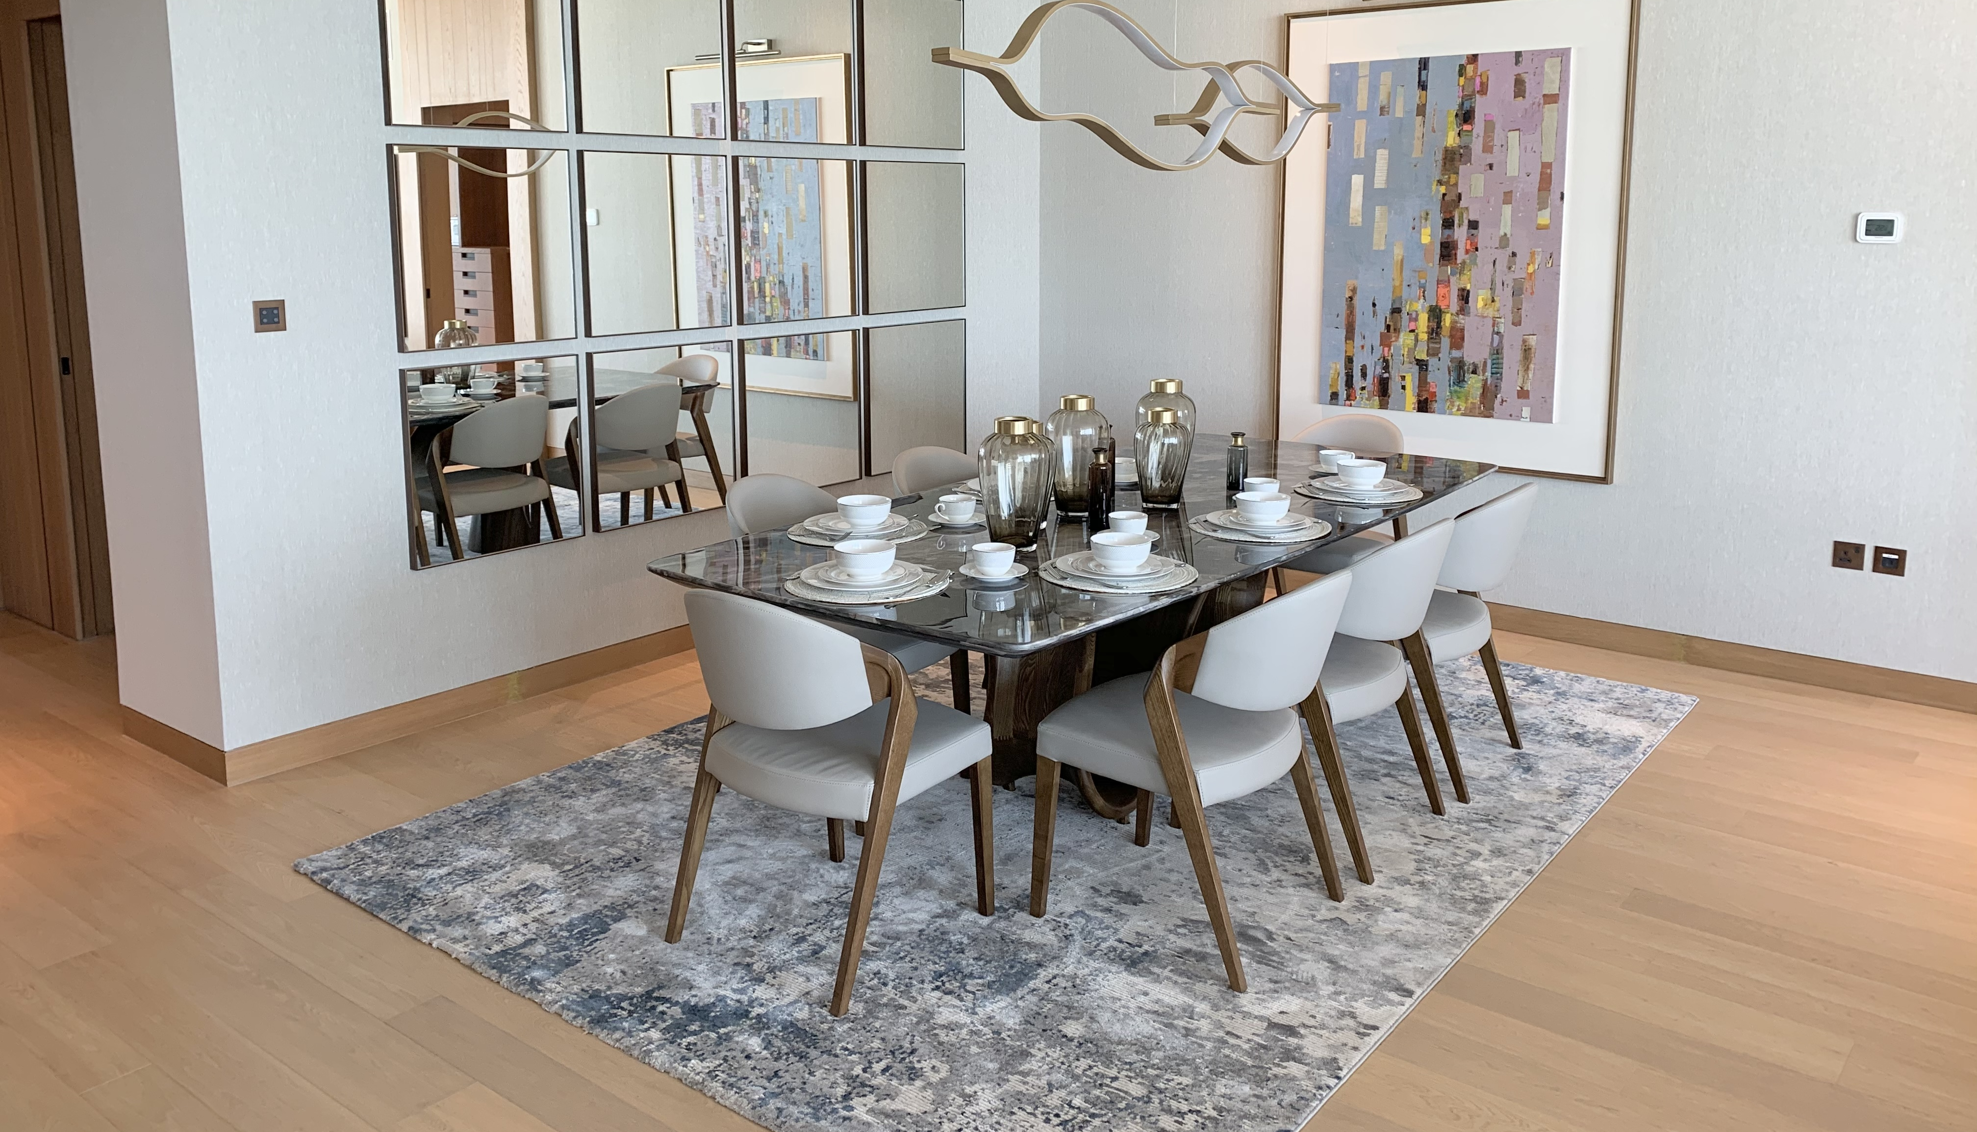
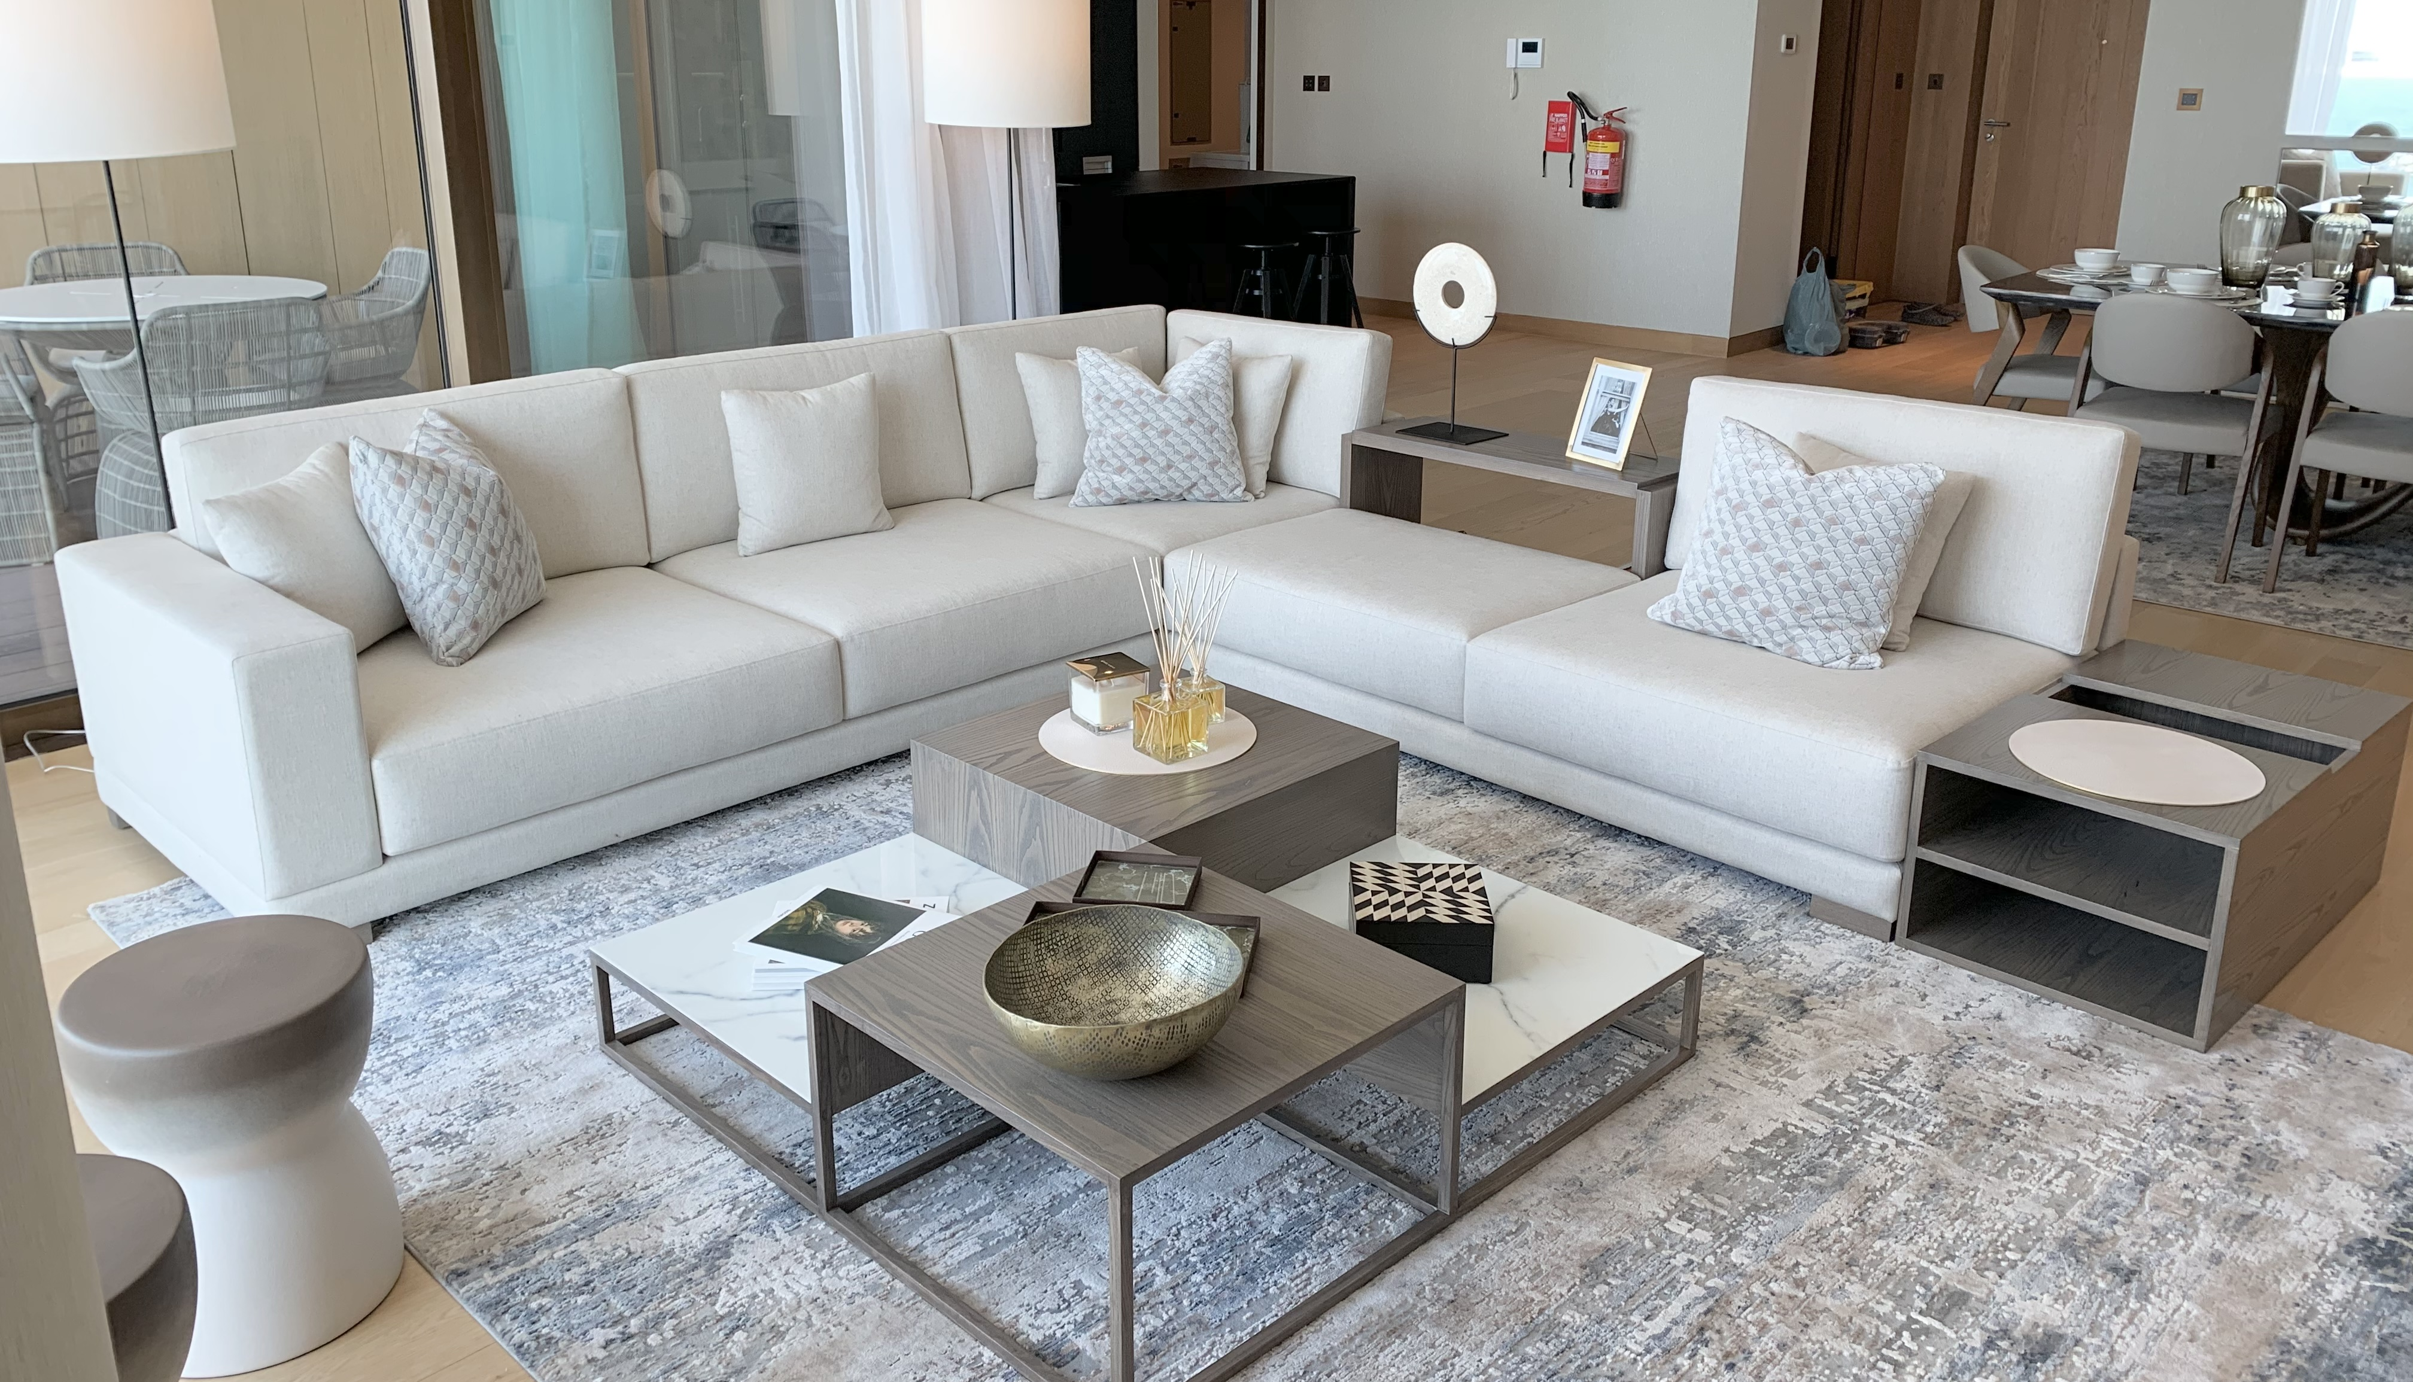
Bvlgari

Slide 15
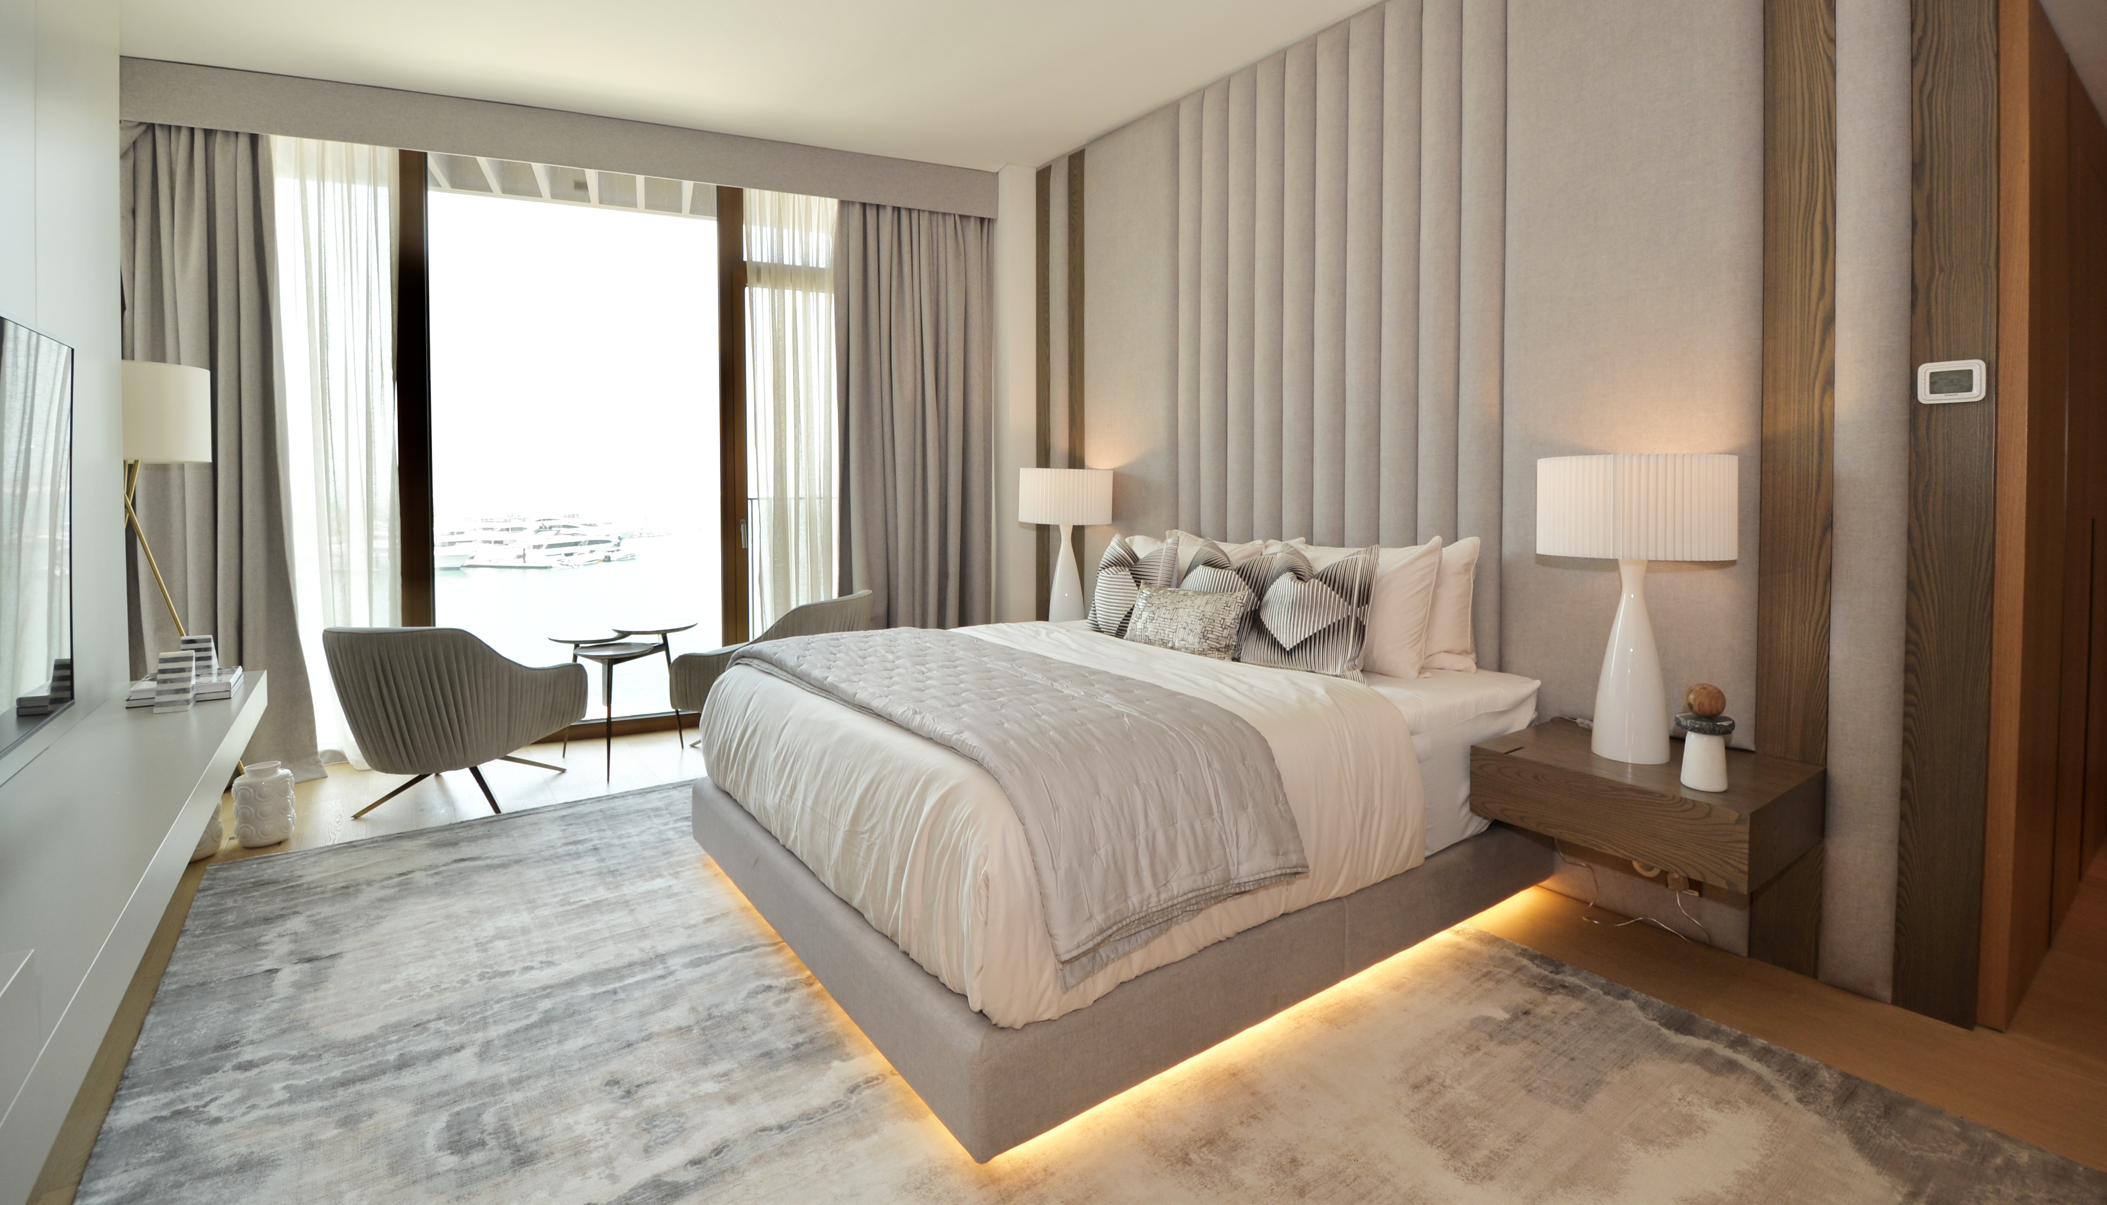
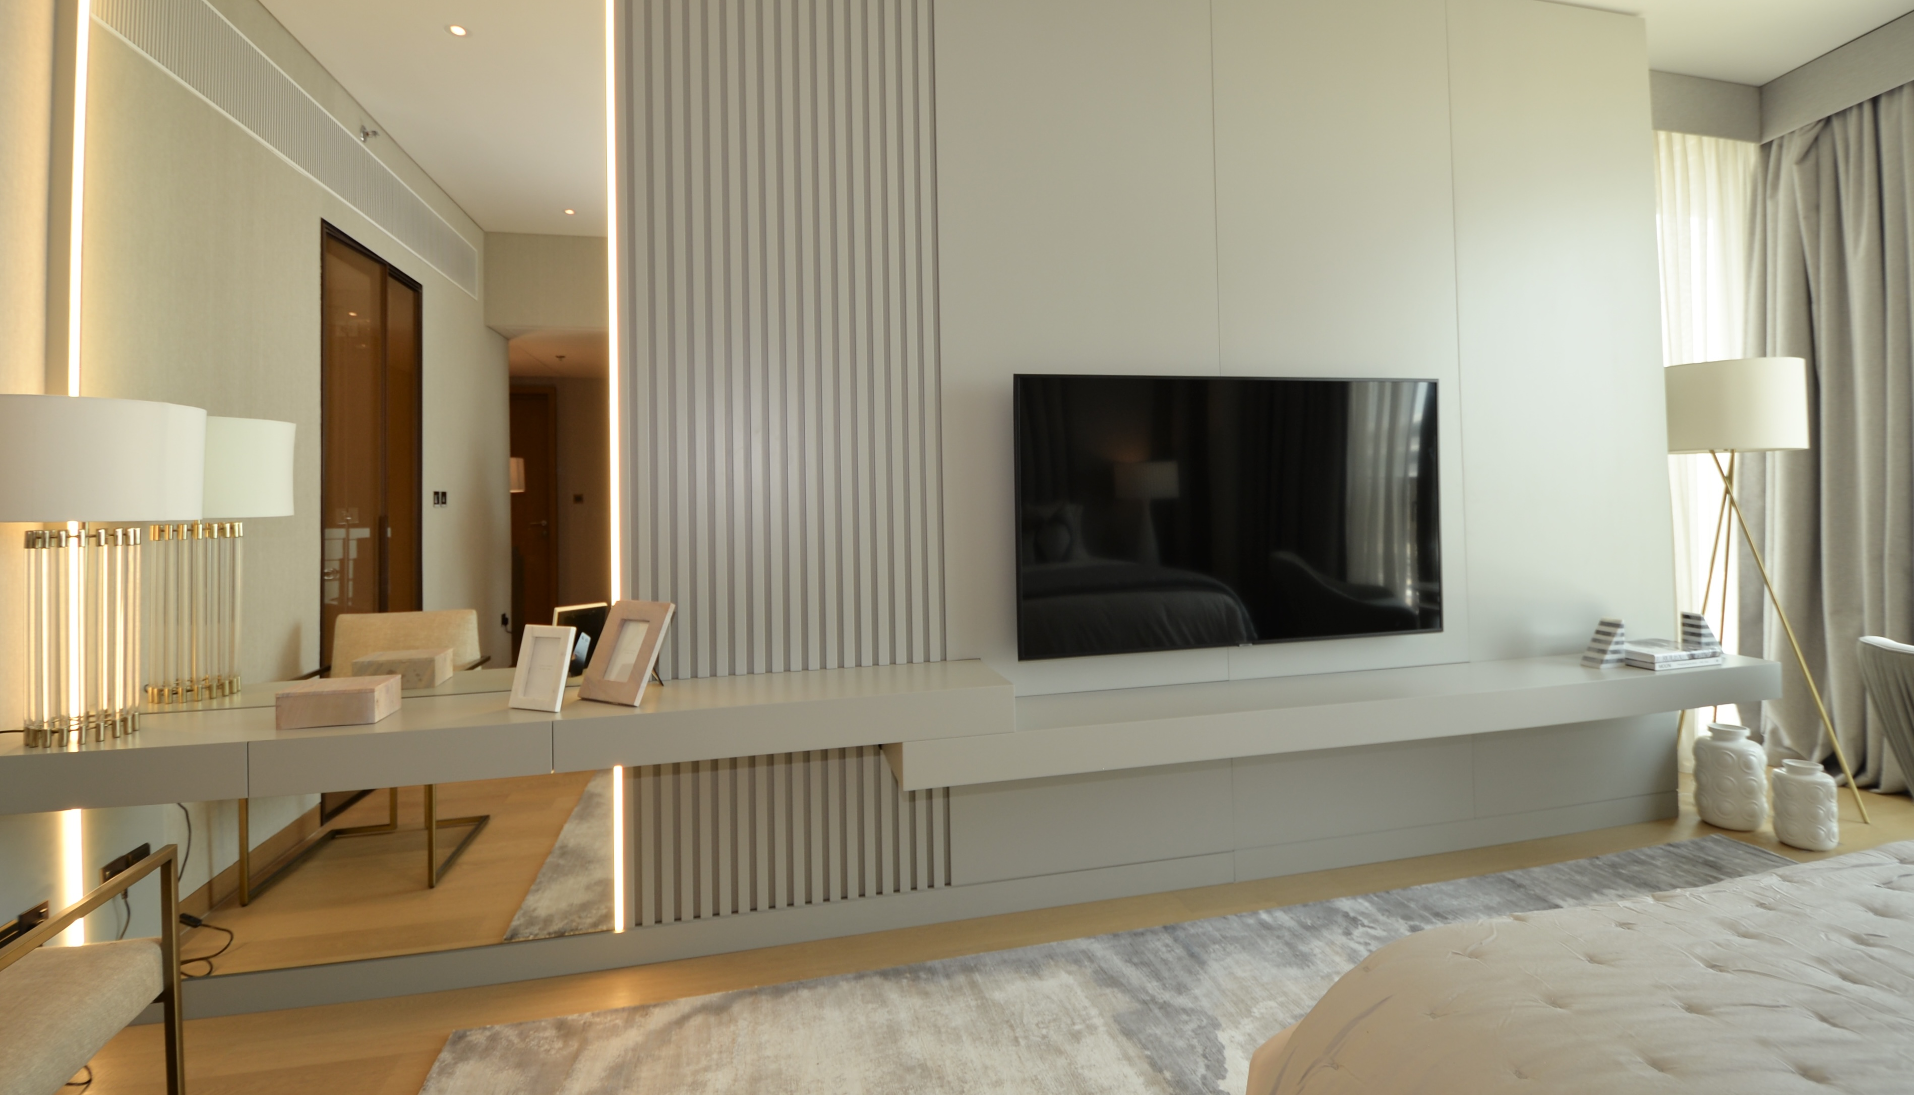
Bvlgari

Slide 16
Thank You

