Slide 1

DRAFT 2.7.25
E-Playbook

Slide 2
The E-Playbook purpose is to operationalize LTC’s commitment to supporting our tenant operators’ efficient and sustainable practices.
Working with our Operators, Third-Party Advisors, and Preferred Vendors, LTC has established consistent and comprehensive practices and approaches that can be replicated and scaled, including:
  Practical and holistic whole-building approach to energy and water efficiency opportunities.
  Knowledgeable and vetted third-party advisors and vendors with technical expertise and proven experience in the senior living and care space, REIT structure, and LTC.
  Responsive and collaborative services from upfront advice to project assessment and solutions to project support and management.
  Best practices, including established and innovative new technologies, implemented successfully across other senior living and care properties and organizations.
  Access to rebates, incentives, and financing from LTC and other third parties.
  Awareness and support around evolving benchmarking and other regulatory compliance.

Slide 3
E-Playbook Team
LTC provides a collaborative team that knows the opportunities and challenges of efficient and sustainable practices as well as the nuances of senior living and care
LTC Management: Sustainability (Mandi Hogan), Facilities and Capital Projects (Eric Smith), Asset Management (Debbra Street)
Program Advisor: Larkspur E-Advisory (Darren Kowalske), over 30 years of senior real estate expertise, providing a broad range of sustainability practices, leadership, and access to a preferred vendor network, including technical advisors
Technical Advisors: trusted and seasoned advisors with engagement and domain expertise across the prop-tech, health-tech, benchmarking, and renewable sectors of senior living and care
  Blue Sky E-3 Partners: (Tom LaVance and Richard Alber), providing ongoing advice and consultation to owners and operators. Helped implement over $3.5 million of Lighting, Water, and HVAC projects for Healthcare REITs over the last two years.
  Benessere Health Advisory Services: (Susan Coppola), former Chief Clinical Officer at Sunrise Senior Living, 30-year experience improving quality and business results through strategic planning, innovation, and application of health-tech solutions, including fall management and continuous vital sign monitoring.
  GreenEconome: (Marika Erdely), team includes Certified Energy Auditors (CEA), Certified Energy Managers (CEM), and energy and water Data Analysts. They provide utility collection, verification, ESPM integration, Benchmarking, and energy audits for owners and operators.
  Solar CFO: (Casey Gilley), former CFO/CPA with 20 years of real estate and solar experience, helping owners and operators evaluate the pros and cons of solar applications.
Preferred Vendors: over 25 preferred and vetted vendors actively engaged and providing services across the senior living and care sector, ranging from energy and water efficiency to utility rebates and financing to rooftop and community solar

Slide 4























Representative Preferred Vendors

Slide 5
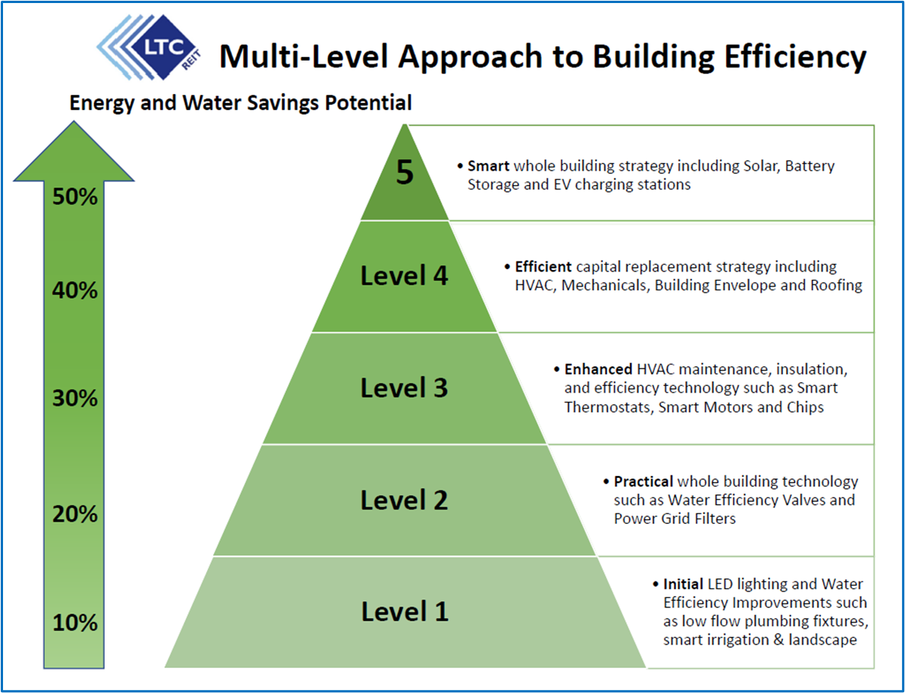
Multi-Level Approach to Building Efficiency

Slide 6
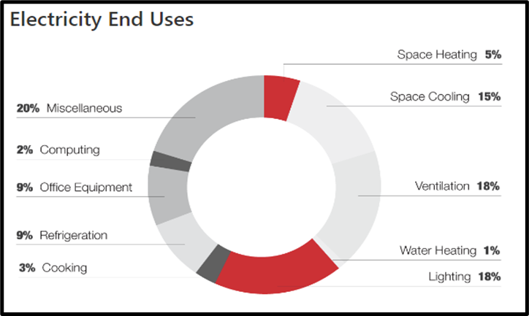
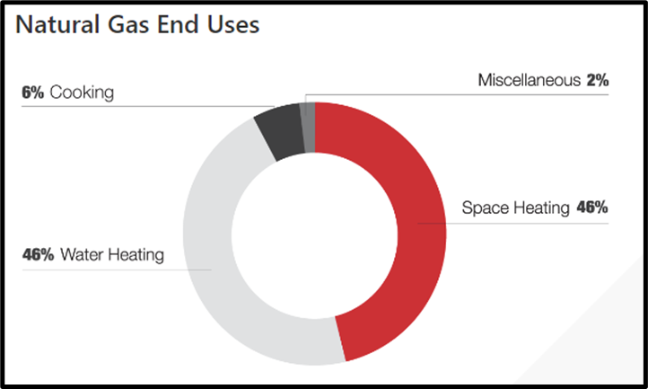

E-Playbook - 80/20 Energy Efficiency Rule
In Senior Living & Care, HVAC, Lighting, and Water Heating typically accounts for up to 80% of energy use*:
Electricity uses include: 18% lighting, 1% water heating, 18% ventilation, 15% space cooling, 5% space heating, 20% miscellaneous, 2% computing, 9% office equipment, 9% refrigeration, and 3% cooking.
Natural gas uses include: 46% water heating, 46% space heating, 2% miscellaneous, and 6% cooking.
HVAC Lesson Learned:
Single largest equipment investment at most properties, often over $1million+
Up to 60% of total energy cost
It is not just the upfront or replacement cost but the total cost of ownership, including maintenance, preservation, and efficiency
Proper maintenance is a critical component to overall efficiency, preservation, and ownership cost
You need to stay on top of issues and plan ahead
If you make a mistake, you will have to live with it for the next 15 years (less if you don’t maintain it)
Operators need to be both Care and Real Estate focused
Average EUI for Nursing Homes in the Midwest

Slide 7
Let’s Have A Discussion

