Slide 1
We need a simple graphic to illustrate a technology transformation. We have used the analogy that we need to rebuild a plane while it's carrying passengers in the air (fixing technology while it is being used). Looking for a graphic of an older prop plane with a newer lear jet and a tightrope/bridge connecting them with people being transferred from one to the other.
Comic book style would be cool but must be clean and easy to read in a power point slide

Slide 2
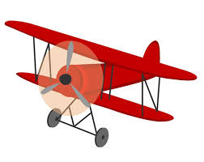
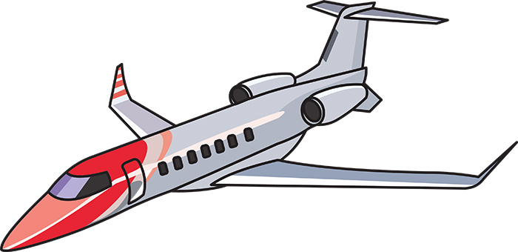
Notes:
- Very simple and clean graphic
The planes should have shades of blue (instead of the red I have in the examples below)
place the company logo on the planes
Example plane graphics below (can be replaced). Prefer a drawing or clipart feel over a photograph

