Slide 1
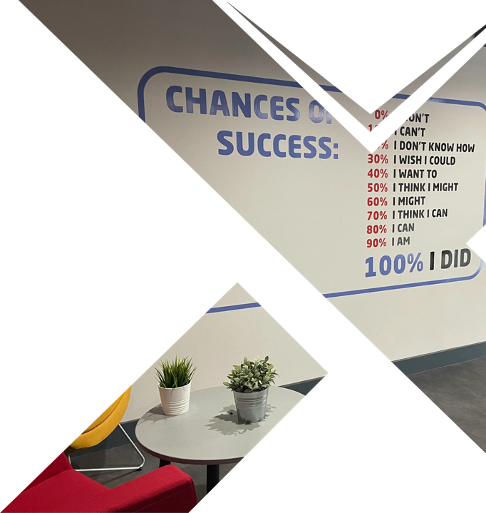


Enabling
Business Growth
  Your Lead Generation
Through Digital Marketing
Notes:
Happy

Slide 2

Target Audience
Persona | Description | Value
Industry | Sector | Construction
Location | Country, City if applicable | Scotland
Company Size/ Annual Rev £ | A) Large Enterprises — Global corporations with 1,000+ employees B) Mid-Sized Companies — Regional businesses with 100-999 employees C) Small Businesses — Under 100 employees, typically more hands-on leadership D) Startups/Scaleups — Fast-growing, innovation-focused companies E) Other (please specify) | Mid-Size
Job Seniority | A) Executives (C-Suite) — CEOs, CFOs, COOs, etc. B) Senior Leaders/Decision-Makers — Directors, VPs, Heads of Departments C) Mid-Level Managers — Project Managers, Team Leads, Operations Managers D) Entry-Level/Junior Professionals E) Specialized Experts — Analysts, IT specialists, Engineers, etc. | CEO – C-Suite CCG – Financial Controller (Personal Rel) Taggarts – Built a relationships Tough - Referral
Notes:
new quote added, needs formating

Slide 3
Target Persona - Basic Demographics
Persona | Description | Value
Name |  | Stephen
Age |  | 50
Income Level |  | >100k
Marital Status | Married / and or number children | Married / 2
Personal/ Family Goals | A lot of these businesses have started as family businesses and are proud to be part of it – aiming for growth, stability Might be hoping that children work in the business | Asked for help for kids with IT
Social Media Platforms? |  | Linkedin Facebook?
Hobbies | Incl favourite sport/teams | Football Rugby Cycling Golf Concerts/Gigs
Years in Job | In Industry, In current position Onsite may change but head office very loyal – long tenures | Come through the ranks >20 years
Professional Goals | What do they want to achieve – promotion? Legacy? | Legacy, sustainability of company
Notes:
new quote added, needs formating

Slide 4
Target Persona – Professional Info
Persona | Description | Value
Source for Industry News | Not just main contractor – subbies important, e.g. Tough Construction | Local news – new sites going up Construction NOW Financial Design Engineering
Industry Events | What events have they attended in last 3 years? | Construction Industry Federation
Primary Market | Who are their customers? We need to message for different types of builders, i.e. private v HA v Commercial | Government / Driven by budget McTaggart/CCG – LA / 90% Housing Association
Industry Challenges | Still heavily paperwork based | Dictated by government / budget Environmental environments when starting build – hidden Heavily regulated health & Safety Personnel compliance Paperwork / audit for regulatory compliance
Professional Personal Challenge1 | Part of Quality submission 80/20 Price | Ageing population in construction, digital skills limited Resistance to change Struggling to hire / retain staff Employee education re H&S, impact of not doing for CEO
Professional Personal Challenge2 | Community Benefit Teams – need to be seen to contributing to HA groups. Have to show employment for diversity criteria | Availability of materials Tender process long – lack of clarity to inform
Professional Personal Challenge3 |  | Traditional Costing models are changing to ‘design & build’ Risk moving from Client to builder – Fixed Price Need to extend teams to capability in design to cope with these
Notes:
new quote added, needs formating

Slide 5
Target Persona – Professional Info
Persona | Description | Value
Worst Outcomes | What could be the financial consequences?​ ​What would be the professional consequences?​ ​What would the personal consequences be?​ ​What is your customer afraid of?​ How would they feel? | Cyber Security Competitors getting ahead Losing their Core clients – are they likely to leave How they are affected by public perception Losing Reputation in market Feel let their family down Loyalty of employees hurt Fierce sense of hands on / Operational
Best Outcomes | What would the perfect solution look like?​ ​What is it they really want more than anything else?​ ​What would they be willing to pay almost anything for? What do they see as VALUE for Now, VALUE for Future? | Want digital efficiency, incremental changes Strong brand is important. Local community as they’re big employer. Understand that they have to move forward overcome any resistance in business ROI : Release staff for more valuable activities Being able to do more with the people they’ve got Increase profit through efficiencies Service: Digital maturity assessment (1-10 across 5 areas) Apps/software Strategy, Customer, Staff, Operations, Technology IT risk & resiliency (technology infrastructure, telephony, network)
Notes:
new quote added, needs formating

