Slide 1
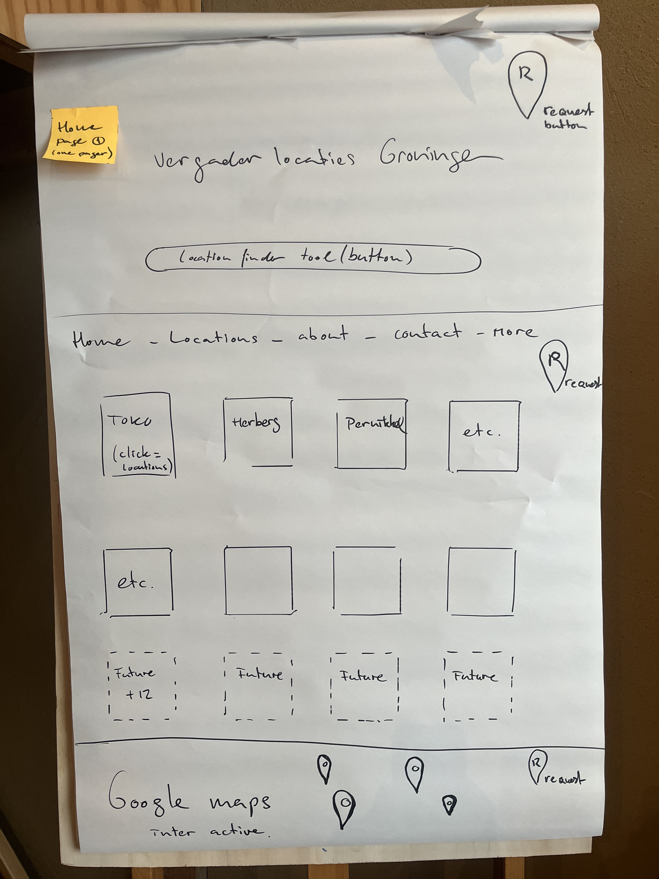
Interactive goolge always goes to page 4 – spefically that location
This is a one pager- Top to down
- LOGO
Location finder TOOL ( like airbnb )
Menu ( 5-6 pages )
Different location ( 4 visible, future more, space for minimal 12, easy to ad one more or skip one. )
Google Review tekst
Google maps (Interactive goolge always goes to page 4 – spefically that location )
R button = Request button.
We need many of those, like in each section
Switch dutch/ENG button in menu

Slide 2
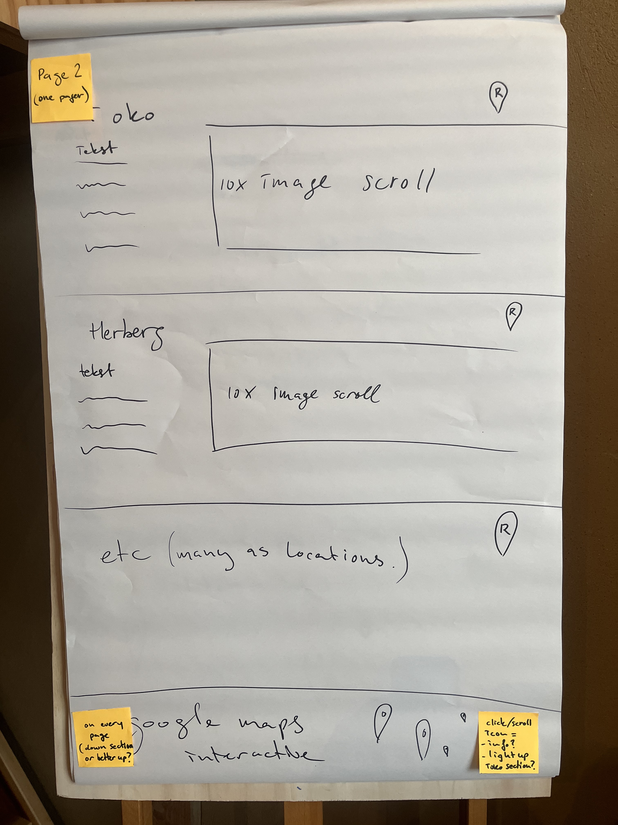
Page 2 Onepager sections about a location
- tekst 200 words
- foto scroll bar, 10 images. Click on image is make it triple size each section is clickable to a deeper level, page 2 b.
Many sections as locations, easy to expand, we just started 3 locations, space for 12 locations.
Interactive goolge always goes to page 4 – spefically that location
What I like about this the clean overview,
but there is a need to find back the home page.
Is there a solution to keeop the cleas quit design, and a link by logo in the corner to find your way back to the homepage?
Or is it wise to make a home page copy , change just the middle section?

Slide 3
This is page 2B, after clicking on the location at the home page or at page two ( locations ) , here it starts with the same design info about the location, some more is added. Just details about this location.
This page 2B design two ideas, wich is the best? :
1 Copy of page one: header and foother are the same. Middle is solo for one location .
Or
2 Just the same google maps foother, top/header is Logo of this compagny.
Middle is solo space for this location.
( foother will bring you to other locations )
Also R request buttons top middle and down.
Insta gram scroll ( exclusive insta link each there own excisiting insta account )
Google review tekst about this location/ or just random review of this platform.

Slide 4
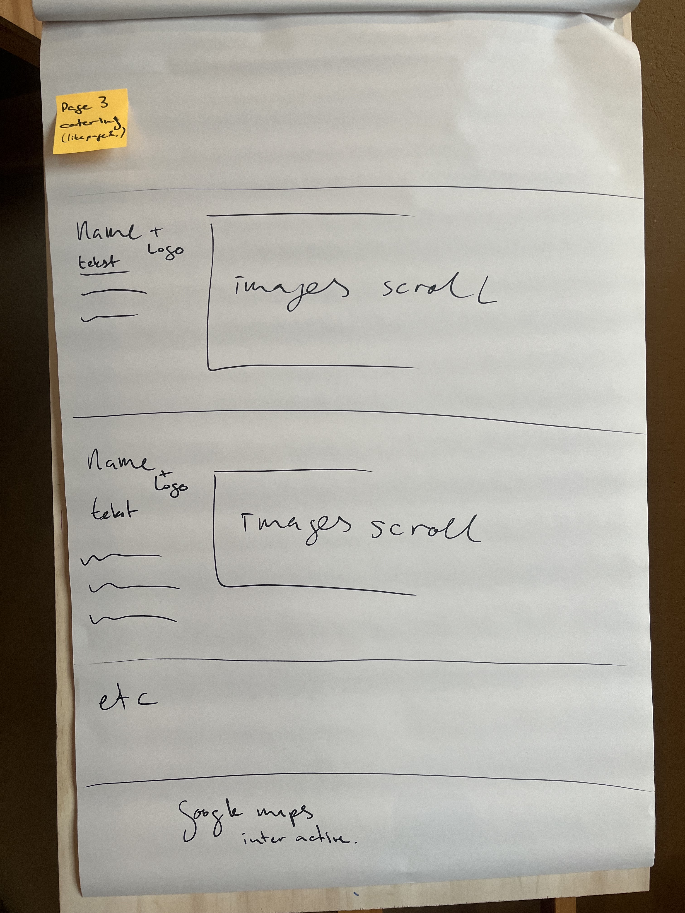
Catering page
Sections design as page 2.( but theres no 3b )
Interactive goolge always goes to page 4 – spefically that location

Slide 5
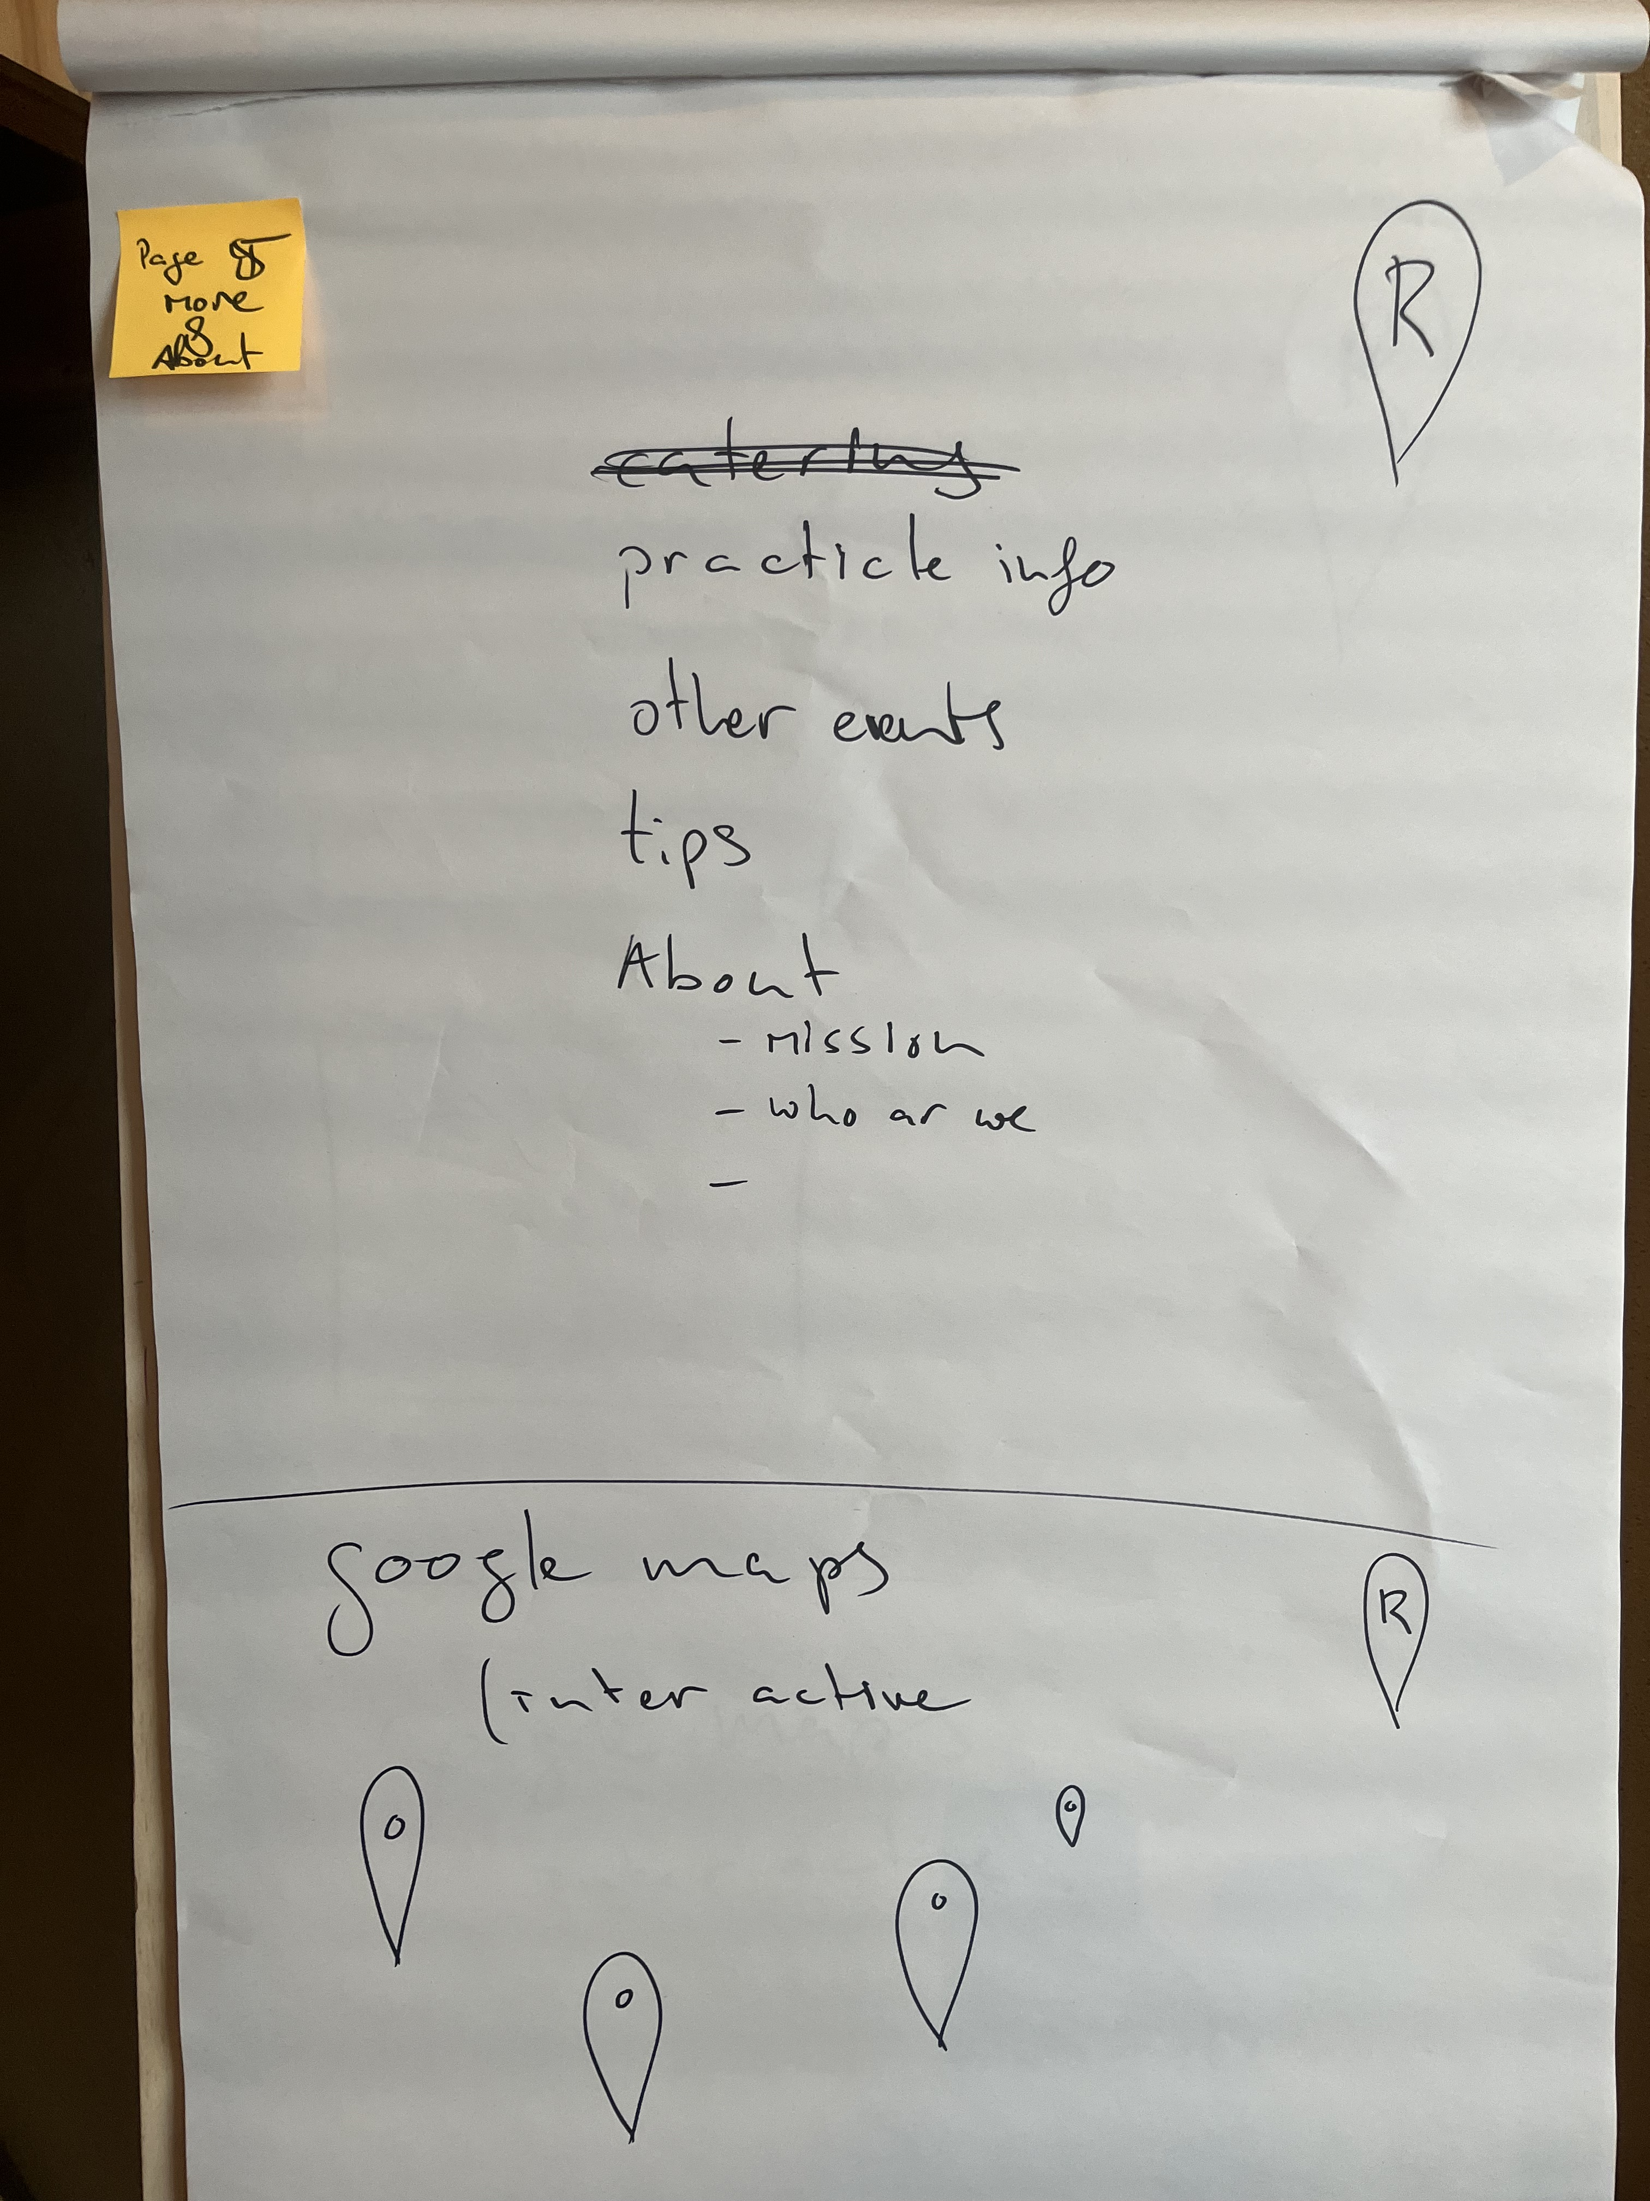
Desig: same: copy page one, change just the middle section.
More&About
- Practicle info
- Other to ad on
- Tips
About
- mission, who we are , vision etc.
Interactive goolge always goes to page 4 – spefically that location
Insta link, 4 images last post from insta.
Google review tekst about this location/ or just random review of this platform.

Slide 6
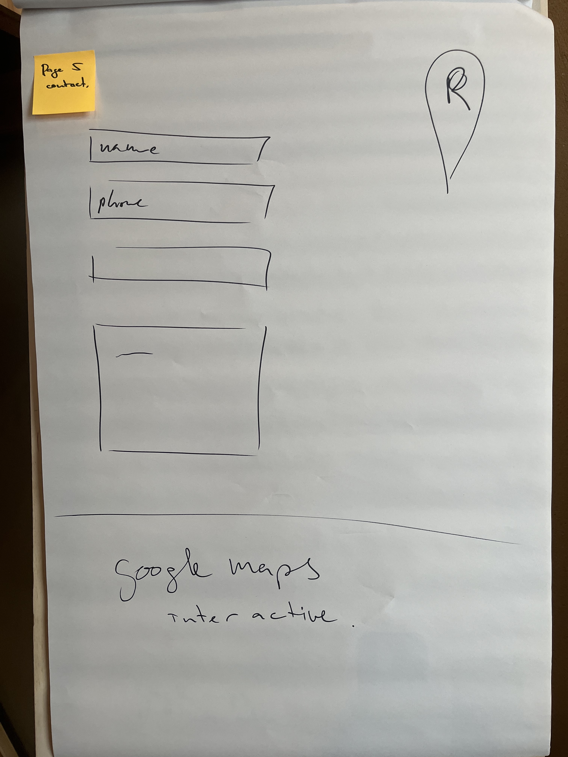
Common contact form:
Name email
Phone number subject tekst
Interactive goolge always goes to page 4 – spefically that location

Slide 7
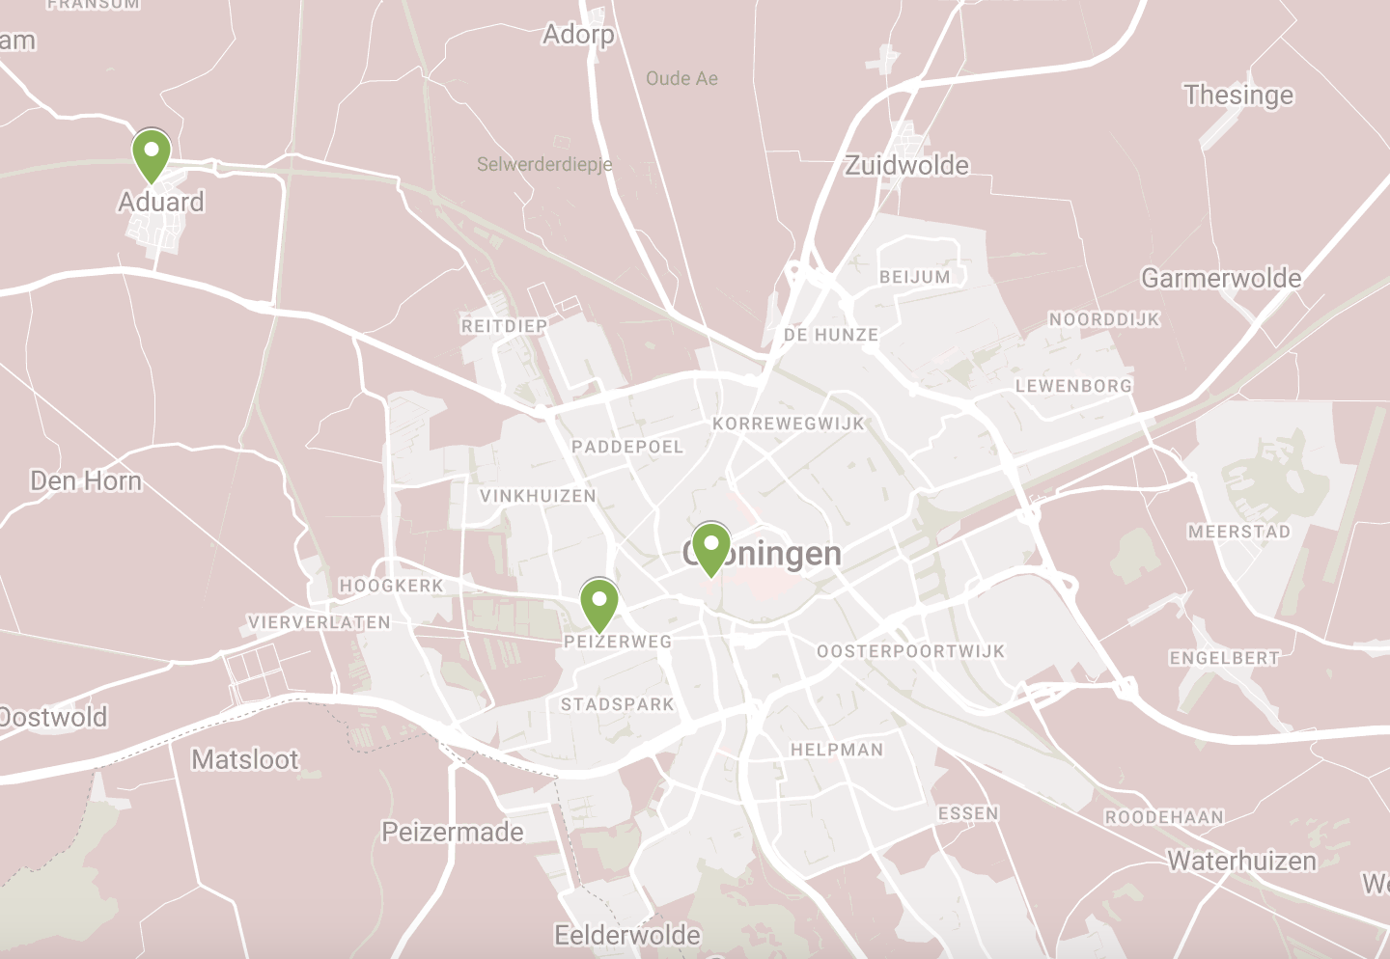
Section footer in each page, google maps interactive.
This could be the concept fun thing on the website.
Moving over the icon/symbol pups up the name of the location on spot.
Double clicking brings you to the personal page of this location.
This map most be possible easy to update with increasing locations.
We need this to do this by our self.

Slide 8
Adresses
Location TOKO : Suikerlaan 24 – Groningen – The Neterlands
Location Pernikkel : A weg 2 – Groningen – The Neterlands
Location Herberg Onder de lInden : Burg.van Barneveldweg 3, 9831 RD Aduard
The Neterlands

Slide 9
Websites
Location TOKO : Suikerlaan 24 – Groningen – The Neterlands www.toko-vergaderlocatie-groningen.nl
Location Pernikkel : A weg 2 – Groningen – The Neterlands www.pernikkel.nl
Location Herberg Onder de lInden : Burg.van Barneveldweg 3, 9831 RD Aduard
The Neterlands www.herbergonderdelinden.com

Slide 10
Tekst and foto’s for page info about the location. ( page 1, page 2, page 2b, page 3. )
Location TOKO : https://toko-vergaderlocatie-groningen.nl/over-toko/
Location Pernikkel : https://toko-vergaderlocatie-groningen.nl/locatie-pernikkel/
Location Herberg Onder de lInden : https://toko-vergaderlocatie-groningen.nl/locatie-herberg-onder-de-linden/

Slide 11




insta https://www.instagram.com/herbergonderdelinden/
Logo’s

Slide 12





/
Logo white TOKO
https://www.instagram.com/t.o.k.o.o.o.o/
Logo’s TOKO

Slide 13




Logo’s insta https://www.instagram.com/spijslokaalpernikkel/

Slide 14
Downloads and links - on each page
Instagram symbol
t.o.k.o.o.o.o
Therms
Cookies
Privacy
Algemene voorwaarden
Cookiebeleid
Privacyverklaring

Slide 15
Booking Tool bar
Name + Telefoon + mail
When?
How many people?
Time frame?
Coffee arrangement?
Lunch / diner?
Note ?
Bring the visitor directly to Mice, same as the R button.
In future this button will give a fast selection of what is available like airbnb.
ifferent as the R button.

Slide 16
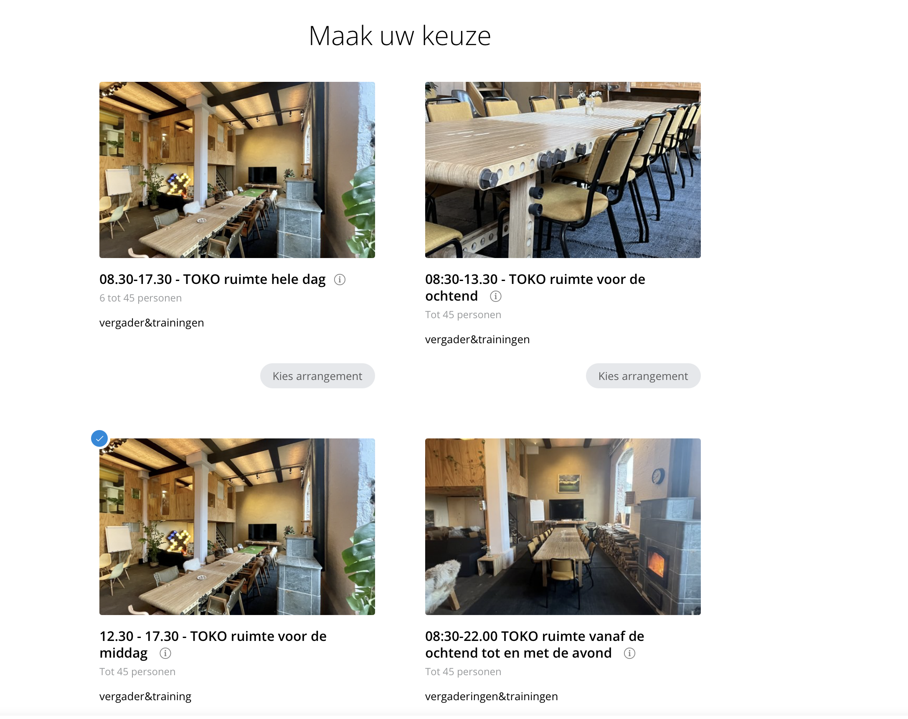
R button
( grapic fun to make this in the location shape? )
Request bring the visitor to a booking Platform named Mice.
Just try it on my current website TOKO
https://toko-vergaderlocatie-groningen.nl
You find a button named “ Nu aanvragen “
https://app.miceoperations.com/widget/f40aead147f9

