Slide 1

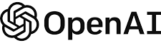
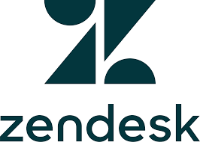



There are 3 major monetization models that have begun to gain traction with AI, and one we expect to see more of
Challenges of GenAI Monetization
Frequently seen today
Future option?
A
B
C
D
User licenses
Usage-based tokens
Outcome-based
Usage-tiered licenses
Description
Charge a flat price for a user to have access to the functionality
Purchase blocks of tokens that can be spend on usage/work of the AI functionality
Pay for the outcomes of the GenAI functionality
Offer different user licenses with different usage capacities
Examples
kinda…
Pros
Simple and easily understood
Covers costs at all scales of usage
Tokens help with predictability issues
Potentially highly value-aligned
Value aligned
Simple & predictable
Natural upsell path
Low barrier to adoption
Cons
High price limits adoption
Not tightly value aligned
Risky if fair usage restriction is not placed on
Upsell dependent on wider adoption
Not tightly value aligned (value may not increase linearly with usage)
Not ARR
Delayed revenue realization
Not ARR
Tough to find the right metric
Limit on the number of tiers

