Slide 1
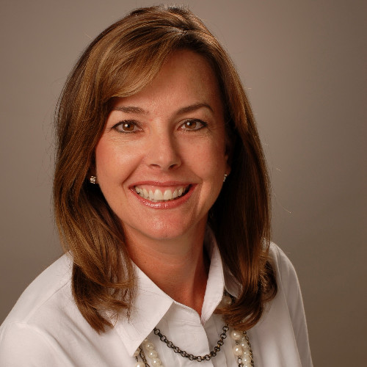


Kathleen Merrill
Vista Board Engagements
Kathleen Merrill
Former Chief Information Officer, Southwest Airlines
Indian Rocks Beach, FL
Kathleen A. Merrill is a retired Chief Executive Officer and Executive Advisor of Southwest Airlines, a role she held from 2017 until December 2024. In this capacity, Ms. Merrill oversaw key strategic initiatives, including advising senior leadership on the company's technology roadmap and five-year strategic plan, optimizing workflow processes for the Technology Supply Chain, and mentoring the incoming Chief Information Officer.
Prior to this role, Ms. Merrill served as Vice President of Business Transformation, Corporate Delivery, and Technology at Southwest Airlines from 2012 to 2017, and as Vice President of Strategic Planning and Implementation from 2008 to 2012. She also held various technology leadership roles at the company before 2008. Before joining Southwest Airlines in 2004, Ms. Merrill held positions at American Airlines and Capital One Auto Finance.
Ms. Merrill holds a B.B.A. in Marketing from the University of North Texas.
With a career defined by innovation, leadership, and a passion for creating meaningful change, Kathleen continues to inspire and lead in every role she undertakes.
Non-Vista Board Engagements
Non-Vista Board Engagements
Expertise
Airline Expertise
Enterprise-wide strategic initiatives
Technology Products and services
Strategy and Change leadership

