Slide 1

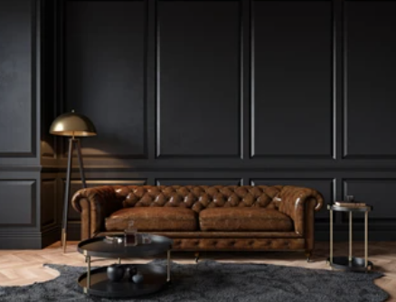
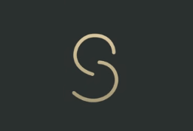
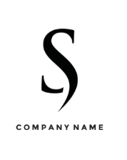
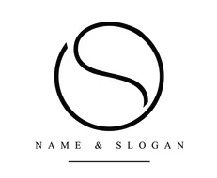
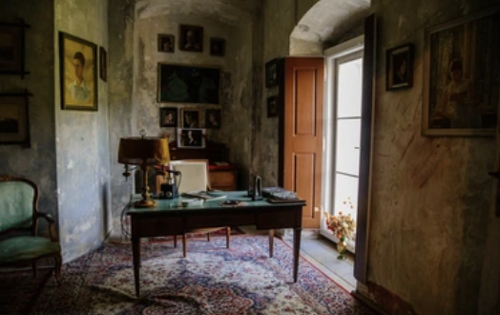
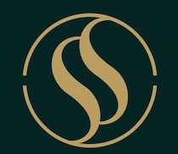
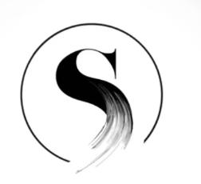
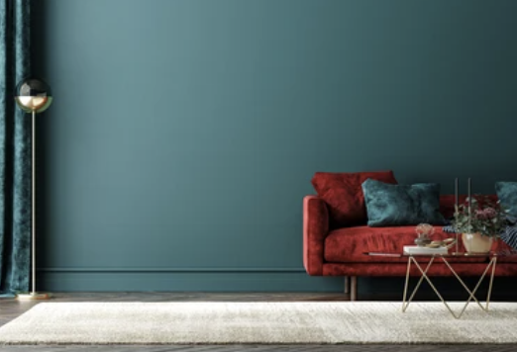
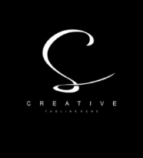
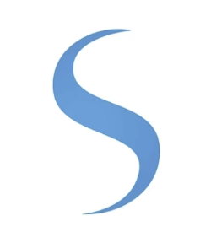
Brand creation process | Brief for logo
Brand creation
Company context and Logo philosophy | What do we want the logo reflect? (key concepts) | Characteristics (lool&feel) visual and other elements for reference
Company context Our company name is Serifos Serifos fosters global innovation and entrepreneurial success through a diverse portfolio of investments. We enable our partners to unlock their full potential and create sustainable growth through strategic investment, operational expertise and access to our extensive network. We are: Bold: we are not afraid to invest and develop original and ambitious ideas Discerning: we believe in niche thinking, emerging ideas and entrepreneurs Approachable: we take our work seriously but not ourselves Company name inspiration Serifos is a Greek island in the Aegean Sea located in the western Cyclades Serifos is our metaphor for success, where we want to take our entrepreneurs | What we want our logo to reflect: Simplicity Sophistication Originality Retro inspiration (discreet) We want our logo to have: An original symbol that can be associated to the name and brand Can be an abstract symbol Can be a symbol that reflect the S of Serifos What we DO NOT want: No corporate style e.g glass buildings and people wearing suits and using suitcases No beach, island reference | https://mellohouse.com/

