Slide 1
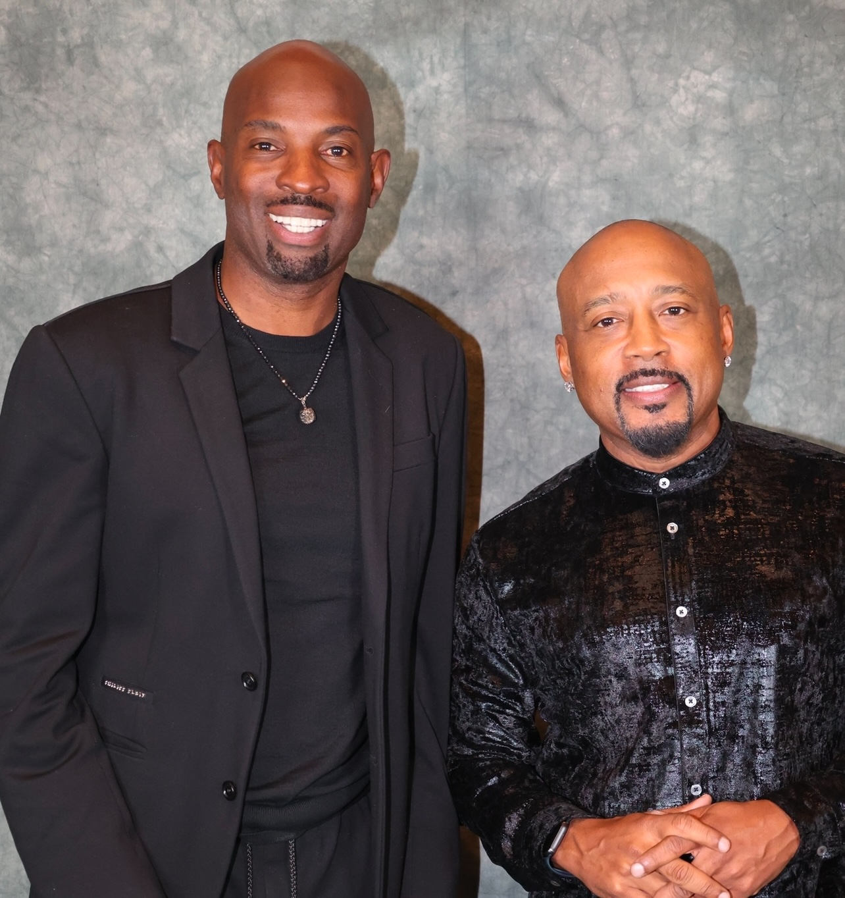
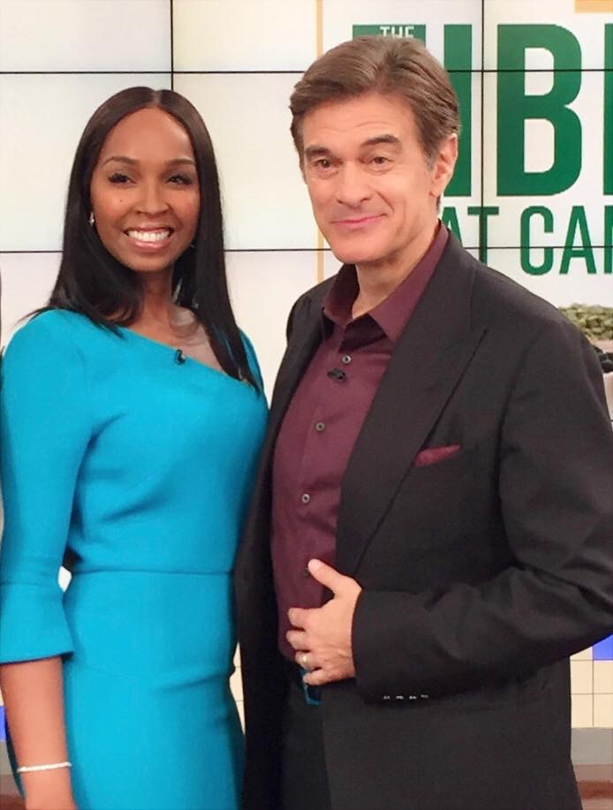
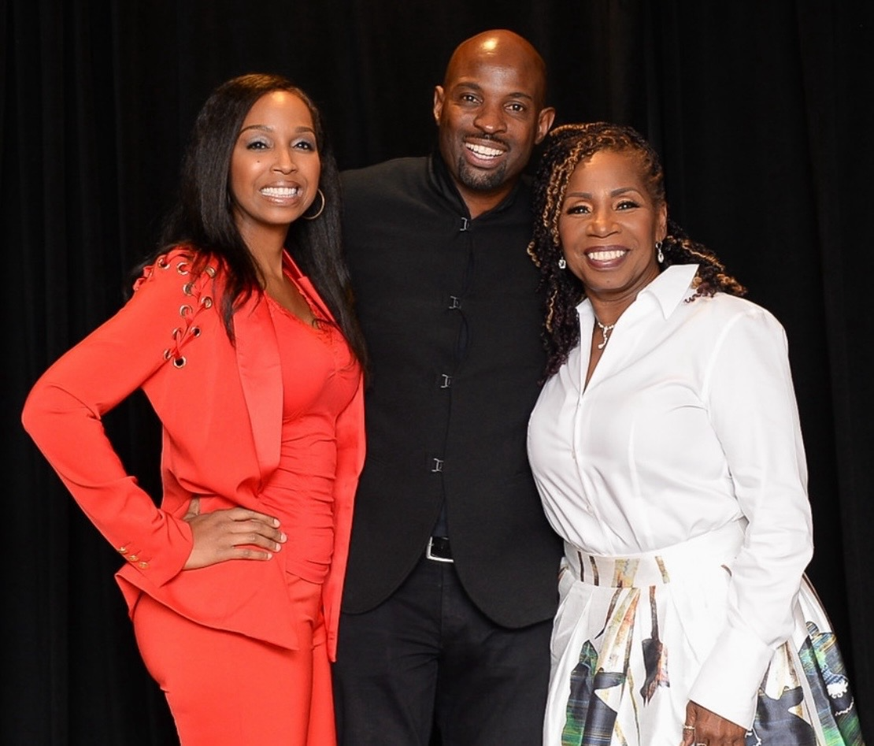
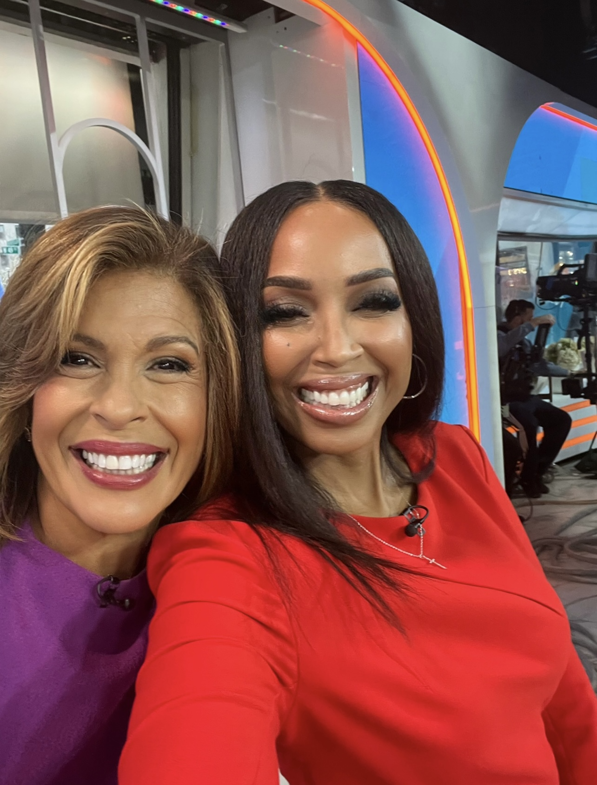
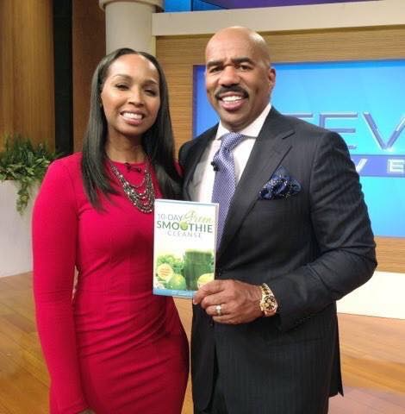

Slide 2
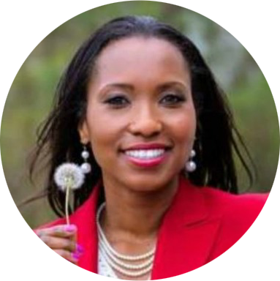
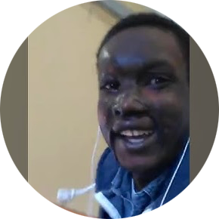
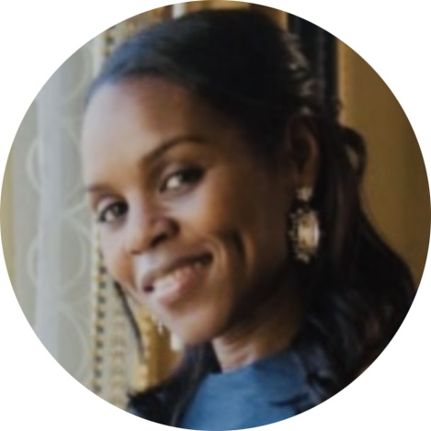
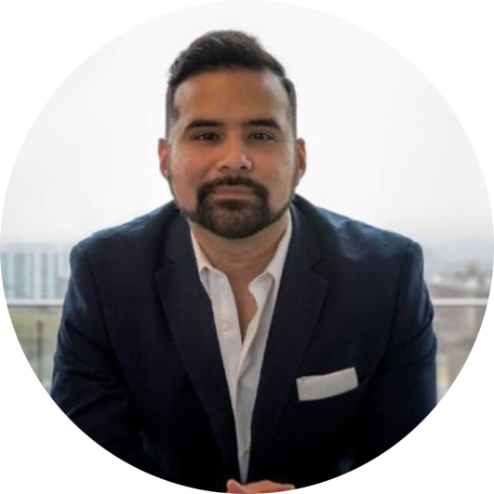
REAL PEOPLE, REAL WINS: SEE WHAT’S POSSIBLE WHEN YOU TAKE ACTION
Thanks to TJ’s daily mentoring and assignments, I am making moves, making money and miracles around the globe! I won my first contract for $250,000. I am beyond ecstatic!
I immediately found what I needed in TJ’s Program. It was a fully customized program that encompasses the entire aspects of success, including education, inspiration and engaging business challenges with tools that enabled me to shift my paradigm, grow my business and begin to BUILD WEALTH. The program is a game changer; no one who embraces its principles and takes massive action, remains the same.
~Adrienne
I feel like this is all a dream! I can’t believe what I paid. I feel like I should've been charged $9,999.99 for the value I've gotten out of these first few days!
Most importantly, and what I'm most thankful for now is that I have sniper vision that has put me in a better position to start my motivational speaking company! I now have the ability to inspire and make a meaningful impact in people's lives and earn an income to take care of my family.
~Romel
I’ve been mentored by TJ since 2017 and ever since he started mentoring me, not only has the vision for what my life could be grown, but so has my income! I’ve been able to grow my monthly income 600% and I thank God every day for having someone like TJ in my corner.
He always pushes me to do more even when I think I can’t. He often asks “so why aren’t you doing this…or doing that”. I finally realized my potential and said “yes” let me try to and do this, by listening and stepping out of my comfort zone, I am doing it! It’s hard work, but it’s worth it.
~Lequisha
Todd has been a business mentor to me as a serial entrepreneur. His program and advice has helped me grow my business and made me a better business owner versus a business manager.
You don't get many opportunities to have access to someone who has built multiple successful businesses from the ground up. It's been a blessing to have Todd in my corner.
~Pedro

Slide 3
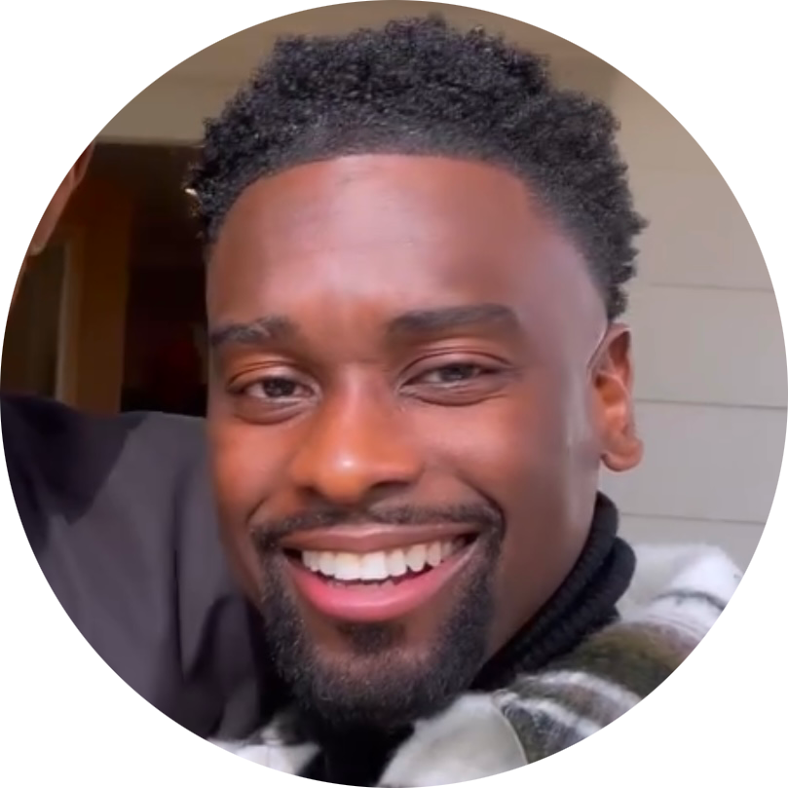
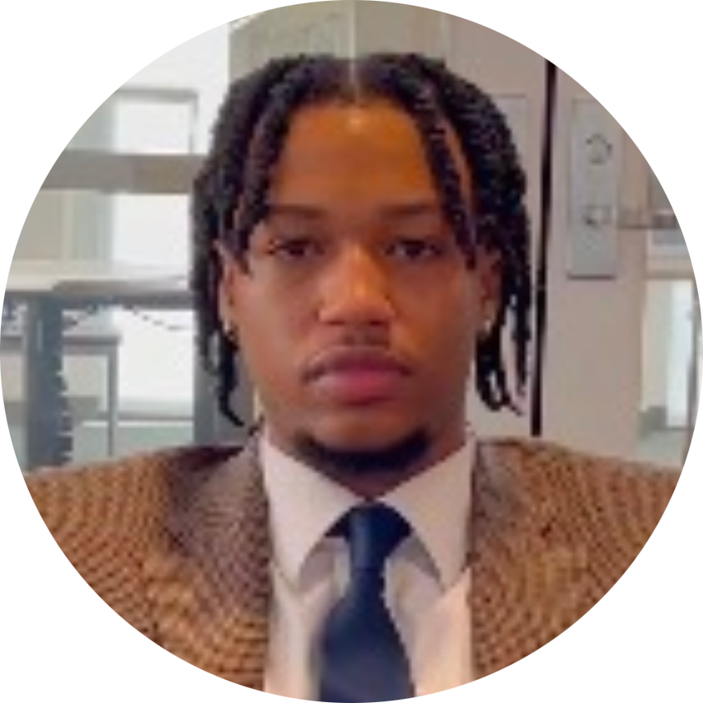
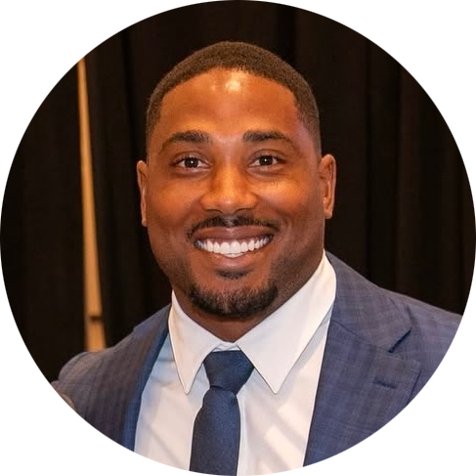
BE INSPIRED: HOW PEOPLE JUST LIKE YOU BUILT WEALTH AND FREEDOM
I run a seven-figure accounting company with over 25 staff members, but I'm the person who had to be on the phone with all the clients. So Todd was immediately able to give me advice on what I needed to do to phase myself out of my own business and create processes and procedures so I can have my time back.
Fast forward now, it's eight months later, and I've made more money than I've ever made inside of my business. I now have more time to spend with my wife and doing the things that I love to do!
~Karlton
TJ changed my life! He equipped me with something that you can never take away, which is knowledge. I thought I had everything down pat in my business. I thought I knew what I was doing. There's no other way I can grow. I just got to keep doing the same thing I'm doing, and I was wrong.
Being around TJ taught me there's a whole other way of thinking that you can be elevated to in order to open up the doors to success for you. TJ really just thinks differently. All of his successes, and he has acquired many. He still wants more success and wants to help others achieve it; he really does, and he taught me the game too!
~Yaw
I doubled down on everything TJ said, and then we were able to solidify our business plan, and now the investors have complete trust in us.
Again, God put us in a position where he put an advisor on our team, and that's really helped our company propel to another level.
~Adrian

Slide 4
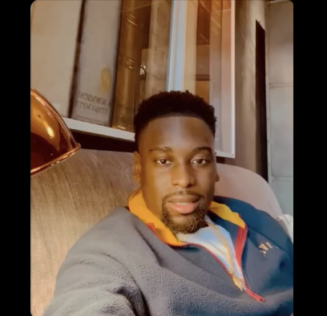
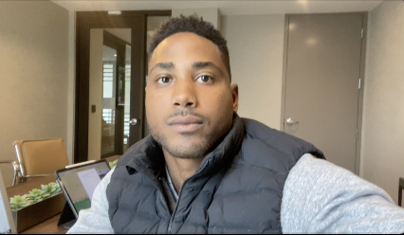
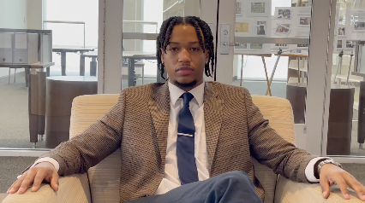

Real Stories. Real Results: See How Others Transformed Their Lives
“I've made more money than I've ever made inside of my business!”
“You Changed My Life and Taught Me the Game!”
“I doubled down on everything and now our investors have complete trust in us!”

Slide 5
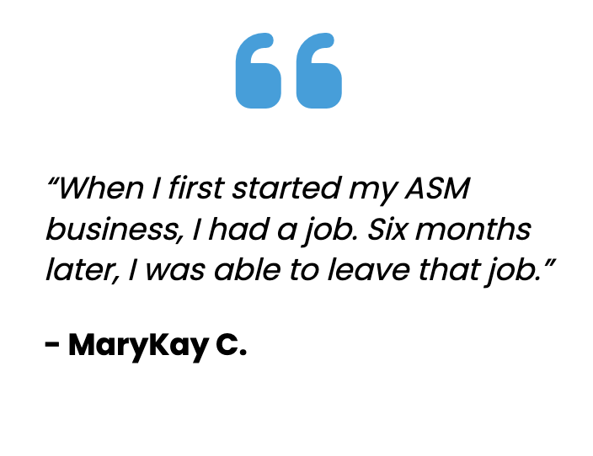
THEY TOOK THE LEAP - SEE WHAT’S POSSIBLE WHEN YOU TAKE ACTION
Whew! Starting this program, I was really worried about starting a business because I didn’t have the money or experience. This program showed me how to start small and still make an impact. I followed the plan, and within 60 days, I landed my first paying client. I never thought I could do it, but I did. This 90-Day challenge changed everything for me. I feel so empowered.”
~Anne
A million dollars worth of game for $999. Much respect and I look forward to completing this challenge with you.
~Rohn
Since joining the Challenge, I've learned to utilize tools that have played a pivotal role in landing contracts with organizations and private clients. I've learned how to maintain momentum and not get "stuck" when trying to build my business. I'm thankful for the invaluable tools that TJ has provided. I've gained a mentor and a friend.
~Shawn

Slide 6
THEY TOOK THE LEAP - SEE WHAT’S POSSIBLE WHEN YOU TAKE ACTION
Todd helped me nearly double my business revenue in one year. I follow all of his advice and it's helped to reshape the way I do and grow my business. I look forward to seeing the next level his advice will take me.
~Nigel
TJ, thank you for creating this amazing program! It truly helped me to cut away the areas in my life that are not producing the money I desire and to prune, cultivate, and focus on the one area that will make me lots of freakin money. The value I got for the price is beyond comprehension.
~AB
I had no idea what I was getting myself into when I started the program. From Day 1, I started to realize how powerful this program was gonna be. I figured out exactly where I wanted to be and had the tools to get there! The best part was the live zoom calls where I got to speak to TJ and JJ directly, that was amazing!
~Mahamat

