Slide 1


The concept
Hello!
We are looking for a wedding invitation design which features the colors of a peacock feather. For the design, feathers can be used (even expected) but we would like either realistic or water color style feathers. We are more classic/elegant than modern in our design taste.
In the concept designs below, you’ll see a love for vellum style invitations and foil accents. Part of the motivation for the vellum style is to allow for more pictures to be used.
Texts for the ceremony invitation, reception invitation, RSVP card (size of a business card maybe?), US reception post card, and accommodation/transportation card are drafted below. Edits to the text might be needed after design (change of time/location).
We are looking for a quality wedding invitation design. However, we are also budget aware. Please keep print costs in mind while designing.
Additional note, we will have circular wax stamps

Slide 2
Designs we need
Ceremony invitation
Reception invitation
RSVP card (and return envelope?)
US Reception Postcard
Accommodation and Transportation
Stationary page for personal notes in the invitation (Likely around an A6)

Slide 3


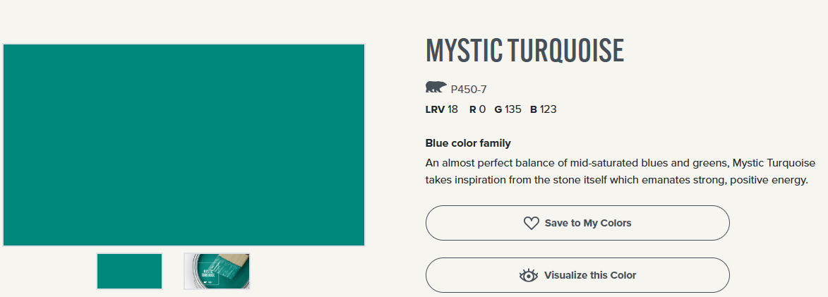

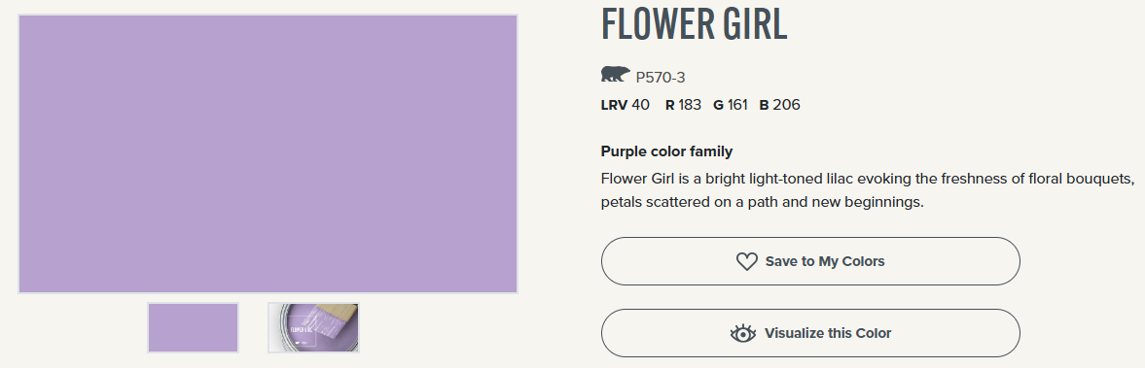

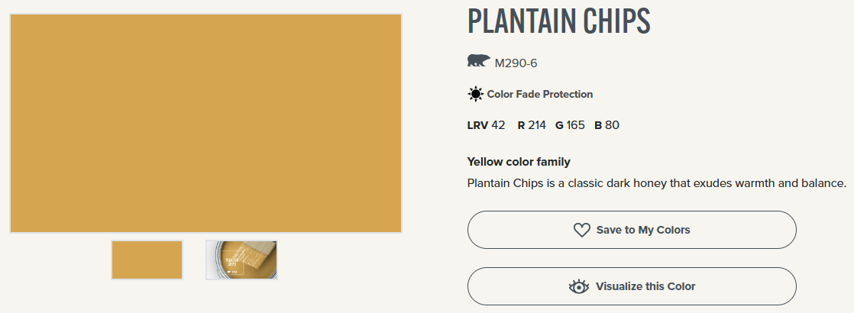

These are the foundation colors for the wedding. Use of accents/additional neutrals are okay
Copper is the ‘metal’ color of the wedding

Slide 4
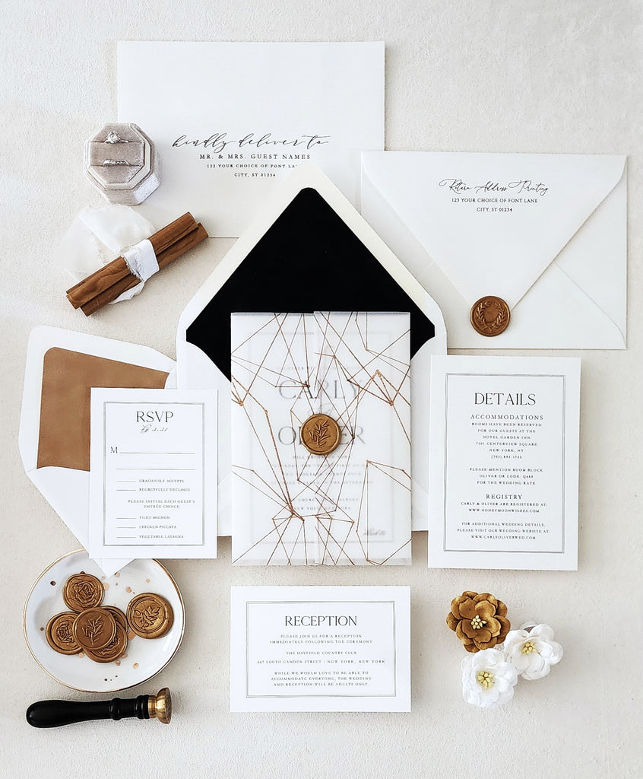
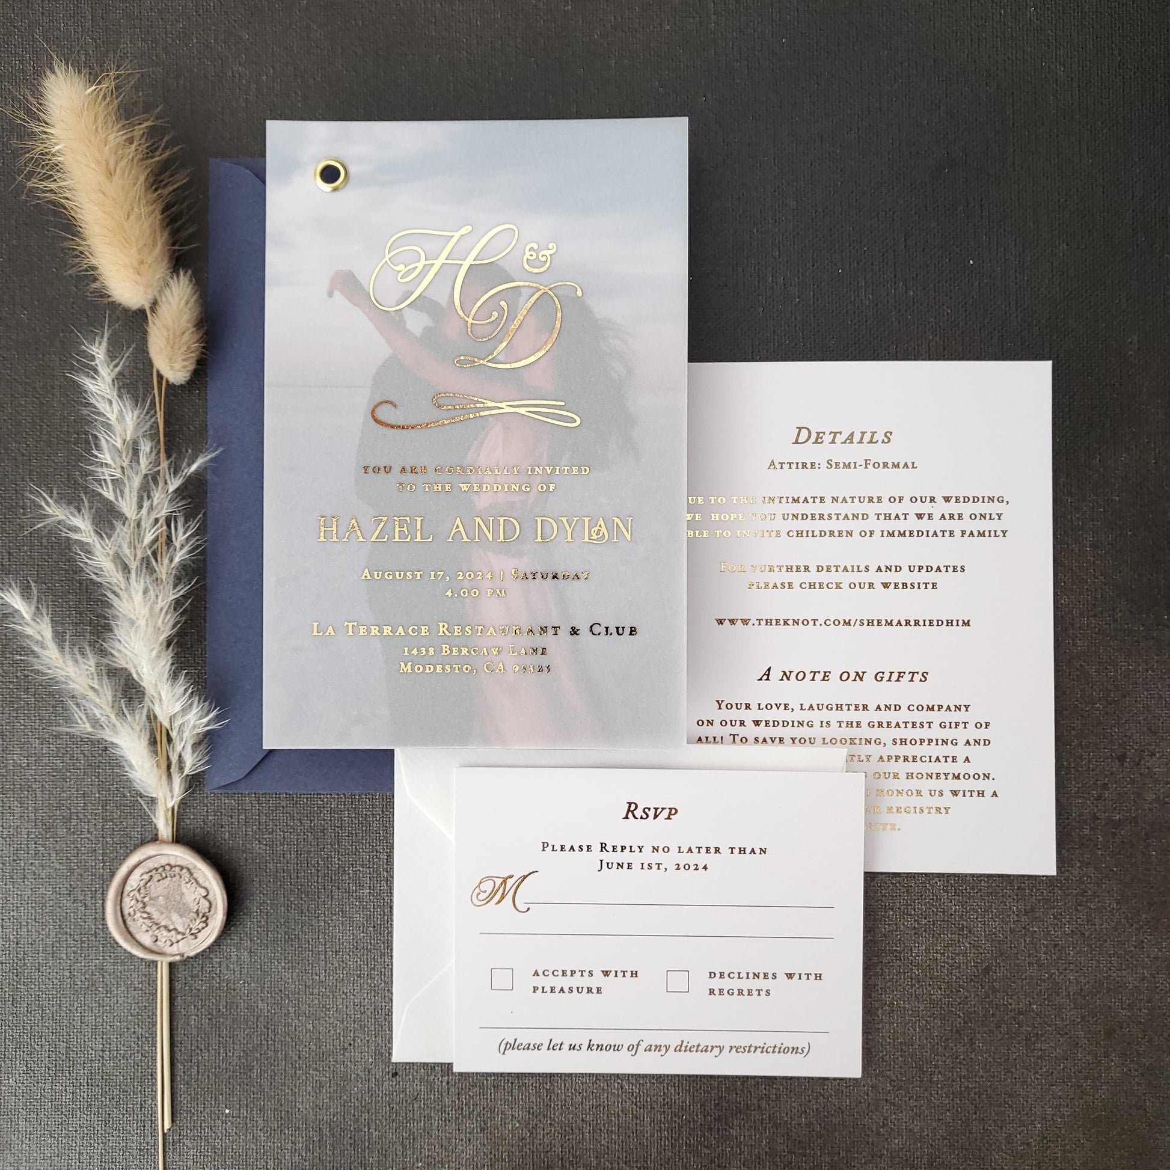
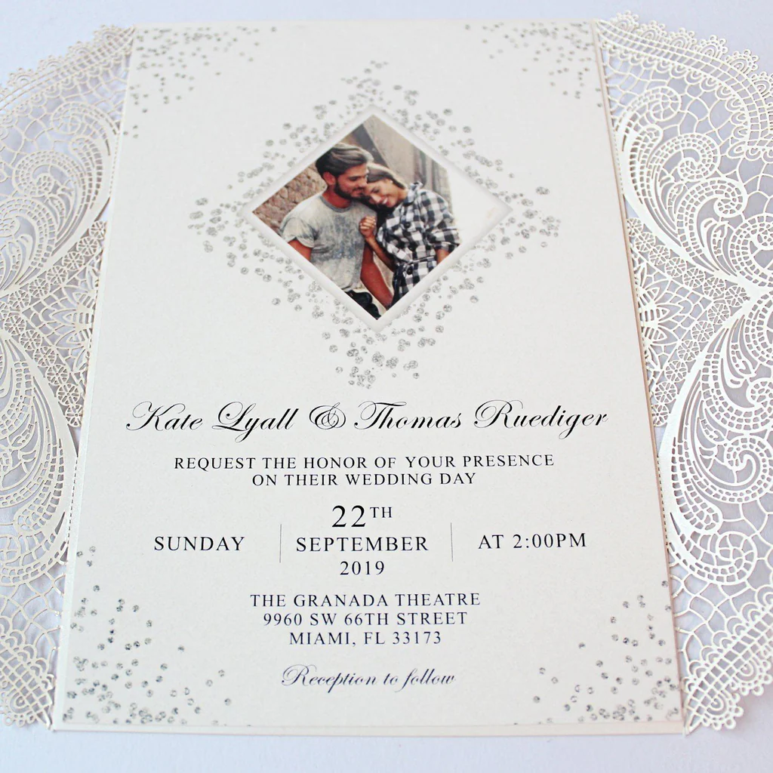
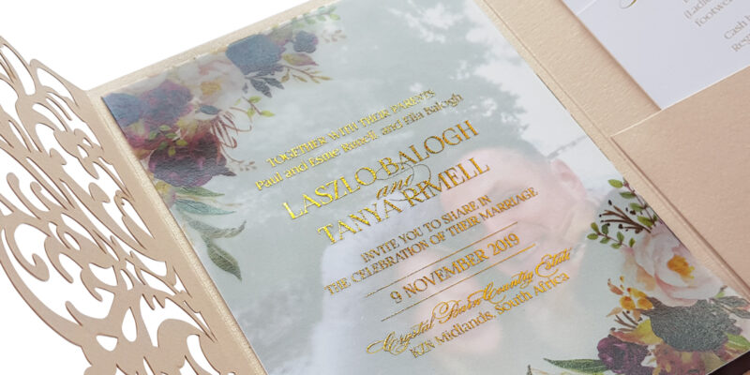
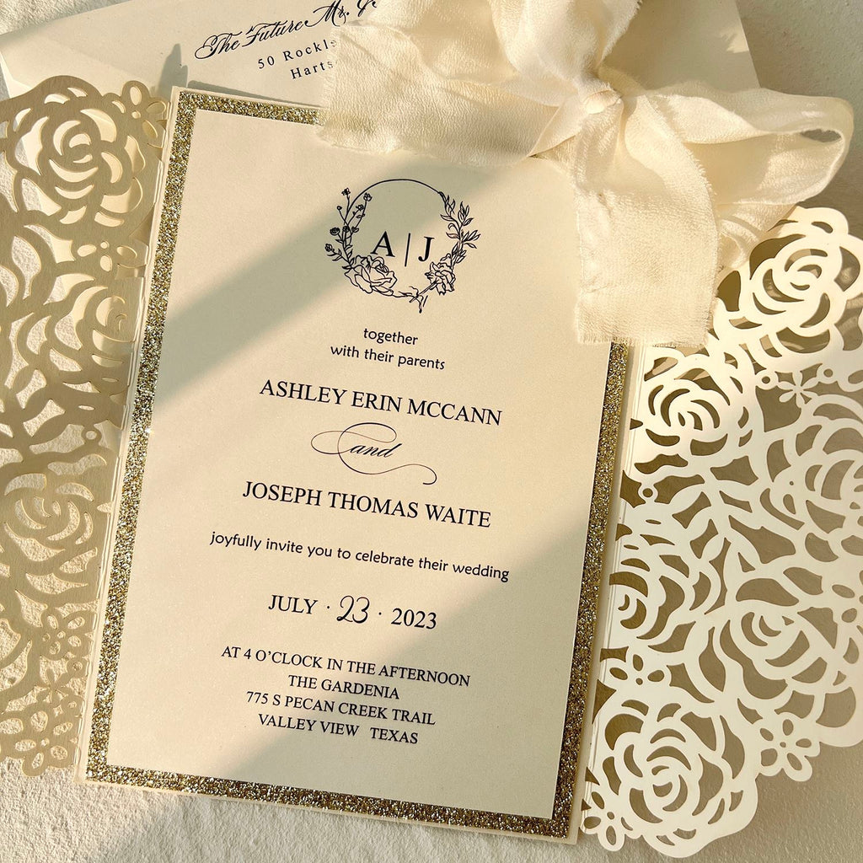
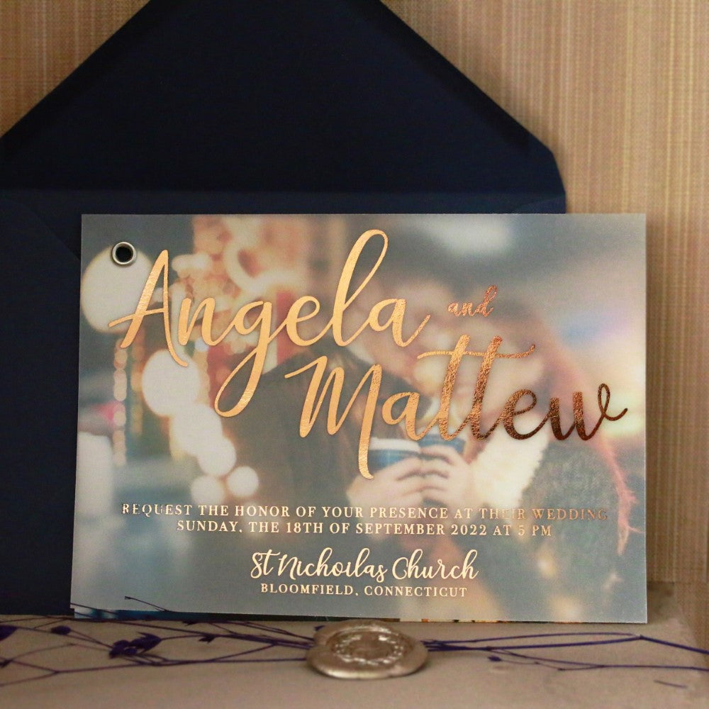
Inspiration

Slide 5


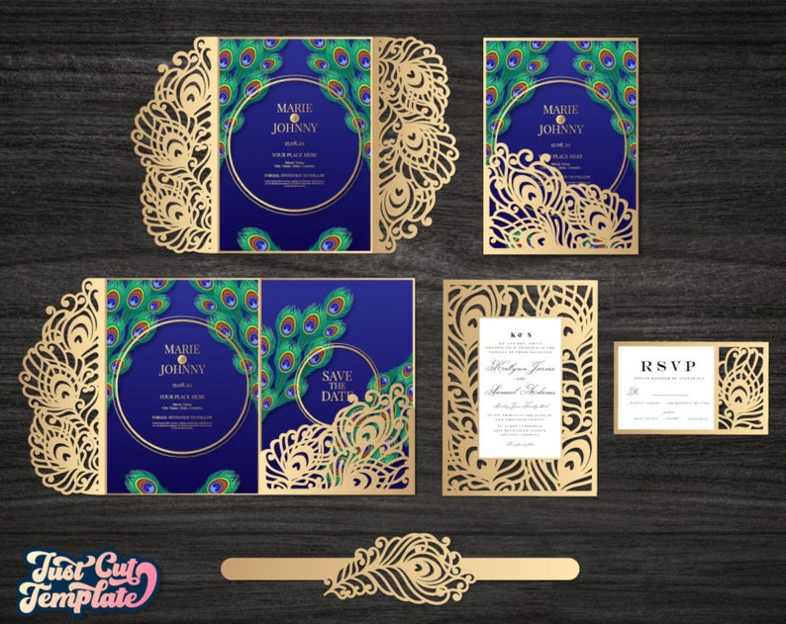
Inspiration
Either of these foil feather pockets are integrated into the design, we’ll purchase and make the pieces ourselves

Slide 6
Ceremony invitation
Mr. & Mrs. Gene Goenner
Dr. and Mrs. Dirk Van Herzele
Request the pleasure of your company
at the marriage of their children
Abigail Marie Goenner
and
William Anton Christian Arnold Van Herzele
Saturday, the twenty-third of August
Two thousand twenty-five
At one o'clock
St. Elisabeth Church
Begijnhofdries 28
9000, Gent Belgium
~Dress formal~

Slide 7
Reception
Following the ceremony please join us for dinner and dance at
Heilig Hart Brouwerij
Brusselsesteenweg 85A, Wetteren
Cocktail starts at 5 with dinner at 1830
Dance to follow
Notes:
Reception Front = Back is image of us?

Slide 8
RSVP by 27 September
Please mail back or respond online at
www.AWVanHerzele.xx.com
____ Happily Accepts | Sadly Declines ____
Or mail back to (Address)
QR code
Notes:
RSVP Front & Back

Slide 9

You are invited!
Join us for a US BBQ Wedding Reception celebrating the marriage of Abigail Goenner and William Van Herzele.
Event Details
Date: Saturday, September 20th, 2025
Time: 11:00 AM – 4:00 PM
Location: Carpenter Nature Center, Wisconsin Campus
279 South Cove Road, Hudson, WI 54016
Dress Code: Casual, like you would for a family reunion!
RSVP: Visit [link] or scan
the QR code by
[RSVP Deadline].
We can’t wait to celebrate with you!
Abigail & William
Address
QR
Notes:
Reception Back

Slide 10
We have blocked rooms at two hotels for our guests:
Gent
*x minute walk from ceremony
Wetteren
Hotel Otus
Oosterzelesteenweg 2-4
*4 minute walk from reception
Notes:
Reception Back

Slide 11

August 23rd 2025
date
the
Save

Slide 12
Mr. and Mrs. Gene Goenner
Request the honor of your presence at the marriage of their daughter
Abigail Marie Goenner
to
William Anton Christian Arnold
Van Herzele
son of Dr. and Mrs. Dirk Van Herzele
Saturday, 23rd of August, 2025
One thirty in the afternoon
xxx
Ghent, Belgium
Reception to follow
Heilig Hart Bruierij
Wettern, Belgium
Formal attire

Slide 13
Mr. & Mrs.
Dr. and Mrs. Yuval Brash
Request the pleasure of your company
at the marriage of their children
Samantha Maxx
and
Andrew Isaac
Saturday, the twenty-first of May
Two thousand twenty-two
At half after six o'clock
Old Westbury Golf and Country Club
Old Westbury, New York
Black tie

Slide 14
Together with their families
Kristin
Michelle Sills
and
Wyatt
Alexander Littles
Request the pleasure of your company at their wedding celebration
Friday, the fifth of November
Two thousand twenty one
at four o'clock in the evening
The Olana
1851 Turbeville Road / Hickory Creek, Texas
Adult reception to follow
Dress formal

Slide 15
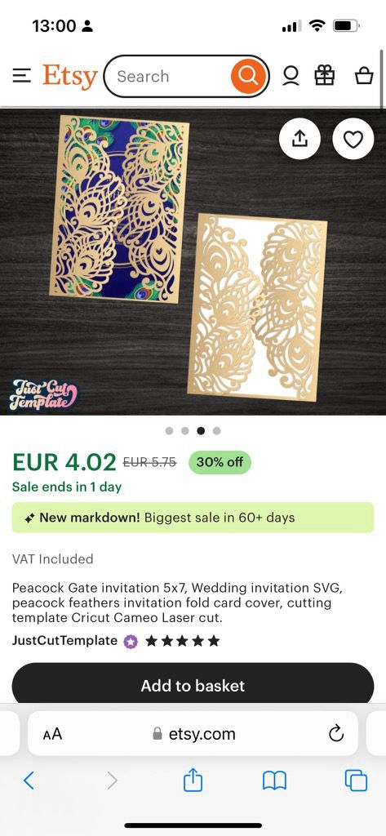


Notes:
RSVP Front & Back

Slide 16
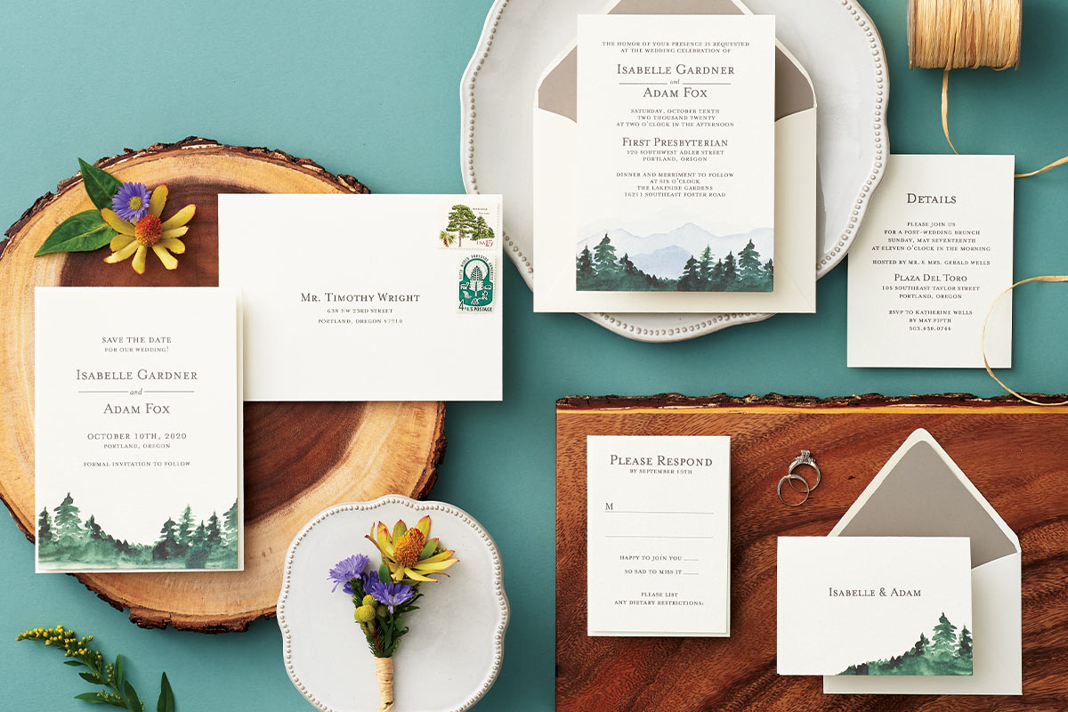
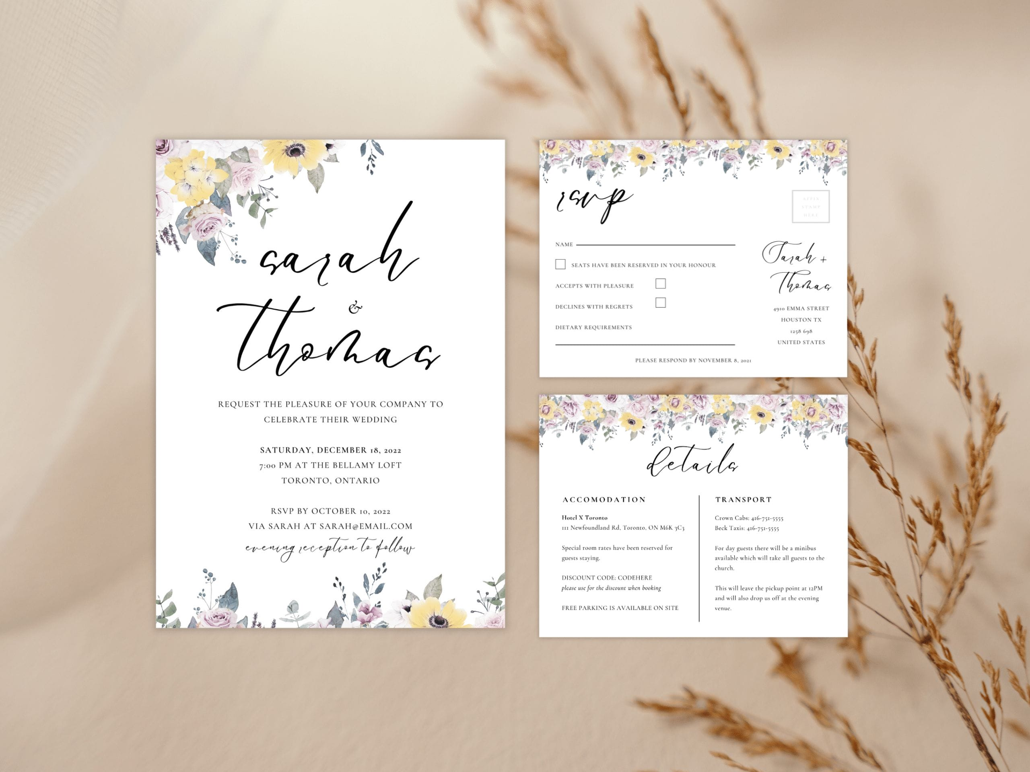
Notes:
RSVP Front & Back

Slide 17
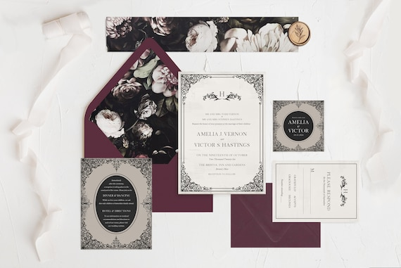

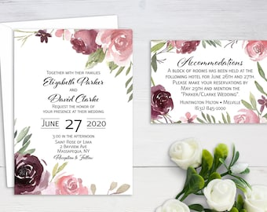

Slide 18
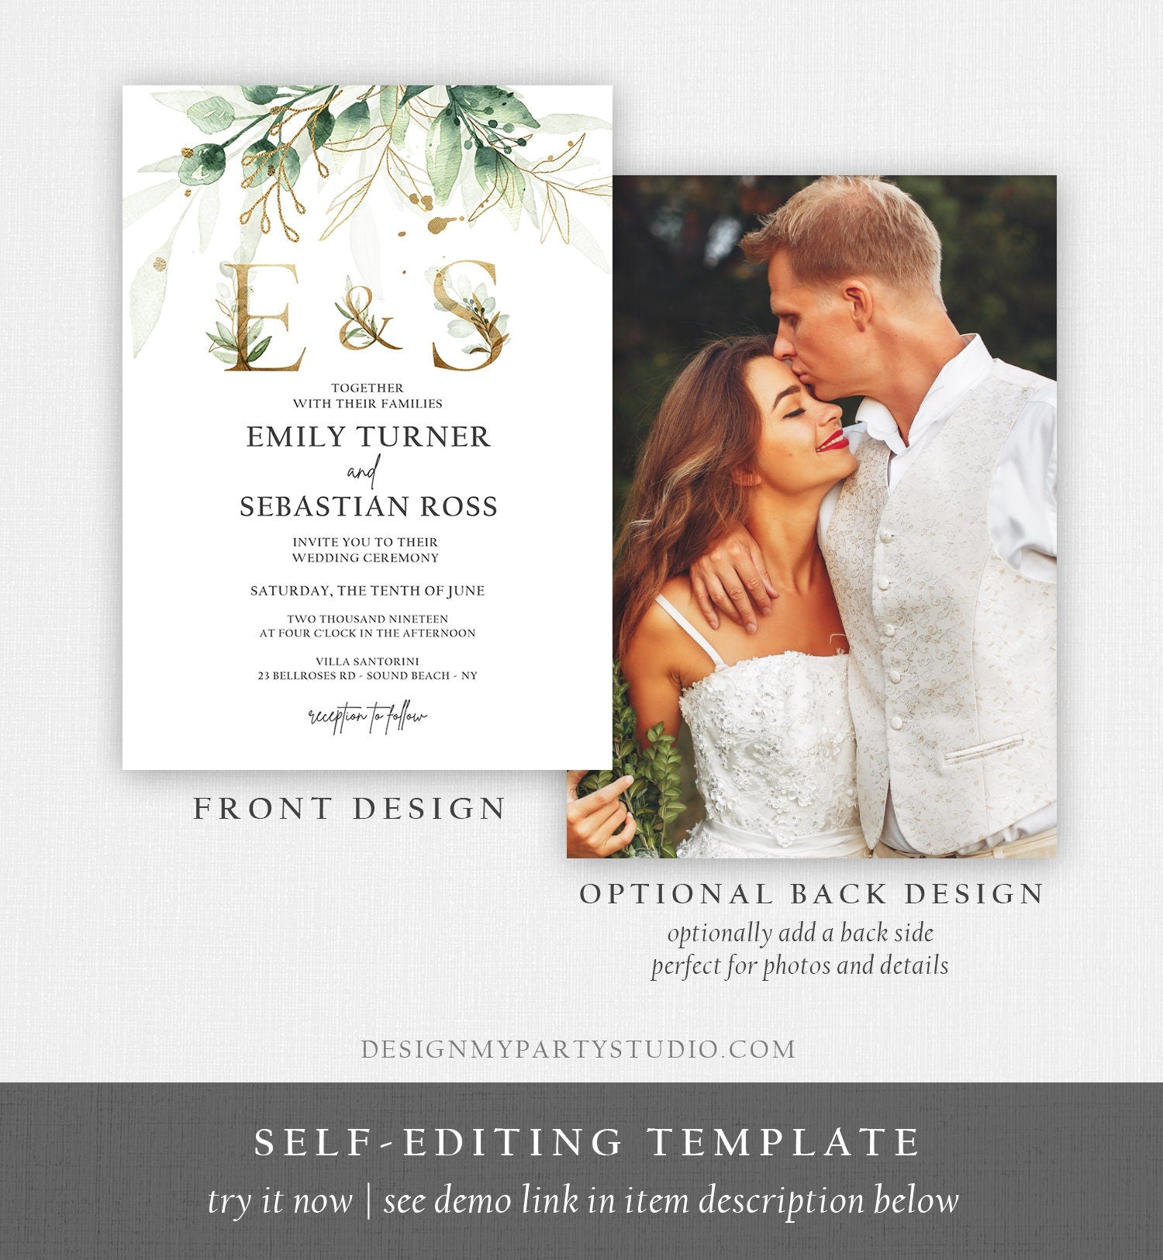
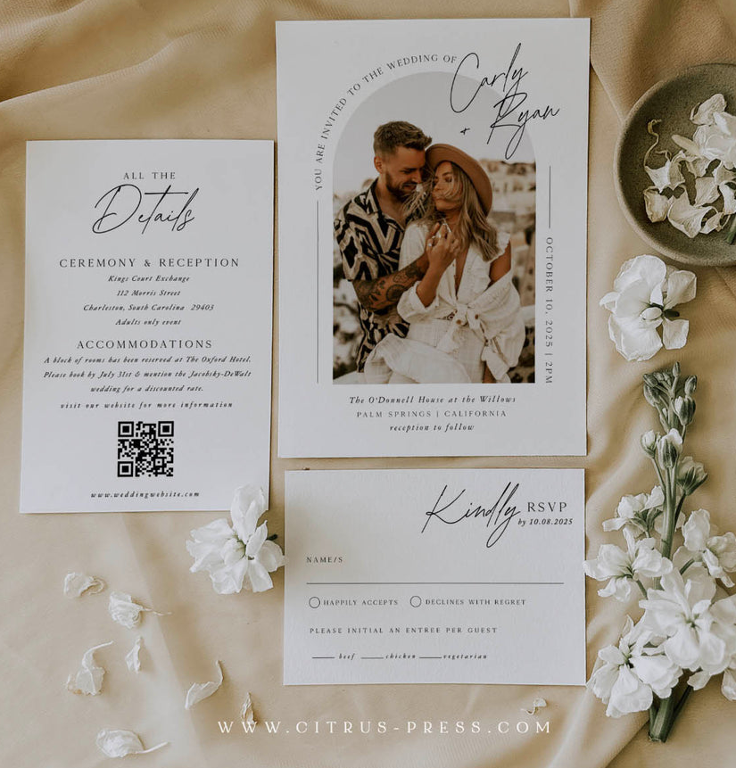

Slide 19
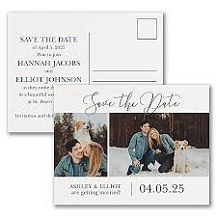


Slide 20
Print we need
Invitation Suite
Ceremony invitation
Reception invitation
RSVP card? (and return envelope?)
US Reception Postcard
Accommodation and further contact (link) ?
Stationary
Additional Wedding Printing
‘Bulletins’ ?
Menu cards ?
Name card ?
Thank yous
Post wedding announcement

