Slide 1
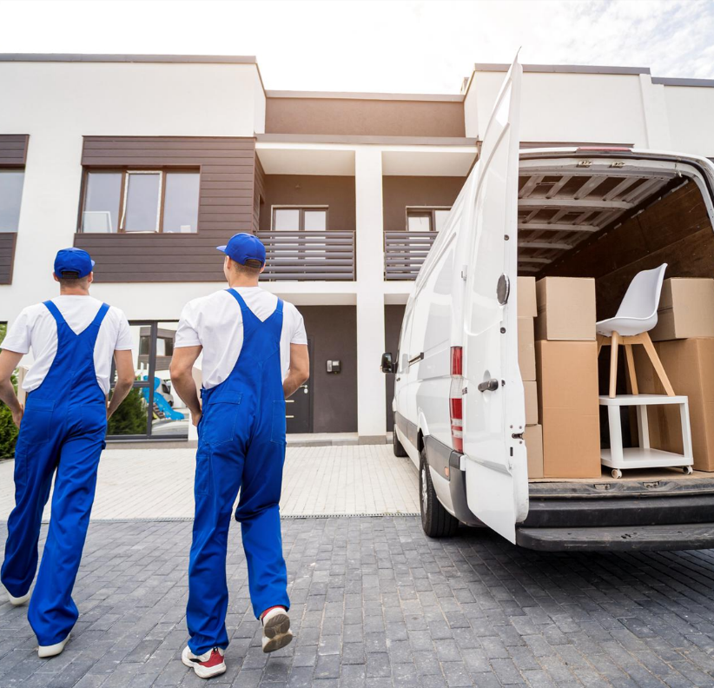



MOVING
FOR THE NEXT
GENERATION

Slide 2




$1.9M
$5
Revenue
Successfully
Raised
To Build
Appraised
Tech Stack
REVOLUTIONIZING
THE MOVING
INDUSTRY WITH AI
NexMuv is transforming the $90-100B moving industry by leveraging AI, GPS, and automated compliance to deliver the first instant guaranteed pricing platform. We’re cutting out inefficiencies and middlemen to improve costs and service quality.
PROVEN MODEL
$500K
B21
Additional
Raise
To Prove
Successful
Model

Slide 3


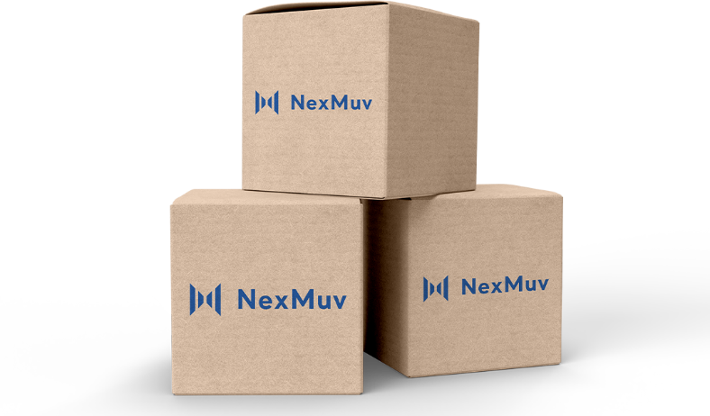

MARKET STRATEGY
REVOLUTIONIZING
Focus on B2I (local movers) first to reach $10M EBITDA within 24 months, leading to a $150M valuation.
Expand into B2B and B2C markets with a $50M Series B for full-scale growth.
THE MOVING
INDUSTRY WITH AI
NexMuv is uniquely positioned to disrupt the market with
AI-powered pricing, automated compliance, and proven scalability in B2I—poised to expand into B2B and B2C
VALUATION TARGETS
B2I (10% of local movers)
$600M valuation
B2B (2.5% of Fortune 1000)
$100M valuation
B2C (1% B2C market)
$1.8B valuation

Slide 4




TRIPLE
MARGINING
THE PROBLEM
Van lines, agents, and brokers each take a cut, leaving frontline movers underpaid and service quality compromised.
INEFFICIENCIES IN
THE MOVING INDUSTRY
The moving industry is plagued by middlemen van lines, brokers, and agents—who drive up costs by 15-40% without adding value. These layers result in inflated prices and poor service quality for consumers.
LACK OF
ACCOUNTABILITY
Service failures, missed deadlines,
and damaged goods are common
due to poor communication between middlemen. The customer needs a clear party to hold accountable.

Slide 5




CUTTING OUT
MIDDLEMEN
AI-DRIVEN INSTANT
PRICING
NexMuv directly connects customers with local movers, eliminating van lines, brokers, and agents. This streamlines the process and ensures transparent, fair pricing.
NexMuv offers the industry’s only instant, guaranteed pricing using AI, GPS, and key moving variables.
THE SOLUTION
NEXMUV’S
AI-POWERED
PLATFORM
AUTOMATED
COMPLIANCE
REAL-TIME CAPACITY
MATCHING
Fully automates interstate regulatory compliance, reducing legal risks for all movers in the supply chain.
The platform optimizes truck capacity by matching real-time availability with customer move requests, improving operational efficiency.

Slide 6

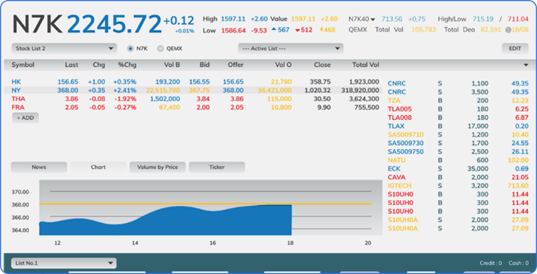
THE OPPORTUNITY
XXX
TARGETING B2I
XXX
Estimated
Gross Profit
$XXX
LOCAL MOVERS
moves/year from new B2I customers
Projected EBITDA over next 24 months
WHY B2I FIRST?
B2I (local movers) represents the most immediate and scalable opportunity for NexMuv. The software’s AI-driven pricing and capacity optimization allow local movers to keep their trucks busy and maximize revenue.
We’ve proven the B2I model… by adding one new B2I customer per week, each averaging four moves a month or 72 moves per year. This provides consistent, recurring revenue for NexMuv.

Slide 7


CORPORATE RELOCATION
XXX
Annual Moves from B2B moves/year from secured corporate contracts
EXPANDING INTO B2B
CORPORATE RELOCATION
PARTNERSHIPS
$XXX
$XXX
After proving the B2I model, NexMuv will concurrently expand into B2B, focusing on corporate relocation services for Fortune 1000 companies. This segment provides high-margin opportunities and long-term contracts.
Estimated Gross
Profit
Projected EBITDA over the next 24 months

Slide 8



B2C STRATEGY
ATTACKING B2C
CONSUMER MOVING
MARKET
With the foundation of B2I and B2B, NexMuv will
enter the B2C market with a large-scale acquisition strategy requiring significant branding & credibility investment, similar to Carvana.
Customer Acquisition Cost
Estimated high 4-figures to
low 5-figures.
Annual Moves from B2C
XXX moves/year.
Gross Profit
Estimated $XXX.
EBITDA
Projected $XXX over
the next 36 months.

Slide 9


VALUATION GROWTH
FINANCIAL
PROJECTIONS
(B2I, B2B, B2C)
B2I Valuation
Growth
Targeting 10% of local
movers, leading to a
$600M valuation
B2I Valuation
Growth
Targeting 2.5% of local
Fortune 1000, resulting
in a $100M valuation
B2I Valuation
Growth
NexMuv valuation
reached $1.8B

Slide 10



TRACTION
Proven B2I Model
Consistent customer acquisition with one new B2I customer per week
WHAT WE’VE
ACHIEVED
SO FAR
Tech Stack Built and
Appraised at $5M
NexMuv’s tech stack is already appraised at $5M, proving our innovation is ready for market
$500K Supplemental
Raised
Successfully raised to prove the B2I model, demonstrating scalable revenue generation
Team Restructuring
Brought in a Best-in-Class management team of industry veterans to lead NexMuv into its next growth phase.
$1.9M Seed Raised
Used to build the platform and conduct early market tests

Slide 11
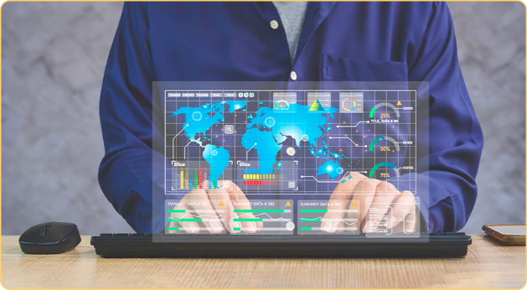



USE OF FUNDS
ROUND A
ROUND A FOCUS
Invest heavily into B2I (primarily) and B2B
(secondarily)to reach $10M EBITDA within 24 months.
USE OF PROCEEDS
Technology Development: Enhance AI capabilities for pricing and capacity matching.
Sales & Marketing: Accelerate customer acquisition for B2I and B2B.
Team Expansion: Recruit key talent to drive operational growth.

Slide 12


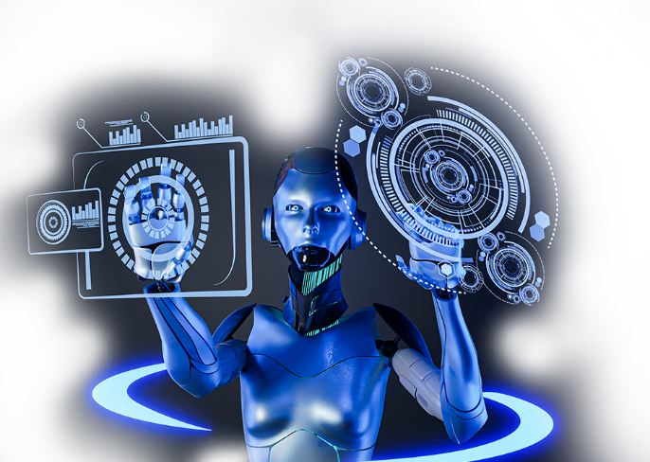
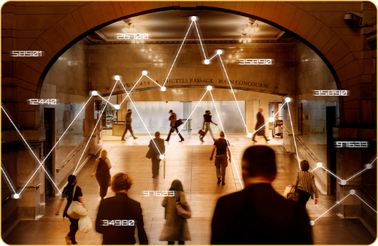
The Only AI-Driven Instant Pricing Platform
No competitor in the moving industry offers instant, guaranteed pricing powered by AI.
Massive Market Opportunity
With a total addressable market cap
of **$2.5B+
WHY NEXMUV?
THE FUTURE
OF MOVING

Slide 13



THE IMPACT
LESS PAY FOR
FRONTLINE MOVERS
Inflated margins leave less money for actual movers doing the hard work.
TERRIBLE TALENT
ATTRACTED
Low pay discourages skilled labor, attracting inexperienced or unmotivated workers.
ON FRONTLINE
WORKERS &
THE INDUSTRY
LOWER QUALITY
SERVICE
Subcontractors are often
the lowest bidder, leading
to rushed moves and damaged items.
THE REAL COST
DETERIORATING TALENT
& SERVICE QUALITY.
NO ACCOUNTABILITY
Van lines, agents, and brokers deflect responsibility for issues, frustrating the customer.

Slide 14



THE FUTURE OF
MOVING

Slide 15


NEXMUV
THE FUTURE
OF MOVING
CUTTING OUT MIDDLEMEN
NexMuv's direct-to-consumer
model eliminates van lines, agents,
& brokers. Customers connect directly
with professional movers, reducing
layers of markup and ensuring clarity.

Slide 16


GUARANTEED, TRANSPARENT PRICING
NexMuv's AI-driven platform instantly provides guaranteed pricing without middleman markups. No surprises, hidden fees, or upselling. Prices are determined upfront based on exact needs, ensuring transparency.
INNOVATIVE, AI-DRIVEN SYSTEM
The NexMuv system learns from every move. It uses data-driven insights and machine learning to predict the exact requirements for each move, making it more intelligent and accurate over time. This leads to optimized service & pricing, fewer delays, and a smoother
customer experience.

Slide 17

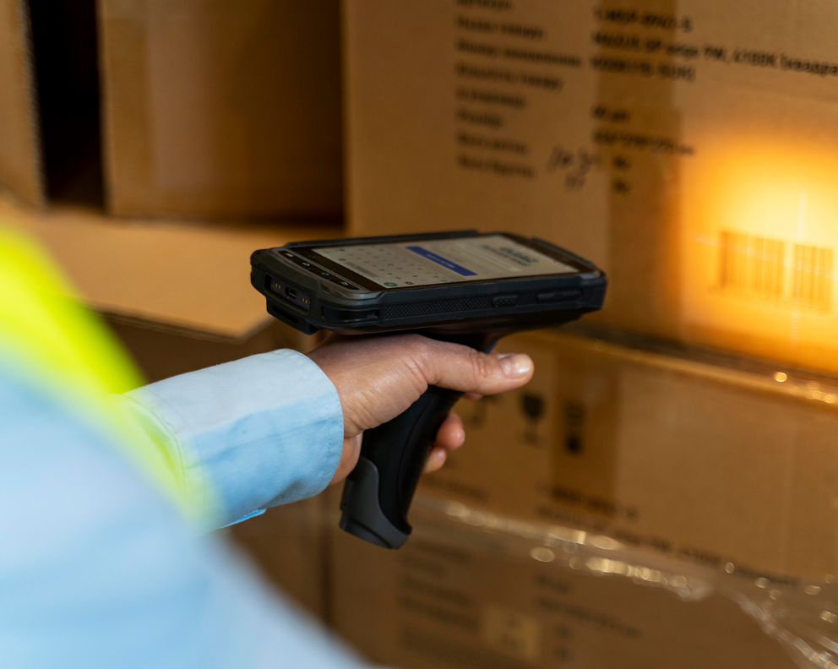
BETTER PAY FOR MOVERS = BETTER TALENT
By eliminating the unnecessary middlemen,
more money stays with the people doing the work—the movers. This higher pay attracts
skilled, motivated professionals who provide higher-quality service and improve the
industry's reputation.
HUB AND SPOKE MODEL FOR EFFICIENCY AND QUALITY
NexMuv operates on a hub-and-spoke model, efficiently routing moves and keeping trucks in local markets. This maximizes profits for movers and ensures faster, more flexible service for customers, particularly in markets with high
lead volumes.

Slide 18


B2I, B2B, AND B2C CUSTOMIZATION
NexMuv tailors its platform to handle the
unique needs of local movers (B2I), corporate relocation clients (B2B), and consumers (B2C). The platform helps movers manage leads,
close deals, and optimize schedules while keeping their operations local and
maximizing efficiency.
SCALABLE FOR GROWTH
NexMuv can scale its technology across local markets and long-distance relocations as a licensed forwarder. It combines automation and human touch for a seamless customer experience. The platform is poised for growth as more movers realize the value of cutting out the middlemen.

Slide 19


AI CUSTOMIZED
VIDEO AND
INSTANT PRICING
NexMuv’s innovative approach includes sending personalized,
AI-driven videos to customers explaining their price breakdown and move process. This ensures transparency, clarity, and trust from the first interaction, something no traditional broker or van line offers.
This version comprehensively explains why NexMuv is the future of the moving industry, highlighting its direct model, AI-powered technology, better pay for movers, and efficiency through the hub-and-spoke model. It also tailors services for multiple client types (B2I, B2B, and B2C). It builds on all your insights and presents a forward-thinking solution.

