Slide 1
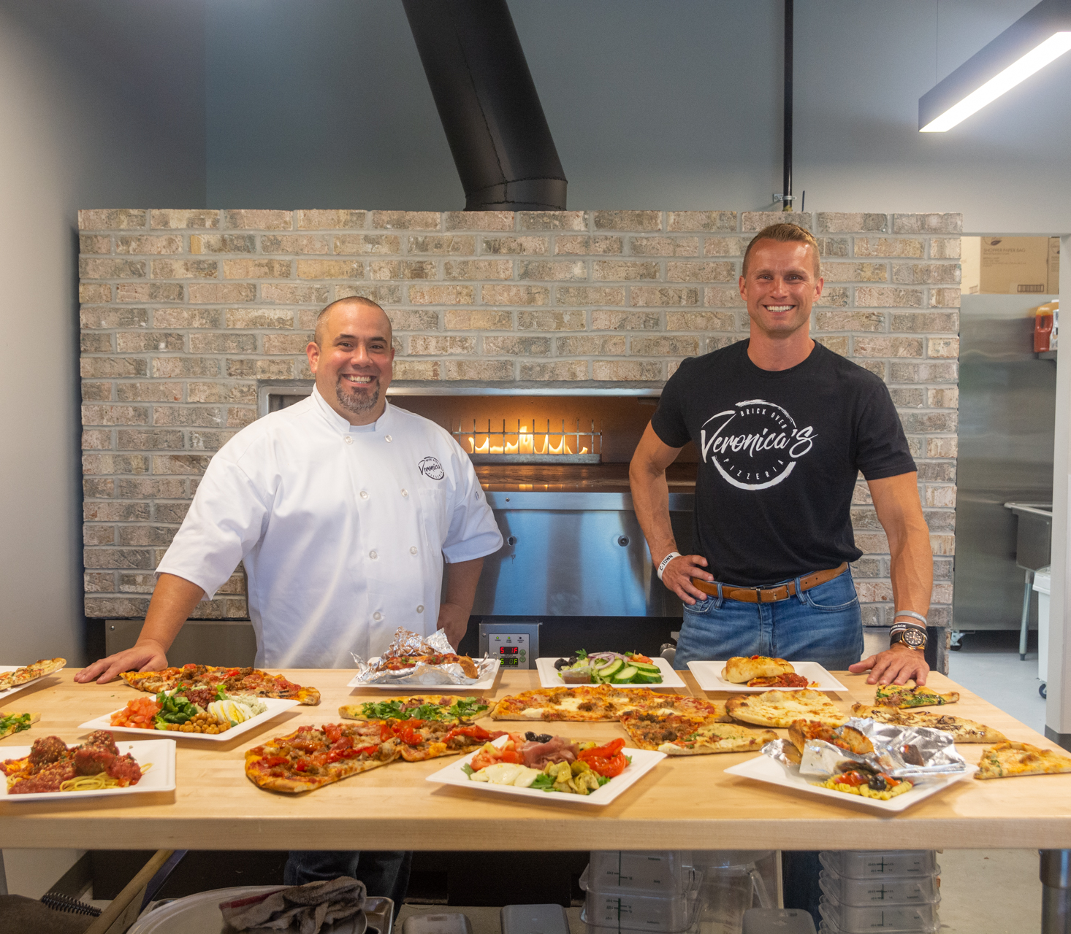
Veronica’s
Brick Oven
Pizzeria
FRANCHISING
Danny Medina
(Co-Owner)
Danny@veronicaspizzeria.com
Justin Derkack
(Co-Owner)
Justin@veronicaspizzeria.com

Slide 2
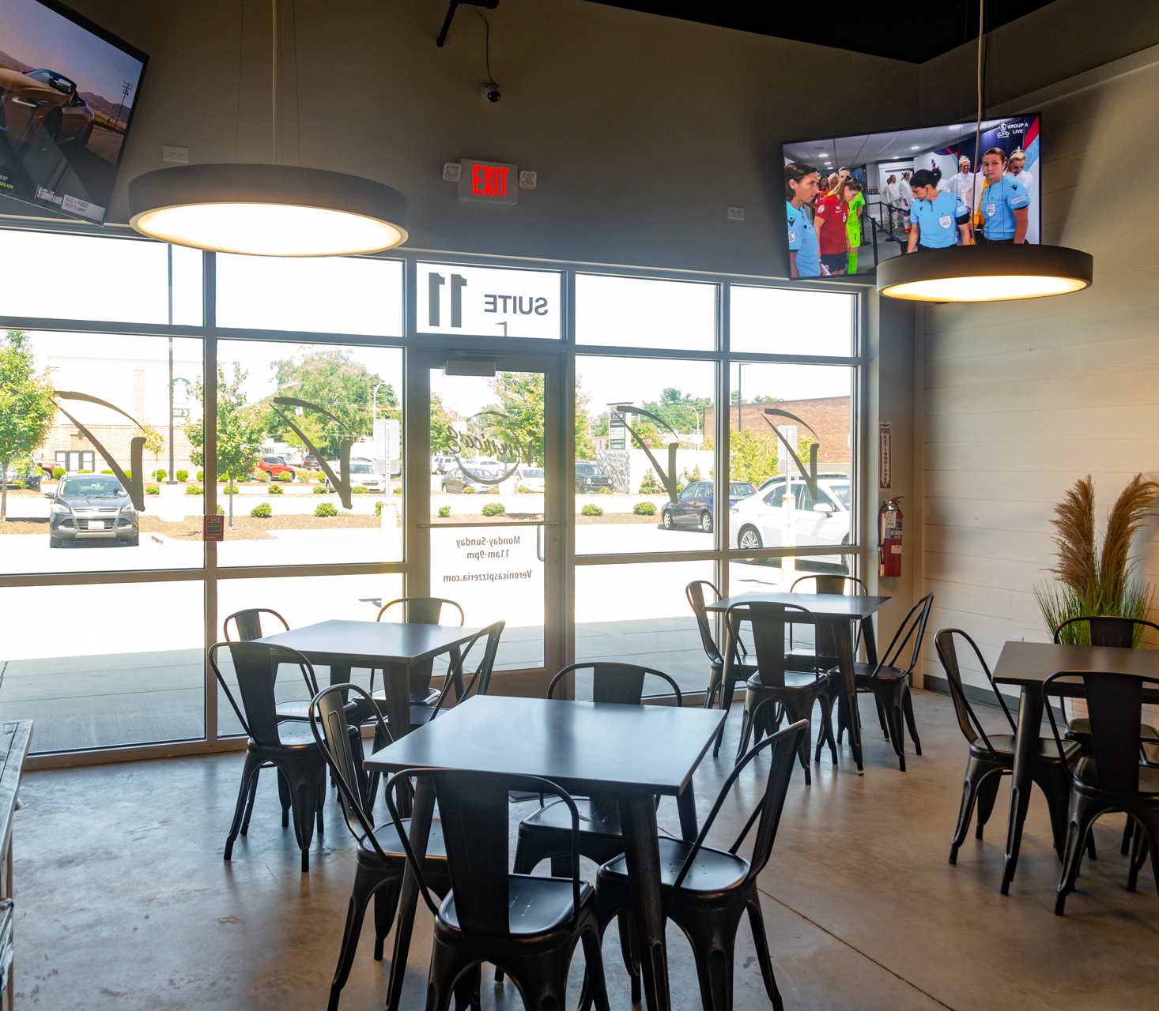
Introduction
In January 2022, Danny and Justin combined over 20 years of friendship and expertise to create Veronica's Brick Oven Pizzeria, a "Quality Casual" concept that delivers authentic, creative, and fresh food crafted with care and precision.
Named in honor of a beloved family member, Veronica's is built on the values she cherished—family, connection, and unforgettable memories. These principles are the heart of our brand, driving us to exceed expectations and create a welcoming experience for every customer.
Now, we’re sharing our dream with aspiring entrepreneurs who want to join a proven concept that values quality, community, and success. Be part of a growing legacy with Veronica’s Brick Oven Pizzeria!

Slide 3
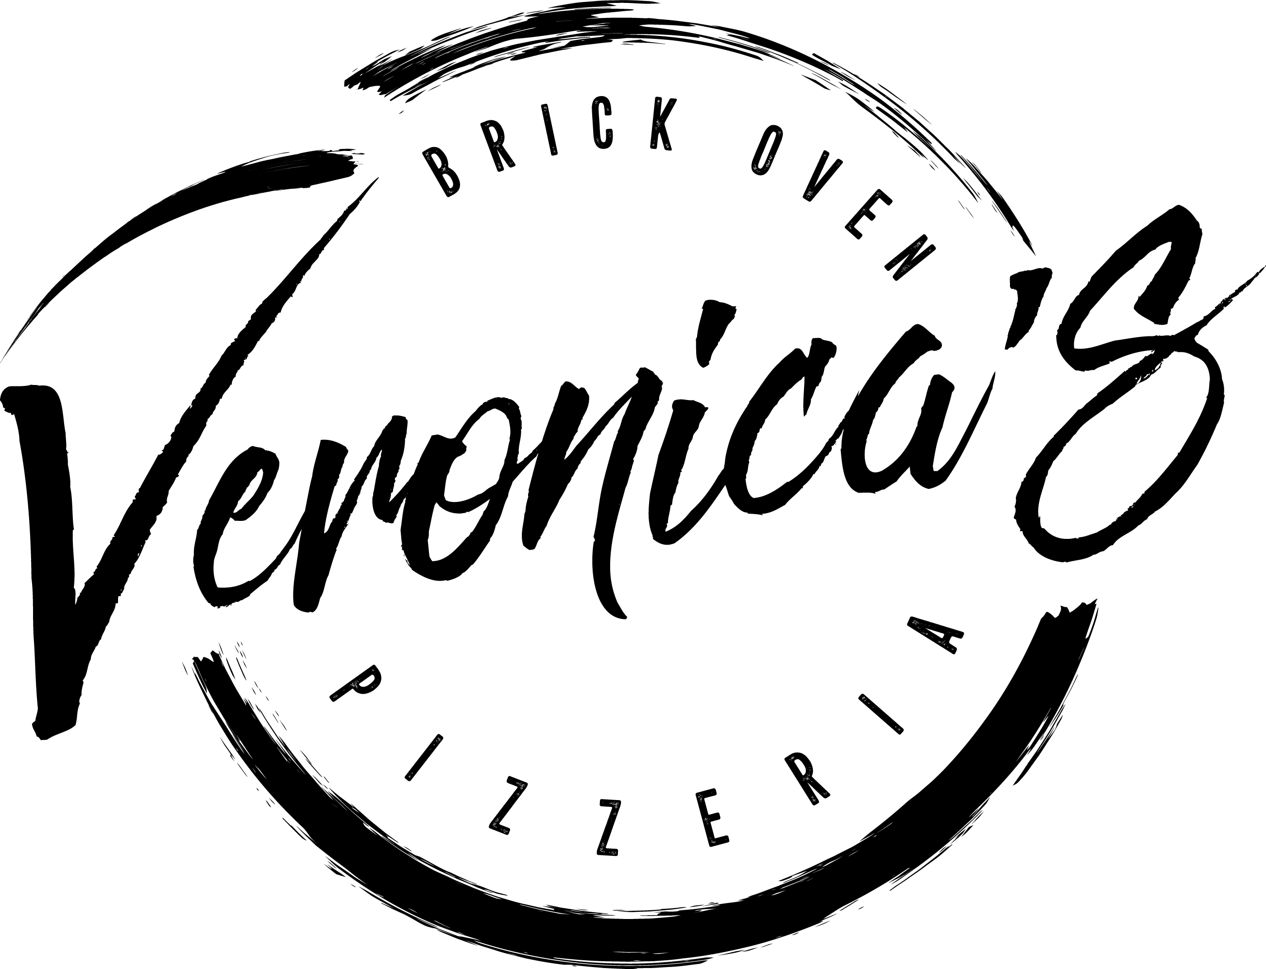
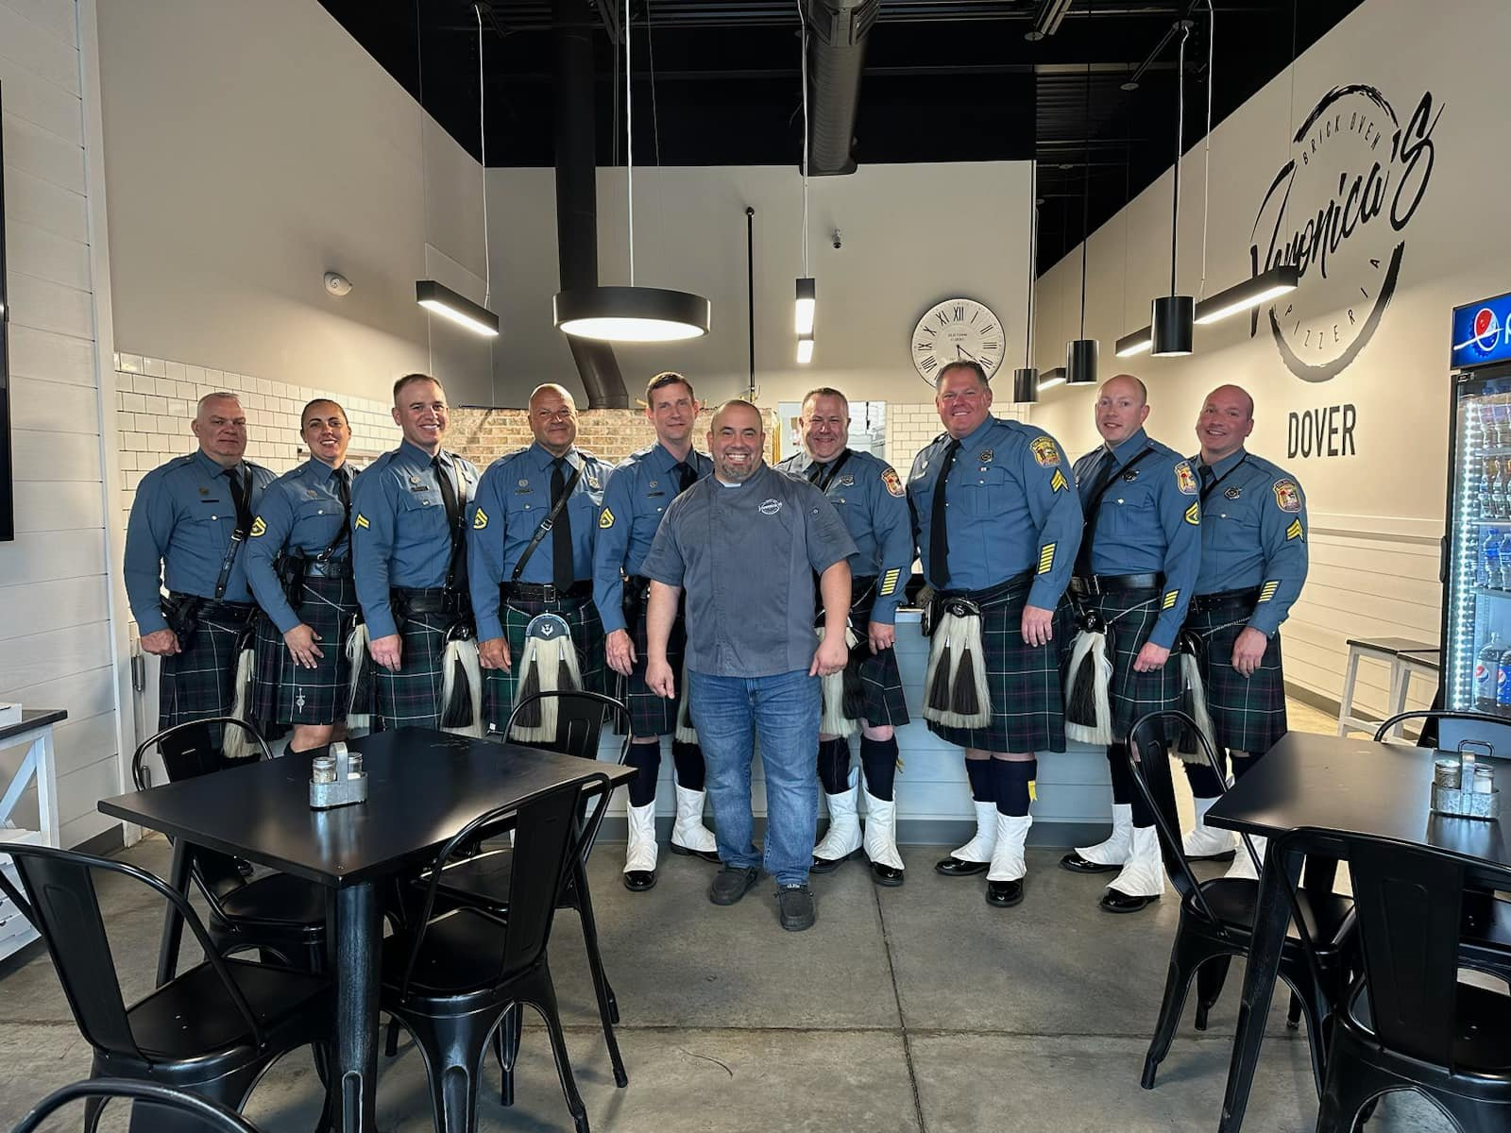
Our
Vision
To become the nation's premier franchise for exceptional pizza experiences, delivering consistent, high-quality food while showcasing our fresh ingredients, outstanding service, and community-focused atmosphere
Our
Mission
To empower entrepreneurs with a proven, high-quality pizzeria concept that delivers exceptional food, fosters community connections, and creates a warm, welcoming destination where guests return again and again.

Slide 4
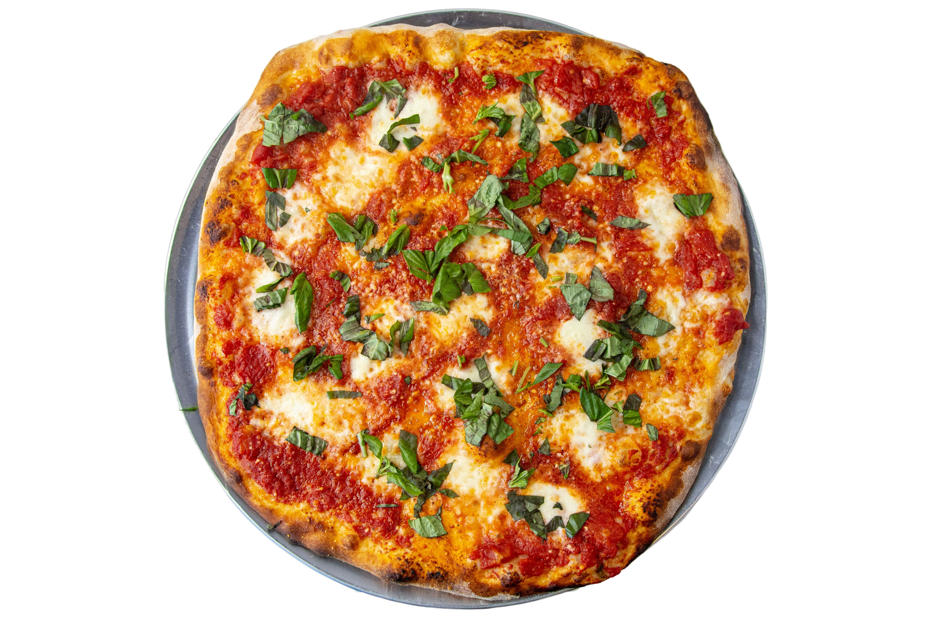
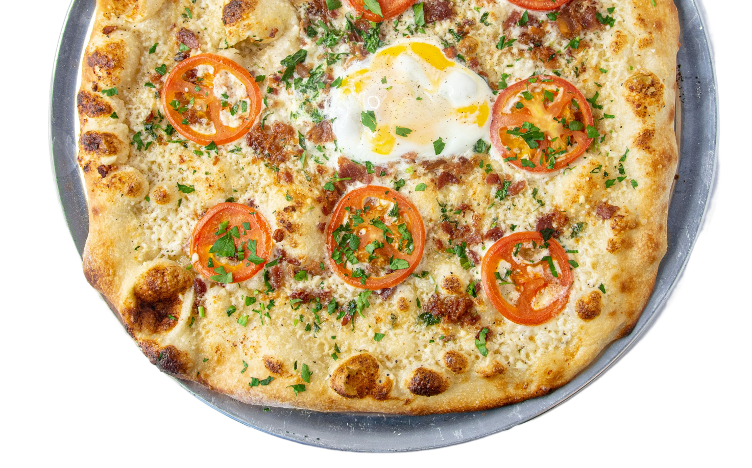

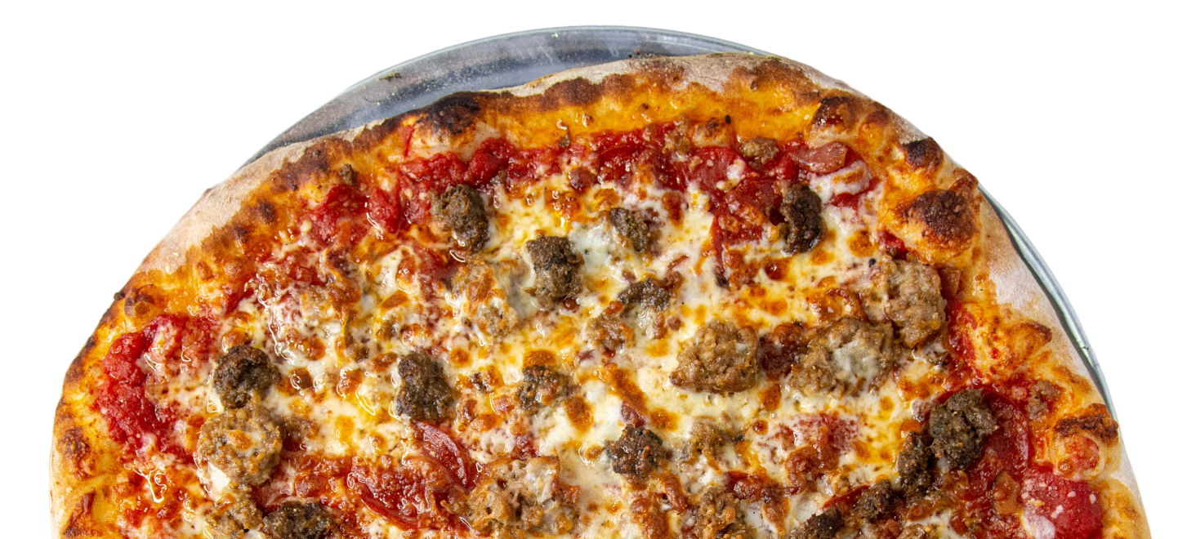
Unique Selling
Proposition
What Sets
Our Pizzeria Apart
Key Differentiators
and Competitive Advantages
At Veronica's Brick Oven Pizzeria, we offer a proven formula for success. Our carefully crafted proprietary recipes for homemade sauce and dough ensure exceptional product quality that keeps customers coming back. Our streamlined, small, and profitable menu guarantees consistency and lightning-fast food times, reducing operational complexity and maximizing efficiency.With our commitment to excellence and a "Quality Casual" concept, Veronica's is the ideal franchise opportunity for entrepreneurs looking to deliver outstanding food while running a scalable, customer-loved business.
At Veronica’s Brick Oven Pizzeria, we combine speed, quality, and convenience to create a seamless experience for both customers and franchise owners. Our ability to prepare any menu item in minutes ensures fast service without compromising on exceptional quality.With multiple ordering options—mobile ordering, delivery, takeout, and in-person dining—we meet the demands of today’s fast-paced lifestyles while maximizing revenue streams.For franchisees, our streamlined operations and proven systems make running a Veronica’s franchise efficient, scalable, and perfectly aligned with modern customer expectations.

Slide 5
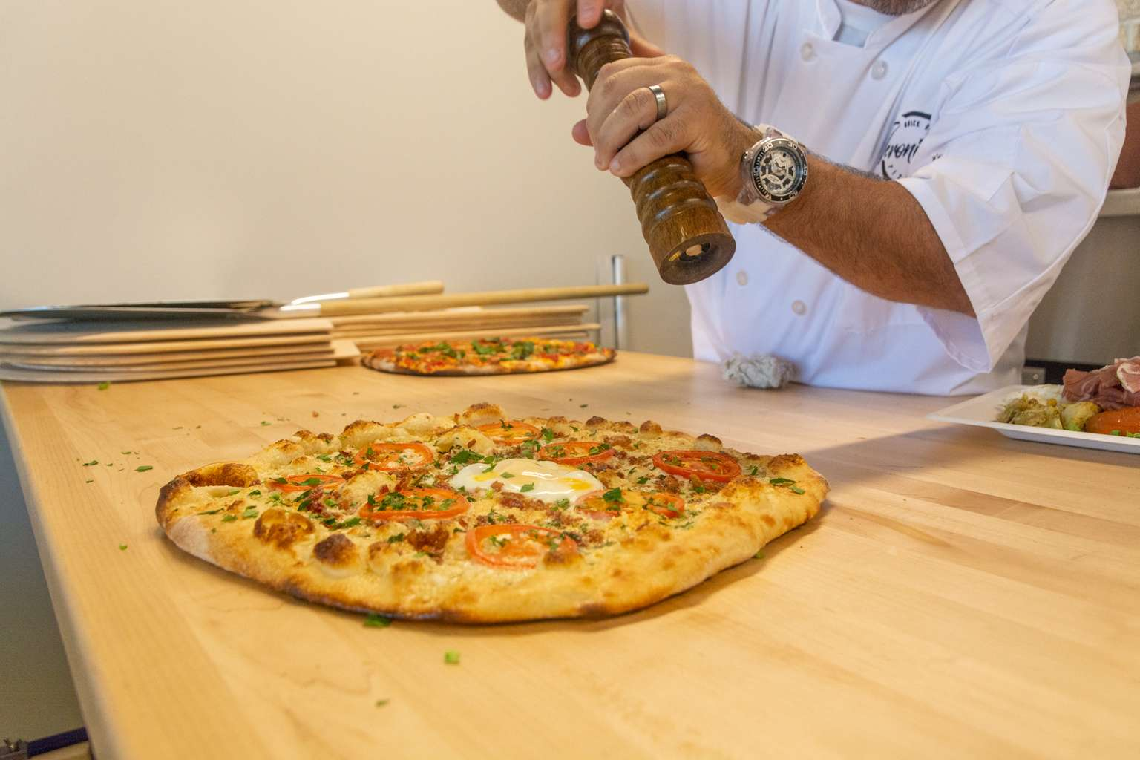
Business Model
Revenue Streams
Our revenue streams include take-out, dine-in, delivery,
and catering services. By offering multiple avenues for customers to enjoy our pizzas, we maximize revenue opportunities and cater to various preferences.
Pricing
Strategy and Menu Overview
We have meticulously priced our menu to ensure maximum profitability while delivering value to our customers. Our menu offers a carefully selected range of signature pies, including the Margy, Bart, and Classic pies, ensuring that each pizza is a delightful experience for our customers.
Operating Hours and Location(s)
Our pizzeria operates from 11 am to 9 pm, allowing us to cater to lunch and dinner crowds. Our flagship location is situated at 50 N. DuPont Highway, Building 1, Unit 11, Dover, DE 19901, providing a convenient and accessible location for customers.

Slide 6
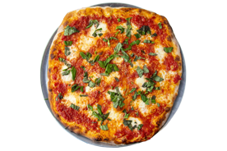
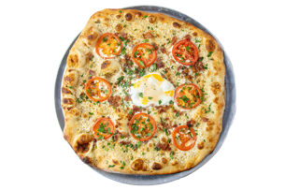
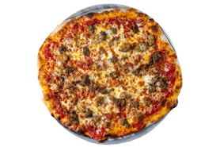
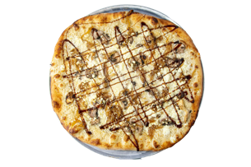
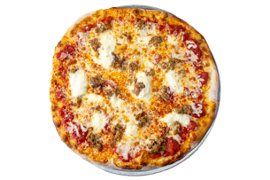
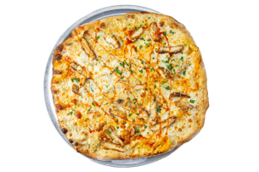
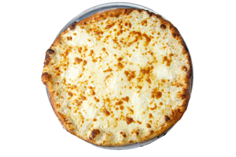
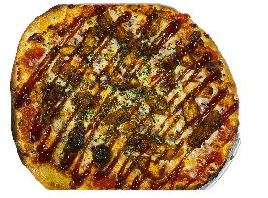
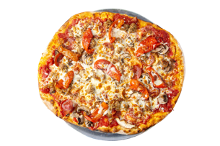
Our Signature Menu
“The Margy”
“The Merri”
“The Bart”
“The Nana”
“The Grey”
“The Wynn”
“The Maddie”
“The Uncle Sal”
“The Carmen”

Slide 7
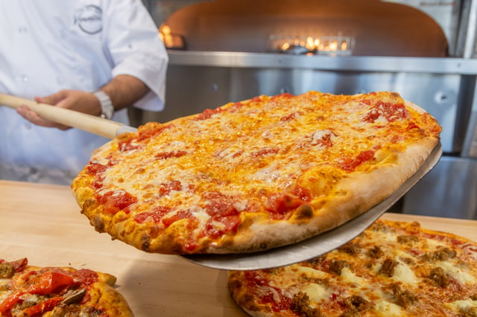
Our Signature Menu Item
“The Create Your Own”

Slide 8
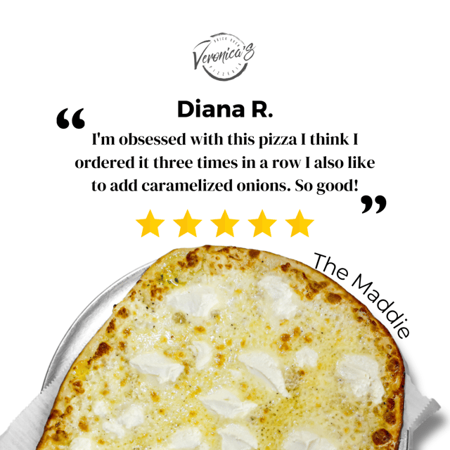
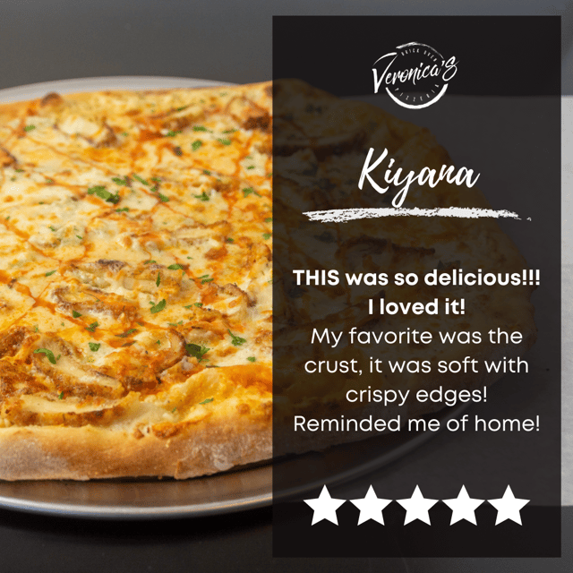
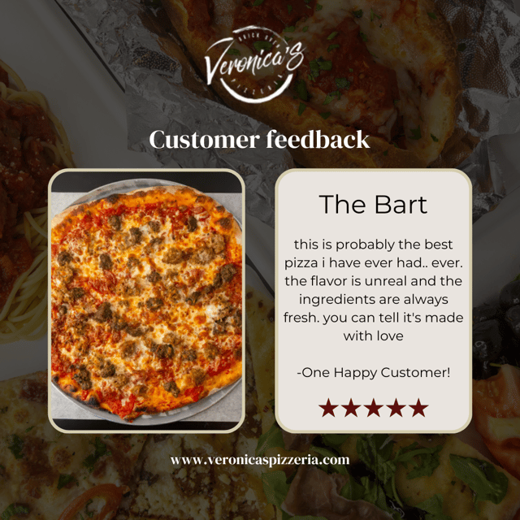
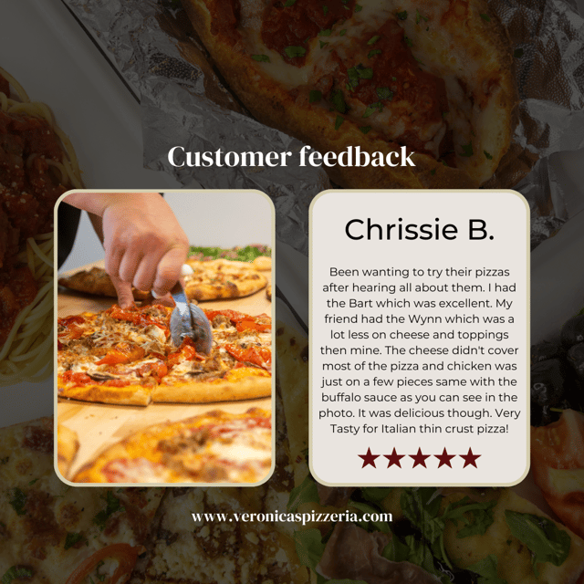
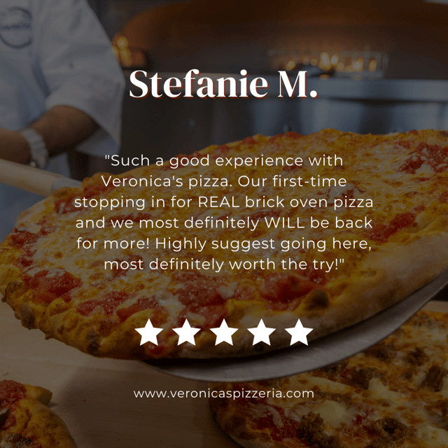
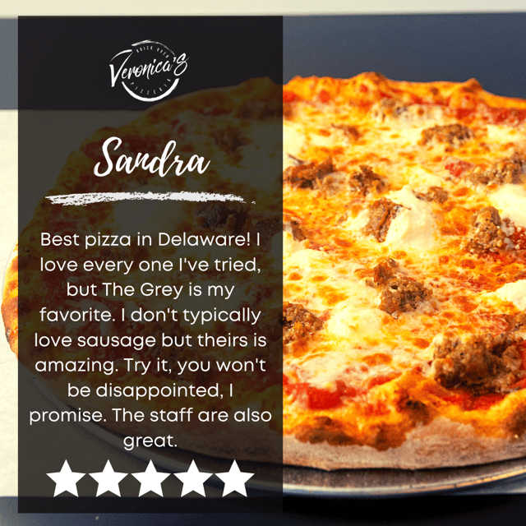
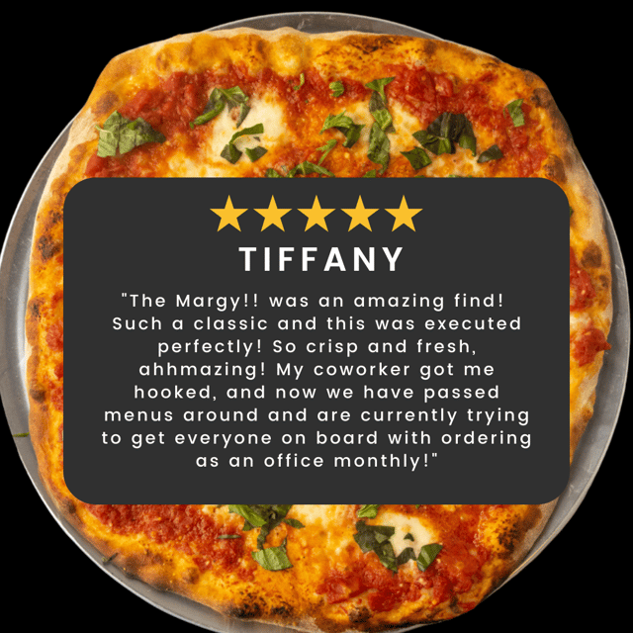
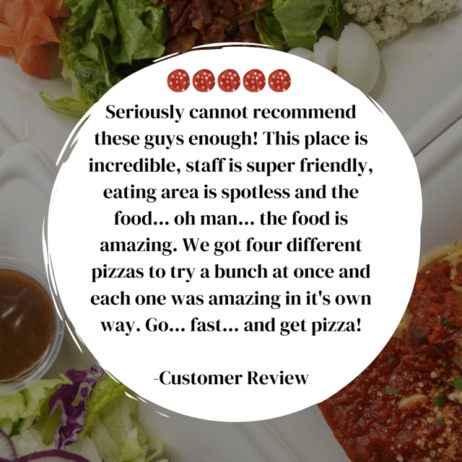
Reviews

Slide 9
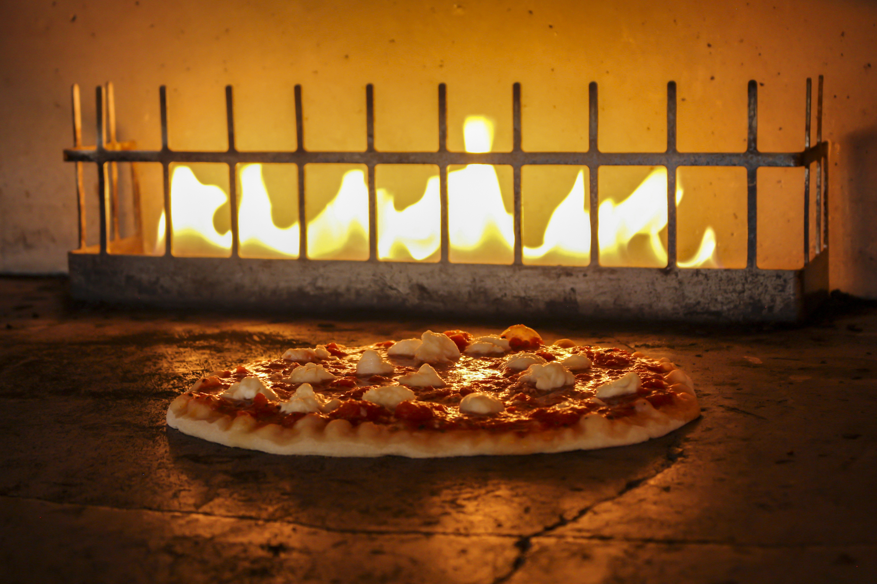
The Market Opportunity
Overview of
the Pizza Industry
The pizza industry is a thriving and highly popular segment of the food service market. With a diverse range of customers and a growing demand for convenient dining options, the pizza industry presents significant growth opportunities.
Market size and share revenue was valued at approximately $270.8 Billion in 2022 and is expected to reach $293.8 billion and its potential for growth remains strong. As we expand our presence, we tap into the market's appetite for quality pizza options and capitalize on the increasing trend of takeout and delivery services.
Market Size
and Growth Potential
Our target audience encompasses a wide range of individuals from 18 to 80 years old, both male and female, with a focus on the middle-class demographic. By offering a menu that
caters to diverse tastes and preferences,
we can attract a broad customer base.
Target Audience and Customer Demographics

Slide 10
4 Great Reasons to Join Us

Slide 11
Financial Projections
Profit Margins
Sales and Revenue Forecast
Our business model is designed to achieve industry-high profit margins of 15-18%. By carefully managing our cost structure, optimizing operational efficiencies, and leveraging economies of scale as we expand, we are confident in our ability to maintain healthy profit margins across all locations.
We project that an average Veronica's Brick Oven Pizzeria location in a high-traffic area can generate annual revenue between $900,000 and $1.8 million. Notably, even our second-year location in a lower-traffic area achieved $1.2 million in revenue for 2024
Franchise Expectations
Our goal is to grow Veronica's Brick Oven Pizzeria to 100 locations within the next 10 years. We've built a proven, profitable model by mastering every step of the process: from creating an iconic brand and developing proprietary recipes to streamlining operations, vendor partnerships, and systems. By replicating the success we've achieved, we are confident in our ability to deliver high standards, operational efficiency, and profitability across every franchise location. Veronica's is ready to partner with dedicated franchisees to bring our unique "Quality Casual" experience to communities nationwide.

Slide 12

Management Team
DANNY MEDINA
Danny Medina, with his extensive experience in the restaurant industry, will be instrumental in this expansion. Danny has managed over 120 employees at Jose Tejas, where he produced significant growth, increasing annual revenue from $4 million to $6 million. His successful management and partner roles at Viva Chicken Holdings, High Five Hospitality-Buffalo Wild Wings, Jose Tejas/Border Cafe, and Bertucci's Italian Restaurant demonstrate his ability to exceed revenue goals, develop high-performing teams, and focus on exceptional customer experiences. Danny is an exceptional leader and will be the driving force in managing and educating our franchise operators, ensuring the consistent quality and success of our brand.
JUSTIN DERKACK
Justin Derkack's entrepreneurial journey spans multiple industries, demonstrating his expertise in finance, operations, and strategic planning. As the current COO and Managing Partner at Med-X Global, which generates $50 million in annual sales, Justin has proven his ability to drive significant growth and manage large-scale operations. His dedication to excellence, community involvement, and strategic vision are vital in scaling Veronica's Pizzeria to multiple locations. Justin's leadership and experience make him an invaluable asset in creating a successful franchise model and ensuring the consistent quality and profitability of our brand.

Slide 13
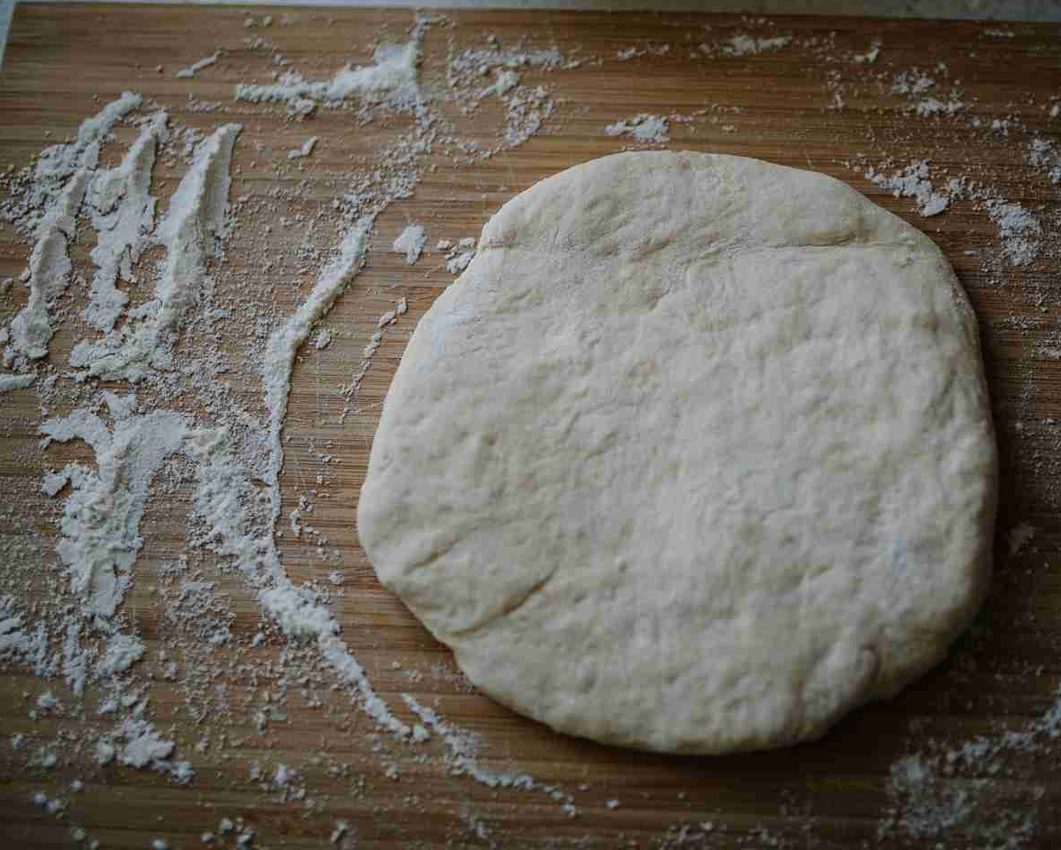
Thank You
Veronica's Brick Oven Pizzeria presents an exciting franchise opportunity in the thriving pizza industry. With our unique selling proposition, strong growth strategy, and experienced management team, we are well-positioned to expand.

