Slide 1
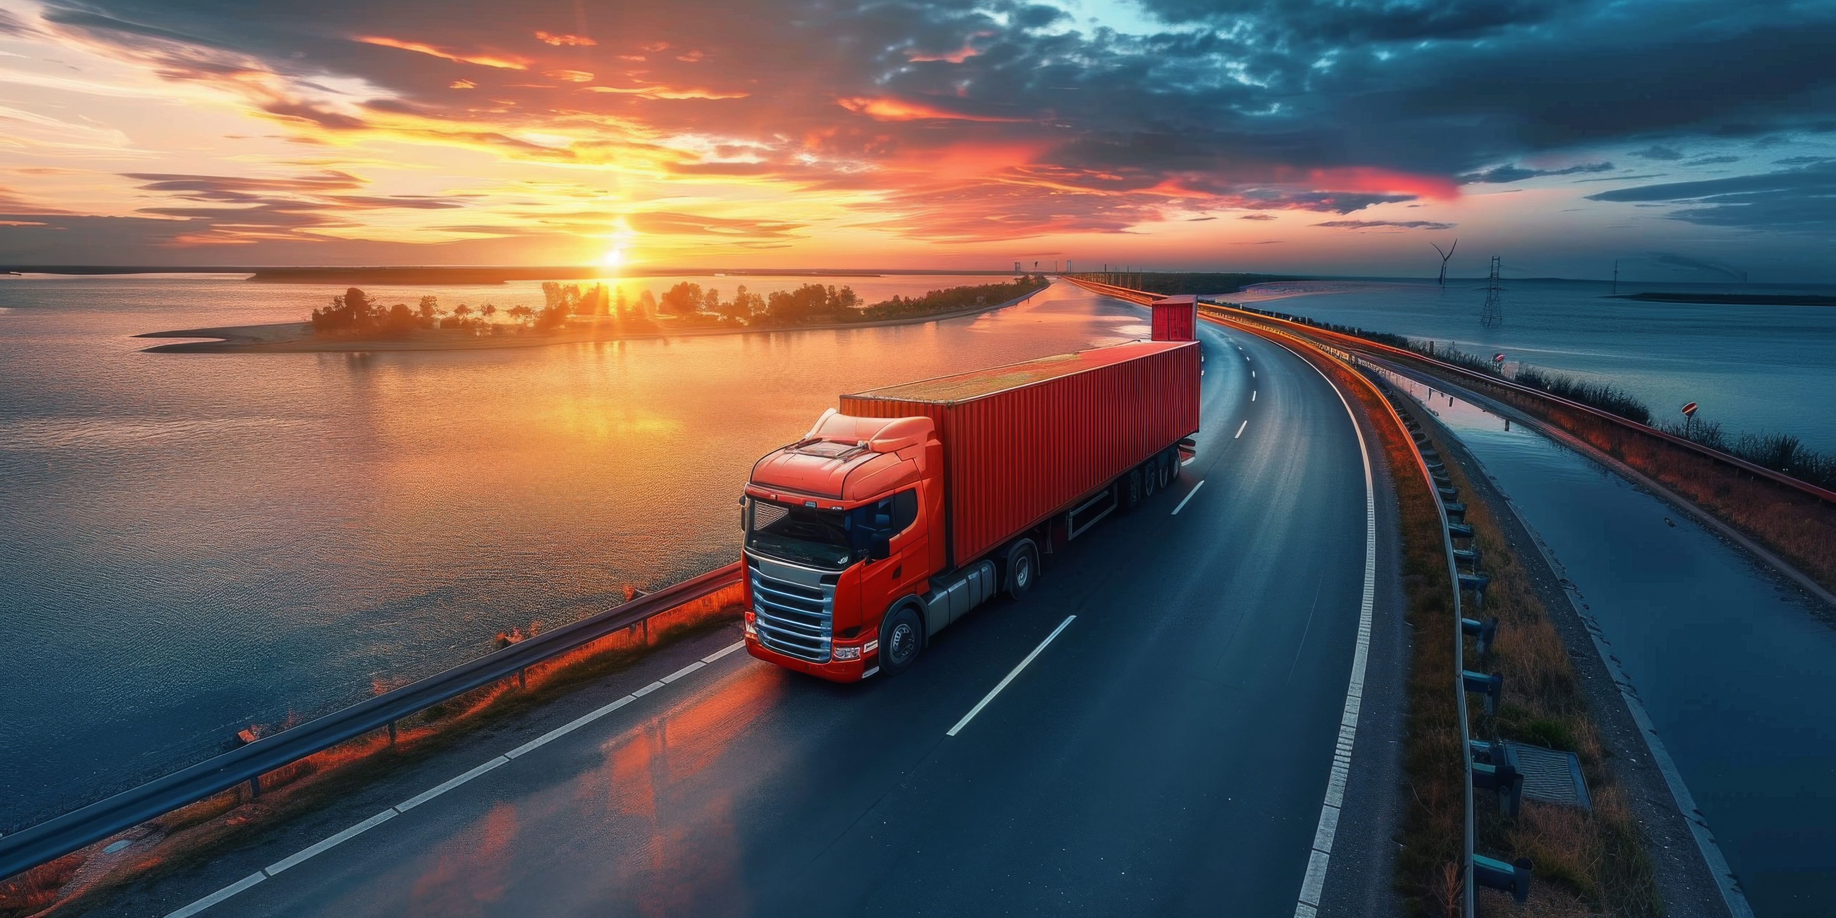
Logistics Redefined: Tailored Solutions for Your Business Needs
© TTL, 2024

Slide 2

VISION & PURPOSE
VISION
INNOVATION
PEOPLE
To be the leading provider of innovative and reliable logistics solutions, recognized for unwavering dedication to safety, reliability, and superior customer service.
We leverage cutting edge technologies to streamline supply chains and maximize value while keeping it simple – getting your product to the right place at the right time.
We are passionate about every job we undertake. You can count on our team to complete each task with integrity, dedication, and enthusiasm.

Slide 3
SAFETY EXPECTATIONS & COMPANY CULTURE
01
Stop Work Authority
Any employee has the right (and responsibility) to halt work if an unsafe condition is discovered
The health, safety and wellbeing of our employees, contractors, clients, and visitors is of prime importance to the success of our business.
We teach our employees from Day 1 that “nothing you do today is more important than going home to your family” and reinforce this by recognizing exemplary safety performance while demonstrating a culture focused on continuous improvement and direct, honest feedback.
We have worked safely without an OSHA recordable injury since 2013!
02
Fully Documented SOPs/EHS Processes
We train our employees rigorously and learn continuously
03
Secure Facilities
Fenced/gated access and surveillance; monthly inventory reporting
04
Continuous Improvement
Investigate all near misses, identify root causes and implement corrective action

Slide 4

EXCELLENCE IN ACTION
We have highly skilled personnel utilizing cutting-edge equipment and processes to load/unload, store, and transport your product safely and efficiently – no matter the location.
Our ERP software provides seamless planning and real-time tracking of your products – from source to destination – with full transparency at every step.
CURRENT VOLUMES
20,000 Tons
525+
Monthly Volume
Monthly Truckloads
40+
30,000 Tons
Monthly Railcars
Average in Storage

Slide 5
KEY DIFFERENTIATORS
Deep industry knowledge and expertise
High volume operation with sustained delivery and inventory accuracy performance >99%
Quarterly business reviews (QBRs) and monthly inventory reporting
Monthly cycle counts and spot checks

Slide 6
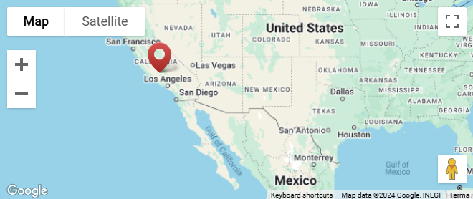
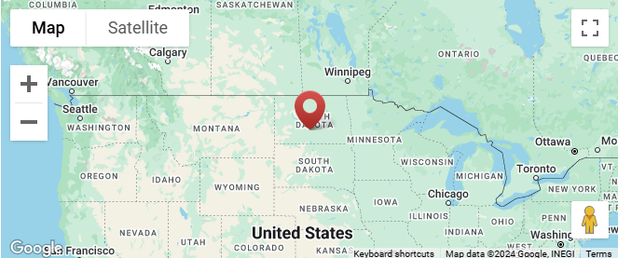
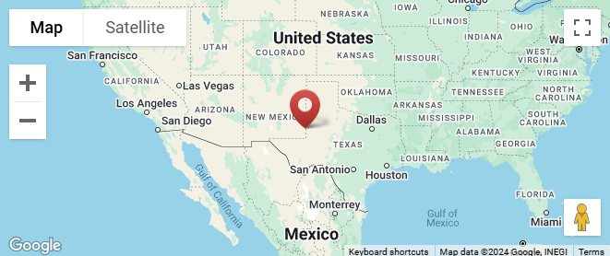
LOCATIONS
Bakersfield, CA
Bismarck, ND
Hobbs, NM
40 acres with a rail spur served by Union Pacific and BNSF with 10 rail car spaces. Over 20,000 tons of storage capacity, 15 acres available for bulk storage, and 22,000 SQFT of warehouse space. Additional laydown storage (20 acres) available upon request.
Capabilities: transportation (including oversized, overweight and specialized loads), storage, forklift rentals, rail service, transloading, on-site supply chain and yard operations personnel.
Active Customers: transloading, steel products (rebar, structural steel, etc.), fencing, scrap metals, concrete, pre-cast products, OCTG (steel casing, tubing and drill pipe)
25 acres with a rail spur served by Canadian Pacific and BNSF with 23 rail car spaces. Over 20,000 tons of storage capacity, and 10 acres available for bulk storage. Additional laydown storage available upon request.
Capabilities: transportation, storage, rail service, transloading, on-site supply chain and yard operations personnel.
Active Customers: transloading, sheet rock, steel products (rebar, structural steel, etc.), fencing, fuel cars, hazardous waste storage, pre-cast products, OCTG (steel casing, tubing and drill pipe)
45 acres with a rail spur served by Union Pacific 25 rail car spaces. Over 20,000 tons of storage capacity, and 15 acres available for bulk storage. Additional laydown storage available upon request.
Capabilities: transportation (including oversized, overweight, and specialized loads), storage, rail service, transloading, on-site supply chain and yard operations personnel.
Active Customers: transloading, steel products (rebar, structural steel, etc.), pre-cast products, OCTG (steel casing, tubing and drill pipe), inspection facilities

Slide 7
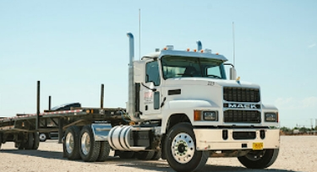
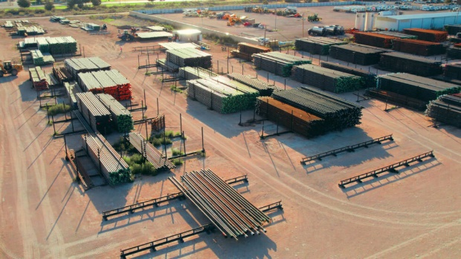
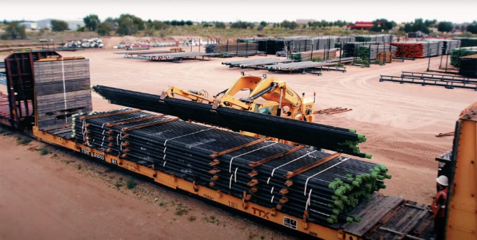
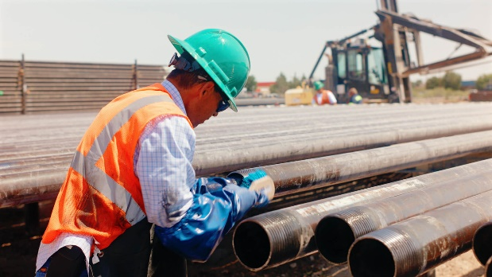
SERVICES
Transportation & Forklift/Crane Rentals
From forklifts to trucking, transloading to inspection, we have top-quality options that support you at each step of the process.
Our team is expertly trained to efficiently move your supplies and products.
Storage
Our customized storage solutions let you expand your market reach and strategically position inventory for lower freight costs and efficient distribution.
Transloading
Our comprehensive logistics services cover every aspect of rail transportation, from the point of origin to the final destination. We assess the required manpower and utilize the right equipment designed to handle the project from start to finish.
Inspection
Trust us to ensure the reliability and safety of your OCTG material. We ensure your product is free from defects by performing both visual and non-destructive testing (NDT).

Slide 8
OTHER SERVICES
01
Supply Chain Solutions
04
Stringing
We optimize your supply chain with logistics solutions, warehouse and distribution services, transportation management, and last-mile delivery offerings to get your product where you need it.
We have the expertise and equipment to handle transportation and stringing for large projects. Our equipment, crews, and supervisors are accustomed to working in extreme conditions and difficult terrain.
02
Yard Management
05
Scrap/Site Cleanup
We have the experience to manage your product in our yards or yours. We manage over 75,000 tons of material for a dozen customers located across the country.
We make it easy to clean up your well site or other location. We provide flat bed or low boy trailers to remove pipe, concrete, scrap metal, or other material and move it to the final destination.
03
Offloading/Stockpiling/Storage
06
Logistics Coordination
With over 100 acres of actively managed inventory space across three locations, we can facilitate a wide range of offloading and storage options to support your requirements.
TTL stands out by managing the acquisition, transportation, inspection, and storage of your product while having best-in-class safety processes.

Slide 9
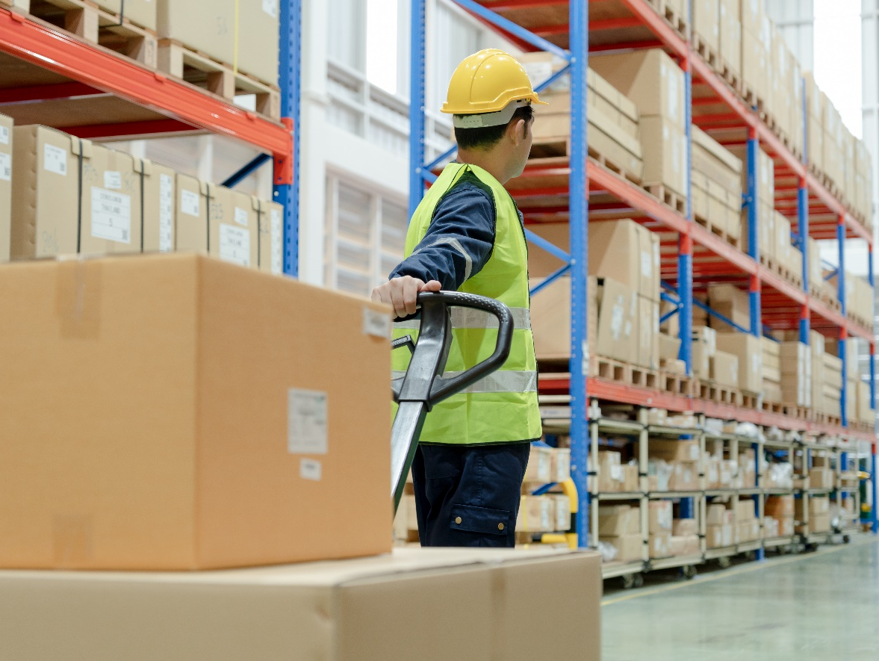

MINORITY OWNED BUSINESS
At TTL, we are proud to be a minority-owned company, bringing unique perspectives and a commitment to inclusivity in the logistics industry. Our leadership and team are dedicated to delivering top-quality logistics solutions in every aspect of our business.
As a member of the NSMDC (National Minority Supplier Development Council) and a recognized MBE (Minority-Owned Business Enterprise) by the Supplier Clearinghouse, we can help your company (or your customers such as public utilities, governmental agencies or healthcare companies) meet spend requirements, government or contractual regulations, and corporate social responsibility targets.
Partnering with TTL means working with a company that champions diversity, values every voice, and strives to make a meaningful impact every day.
© TTL, 2024
9

Slide 10


LET’S WORK TOGETHER
“
The TTL Difference
Integrity – we operate with honesty and transparency, building trust through every interaction. We hold ourselves accountable to our clients, partners, and each other.
Safety – safety isn’t just a priority; it’s embedded in everything we do. From planning to delivery, we adhere to strict safety protocols to ensure the protection of people, assets and the environment.
Customer Focus – our clients are at the heart of our operations. We customize solutions to fit their unique needs, and our team is always ready to go the extra mile to exceed expectations.
Reliability – consistency is key. Our commitment to delivering safe, timely, and accurate logistics solutions means you can depend on us, day in and day out.
Innovation – in a fast-paced industry, we stay ahead by embracing technology and innovative solutions. We’re always looking for better, smarter ways to serve our clients.
Ready to elevate your logistics experience?
Join countless satisfied clients who trust us with their logistics needs.
Let us provide a consultation to show how we can optimize your supply chain for maximum efficiency and cost savings!

Slide 11

YouTube Channel
Company Overview
Click here! (Control + Click)
(https://youtu.be/YWoO8pG1zVo)
Hobbs (New Mexico) Highlight
Click here! (Control + Click)
https://youtu.be/Ud0yQRXmEyQ

Slide 12

CONTACT US
We understand that every business is unique. Our team will work closely with you to create custom solutions that meet your specific needs and challenges.
Partner with us for seamless, reliable, and cost-effective logistics solutions tailored to your business needs.
www.tubulartransport.com
Phone: (562) 280-7185
Email: contactus@tubulartransport.com

