Slide 1


Slide 2


OUR MISSION
To connect with health audiences in a way that makes a real difference – making change work
OUR PRINCIPLES
1
We only do what we are best at – otherwise we find who is!
3
We cherish data as data is a goal not a by-product.
2
The value is in the doing not just the done
4
We think big, start small, scale fast, LEARN

Slide 3
Why Invosphere? – we know how to make innovation successful
1
2
3
4
5
Our experience
Our impact
Our connections
Our team
Our choice
We bring years of experience, drawn from across the widest range of healthcare challenges, in imagining, designing and implementing digital and transformational change.
We are focused, efficient and connected, enabling rapid and sustainable progress
We are connected to a wide range of focused experts and partners, meaning we just do what we are good at.
We are built from trust and relationships, having worked together across many years and projects
We don’t have to do this, but this is what we enjoy!

Slide 4













Our experience
We have experience of working across a wide range of healthcare businesses and challenges. combined experience have delivered solutions made changes for these organisations that have tangibly transformed their way of thinking, working and achieving an improved performance
Corporate
Rx
Devices
Consumer Health
We will add in additional logos for approx. 6 per column

Slide 5









Our experience
And we have worked to shape a wide range of digital solutions across a very broad selection of target audiences
Patients
GPs
Specialists
Carers
Employees
Influencers
Policy makers
Public

Slide 6
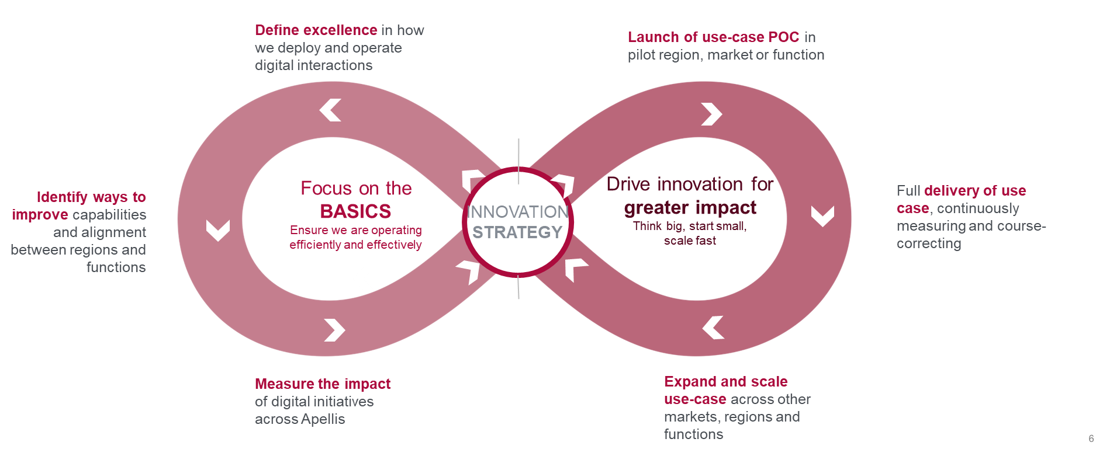
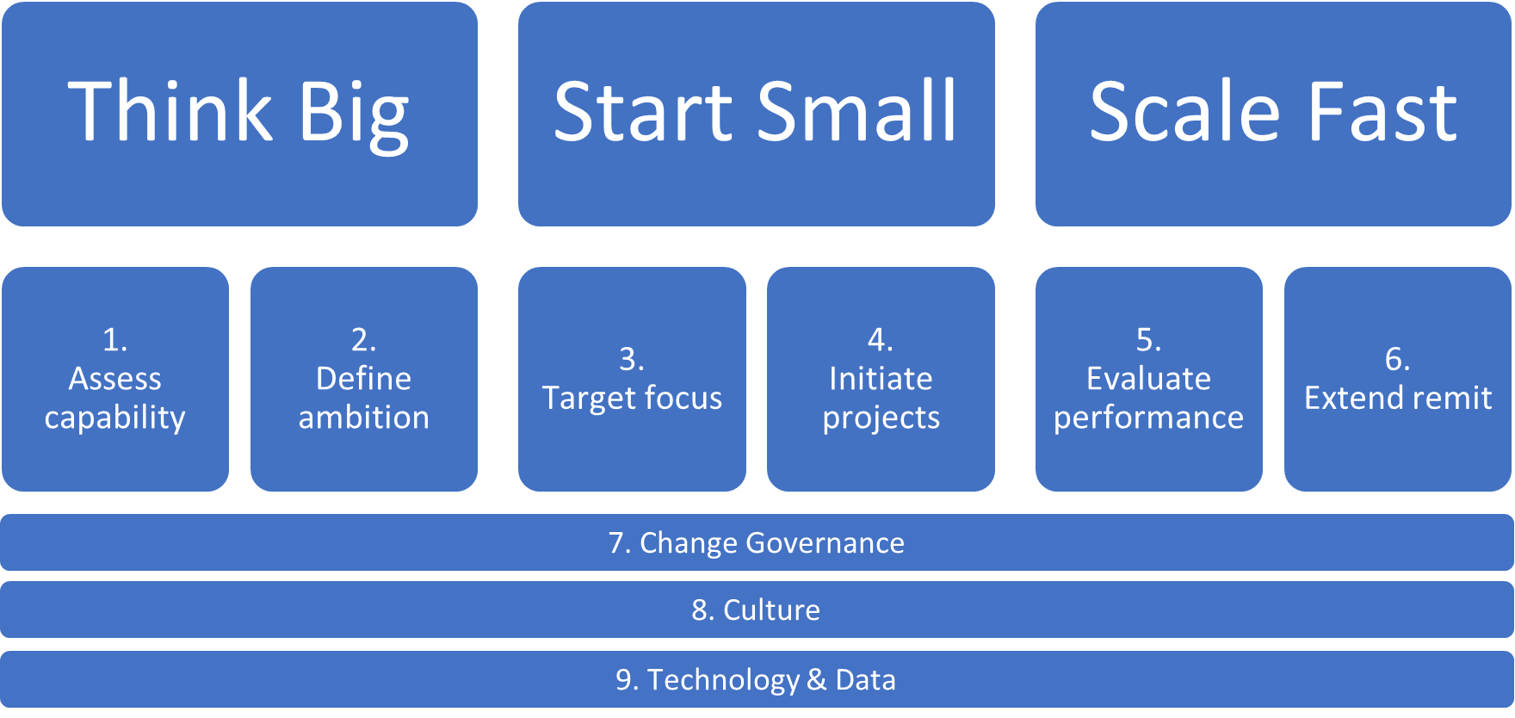
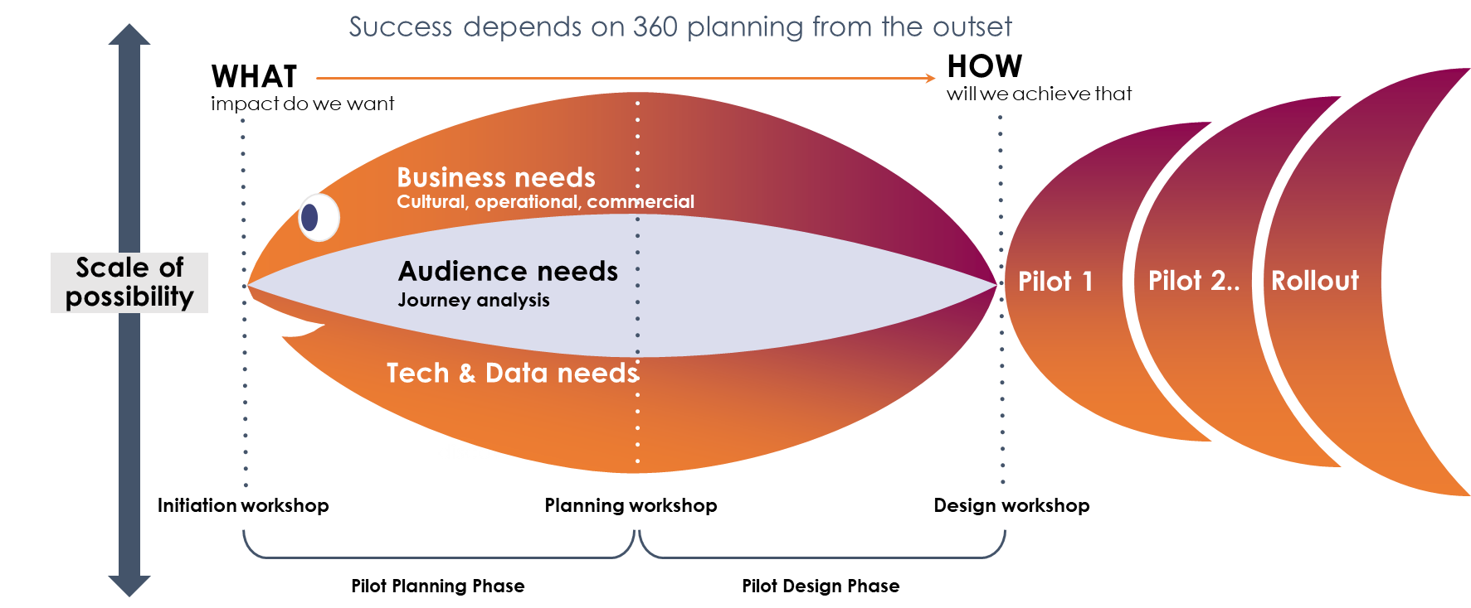
Our impact
We have many years experience in imagining and designing solutions that embrace new technology and new ways of working. We have created a huge range of tools, models and processes that accelerate our ability to deploy such solutions.
More visual examples of IP we have developed in delivering such projects to be added below these 3

Slide 7
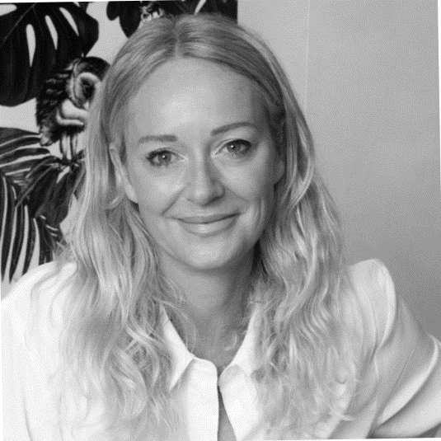

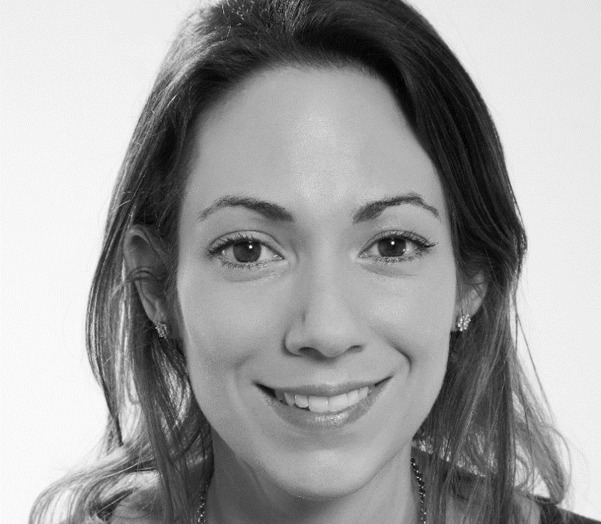
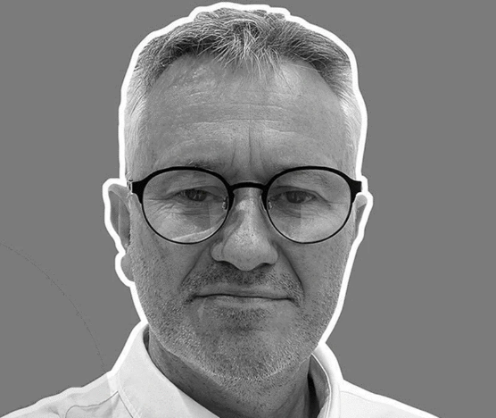

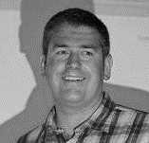
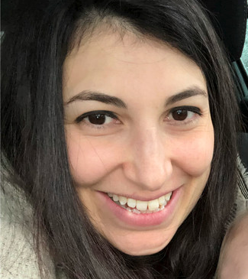
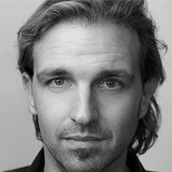
Our team
Not only do we bring our years of expertise in Pharma Transformational Change, supporting clients with a pragmatic and independent perspective, we are also connected with a wide range of carefully selected partners, across multiple disciplines, to ensure we are able to bring the right expertise in at the right time!
Experience
Intelligence
Activation
Innovation
Ross Taylor
Founder, 30+ years innovation and transformation,20+ years healthcare
Rob Harrison
Founder, 30+ digital communications, 20+ years healthcare
Tanya Wright
20+ years strategy, delivery and team management
Molly James
20+ years strategy, analysis and experience design
Rick Mills
Founder, 30+ years communications strategy,20+ years healthcare
Haze Eastman
Founder, 30+ years technology and data strategy and development
Leanne Kleiman
15+ years medical communications strategy and content
Steve Ramondt
25+ years creative, experience and innovation lead, 15+ years healthcare

Slide 8














Our connections
Not only do we bring our years of expertise in Pharma Transformational Change, supporting clients with a pragmatic and independent perspective, we are also connected with a wide range of carefully selected partners, across multiple disciplines, to ensure we are able to bring the right expertise in at the right time!
Experience
Intelligence
Activation
Innovation

Slide 9
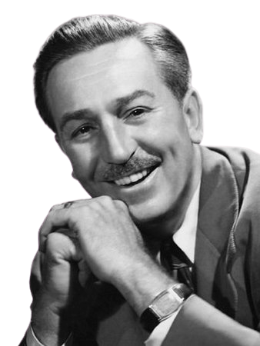
Our choice
We love to work together on healthcare challenges, bringing our different ways of thinking along with our deep experience, and most importantly, our curiosity inspired by new opportunities. But this isn’t just strategy, a powerpoint deck or a plan, but real and tangible change, whether at a proof of concept, a project or an organisational level.
Our core methodology is very simply expressed as:
Experience
Intelligence
Activation
Innovation
Understand the experience right now,
Imagine what it could be, based on new thinking
DESIGN DIFFERENT
GET STARTED
And learn how to make it even better
“The Way To Get Started Is To Quit Talking And Begin Doing.”
Walt Disney

Slide 10

So, what’s the problem?
How can we help?
T
Where do we start to prove the case for investment in doing things differently?
I know we need to do better but I don’t know where to start?
How do I build a business case to support our innovation strategy?
These are just a few examples of the questions we love to explore. So, if you want to do better, then lets have a chat!
How can I connect to our patients/HCPs more effectively?
What’s an alternative to the big consulting firms in setting up a transformation program?
How can I help the team be more positive and involved in our transformation?
How can we make the most of the possibilities that AI is offering?

Slide 11
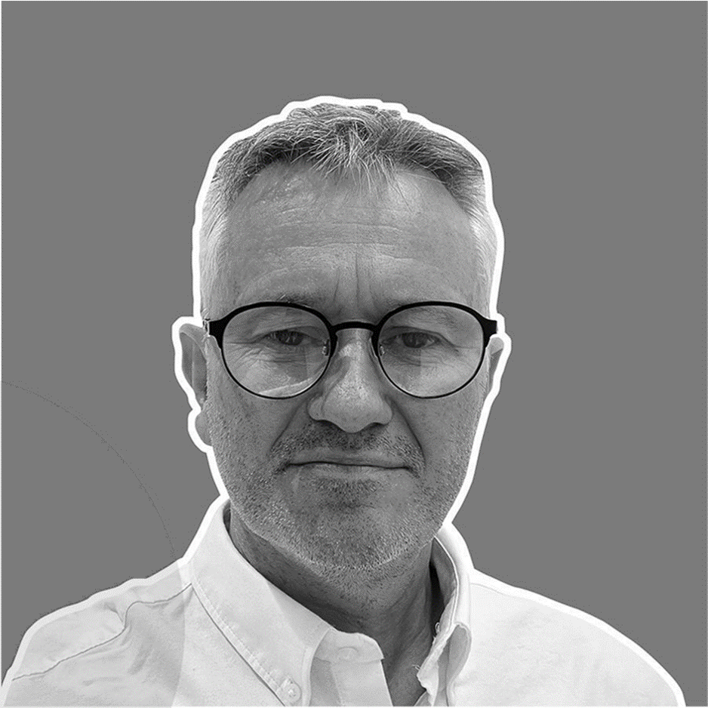
Thanks for listening, and do
share your thoughts!
ross@invosphere.co.uk
07504 891357

