Slide 1
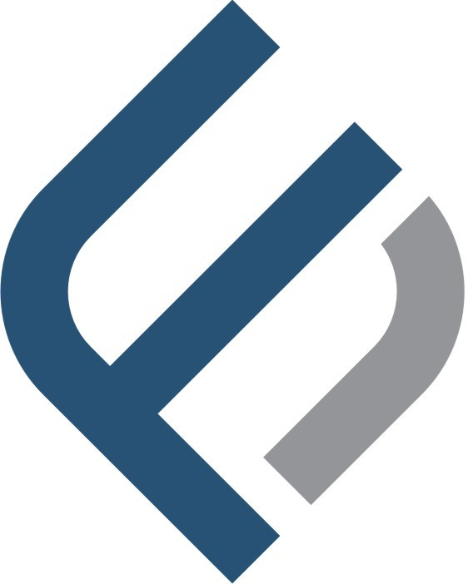
Leading Your Path to Financial Resolution
Trusted Expertise in Debt Collection and Legal Support

Slide 2
Introduction
Ibrahim Jeian Business professional with 20 years of experience in debt recovery and management. Holds a Bachelor’s degree in Business Management and has completed multiple professional development courses. Successfully managed loan repayments for Gulf Finance Corporation in Dubai, implementing an effective Recovery and Remedial Plan for non-performing loans. In 2016, established Fort Equity, a company specializing in debt collection, claims recovery, and litigation services. Skilled in client relationship building, legal coordination, and optimizing debt recovery processes. Recognized for leadership, professionalism, and delivering results in complex financial environments.
Established in 2016, Fort Equity has become a trusted partner in the debt collection and claims recovery sector.
Our skilled industry experts uphold our relationship-focused values, ensuring consistent, professional service. We prioritize strong client relationships, providing regular updates and fulfilling commitments.
Mission: To provide customized debt recovery and claims management strategies that enable businesses to focus on growth.
Vision: To be a trusted partner transforming debt challenges into thriving business success.

Slide 3

Core Services
Claims Recovery Solutions
Skip Tracing and Investigation
Comprehensive Credit Rating Reports
Court-Issued Legal Notices
Criminal Record Verification
Certified Legal Translation Services
Legal Assistance for Civil Cases, Arbitration, DIFC Courts, and All UAE Jurisdictions
Detailed Field Visit Reporting
Debt Collection and Settlement Services
• Due Diligence and Background Checks
• Notarization and Document Authentication
• Payment Plan Structuring and Monitoring
• Fraud Investigation and Reporting

Slide 4
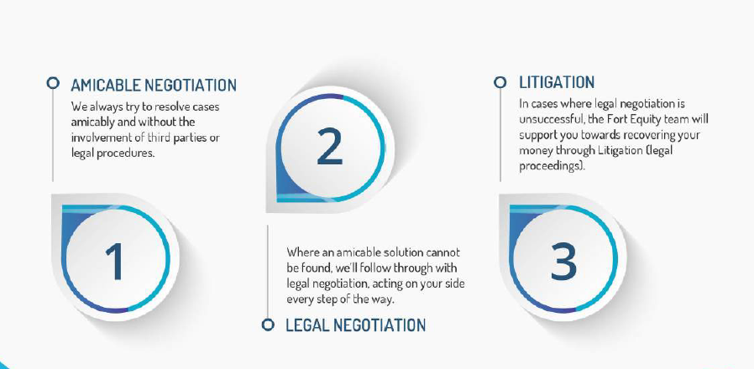
Our Process
  Initial Assessment: Evaluate client’s needs and outstanding claims.
  Strategic Planning: Develop a custom approach to recovery.
  Execution and Communication: Transparent updates throughout the recovery process.
  Results and Reporting: Final outcomes with comprehensive reporting

Slide 5
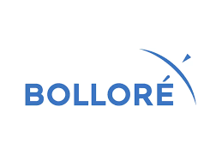
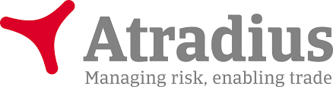
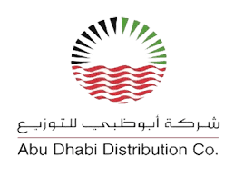
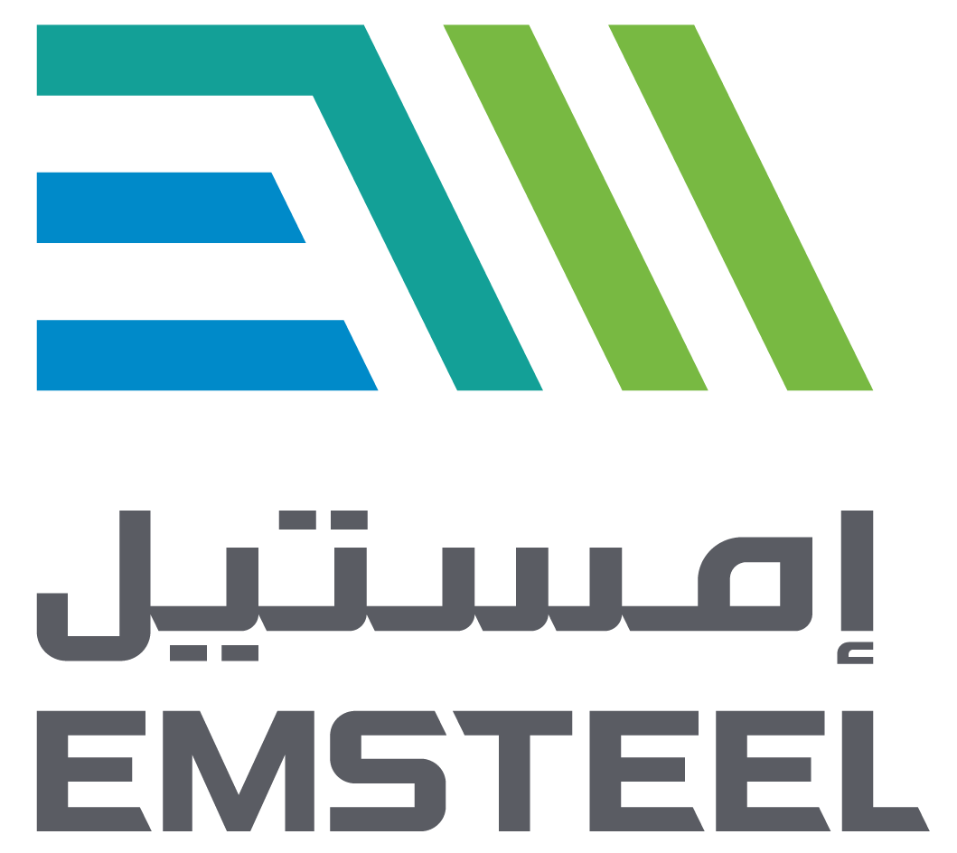
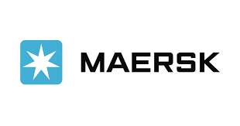
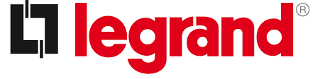
Why Choose Fort Equity? Clients !
ADDC – Atradius – Emirates steel (Arkan) – MERSIC – Ballore –
Proven Track Record: High recovery rates and successful client outcomes.
Industry Expertise: Experienced team with deep knowledge of regional regulations and practices.
Customized Solutions: Tailored strategies to meet client-specific needs.

Slide 6
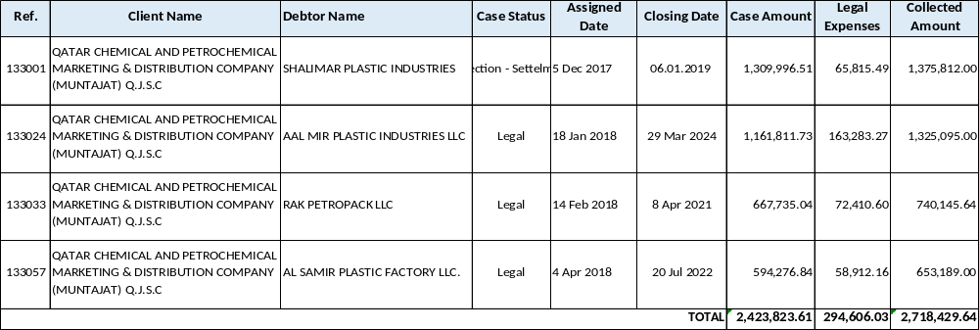
Case Studies & Success Stories
Case 1: Muntajat - Qatar Chemical and Petrochemical Company
Muntajat is A state-owned company established in 2012, which acts as the exclusive exporter of the chemical and petrochemical products from the State of Qatar to the world.
Muntajat, (Qatar Chemical and Petrochemical Marketing and Distribution Company) Q.J.S.C. is the gateway to Qatar’s exports of over 11 million metric tons of chemical and petrochemical products. Established in 2012, the company is driving the growth of the State of Qatar’s downstream industry and increasing its footprint on the global scene.

Slide 7
Case 1: Muntajat - Qatar Chemical and Petrochemical Company
Client Background:
Muntajat, a Qatar-based leader in chemical, polymer, and fertilizer distribution, faced four complex debt cases totaling AED 2.4 million during a period of regional instability.
Challenges:
Recovering debts amid regional tensions.
Securing full repayment, including court fees and interest.
Managing both negotiations and litigation.
Approach & Results:
Negotiated a 12-month settlement for one case, recovering full payment with interest by 2019.
Successfully recovered the remaining three cases through litigation, with closures in 2021, 2022, and 2024.
Impact:
Muntajat fully recovered AED 2.7 million, including court fees and interest, reinforcing financial stability despite challenging circumstances.
Conclusion:
This case highlights Fort Equity’s ability to deliver impactful solutions, leveraging negotiation and litigation to achieve remarkable outcomes.

Slide 8
Case 2 :(Atradius) Supporting an International Partner’s Growth
Since 2017, we have been a trusted partner for one of our international clients, delivering more than just collection and legal support. Over the years, they have entrusted us with approximately 574 cases, totaling over AED 122 million. Beyond case management, we played a pivotal role in their expansion by:
Assisting with the recruitment and onboarding of their first employees in Dubai.
Providing visa and insurance services for their team during their initial years.
Supporting the establishment of their Dubai office, enabling them to operate efficiently in the region.
This partnership showcases our ability to provide comprehensive, tailor-made solutions that drive both operational success and strategic growth for our clients.

Slide 9
Client Testimonials: Highlight positive feedback from satisfied clients.
Balore Case (Rental)
Atradius
Euler Hermes – Alliance trade
ADDC
EMIRATES STEEL
(WOKING ON IT)

Slide 10
Key Metrics & Achievements
Total Recovery Value: Showcase cumulative recovered debt since inception.
Client Retention Rate: Demonstrate long-term relationships and trust.
Average Recovery Time: Emphasize efficiency in resolving claims.

Slide 11
Industry Insights & Statistics
Market Overview: Key industry statistics and trends.
Comparative Analysis: Where Fort Equity stands against competitors.

Slide 12
Client Benefits
Increased Cash Flow: How our services improve financial health.
Reduced Risk: Minimized legal exposure and process delays.
Expert Guidance: Continuous support and consultation.

Slide 13
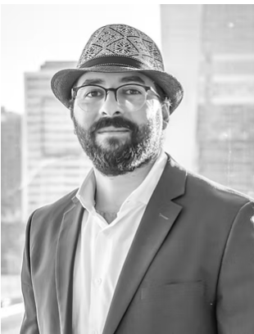
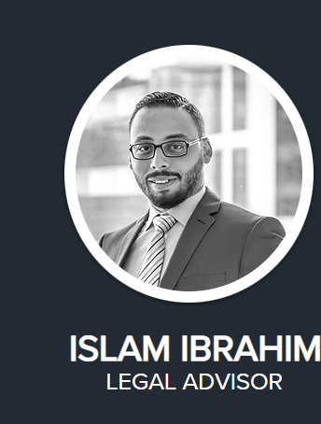
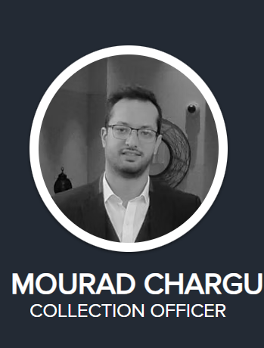
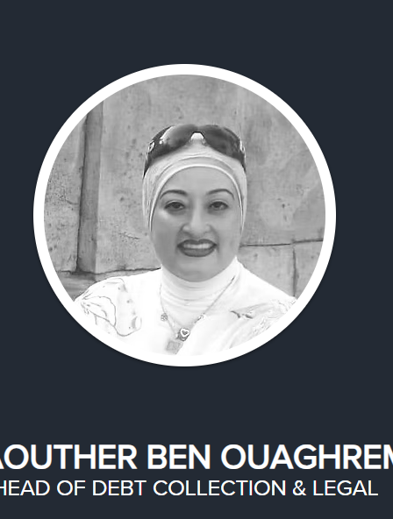
The Team

Slide 14
Q&A
Open Floor: Invite questions and provide clear, concise answers.

