Slide 1
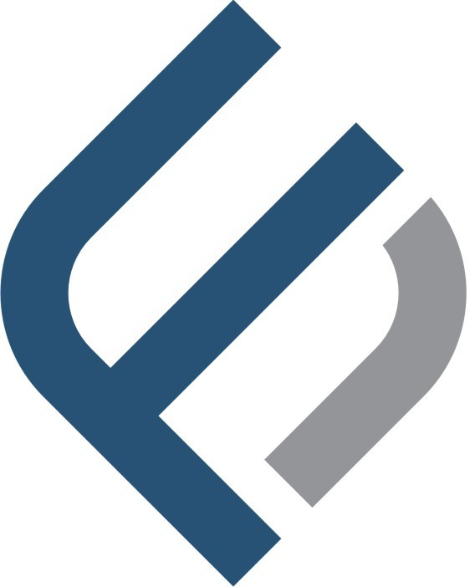
Leading Your Path to Financial Resolution
Trusted Expertise in Debt Collection and Legal Support

Slide 2
Introduction
Established in 2016, Fort Equity has become a trusted partner in the debt collection and claims recovery sector.
Our skilled industry experts uphold our relationship-focused values, ensuring consistent, professional service. We prioritize strong client relationships, providing regular updates and fulfilling commitments.
Mission Statement: Empowering businesses with expert debt recovery and litigation support, enabling them to focus on growth while we manage past-due accounts with efficiency and transparency for lasting financial stability.

Slide 3
Core Services
Claims Recovery Solutions
Financial Management Services
Skip Tracing and Investigation
Comprehensive Credit Rating Reports
Court-Issued Legal Notices
Criminal Record Verification
Police Case Initiation Support
Certified Legal Translation Services
Legal Assistance for Civil Cases, Arbitration, DIFC Courts, and All UAE Jurisdictions
Detailed Field Visit Reporting

Slide 4
• Debt Collection and Settlement Services
• Asset Tracing and Recovery
• Dispute Resolution and Mediation Services
• Contract Drafting and Review
• Due Diligence and Background Checks
• Risk Assessment and Advisory
• Negotiation Support for Debt Restructuring
• Compliance and Regulatory Consulting
• Financial Forensic Analysis
• Garnishment and Enforcement Actions
• Notarization and Document Authentication
• Payment Plan Structuring and Monitoring
• Fraud Investigation and Reporting
• Corporate Legal Advisory
• Bankruptcy Filing Assistance
• Liaison with Law Enforcement and Government Agencies
• Legal Document Preparation and Filing
• Bilingual Client Representation
• Expert Witness Testimony Services

Slide 5
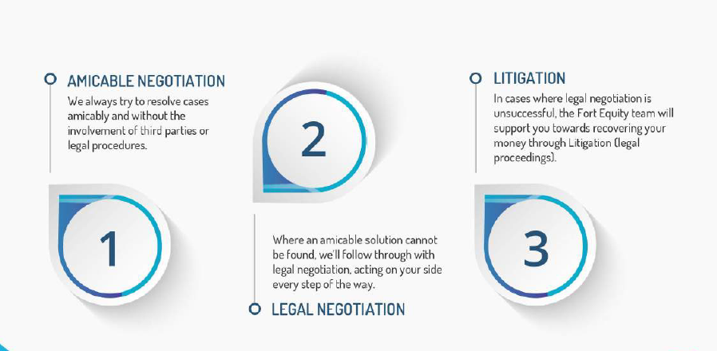
Our Process
  Initial Assessment: Evaluate client’s needs and outstanding claims.
  Strategic Planning: Develop a custom approach to recovery.
  Execution and Communication: Transparent updates throughout the recovery process.
  Results and Reporting: Final outcomes with comprehensive reporting

Slide 6
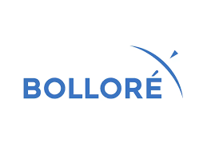
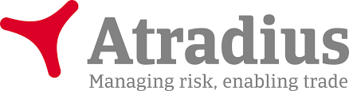
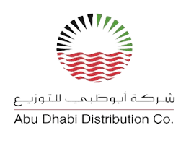
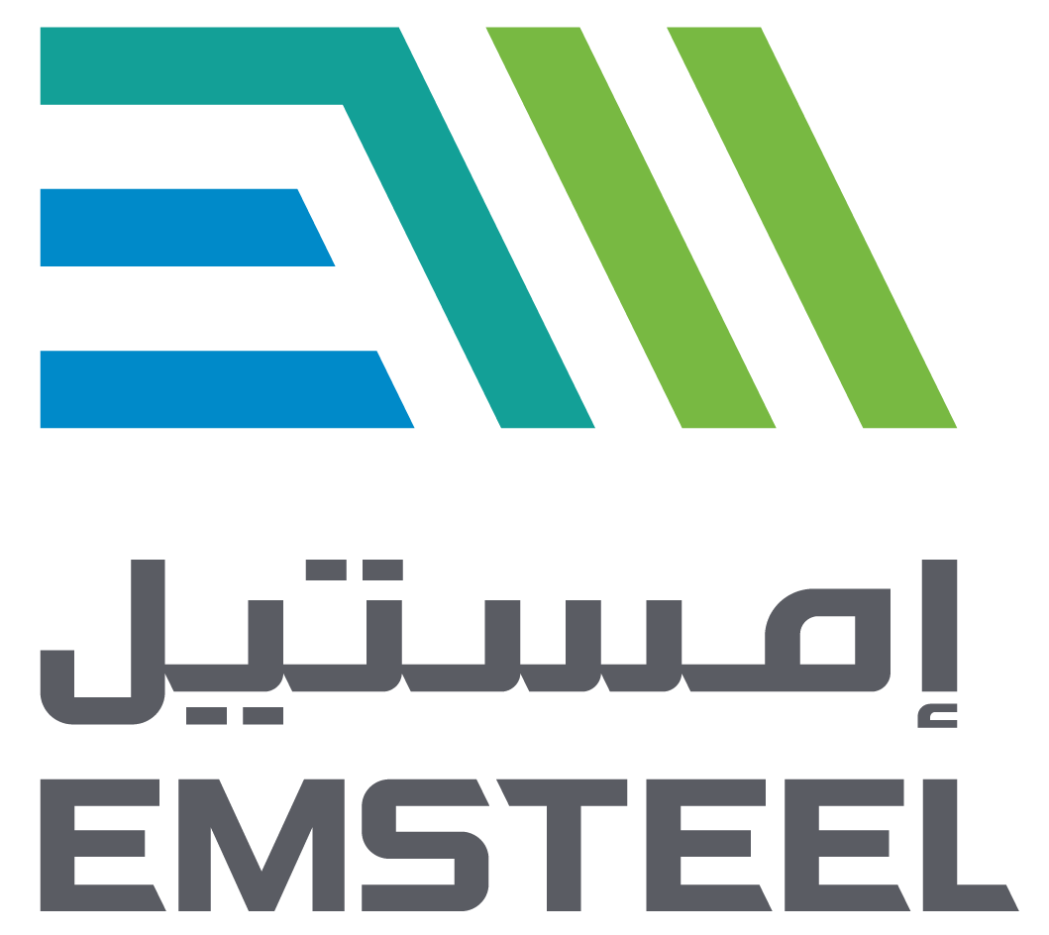
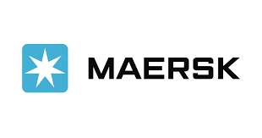
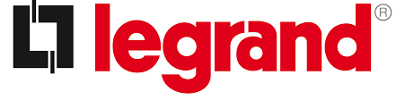
Why Choose Fort Equity? Clients !
ADDC – Atradius – Emirates steel (Arkan) – MERSIC – Ballore –
Proven Track Record: High recovery rates and successful client outcomes.
Industry Expertise: Experienced team with deep knowledge of regional regulations and practices.
Customized Solutions: Tailored strategies to meet client-specific needs.

Slide 7
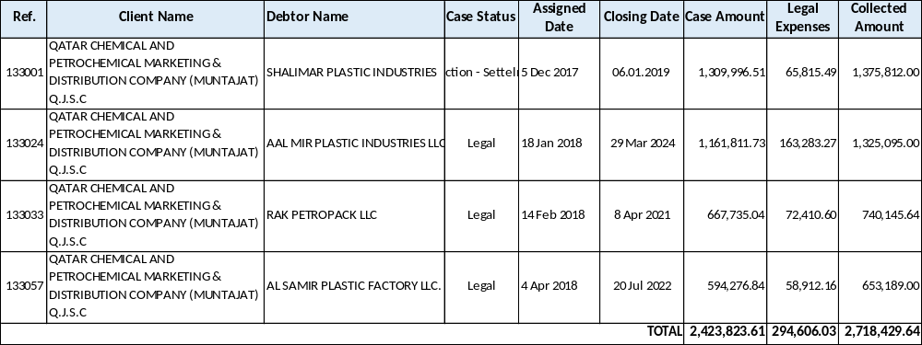
Case Studies & Success Stories
Case 1: Muntajat - Qatar Chemical and Petrochemical Company
Muntajat is A state-owned company established in 2012, which acts as the exclusive exporter of the chemical and petrochemical products from the State of Qatar to the world.
Muntajat, (Qatar Chemical and Petrochemical Marketing and Distribution Company) Q.J.S.C. is the gateway to Qatar’s exports of over 11 million metric tons of chemical and petrochemical products. Established in 2012, the company is driving the growth of the State of Qatar’s downstream industry and increasing its footprint on the global scene.
Case 2: [Brief description of another impactful result]
Client Testimonials: Highlight positive feedback from satisfied clients.

Slide 8
Key Metrics & Achievements
Total Recovery Value: Showcase cumulative recovered debt since inception.
Client Retention Rate: Demonstrate long-term relationships and trust.
Average Recovery Time: Emphasize efficiency in resolving claims.

Slide 9
Industry Insights & Statistics
Market Overview: Key industry statistics and trends.
Comparative Analysis: Where Fort Equity stands against competitors.

Slide 10
Client Benefits
Increased Cash Flow: How our services improve financial health.
Reduced Risk: Minimized legal exposure and process delays.
Expert Guidance: Continuous support and consultation.

Slide 11
Q&A
Open Floor: Invite questions and provide clear, concise answers.

