Slide 1
Production Foundations
Production Foundations
KPIs & Production Fundamentals

Slide 2

KPI & Production Fundamentals
At the end of this module, you will understand
Understand the key concepts of mine production KPIs
  Time Usage Model
  Availability, Utilization and Productivity
  Elements of the haul cycle
  Elements of the loading cycle
  How changes in each of these elements impact mine production
The goal will be to create a baseline of understanding and a common language across the entire mine-ops team
You may already understand these concepts
This is the time to ask questions and get clarification!

Slide 3
What Makes up Production
In its simplest terms, we calculate production like this:
This is true for any process
  Mowing the lawn
  Driving
  Mine Production
Production goes up or down because of a change in Equipment Productivity or Operating Time
Production
Equipment Productivity
Operating Time

Slide 4
What Makes up Production
At its simplest terms, we calculate production like this:
Operating time is the time when a piece of equipment is performing it’s primary function
To better understand, communicate and discuss the different categories of how we calculate operating time, we use something called a Time Usage Model
Each industry has its own time usage model, and they can vary slightly from industry to industry
Even within an industry, (e.g. Mining) a Time Usage Model can vary from operation to operation
Production
Equipment Productivity
Operating Time

Slide 5
Generic Time Usage Model
This is a generic Mining time usage model
There may be variations from mine-to-mine (ie Utilized time vs Operating Time) but this model describes everything mine operations needs to know about the time usage of a piece of equipment

Slide 6
TUM – Calendar Time
Calendar time means all the time in a period
  Calendar time for 1 Year = 365 Days
  Calendar time for October = 31 days
  Calendar time for 1 shift = 12 hours

Slide 7
TUM – Available Time
Available Time is the time a piece of equipment
(or fleet) is mechanically available to operate
Available Time = Calendar Time – Down Time
Downtime can be
  Planned (PMs, Rebuilds)
  Unplanned (Breakdown, Accident Damage)
Availability % = Available Time / Calendar Time

Slide 8
TUM – Operating Time
Operating Time is the time where the equipment (or fleet) is working as planned
It excludes periods of standby and operating delays
Standby time is typically time where the piece of equipment isn’t required to operate
  This could be because there isn’t work to do (No Shovel, No Muck)
  It could also be because there is nobody to operate the machine (No Operator)
Operating Delay occurs when the equipment is required to operate but can’t perform it’s primary work function
  Fueling, Tramming, Moving
  As a rule of thumb, if there is a ‘butt in the seat,’ it is considered an operating delay, not a standby
Utilization % = Operating Time / Available Time
Some sites refer to this as Use of Availability % or UofA %

Slide 9
TUM – Effective Time
Effective Time is the time when the equipment is doing its productive activities
It excludes waiting/idle time that is included in operating time
This waiting/idle, non-effective time is a part of the regular operation of the machine, but is not productive
  Shovel Hang
  Truck wait @ dump or wait @ shovel
Effective Utilization % = Effective Time / Available Time
OEE % = Effective Time / Calendar Time

Slide 10
TUM - Summary
The Time Usage Model is a way of describing how time for equipment is allocated over a period (shift/month/year)
Availability % = What percentage of the shift/month/year is the equipment down?
Availability % = Available Time / Calendar Time
Utilization % = What percentage of the time the equipment is available is it Operating?
Utilization % = Operating Time / Available Time

Slide 11
What Makes up Production
In its simplest terms, we calculate production like this:
The other side of production is Equipment Productivity
This metric describes how PRODUCTIVE the equipment is during the operating time
For this course, we will focus on productivity of Trucks and Shovels
Production
Equipment Productivity
Operating Time

Slide 12
Equipment Productivity – Haul Trucks
Equipment Productivity
Cycle Time
Tonnes per Cycle
For haul trucks, tonnes per cycle is simply Payload
The higher the payload, the higher the equipment productivity
What are the limitations of Payload?

Slide 13
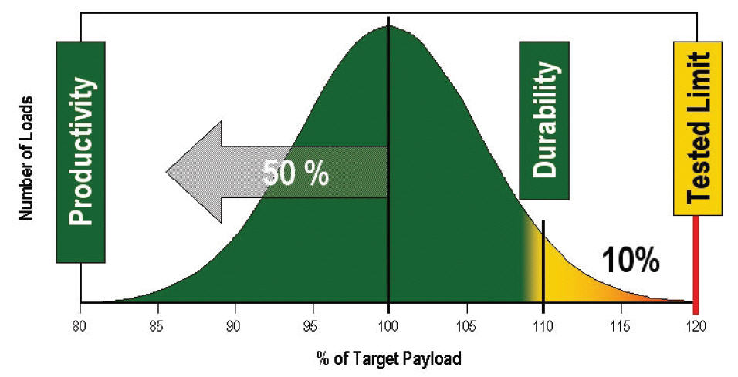
Equipment Productivity – Haul Trucks
To increase productivity, we want to maximize truck payload while adhering to the 10/10/20 rule
No more than 10% of loads between 110% and 120% of Nominal Payload
No loads greater than 120% of Nominal Payload

Slide 14


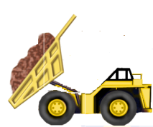
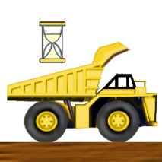

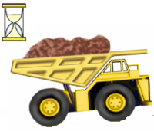

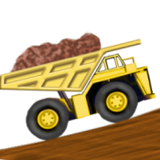

Equipment Productivity – Haul Trucks
To minimize cycle time we reduce the time it takes for each haul cycle element
The first step is to try to reduce non-effective time in a haul cycle
What are the non-effective elements of the haul cycle?
What are some ways to reduce non-effective time in a haul cycle?
What are the effective elements of a haul cycle?
What are some way to reduce effective time in a haul cycle?
Stopped Empty
Traveling Empty
Wait/Queue at Shovel
Dumping
Wait/Queue at Dump
Spotting
Traveling Full
Loading
Stopped Full

Slide 15
Production Foundations
The Theory of Constraints

Slide 16
Objectives
Objectives
At the conclusion of this module, you will be able to:
  Understand the Theory Of Constraints.
  Apply the principles of the Theory of Constraints to Truck & Shovel Operations
  Understand how we can practically use this information to take action in the mine

Slide 17
Theory of Constraints (ToC)
Theory of Constraints (ToC)
Simply put, the theory of constraints states that the throughput of a given process with multiple sequential steps is determined by the one step that takes the most time to complete.
This step is referred to as the bottleneck.
The process bottleneck step will usually be evident by a build-up of inventory
or work in progress in front of this step.

Slide 18
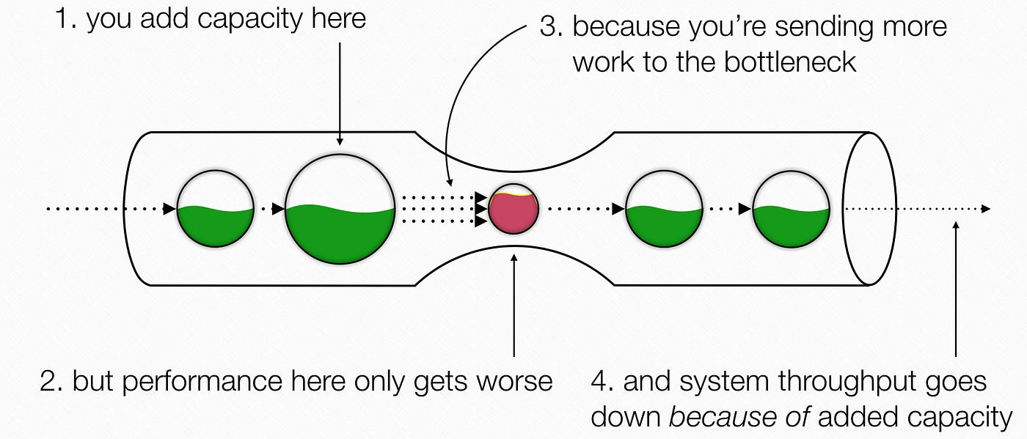
Process Bottleneck

Slide 19
Process Bottleneck – Mine Operations
Hauling
Drill & Blast
Loading
Crusher
Mill

Slide 20
Process Bottleneck - Plant
Ball + SAG Mill
Primary Crusher
Dome (inventory)
CIP
Tailings

Slide 21
Process Bottleneck – Detour Lake Mine
Mill
Exploration
Mining
Tailings
Reclamation

Slide 22
The Process to Address & Manage Constraints (Bottlenecks)
The Process to Address & Manage Constraints (Bottlenecks)
The Theory of Constraints is a five-step process:
  IDENTIFY the process constraint.
  Decide how best to EXPLOIT the process constraints.
  SUBORDINATE everything else to the above decisions.
  ELEVATE the process constraint.
  Remove the constraint and RE-EVALUATE the process.
From the book ‘The Goal’ by Dr. Eli Goldratt

Slide 23

The ToC Process:
Step 1: Identify the Process Constraint
The ToC Process:
Step 1 – Identify the Process Constraint
How to Identify The Process Constraint or Bottleneck
  The step in the process that never seems to stop, always trying to catch up
  Observation – look for the points in the process with large numbers of “things” piled up at the input.
  Look at the capability (TPOH) of that step in the process

Slide 24
The ToC Process:
Step 2: Exploit the Process Constraint
The ToC Process:
Step 2 – Exploit the Process Constraint
Decide how to exploit the constraint – Make the constraint as productive as possible
  Examples might include:
    Making sure it works as consistently as possible
    Never has to take breaks, or as infrequently as possible
    If interruptions have to occur, try to have multiple at the same time
    Cross train employees to provide for shifting resources when volume exceeds
    the capability of the constraint.

Slide 25
The ToC Process:
Step 3: Subordinate Everything Else
The ToC Process:
Step 3 – Subordinate Everything Else
Subordinate everything else to the process constraint
  An hour lost at the constraint is an hour lost in the entire process,
  The constraint is, therefore, the top priority.
  It should never be idle; resources should never be taken
  from the constraint to work on other priorities.
  Other processes can be made less efficient if it is Better for the Contraint

Slide 26

The ToC Process:
Step 4: Elevate the Process Constraint
The ToC Process:
Step 4 – Elevate the Process Constraint
Elevate the process constraint – determine how to remove the constraint.
  Examples might include:
    Reduce queue times.
    Reduce maintenance times
    Reduce setup / work preparation time.
    Reduce the time required to complete the task
    (usually a small percentage of the cycle time).

Slide 27
The ToC Process:
Step 5: Re-Evaluate the Process
The ToC Process:
Step 5 – Re-Evaluate the Process
Once you have removed a constraint, you have created another.
There will always be a slower / less productive process step, and the chain is only as strong as the weakest link.
  Return to step one and identify the new constraint.

Slide 28
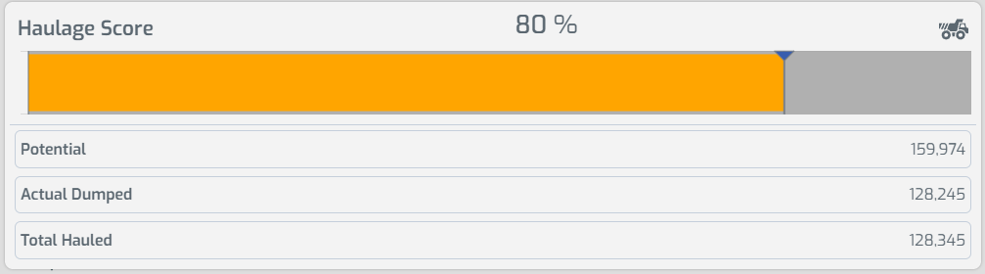
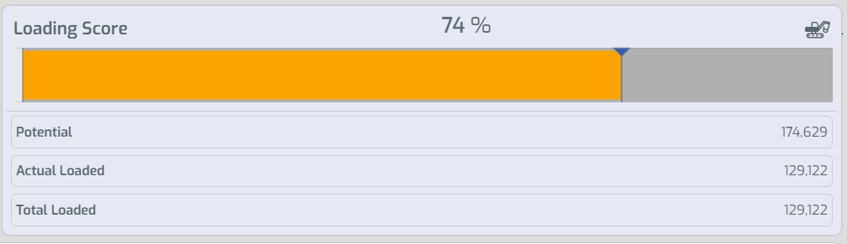
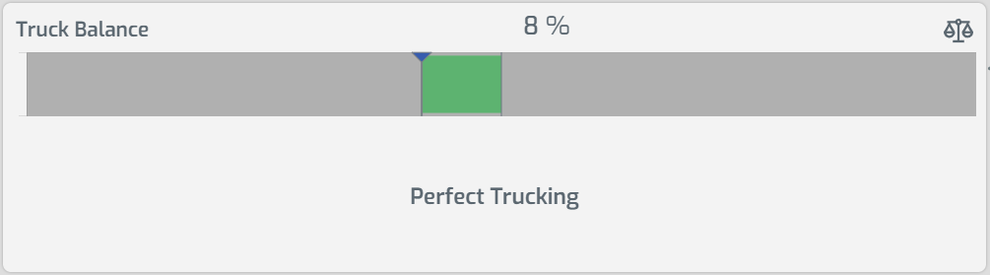
Theory of Constraints & the SIC Tool
The Short Interval Control tool Summary Page shows the capability of the Loading Fleet and Hauling Fleet
Overtrucked or Undertrucked is based on the capability of the loading fleet or hauling fleet
Capability is based on
  Availability
  Haul Distance
This gives an average for the shift. Wenco and dispatch can determine if the shift is overtrucked or undertrucked in real-time
The Truck balance can shift Quickly if a shovel goes down/comes up.

Slide 29
IAMGOLD – for Côté Gold Mine
Visual Management & Short Interval Control
September 3rd, 2024
Production Foundations – Expectations for Supervisors and Dispatchers
SIC & Visual Management

Slide 30
Overview – SIC & Visual Management
Dispatchers and Pit Supervisors use the SIC tool to monitor the real-time performance of the truck and shovel fleet.
The tool is monitored hourly to identify underperformance. The dispatcher may be the lead in identifying actions for the Pit Supervisor
Once opportunities or underperforming areas are identified Dispatchers and Supervisors will take collaborative action to address them
The Visual Management process is an accountability check and information share. ‘Did we monitor the SIC, communicate opportunities and take action during the shift?’

Slide 31
SIC Tool - Expectations
Expectations During the Shift
  All Roles monitor SIC trends for their accountable KPIs ~ once per hour
  Supervisors actively engage with shovel & support equipment operators
  Dispatchers Monitor Queue and Hang at shovels – take action if opportunities are identified (re-assign trucks, longer hauls, fueling/breaks etc)
  Use Minestar & SIC Trends to assess the truck balance. Based on the operating scenario (over-trucked or under-trucked) look for opportunities (haul long, haul short, fueling, breaks etc)
  Supervisor Monitors Queue @ Dump, Dumping Times
  Controller actively monitors dome levels & queue at the crusher
  Controllers and Control room supervisors pro-actively communicate with the supervisors on truck/shovel balance and if they see opportunities/issues in their area

Slide 32
Visual Management – Process
Visual Management Meeting - 5:00 AM, 12:00 PM and 5:00 PM
The goal is for the meeting to take 10 minutes only
Attendees should come prepared
Understand the operating scenario – over-trucked or under-trucked, crusher status, etc. What strategies should be employed based on the operations playbook
Review Visual Management Slides in Order
Review red KPIs, move past green ones
Not a deep dive or time to investigate SIC trends
Focus on identifying issues and taking action

Slide 33
Visual Management
Expectations @ Visual Management Meeting – Senior Supervisors
Senior Supervisors own the meeting
Review the SIC prior to the meeting – Outliers to support
Set expectations and hold Dispatchers & Supervisors accountable
Keep process on track
Stay out of trends/details
Reset expectations and speak straight, respectfully if expectations aren’t met
Celebrate Success and provide positive reinforcement

Slide 34
Visual Management
Expectations @ Visual Management Meeting – Dispatchers & Supervisors
For each KPI they are accountable for Dispatcher and Supervisors must report:
  What happened during the shift – Good, bad and changes in KPI
  When were issues identified
  What communication & actions did you take
  Did it improve
  How will KPI look going forward
  Any other actions required
If you are monitoring the SIC during the shift it is easy to answer these questions

