Slide 1
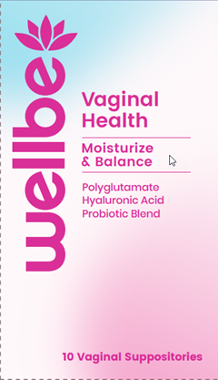

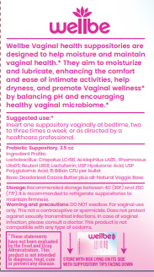

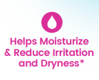


Free Shipping (scrolling at the top)
Subscribe & Save
Logo
About Contact
Pharmacist-Formulated Vaginal Suppositories:
Hydration & Balance
Feminine Image or video
Badge – “Expertly compounded by pharmacists”
Welbe Vaginal Hydration Suppositories
Advanced, hormone-free vaginal suppositories formulated with hyaluronic acid, polyglutamate, and probiotics for optimal hydration and microbiome support
One-time Purchase – 10 Suppositories – 1 month supply
$45.00
Subscribe & Save 10% - 20 Every 2 Months
$79.78
Description
Ingredients
How to use
Trust Badges: Include badges like “Made in Certified Lab,” “100% Natural Ingredients,” and “No Synthetic Hormones.”
FAQs
Clinical Studies
Ingredients Make Welbe Different
Hyaluronic Acid:
• "Deep Hydration for Lasting Comfort": Hyaluronic acid is known for its ability to hold up to 1,000 times its weight in water, delivering deep, long-lasting moisture to delicate vaginal tissues, easing dryness and discomfort.
• "Promotes Natural Lubrication": Helps restore the body’s natural moisture levels, reducing irritation and promoting comfort during intimacy.
• "Gentle, Hormone-Free Relief": Provides hydration without the use of hormones, making it a safe and eAective option for women of all ages.
Polyglutamate:
• "Boosts Hydration Retention": Polyglutamate holds five times more moisture than hyaluronic acid, amplifying the skin’s ability to retain hydration.
• "Supports Elasticity and Firmness": This powerful ingredient enhances the elasticity of vaginal tissues, promoting firmness and flexibility.
• "Long-Lasting Moisturizing EGects": Works synergistically with hyaluronic acid to lock in moisture for extended periods, providing all-day comfort.
Probiotics:
• "Balances Vaginal pH": Probiotics promote a healthy vaginal microbiome by balancing pH levels, reducing the risk of infections like bacterial vaginosis and yeast infections.
"Restores Natural Flora": Helps maintain healthy bacterial populations, supporting overall vaginal health and protecting against irritation and discomfort.
• "Supports Immune Function": Probiotics work to strengthen the vaginal immune system, keeping the delicate balance of good bacteria intact.
Compare Welbe to Others
 | Welbe | Others with Hyaluronic Acid | Traditional Suppositories
Hyaluronic Acid | ✅ | ✅
Probiotics | ✅
Polyglutimate | ✅
How to Use
Insert one suppository vaginally at bedtime, two to three times a week, or as directed by a healthcare professional.
2 to 3 times weekly
• Visual Aid: A simple graphic or diagram showing how the product is applied for easy understanding.
Common Questions
How often should I use it?
Is it safe for post-menopausal women?
How long does it take to see results?

Slide 2
Welbe Developed with Science
Polyglutamate Hydration
Polyglutamate Compatibility
Novel Peptide
Here we want an icon or illustration of a clinical white paper to link to it. Something that people will recognize as a typical white papwerbut more simple, flowing with the design of the site.
Here we want an icon or illustration of a clinical white paper to link to it. Something that people will recognize as a typical white papwerbut more simple, flowing with the design of the site.
Here we want an icon or illustration of a clinical white paper to link to it. Something that people will recognize as a typical white papwerbut more simple, flowing with the design of the site.
It is a potent humectant, able to retain up to 5,000 times its weight in water, significantly enhancing skin moisture retention. This makes it more effective than even hyaluronic acid for deep skin hydration, making the skin plump and soft. It also helps in maintaining hydration over time by inhibiting the enzyme hyaluronidase, which breaks down hyaluronic acid
Polyglutamic acid works synergistically with other ingredients like hyaluronic acid and peptides, making it an ideal component in multi-functional skincare products. Its film-forming properties also protect the skin from environmental stressors
Research shows that PGA increases skin elasticity and reduces the appearance of fine lines and wrinkles. By forming a protective barrier on the skin, it prevents moisture loss and helps smooth the skin's surface. PGA has also been shown to stimulate collagen production, improving skin firmness and overall texture

