Slide 1

CRST Specialized Solutions
Overview for
October 20, 2024

Slide 2
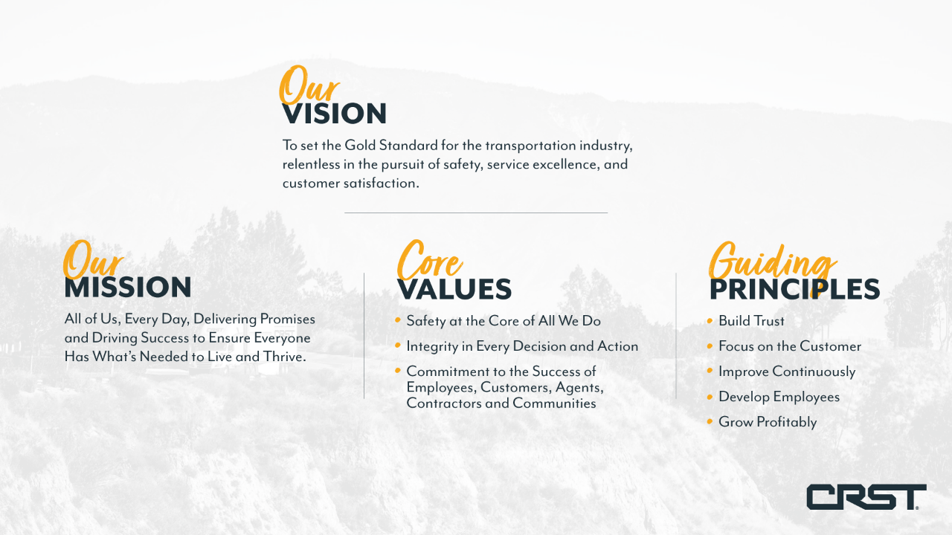

Slide 3





Customer Benefits of Agent Partnership
Turnkey Solution to Rhenus for EGYM
shipment management and proactive customer communications
01
05
06
07
Sample Headline
Sample Headline
Entrepreneurial Sales Agents
White-Glove Experience
Customer-centric Communication
Integrated Operations

Slide 4
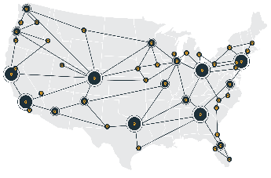

Solutions That Go Beyond the Traditional
providing damage-free handling for high-value goods
Nationwide Scheduled LTL - TL
Asset Based Fleet
2+ Person Crews
Reverse Logistics – Asset Recovery
Environmentally Responsible
99.5% Damage Free Deliveries

Slide 5













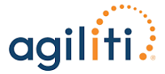

Our High Value Customers

Slide 6
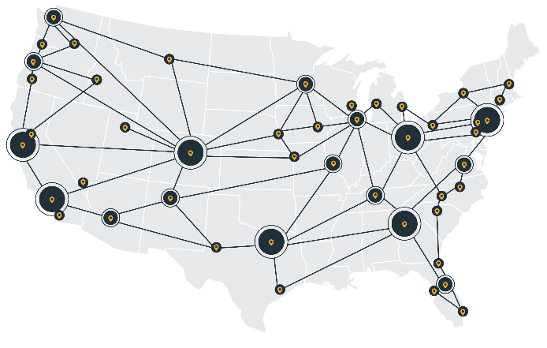



Scheduled Network LTL
We are not a common carrier LTL or Forwarder....
60
DISTRIBUTION CENTERS
360
WEEKLY SCHEDULED DEPARTURES
310
DEDICATED LOCAL TRUCKS
100%
REAL TIME SHIPMENT VISABLITY

Slide 7
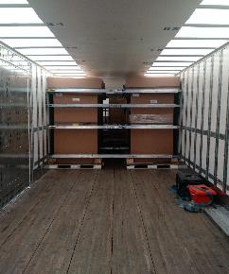
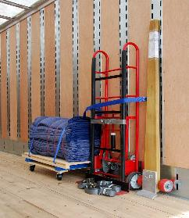
Non-traditional Equipment
53 ft. Liftgate and Non-Liftgate
Full trailer E-Tracks (18” on center)
Translucent Ceilings for lighting
2-Wheel & 4-Wheel Dollies; J-Bar
144 Pads; 50 Straps
33 Beams; 12 Sheets Plywood
Pallet Jack
Small & large dock plates
3rd party stair-crawlers & genie-lifts
Specialized Solutions

Slide 8
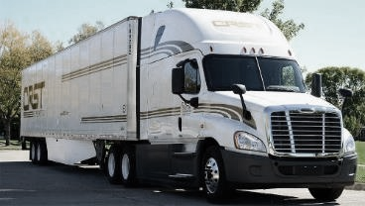

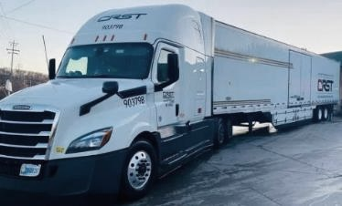
From LTL to Full-Service Truckload
  EQUIPPED ASSET FLEET
  350 OWNER-OPERATORS
  LIFTGATE, INSIDE LOAD & DELIVER
  850 SPECIALIZED TRAILERS
  CORPORATELY PLANNED & DISPATCHED FLEET

Slide 9
Specialized Handling
Average Driver tenure = 10 years
Average Fleet turnover = <25%
Drivers satisfy all D.O.T & CRST requirements
Corporate Managed & Dispatched
Additional Labor:
  Premium & Standard labor options.
    Driver is Supervisor over Labor
    Extra Labor has appropriate attire, PPE & valid photo I.D.
    Premium Labor has security clearances
    Driver conducts briefing protocols prior to start
Live Load, Dock Sweeps, Drop Trailers
Single Operation
FTL, large LTL & Climatic Options
Product Specific SOPs
Real Time Tracking

Slide 10

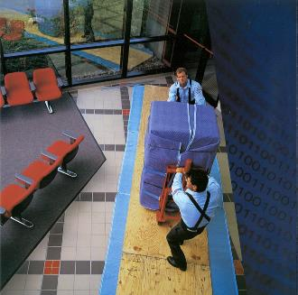



Complex Services
WHITE GLOVE
ON-DAY, ON TIME
2+ MEN, LIFTGATE
INSIDE PICK/PLACE
Pre-Call – Light Assembly – Packing/Unpacking - Debris Removal

Slide 11
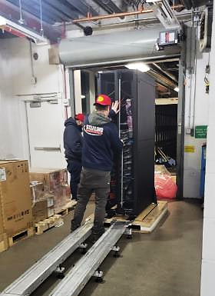






Data Equipment Expertise
high value, top heavy, hard to handle, complex deliveries
Extensive Driver & DC training and experience
SOPs specifically designed for Loaded Rack handling
Inside pick up or delivery with packing, unpacking & labor services

Slide 12


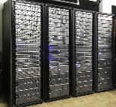

Data Equipment Expertise
IoT Trackers
Data Service Profiles
Equipment Orientation
Verification Processes
SOPs specific to model
Driver photographs & uploads
Driver/DC removes and small-package ships
Equipment relocations
Lease returns
Data Center moves
Servers, loaded & empty racks & data components
Crated or Loose
Antistatic bubble-wrap
Cornerboards with anti-static wrap
Valuation up to $3.5M per truck
Expedited services
On Day, On Time
Escorts; Climate-Control
Labor, accessibility & path
Project management applications from start to finish

Slide 13
Supply Chain Solutions
providing aggregation and distribution with just in time delivery
ERP integration for shipment registration
Staggered production, imports, or pre-buys
CPM for increased visibility
Real time Warehousing & Inventory Management
Warehouse Integration
Leveraging nationwide footprint to assure minimal transit to project site & full visibility
Timed Final Mile Delivery
Just in time execution
Reverse Logistics
Return, Recycle, Resell or Dispose
Notes:
Integrated technologies for customers systems to allow for seamless integration and inventory tracking.
Inventory management capabilities allow us to provide reverse logistics – CPM (eyes on everything) - as well as closest to site (project management) with timed final mile deliveries.
Tools to integrate inventory management pushed to your ERP.
Partner structure allows for regional site proximity warehousing.
Integrated technologies for customers systems to allow for seamless integration and inventory tracking.
NOTES:
CPM Switch reverse logistics and ERP (at the bottom)
Inventory management capabilities allow us to provide reverse logistics – CPM (eyes on everything) Tools to integrate inventory management pushed to your ERP.
Partner structure allows for regional site proximity warehousing.

Slide 14



Quality Management (QMS) Processes
Issue Tracker / CAR database
GEMBA “Walk” application
“Knowledge Base”
Proprietary on-line system for tracking reported “Issues”
Root cause analysis and CAR database maintained
QMS manual available
5 Functional Operations groups participating at Corporate/FWA
Data updated weekly/reviewed bi-weekly
Track # CARs, days open, documentation & effectiveness
Proprietary on-line document control system and portal
Available to all CRST locations, employees, DCs, Agents & Drivers

Slide 15
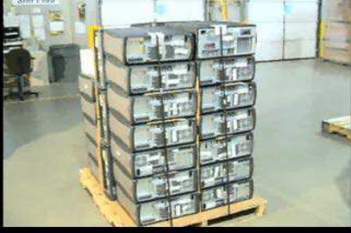
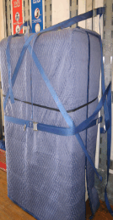
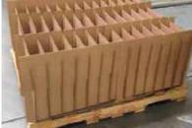


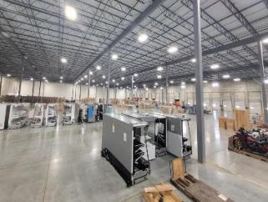

Reverse Logistics
safeguarding assets, ensuring damage-free returns
2-person (+) team with inside pickup
Unique product identification
and tracking
Pad wrapping or packaging services
Disposal, Liquidation, or Inventory
Nationwide Footprint
Specialized Solutions

Slide 16
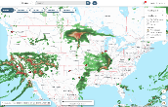

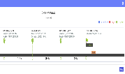


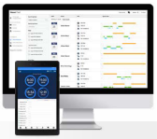
Technology Driving Us Forward
Real-time geo-fenced updates for LTL network
Crossdock piece count scanning
Safety
Visibility to tracking status from pick up to delivery
Friction free dashboard
Service
Interstate Qualcomm tracking
AI active driver coaching & event recording
Evolving features to improve productivity
Efficiency
Notes:
Given the reach of our operations and the diversity of the transportation services offered we continue to make significant capital investments in technology and data fluency. Most of which are behind the scenes that keep our professional drivers and your freight safe.
Weather updates and situational traffic reroutes are important to keep your freight moving.
This connectivity allows for greater accuracy with ETA communication to improve service and load planning efficiency.
Which is particularly beneficial to our stop level receivers. (Multi-stop drivers)
Our technology roadmap is a journey, and we will continue to invest in the success of our drivers and your freight for the long haul.
Notes:
Vantage (CRST proprietary technology platform to support the enterprise)
Vantage: Geo-fenced based alerting system that can be used for weather updates, construction re-routes and other traffic alerts. With push notification to impacted drivers.
Guardian (our internal/external AI augmented camera technology): AI technology with active driver coaching – Interior and External AI technology that provides real time feedback and alerts to the driver. Inward and outward camera system the monitors the road and other vehicles in front of the vehicle. It recognizes poor driving behavior and alerts the driver with an audible notification for things like lane departure, poor following distance, hard braking, etc. it also records these events and then those events can be used for coaching, driver improvement, and exoneration. The inward lens looks for signs of distraction, fatigue, no seat belt, and even use of a handheld mobile device.
ETA: Continued evolution – LME currently provides ETA. Vantage is under development for a more sophisticated calculation.
Can be seamlessly integrated with 3rd party software like MacroPoint, Project44, etc.
SkyBitz trailer tracking/cargo sensors – Real-time visibility to locations of trailers. Notifications of abnormal activity.
Route/Operation Review: Internal process (Dedicated) to refine existing routes and operations based on performance to KPI’s.
VANTAGE also offers exception reporting to driver managers to stay on top of certification requirements and general driver continuity
Driver mobile app – Maven – real time communication and tracking intelligence with associated workflows. Geo-tracking.
Digital document capture and submission, special instructions (gate codes) Customer specific requests.
New Features:
Dedicated – customer facing portal – orders- tracking- temperature deviations – performance data – historical – financial data

Slide 17




Why CRST Specialized?
We manage Solutions differently....
SECURITY
99.5% Damage Free
Sustainable packing processes
QMS programs & processes
TRANSPORT SOLUTIONS
Scheduled network LTL,
Asset Based Full-service TL,
White Glove Final Mile,
Up to $3.5M valuation
"We Manage Solutions Differently”
VALUE ADDS
Warehouse Scalability (no minimum),
Inventory Visibility,
Single Operating Authority,
Control Tower support
TECHNOLOGY
Cross-dock Scanning for LTL,
Warehouse Inventory (CPM) Scanning,
Real-Time Tracking

Slide 18
Questions?
Thank You

