Slide 1

CRST Specialized Solutions
Walmart Business Review
September 25, 2024

Slide 2



Agenda
Executive Summary, Highlights & Challenges
01
Key Metrics and Dashboard Review
02
Current Inventory
03
Opportunities, Conclusions & Actions
04

Slide 3

Executive Summary YTD
483 Active/Pending/Left-Over Projects (4% down from August)
6,003 Cases in Local Project Warehouses (7% down from August)
Regional Hubs @ 1,405 Cases (3.1% up from August)

Slide 4
Opportunities, Challenges & Changes
Strategic Improvement Meetings targeted for October 2024 – working on date*
Coupa billing underway
CPM Payables slippage – Collections is pulling invoice copies to share

Slide 5
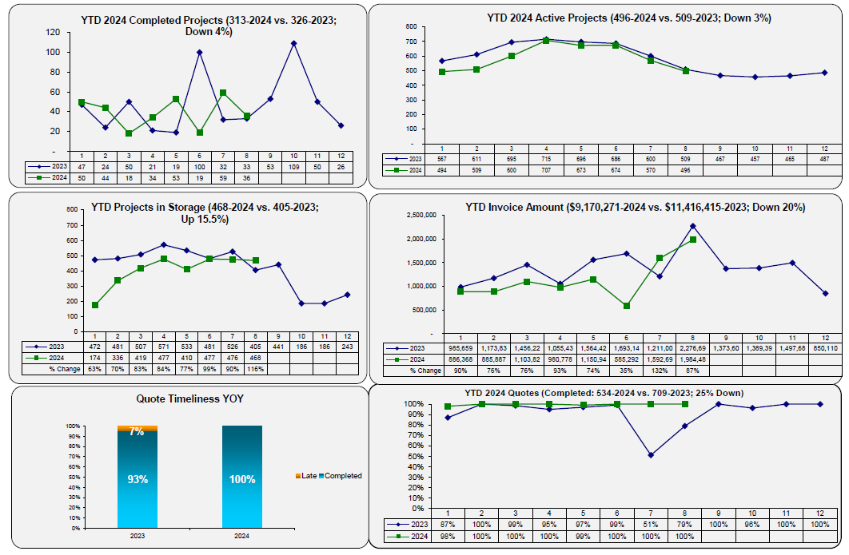
August 2024 Dashboard – Page 1

Slide 6
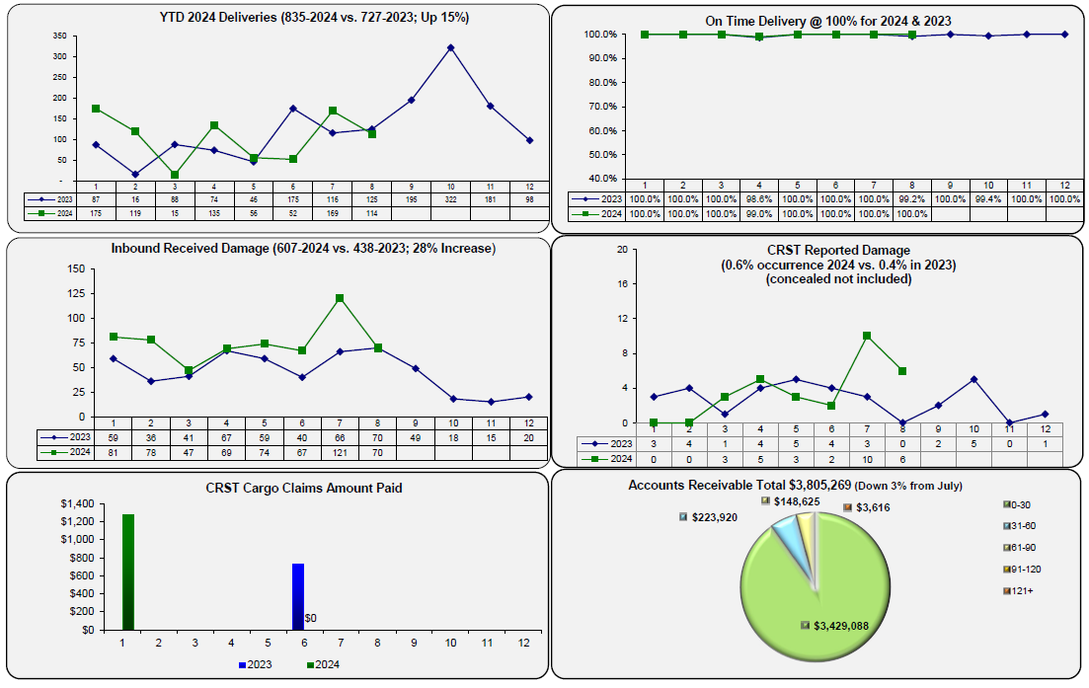
August 2024 Dashboard – Page 2

Slide 7
Local Project Warehouses

Slide 8


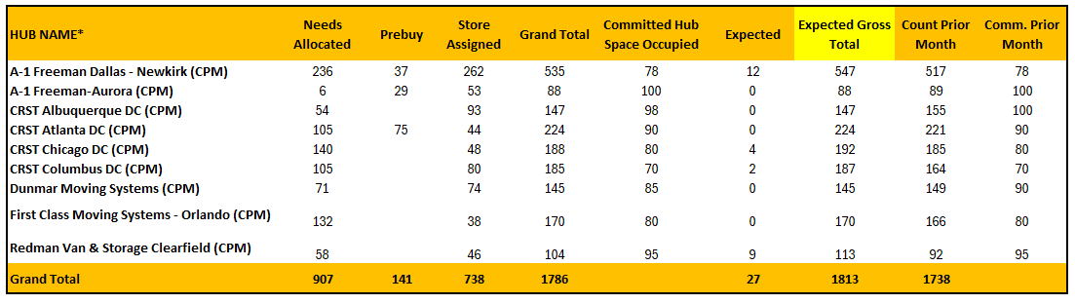
Regional Hubs
HUBS SUMMARY
TOTAL 1,405 CASES
141 Pre-Buys (ITN’s)
907 Reallocations (ITN’s)
738 Store assigned (ITN’s)
TOTAL ITN’S (UOM) = 1,786
(Down 5% from August)
ITN’s or UOM include all items except Honeywell (i.e., cases, evaporators, switchboards, etc.)

Slide 9
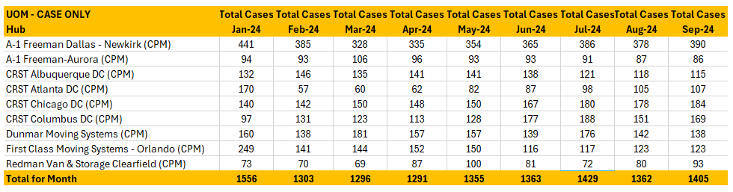
Regional Hubs – Cases Only

Slide 10
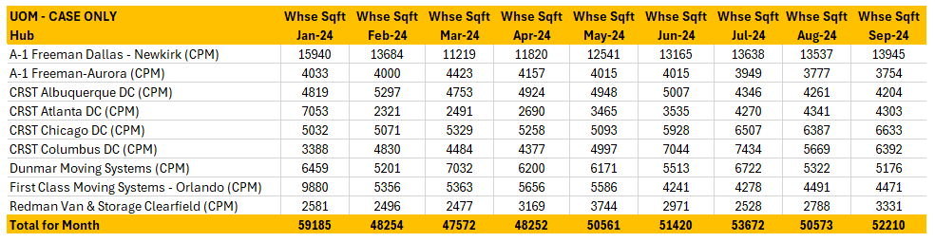
Regional Hubs – Sq. Ft. for Cases Only
NOTE: Case square footage does not include aisle space

Slide 11
“Reallocations” – Hub ITN’s & Dwell Days
*Includes Cases returned from store projects waiting for reallocation or disposition
ITN’s Count (907) for “Reallocations” are up 9% since January 2024
Dwell Days (307) are up 65% since January 2024 for Reallocation ITN’s

Slide 12
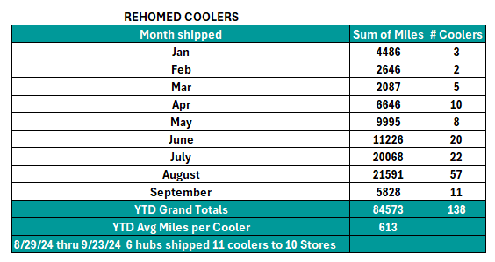
“Reallocated” Cases
*From the Hubs reallocated (“rehomed”) to Stores

Slide 13
“Store Assigned” – Hub ITN’s & Dwell Days
*Includes Cases shipped early by vendors or delayed stores; will ship to Local Project Warehouses closer to Possession
ITN’s count (738) for “Store Assigned” is down 14% since January 2024
Dwell Days (256) for “Store Assigned” are up 75% since January 2024

Slide 14
“Pre-Buys” – Hub ITN’s & Dwell Days
ITN’s count (141) for “Pre-Buys” is up 64% since January 2024
Dwell Days (226) for “Pre-Buys” is up 21% since January 2024

Slide 15
Damages By Category 2024
Warehouse
Damage in CRST Custody
2 New 31 YTD
Delivery Damage
0 New 8 YTD
Damage Occurred in transit or at site
Short
Manufacturer Shipped short
0 New 9 YTD
Inbound Damage YTD
74 New 1,041 YTD
Linehaul carrier damaged goods

Slide 16
Damage Totals by Type
62
Rails & Control Panels
Total Amount
61
Broken Glass
1467 cases have been damaged.
416
Scratches
115
Shelving
2023 vs 2024 Comparison:
431
Dents
2023
1152
2024
1467
27% DMG Increase YTD

Slide 17
Damage Types by Vendor
Damage Ratio
11%
47/422 cases
Damage Ratio 5%
124/2540 cases
Damage Ratio
6%
342/5548 cases
Damage Ratio
9%
553/6048 cases
Damage Ratio
22%
66/299 cases

Slide 18
Custom Deli 2024
Top 2 Carriers
Averitt
2. Central Transport
Case damage fell last month. (12% vs 14%).
# of shipments falling

Slide 19
Hill Phoenix 2024
Top 2 Carriers
Uber Freight
Arch Transport
# of shipments falling as well. 0/27 cases damaged! Bravo!

Slide 20
Hussman 2024
Top 2 Carriers
Landstar
Watco
# of shipments fell as well. Damage percentage almost doubled (6% vs 3 % last month)

Slide 21
Kysor Warren 2024
Top 4 Carriers
TNI
Watco
Landstar
Uber Freight
Slightly lower number of shipments. Only 14 less cases damaged, although 252 less were sent. Why?

Slide 22
Vendor Compliance 2024
Compliance Ratio 74%
194/262 compliant
Compliance Ratio 95%
603/633 compliant
Compliance Ratio 85%
977/1146 compliant
Compliance Ratio 96%
1098/1142 compliant
Compliance Ratio 66%
169/255 compliant

Slide 23
THANK YOU

