Slide 1
CRST Specialized
Supply Chain Solutions
August 28, 2024

Slide 2
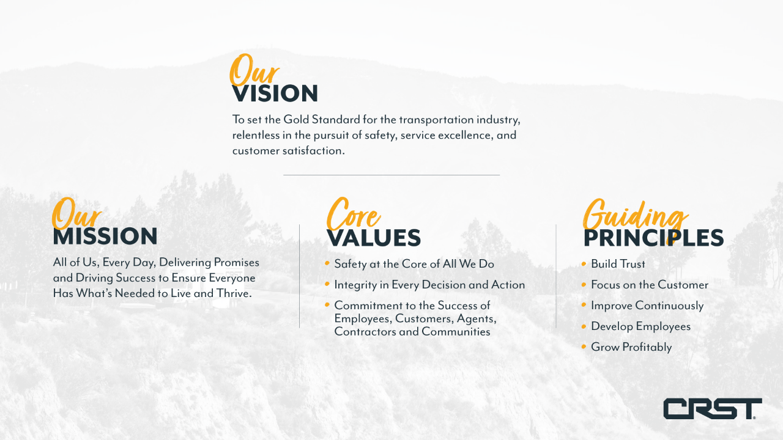

Slide 3


Solutions that go beyond the Traditional
for high value equipment, furniture & fixtures
Transportation Solution & Pricing
Warehouse options that Remove inefficiencies, Reduce risk & cost, and Increase visibility.
Asset-based transportation for products requiring specialized Handling, Equipment &/or Services.
Final Mile “timed” expertise to meet technicians or contractors on-site, and Reverse Logistics asset management & disposition.
02
Warehousing & Inventory Mgt.
Specialized LTL/TL
Timed Final Mile & Reverse Logistics
Specialized Solutions

Slide 4
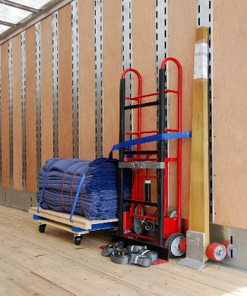
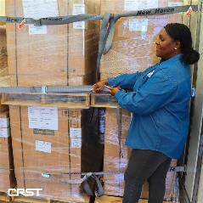
Complex Transportation
We’ve got you covered!
White Glove Service
High Value Products
High Touch Cargo
Full Service Padded Van TL Fleet
BWTL for Customer Load/Unload
Liftgate & Non-Liftgate 53 ft. trailers
Only Nationwide Scheduled LTL Network
360 Weekly Network Departures
59 Distribution Centers in North America
Specialized Solutions

Slide 5
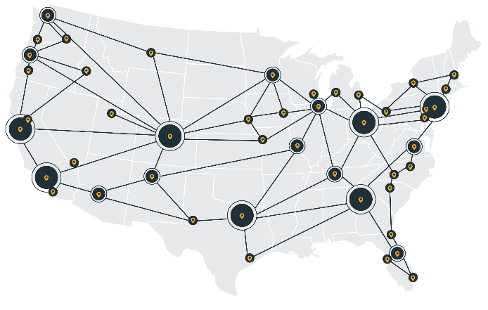



Operating a scheduled service network
59
DISTRIBUTION CENTERS
360
WEEKLY SCHEDULED DEPARTURES
3.1M
FLEXIBLE WAREHOUSE SPACE
100%
REAL TIME VISIBLITY
Specialized Solutions
Notes:
Our Nationwide network runs coast to coast and includes 60+ distribution centers across the country.
At
We schedule 360 weekly departures to keep our trucks moving. Counter to other models where filling the truck is required before scheduling departures
The security and efficiency we gain we from a consistent schedule is another example of how we handle things differently.
5 key lanes with Hub and Spoke routes to cover the United States.
310 Local trucks tasked with pick up and delivery direct from customers
Our 100% CRST exclusive operations (no brokerage or 3rd parties) means we have real time visibility from origin to destination.

Slide 6
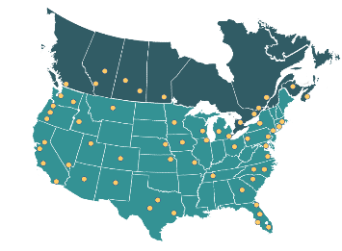
Supply Chain Solutions
providing aggregation and distribution with just in time delivery
ERP integration for shipment registration
Staggered production, imports, or pre-buys
CPM for increased visibility
Real time Warehousing & Inventory Management
Warehouse Integration
Leveraging nationwide footprint to assure minimal transit to project site & full visibility
Timed Final Mile Delivery
Just in time execution
Reverse Logistics
Return, Recycle, Resell or Dispose
Specialized Solutions

Slide 7


Warehouse Integration
…offering the most comprehensive services in the industry
Major Market
DC’s
North American
Footprint
Inventory
Visibility
Over 3M sq ft
of Capacity
Easily
Customized
Well Organised
Flexible
Easily Monitored
Cost Effective
Scalable
Avoid
Capital Costs
No Personnel
Constraints
Project Management
Collaborative
Tools & Teams
Specialized Solutions
Notes:
Warehouse options that Remove inefficiencies, Reduce risk & cost, and Increase visibility.
With no minimum space of duration requirements, we have over 3.1M sq ft of capacity across our warehouse network.
Each staffed with the needed resources to provide white glove transportation to your ultimate customer
With over 50 years experience with complex warehouse execution.
These locations offer strategic warehouse space with On-Demand availability across the country allowing industry leading coverage.
Real time tracking of your products at the granularity you need.
We can assist in the most complex supply chains from door to door with an integrated inventory management platform that offers visibility across all locations.
Flexible operating models
Leased cross-dock
Managed cross-dock
DC or Store to door
Agent network

Slide 8
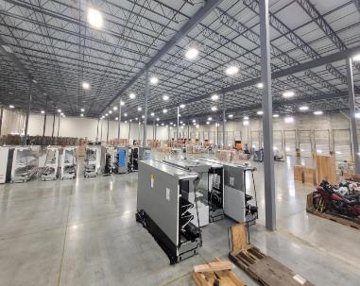
Warehousing Made Easy
EDI, API, XML integration
Scalable model
Custom inventory reporting
Corporate Control Tower managed
On Demand, no minimum option
RF scanning & inventory management (SKU & serial number)
Web-based visibility across all locations
Specialized Solutions

Slide 9
Project Logistics Solutions
Local or regional, multi or single warehouse locations
Corporate Control Tower
Project Initiation
Single Insurance & COI Compliance
Program Management
Communications
With the Customer direct
With all Warehouse Personnel
With Delivery crews & on-site personnel
Single POC From Start to Completion
Assess & Select
Load(s) Assessment
Equipment & Labor Determination
Quality Selection & Confirmation
Functionality Verification
Specialized Solutions

Slide 10
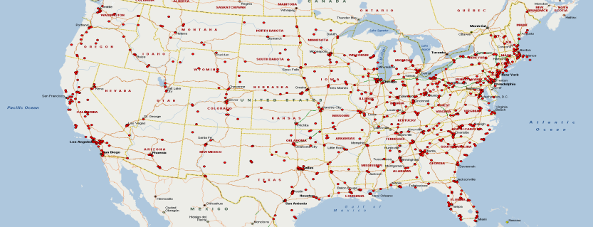
Project Warehouses
OVER 1,200 PROVIDERS NATIONWIDE (INCLUDES 59 DC WAREHOUSES)
250+ CONSISTENTLY USED FOR “ON-DEMAND” WAREHOUSING
ADDITIONAL WAREHOUSING, LABOR, DELIVERY & CROSSDOCK SUPPORT
Specialized Solutions

Slide 11

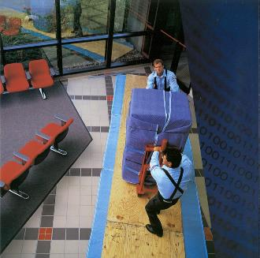



Final Mile Capabilities
WHITE GLOVE
ON-DAY, ON TIME
2 MEN+, LIFTGATE
INSIDE PLACE
Minor Assembly – Extra Labor - Packing/Unpacking - Debris Removal – Returns
Specialized Solutions

Slide 12
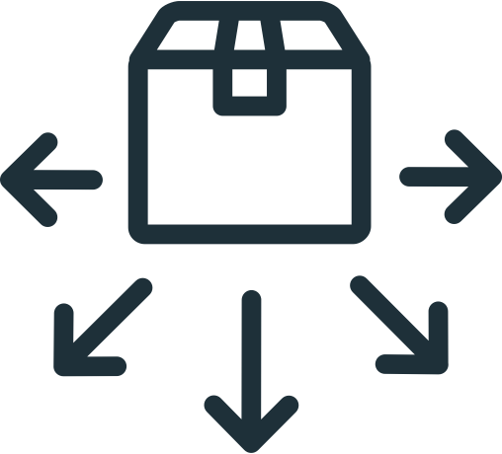
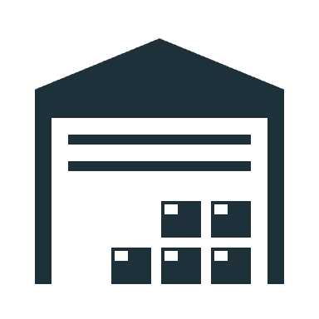
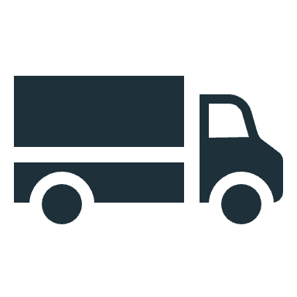
Total Solutions
...over 5,000 stores and 46,000 units delivered
FINAL MILE WAREHOUSING
TIMED FINAL DELIVERY
REGIONAL HUB WAREHOUSING
Pre-Buys, Store Specific & Reallocations
Warehousing with Inventory Management
Single or multi warehouse locations
Closest to Project Store(s)
Remodels, New Builds, Capex & Special Projects
Over 250 warehouses used daily
Scheduled just in time to meet Installers
Store Transfers
Reverse Logistics asset management & disposition
Specialized Asset-based transportation Equipment designed to service Unique Products like yours.
Specialized Solutions

Slide 13
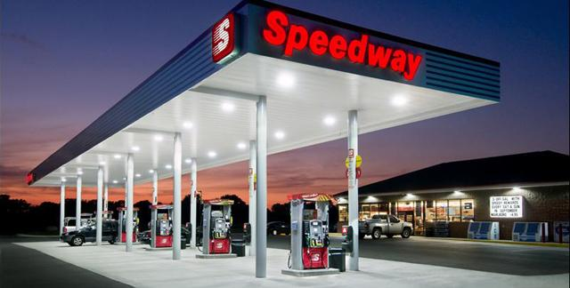
Total Solution Example
Forward Stocking – 1200 stores, 93 SKUs per store, and 16 suppliers
Supplier Management & Direct Ship – Padded-van Truckloads from 2 suppliers direct to store; 14 SKUs per truck
Order Fulfillment – 1348 store POS systems; 41 SKUs; 17 Suppliers
Reverse Logistics
Specialized Solutions

Slide 14
Reverse Logistics
Serialization capture on pick up
2-person (+) team with inside pickup
Pad wrapping or packaging services
Disposal, Liquidation, or Inventory
Nationwide Footprint
Specialized Solutions

Slide 15
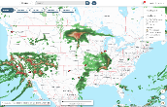

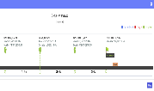


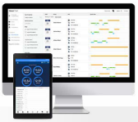
Technology Driving Us Forward
Real-time geo-fenced updates for LTL & Local Final Mile
Crossdock piece count scanning
Safety
Visibility to tracking status from pick up to delivery
Friction free dashboard
Service
Interstate Qualcomm TL tracking
AI active driver coaching & event recording
Evolving features to improve productivity
Efficiency
Specialized Solutions

Slide 16




Why CRST Specialized?
We manage Solutions differently....
SECURITY
99.5% Damage Free
Sustainable packing processes
QMS programs & processes
TRANSPORT SOLUTIONS
Scheduled network LTL,
Asset Based Full-service TL,
White Glove Final Mile,
Up to $3.5M valuation
"We Manage Solutions Differently”
VALUE ADDS
Warehouse Scalability (no minimum),
Inventory Visibility,
Single Operating Authority,
Control Tower support
TECHNOLOGY
Cross-dock Scanning for LTL,
Warehouse Inventory (CPM) Scanning,
Real-Time Tracking

Slide 17
Thank You

