Slide 1
Briefing design
The-datagarden.io

Slide 2
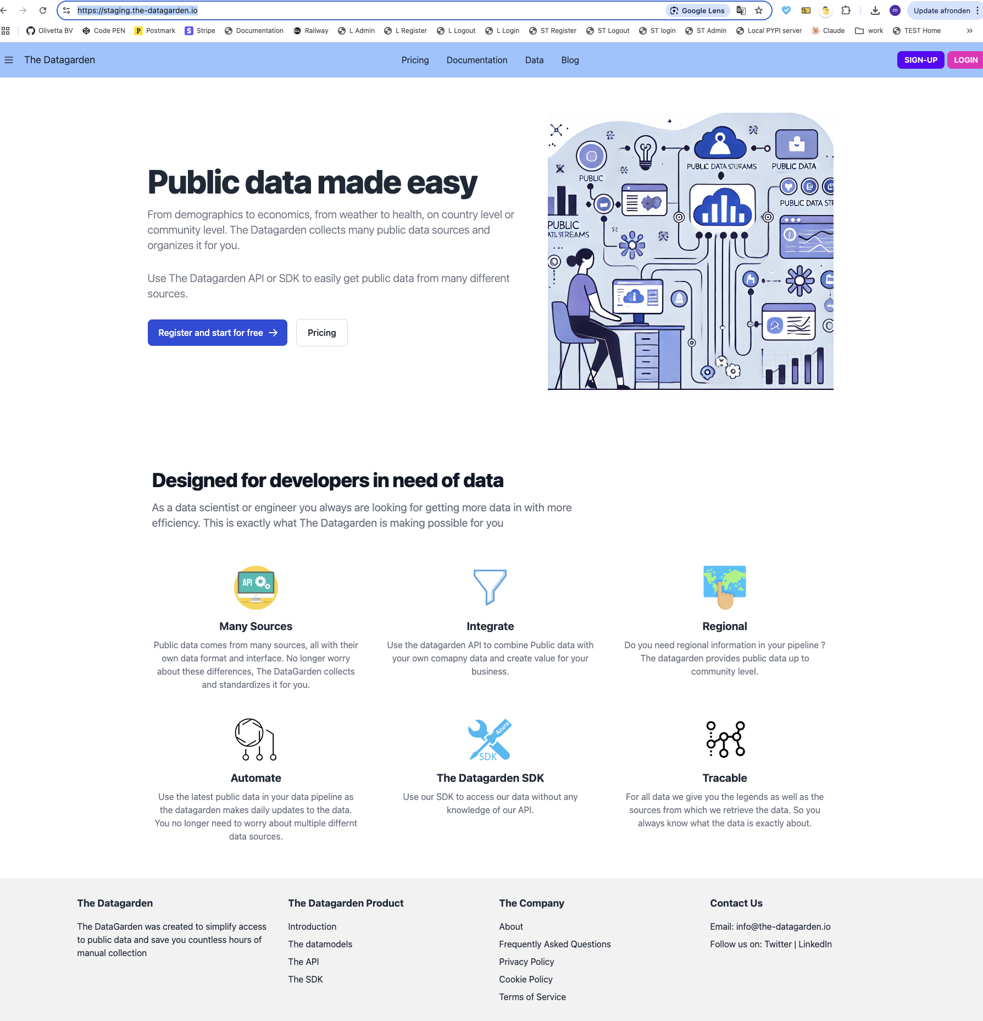
Current HP on staging
Website currently under development
Staging can be found add
- https://staging.the-datagarden.io/
Clearly some design is need

Slide 3
Scope of Homepage design
1. Design overall color schema
2. Design header
3. Design company logo
4. Design big visual on HP.
- This one is way to busy.
5. Design the 6 incons.
- These were just taken from the web to have something
6. Design the footer
Website is build using tailwind css.
Backend is build in django.

Slide 4
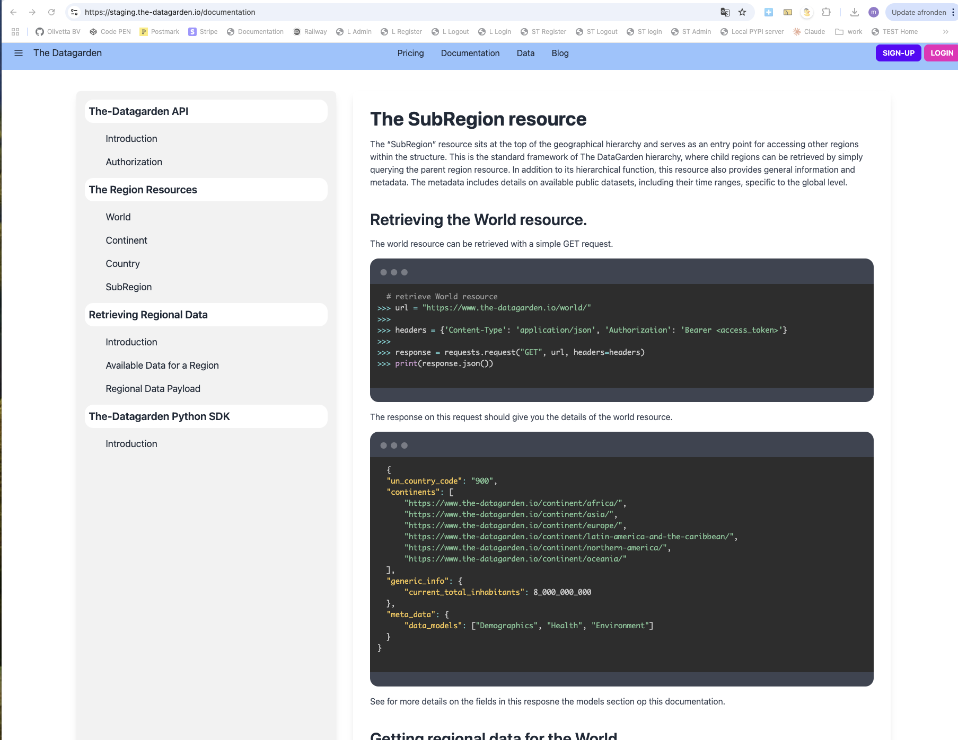
Current documentation page on staging
https://staging.the-datagarden.io/documentation

Slide 5
Scope of documentation page
1. Design Menu
2. Design the page

Slide 6
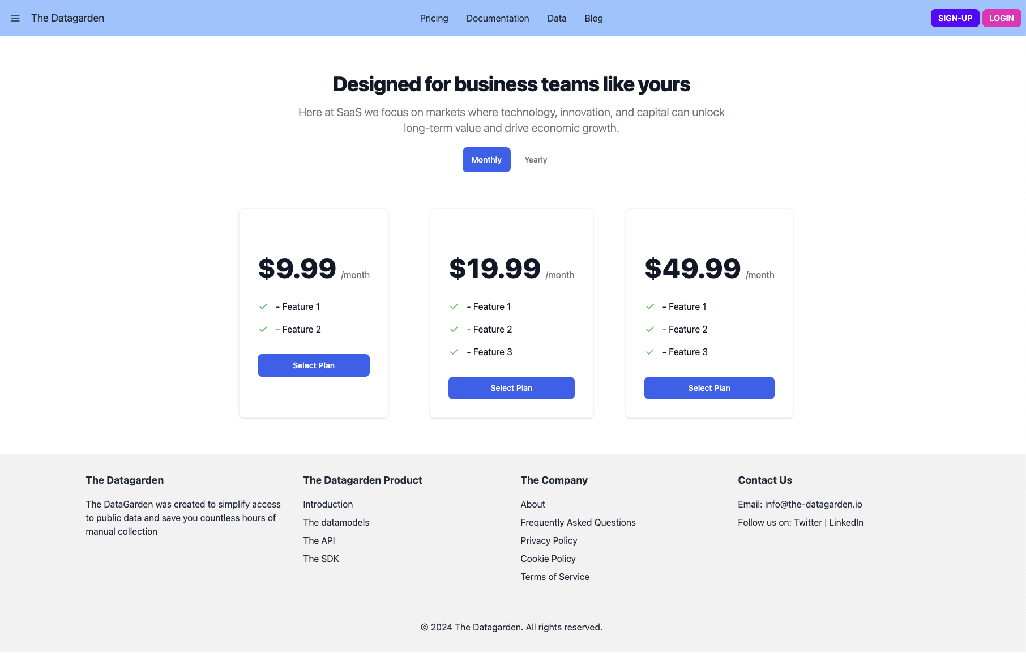
Current pricing page on staging
https://staging.the-datagarden.io/pricing/

Slide 7
Scope of pricing page
1. Align pricig page with color scheme
2. Refresh improve where needed

Slide 8
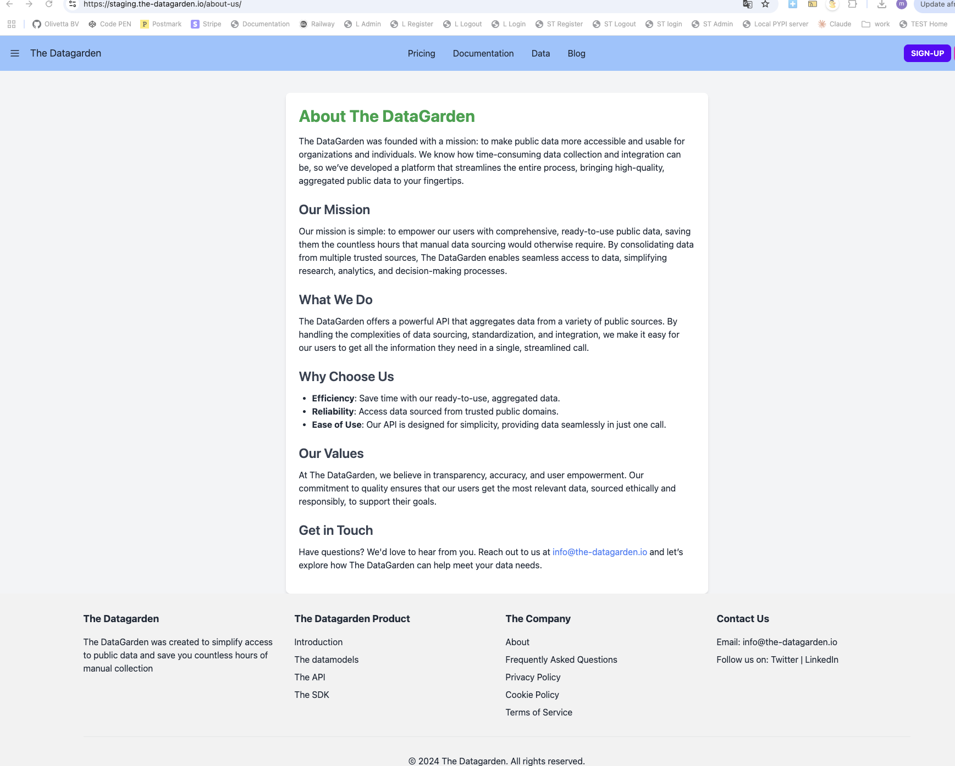
Current generic content page on staging
https://staging.the-datagarden.io/about-us/

Slide 9
Scope of generic content page
1. Align page with color scheme
2. Refresh improve where needed

Slide 10
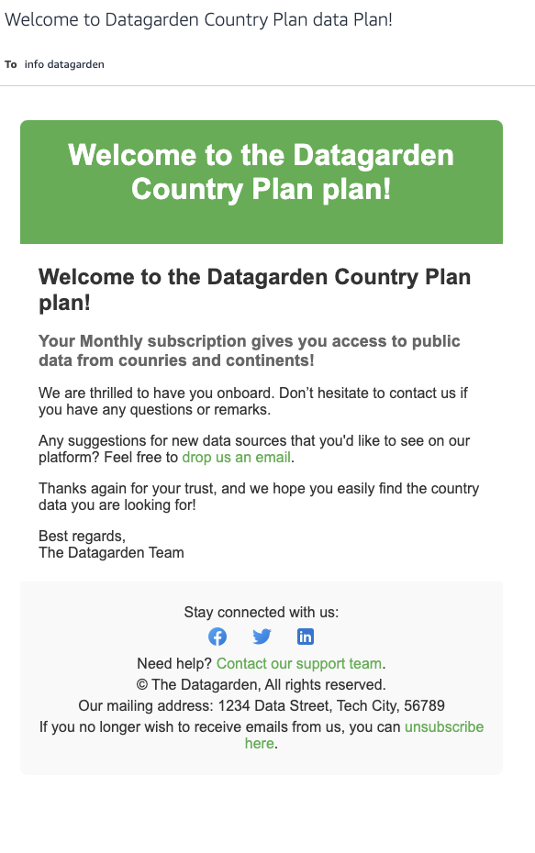
Current emaild design

Slide 11
Scope of email design
1. Align page with color scheme

