Slide 1
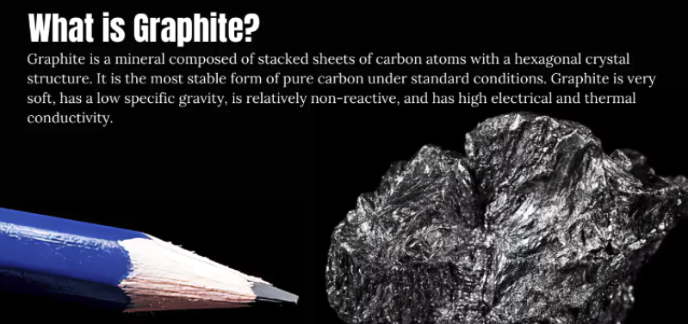
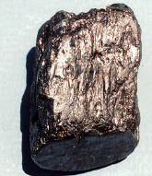
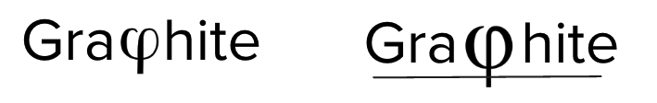
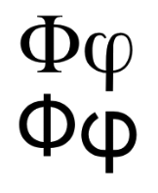
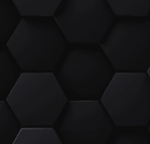

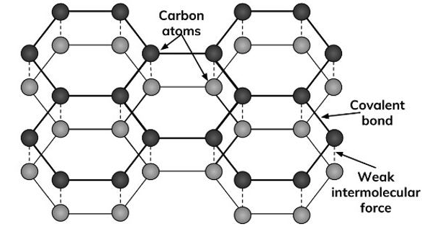


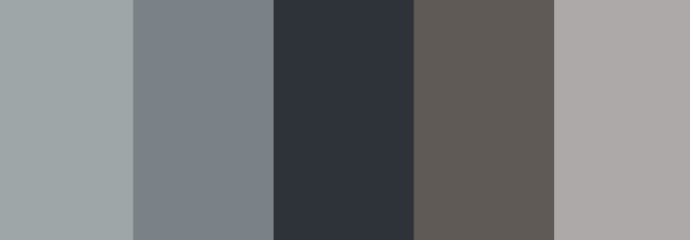
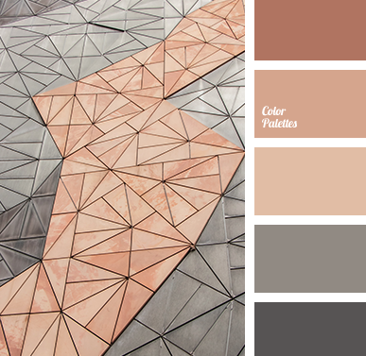
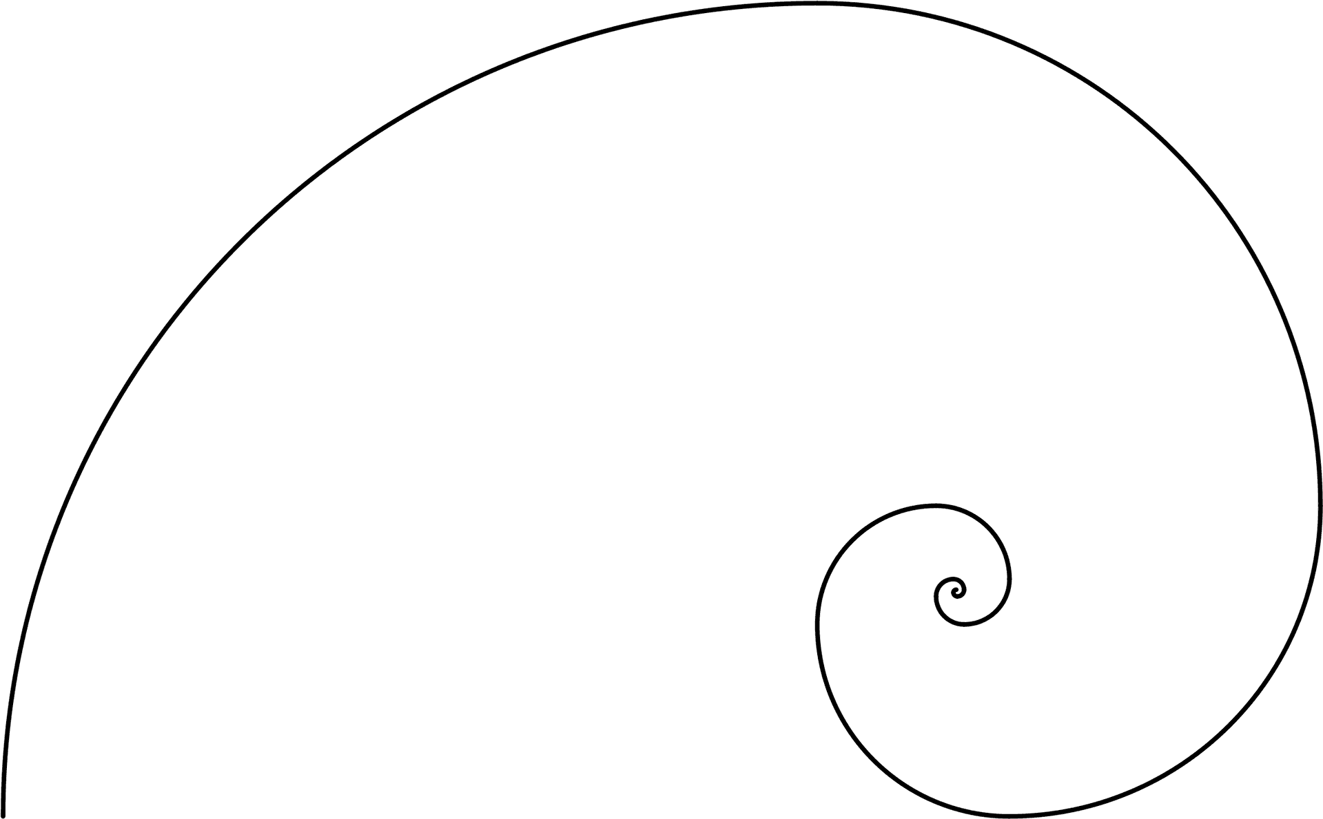
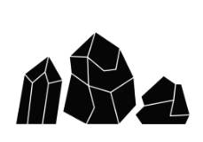

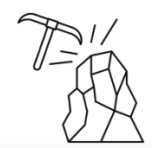
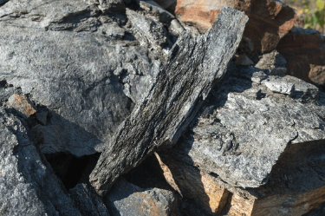
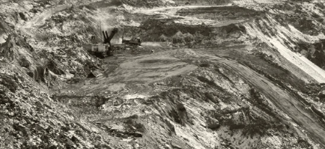
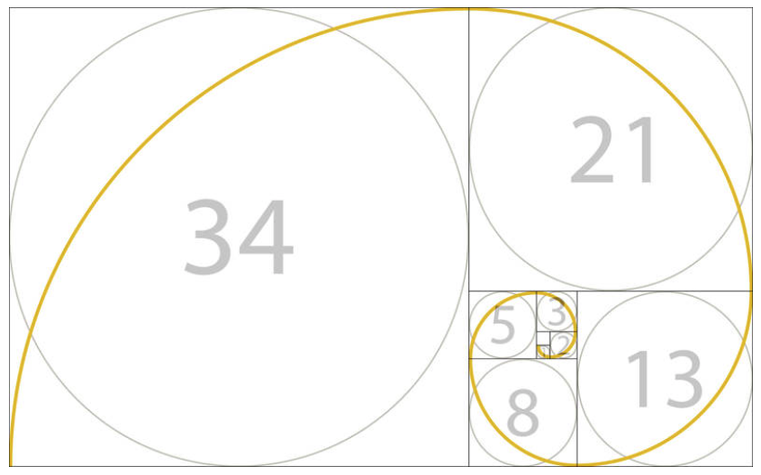
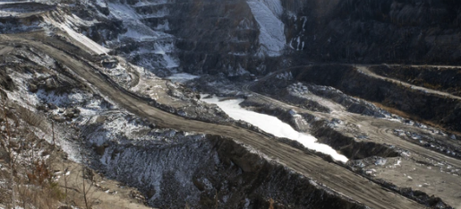
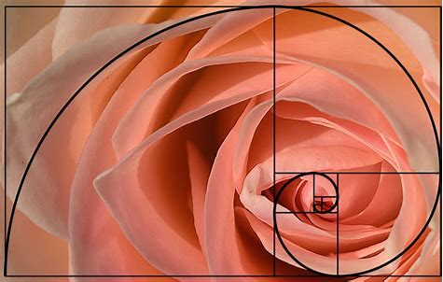
Brand creation process | Brief for logo
Brand creation
Company context and Logo philosophy | What do we want the logo reflect? (values, culture, etc) | Characteristics (lool&feel) Main colours and typography | Other visual elements for reference
Company context Our company name is Graphite. We aspire to become a leader in operations consulting services by leading our clients in their business and operations transformation. Target industries: primarily Mining Energy/Utilities, Pulp & Paper Location: South America, mostly Chile Our values: Excellence, Fun, Impactful Diverse Logo philosophy: Lean into the “Golden ratio”, also known as the golden number, Phi, 1.618. The name integrated the Phi ”graphite” Graphite is a type of carbon so is linked to the industry (mining) We can link it elements of nature too good colour palette using the graphite tones and nature (black, silver, green, gold, etc) The name is easy to understand in English and Spanish Rich imagery about graphite, nature, etc for designing templates and collateral | Our values: Excellence, Fun, Impactful Diverse Colour palette: Use colours that represent graphite but also nature Simplicity: It has to be simple but elegant and professional Originality: play with the word “Phi” in graPHIte Neutral: giving the space to tell the story we want around the logo | Black, silver, copper, graphite Play with the colour palletes added in visual elements
Notes:
Project name: Graphite logo
Text description: we need a logo design for a new company named “Graphite” that is based in Chile. our company offers consulting services in business operations and transformation with a set of technical expertise, consulting and technology capabilities. We want a neutral logo design that integrates the concept of the “Golden ratio”, also known as the golden number, Phi, 1.618. Using colours that represent graphite but also nature, being simple but elegant and professional.
Logo text: Graphite

Slide 2
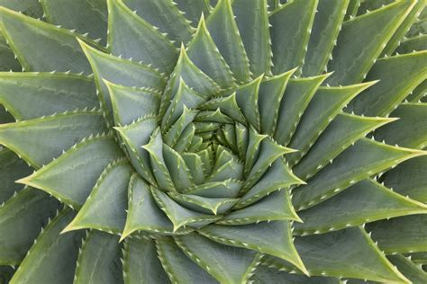
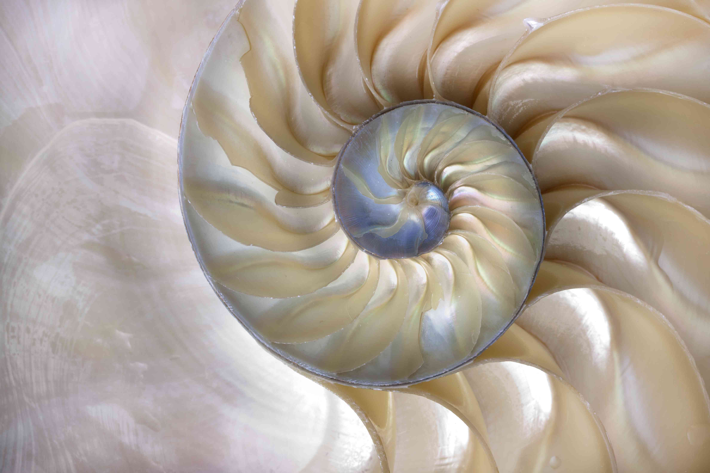
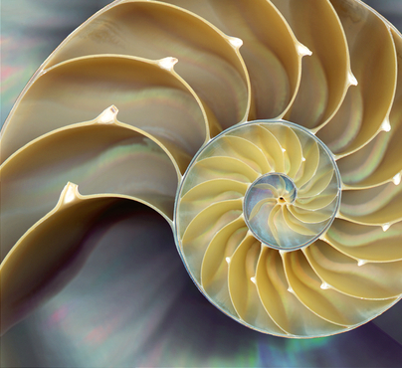
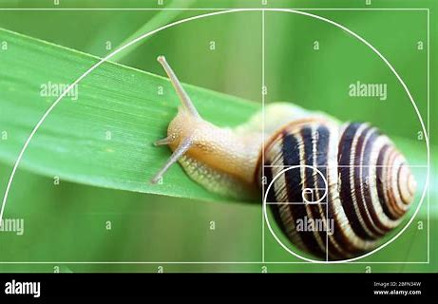
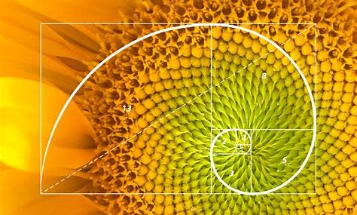
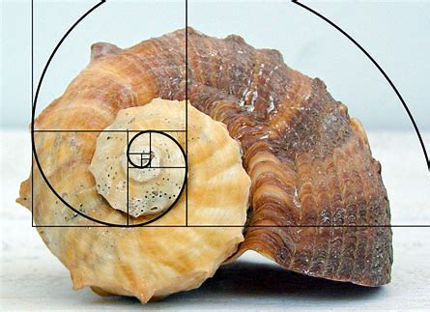
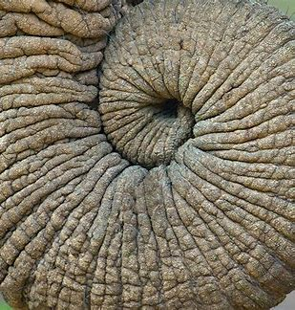
Golden ratio in nature
Brand creation

Slide 3
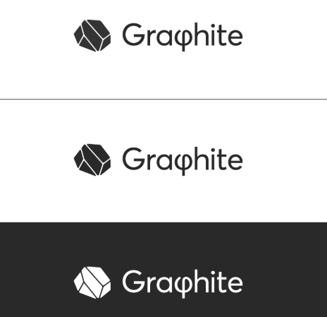
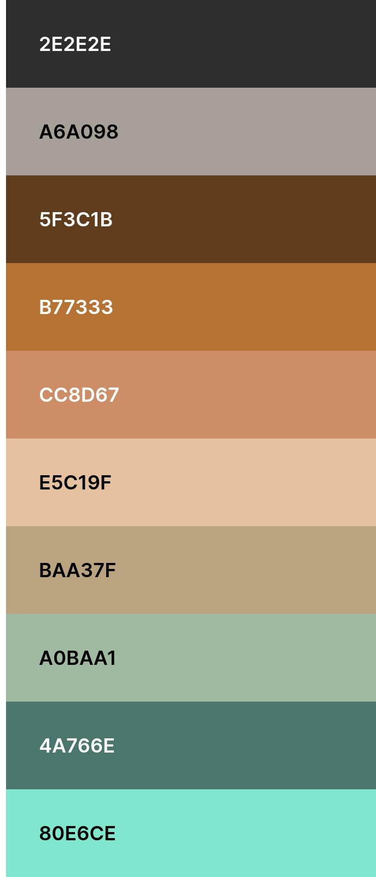
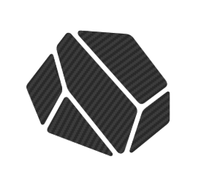
Graphite logo
Brand creation
Monochromatic Logo | Colours
Typography: ok PHI: ok Mineral element: ok Colour: OK | Draft: 1 logo in each colour of the palette

