Slide 1
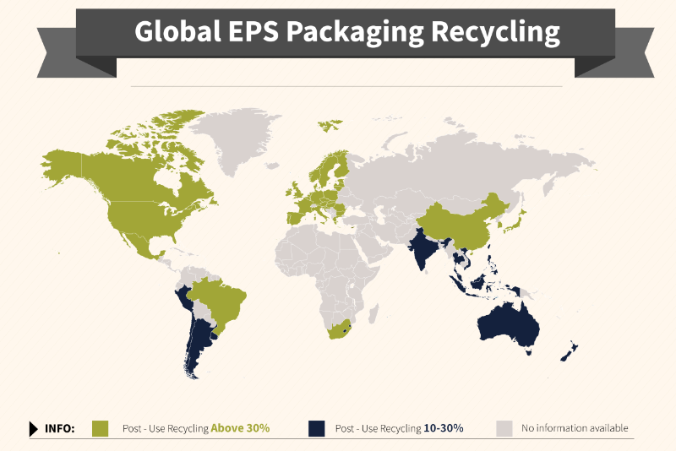
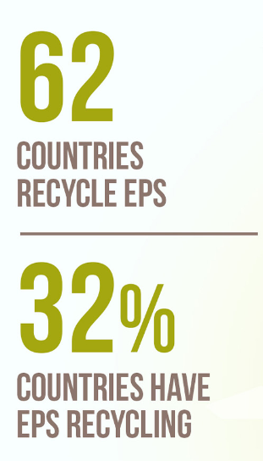
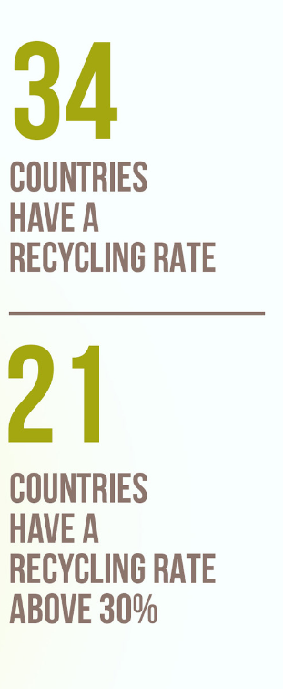
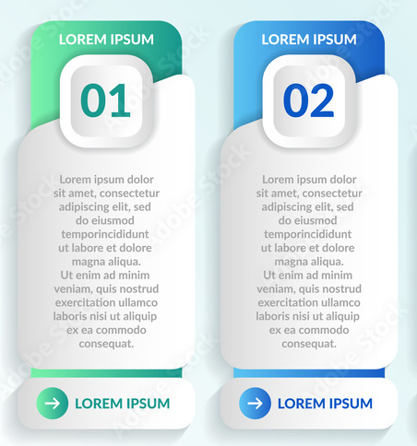
Leading EPS Recyclate Sources Worldwide
automotive
Seafood & fisheries
Furniture
Automated manufacturing assembly parts packaging, cold chain shipping containers for fresh fish, bracing for furniture distribution & packaging protection for appliances are key sources of EPS transport packaging being diverted from the landfill or otherwise mismanaged disposal practices.
The Global Plastic Pollution Treaty Will Facilitate Improved Data Collection Through Mandatory Reporting Guidelines.

