Slide 1
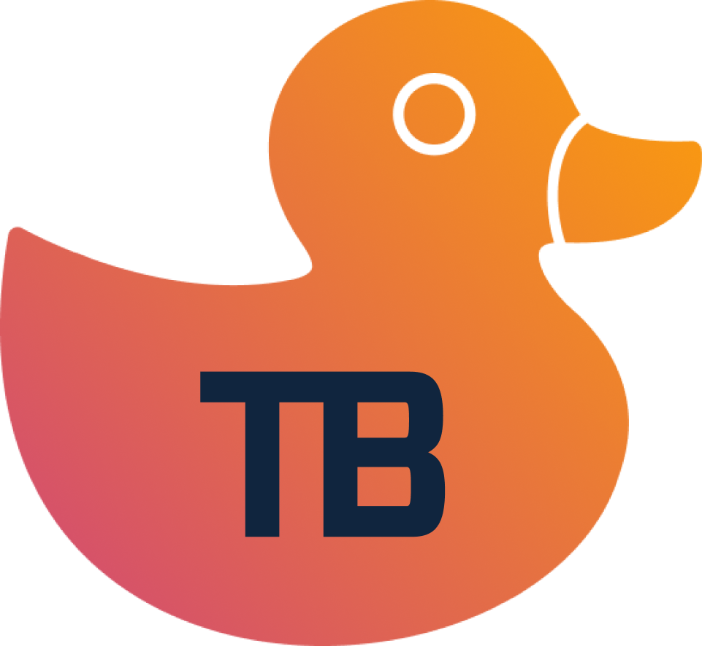


FTO Platform
TB
Operating System for Fair Token Offerings
@tokenbuilderai
Notes:
FTO Platform is a larger concept than just a "launchpad" and our end to end approach could be simply called "Operating System".
DeFi
Inclusive
Transparent
Fair
Duck logo will be TB logo, not just DIAR, as it makes a good backstory on how we are all about having duck in a row and crypto companies catching up with Silicon Valley VCs on due diligence and stop this anynomous BS that has just been enablier of trolling, fake news and scamming, the exact thing this even Elon Mask with X is fighting against.
This deck is about writing everything in clear simple text and next step is that once we agree that the basics are good, we make it all exciting and sexy. But we have to be albe to explain it all so simple story as foundation.

Slide 2


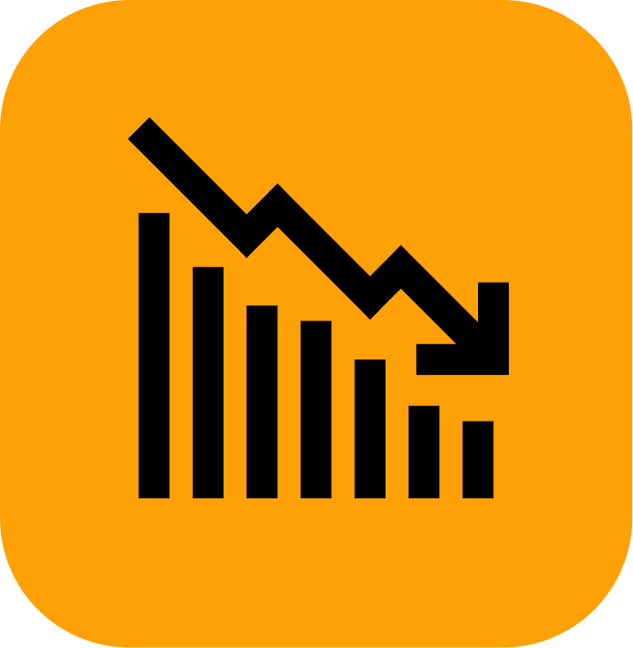

The Problems
The blockchain infrastructure is ready to scale. To go mainstream, we need to eliminate scams, improve tokenomics, and start building killer apps to drive crypto adoption.
These are the problems we are working to solve:
SCAMS & RUG PULLS
INFLATED EARLY MARKET CAPS
Lack of transparency and anonymous teams lead to scams and rug pulls
Early token price gains occur in private markets, significantly limiting retail investors upside
LOW CIRCULATING SUPPLIES
NO KILLER APPS
Low circulating supplies are restricting liquidity and limiting price discovery
The crypto sector needs new groundbreaking dApps to attract and retain millions of users

Slide 3
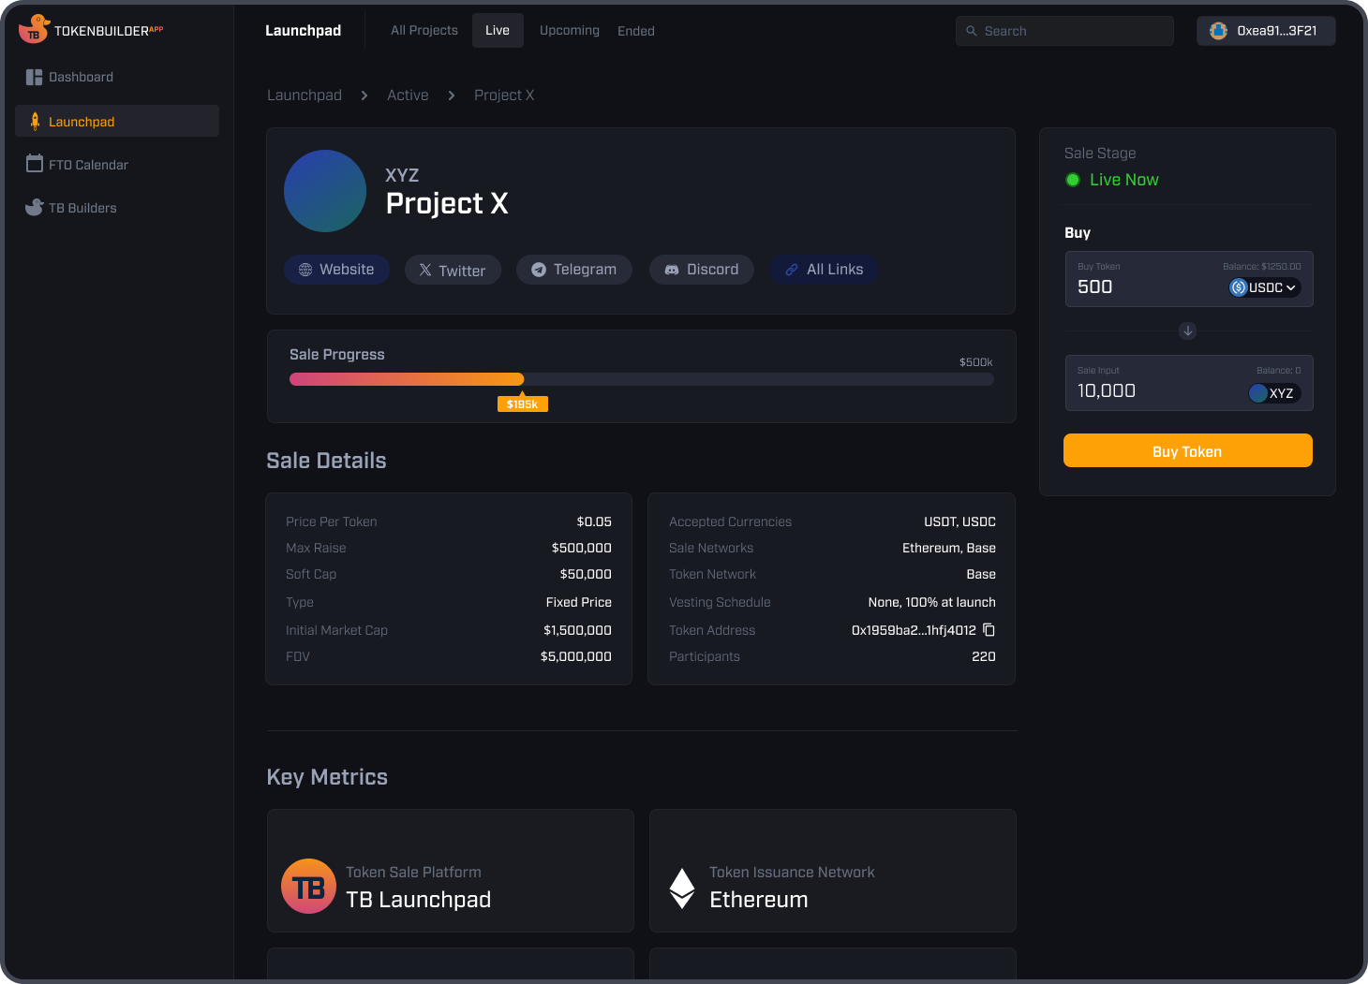

Why Fair Token Offerings?
Defition of FTO will continuously evolve as we embrace new best practices and explore innovative methods to enhance token launches for both builders and investors
DEMOCRATISED ACCESS
Anyone can invest in the private round
SIGNIFICANT INITIAL FLOAT
At least 20% of tokens floating from the start
ACCESS TO LIQUIDITY
Clear schedules for secondary market trading on DEXs and CEXs
IMPROVED TRANSPARENCY
Basic Due Diligence to eradicate rug pulls
Notes:
We should all the time keep and adjust a list of thing that makes FTO. Not all needs to happen but if the private sale is open for the everyday investors, and initial float is over 20% and we know who is behind the project we could call that a fair token offering.
This list should be a topic on our Discord so that other can comment, give their opinions and suggestions.

Slide 4
FTO Platform Process
From announcing your Token Offering to making it tradable on exchanges, TokenBuilder provides you with the tools and insights you need from start to finish
FTO Calendar
DIAR
Marketing
Fair Token Offering
Secondary Market
Community Interest
Transparency
Narrative & Content
Liquidity Bootstrapping Pool
DEX
Investor Interest
KYC / Compliance
KOL Network
Fixed Price
CEX
Building Consortium
Tokenomics
Community Marketing
Node Sale, etc.
Market Making
Notes:
Here, we basically want to show that how with TB tools, projects have Fair Token Offering Operating System.
On FTO Calendar
Is different than just having a Web3 project listing as Calendar gives a promise of things happening and in this case it means FTO so liquidity event of some sort.
We want people to start follow the project as just Members (Community members) or as Investors.
Consortium can also be Syndicate but that job is to make sure that promising projects has first $10-50k done.
DIAR will be designed purely to be a Duck In A Row tool for FTOs. We should strongly recommend projects for doing the DIAR first as it prefills the FTO Calendar.
Marketing will completely be build around Narrative, Content and Community (KOLs are part of community).
Also, we can't really make marketing work unless we have performance based, we need to know marketing efforts convert to our marketing goal of having a bigger community, more people reading your content or more people investing in a FTO.
On FTO section, we will first start with the LBP and FP (fixed price) smart contracts as then we can serve all obvious clients and do our own FTO.
Secondary Market / DEX:
Is Uniswap our goto DEX? How can we integrate with them?
I would like to have our own market making tool for Uniswap.

Slide 5
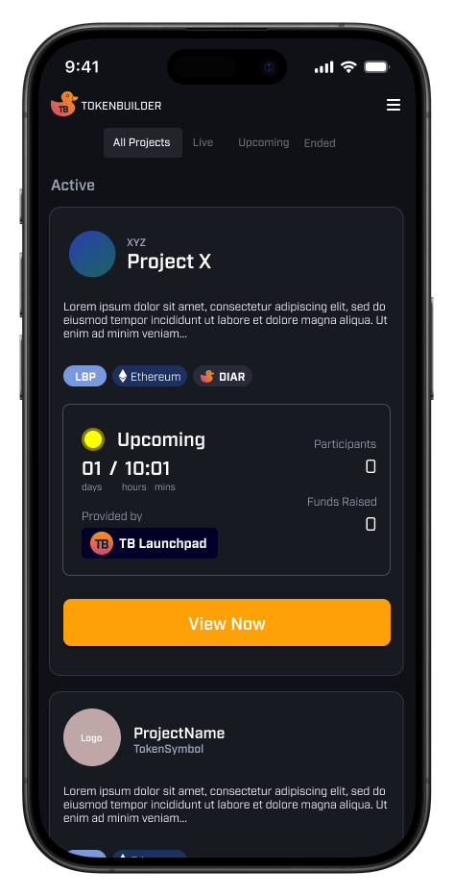
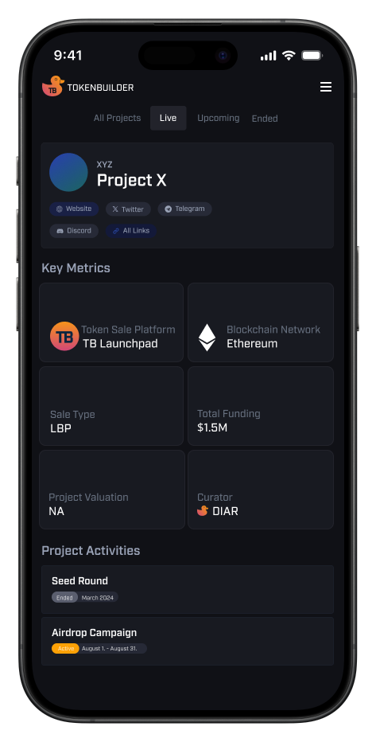
FTO Calendar
The FTO Calendar is the first step in making your project public, allowing you to build a community, investor interest and gain visibility
Build Investor base and Community
Provide Regular Updates: Daily, Weekly, Monthly
TB Members can do their own research
Link additional info, such as Github
Notes:
Might be cool here to have a large screenshot of the FTO calendar and have rows pointing to specific sections of the screenshot to depict and explain the calendar's key functions

Slide 6

DIAR - Ducks In A Row
Project due diligence is crucial for making your project attractive to investors. TokenBuilder's DIAR system is designed to align with venture capital standards. The more 'ducks' in place, the better the information provided, enabling investors to conduct thorough research
BASIC INFORMATION
TOKENOMICS
TEAM VERIFICATION
INCORPORATION DOCUMENTS
BUSINESS PLAN, ROADMAP, AND WHITEPAPER
CAPTABLE DISCLOSURES

Slide 7

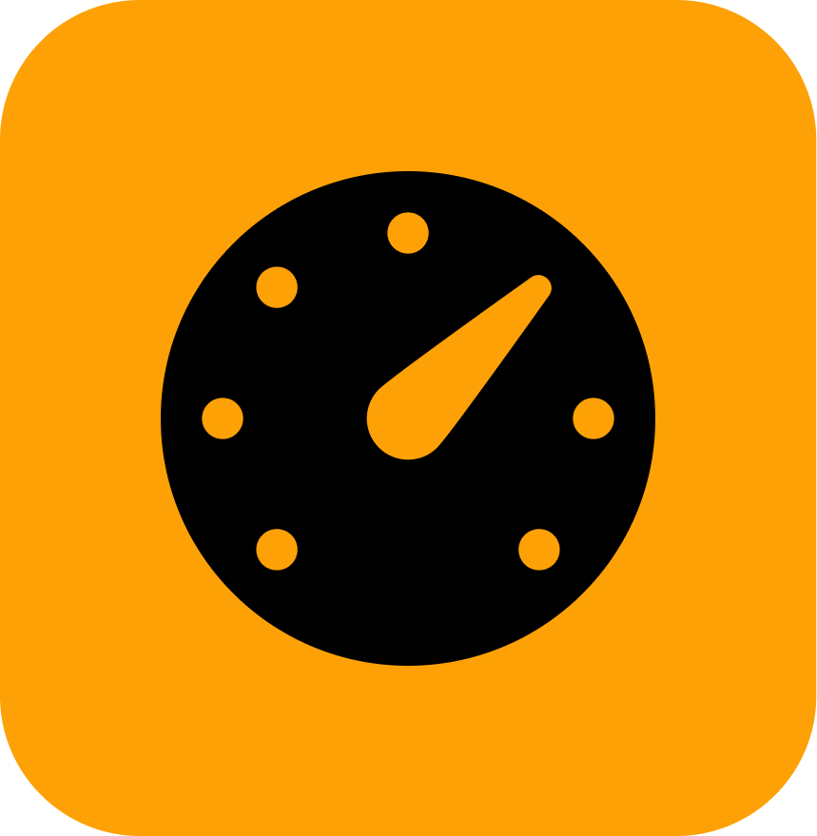


Marketing & Community Building
We believe good content and community engagement are key to successful projects and token offerings. Our platform measures marketing performance, including community growth, content reach, and funds raised. We also offer a KOL Network and an Ambassador program, both aligned with each project's goals
KOL Network
Performance-Based Incentives
Narrative Crafting
Community Platforms & Tools
Engage with key figures who drive community interest and mobilise targeted audiences
Reward KOLs and Ambassadors based on results and value added
Create a compelling, relatable story that resonates with your audience
Utilise TB Point System, Zealy, and Galxe to boost engagement

Slide 8


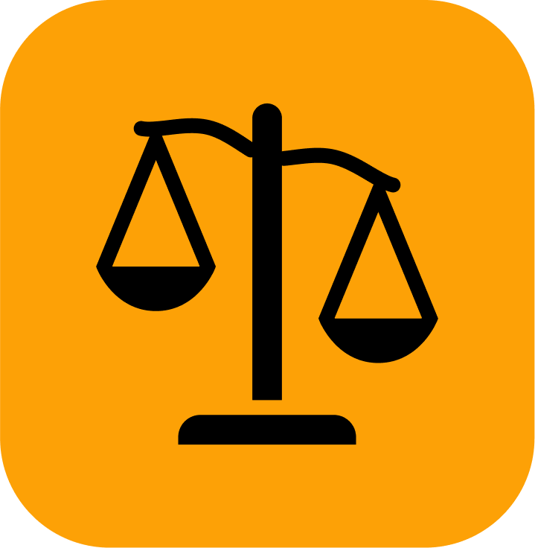

The use of AI
TokenBuilder's AI is a suite of specialised, vertical agents that assist builders and investors with all aspects of FTOs. By combining top language models, proprietary data, and extensive training, TBAI delivers real value for token offerings
COPILOT:
On-chain agent for builders and investors with sector-specific knowledge
TOKENOMICS:
AI-reseach and intel on pricing, allocation, utilities and distribution strategies
LEGAL & COMPLIANCE:
Automated legal opinions and corporate structure recommendations
MARKETING:
AI-driven content creation, A/B testing, and performance auditing

Slide 9
FTO Launchpad
Tailored Solutions for Every Token Offering
Liquidity Bootstrapping Pool:
Dutch Auctions ensure fair pricing
Current market leader Fjord Foundry has done $1 billion over the past 24 months
Fixed Pricing:
Equal opportunities for everyday investors with no allocation minimums
Node Sale:
Compliant with tighter DeFi regulations
…and more:
Next great token issuance method is…
Notes:
We will start with LBP and FP (fixed price) smart contracts. The key thing is that they are fully integrated with our KOL Network.
- KYC will be required
- US investors blocked
Node Sale - we add once there is demand and same with any other new formats. License for node.

Slide 10
Crypto Exchanges
TokenBuilder recommends all new token offerings set a clear agenda when the token will be available on secondary market trading on crypto exchange(s)
Secondary market action.
Rule of thumb: Decentralized first, then Centralized (if needed)
Centralized Exchanges:
Gatekeepers for listings
No transparency on real volumes
Outrageous listing fees
Bad customer service
Market Makers
Monthly fees (illegal on stock market)
Float given by Token Issues
Market makers make money either way
Decentralized Exchanges (DEXs):
Uniswap
SushiSwap
Raydium
Notes:
We need to promote and have guidance on how to list token on Uniswap (or any other DEX) as marketed in the FTO.
I think we should say on the deck why there tied 2-3 exchanges are bad idea:
- Real volume murky
- Launch strategies (selling marketing token)
- On normal market benefit non-existing

Slide 11




TBAI Token Utilities
TokenBuilder's TBAI token utilities include staking, governance, AI training, and airdrops.
These will evolve as the platform grows
STAKING:
By staking TBAI, members receive early access to information, allocation, and airdrops on FTOs
GOVERNANCE:
Influence project quality and transparency through voting on ideas, transparency, tokenomics, etc.
AI TRAINING:
Earn tokens by training the platform’s vertical AIs
Link to TBAI Tokenomics Paper
Notes:
Staking:
Governance:
AI Training:

Slide 12

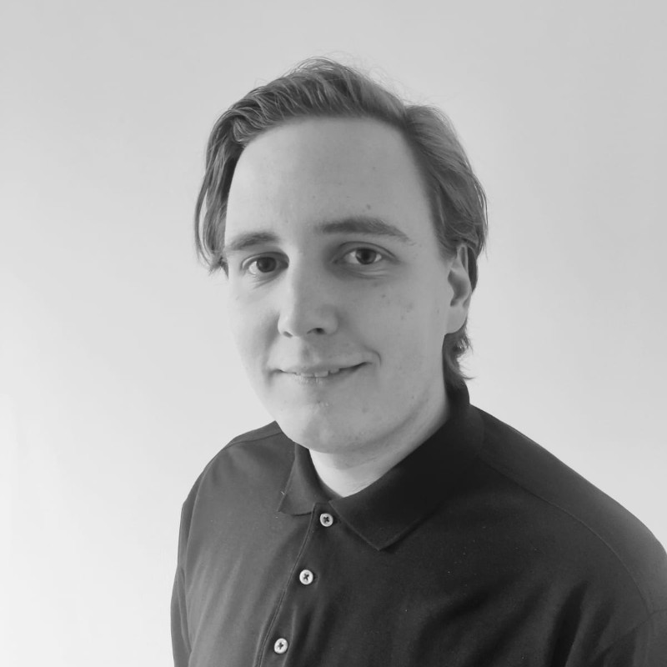
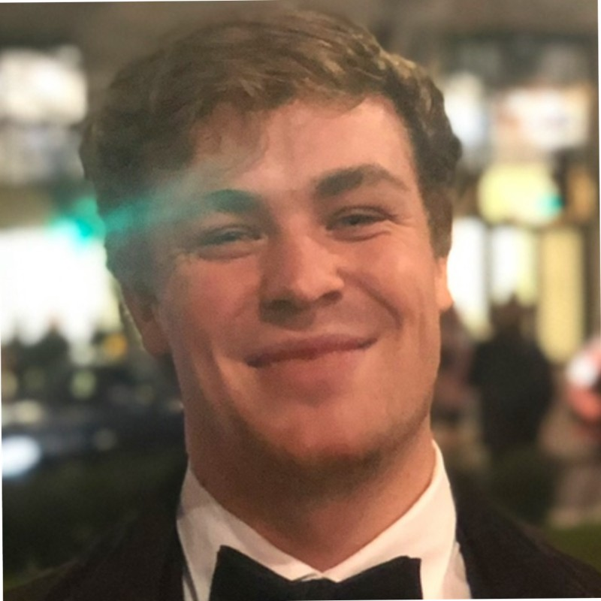
Team
The team has 8 years of experience in token issuances and has managed over 30 ICOs
Ransu Salovaara
Our team has been operating in the space since 2014, witnessing the launch of Ethereum, the DAO crash, the ICO era, DeFi summer, and beyond.
CEO
ransu@tokenbuilder.ai
Junnu Salovaara
Background:
Europe based team: France, Finland, Italy, and United Kingdom
10 years expertise in crypto with 8 years in token issuances:
  Managed 30 ICOs that raised $300 million for clients
  Previous clients include: Civic, Strj, Dent, Crypto.com
TokenBuilder investors:
Shima Capital, DAOmaker, Gate.io, FishDAO
Head of Product
junnu@tokenbuilder.ai
Eric Della Casa
BD
eric@tokenbuilder.ai

Slide 13
TokenBuilder Ltd.
BVI company with a registration number 2069459
Email: team@tokenbuilder.ai
Telegram: @tokenbuilderai
Website: tokenbuilder.ai
@tokenbuilderai
Notes:
Our company is registered in British Virgin Islands with the same name as we do business with TokenMarket Ltd. (Limited) and I am the Director of the company and the company is in good standings.
In BVI companies can do token sales for themselves and our FTO business do not require crypto license in BVI.
As our business evolves, we are prepared to apply for a crypto license in BVI and elsewhere as needed.

Slide 14
Appendix
@tokenbuilderai
Notes:
Our company is registered in British Virgin Islands with the same name as we do business with TokenMarket Ltd. (Limited) and I am the Director of the company and the company is in good standings.
In BVI companies can do token sales for themselves and our FTO business do not require crypto license in BVI.
As our business evolves, we are prepared to apply for a crypto license in BVI and elsewhere as needed.

Slide 15
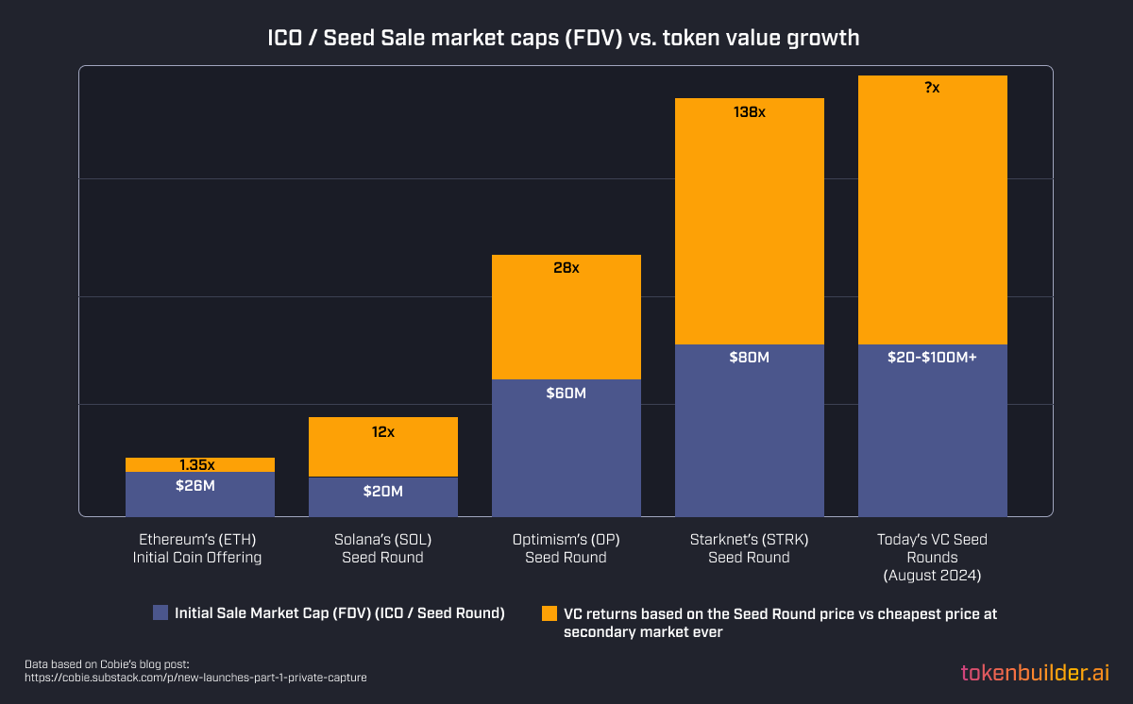
Price appreciation happens in private markets that are only accessible to VCs
This sale structure significantly limits retail investors upside

