Slide 1

Moving For The Next Generation
Partner Overview Presentation
February 1, 2024
www.nexmuv.com

Slide 2

About Us
NexMuv is the next logical evolution in professional moving. Professional moving clients have battled soaring prices, acute capacity problems and deteriorating service levels.
NexMuv was founded by lifelong moving professionals who have developed the answer to better moving services. Poised as THE industry disruptor, we deliver faster, offer guaranteed prices and even offer no credit check financing options. We are a technology first organization using proprietary software to deliver moving's best service experience.

Slide 3
OUR VISION
The traditional moving industry is broken, outdated, inefficient, and unable to change.
Our Vision
Our Mission
Our Goal
Revolutionize the moving industry by providing great value to everyone involved
Disrupt a $86B sleepy giant of an inefficient industry
Becoming the moving platform of choice
NexMuv Customers - Consumers, Movers, Corporate Clients, and Relocation Management Companies all receive better value with NexMuv than anywhere else.
NexMuv’s deep understanding of the professional moving industry, supported by extensive market research has set NexMuv up for ultimate success in disrupting this industry by creating cost-saving efficiencies throughout.
As NexMuv’s market share grows, the customer acquisition cost and operational cost plummets. This creates even more market penetration, more efficiencies, and exponential growth.

Slide 4

Moving’s Problems
Cost
Capacity
Services
Transparency
Moving cost has skyrocketed over the last three years. Charges have increased 38% since 2018.
Long-haul driver shortages and limited equipment coupled with growing demand has pushed capacity to a crisis state
Quality labor has been difficult to source and afford. Virtually all RMC’s report a decline in service quality
Too many margin layers...van line, agent, driver and help. In addition, charges are convoluted and
confusing

Slide 5
What NexMuv Has Accomplished
Reduce Costs
Simplify the Moving Process
One
Two
Three
Four
Five
Eliminate Capacity Constraints
Improve Service Levels
Break the Typical
Moving Mold

Slide 6



NexMuv Solution
Uberized Process
NexMuv automatically audits: Compliance, Insurance, Regulatory, Bonding, Background checks, and Quality.
One Point of Contact
Today moves are sold from broker to broker until it’s finally sold to a mover. Many entities involved means a confusing line of correspondence for the customer.
Book Now Pay Later
Moving has a high price tag, but no one has ever offered a pay later solution. Much less a no credit check offer.
GPS Tracking
Amazon has conditioned consumers to expect real-time tracking of goods. Only NexMuv enables you to track all of your belongings door to door.
Simple Honest Pricing
NexMuv’s proprietary algorithms and data are backed up by a checks and balances process giving the first instant pricing solution that won’t change.

Slide 7
NexMuv Built-in Checks and Balances
1
2
Independent Survey Company
Multiple Network Service Providers
NexMuv automatically audits: Compliance, Insurance, Regulatory, Bonding, Background checks, and Quality.
With several professional teams engaged there are a series of checks and cross checks.
3
4
Independent groups working together to mitigate risk and error
Concierge Service
Immediate Capacity Secured
Proven, proactive process operated by our award-winning team of experienced customer service professionals.
Virtually limitless capacity even during peak moving days.

Slide 8



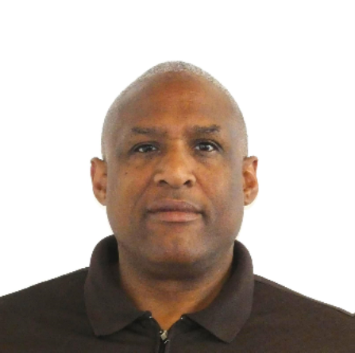

Leadership Team
Wes Struebing
Chief Executive Officer
Steve Kuhn
Chief Operations Officer
Jerad Lovett
Founder CIO
Mario Reyes
SVP B2C
Georgia Angell
VP B2C

Slide 9
Why Does NexMuv Matter?
Partner with NexMuv and elevate your moving business by expanding your reach and capabilities without the hassle.
Maximize Opportunities
Efficient
Pricing
Hassle-Free Management
Never miss out on another long distance move opportunity again.
Easily quote competitive pricing and maintain desired profit margins.
Schedule, pay and track moves all through NexMuv

Slide 10
How It Works
NexMuv is a tech-driven moving company that automates the move management process.
1
2.
3
4
SPOT AN OPPORTUNITY
GET A QUOTE
SET YOUR PRICE
SEAMLESS SCHEDULING
Do not let a long-distance move prospect slip away.
Quickly input details on NexMuv.com.
Offer a suitable price to your customer and secure a deal.
Use NexMuv.com to schedule the service. Just pay the deposit and leave the rest to us. You can even take advantage of our move concierge if that is easier.
Our proprietary technology streamlines the process, offering customers and partners a seamless experience and peace of mind. We have simplified the complex and often stressful task of moving.
6
5
STAY INFORMED
FLEXIBLE PRICING STRUCTURE
We ensure constant communication so you can update your customers at every step.
You decide the charges. We only bill you., letting you keep your desired profit.

Slide 11
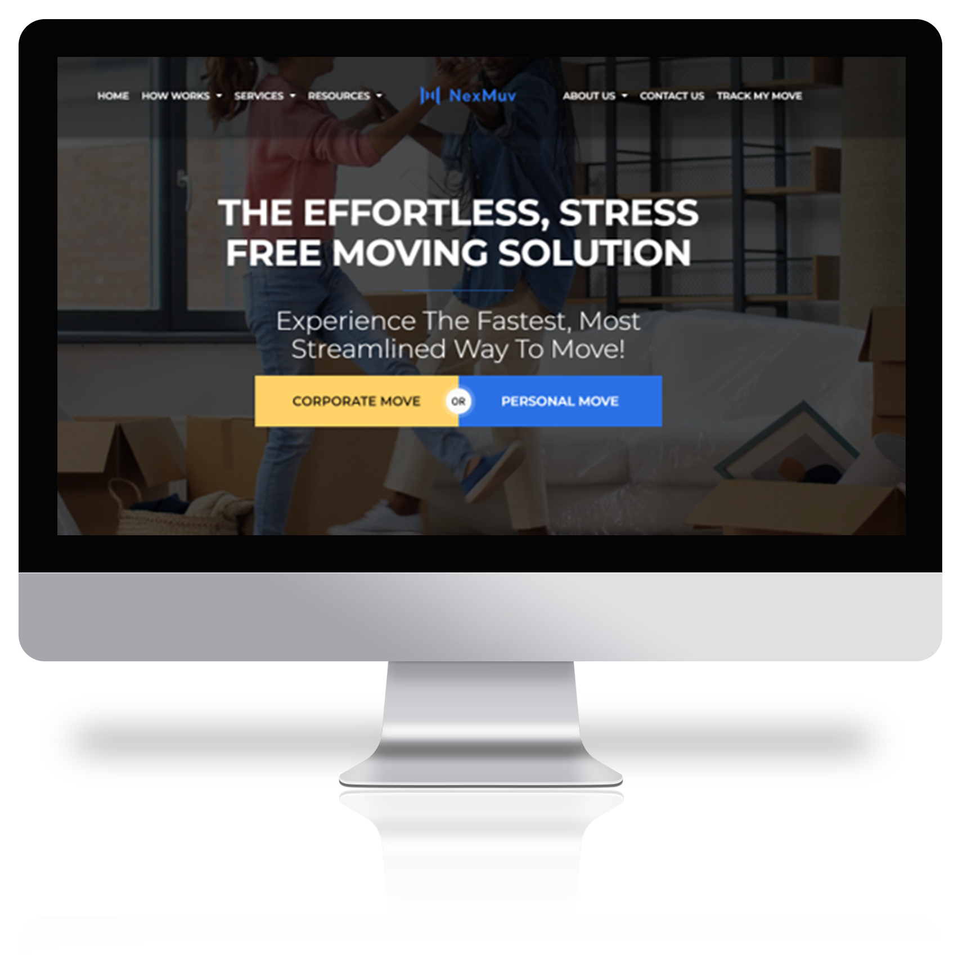
NexMuv White Label
Partner with NexMuv and take advantage of our cutting-edge technology to gain a competitive edge in the industry.
NexMuv offers a white labeling solution for companies looking to capture direct moves. Our technology platform can be customized with your branding to provide a seamless integration with your existing systems and processes. This allows you to offer a top-notch interstate moving experience to your customers, while leveraging the power of NexMuv's proven technology. With this solution, you can streamline your operations, increase customer satisfaction, and capture more business in the lucrative long-distance move market.

Slide 12
REAL-TIME TRACKING
GPS tracking on every shipment.
Why NexMuv
Stands Out
DEDICATED SUPPORT
One point of contact throughout the entire move..
GUARANTEED TIMELINES
Fixed pick-up dates and practical delivery spreads.
Become a
Service Partner
QUALITY ASSURANCE
Handpicked service providers for consistent quality.
Unlock the ability to be one of our esteemed service providers. If you deliver top-notch services and can handle origin & destination tasks for our moves. We would welcome you aboard!
WIDE COVERAGE
Operating in 49 states catering to shipments of all sizes.
nexmuv.com
page
12

Slide 13
211 N. Robinson Ave., #840NB
Oklahoma City, OK 73102
(800) 338-3803
Thank You
nexmuv.com
support@nexmuv.com

