Slide 1
DBX PPT Templates
(built around a company intro, capability offerings, and business plan agenda)
Mission, Vision, and Core Values (Mission should be a tag line in cover page)
Capabilities Offerings
Problems We Solve
Solutions (for demos) - one slide per solution
Value Proposition
Organizational Team Structure
Market Opportunities and Pipeline
Competitive Analysis
Funding and Growth Strategy
Risk Analysis and Mitigation
Go To Market Strategy
Thank You (with company info and social media links)

Slide 2
Mission
Vision
Capability Offerings
Business Transformation Offerings (1 Slide)
Scaled Agile Delivery Management - End-to-end Agile transformation – from coaching to large-scale project execution and delivery with measurable results
Project Management Office – Establishment and management of PMOs, ensuring alignment with agency goals; and delivery of structured project governance, on-time completion, and within budget execution
Strategy and Business Transformation - Assisting federal agencies with high-level strategic planning and digital transformation initiatives; Aligning business processes, technology solutions, and organizational structures to meet modern federal demands; Roadmap development for digital modernization and operational efficiency improvements.
Business Process Optimization and Automation – Streamlining operations, reducing manual efforts, enhancing accuracy, and accelerating service delivery, aligning processes with strategic goals while integrating cutting-edge technologies such as AI/ML, RPA, and cloud-based platforms
Digital Transformation Offerings (1 Slide)
Cloud Strategy and Implementation – Full spectrum of cloud services, from migration planning to architecture design, and multi-cloud management
AI & GenAI Solutions and Governance – Development and implementation of custom AI models to drive process automation and data analytics; Leveraging GenAI to analyze unstructured data, deliver insights, and improve decision-making
Data Modernization – Transformation of agency data infrastructure using cloud-based data lakes, data warehouses, and advanced analytic platforms to prepare organizations to harness the power of AI
Application Modernization – Modern approach to application development including leveraging GenAI and API first approach
DevSecOps – Fully integrated, AI-enabled, and automated end-to end CI/CD pipeline capability with built-in security, quality, and ability to rapidly deploy solution
Our vision is to be the leading catalyst for digital transformation in the Federal government, setting new standards for technological excellence, agility, and impact. We aspire to build a future where Federal agencies can harness the power of advanced technologies at speed and scale to better serve citizens and meet the challenges of tomorrow.
Our mission is to help our clients accelerate their business and digital transformation journey with precision, and lasting impacts.

Slide 3
Design Style
Based on Vision and Mission, the overall vibe needs to be acceleration, transforming, futuristic, dynamic, modern while simple
Can we use the fonts in the logo in some areas to carry the theme of modern and simplistic?
Color wise, I would like to create a strong, sharp, impactful yet simple look and feel. And could we use the more muted teal (see color codes in next slide) for large background or blocks of color and use the brighter more green teal as strong accents but in smaller blocks. We could use some blocks of black as background for graphics?
Can you use the more modern and simplistic style for icons?
For pictures, if we use pictures with people in meetings settings, please include a variety mix of men and women

Slide 4
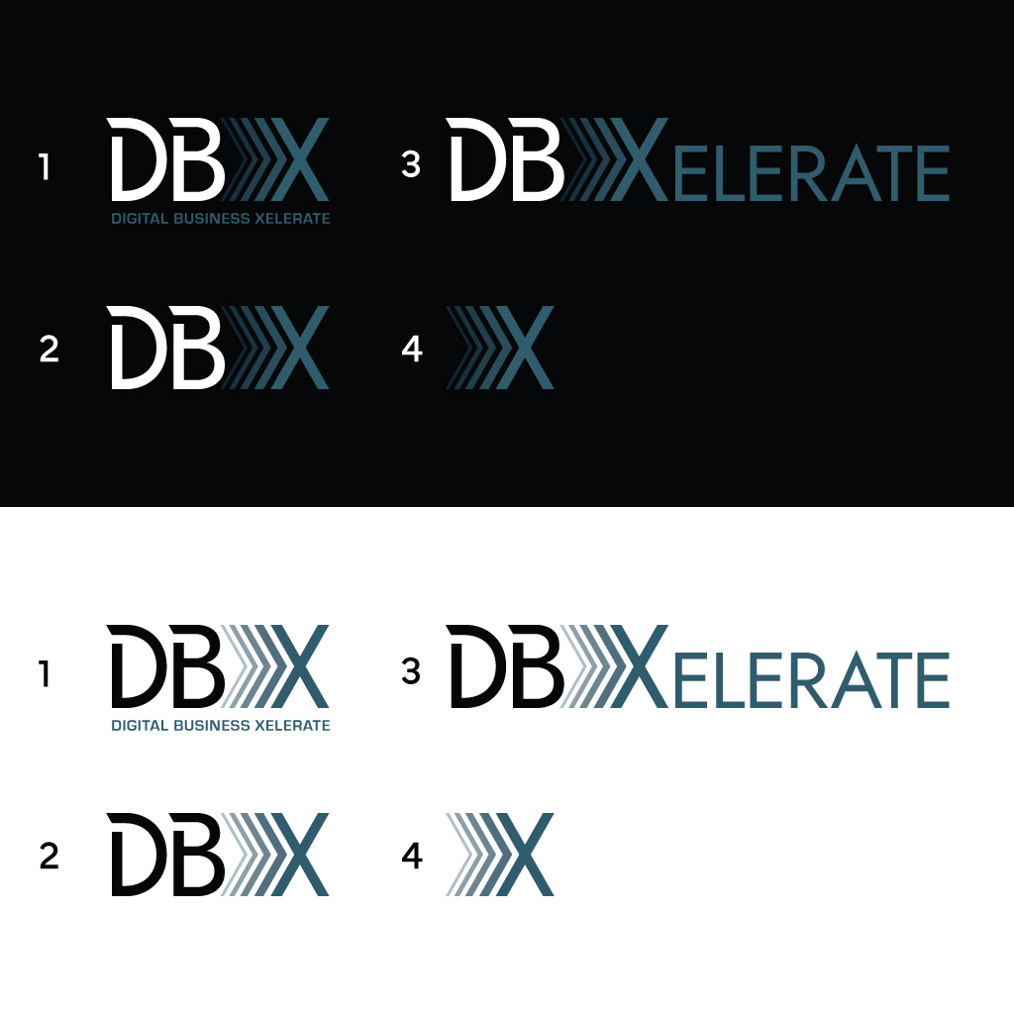
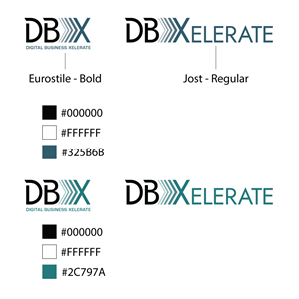
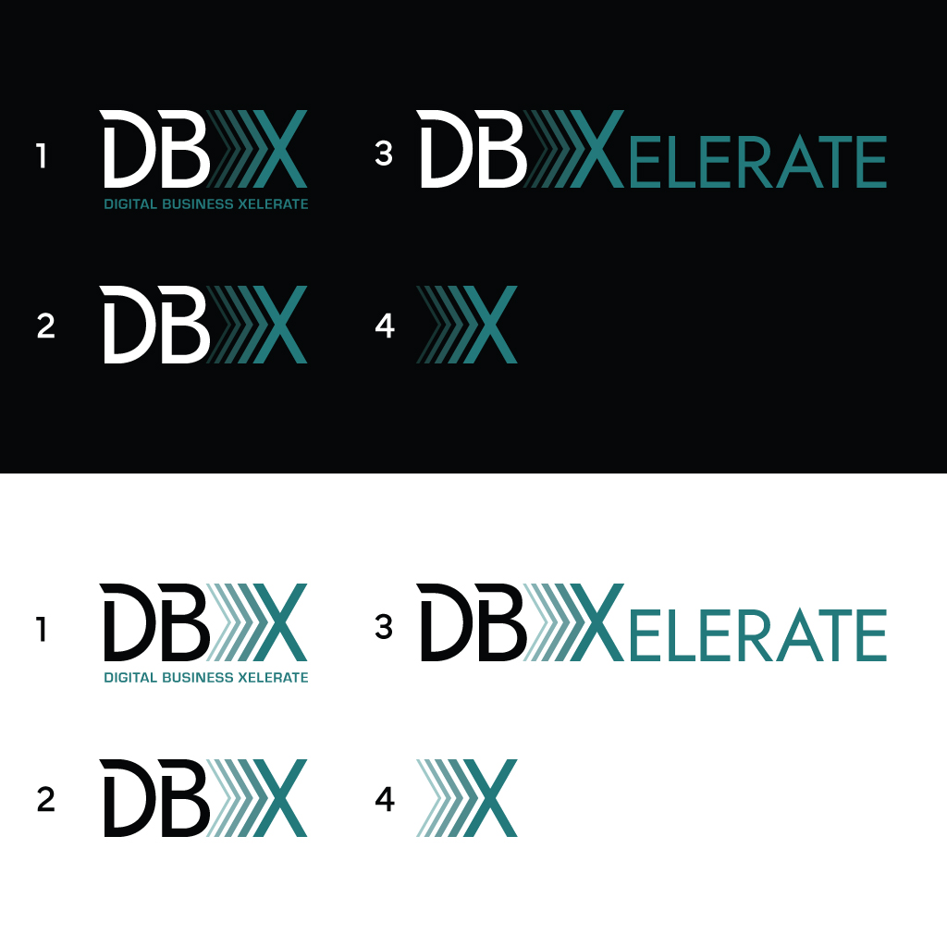
Logos Variations – Please let me know if you need jpg or png formats of any of these variations

Slide 5






Logo Files

Slide 6






Logo Files

Slide 7
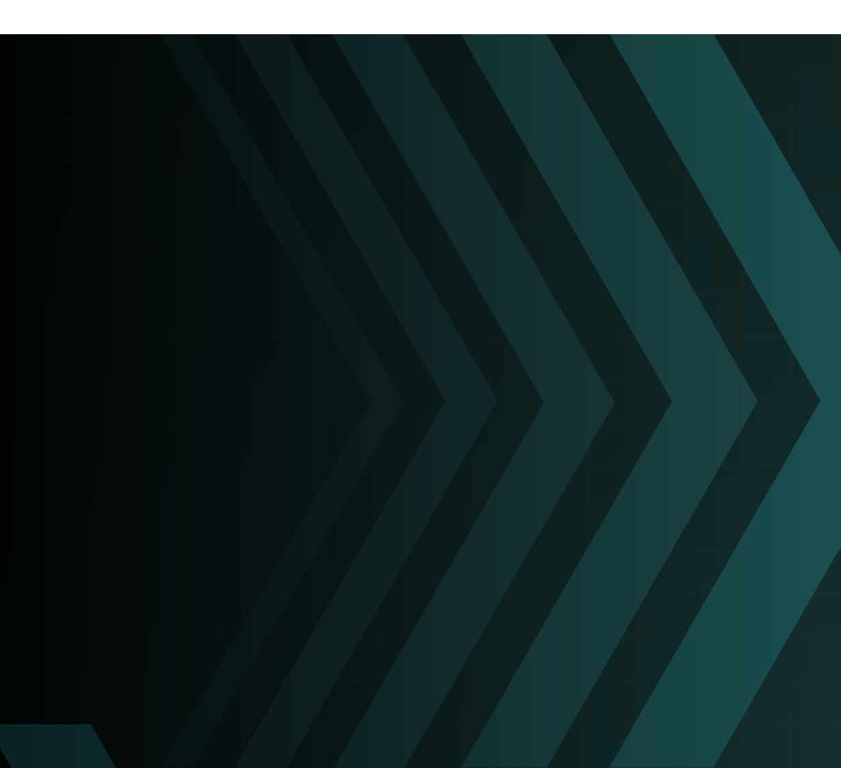
This can be a potential design for Cover background slide and break slide

