Slide 1





Inspiration Ideas:
While I do not want to use these marks, I like these logos (for style inspiration)

Slide 2

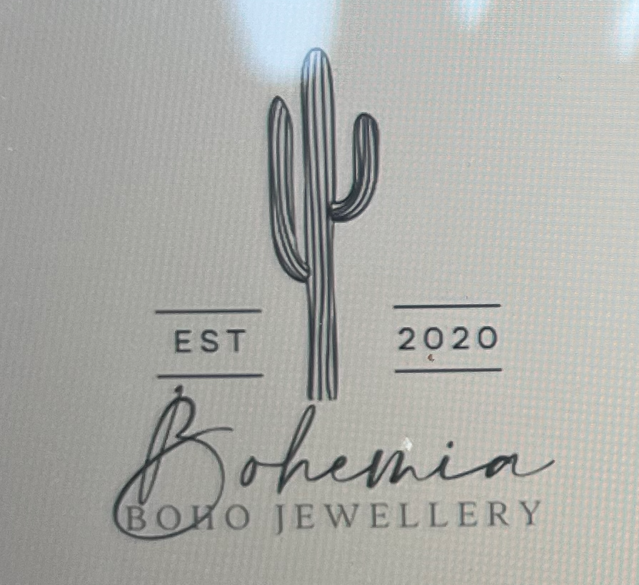
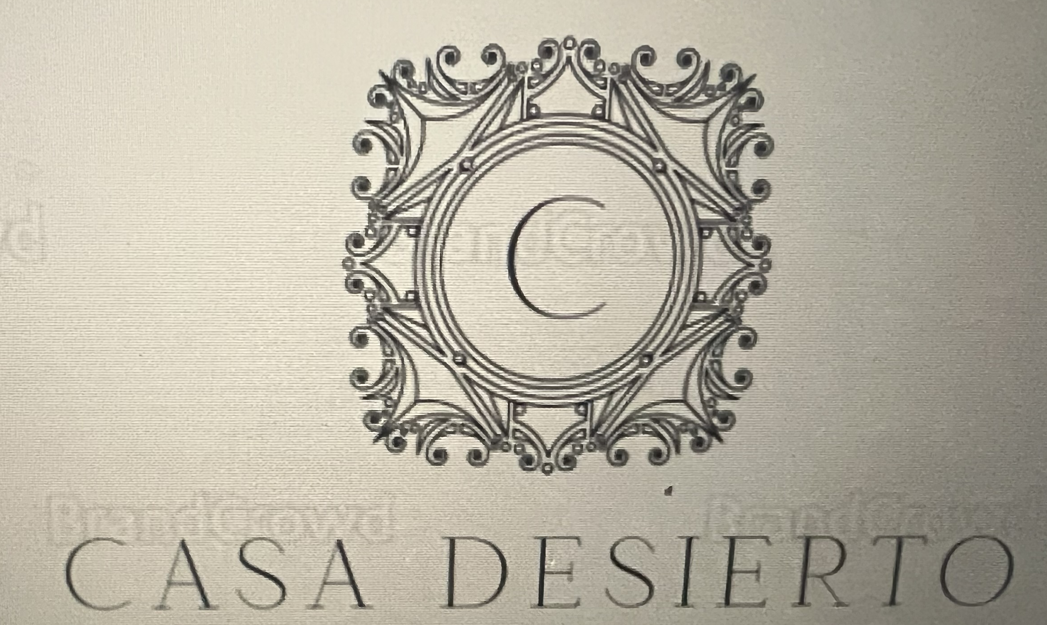
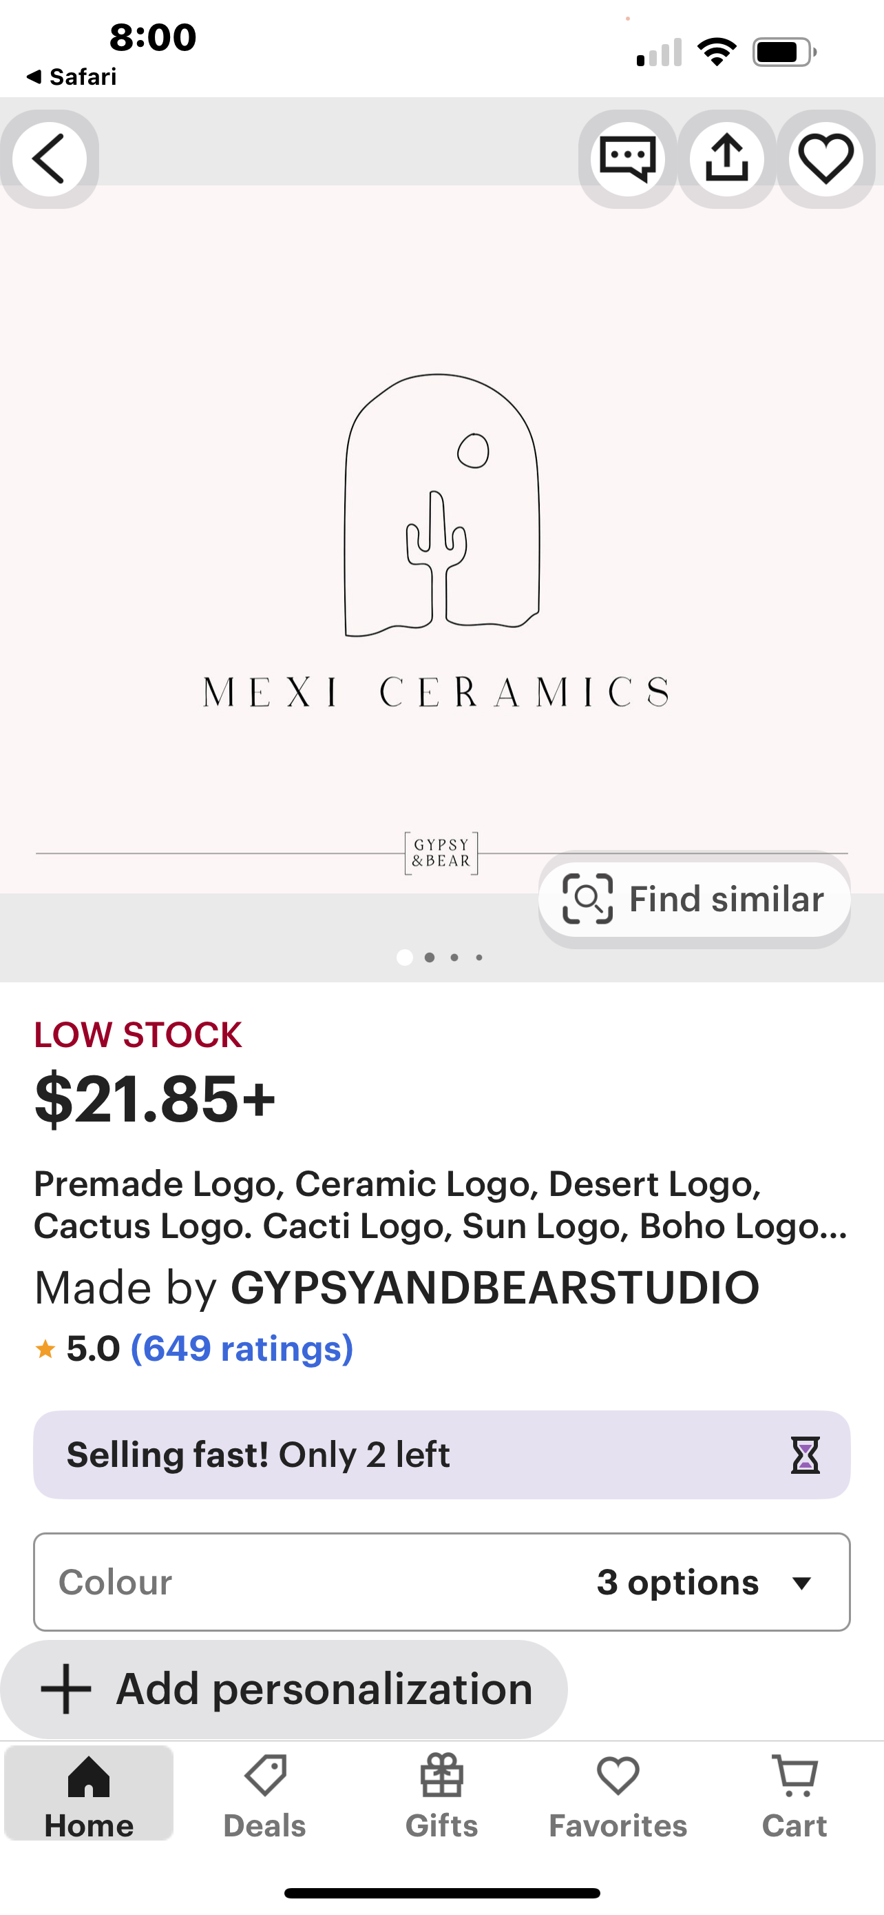
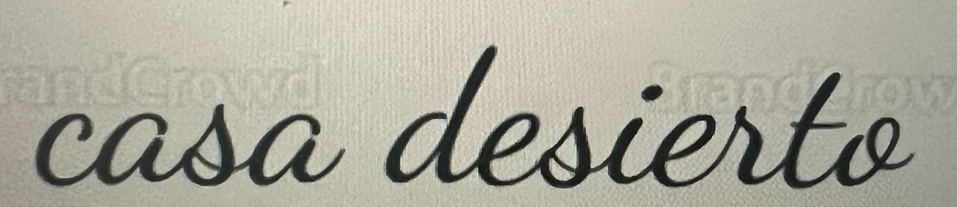
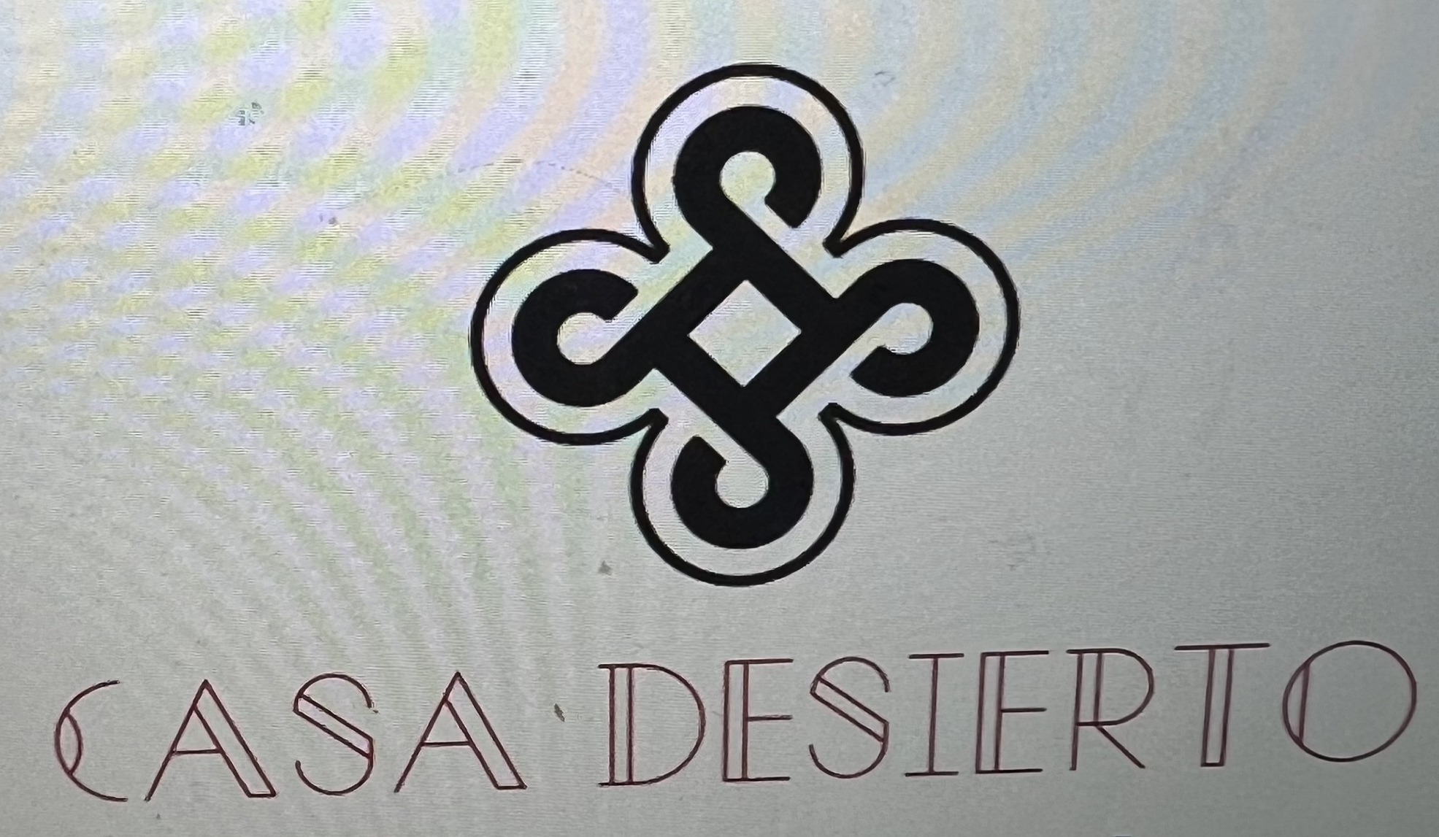
Idea 1
Idea 2
Idea 3
Replace “Bohemia” with Casa Desierto in a font similar to above
No need for box/background color
Remove EST 2020
Replace Boho Jewelry with Scottsdale
For Casa Desierto, also try a font similar to below
Replace the C with a Saguaro Cactus or similar southwestern mark
No need for box/background color
Add Scottsdale below Casa Desierto
Replace Mexi Ceramics with Casa Desierto
No need for box/background color
Add Scottsdale below Casa Desierto

Slide 3


Idea 4
Idea 5
Replace “Bohemia” with Casa Desierto in a font similar to above
No need for box/background color
Remove EST 2020
Replace Boho Jewelry with Scottsdale
For Casa Desierto, also try a font similar to below
Open to ideas on the cactus
Replace Cactus with Casa Desierto (like font, no background)
Add Scottsdale below Casa Desierto

