Slide 1



EHR
CorrecTek Spark | Complete. | Easy. | Affordable.
Correctional Electronic Health Records (EHR) for Today and the Future.
www.correctek.com
866-438-3671

Slide 2




CorrecTek Biography | The National Leader in Correctional EHR
Corporation Formed | 2006
Customers | County Jails, Juvenile, State DOC’s, Private Facilities Nationwide
Customer Size | Under 100 ADP to over 4000 ADP
Business Expertise | Correctional Electronic Health Records: Develop, Implement, & Support EHR For The Correctional Healthcare Services Of: Medical, Dental, Behavioral Health, & Others
Certification | ONC ARRA 2011, 2014, 2015 “Complete” EMR Certification
Headquarters | Paducah, Kentucky USA
CorrecTek Bio
Why Spark EHR?
Workflow
Patient Chart
Configuration
Drug Management
Interfaces
Optional Programs
Summary
All services performed by CorrecTek employees. CorrecTek does not outsource any work.
Slide 2

Slide 3
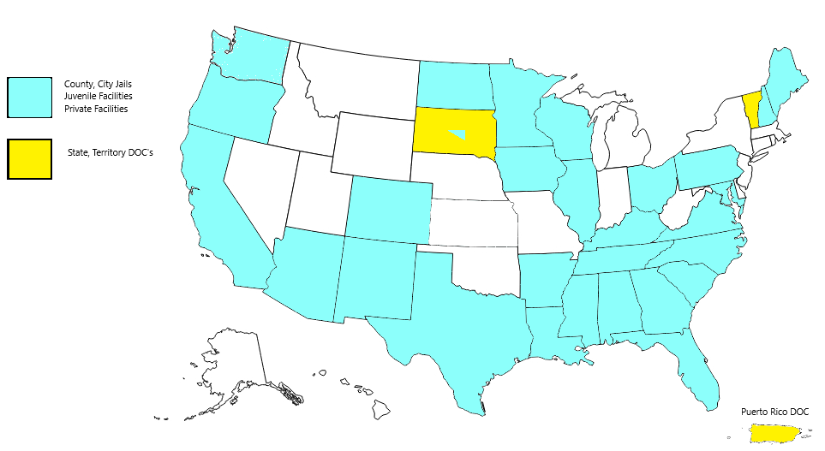
CorrecTek Biography | The National Leader in Correctional EHR
100+ Customers across 30 states and Puerto Rico
CorrecTek Bio
Why Spark EHR?
Workflow
Patient Chart
Configuration
Drug Management
Interfaces
Optional Programs
Summary
Slide 3

Slide 4

CorrecTek Biography | The National Leader in Correctional EHR
In 2023 - 73.75 % of all Support Calls were resolved on the day of the call.
Customers that relay on a sophisticated EHR such as the CorrecTek Spark EHR demand a level of support commensurate with the sophistication of the EHR. CorrecTek prides itself on full-service, 24/7 telephone support.
Perhaps unlike other technology firms (EHR or otherwise), CorrecTek still believes that telephone support is the “best” support, as it allows the problem to hopefully be solved on the initial call, or soon thereafter.
CorrecTek Bio
Why Spark EHR?
Workflow
Patient Chart
Month | % Closed on Same Day | % Closed on Day 2 | % Closed on Day 3 | % Closed on Day 4+
January 2023 | 69% | 13% | 6% | 12%
February 2023 | 65% | 18% | 4% | 13%
March 2023 | 73% | 11% | 4% | 12%
April 2023 | 82% | 8% | 4% | 6%
May 2023 | 77% | 12% | 3% | 8%
June 2023 | 76% | 10% | 3% | 11%
July 2023 | 77% | 9% | 4% | 10%
August 2023 | 73% | 14% | 3% | 10%
September 2023 | 74% | 10% | 3% | 13%
October 2023 | 73% | 14% | 2% | 11%
November 2023 | 76% | 10% | 3% | 11%
December 2023 | 70% | 14% | 6% | 10%
Configuration
Drug Management
Interfaces
CorrecTek
2023 Support Ticket
Resolution Metrics
Optional Programs
Summary
Slide 4

Slide 5




Why CorrecTek Spark? | A Complete, Correctional-Specific, Electronic Health Record System
Why CorrecTek Spark?
1. Easy to use – Focus is on the day-to-day user with a goal of never typing.
2. Configurable – Each Spark install is configured to the customer’s specs.
3. Reporting – Virtually all information in Spark is reportable.
CorrecTek Bio
Why Spark EHR?
Workflow
Patient Chart
Configuration
Drug Management
Interfaces
Optional Programs
Summary
CorrecTek Spark is a Complete, Correctional-Specific, Electronic Health Record System.
Slide 5

Slide 6
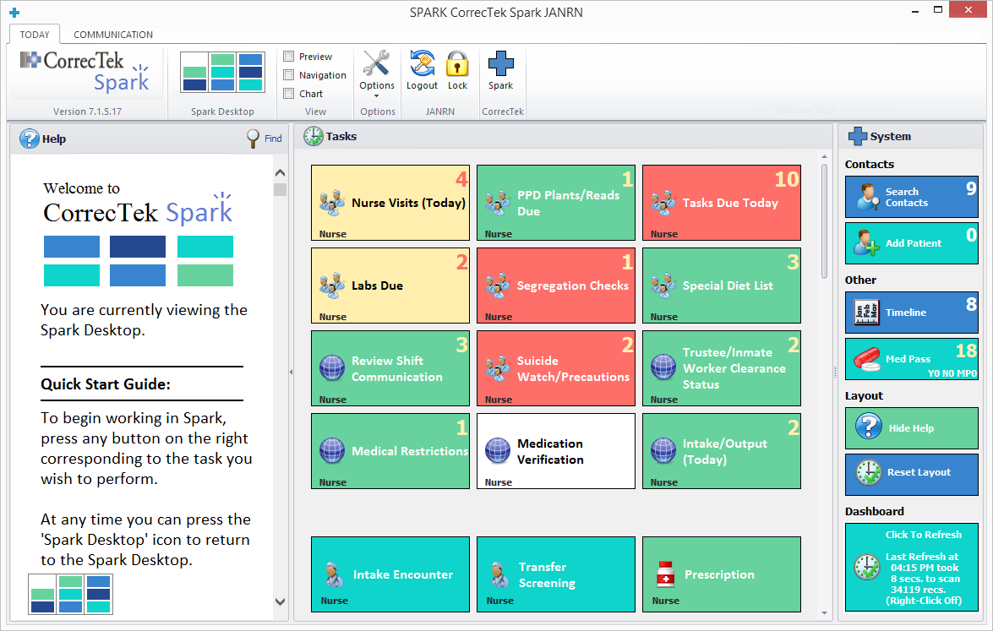
Spark Desktop | There is a button for every user task. | Click on the button to start the task. | Typical tasks include Nurse Visits, Intake, Med Pass, Blood Sugars, etc.
Each Button Starts a Workflow.
Color can indicate urgency.
Numbers indicate how many items are pending.
Each Department has its own “Button Set”
Buttons are “configured” around facility workflows.
CorrecTek Bio
Why Spark EHR?
Workflow
Patient Chart
Configuration
Drug Management
Interfaces
Optional Programs
Summary
The Spark desktop is actually an interactive dashboard.
Slide 6

Slide 7
Workflow | A. To Start - Press a Button
To start a Workflow, simply click on a Button.
Background:
Clicking a button will run a report linked to the button.
Any report can be linked to a button.
Therefore, virtually any information in CorrecTek Spark can be behind a button:
Stat Reports, Compliance Reports, Workflow Reports, etc.
CorrecTek Bio
Why Spark EHR?
Workflow
Patient Chart
Configuration
Drug Management
Interfaces
Optional Programs
Summary
Summary
Clinicians will have workflow button sets for nurse duties, provider duties, etc.
Management can have button sets based on exceptions, compliance, statistics, etc.
Slide 7
Page 6

Slide 8
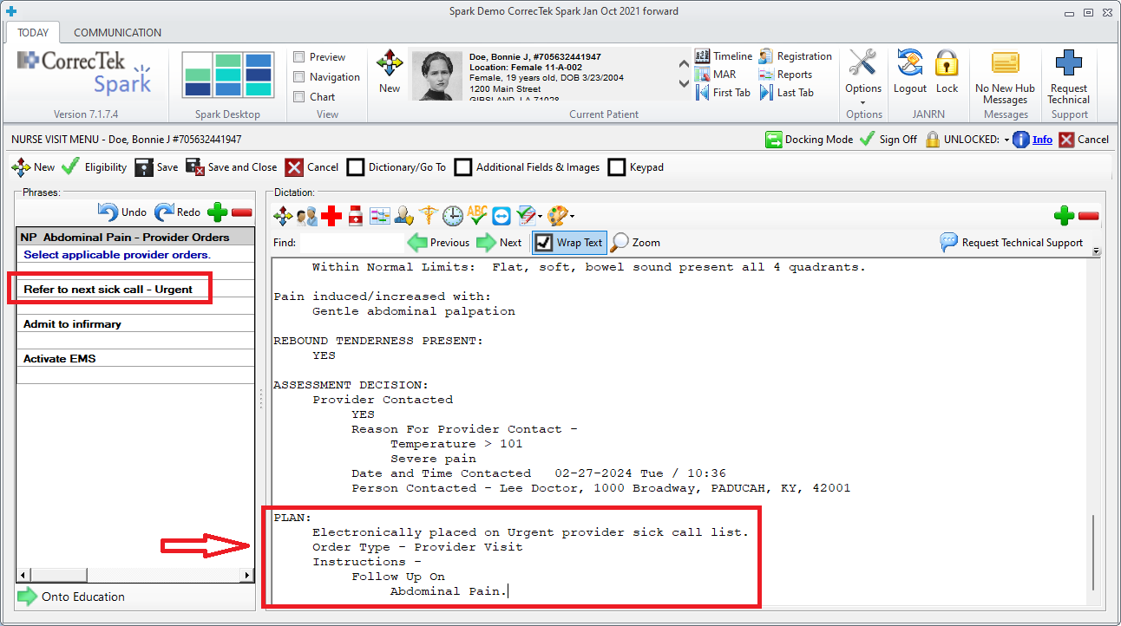
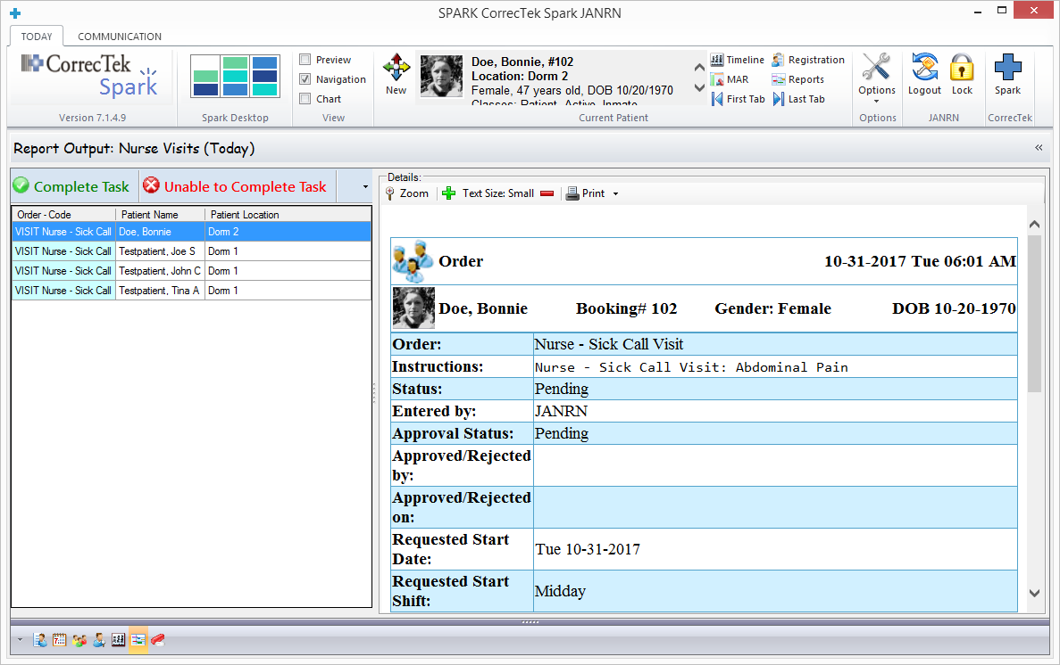


Workflow | A. Press a Button | B. Select a Patient
The list (report) of items behind the pressed workflow button is shown here on the left.
The details of the highlighted item is on the right.
The user now has 2 options:
These are 2 “operational” buttons.
CorrecTek Bio
Why Spark EHR?
Workflow
Patient Chart
Configuration
Drug Management
Interfaces
Optional Programs
Summary
Slide 8

Slide 9
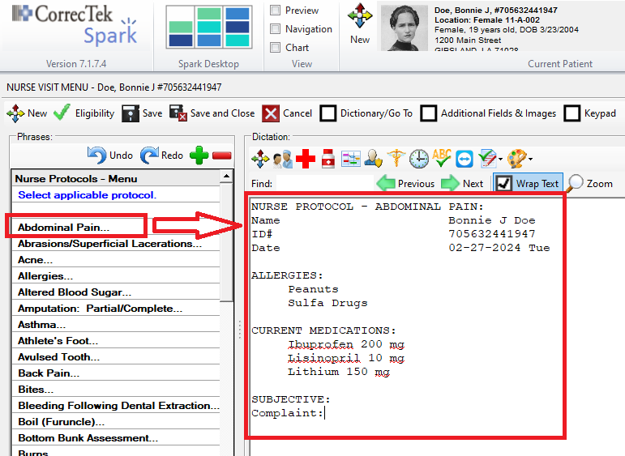
Workflow | A. Press a Button | B. Select a Patient | C. Click on choices to build Documentation.
Select Protocol:
Documentation starts with automatic insertion of relevant data already on file.
Background:
For each “operational” button (on the previous screen), documentation templates or other processes can be linked to the button.
In this example, the Nursing Protocols Templates have been linked to the
operation button (on the previous screen).
CorrecTek Bio
Why Spark EHR?
Workflow
Patient Chart
Configuration
Drug Management
Interfaces
Optional Programs
Summary
Slide 9

Slide 10
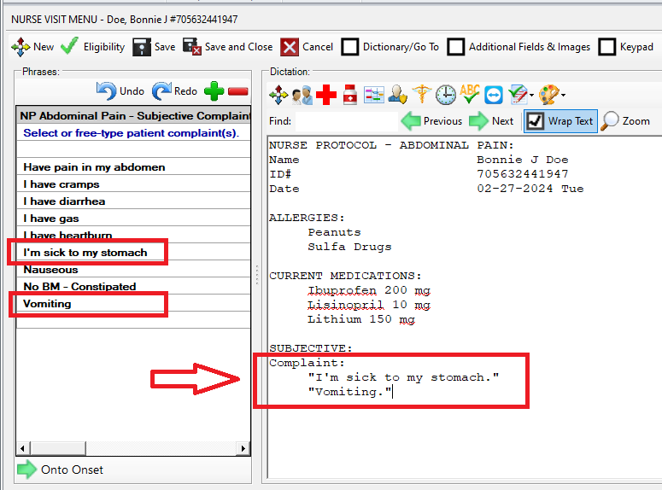
Workflow | A. Press a Button | B. Select a Patient | C. Click on choices to build Documentation.
Chief Complaint:
Click on pertinent choices in the left hand column to build documentation on the right.
No typing is needed – just click on the choices presented.
(However, you can type at anytime if the choice you need is not available…
CorrecTek Bio
Why Spark EHR?
Workflow
Patient Chart
Configuration
Drug Management
Interfaces
Optional Programs
Summary
Both
choices (left side), and
inserted text (right side)
will be configured to the customer’s specifications as part of the implementation.
Slide 10

Slide 11
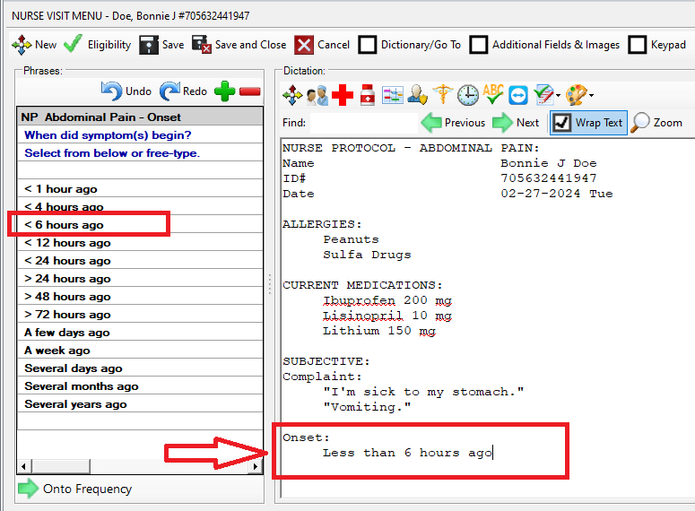
Workflow | A. Press a Button | B. Select a Patient | C. Click on choices to build Documentation.
For this protocol - after the question concerning ‘Onset’ is answered, additional questions such as these, will continue on:
Frequency
Pain Scale
Location
Type/Quality
Pain Radiation
Last BM
Associated Symptoms
Vital Signs
Color
Skin
Turgor
Etc.
Followed by the Plan section shown on the next screen.
CorrecTek Bio
Why Spark EHR?
Workflow
Patient Chart
Configuration
Drug Management
Interfaces
Optional Programs
Summary
Slide 11

Slide 12
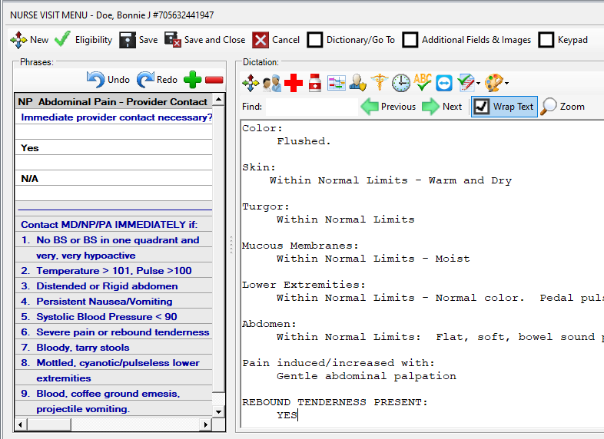
Workflow | A. Press a Button | B. Select a Patient | C. Click on Choices to build Documentation | D. Plan (Actions/Communicate) Orders, Meds, Referrals, etc.
Plan Section 1 of 2:
Plans are configured based on each customer’s requirements.
In this example, the nurse must decide if a provider should be contacted.
The guidelines in blue are supplied by the healthcare authority for the correctional organization.
CorrecTek does NOT provide medical guidelines or advice.
CorrecTek Bio
Why Spark EHR?
Workflow
Patient Chart
Configuration
Drug Management
Interfaces
Optional Programs
Summary
Slide 12

Slide 13
Workflow | A. Press a Button | B. Select a Patient | C. Click on Choices to build Documentation | D. Plan (Actions/Communicate) Orders, Meds, Referrals, etc.
Plan 2 of 2:
With one “click” the nurse has transferred care of the patient to the Provider.
Depending on the protocol, other choices could auto-generate:
Medications,
Orders,
Tasks,
Follow Ups,
Allergies,
Problem,
Etc.
CorrecTek Bio
Why Spark EHR?
Workflow
Patient Chart
Configuration
Drug Management
Interfaces
With one “click” the user can both document and initiate new “workflows” on behalf of the patient..
Optional Programs
Summary
Slide 13

Slide 14
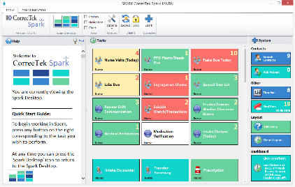
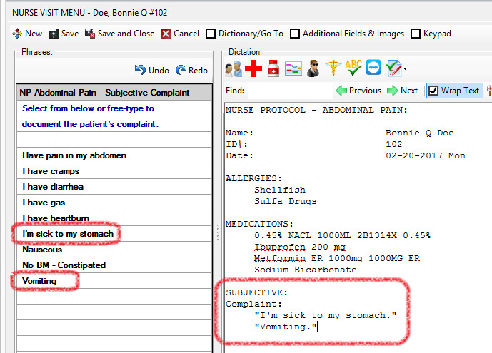
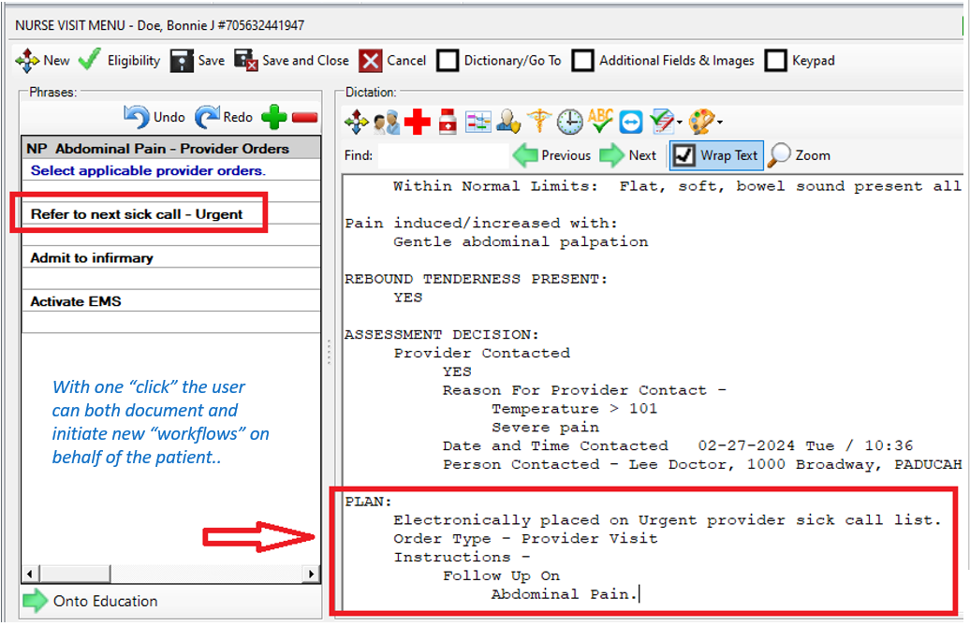
Workflow Summary | A. Press a Button | B. Select a Patient | C. Click on Choices to build Documentation | D. Plan (Actions/Communicate) Orders, Meds, Referrals, etc.
Documentation | From Start to Finish
Easy To Start | Just press the desired button on the Spark Desktop.
Easy To Finish | Spark leads you “step-by-step”.
Fast | As fast as you can “click” (or interview the patient).
Thorough | Customer Designed Protocols = Complete Documentation to the Customer’s Standards.
Immediate | Plans of Action are immediate: Orders, Medications, Referrals, Follow-Ups, etc. can be auto-generated “on-the-fly” for any concerns.
Communicate | New “Work” can be automatically sent to other users/departments (as documentation is entered) and that new “work” will then appear behind the Workflow Buttons for those users/departments.
CorrecTek Bio
Why Spark EHR?
Workflow
Patient Chart
Configuration
Drug Management
Interfaces
Optional Programs
Summary
Slide 14

Slide 15
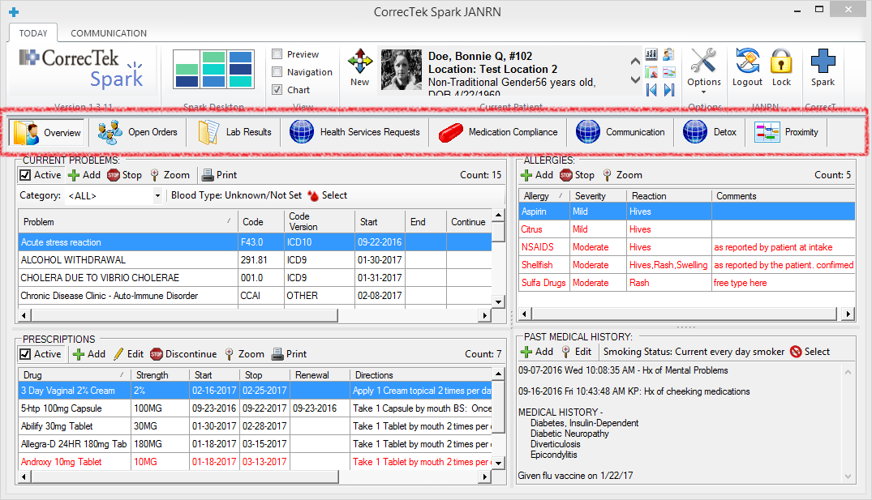
Patient Chart | Tab Based | Just Press a Tab to view pertinent records | Tabs can be conditional based on Medical Condition, Age, Classification, Gender, etc.
CorrecTek Bio
Why Spark EHR?
Workflow
Patient Chart
Configuration
Drug Management
Interfaces
Optional Programs
Summary
Slide 15

Slide 16
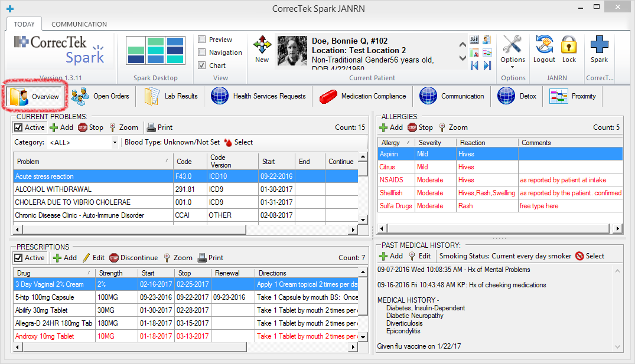
Patient Chart | Overview Tab | Problems, Medications, Allergies, & Past Medical History
CorrecTek Bio
Why Spark EHR?
Workflow
Patient Chart
Configuration
Drug Management
Interfaces
Optional Programs
Summary
Slide 16

Slide 17
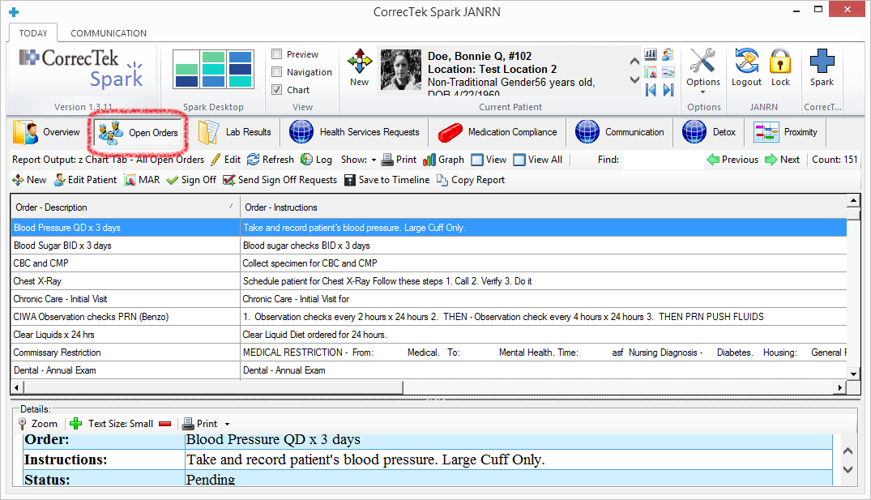
Patient Chart | Open Orders | Tasks that are currently in process for this patient.
CorrecTek Bio
Why Spark EHR?
Workflow
Patient Chart
Configuration
Drug Management
Interfaces
Optional Programs
Summary
Slide 17

Slide 18
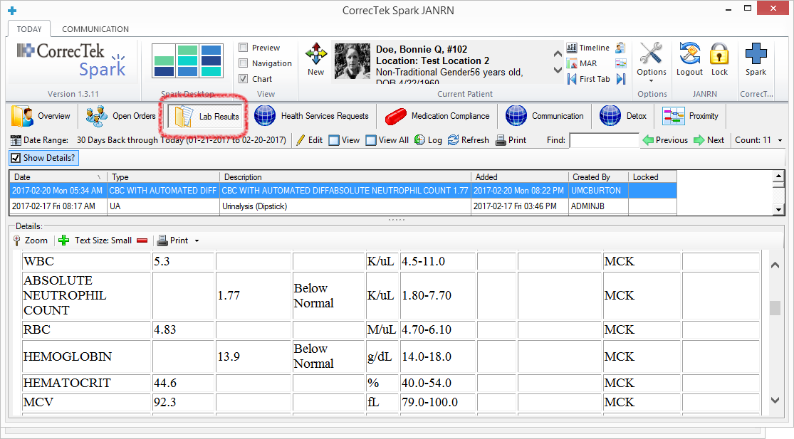
Patient Chart | Lab Results | Lab orders entered in Spark are sent to the Lab Vendor. Lab results auto-return and Spark can issue Alerts if required.
CorrecTek Bio
Why Spark EHR?
Workflow
Patient Chart
Configuration
Drug Management
Interfaces
Optional Programs
Summary
Slide 18

Slide 19
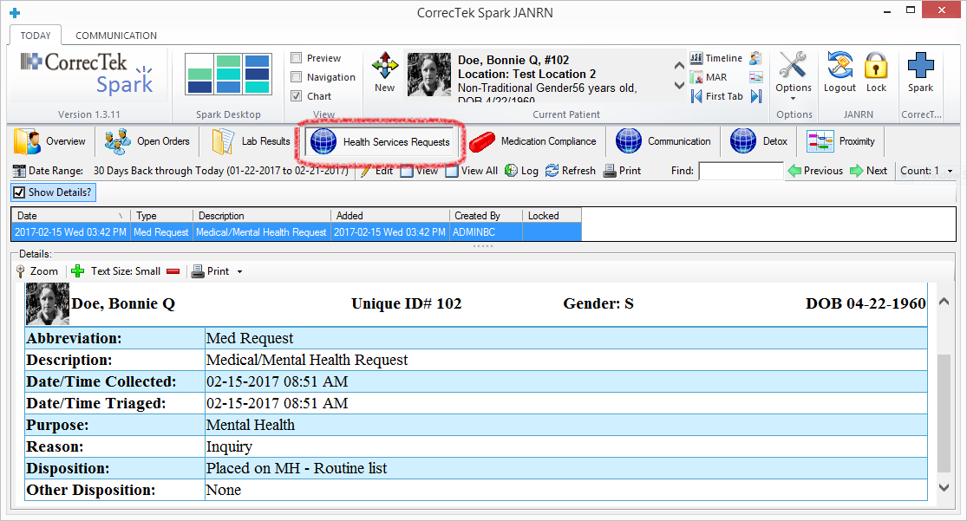
Patient Chart | Health Services Request | Request for Health Services can be collected, triaged, and monitored (e.g. compliance report)
CorrecTek Bio
Why Spark EHR?
Workflow
Patient Chart
Configuration
Drug Management
Interfaces
Optional Programs
Summary
Slide 19

Slide 20
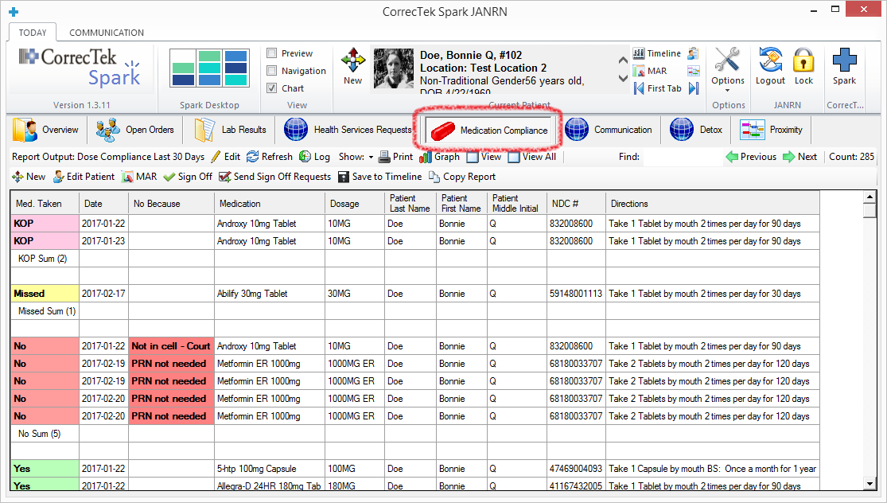
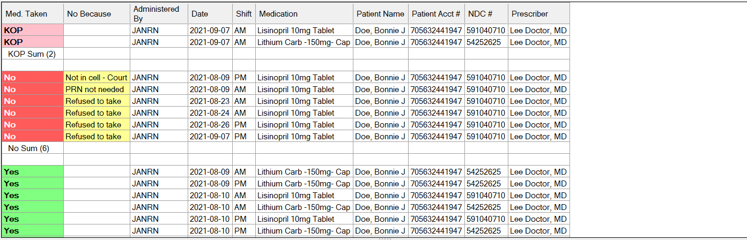
Patient Chart | Medication Compliance | Report on Patient Medication Compliance
CorrecTek Bio
Why Spark EHR?
Workflow
Patient Chart
Configuration
Drug Management
Interfaces
Optional Programs
Summary
Slide 20

Slide 21
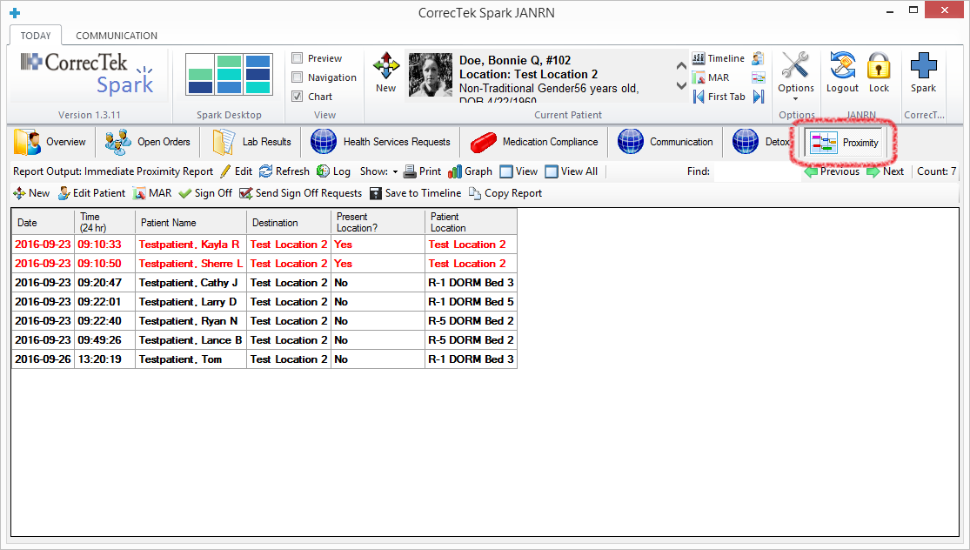
Patient Chart | Proximity Report | Patients in the same place at the same time.
CorrecTek Bio
Why Spark EHR?
Workflow
Patient Chart
Configuration
Based on ‘moves’ received
from an interface with the
inmate/resident tracking
system used by the custody/administrative staff.
Drug Management
Interfaces
Optional Programs
Summary
Can be used to manage contagious disease outbreaks.
Slide 21

Slide 22
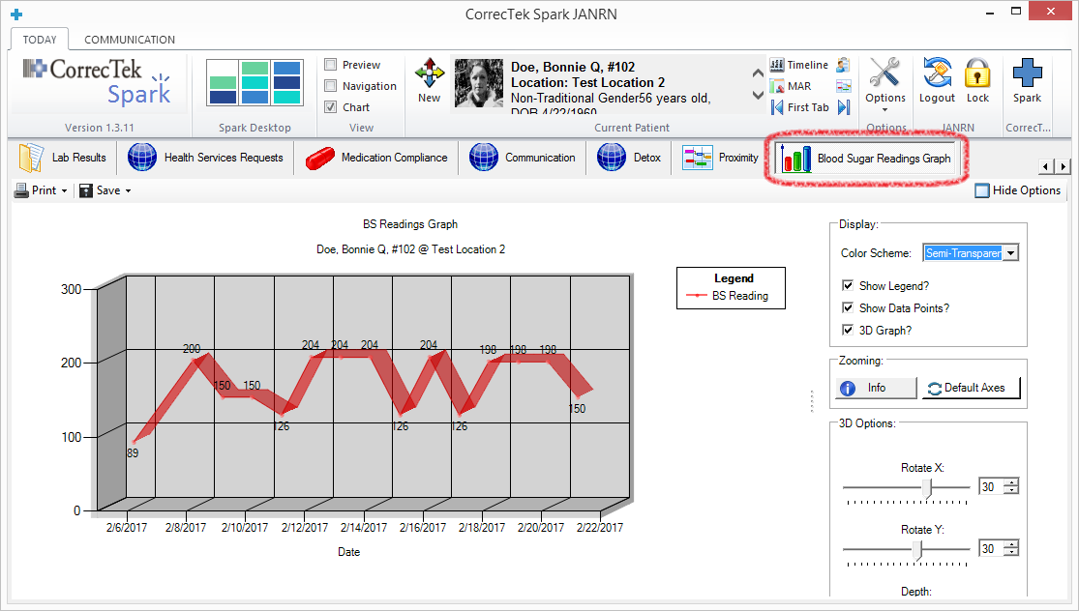
Patient Chart | Blood Sugar Graph | Any numeric data (e.g. BP, Weight) can be graphed
CorrecTek Bio
Why Spark EHR?
Workflow
Patient Chart
Configuration
Drug Management
Interfaces
Optional Programs
Summary
Slide 22

Slide 23

Spark Configuration | Documentation Workflows, Processes (Protocols), Orders, and Reports | CorrecTek will “build out” Spark to meet the Client’s specific needs.
Presentation Outline
Complete Build-Out For Medical, Behavioral Health, & Dental
CorrecTek Bio
Why Spark EHR?
Spark Configuration Category | Examples (By no means inclusive)
Workflow/Documentation Processes a. Data Collected, b. In-House Orders, c. Outside Referrals | AIMS, Behavior Treatment Plan, Intake, Blood Sugar, Chest X-Ray, H & P, Sick Call, Behavioral Health Exams, Nurse Visit, Provider Visit, Chronic Care, Alcohol Detox, Suicide Assessment, Dental Exam, Consent, Refusal, Flow Sheets, …
Order Definitions (Types) For a. Medical, b. Dental, c. Behavioral Health | Detox, Diet, Injection, Labs, Observation, Outside Provider, PPD Plant, Restrictions, Blood Pressure, Blood Sugar, Vaccinations, Vitals, Verbal, Wound Care, Behavioral Health Assessments, Chronic Care Visits, Nurse Sick Call, …
Report Definitions For a. Workflow, d. Cost Analysis, b. Productivity, e. Compliance, c. Statistics, f. Clinical Trends | Cancer Patients, Cardiology Patients, Diabetic Patients, HIV Patients, Pregnancies, Open Orders, BP Checks, TB Patients, ER Visits, Behavioral Health Visits, No Meds, No Treatments, PPD Plants, Physicals, Chronic Care, Dental, …
Workflow
Patient Chart
Configuration
Drug Management
Interfaces
Optional Programs
Summary
Slide 23

Slide 24


Spark for State / Federal | U.S. Immigration and Customs Enforcement, US Marshals, and/or State Requirements
Presentation Outline
Spark can be configured around unique ICE, US Marshals and/or specific State requirements:
  Forms / Documentation
  Pre-Approval Processes
  Reporting
    Cost Analysis
    Compliance
    Audit Logs
CorrecTek Bio
Why Spark EHR?
Workflow
Patient Chart
Configuration
Drug Management
Interfaces
Optional Programs
Summary
CorrecTek currently supports several private and governmental facilities that house state inmates and/or ICE, US Marshals detainees.
Slide 24

Slide 25
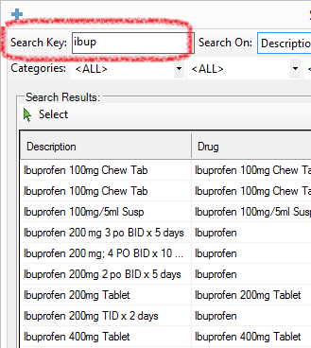
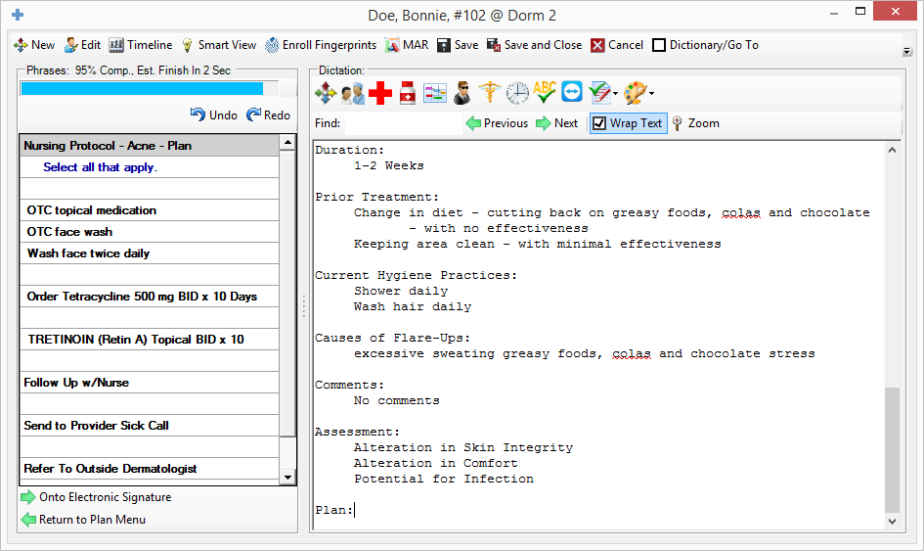
Drug Management | Medication Order Entry (CPOE) | Multiple Methods of Rx Entry
Medication Order Entry – Ad hoc
Rapid Rx selection
Just type a few letters
Auto-send to Pharmacy
Medication Order Entry – Specific Rx’s Tied to Protocols
Example Below: Nursing Protocols for Acne
Specific Rx’s can be presented for “one-click” selection
Rx’s can be marked “Verbal Order” for later Provider Approval
CorrecTek Bio
Why Spark EHR?
Workflow
Patient Chart
Configuration
Drug Management
Interfaces
Optional Programs
Summary
Slide 25

Slide 26
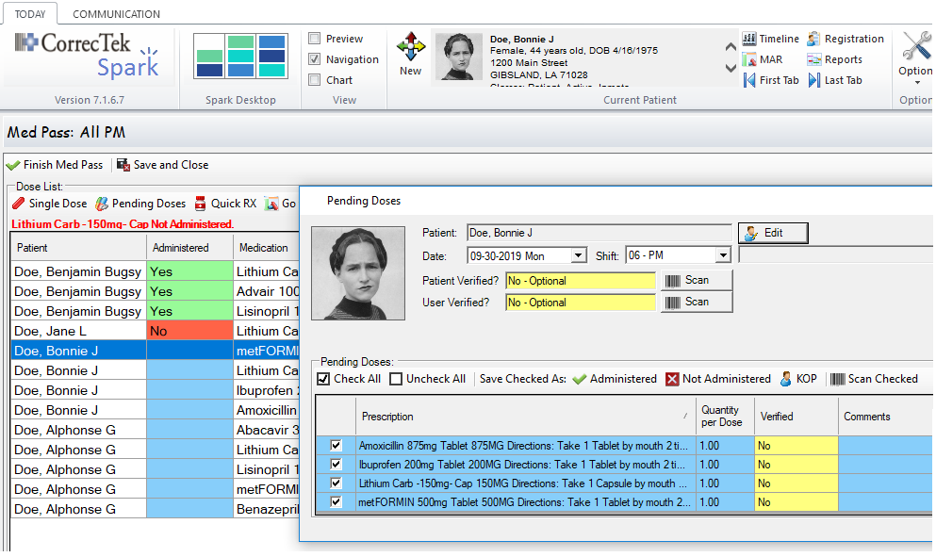


Drug Management | Electronic Medication Administration Record (Electronic MAR, or eMAR) | Both “Med-Pass” and “Pill Window” workflows are supported.
At Drug Administration
Bar Codes can be used to confirm any of the following Patient Medication, User
Signature Pads for Consent Refusal Witnesses
Full EHR Integration for easy chart access if verification of labs or vitals is needed prior to administering a drug.
CorrecTek Bio
Why Spark EHR?
Workflow
Patient Chart
Configuration
Drug Management
Interfaces
Optional Programs
Summary
To document drug administration, select one of:
Slide 26

Slide 27



Interfaces | Send information to Spark | Receive information from Spark
Spark 3rd-party interfaces eliminate duplicate data entry and provide real-time data updates.
CorrecTek Bio
CorrecTek Spark Standard Interfaces (Included in Base License/Lease)
1. Offender Management | Inmate Demographics, Movements, & Photos
2. Pharmacy Vendor | Medication Orders
3. Laboratory Vendor | Lab Orders and Lab Results
Why Spark EHR?
Workflow
Patient Chart
Configuration
Drug Management
CorrecTek Spark Optional Interfaces (Additional Fees Apply)
1. Sick Call Feed | 7. Health Information Exchange
2. Charges Feed | 8. Carequality Network
3. Surescripts Patient Medication History | 9. AI / Analytical Systems
4. Radiology | 10. Cancer Registries
5. Hospital Records / Direct Messaging | 11. Medicaid Billing
6. US Marshals | 12. Patient Portal
Interfaces
Optional Programs
Summary
Slide 27

Slide 28





CorrecTek Optional Programs | For Customers That Desire a “Concierge” Level of Support
CorrecTek Advantage Program* – Includes
 | Unlimited configuration Reports Documentation Templates Word Documents User Forms Order Definitions Spark Workflow
 | Unlimited Training Travel charges will apply if training is on-site.
* The CorrecTek Advantage Program begins after the Initial Implementation of the CorrecTek Spark system. | * Advantage Program begins after the Initial Implementation of CorrecTek Spark
CorrecTek Account Manager Program
 | Your Assigned Account Manager will Be a “Subject Matter Expert” on your business needs for CorrecTek Monitor your use of CorrecTek Manage all CorrecTek projects Attend your regularly scheduled staff meetings via phone. Oversee all support Issues If needed, serve as your point-of-contact for escalations Keep you informed of new releases
CorrecTek Bio
Why Spark EHR?
Workflow
Patient Chart
Configuration
Drug Management
Interfaces
Optional Programs
Summary
CorrecTek Optional Programs are available as an additional monthly fee in addition to your support & upgrade fees (or subscription fees).
Questions
Slide 28

Slide 29






Benefits Summary
Additional Benefits
No more lost patient charts.
Logs of all changes made.
Easy to print a patient chart.
Access the system remotely.
Complete. Easy. Affordable.
Correctional EHR for Today and the Future.
CorrecTek Bio
Why Spark EHR?
In Summary – Benefits of the CorrecTek Spark System
 | Spark is configured to the organizational standards set by the medical authority of the organization.
 | Intuitive workflows allow the user to easily and efficiently document to those organizational standards.
 | Spark workflows allow users to easily refer/send patients to other responsible departments.
 | With Spark, the customer can manage user compliance and accountability to organizational standards.
 | Spark reports can track data across all areas of the system, e.g. statistics, compliance, costs, etc.
Workflow
Patient Chart
Configuration
Drug Management
Interfaces
Optional Programs
Summary
Also view the free Spark eLearning library at www.correctek.com/eLearning.
All courses needed to learn the Spark system are available.
Slide 29

