Slide 1
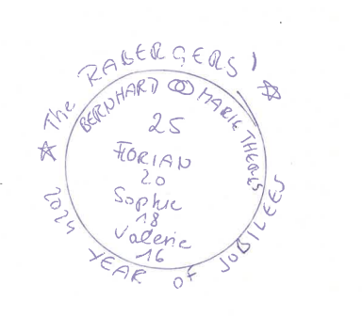


THE RABERGERS‘ 2024 YEAR OF JUBILEES
Bernhard Marie Theres
25
Florian
20
Sophie
18
Valerie
16

Slide 2
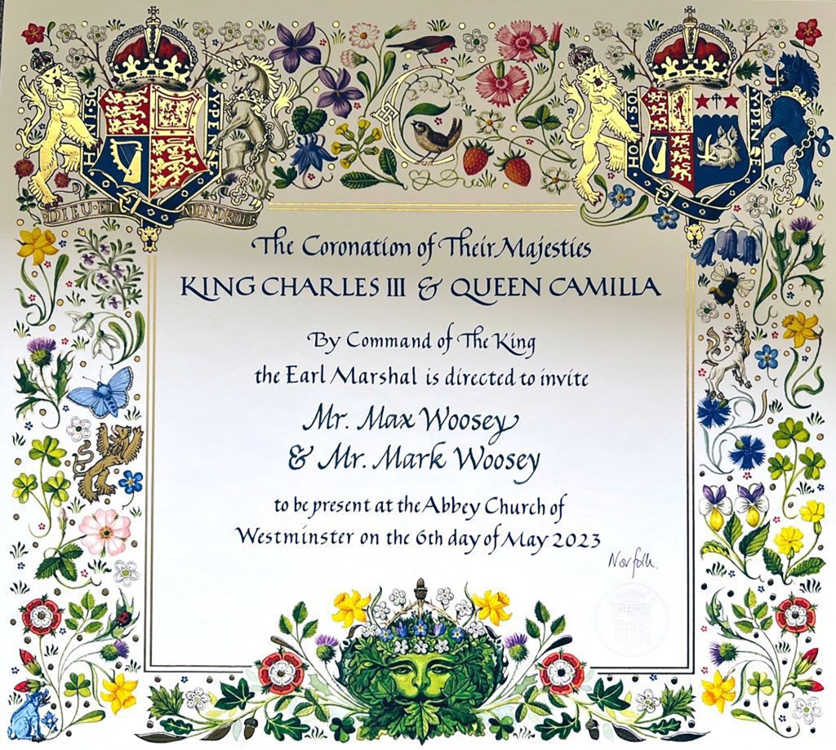
Look & Feel
Royal
Floral
Elegant
Classic
Shiny gold letters?
Replace crests with flowers!!
16th of November 2024, openhouse 11 am,
Thimiggasse 48/5, 1180 Vienna RSVP by October 20th

Slide 3
Format
PDF
.PNG

