Slide 1
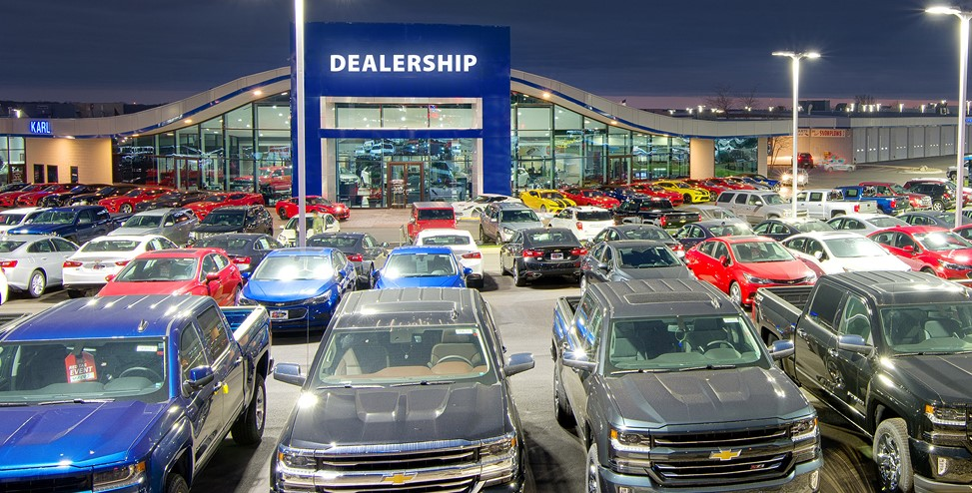

Car Washes Designed for Auto Dealers
Dealer Service Wash System

Slide 2
Turnkey Program Includes
Coordination with your architect and contractor to seamlessly integrate the Car Wash system to your facility
Complete carwash package including floorplans, equipment package & MEP requirements
Equipment package designed to provide clean vehicles quickly and safely
Professional installation of equipment
Maintenance, Chemical and Training programs for ease of daily operations
Guaranteed uptime of wash system

Slide 3
Turnkey Program Benefits
Provide Clean, dry, shiny vehicles to Service Customers quickly and cost efficiently
Keep lot cars and Service vehicles clean while decreasing labor expenses
  Track wash expenses by department
  Wash System designed by Car Wash professionals specifically to meet the needs of Auto Dealerships
  Increase CSI scores by providing a professional car wash experience for customers to increase retention
  Produce a high volume of clean vehicles during peak delivery times without backups or bottlenecks
Save labor and water versus handwashing with a fully automated wash system

Slide 4
Physical Requirements
DSW60
DSW90
Process up to 70 Vehicles per Hour
Process up to 100 Vehicles per Hour
67’ x 26’ Building/System/Facility Footprint
Stand alone or within existing facility
2” Water/ Sewer Connection
600 amp Electrical Service – 480 Volt
60’ Conveyor
107’ x 26’ Building Footprint
Stand alone or within existing facility
2” Water/ Sewer Connection
800 amp Electrical Service – 480 Volt
90’ Conveyor

Slide 5
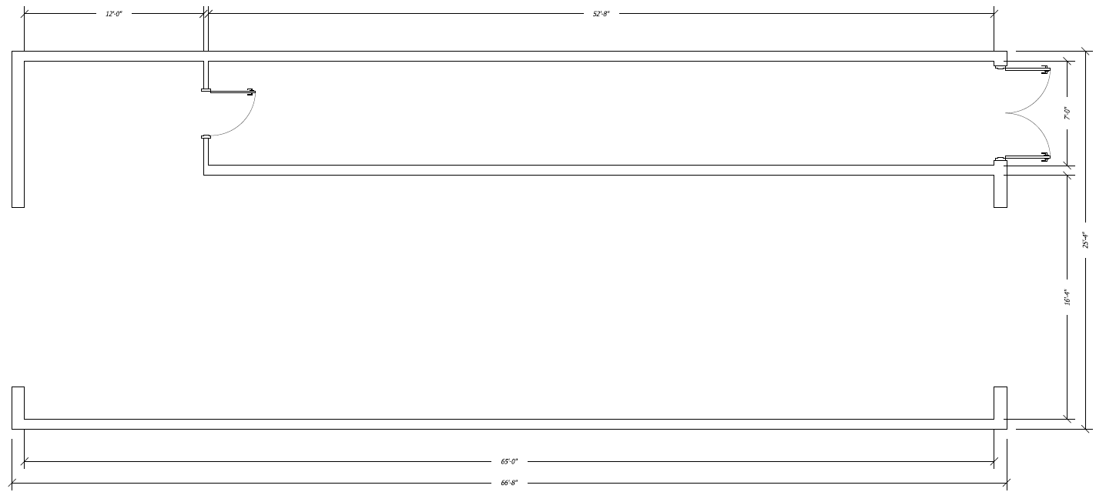
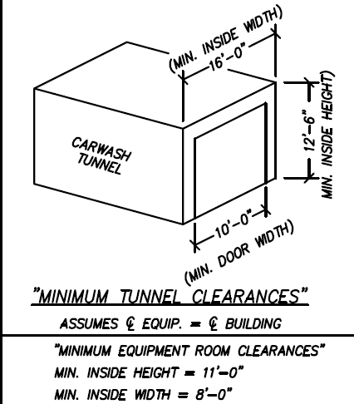
Building Layout DSW60
Includes Equipment Room

Slide 6
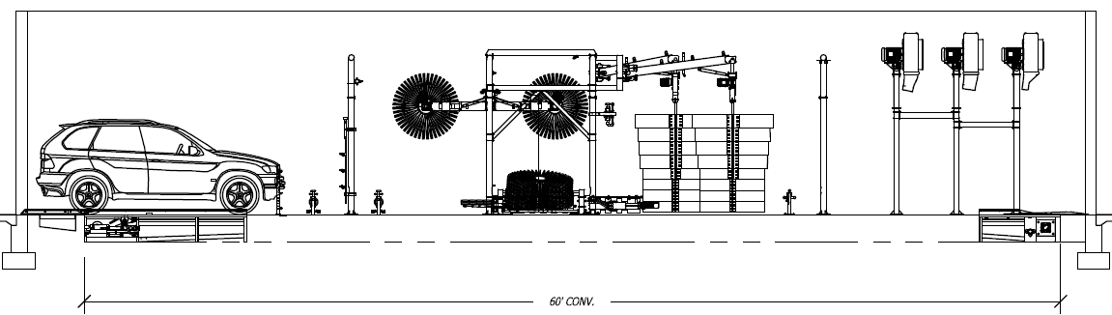
DSW60 Wash package

Slide 7
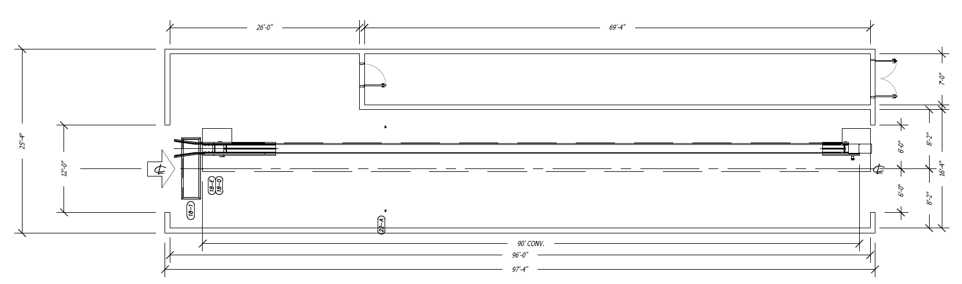
Building Layout DSW90
Includes Equipment Room

Slide 8
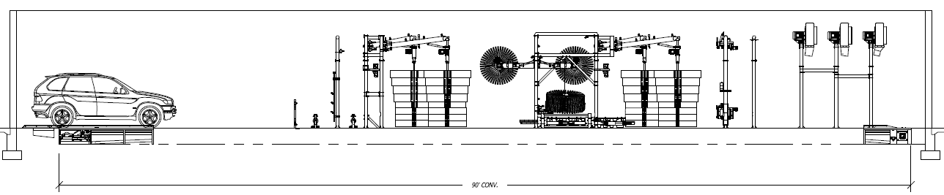
DSW90 Wash package

Slide 9
About Alliant Car Wash Services
Alliant’s team has over 200 years of combined car wash expertise and has worked extensively with Auto Dealers over the past 10 years. Alliant brings all the required expertise to help you implement the Car Wash system best suited to your dealership’s needs, volume requirements, space limitations and financial considerations. Let Alliant Car Wash Services assess your wash requirements and suggest a program that will best suit your needs.
Contact us:
Alliant Car Wash Services
Frank Lash
757-788-9365
Flash@AlliantCarWashServices.com

