Slide 1
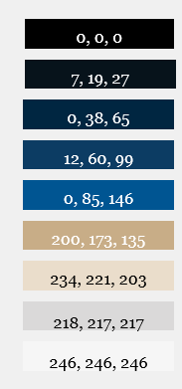
JG to update
Notes:
Add SK

Slide 2
Manufacturing Executive Newsletter
  Executive Summary: Letter from Mufson Howe Hunter (MHH)
  MHH Manufacturing CEO Interview
  Select Q2 Current Events
  Manufacturing Sub-Sector Analysis
  M&A Transactions Period Ended August 2024
  MHH’s Experience in Manufacturing & Industrial M&A
Table of Contents

Slide 3
Executive Summary: Letter from Mufson Howe Hunter
Dear CEOs and Executives in the Manufacturing/Industrial Sectors,
Welcome to the August 31st, 2024 edition of our CEO Briefing. Our goal is to empower you with the latest insights and trends, helping you navigate the very dynamic landscape of the manufacturing and industrial markets.
For years, we have assisted Owners and CEOs in preparing, positioning, and selling their companies, and our expertise is built on continuous monitoring of industry data, strategic shifts, and acquisition activities.
Industry Growth Dynamics
The manufacturing sector is experiencing robust growth, supported by significant government-funded initiatives like the CHIPS Act and the Inflation Reduction Act, along with a strong U.S. economy. However, challenges persist, including ongoing inflation, elevated interest rates, and a tight labor market. On pages 8-9, you will find links to current events and key announcements from the past months. On pages 11-12, you will find a listing of notable M&A transactions from over the last several months. If you have interest in more detail in any of these transactions please contact us.
Investment Activity & Advanced Technology
Investment in advanced manufacturing technologies continue to drive the industry forward. Innovations in:
Artificial Intelligence
Machine Learning
Robotics
Automation
Embedded Software
IoT
Big Data Processing
Advanced Composite Materials
Laser Machining/Welding
are transforming manufacturing processes and enhancing competitiveness. We will explore the M&A implications of these technologies in upcoming Briefings. In this issue, Dawn Ainger, CEO of Genova Technologies, shares how Embedded Software is providing significant competitive advantages for their clients. If you only read one section in this briefing, please read her insights on pages 5-8.
Notes:
JG to update this letter

Slide 4
Letter from Mufson Howe Hunter
(continued…)
We maintain close contact with potential buyers and understand their acquisition strategies and growth ambitions. Positioning your business as a strategic imperative can significantly enhance its appeal and value.
For personalized advice and assistance, please reach out to us at jgolden@mhhco.com. We are here to help you achieve the best possible outcome for your business.
Thank you for your continued trust and partnership. We wish you ongoing success.
Sincerely,
Joe Golden and the MHH Team
Our research sources include, CapIQ, Datasite, Industrial Distribution magazine
Notes:
JG to update this letter

Slide 5
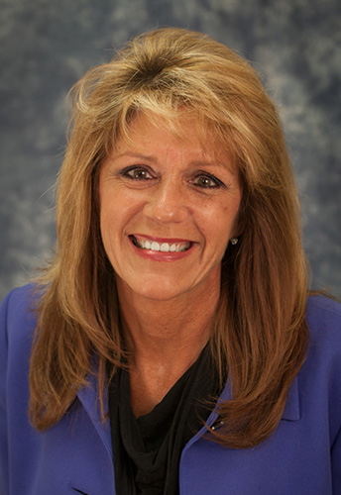
MHH Manufacturing CEO Interview
CEO Briefing
Dawn Ainger
CEO & President
Genova Technologies
4250 River Center Ct NE, Cedar Rapids, IA 52402
www.genovatech.com
Dawn.ainger@genovatech.com
info@genovatech.com
Joe Golden/Mufson Howe Hunter: Good morning Dawn, can you tell us a bit about your background and how you acquired Genova Technologies many years ago?
Dawn Ainger/Genova Technologies: When I arrived at work one day in 1998, I was dismayed to find that the doors to Genova Technologies were locked. The owner had filed for bankruptcy. As a single mother with three young boys to raise, I didn’t want to leave my job as a software engineer. I convinced the remaining investors to let me run the software services company myself. I wanted control over the financial stability and direction of the company. The investors and I quickly made major changes. I immediately cut unnecessary expenses. I moved the company out of posh offices into more reasonable, comfortable surroundings. I shifted Genova’s focus from a software development generalist to a vertical specialist….specifically health care, agriculture and defense.
What we do is make more than phones ‘smart’.
Joe Golden: For those unfamiliar with Genova, could you provide an overview of the company and its mission in the manufacturing sector?
Dawn Ainger: Genova focuses on helping manufacturers get their equipment ‘smart’. Very few people would think about buying a new thermostat for their house that couldn’t communicate with their phone. Consumers expect this type of technology and the real time communication it provides. Unfortunately, many manufacturers are unprepared. They know how to manufacture good products, but now those manufactured goods need to communicate, take action, and make the buyer’s life easier and more productive.
Genova helps manufacturers get that accomplished.

Slide 6
MHH Manufacturing CEO Interview
CEO Briefing
Joe Golden: Genova specializes in developing embedded software and AI. Can you explain how these technologies are integrated into your solutions and the unique benefits they offer to manufacturers?
Dawn Ainger: AI seems to be top of mind for everyone. Genova is on the leading edge of implementing AI technology advantages for Manufacturers. On October 2, my presentation at the Iowa manufacturers conference will address cost effective ways to integrate AI into your manufacturing environment. I will provide my contact info at the interview.
Note: If you would like to receive a copy of my AI presentation, you can contact me directly – my contact information is found at the end of this Interview.
Joe Golden: Can you share specific examples of how your embedded software and AI solutions have helped manufacturers improve their operations or products?
Dawn Ainger: Yes, definitely. Please see the following examples:
Agricultural Machinery -
Genova is helping agricultural equipment manufacturers make their equipment ‘smart’. From self-driving combines and tractors, to weed-identifying field sprayers, Genova is on the leading edge of technology. Genova has been instrumental in building the software for a major ag manufacture in making combines ‘self driving’, as seen in this video from the PBS episode ‘The Future of Work’ :https://www.pbs.org/wgbh/future-of-work/watch/ (goto Video Shorts – ‘Farming and Technology Revolution’ towards the bottom of the web page; It showcases Genova’s work for John Deere.) Is it okay to disclose the John Deere name ?
High Dollar Consumer Products:
Another of Genova’s customers, Dexter Laundry, agreed to allow us to showcase their achievements. They are a worldwide laundromat machine manufacturer. Laundromat owners had a large problem. Laundromat customers were unable to pay for their loads of laundry because (1) they didn’t have the right change or (2) the change machine was empty or (3) the credit card machine wasn’t working due to the constant humidity in the laundromat. They asked us if we could build them a phone app that would allow the laundromat customer to select settings and pay for a load of laundry, all on their phone. This allowed the customer to leave the laundromat and be notified when the laundry was complete. Genova built it for them in half the amount of time and money that another vendor had spent. We are proud to support their hugely successful app today. Genova also built a portal for the laundromat owners so they can monitor and evaluate how their laundromats are doing (from both a financial and maintenance standpoint).

Slide 7
MHH Manufacturing CEO Interview
CEO Briefing
Vending Machines:
Genova also has a customer who we started with before COVID. We were discussing the apps they wanted to add to their vending machines. They supply vending machines to many industries including factories, to dispense safety equipment, hospitals to dispense narcotics, and vending machines dispensing snacks. When COVID hit, they found themselves held hostage to the custom chip manufacturer that they needed for their machines. Much of the world experienced a chip shortage. Genova’s customer was at a loss as to what to do. Genova built a ‘software wrapper’ around a generic chip so that the custom chip was not longer needed. The software wrapper protected the rest of the machine from knowing that the custom chip had been swapped out for a generic one, making it easier for Genova’s customer to buy the quantity of chips they needed to keep their sales growing.
Military Jets
Genova has a top secret clearance. I can’t provide you with the details of the project, but we are working on the Navy’s F-35 program.
Joe Golden: How have your solutions helped your customers create a competitive advantage in their respective industries? What differentiates Genova from other providers in this space?
Dawn Ainger: Yes, over the last thirty years, Genova has come in, or under budget over 97% of the time. This is not an accident or a coincidence. Genova employs a very effective proprietary process call ‘The BOSS™ ‘ which stands for “Business Objective Software Supplement”. This process ties the business’s objectives to the ‘bits and bytes’ that software engineers need to know to build good software. One of Genova’s customers says that they will never do another software project without doing the BOSS first. The BOSS provides a roadmap to keep the team on course, on budget, and on time. Genova grew from a $1M company in 2001 to a $35M company in 2014 due to the BOSS. It is roadmap for assuring success.
Joe Golden: How do your customers typically see a return on their investment when they implement your solutions? Can you provide some metrics or case studies?
Dawn Ainger: Many of our customers are privately held or ESOPS so we are unable to access financial information. The exception is John Deere. Dawn recently was asked to speak at a business conference and in the presentation, she compared Kodak to John Deere. Kodak made a decision not to invest in digital technology which John Deere made the decision to invest heavily in digital technology. Here’s the different in stock value from 1976 to now (the red line is in today’s dollars). In 1900, 96% of Americans were involved in the production of food. In 2020, that was down to 1.96%. John Deere lost almost 94% of its market in the drop of people working in agriculture during the twentieth century, but at the same time, they became a world leader with rising stock values. Genova’s software is part of their success.

Slide 8
MHH Manufacturing CEO Interview
CEO Briefing
Joe Golden: What upcoming trends or innovations in embedded software and AI do you foresee having the biggest impact on manufacturing in the next few years? How is Genova preparing to address these trends?
Dawn Ainger: Genova is working on AI technologies for manufacturers and beyond. Genova is working with Texas Tech Hospitals to help their researchers find published articles faster and with higher quality than they’ve experienced before. Genova has been using automated code generation (AI code generation) for over a decade. This is called Model Based Development
This saves our customers time and money getting new products to market. Genova is also working with its customers for innovations to help make their equipment ‘smart’, along with automating their manufacturing processes.
Joe Golden: For our readers who are interested in learning more or potentially partnering with Genova, what is the best way for them to reach out to you?
Dawn Ainger: Please send an email to Dawn.ainger@genovatech.com – and reference “CEO Briefing” in the subject so you don’t get lost in my spam folder.

Slide 9
Select Current Events – Manufacturing, Industrial, & Distribution
CEO Briefing
Trends, Forecasts, & Economic Updates
3 Trends shaping the manufacturing industry
US industrial production comes in hot in May
U.S. industrial production makes biggest jump in 10 months
Anxiety over inflation again drives down consumer sentiment
KPMG Industrial Manufacturing top risks forecast
US manufacturing group calls for stronger protection against Chinese imports
Five key challenges facing U.S. manufacturing
Expensing could help manufacturing's productivity problem
Made in America: The boom in U.S. manufacturing investment
How American can make a sustainable industrial transformation
There's more large industrial spaces near major seaports than in decades
Key supply chain management strategies for OEMs -- and the questions to ask
Optimizing strategies to avoid deindustrialization
B2B web store woes drive manufacturing buyers elsewhere, survey finds
Hydrogen developers flexing for transport and industrial sectors
The manufacturing side of the economy appears to have stalled,' ISM says
Top 20 most industrial cities in the US
Distributors remain optimistic amid rising prices, hiring challenges
Too much construction? That could be the industrial market's top challenge today
America's manufacturing renaissance: the key to restoring powerhouse status
The trends that are driving a surge in manufacturing M&A deals
How manufacturing execution systems can solve staffing shortages
Manufacturing industry optimism on the rise, survey says
The next big area of environmental regulation: PFAS & the evolving federal regulations: Part II
Marketing strategies for manufacturers: How building community helps build your business
What's next for research and innovation in manufacturing
An upward spiral in industrial production
U.S. Industrial Production Climbs More Than Expected in June
Remote work: How manufacturers are experimenting in a hands-on industry
Vendavo Reveals Top Growth Strategies in Manufacturing and Distribution
Reshoring in North America: Strategy for Manufacturing Excellence

Slide 10
Select Current Events – Manufacturing, Industrial, & Distribution
CEO Briefing
Contracts & Transactions
Schneider Electric to invest millions in South Carolina Operations
The world's largest industrial mixing business and the world's largest fluid mixing conference meet to drive industry innovation forward
US Navy's $500M deal with BlueForge to bolster submarine base
Moblico, Continuum announce partnership to revolutionize distributor returns
German industrial giant Siemens to partner on South Carolina battery manufacturing ecosystem
Grainger continues to set growth records
Tetra Tech wins $464M multiple-award contract for environmental remediation services
Parsons wins position on $464M U.S. army remediation contract
First Citizen's Bank provides $25M to largest wholesale distributor of plumbing, heating, and industrial products in Northeast: F.W. Webb
Advanced Manufacturing
How AI can transform a burdensome and complex manufacturing environment
Investment grows in radiopharma manufacturing
The undeniable impact of AI on modern manufacturing
Connecting the dots of smart manufacturing and networking
Rockwell Automation to advance intelligent automation, mobile robotics in manufacturing logistics in collaboration with NVIDIA
Boosting industrial manufacturing capacity for the energy transition
DOE announces new advanced manufacturing opportunity for hydropower projects
How digital solutions are revolutionizing inventory management for industrial procurement
Harnessing AI to fortify manufacturing supply chains
How Energy-Efficient Components Transform Industrial Automation

Slide 11
Sector Index Performance
Table of Contents
Comparative Index ^{(a)} Performance (Last Three Years)
Comparative Index ^{(a)} Performance (Last Twelve Months)
Price Performance |  | 3-Year |  | LTM |  | 3-Month
MHH Aerospace & Defense |  | 23.8% |  | 14.5% |  | 6.4%
MHH Components & Materials |  | -16.0% |  | 1.1% |  | 5.9%
MHH Industrial Equipment |  | 32.6% |  | 24.5% |  | 4.3%
MHH Industrial & Technical Services |  | 45.3% |  | 16.7% |  | 6.3%
NASDAQ |  | 20.0% |  | 22.7% |  | 12.4%
S&P 500 |  | 25.6% |  | 20.3% |  | 9.7%
(a) Market cap weighted index assuming no dividend reinvestment.
Source: S&P Capital IQ

Slide 12
Select Recent Manufacturing & Industrial M&A Transactions 2024
CEO Briefing
Imperial Dade acquires Inland Supply | Distribution Solutions Group agrees to acquire Source Atlantic
Core & Main to acquire Green Equipment Co. | Core & Main to acquire HM Pipe Products
BlackHawk Industrial acquires Pennsylvania Tooling Supplier | Sonepar to acquire Robertson Electric Wholesale
BSC Industries acquires Warren Pike | TA Industrial Solutions acquires Fullmer Industrial Sales
Hitachi Global Air Power acquires Sullair Distributor in TX | CNC Flow Control acquires Mako Products
Aliaxis to acquire Johnson Controls' CPVC Pipe, Fittings business | MCE acquires Romanoff Industries
Motion to acquire LSI Supply | BFG Announces Acquisition of VG Supply, Company Brand Refresh and New Sales Leadership
Core & Main to acquire GroGreen Solutions Georgia | Aeromed Group Acquires Aerospace Products International
Wynnchurch Capital acquires ORS Nasco from One Equity Partners | Threaded Fasteners Inc. Acquires Ricco Fasteners in GA
ABC Supply acquires America Building Materials | White Cap Supply Holdings LLC
Walter acquires PDQ Workholding | MSC Acquires ApTex and Premier Tool Grinding in WI, AZ
Ryerson acquires fellow distributor Production Metals in CT | UPS Agrees to Sell Freight-Brokerage Division to RXO
Timken to acquire CGI Inc. | TopBuild Acquires Energy One America Subsidiary
Harrington acquires Cortrol Process Systems to enhance offering of flow control solutions | Belt Power Acquires Mol Belting Systems
ORG-backed Standard Iron acquires manufacturer Helgesen Industries | Honeywell to Aquire CAES to Enhance Defense Technologies
Motion & Control Enterprises acquires Air Automation Engineering | Macomb Group Acquires Trident Fire & Fabrication
MiddleGround Capital acquires electric motor manufacturer | AFC Industries Acquires Circle Bolt & Nut
Angeles Equity Partners-backed Acieta acquires industrial robotics firm Capital Industries | Air Distribution Technologies to Be Acquired by Private Equity Firm
American Industrial Partners to acquire AGCO's Grain & Protein Business | Home Depot Completes $18B SRS Distribution Acquisition
Imperial Dade acquires City Maintenance Supply | WILsquare Capital Expands Digital Marketing Platform with Acquisition of TopSpot
Sonepar to aquire Echo Electric Supply | Kodiak Building Partners Acquires Simonson Lumber
Ballymore Safety Products acquires DOC Services | TTDS Acquires Thermal Devices
Wolder Inc. acquires Cincinnati Crane & Hoist | EVI Industries to Acquire Laundry Pro of Florida
Cook & Boardman acquires Bunting Door & Hardware | White Cup Acquires Sales Management Plus
Great Lakes Fasteners Group acquires Superior Components Supply | BradyPLUS Acquires Idaho Package Company
BradyPLUS acquires TED supply | Hengst Filtration Acquires Canadian-American Hydraulic Filter Specialist Main Filter
Stellar Industrial Supply acquires PPE distributor USA Safety Supply | White Cap Acquires Dayton Superior
All State Fastener acquires Creative Assembly Systems | CSV Marketing Acquires Paramont Representatives
White Cap acquires B&R Reinforcing in Ohio | MiddleGround Capital Acquires GMS Instruments
Atlas Copco acquires Italian distribution company Easy Filtration | Blue Ribbon Fastener Acquires Nationwide Fastener Systems
SureWerx acquires Fall Safe | Portland Bolt Acquires Southern Anchor Bolt
Vallen acquires Eastland Engineering Supply | Winsupply acquires General Metals Manufacturing & Supply Co.
Imperial Dade acquires Pro-Tech Sanitation | White Cap Acquires Rebar Solutions
NEFCO acquires Modern Fasteners | Wesco Acquires Software Developer, entroCIM, in $30M Deal
Honeywell to Acquire Air Products' Liquefied Natural Gas Process Technology and Equipment Business | Dallas’ Heater and Controls Co. Acquired by Ohio Distribution Platform in Southwest Expansion

Slide 13
Select Recent Manufacturing & Industrial M&A Transactions 2024
CEO Briefing
Holland Pump Acquires Florida Dewatering | Abrasives & Tools of N.H., Northern Tool Supply announce merger
Meritus Gas Partners Announces Three Acquisitions | BlackHawk Industrial acquires Factory Outlet Tooling
AD, IMARK Electrical Announce Intent to Merge | Oshkosh Corp to acquire AUSA
Ingersoll Rand Acquires Three Companies in $150M Deal | Imperial Dade acquires R.D. McMillen
Ingersoll Rand Acquires Three Companies in $150M Deal | MPE Partners and Appearance Technology Group announce the acquisition of BAF Industries
Ingersoll Rand Acquires Three Companies in $150M Deal | Mallard Manufacturing joins the MacLeanFogg Family of Companies
Imperial Dade Acquires Regional Distributors Inc. | TopBuild to acquire Insulation Works
Thermal Technology Distribution Solutions Acquires Southwest Heater and Controls | Belt Power acquires Avtech Industrial Products
EVI Industries Completes Acquisition of Ed Brown Distributors | Rexel agrees to acquire Talley Inc.
MCE Acquires Ives Equipment | Applied Industrial Technologies closes Grupo Kopar acquisition
MingZhu Logistics Agrees to Acquire Oxylus Global | Sonepar closes Madison, Standard acquisitions
Sonepar to Acquire Electric Supply Center | Sonepar closes Madison, Standard acquisitions
Investment Firm Partners with B&J Welding Supply | Dallas' Lone Star Funds acquires NetherlandsBased Industrial Services Provider ERIKS
Tencarva Machinery Company Acquires Tri-State Coating & Machine | Motion & Control Enterprises acquires General Machinery Company, Inc.; 11th deal in 16 months
EMS Acquires Eagle Metal Distributors | Nippon Steel delays closing of acquisition of U.S. Steel
CORE Industrial Partners Portfolio Company PrecisionX Group Acquires National Manufacturing | Lawson acquires Auto, Industrial Parks Supplier S&S
White Cap acquires South Carolina Steel Fabricator | Valin Corporation acquires Dynamic Solutions
SugarCRM acquires sales-i | Venturi Supply acquires Monumental Supply in Maryland
Blue Point Capital Partners acquires National Safety Apparel | MSC Industrial Supply acquires Kar Industrial
LindFast acquires Merco Tape | Distributors TopBuild, SPI Nix acquisition deal (valued at $960M)
AFC Industries acquires California aerospace fastener distributor | Prysmian to acquire Encore Wire in $4.2B deal
Battery Ventures agrees to acquire Medical and Industrial-Automation Company steute Technologies | Ballymore Safty sold to PE firm One Equity Partners
H.B. Fuller acquires ND Industries | Purvis Industries acquires PTE Drives
Winsupply acquires Meter Service and Supply Co. | Resideo to acquire Snap One in $1.4B deal
GMS to acquire Yvon Building Supply | Martin Supply acquires Trinity Hardware headquarters
KPS Capital to acquire Siemens Electrical Motors, drives supplier | Core & Main to acquire Geothermal Supply Company Inc.
Bishop Lifting acquires Oceanside Equipment in Eastern Canada | Quantix acquires TMS provider CLX Logistics
Imperial Dade acquires 3G Packaging, Inc. expands coverage in New York | TFC Acquires Supaseal
Motion to acquire Buffalo Electrical, Automation Company | NEFCO acquires Unicoa
HVH Industrial Solutions acquires Metro Industrial Supply | OTC Industrial Technologies acquires Allied Sales & Service
Painters Supply & Equipment acquires AeroCoat in New Jersey | Beacon to acquire specialty waterproofing distributor
Macomb Group acquires Woodhill Supply | MCE acquires Daughtridge Sales Co.
Ficodis Group acquires Dorson | Vallen Distribution completes acquisition of Wesco Integrated Supply
White Cap acquires National Ladder & Scaffold Co.

Slide 14
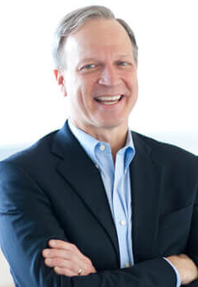
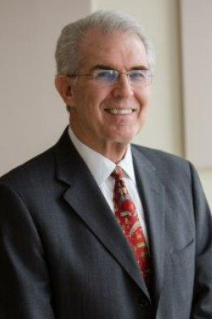



Overview of Deal Team
CEO Briefing
Joe Golden
Managing Director
703.785.5525
jgolden@mhhco.com
Michael J. Howe
Managing Director
215.399.5413
mhowe@mhhco.com
MHH leverages its strategic affiliate relationship with Eaton Square to broaden relationships with international acquirers, which in turn provides a more extensive buyer/investor network to our clients.
Eaton Square is a cross-border M&A and capital service provider with over 100 senior professionals across the US, Canada, Australia, New Zealand, UK, Andorra, Italy, Spain, Switzerland, China & Hong Kong, Singapore and Malaysia.
Education:
Education:
Virginia Tech (BS, Magna cum laude)
Villanova University (BEE)
University of Pennsylvania, Moore School and Wharton School (MSSE & MBA)
Experience:
(25+ years in Investment Banking)
  Principal at Eaton Square – International M&A and capital service provider
  Managing Partner and Co-Founder of BGX Advisory
  Managing Partner at The McLean Group
  Owner / Founder / Executive of five successful businesses
Experience:
(30+ years in Investment Banking)
  President of Susquehanna Financial Group (SIG); Co-manager of SIG’s private equity division
  Research Director, Senior Technology Analyst, Investment Policy Committee & Board Member at Butcher & Singer (Wells Fargo Capital Markets)
  Designed GPS satellite, secure telecom and robotics systems (including Space Shuttle robot arm control system) at AII (i.e., RCA spinoff), Honeywell, General Signal & GE
Scott Kendrick
Director
215.370.6128
skendrick@mhhco.com
Isabel Schaefer
Vice President
601.888.1937
ischaefer@mhhco.com
Education:
Education:
University of Pennsylvania
Wharton School (BS)
Franklin & Marshall College (BA)
Experience:
(18+ years in Investment Banking)
  Director, Strategy and M&A, at BGX Advisory
  Senior Vice President, M&A advisory, at The McLean Group
  Vice President at KippsDeSanto & Co.
  Senior Associate at OceanBridge Partners (direct equity investment)
  Analyst and Associate positions at Goldman, Sachs & Co., Investment Banking and Alternative Investments
Experience:
(4+ years in Investment Banking)
  Credit Analyst at Citizens Financial Group
    Leveraged Finance and Foreign Corporate Banking groups
  Bachelor of Arts in Business & International Studies

Slide 15


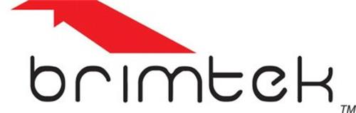
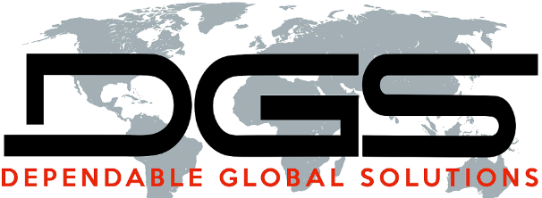






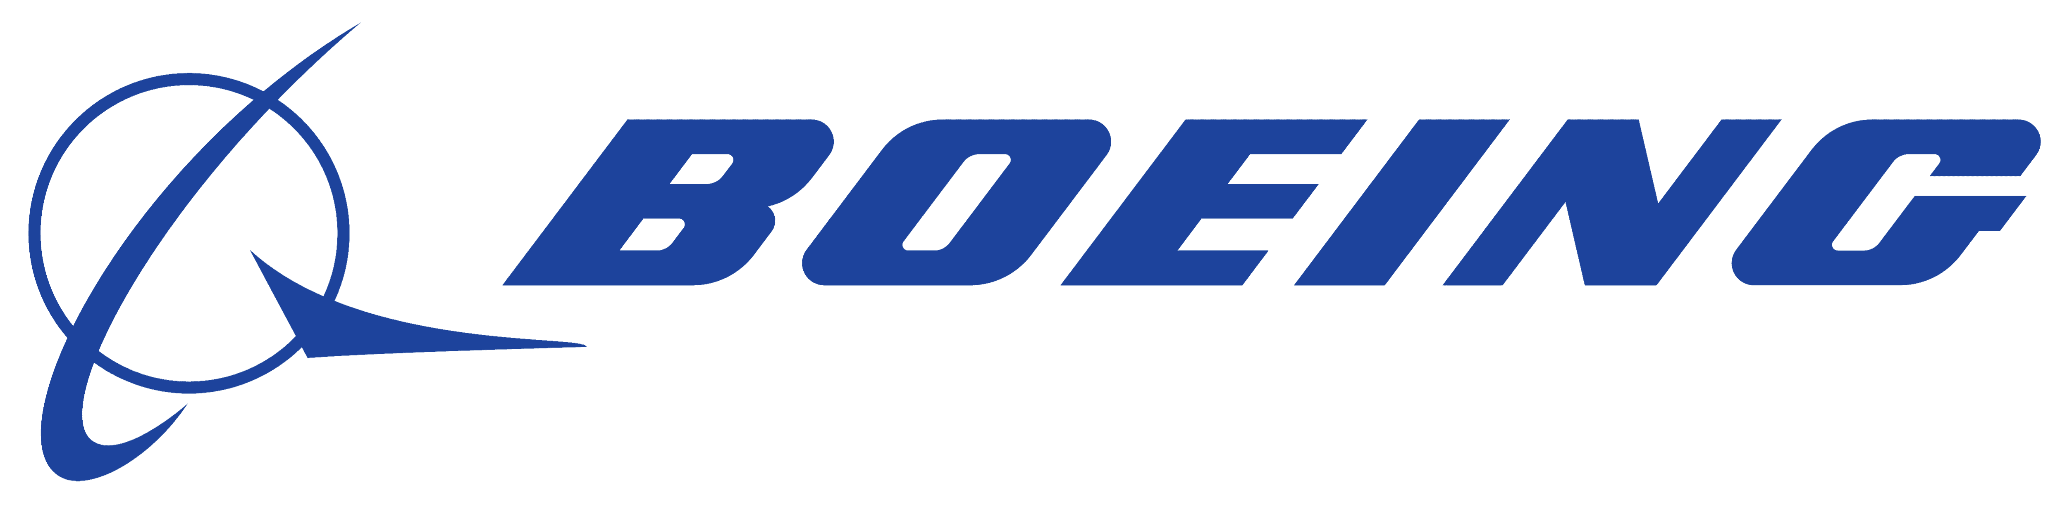

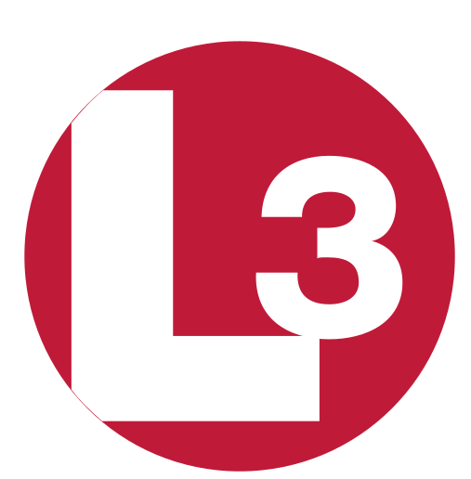






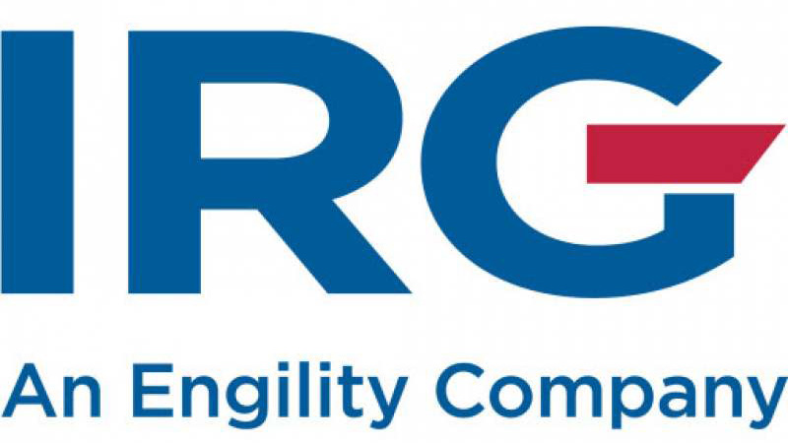

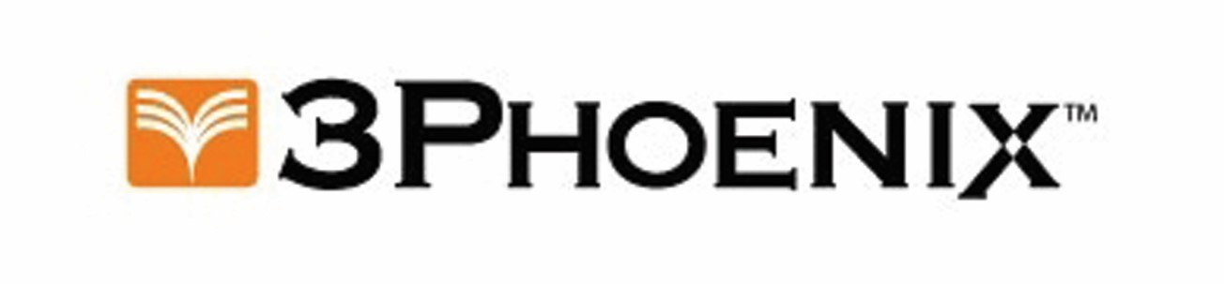



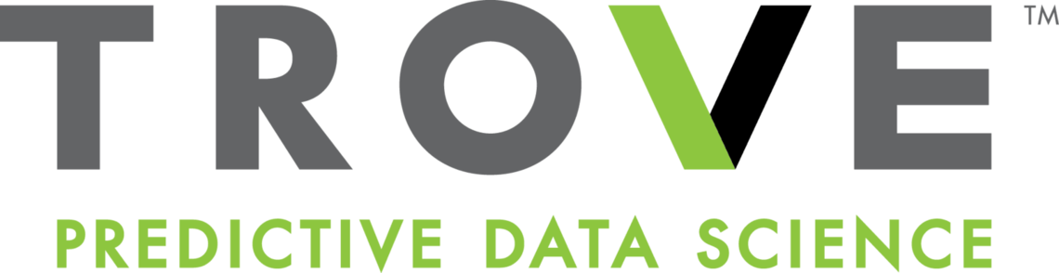


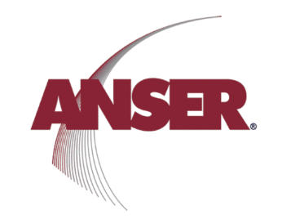





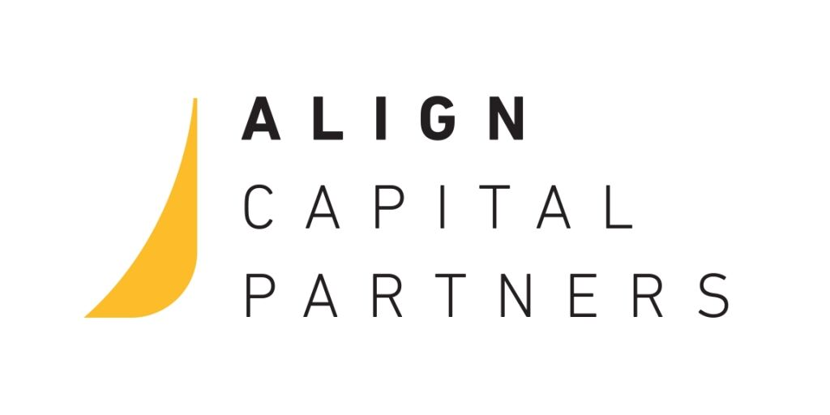











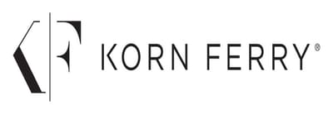




MHH Transactions – Manufacturing, Industrial, & Distribution
CEO Briefing
X
Unified door
Elizabeth Eakins
Security Source
Eminent Global Logistics
Switch I&I Slingmax up to where Exmeritus is at the top
Switch Nemo to #3 and move Brimteck
has been acquired by
has been acquired by
has been acquired by
has been acquired by
has been acquired by
has acquired
has been acquired by
has raised a Series A financing from an institutional investor led by
a subsidiary of
a portfolio company of
The undersigned served as exclusive financial advisor in this transaction
The undersigned served as exclusive financial advisor in this transaction
The undersigned served as exclusive financial advisor in this transaction
The undersigned served as exclusive financial advisor in this transaction
The undersigned served as exclusive financial advisor in this transaction
The undersigned served as exclusive financial advisor in this transaction
The undersigned served as exclusive financial advisor in this transaction
The undersigned served as exclusive financial advisor in this transaction
*
*
*
*
*
X
X
An Affiliate of SCRA
has been acquired by
has been acquired by
has been acquired by
has been acquired by
has been acquired by
has been acquired by
has completed a recapitalization with
has been acquired by an affiliate of
a portfolio company of
a portfolio company of
The undersigned served as exclusive financial advisor in this transaction
The undersigned served as exclusive financial advisor in this transaction
The undersigned served as exclusive financial advisor in this transaction
The undersigned served as exclusive financial advisor in this transaction
The undersigned served as exclusive financial advisor in this transaction
The undersigned served as exclusive financial advisor in this transaction
The undersigned served as exclusive financial advisor in this transaction
The undersigned served as exclusive financial advisor in this transaction
*
*
*
*
*
has been acquired by
X
has been acquired by
has been acquired by
has been acquired by
has been acquired by
has been acquired by
has been acquired by an affiliate of
has acquired and has completed a debt recapitalization
a portfolio company of
a portfolio company of
a portfolio company of
The undersigned served as exclusive financial advisor in this transaction
The undersigned served as exclusive financial advisor in this transaction
The undersigned served as exclusive financial advisor in this transaction
The undersigned served as exclusive financial advisor in this transaction
The undersigned served as exclusive financial advisor in this transaction
The undersigned served as exclusive financial advisor in this transaction
The undersigned served as exclusive financial advisor in this transaction
The undersigned served as exclusive financial advisor in this transaction

Slide 16
MHH Manufacturing Universe Directory
MHH tracks the following public companies:

Slide 17
Mufson Howe Hunter & Co. is an independent investment bank for middle-market companies. We focus on mergers, acquisitions, recapitalizations, and raising capital.
Mergers & Acquisitions
Advise buyers and sellers (public and private companies)
Sale of businesses, strategic acquisitions, management buy-outs and industry build-ups
Raise Capital
Equity (control and non-control)
Mezzanine financing
Senior and junior debt
Typically raise capital from banks, finance companies, private investment funds, and private equity groups
Financial Advisory Services
Analysis of business strategies and options
Fairness opinions
Valuations
Contact us
www.mhhco.com
Joe Golden Managing Director Mobile: 703.785.5525 jgolden@mhhco.com
Michael J. Howe Managing Director Direct Dial: 215.399.5413 Mobile: 215.808.0160 mhowe@mhhco.com
Scott Kendrick Director Mobile: 215.370.6128 skendrick@mhhco.com
Isabel Schaefer Vice President Direct Dial: 215.399.5418 Mobile: 610.888.1937 ischaefer@mhhco.com
Broker dealer services provided by our wholly-owned subsidiary:
Mufson Howe Hunter & Partners LLC
Member SIPC | FINRA

