Slide 1


Career-Connected Learning Suite
All materials supporting the CTE Statewide Advisory Board (including agendas, surveys, flyers, and the event website) were developed under grant number H421E230016 - STATE OF NEW MEXICO PUBLIC EDUCATION DEPARTMENT from the Department of Education. However, those contents do not necessarily represent the policy of the Department of Education, and you should not assume endorsement by the Federal Government. (Authority: 20 U.S.C. §§ 1221e-3 and 3474).

Slide 2
“
To find out what one is fitted to do, and to secure an opportunity to do it, is the key to happiness.
–John Dewey
“

Slide 3
Education with Destination in Tennessee

Slide 4
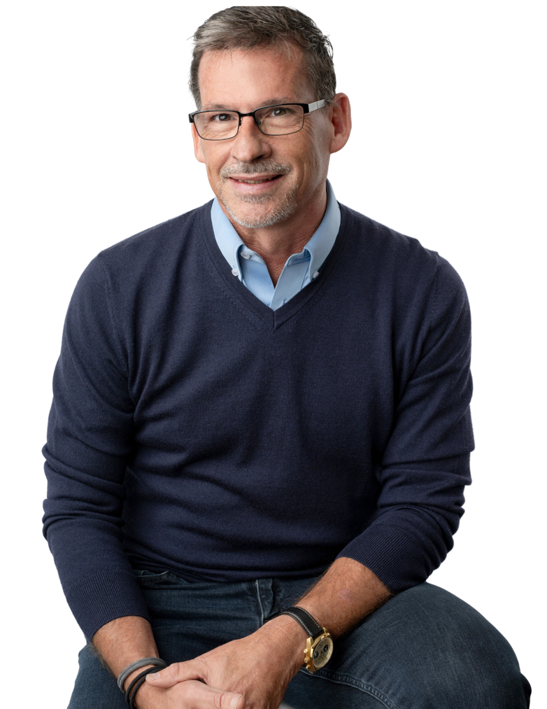



Dr. Joseph Goins, CEO
joseph.goins@p2c.org
865.414.0033

Slide 5

shelly.robinson@p2c.org
Shelly Robinson
Customer Success Project Lead (NM)
505.225.2911

Slide 6
WHO is P2C?

Slide 7
WHO is P2C?

Slide 8


We’re P2C!
We believe when education becomes relevant, learners can fully engage.

Slide 9

We’re P2C!
We believe when education becomes relevant, learners can fully engage.

Slide 10
About P2C

Slide 11
P2C History
P2C (formerly NS4ed) was founded in 2016 by Dr. Joseph Goins with the mission to provide high value research, and educational materials that yield actionable results for both the classroom and the workplace.
For nearly a decade, P2C has been at the forefront of career-connected learning with ready-to-implement solutions that work. Our products are supported by a career readiness model that increases student motivation and performance, while our research and support services have the capacity to alter policy and transform communities.

Slide 12

Our Mission
We’re dedicated to clearing the biggest hurdles in education by challenging current approaches and motivating student learning through career-connected relevance.

Slide 13

Our Vision
By connecting classroom and career paths, we believe we can transform not just the future prosperity of individual students, but the economies of whole communities.

Slide 14
WHAT is P2C?

Slide 15
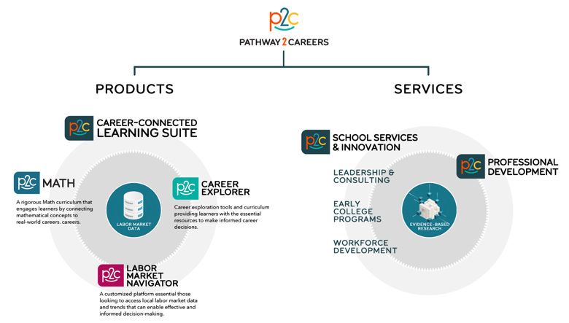

Slide 16
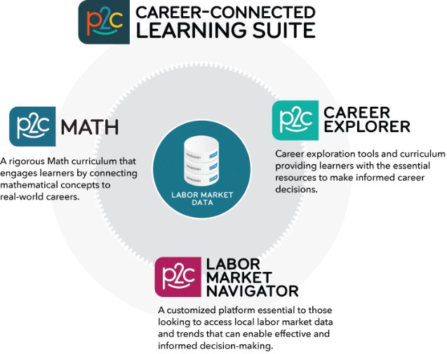

Slide 17
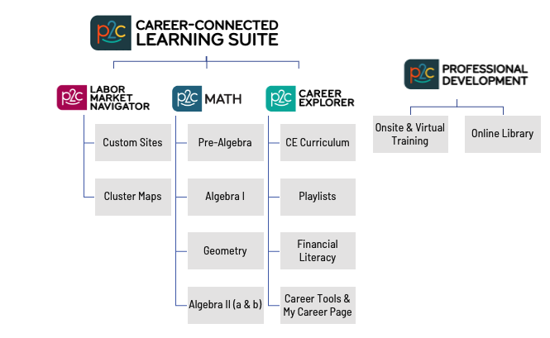

Slide 18



RESEARCH
POLICY
PRACTICE
Supporting education initiatives and priorities with actionable research
Validating policy issues in K-12, post-secondary, and business
Data-informed and evidence-based practices to create a robust career readiness model

Slide 19
WHY P2C?

Slide 20

Why P2C?
Why? Because when education becomes relevant, learners fully engage.
Relevance yields motivation
Relevance increases career readiness

Slide 21
Motivation

Slide 22
“
Tell me and I forget,
teach me and I may remember, involve me and I learn.
– Xun Kuang
“

Slide 23
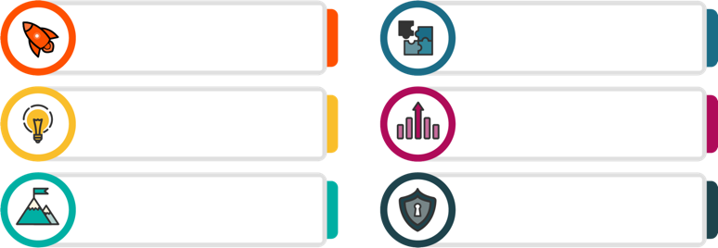
Research shows…
When students experience purpose in their learning, there is an increase in:
Motivation to learn
(Frymier & Shulman, 1995; Jang, 2008)
Task/course completion
(Fortenberry, Sullivan, Jordan, & Knight, 2007; Zusho, Pintrich, & Coppola, 2003)
Interest & engagement
(Assor, Kaplan, & Roth, 2002; Hulleman, Godes, Hendricks, & Harackiewicz, 2010; Hulleman & Harackiewicz, 2009)
Performance
(Hulleman et al., 2010; Hulleman & Harackiewicz, 2009; Malka & Covington, 2005)
Effort & persistence
(Trautwein & Ludtke, 2007; Yeager et al., 2014)
Retention of new information
(Perin, 2001; Yeager et al., 2014)

Slide 24
The Effect of Motivation on Dropout Prevention
Strategy effect sizes from meta-regression model*
STRATEGY | EFFECT SIZE
Career development/job training | 0.81
Family engagement | 0.67
Mentoring | 0.63
Behavioral intervention | 0.46
Literacy development | 0.42
Work-based learning | 0.26
School/classroom environment | 0.25
Service-learning | 0.21
Health and wellness | 0.18
Academic support | 0.11
*Data sourced from the National Dropout Prevention Center

Slide 25



CTE Fact Check
What is the HS graduation rate for CTE students nationwide?
81%
73%
60%
93%
What percent of students who take
2 CTE credits enroll in post-secondary?
58%
91%
75%
What is the college completion rate for CTE concentrators?
80%
56%

Slide 26
Career Readiness

Slide 27
“
Most high-paying jobs require additional education and training beyond a high school diploma.
We must make sure that our children, particularly those who are traditionally underserved, are prepared for and have access to postsecondary education.
– Gov. Bob Wise, Alliance for Excellent Education
“

Slide 28
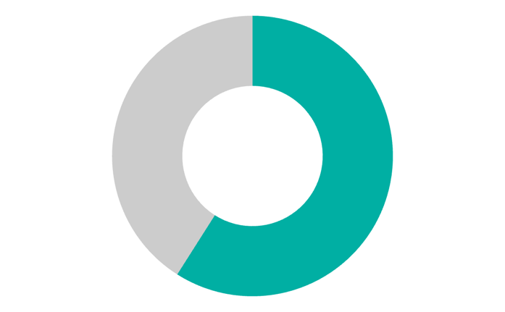
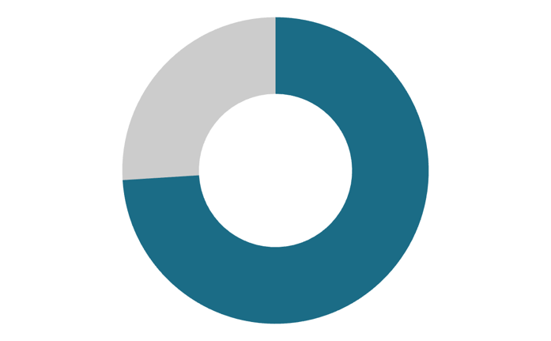
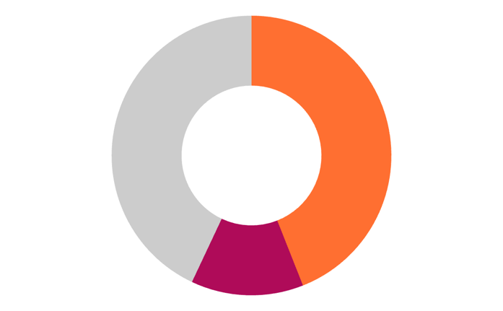
The Gap Between Education & Industry
Employment
Economic Development
Education
59%
57%
of students who start a postsecondary program earn a degree within 6 years.
of low income students, earn a degree within 6 years.
74%
of recent grads are working in jobs that require a college degree.
of hiring managers agree that a “skills gap” persists in the current US labor and hiring economy.
13%

Slide 29



The Gap Between Education & Industry
Education
Employment
Economic
Development
EQUITY ISSUES

Slide 30
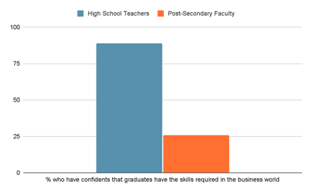
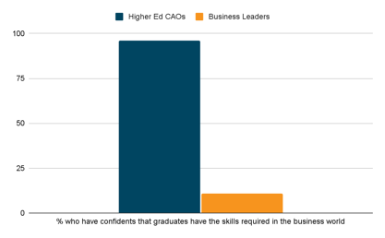
The Gap Between Education & Industry
96%
89%
26%
11%
Percent who believe incoming higher ed freshmen are “ready”
Percent who have confidence that graduates have the skills required in the business world

Slide 31
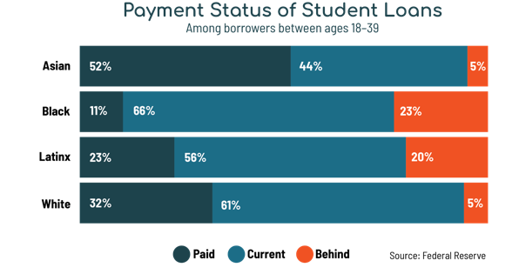
Significant Long-Term Impact
When young people have low employability, they experience greater challenges in reducing their student loan debt.

Slide 32
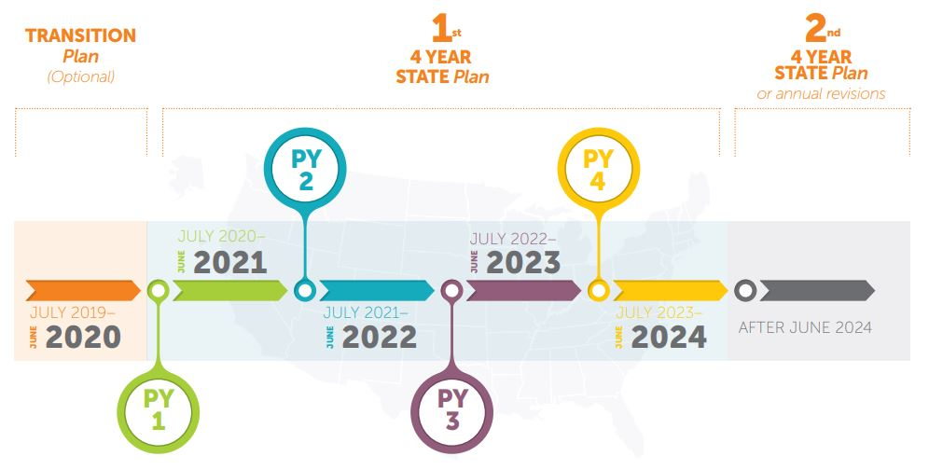
Initiatives to Address Career-Readiness Gaps
Perkins V
96%
Purpose: To develop more fully the academic knowledge and technical and employability skills of secondary education students and postsecondary education students who elect to enroll in career and technical education programs.
Notable Changes:
Emphasis on data-informed decision making
Reduction in the role of the U.S. Secretary of Education
Increase in stakeholder involvement

Slide 33
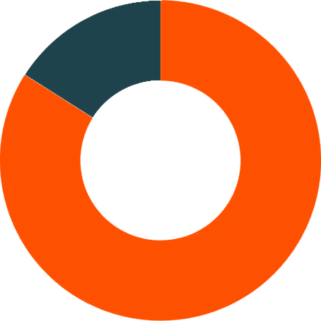
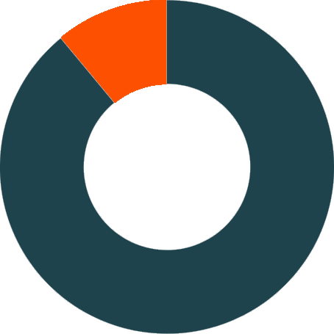
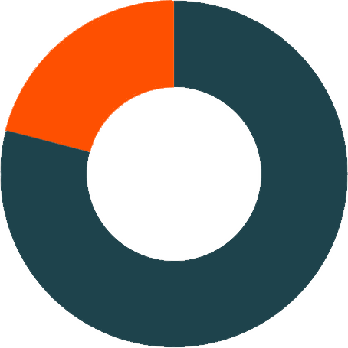
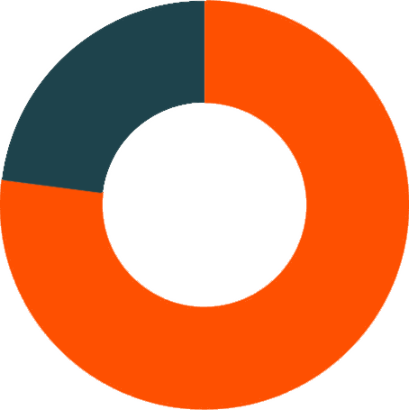
Initiatives to Address Career-Readiness Gaps
Early College
Students moving on to post-secondary education
College completion within 4 years of HS graduation
Purpose: An effective way to increase college-going and college completion.
89%
89%
77%
84%
11%
21%
26%
26%
Early college students
Control students
Early college students
Control students

Slide 34
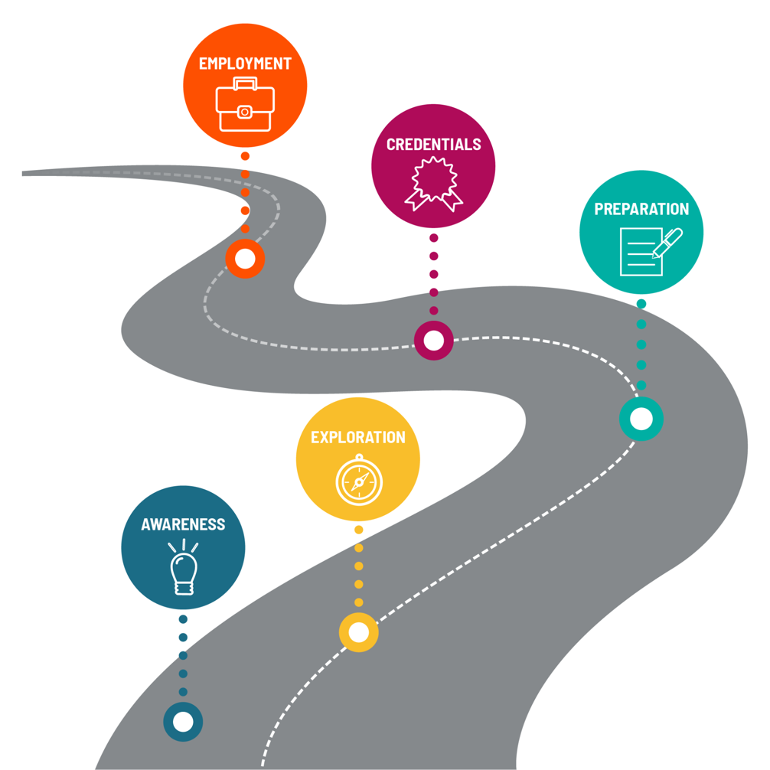
Career Pathways
From the student & educator perspective

Slide 35
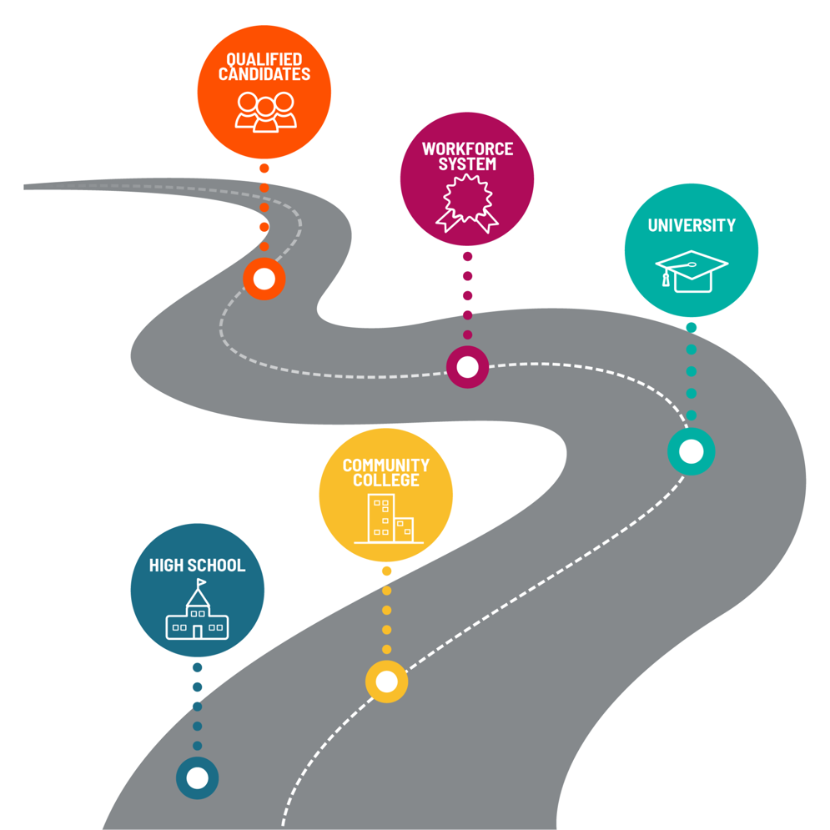
Talent Pathways
From the employer perspective
Experience Short-term skills-based credentials
BA/BS
Masters
PhD
Skills-based credentials AA/AS degrees
Basic & soft skills

Slide 36
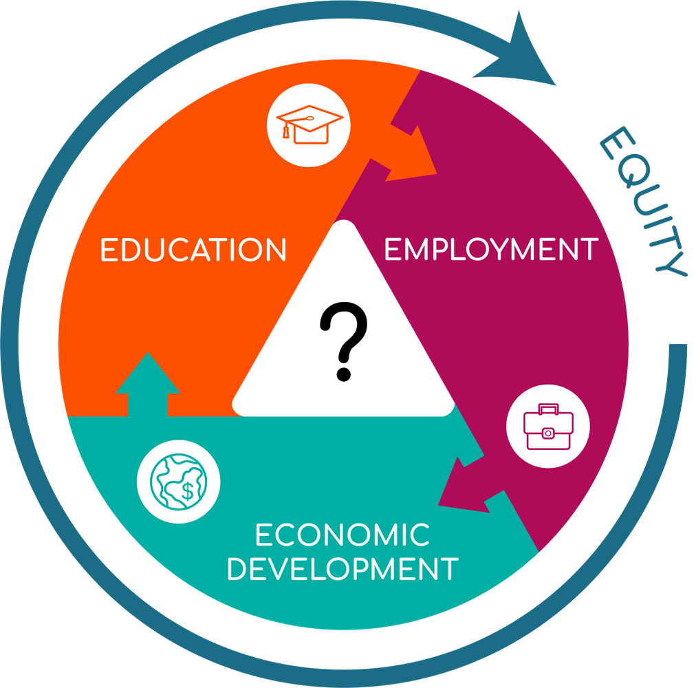
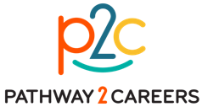

The Four “E”s
P2C operates at the intersection of education, employment, & economic development with an intentional focus on the underserved.

Slide 37

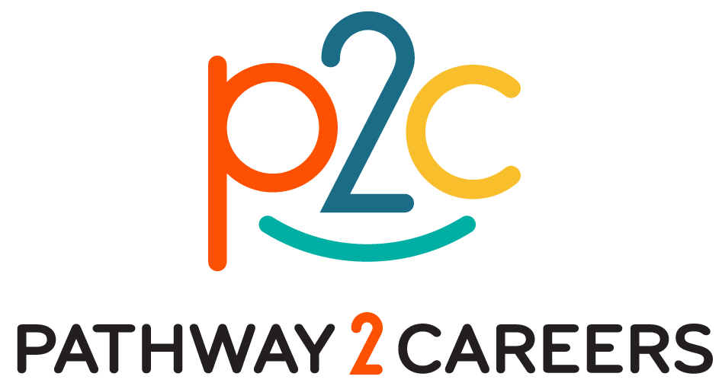
The Four “E”s
What is at the intersection of education, employment, & economic development
that also addresses equity at each stage?

Slide 38
HOW does P2C work?

Slide 39

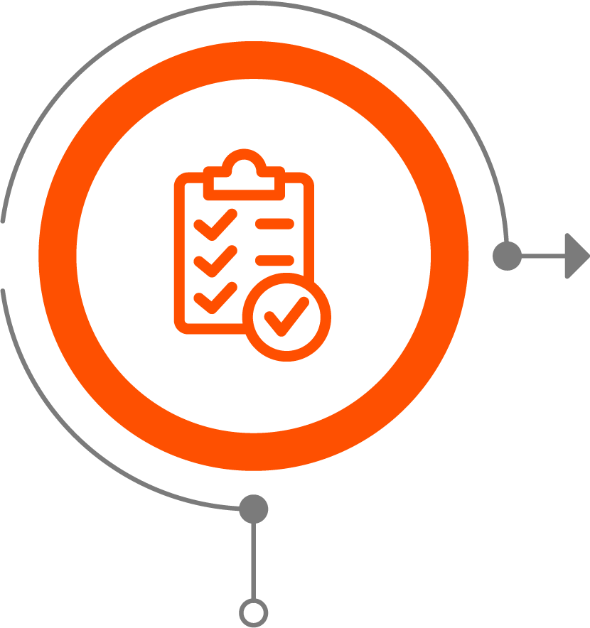
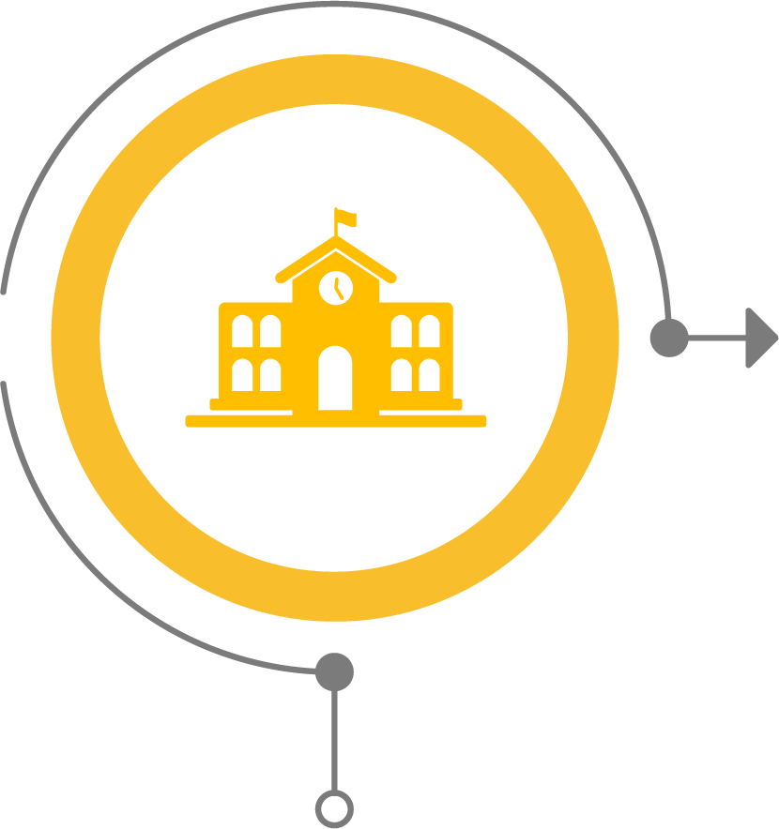

Program Alignment
Assess Needs
Use data to diagnose needs and establish policies for effective career resources.
Plan
Develop and prioritize strategies that align to your vision and ensure students have workplace skills.
Operationalize
Extend plans to reach and engage stakeholders, including teachers and students.
Maintain Momentum
Support ongoing success through community communications and stakeholder involvement.

Slide 40
Assess Needs

Slide 41
Assess Needs
Explore high-value careers for sixteen career clusters
Understand programs associated with high-value careers in each cluster
Gather information to evaluate current programs and develop plans for adding, revising, or removing programs
Align programs to high-value careers
Assess Needs
Use data to diagnose needs and establish policies for effective career resources.

Slide 42
Labor Market Navigator
Product Spotlight

Slide 43
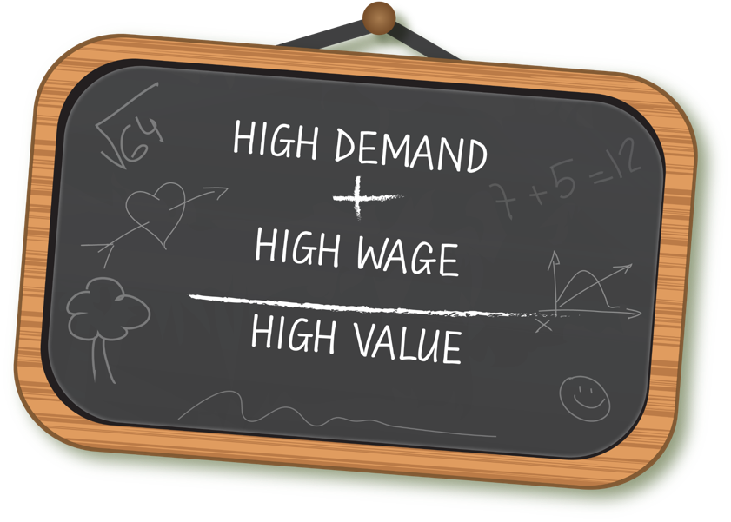
Benefits of Leveraging Labor Market Data
Use labor market data to understand career destinations for students in their local areas
Identify occupations expected to be high in demand and wage
Align educational practices with critical skills
Prioritize learning opportunities that prepare students for good jobs in their communities

Slide 44
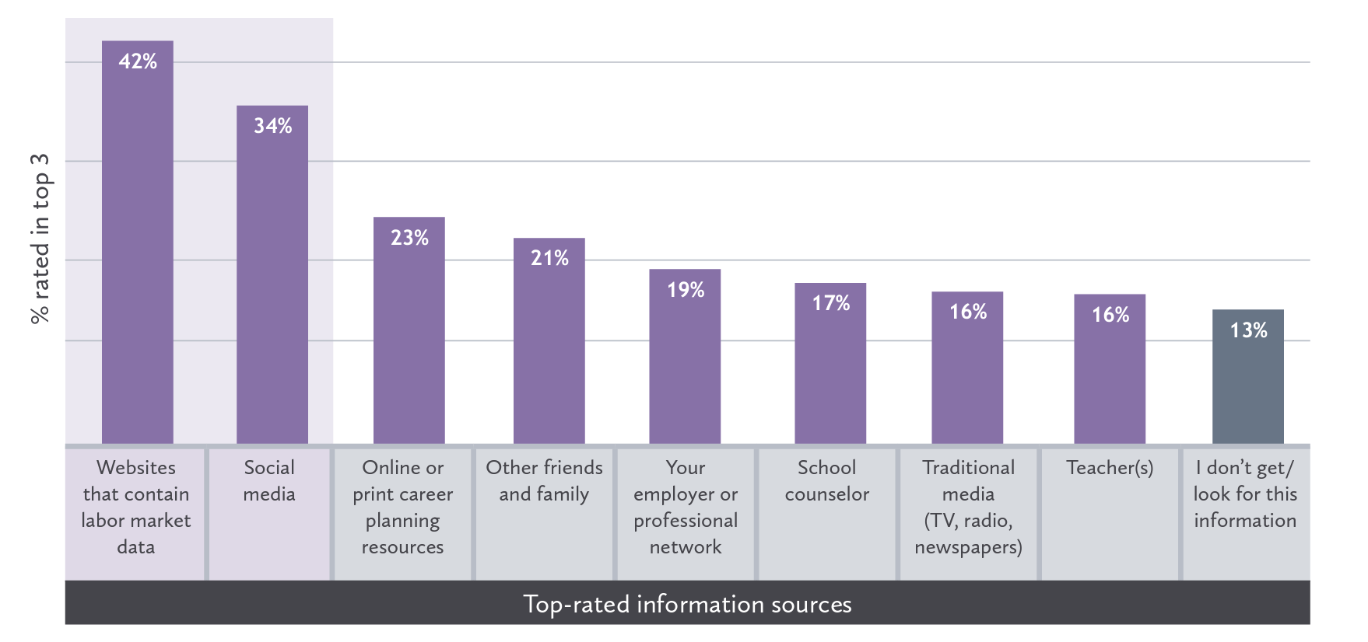
Where do Students Learn About Careers?

Slide 45
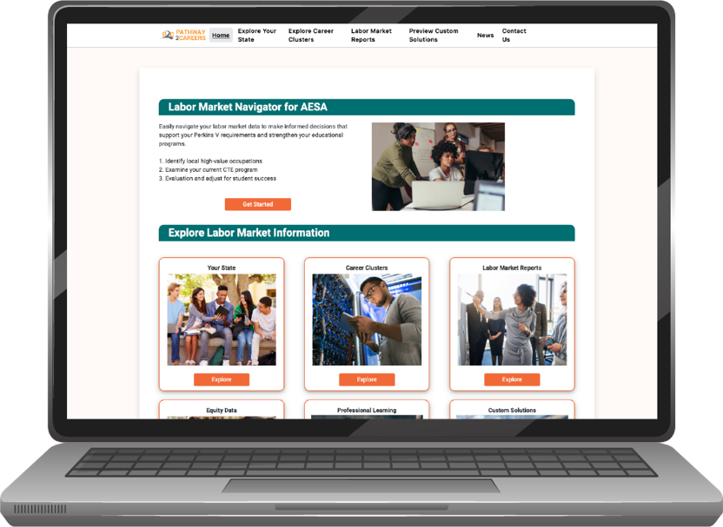
Labor Market Navigator (LMN)
The LMN dashboard makes the
complicated simple
Educators and learners can navigate complex data in an engaging and digestible way

Slide 46
Labor Market Navigator is a Policy Tool
How to evaluate your alignment:
1
2
3
4
Identify local high-value occupations
Examine current CTE programs
Adjust program offerings as needed
List program offerings in CLNA
Utilize our labor market dashboard.
Do your current programs support high-value careers?
Add programs to meet demands and revisit programs.
Use supporting data for high-value careers including annual openings and median wages.

Slide 47
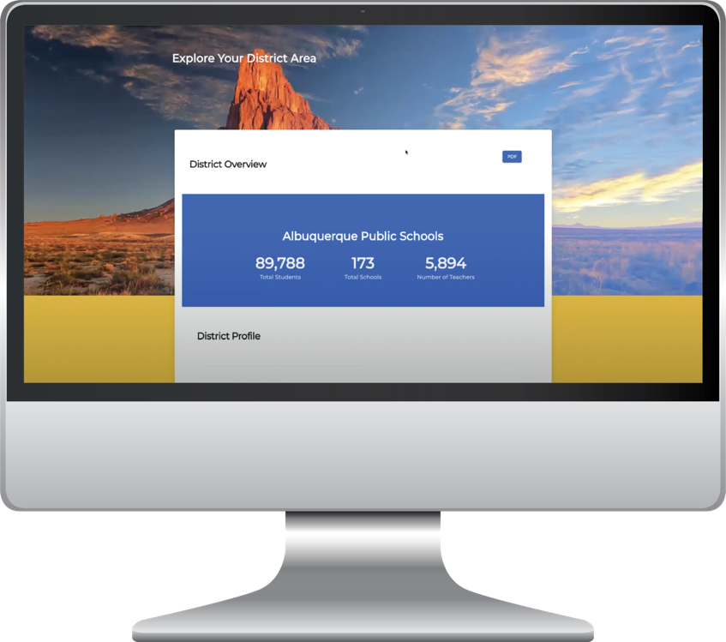
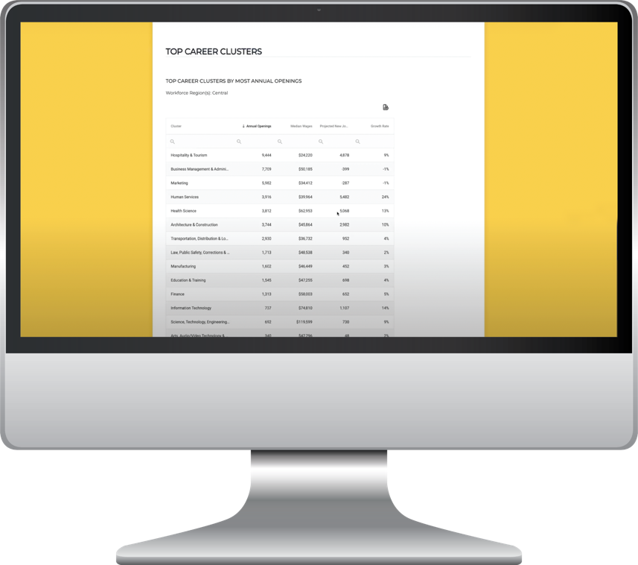
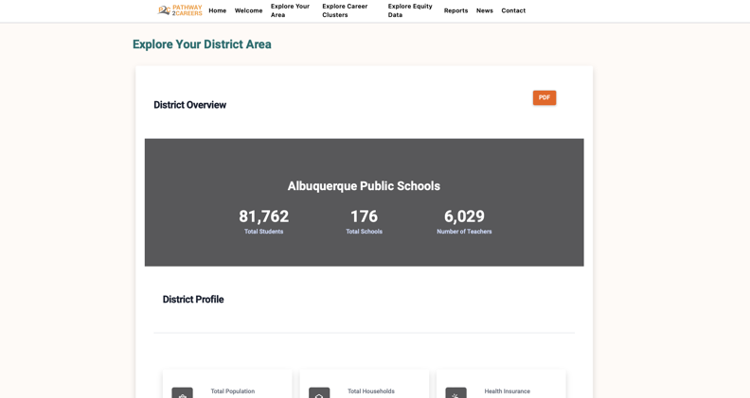
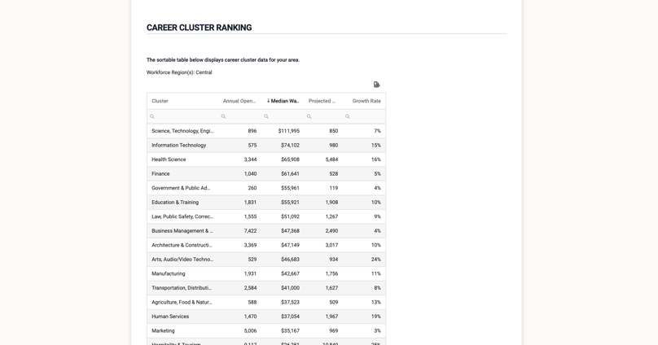
Labor Market Navigator (LMN)
New Mexico Case Study

Slide 48
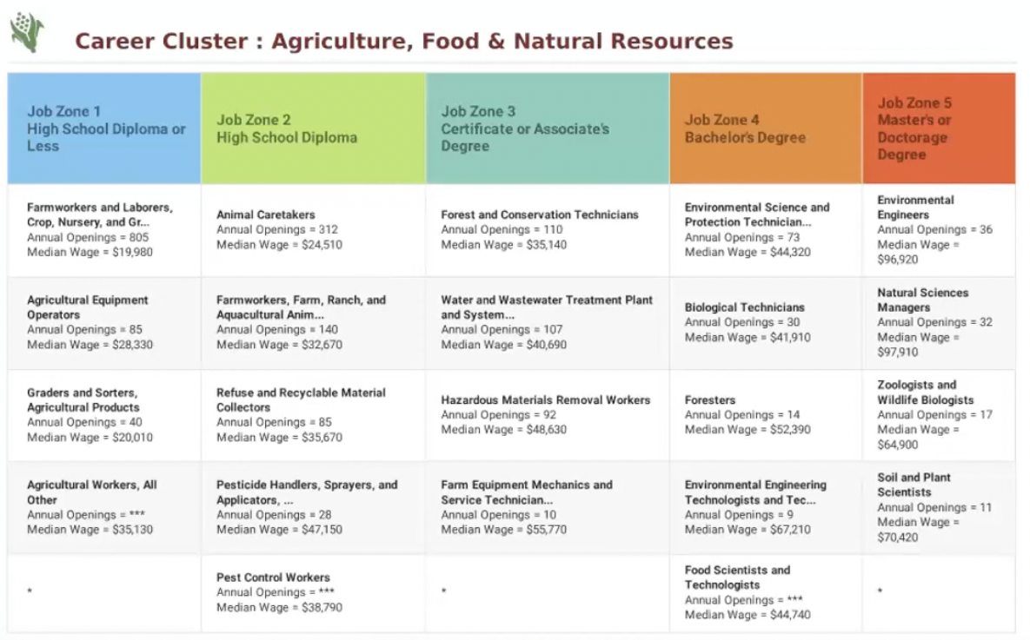
Labor Market Navigator (LMN)
The career cluster results in the P2C labor market report allows you to overlay a skill or set of skills with relevant local job demand.

Slide 49
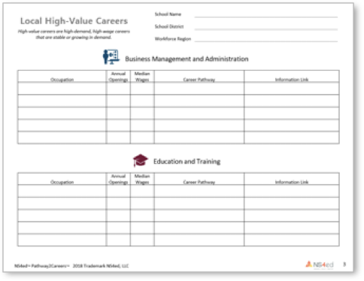
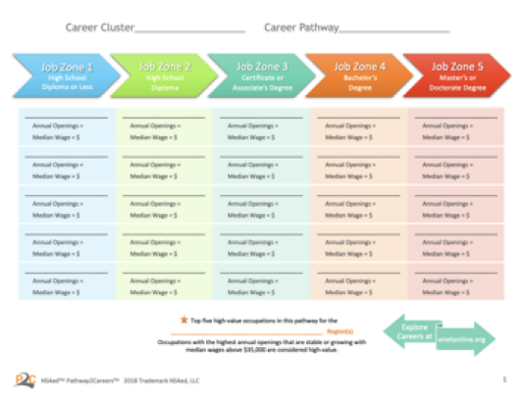
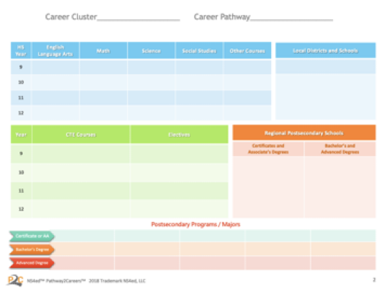
Additional Alignment Resources

Slide 50

Additional Benefits
Have access to complete high-value careers table for 16 career clusters
Understand education programs associated with high-value careers in each cluster
Reference necessary information to evaluate current programs and develop plans for adding, revising, or removing programs
Recommend changes to align programs to high-value careers

Slide 51
Plan

Slide 52
Program Alignment
Assess Needs
Use data to diagnose needs and establish policies for effective career resources.
Plan
Develop and prioritize strategies that align to your vision and ensure students have workplace skills.
Operationalize
Extend plans to reach and engage stakeholders, including teachers and students.
Maintain Momentum
Support ongoing success through community communications and stakeholder involvement.

Slide 53
Plan
Establish criteria to select career-connected learning initiatives.
List existing programs offering career-connected learning.
Identify areas to infuse career-connected learning.
Select new programs and initiatives to motivate, engage, and align to your strategic vision.
Plan
Develop and prioritize strategies that align to your vision and ensure students have workplace skills.

Slide 54

Career-Connected Programs Should Include:
Meaningful learning experiences
Clear and accurate information about local career opportunities
Upscale learning efforts to teach valued skills

Slide 55
P2C Math
Product Spotlight

Slide 56
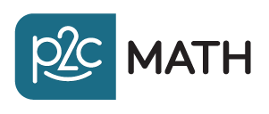
Product Spotlight
P2C Math

Slide 57
What is the number one question students ask in math class?

Slide 58

P2C Math is not…
About creating a better math problem, but instead answering the most often asked question
”When will I ever need to know this in the real world?”
P2C Math utilizes Understanding by Design (Wiggins and McTighe) framework
Focused on student learning and motivation
Career-connected learning is a powerful approach to incorporate purpose into math learning

Slide 59

How can relevance be increased while supporting the pathway to postsecondary success for all students, particularly those traditionally underserved?
High School Disengagement
Elementary School
76%
Middle School
61%
High School
44%
The 2012 Gallup Student Poll asked students how involved and enthusiastic they feel about school. Nearly 8 in 10 elementary students reported high engagement. By high school only half that many did.

Slide 60
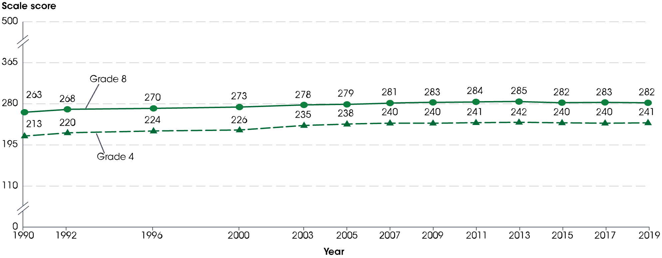
Traditional Approaches to Math Instruction
Average National Assessment of Educational Progress (NAEP) mathematics scale scores of
4th- and 8th-grade students: Selected years, 1990–2019
Note: A similar trend is observed for grade 12 results. Grade 12 mathematics scores are not shown because they are reported on a scale of 0 to 300.
Source: The Condition of Education 2020

Slide 61
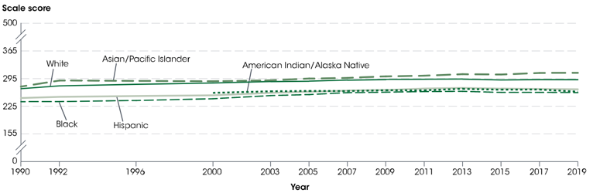
Traditional Approaches to Math Instruction
Average National Assessment of Educational Progress (NAEP) mathematics scale scores of
8th-grade students, by selected characteristics: Selected years, 1990–2019
Source: The Condition of Education 2020

Slide 62
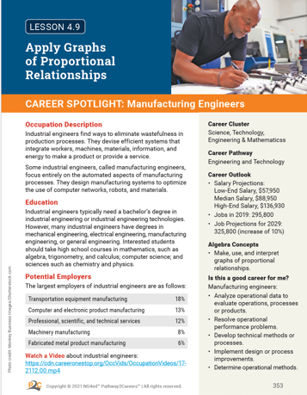
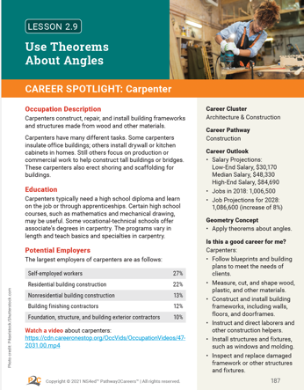

Slide 63
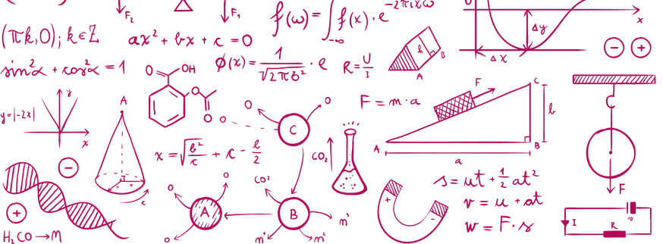
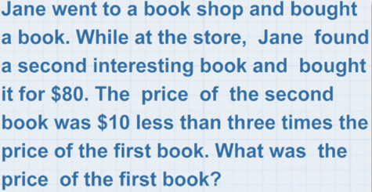
Traditional approaches to math education often look like this:
Traditional approaches to math education often look like this:

Slide 64

As math problems get more complex, studies have shown that students’ attitudes toward math decline.

Slide 65
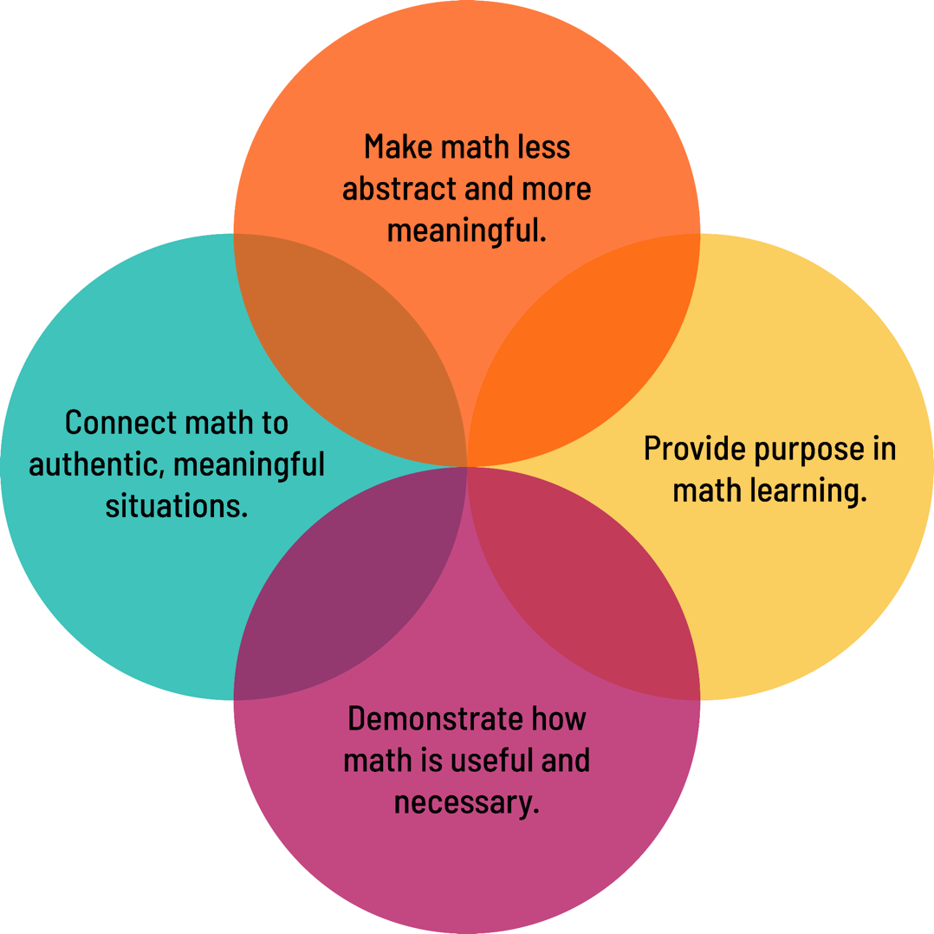
In order to modernize math, we must:
Career-Connected Learning

Slide 66

Benefits of Career-Connected Learning
Connecting math to careers can be a powerful approach to incorporate purpose into math learning.
Doing so will improve students’ attitudes toward math and enhance motivation to acquire the critical math skills students will need for employment success.

Slide 67
With Career-Connected Learning….
…students will see:
How math is applied in meaningful, everyday tasks
The relationship between math proficiency and successful job performance
The value in using math to reach job-related goals

Slide 68
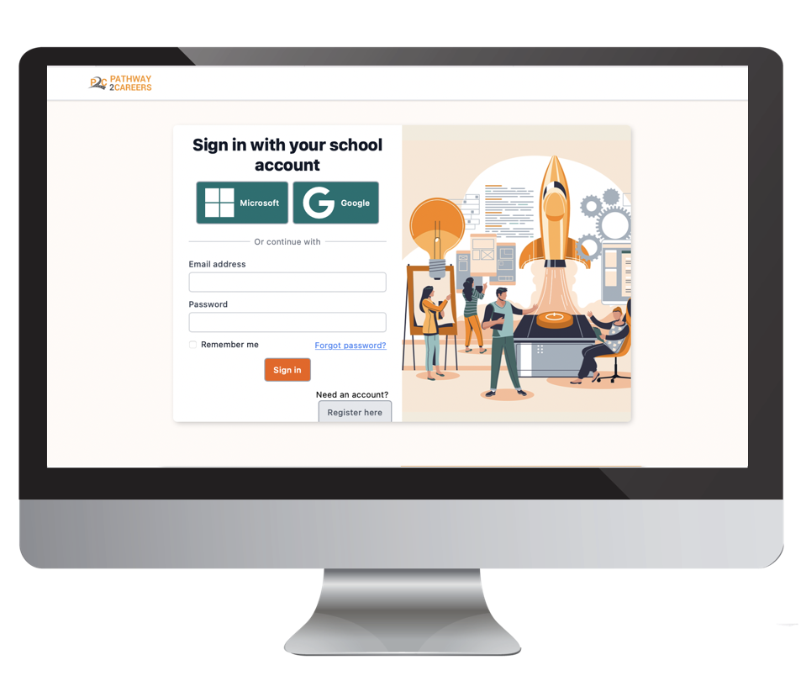
P2C Math Connects Curriculum to Careers
Comprehensive career exploration and pathway development system
Connecting learning to the local/regional employers needs in the workforce

Slide 69

P2C Math Objectives
Students understand the value of math skills in the workplace
Students benefit from career exposure
Students develop purpose in learning

Slide 70
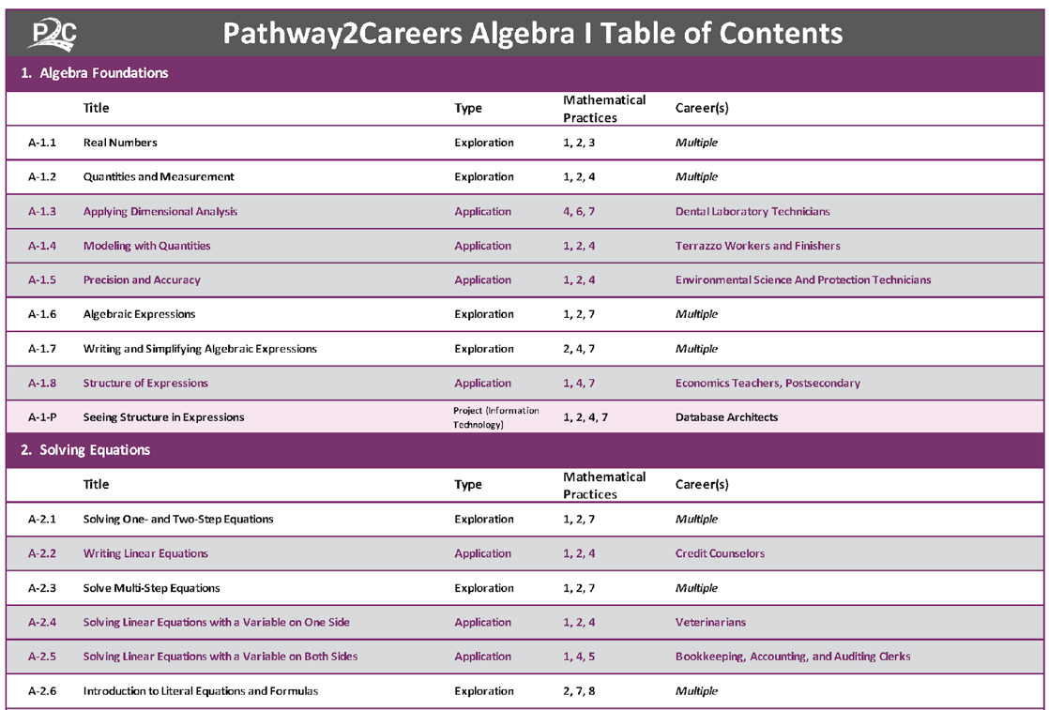
650+ Careers to Discover
Nearly 200 application lesson offers
in-depth exploration of specific math concepts in the context of a spotlighted career
Occupations represent high-value careers in multiple fields
  High-Demand (O*NET Bright Outlook)
  High-Wage (above $35,000)
  All 16 Career Clusters

Slide 71
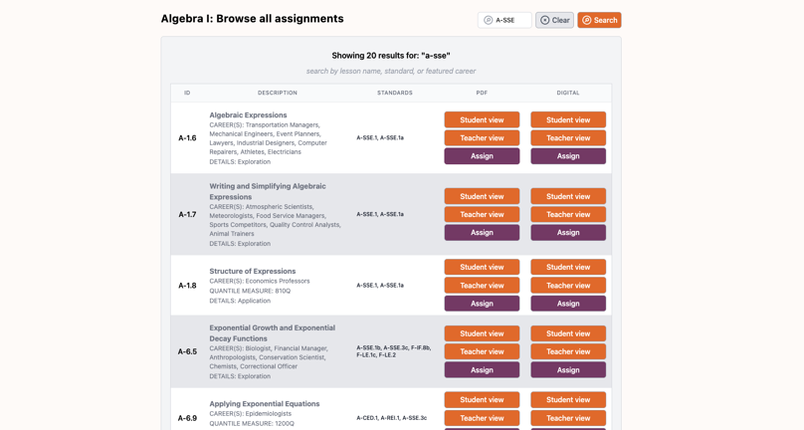
P2C Math Curriculum
Aligned with Specific State Standards + Common Core State Standards
Standards are clearly identified in every lesson
Each skill and concept explored is tracked

Slide 72
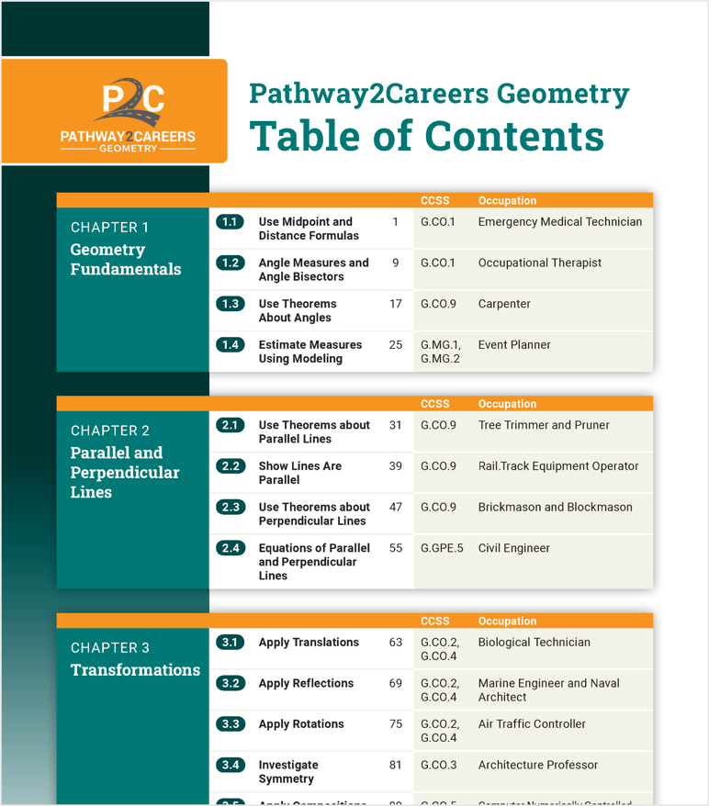
Best Practices & Quality Content
Written and evaluated by experts in math curriculum development
Content is presented using well-established methods and best practices in math instruction

Slide 73
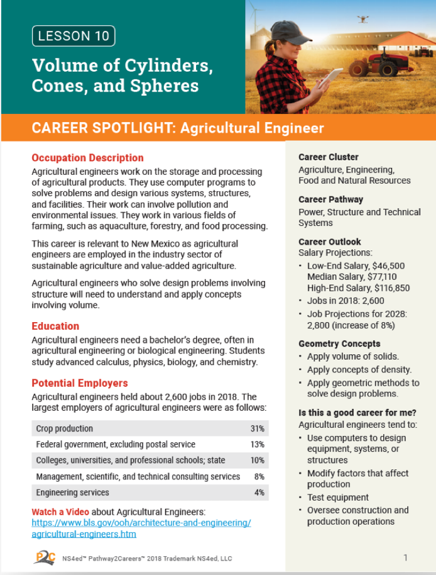
Lessons Include:
Job Duties and Responsibilities
Education Requirements
Types of Employers
Career Cluster and Pathway
Labor Market Data (wage and demand projections)
Occupation-Related Math Concepts
Common Work Tasks

Slide 74
Operationalize

Slide 75
Program Alignment
Assess Needs
Use data to diagnose needs and establish policies for effective career resources.
Plan
Develop and prioritize strategies that align to your vision and ensure students have workplace skills.
Operationalize
Extend plans to reach and engage stakeholders, including teachers and students.
Maintain Momentum
Support ongoing success through community communications and stakeholder involvement.

Slide 76
Operationalize
Identify all areas to support career-connected learning.
Engage stakeholders in launch plans.
Enhance academic programs to support career-connected learning.
Address professional learning opportunities.
Plan frequent check-ins to support implementation.
Operationalize
Extend plans to reach and engage stakeholders, including teachers and students.

Slide 77
Operationalize: Engage Students
Because connecting students to their
interests and career paths matters.

Slide 78
P2C Career Explorer
Product Spotlight

Slide 79
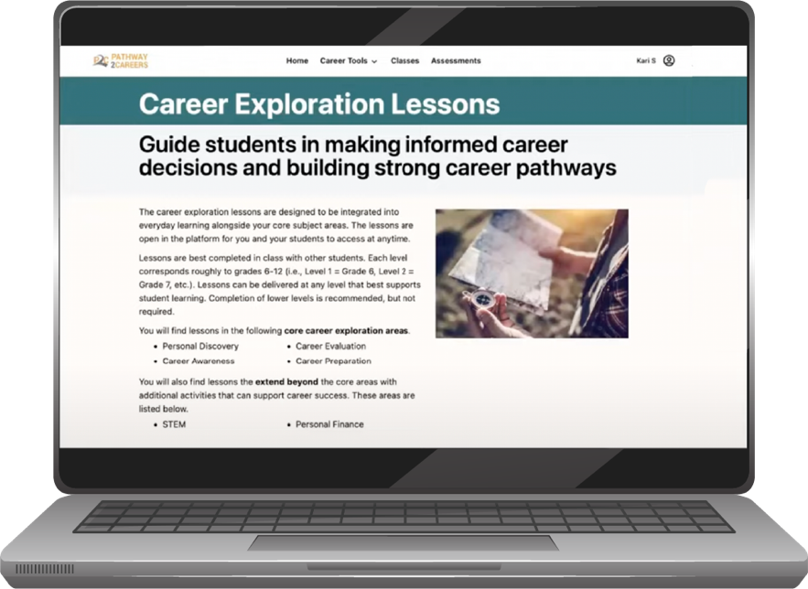
P2C Career Explorer
How do we…
scaffold career exploration so that students are learning the right information at the right grade level?
put that model in the hands of all educators?

Slide 80

P2C Career Explorer
Connects personal factors to external factors so students can make informed career decisions.
Personal Factors
External Factors
Work interests
Work values
Lifestyle aspirations
Job market trends
High-value careers
Local job opportunities

Slide 81
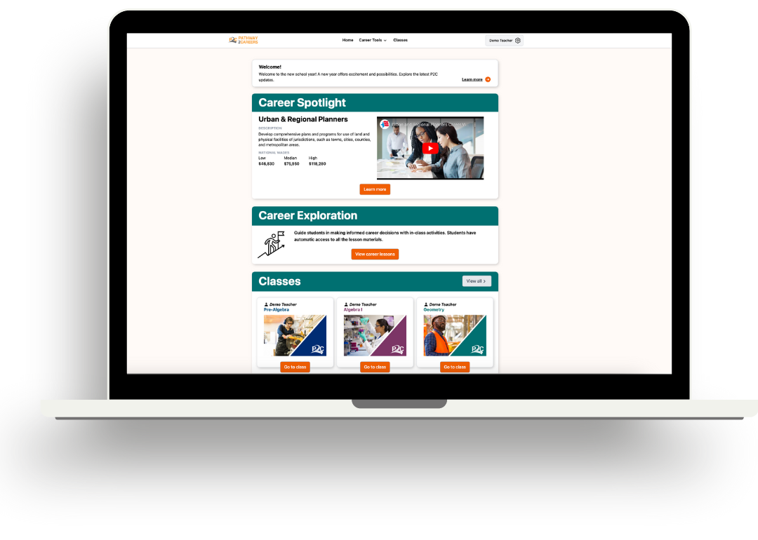
P2C Career Explorer
Career exploration is not a one-time event
It is fully integrated within the standards-aligned content

Slide 82
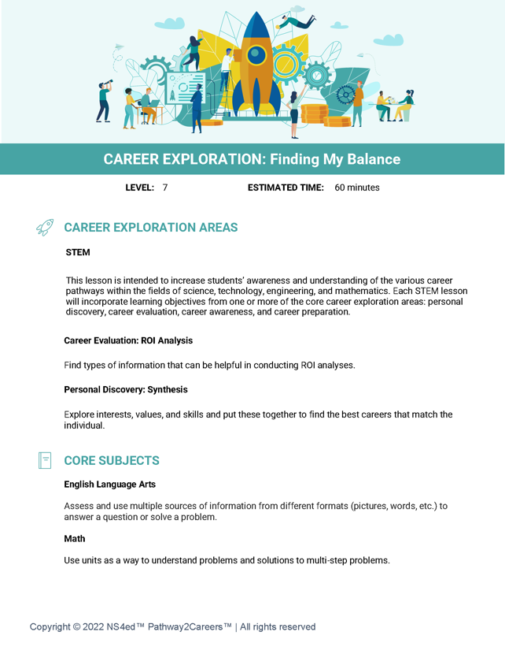

P2C Career Explorer
Lesson Demo

Slide 83
The Architecture of P2C Career Exploration Curricuum
Lessons span 7 grades
Multiple subject integration
Dual learning objectives
Grades 6–12
10 lessons per grade
70 total lessons
English language arts
Mathematics
Science
Social Studies
Physical Education
Career exploration objectives
Subject-specific objectives

Slide 84
Maintain Momentum

Slide 85
Program Alignment
Assess Needs
Use data to diagnose needs and establish policies for effective career resources.
Plan
Develop and prioritize strategies that align to your vision and ensure students have workplace skills.
Operationalize
Extend plans to reach and engage stakeholders, including teachers and students.
Maintain Momentum
Support ongoing success through community communications and stakeholder involvement.

Slide 86
Maintain Momentum
Identify all areas to support career-connected learning
Engage stakeholders in launch plans
Enhance academic programs to support career-connected learning
Address professional learning opportunities
Plan frequent check-ins to support implementation
Maintain Momentum
Support ongoing success through community communications and stakeholder involvement.

Slide 87
“
Effective education is not adding a program or a set of programs to a school. Rather, it is a transformation of the culture and life of the school.
– David Berkowitz
“

Slide 88

Establish a Culture of Career-Connected Learning
Define a CCL Culture
Offer Supports
Revisit & Adjust
Embed in All Areas

Slide 89
P2C Professional Development
Service Spotlight

Slide 90
“
The single greatest effect on student achievement is not race, it is not poverty - it is the effectiveness of the teacher.
– Harry Wong
“

Slide 91

P2C Professional Development
Effective teaching involves a deep understanding of the knowledge and skills students will require to be successful in the workplace someday. In this fast-changing world of work, educators need to be equipped with the resources to navigate this constant change and meet their students’ needs.
Our team of seasoned professionals are equipped to provide prescriptive, tailored learning experiences to meet the needs of our participants.

Slide 92

P2C Professional Development
Professional Development at P2C is not a “one-and-done” training. Our professional development includes on-going support via follow-up virtual sessions, collaborative online learning communities, and access to online courses reflecting the latest research within the industry.
At P2C, we believe:
Teachers are the cornerstone to student achievement
Effective educator resources are rooted in best practices

Slide 93
P2C Professional Development
At P2C, our goal is to:
Advance a culture of career readiness by connecting careers to all academic coursework
Establish trusted partnerships to support all P2C educators with diverse and collaborative learning options
Foster a culture-shift in schools by making career readiness important to everyone

Slide 94
WHO Does P2C Work For?
Efficacy & Testimonials

Slide 95


Positive results emerge as New Mexico usage grows.
Course | Number of Students | State Pass Rate | P2C Pass Rate | P2C Course
Algebra 1 | 1,184 | 76.31 | 88.94%
Geometry | 987 | 79.45% | 88.65%

Slide 96


With extended P2C use…
Surveys show student interest in math increases.
Survey 1
Survey 2

Slide 97


With extended P2C use…
Surveys show student interest in career exploration increases.
Survey 1
Survey 2

Slide 98
In the words of P2C teachers…
“
Never in my 20 years of educational experience have my students ever experienced such in-depth career focused math problems.
“

Slide 99
In the words of P2C teachers…
“
P2C curriculum is extremely unique. It lifts the veil and perfectly focuses the spotlight on the type of math used in any chosen profession.
“

Slide 100
In the words of P2C teachers…
“
With the P2C lessons, I saw more of my students take risks and engage in conversation during the lessons, which helped our class build more community and self-confidence.
“

Slide 101
In the words of P2C teachers…
“
Many of the teachers that I work with absolutely love the way their students glow and marvel at grasping concepts that they otherwise…may not have understood.
“

Slide 102



Shelly Robinson
Customer Success Project Lead (NM)
shelly.robinson@p2c.org
THANK YOU!
505.225.2911

Slide 103
Dr. Joseph Goins, CEO
joseph.goins@p2c.org
THANK YOU!
865.414.0033

