Slide 1

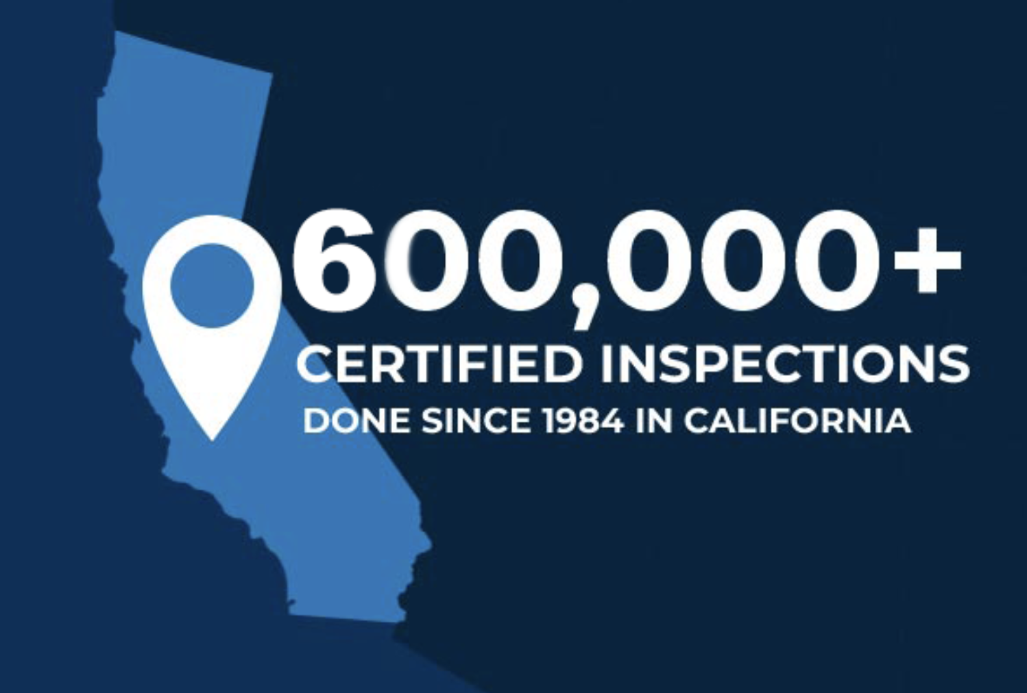
HOME MOLD SEWER TERMITE COMMERCIAL ROOF

Slide 2


Slide 3
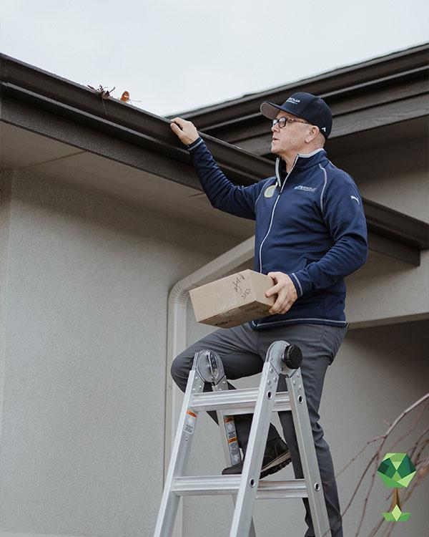

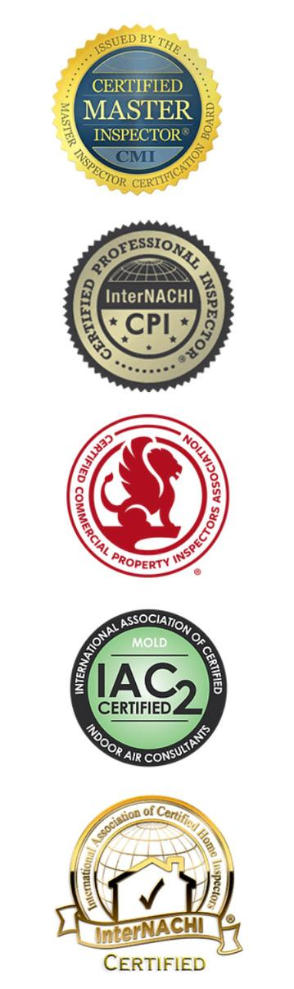

The Elite Group
40 Years In Business
600,000+ Inspections
10,000+ Five Star Reviews
80+ Inspectors
7 Days A Week Availability
8+ Inspection Services
6 Counties in So Cal
ZERO Companies like us
24 hour reports

Slide 4
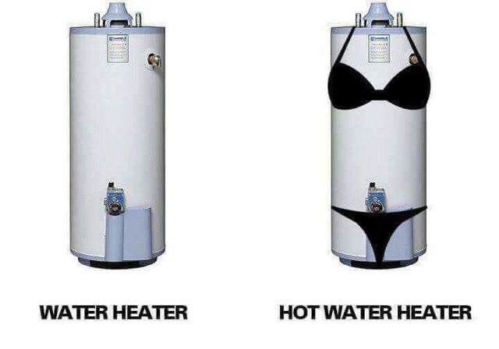
WHAT IS THE DIFFERENCE BETWEEN A WATER HEATER AND HOT WATER HEATER?

Slide 5
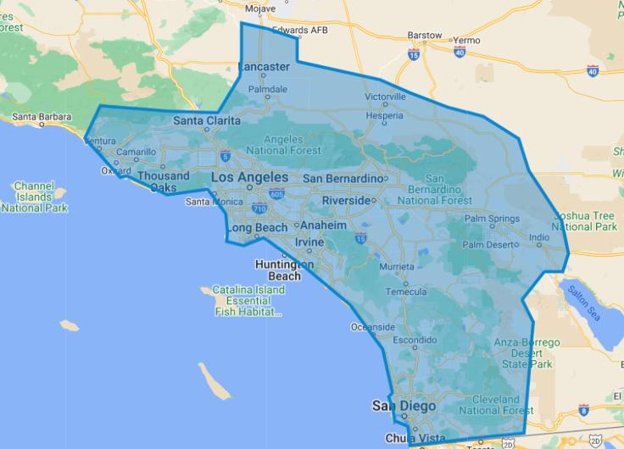

We Go Where You Do!

Slide 6
CALIFORNIA INSPECTOR REGULATIONS

Slide 7
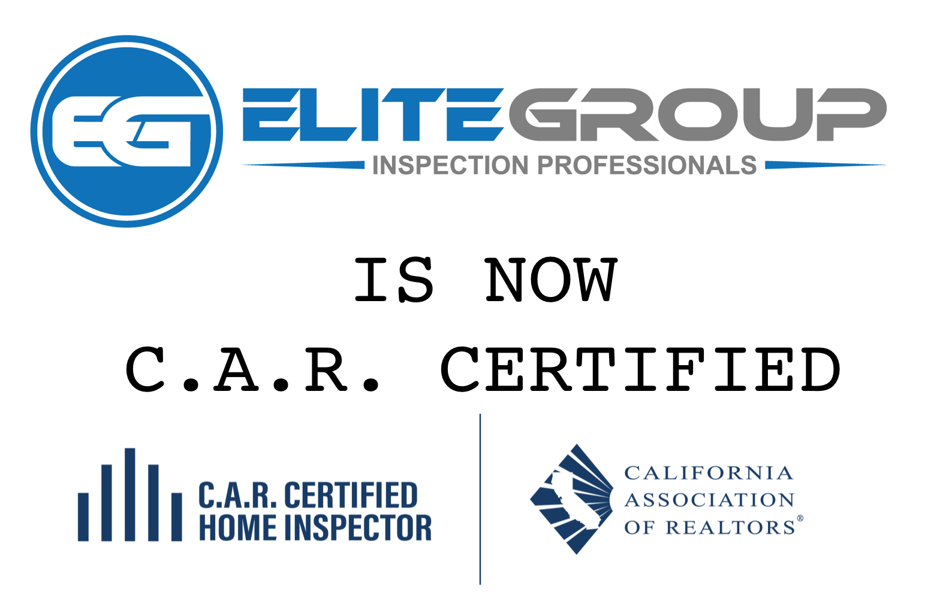

Slide 8
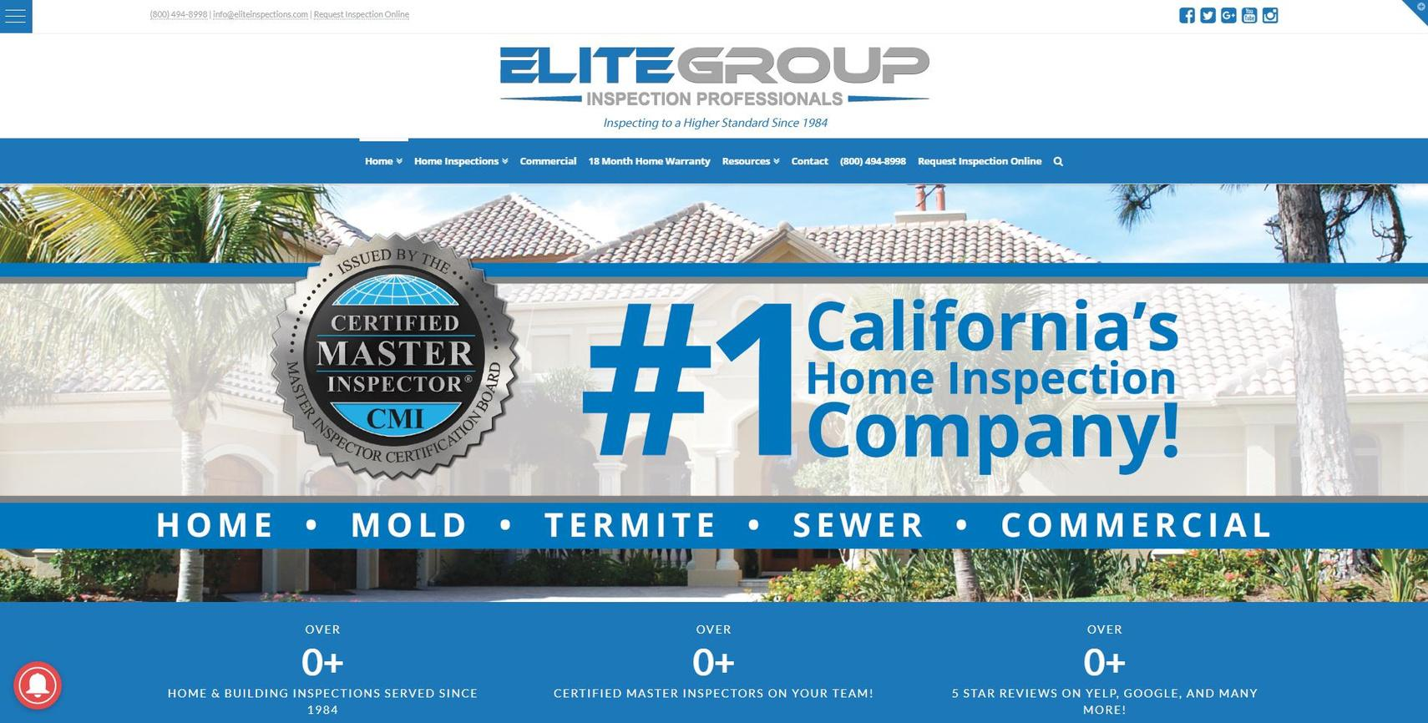
Every Inspector....
C.A.R. & InterNachi Certified!
Background Checked & Insured!

Slide 9
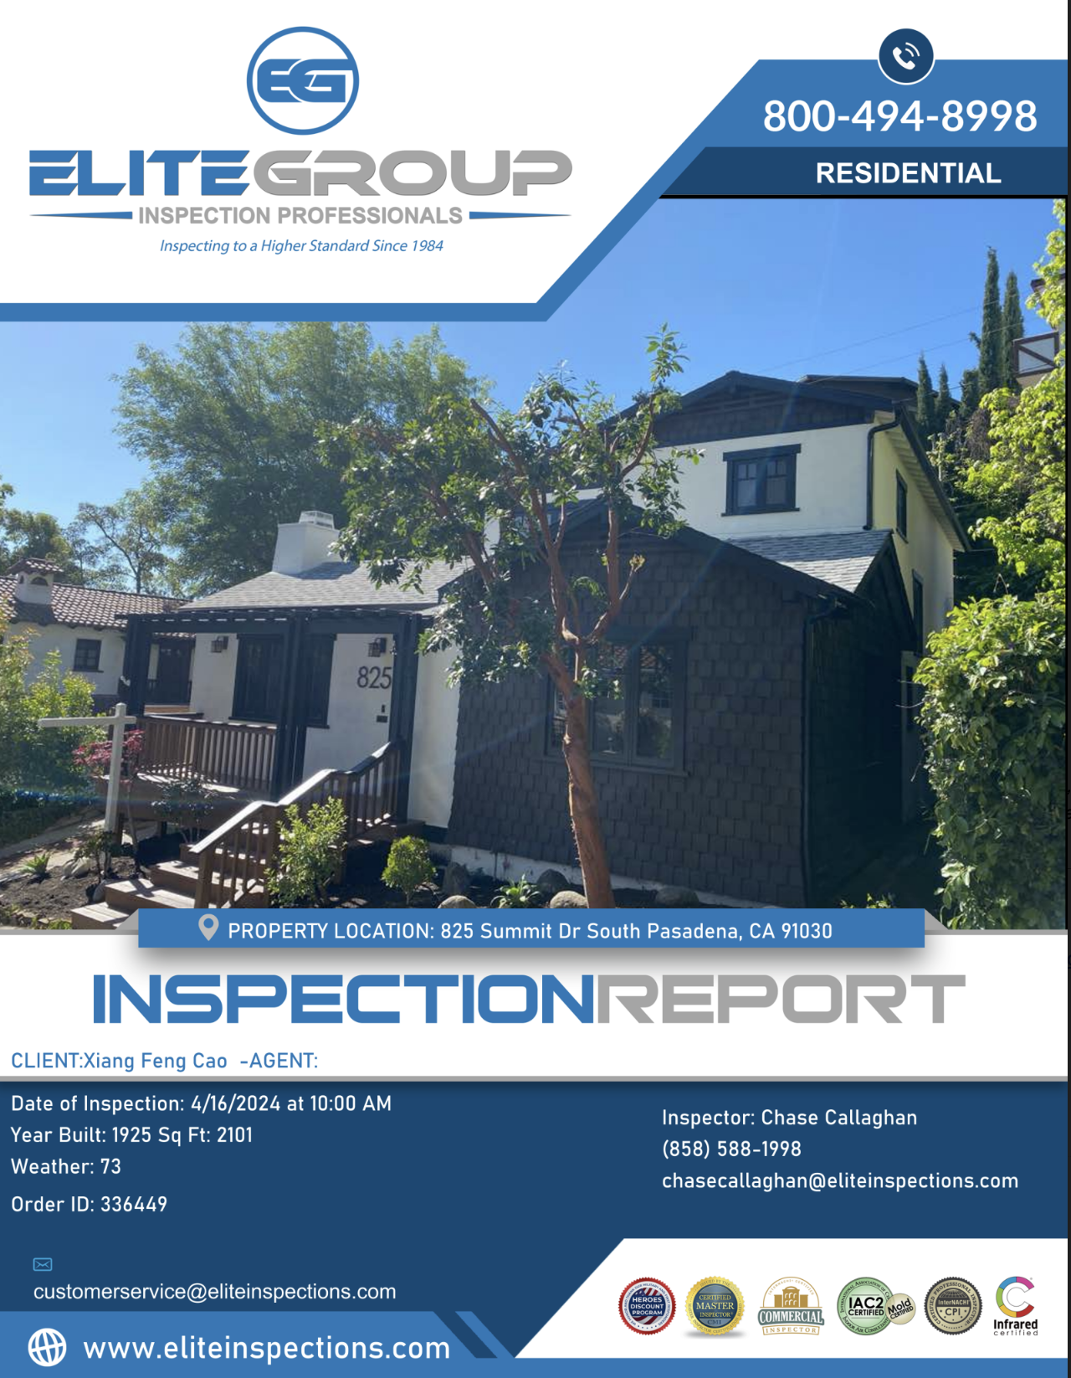
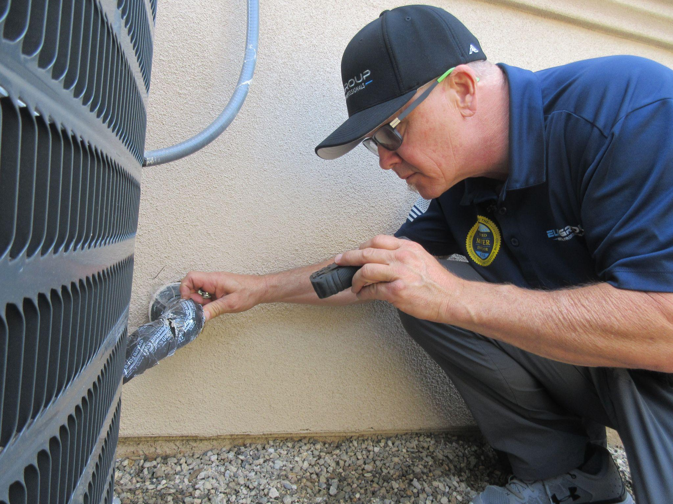
HOME INSPECTIONS

Slide 10
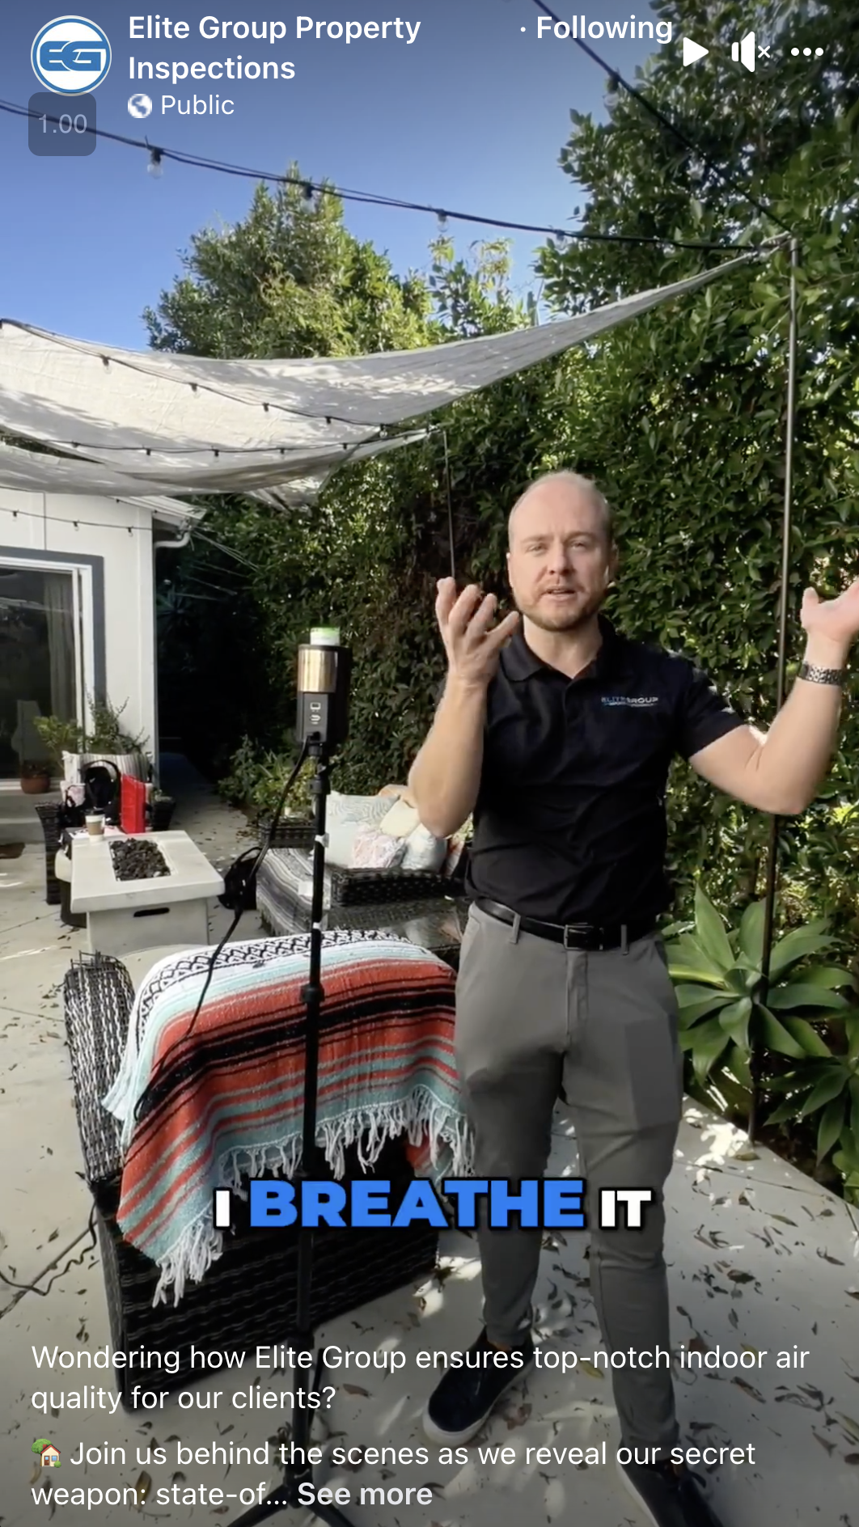
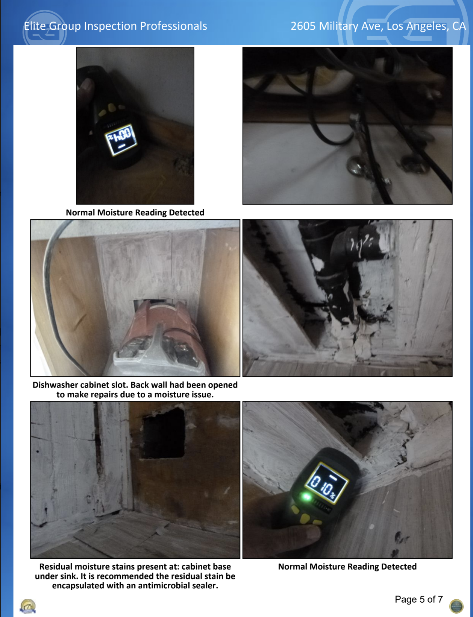
MOLD INSPECTIONS

Slide 11
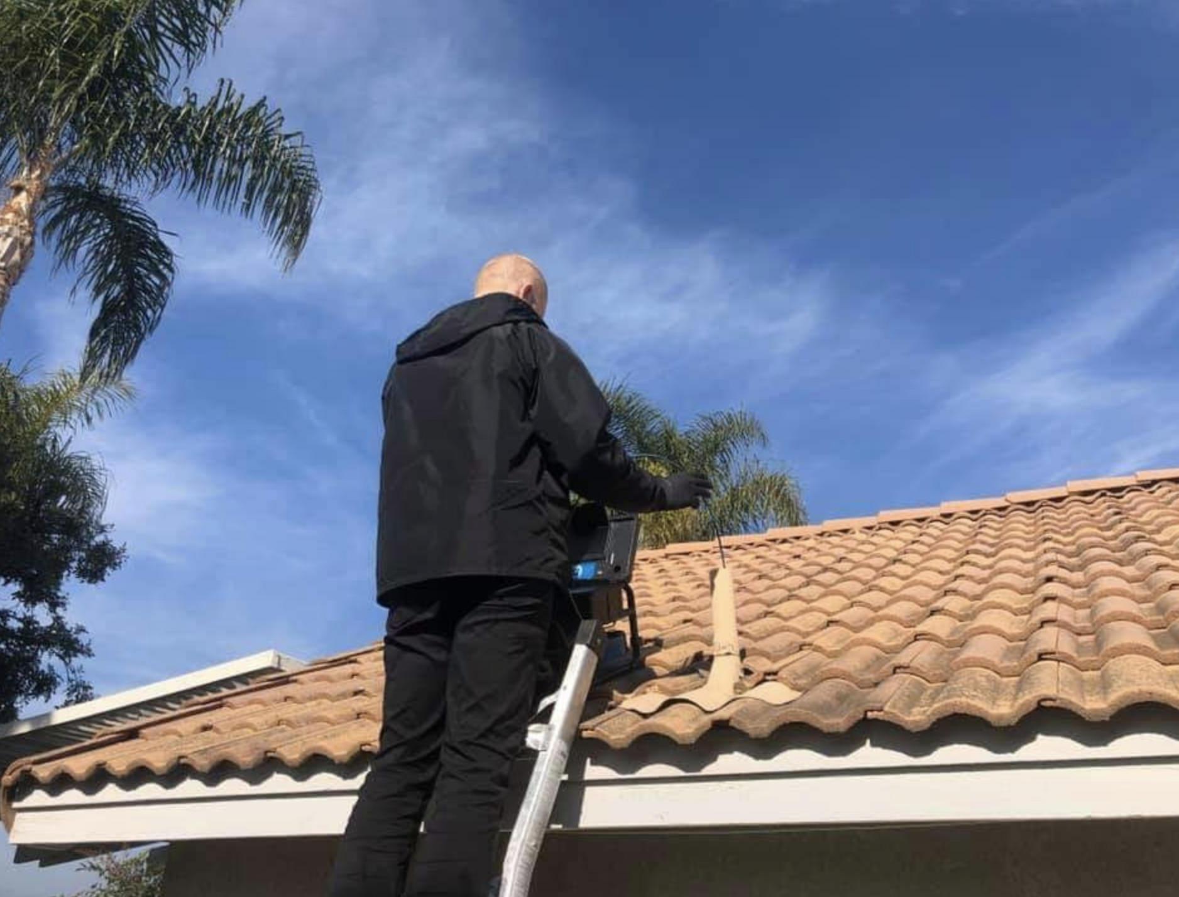
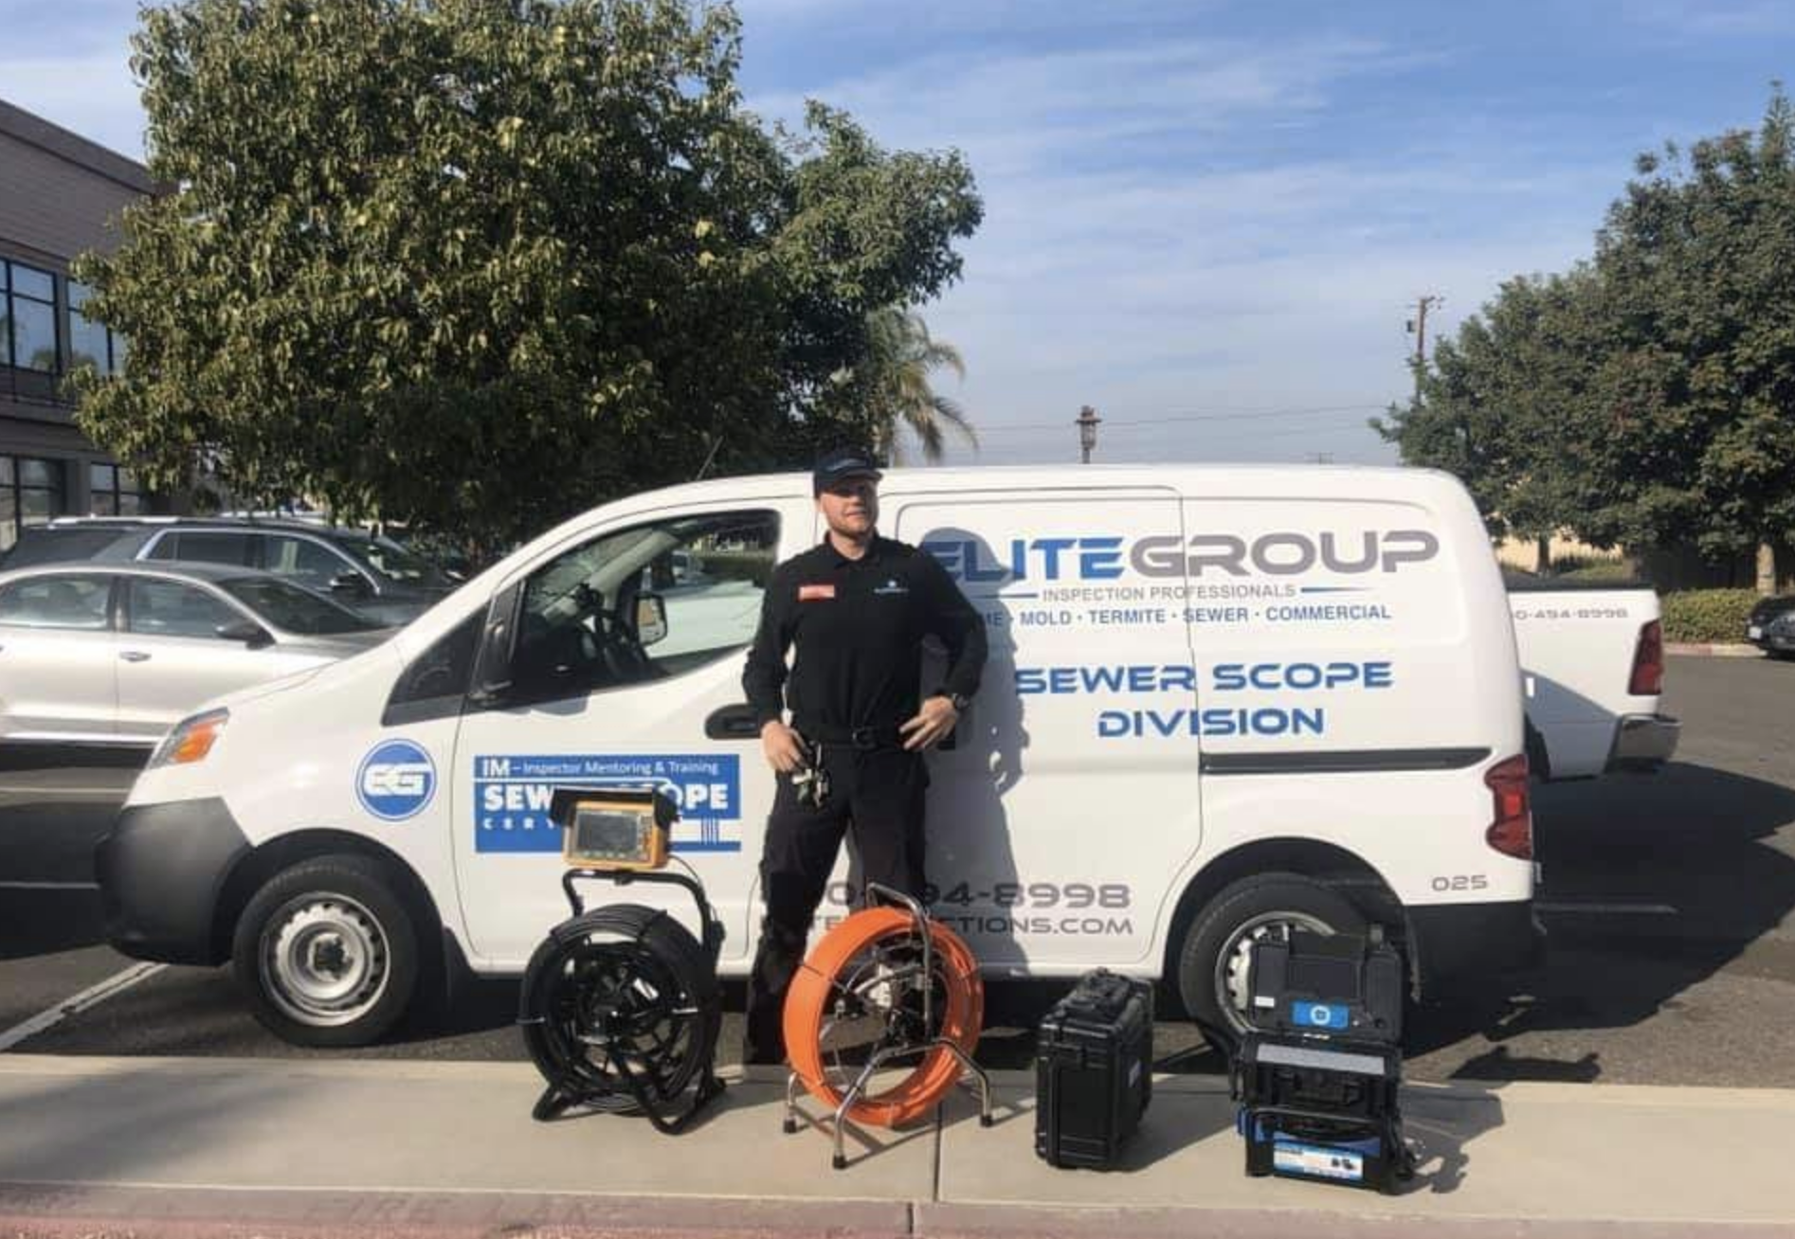
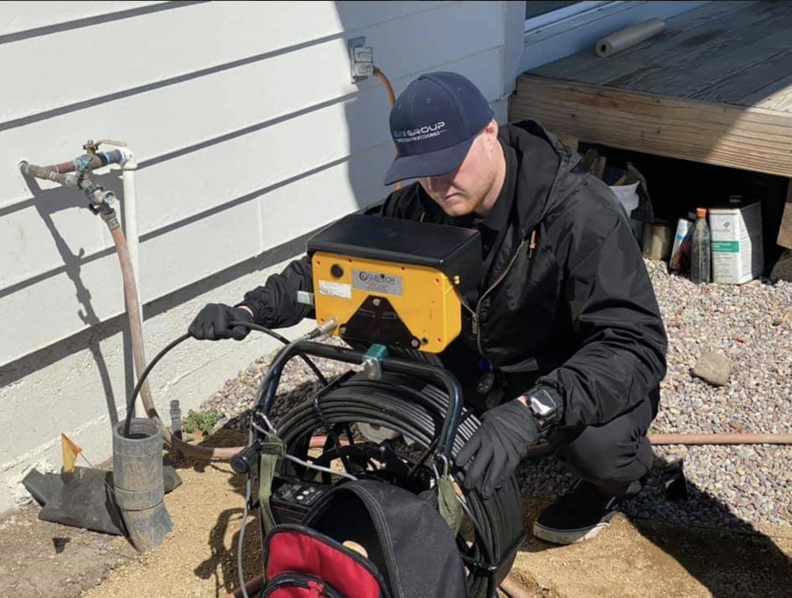
Sewer Camera Inspections
$275
$325

Slide 12
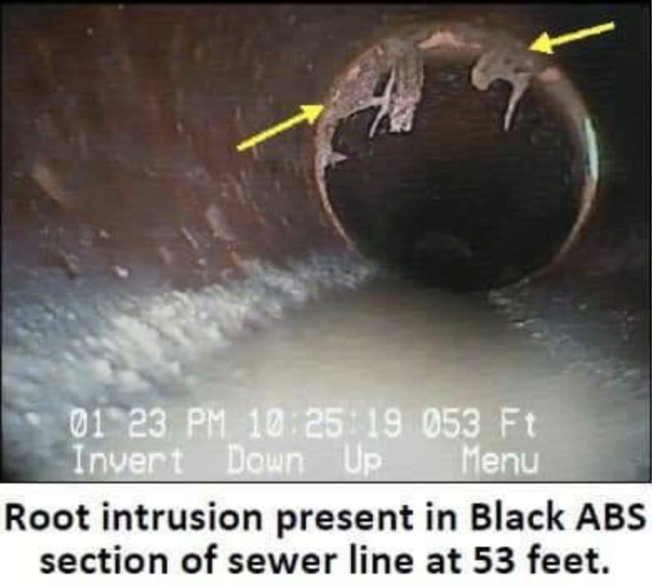
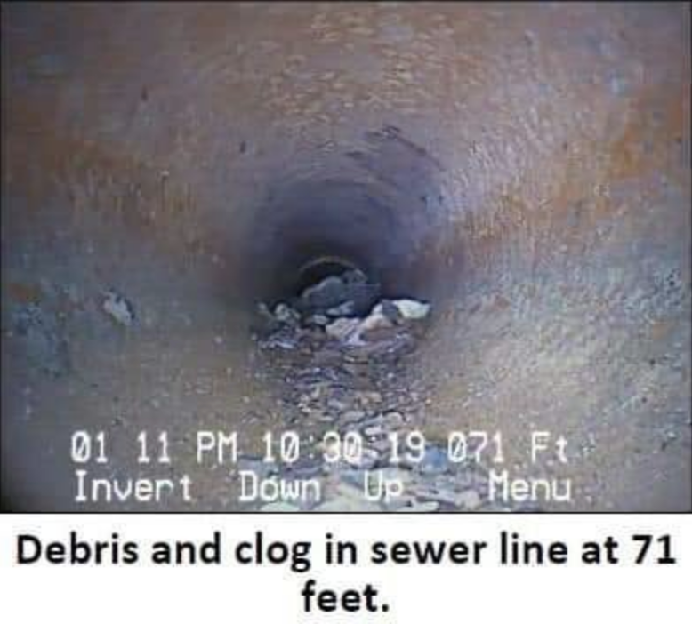
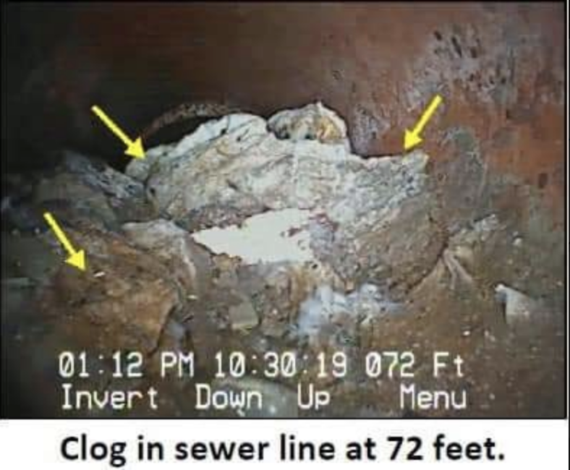

Slide 13

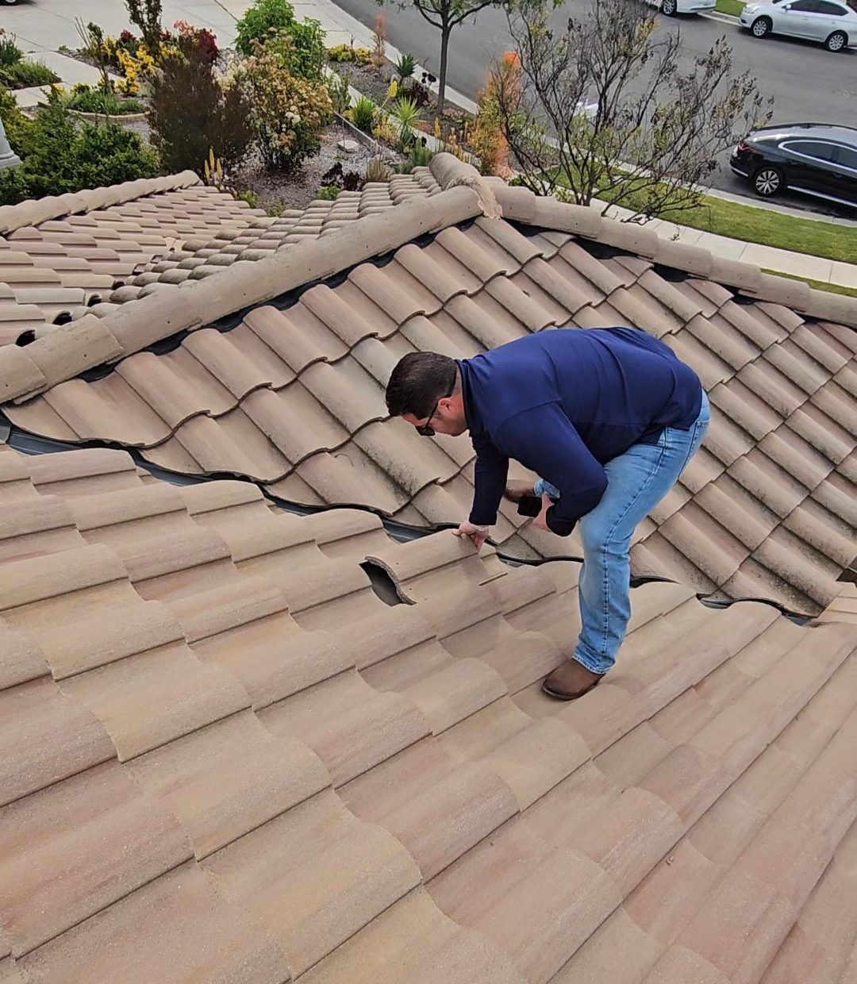

Slide 14
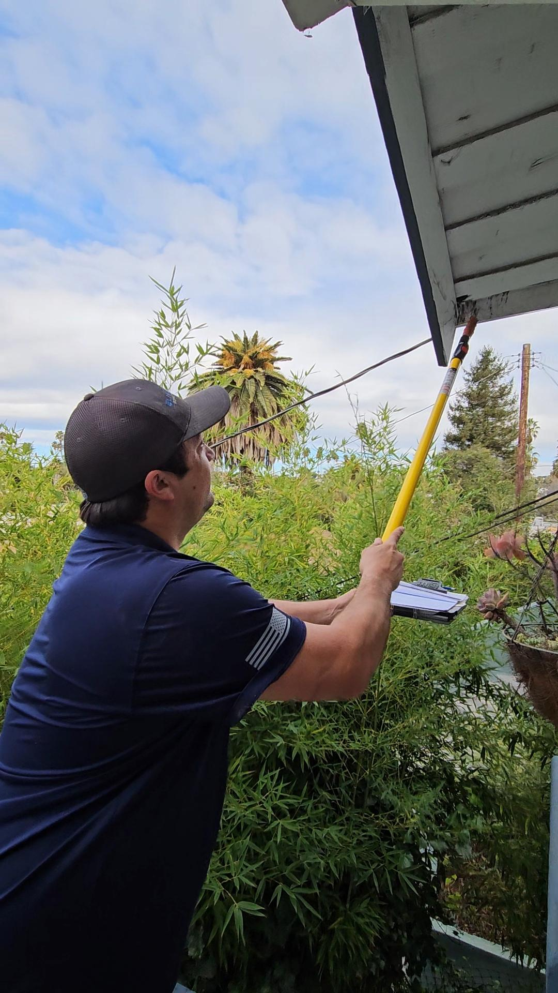
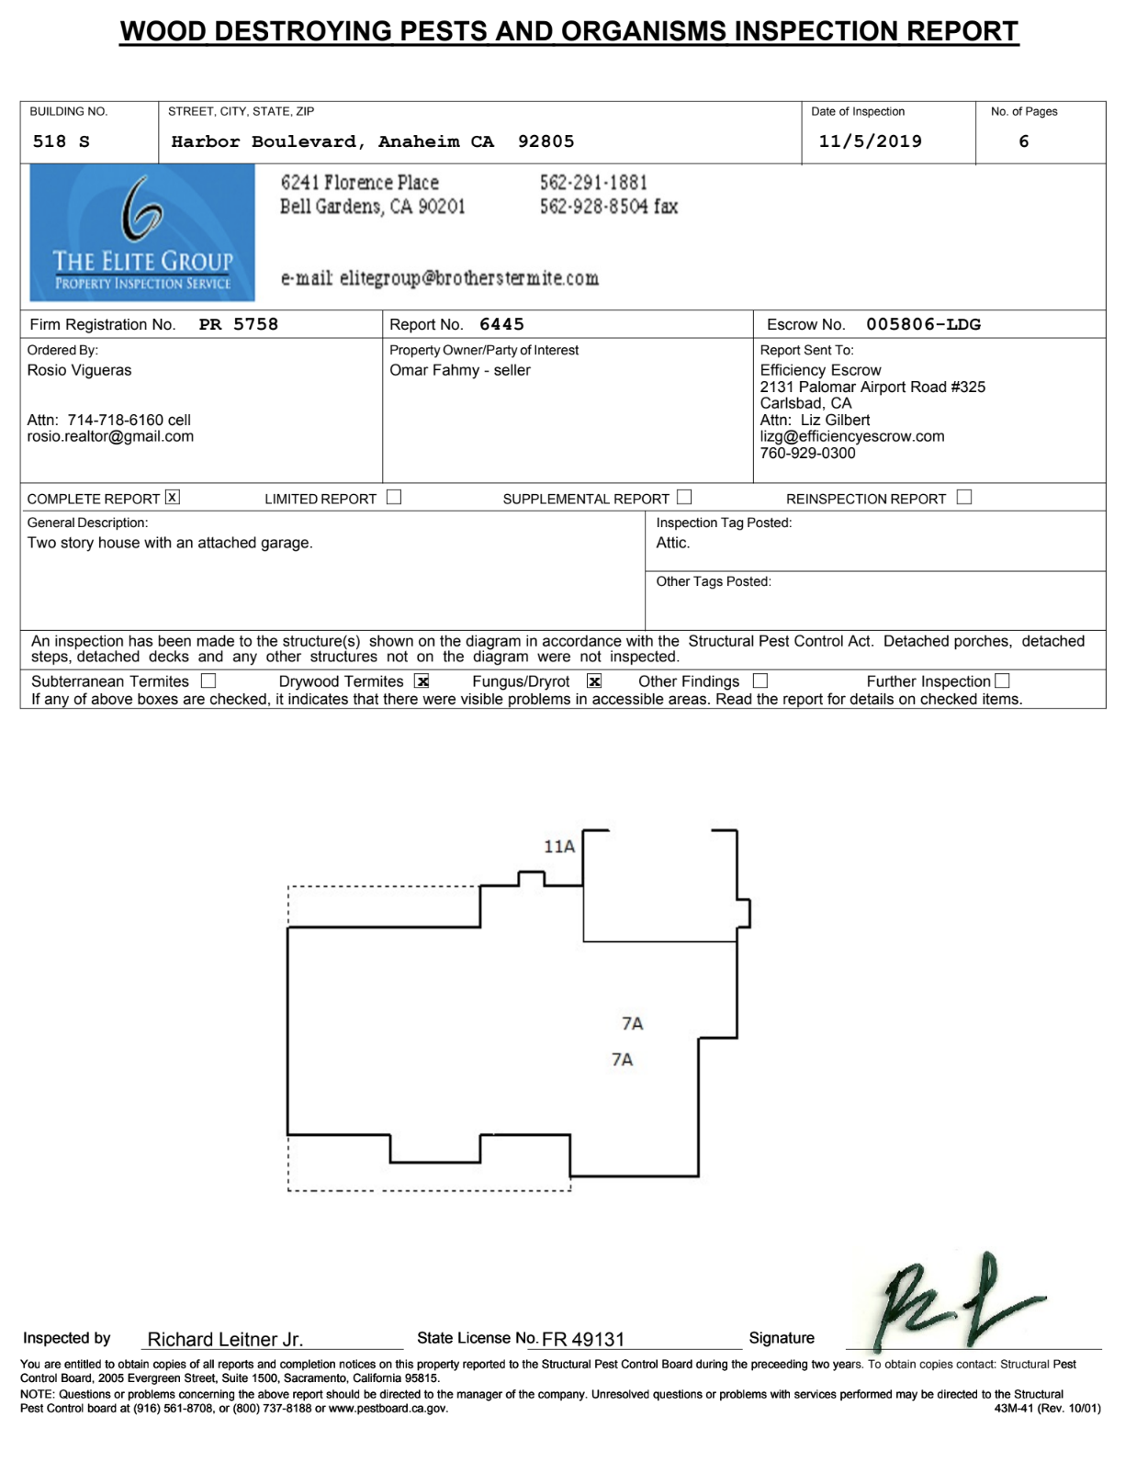

Slide 15
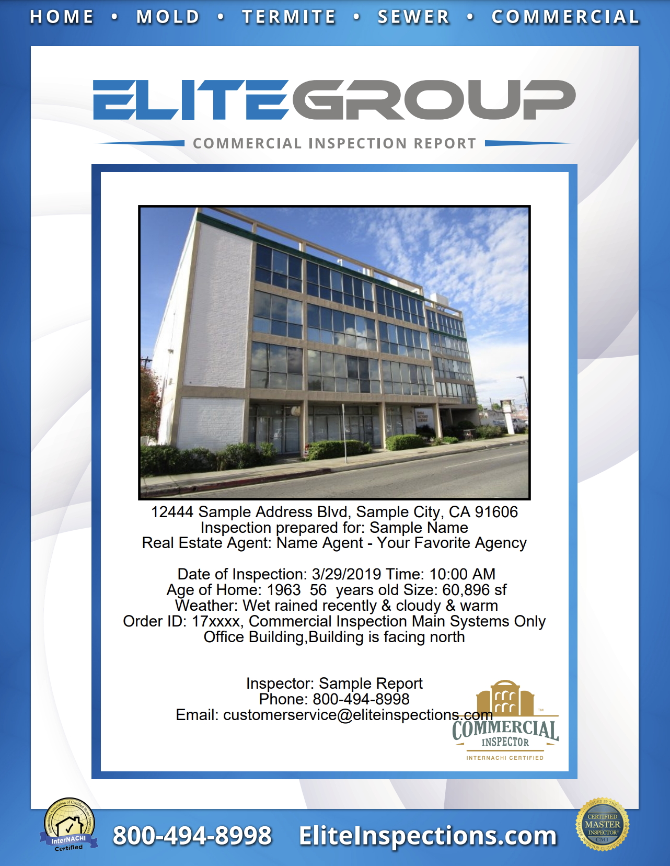

Commercial

Slide 16

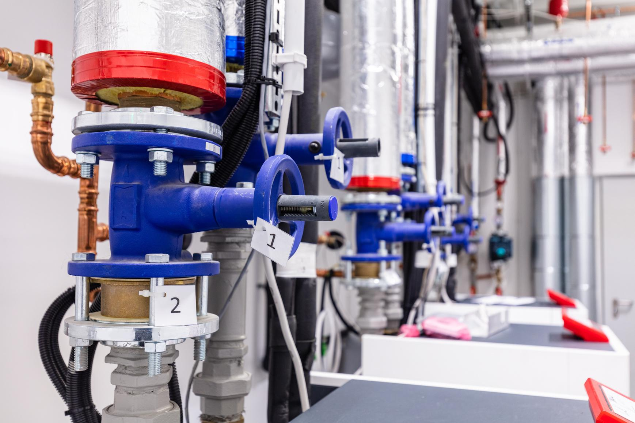

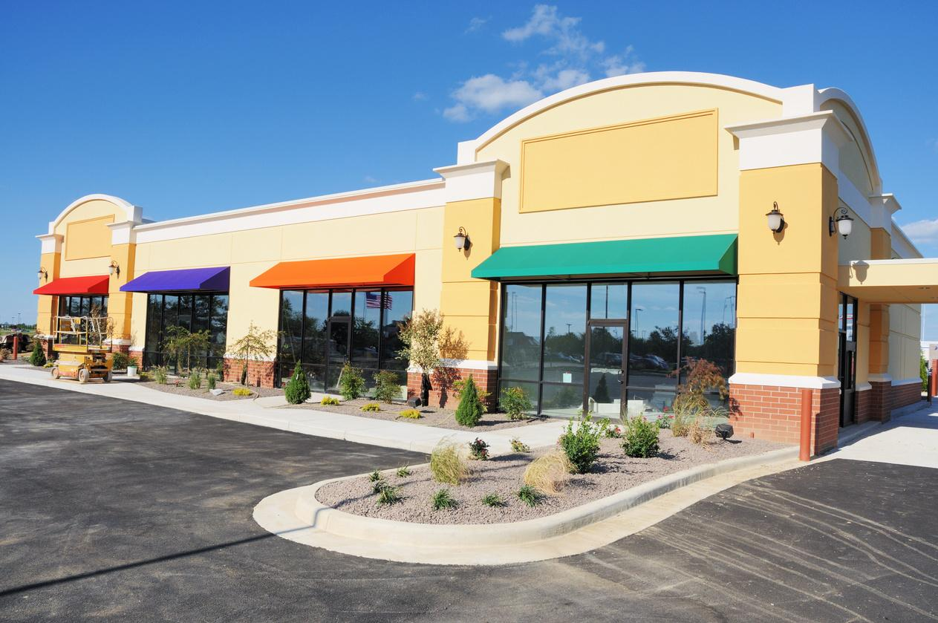
Commercial Inspections
Inspections include main structure, and systems inherent to the structures, such as plumbing, HVAC, roof, electrical and mechanical systems, and more!

Slide 17




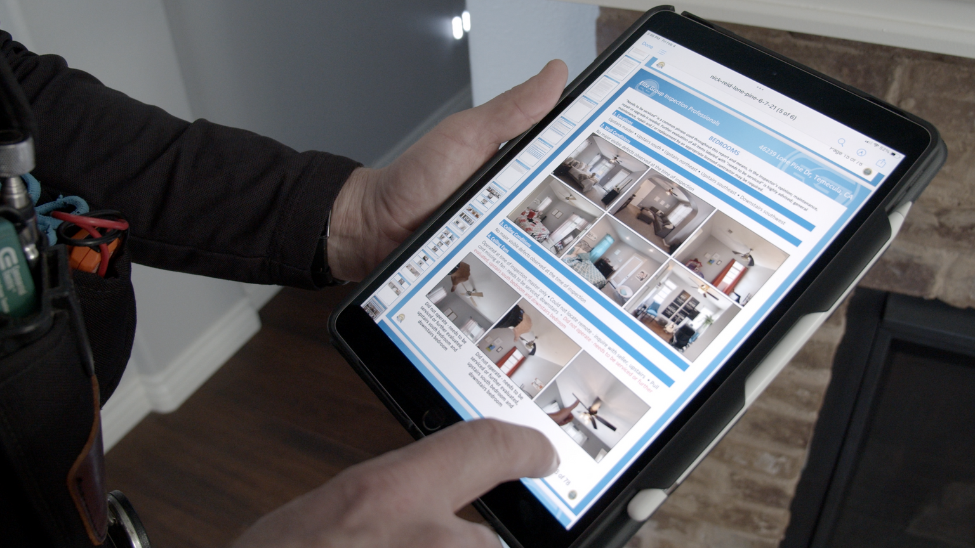

What Makes
A Superior
Home
Inspection
First Impression
Elite inspectors show up on time, dress professionally, and engage with agent and client to promote communication and clarity.
Thorough Inspection
We closely examine the structure, and systems inherent to the structure, such as HVAC, electrical, plumbing, roof, attic, and crawlspace.
Identify Issues
Elite inspector’s thorough investigation of the home will reveal defects, as well as health & safety issues that may be of concern to potential buyers.
The Review
Our professional inspector will go over findings on-site, answering questions and addressing concerns for your client, ensuring a comfortable and manageable transaction.

Slide 18
ACCESS & ATTENDANCE
Ensure our inspector can arrive at property in timely manner and gain entry.
Common Access Issues
Gated communities, guarded gates, and property gates, and dogs.
Ensure access points and areas of concern are free of obstacles/belongings: Garage, under sinks, closets and more!
Move objects for additional access - Refrigerators, furniture items, etc.

Slide 19
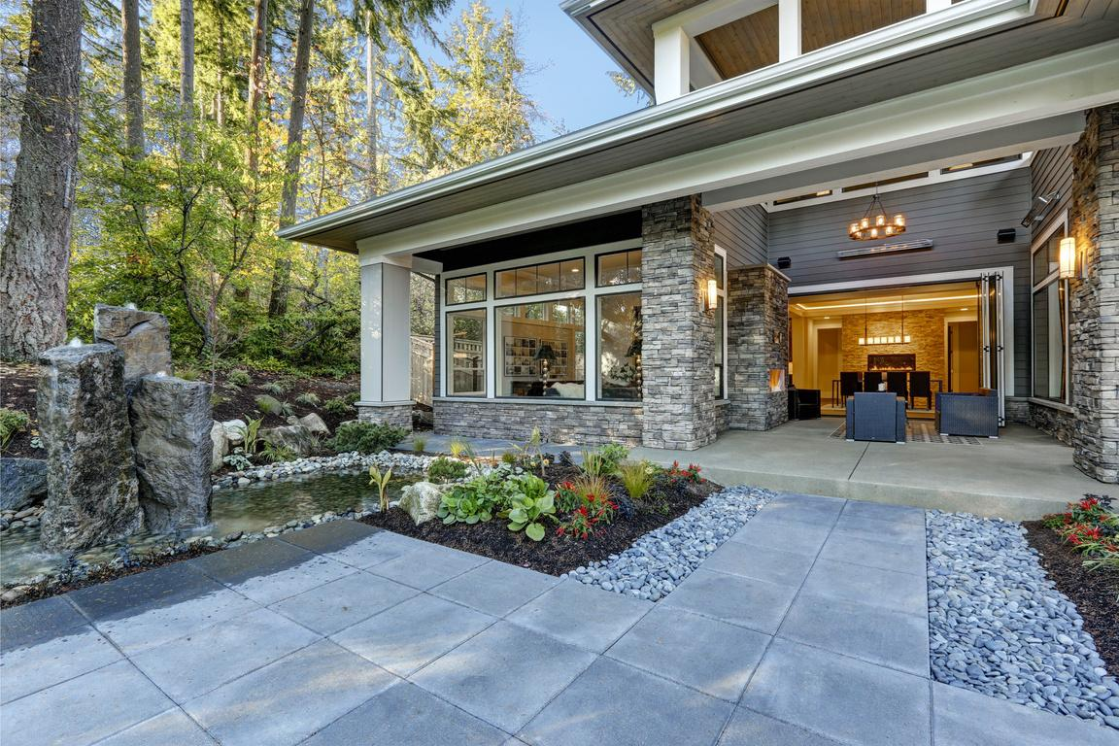

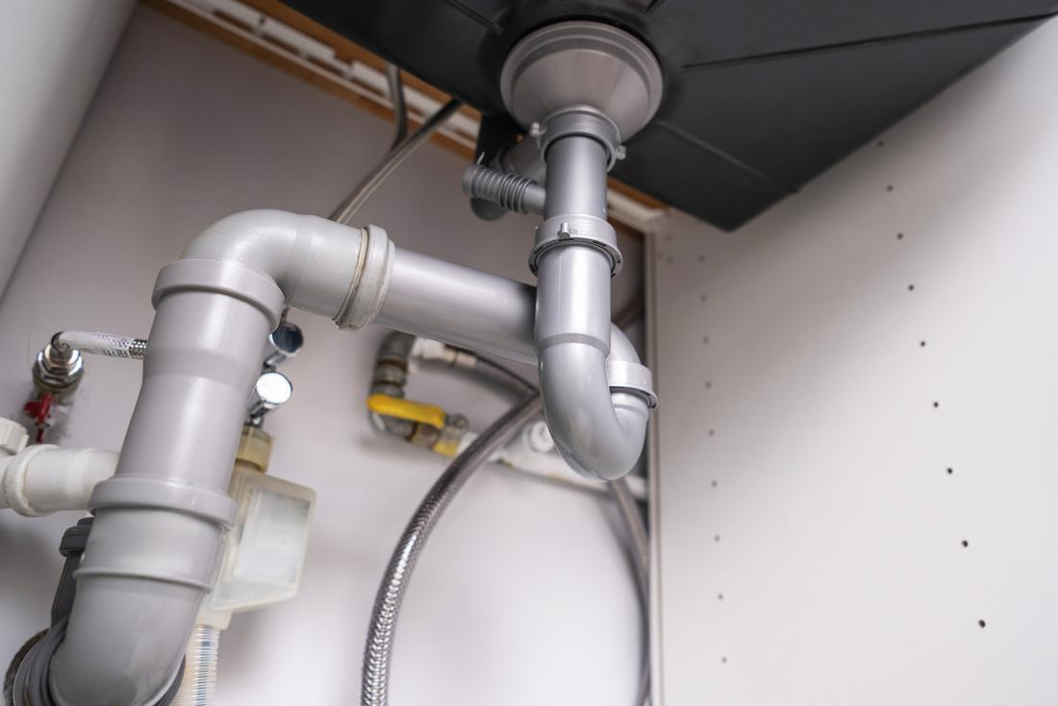
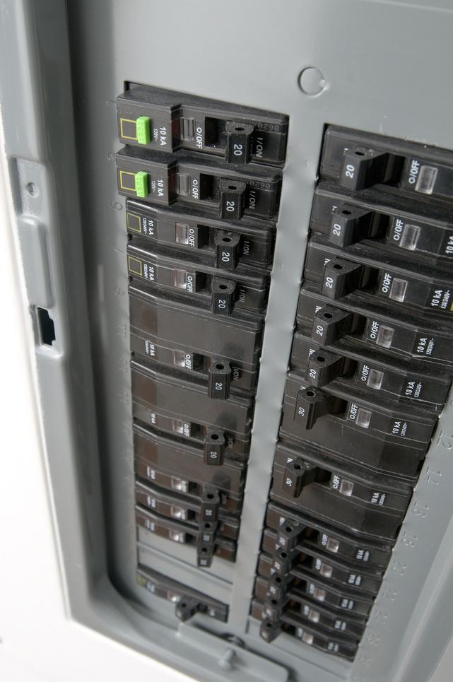
Whats included in a home inspection?
Exterior
Interior
Plumbing
Electrical
We thoroughly check the condition of your home’s exterior from front to back. This includes the driveway, porches, siding, windows, doors, grading, foliage, and more. The exterior should support your home’s integrity.
Every homeowner desires a safe and well-functioning home. By thoroughly inspecting the entire interior space from floor to ceiling, we can inform you of what to expect or prepare for in the near or distant future.
Your home’s plumbing is essential for smooth operation, and should work as intended. Our goal is to ensure plumbing is in top condition by identifying defects or issues that need attention or by confirming your home is ready to enjoy.
We inspect outlets, switches, and fixtures in your home for safety and functionality. Also, we check the incoming power supply, electrical panel, and wiring to ensure your home is safe and capable of supporting its size and function

Slide 20
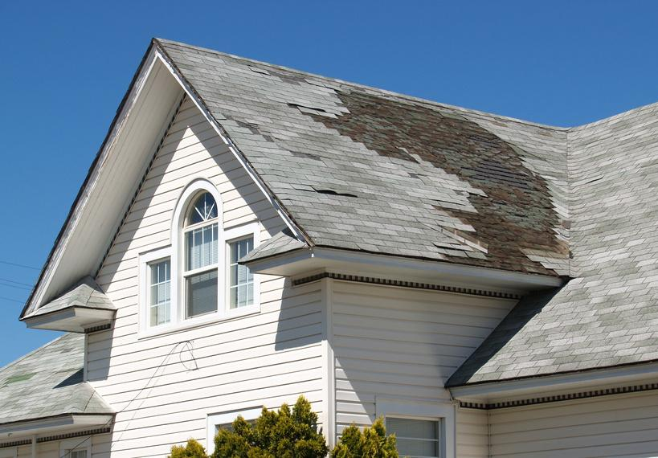
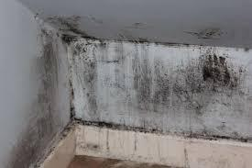
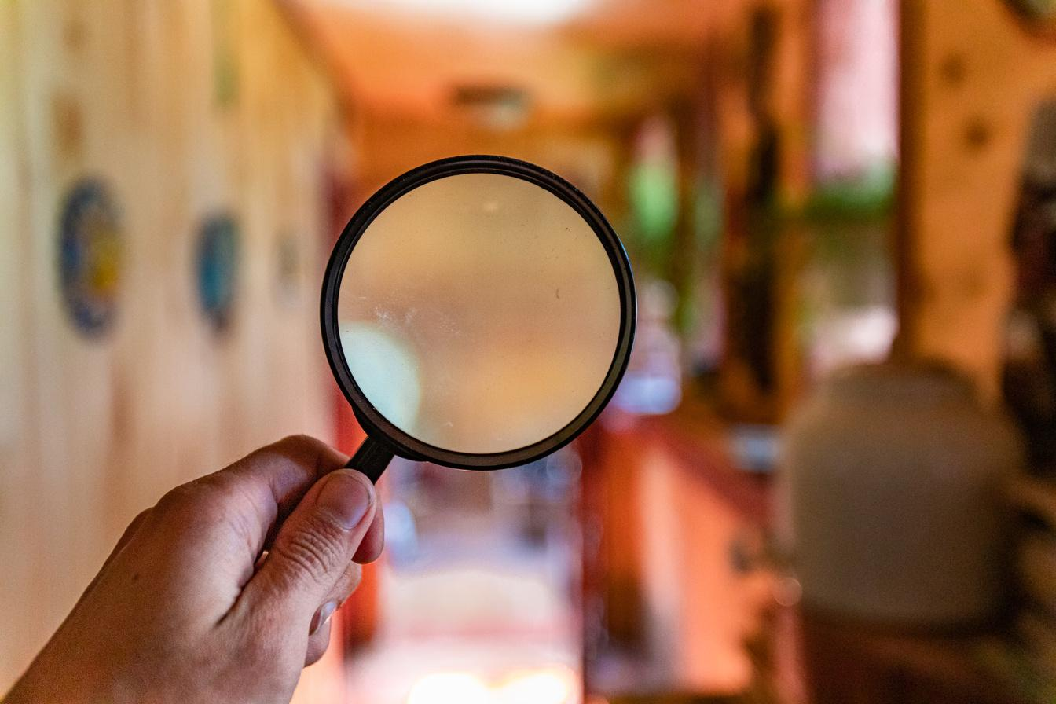
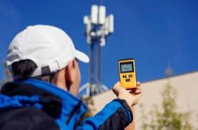
Additional Inspection Services
Roof Certification
Mold Analysis
Indoor Air Quality
Electro Magnetic Field
We conduct a comprehensive assessment of your home’s roof condition and integrity. If the roof requires no repairs, our licensed roofing contractor will certify the roof against leaks for 2 to 5 years as requested.
When visible staining or growth is noted, our technicians can swab the substance and send the sample to our lab for testing. Identifying the substance is an important and crucial step to understand how best to remediate it.
Whether a portion of the home has a damp or musty odor, or you just seek peace of mind, our air testing measures mold spores present and can identify issues even if the problem is not in plain sight.
Specialized meters allow us to measure the electromagnetic waves which emit from elements near the property such as cell towers, antennae, and power lines.

Slide 21

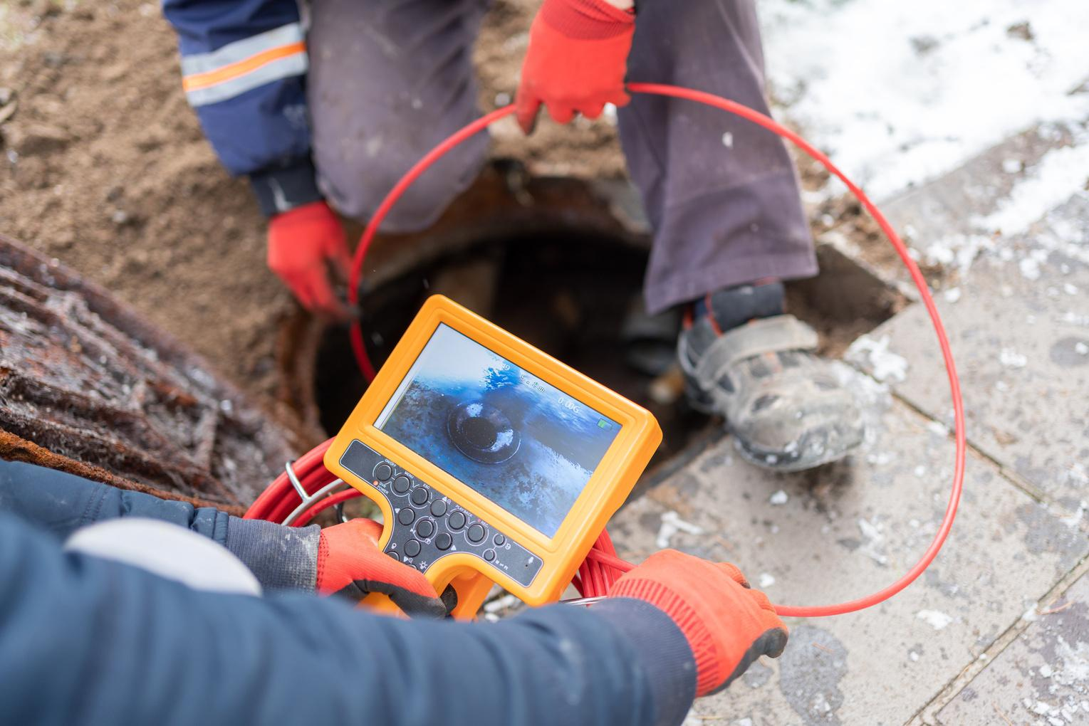
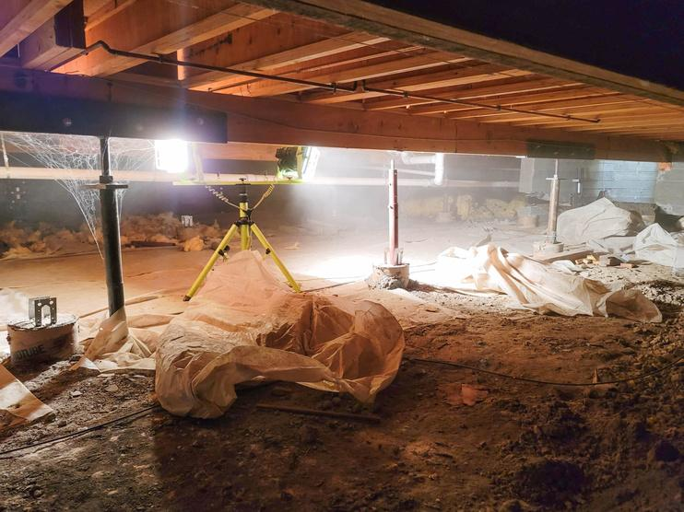
Additional Inspection Services
Termite
Sewer Scope
Foundation Review
Pool/Spa
Our inspectors search for signs of termites, such as damp wood, termite tunnels, or damage to the home. Once identified, a clear and actionable course to rid the property of termites is provided as well as repairs.
Performed with the help of an advanced plumbing camera, this inspection provides a full picture of your main sewer line. The goal is to identify or rule out possible root intrusion, damage, breaks, and blockages.
Every home is built on a foundation, whether it’s a basement, crawlspace, or slab. Our goal is to identify any defects or issues that could compromise your home’s stability.
Elite inspectors are trained and certified to visually inspect the pool structure, decking, coping, tile, lights, filters, valves, pumps, and much more. Mechanical or safety concerns are reported for your clarity.

Slide 22



REPAIR PRICER REPORTS!
The most common question we are asked is,
“How much will that cost to repair?”
Repair Pricer Report included with
every home SFR/Condo inspection
at no additional cost!
The ultimate tool for rapid and smooth
negotiations.

Slide 23






HOMEBINDER
What would you expect a Home OS to do?
Store my inspection documents
Save all the home pros I’ve worked with
Hold warranty information
Organize paint colors by room
Record the details of home projects
Have my current insurance policy
** Send me maintenance reminders
Help me with home inventory
Track the value of my home
Provide access to goods and services
Notify me of an appliance recall
Calculate the cost basis of my home
Give me access to building permit records

Slide 24

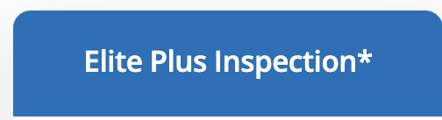

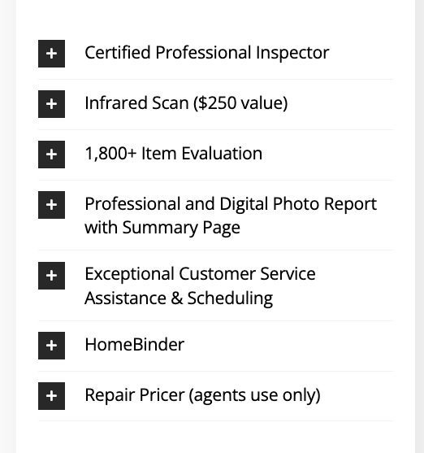
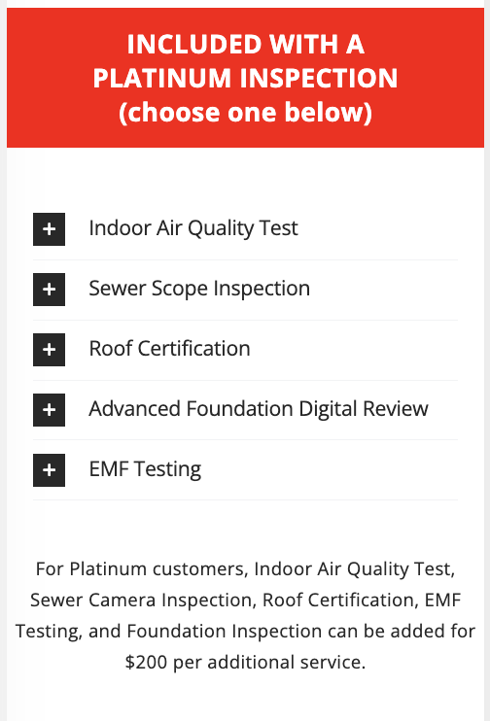
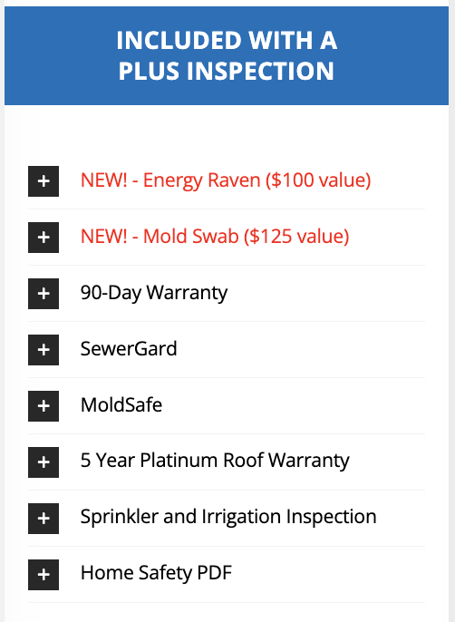
Includes everything in Elite Plus and Base
Includes everything in Elite Base Inspection

Slide 25
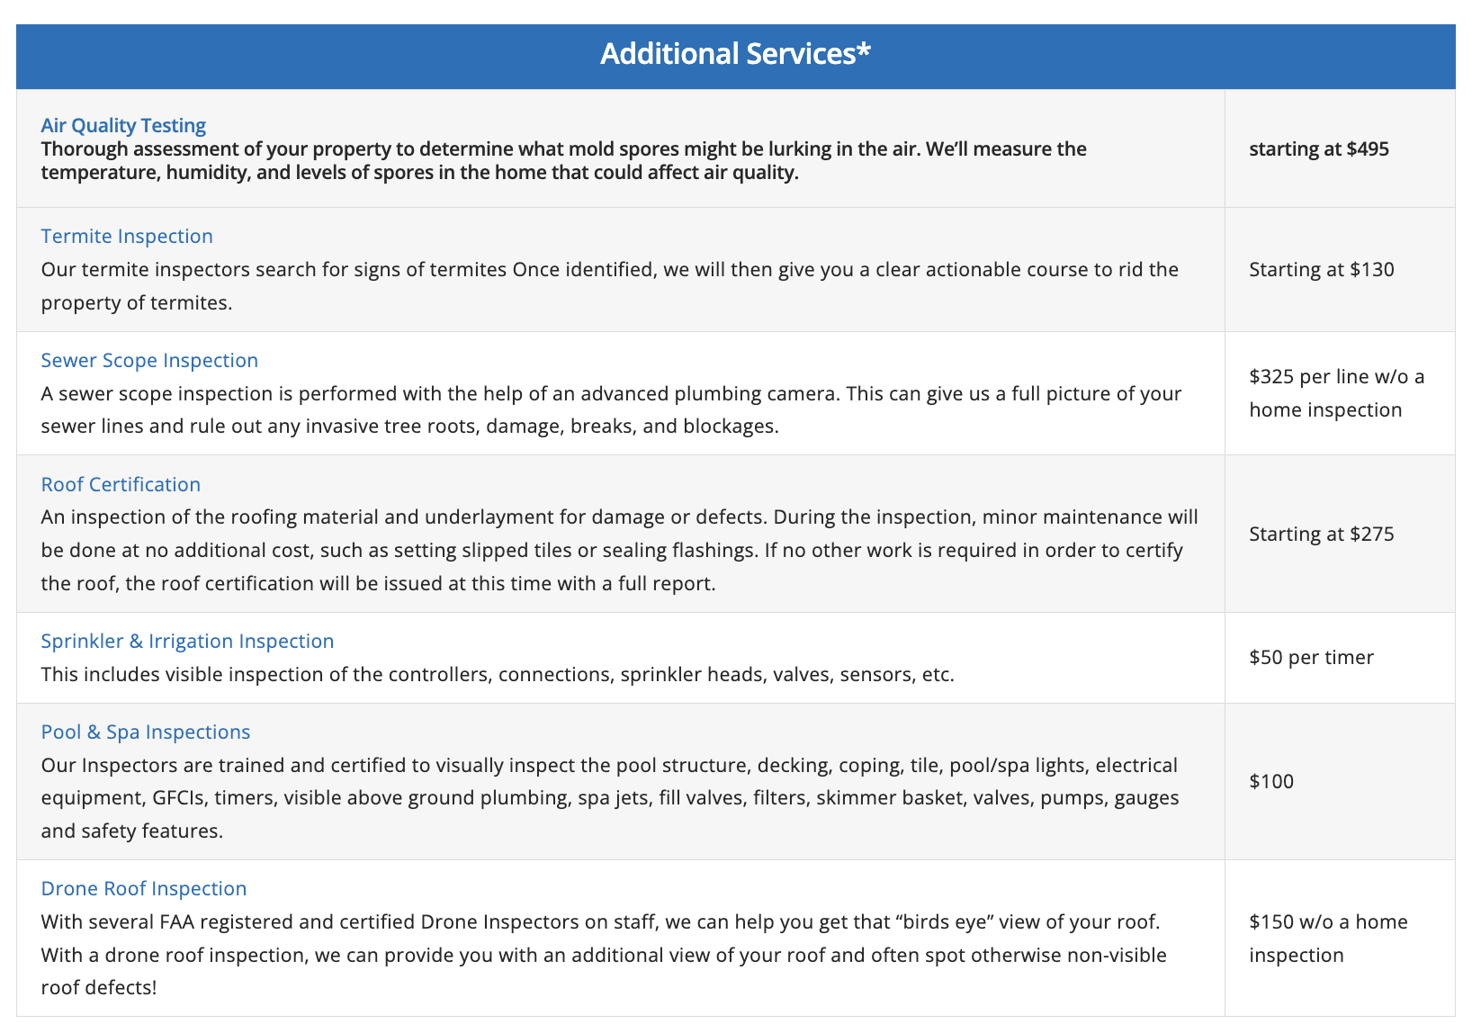

Slide 26
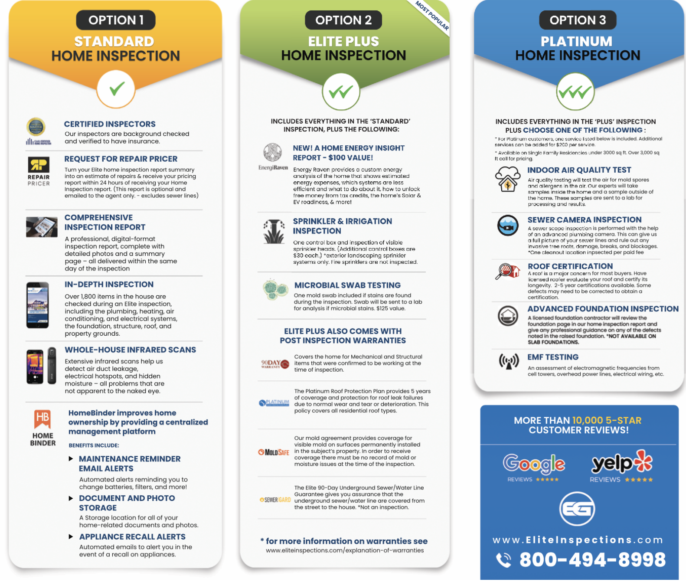

Slide 27


PAYMENT OPTIONS
1
2
3
4
ON-SITE
ACH
CREDIT CARD
FLEX FUND
Cash or check payments accepted on-site at the inspection
Our electronic check option
is available for no
additional fee.
Credit or debit card
payments accepted
online, directly.
Elite’s pay at close of
escrow option, available
for all buyer-side
transactions!

Slide 28
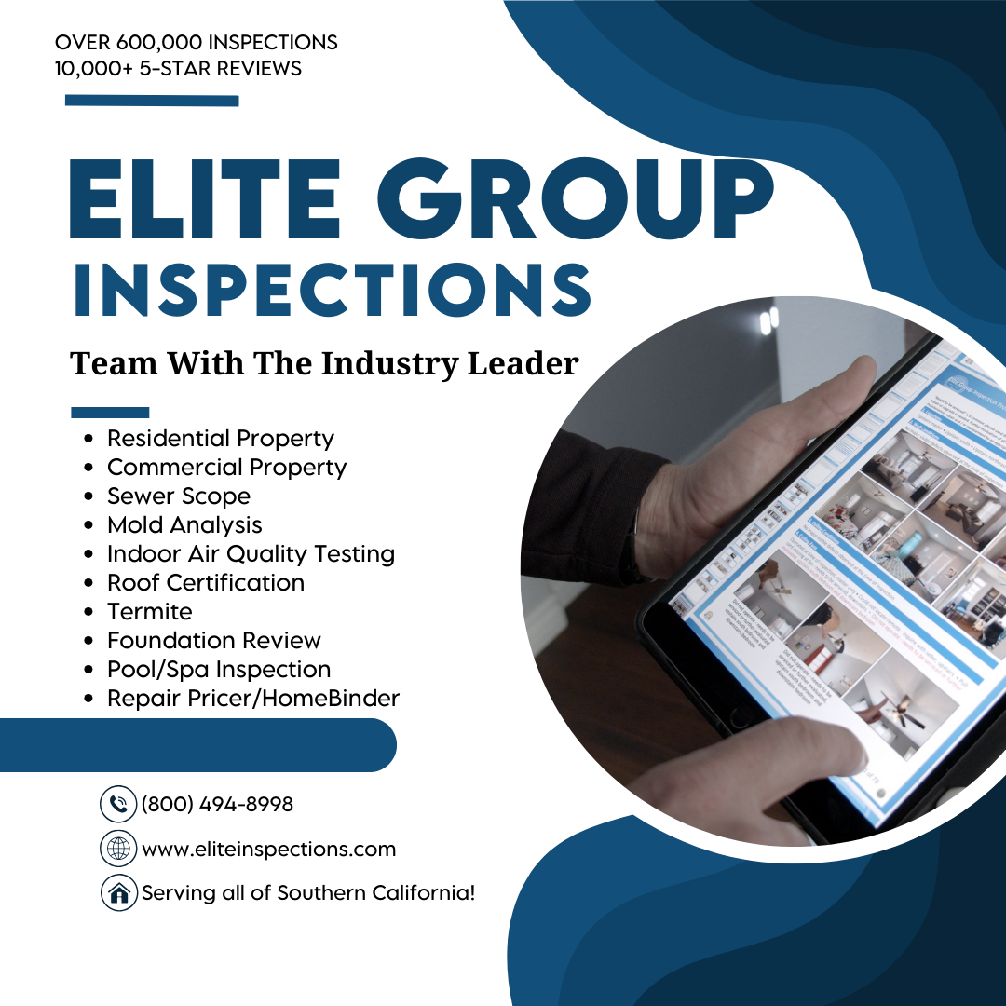

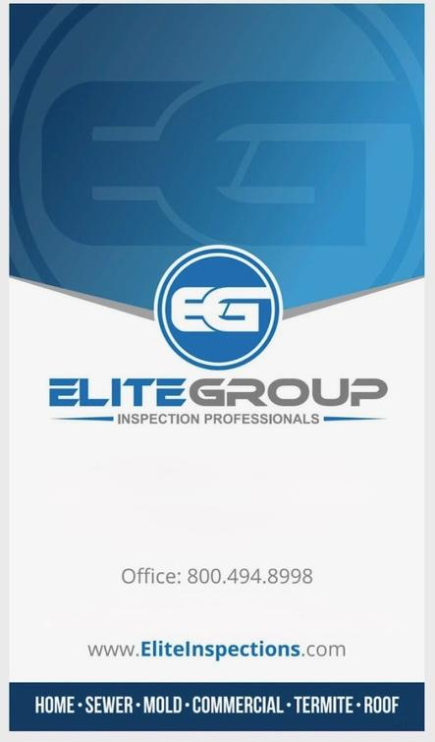
THANK YOU

Slide 29
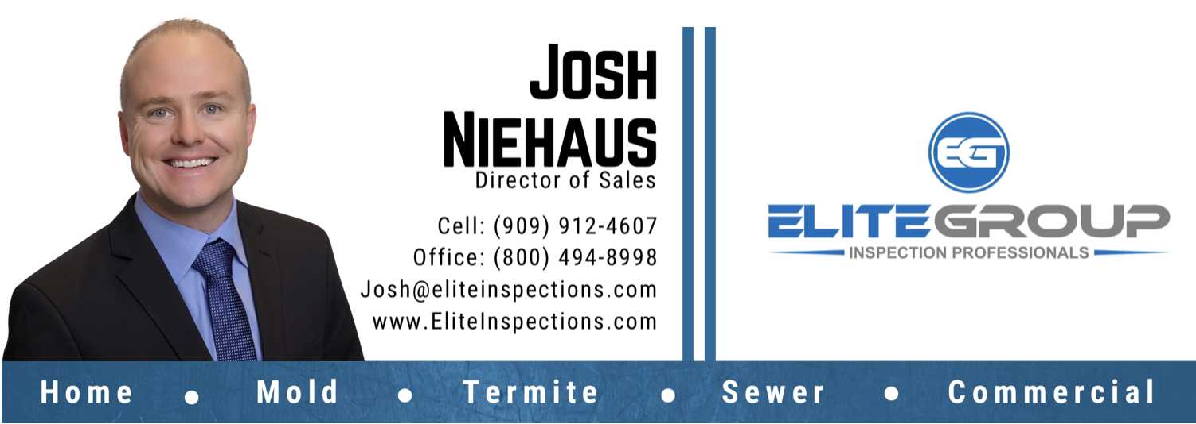

Slide 30


