Slide 1

Integrated CX Solutions:
Data-Led, Content-Driven, Contact Center Empowered
1

Slide 2





ABOUT US
CNCData empowers industry-leading brands with cutting-edge, data-driven CX solutions that seamlessly integrates data intelligence, compelling content, and expert insights with localised contact center to drive success across the Asia Pacific and Oceania regions.
We enable brands to efficiently acquire new customers and maintain exceptional customer experiences through state-of-the-art, tailored marketing strategies uniquely designed to meet specific business goals.
2010
YEAR ESTABLISHED
8
REGIONAL OFFICES
200+
EMPLOYEES
200+
REGIONAL AND
GLOBAL CLIENTS
10M+
B2B DATA ACCESS

Slide 3



Our Four Core Pilers
CONTACT Centre
DATA
Data-led Conversations With Potential Buyers
Data is at the heart of our expertise. We specialize in guiding you through the process of acquiring the precise data you need. Leveraging our proprietary dataset, along with our extensive Data Partner Network, we deliver tailored data solutions that align your marketing objectives.
Driving Results Through Deep Customer Experience
Our hyper-localized contact centers are laser-focused on delivering exceptional customer experiences daily. With thousands of interactions with a diverse audience, we've developed a deep understanding of their daily challenges. We use these insights to drive better results for your business.
CONNECTCX
Harness The Power with AI Enhanced Content Channel
IT decision-makers rely on the latest industry insights and technology updates, keeping ConnectCX's audience engaged and continuously expanding.
This loyal readership offers a prime marketing opportunity for technology companies seeking effective B2B lead generation
Digital channel
Precision Marketing Through Advanced Digital Channels.
Our sophisticated digital channel partnerships and technologies, combined with our experience, ensure that the right marketing messages reach the right audience at the right time

Slide 4



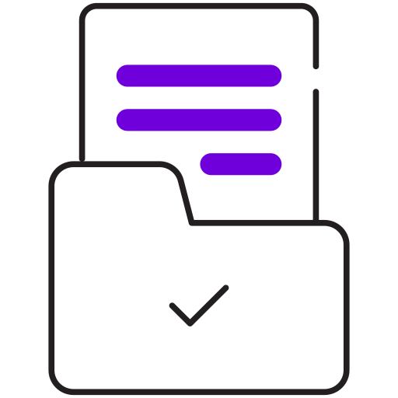


Our Solutions
Effective Multi-Channel
Demand Generation
B2B CONTACT DATA ACQUISITION
attendees generation
For events
DATA MANAGEMENT
Business Process Outsourcing/CX solutions
Account profiling
Digital marketing

Slide 5


B2B Coverage
Firmographic Data
Demographic Data
Technology Installed Data
Intent Data
1M
Companies
2M
Contacts
4M
Companies
10M
Contacts
CNCData Owned
With Partner Network
Global Data Partner Network
  Through our Data Partner Network, we can access the appropriate and pertinent data to fulfill all your marketing requirements.
Proprietary Data Asset
  Dataplus – An enterprise level self-serve DaaS platform that enables direct access to high quality, hard to reach B2B data with over 2M contacts.
  Data coverage up to 25 Asia Pacific countries Including ASEAN, ANZ, Greater China, India, Japan, Korea and Emerging Countries across Asia.

Slide 6






Balanced scorecard slide 2
Our DATA
Expand your market reach and refine your your go-to-market strategy in the Asia Pacific and Oceania with our expanded data coverage
10M
4M
3M
25
150+
30+
CONTACTS
COMPANIES
TECH INSTALLS
APAC COUNTRIES
INDUSTRIES
JOB FUNCTIONS
Firmographics Data
Industry :
CNCData Industry Classification / US SIC / NAICS
Employee Size :
Country Employee Counts and Global Employee counts.
Locations:
Locations across Asia and Oceania
Demographics Data
Job Function:
30+ Job functions to include functional level decision makers.
Job Title:
Classification of senioory within the organisatoin.
Contact Info: Business email and Phone numbers.
Technographic Data
Categories: 90+ technology product categories.
Vendors: 3000+ Software and hardware vendors.
Products : 7000+ products

Slide 7
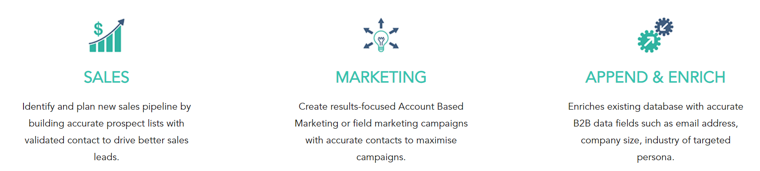
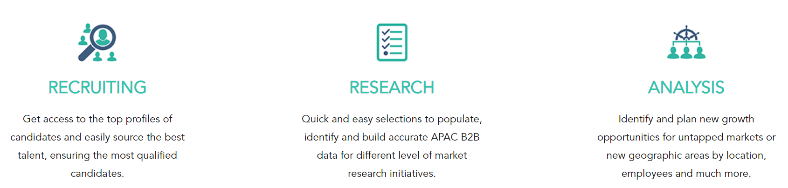
Balanced scorecard slide 2
Usage of Data
Dataplus data can be a functional asset for organisation in the areas of:

Slide 8

CONNECTCX
ENTERPRISE APPLICATIONS
Pulse of the digital future is constantly monitored and interpreted
ARTIFICIAL INTELLIGENCE
DATA CENTRE
CLOUD
Our AI-enhanced content platform offer a lens through which the intricate dance of technology with humanity is viewed, making every piece of content a bridge to understanding the digital age.
It predicts how technology will continue to transform our society, business, culture, and daily lives.
IoT
DATA
SOCIAL MEDIA
SECURITY

Slide 9




CCX - Value Proposition
Content Syndication
Leveraging the power of Connect CX, we deliver your content in versatile, interactive formats designed to captivate your target audience, boost engagement, and drive meaningful connections.
Lead Generation
By leveraging the Connect CX platform, we precisely identify and target key companies and individuals at every stage of the Buyer’s Journey, ensuring focused and impactful engagement.
Advertising
Connect CX amplifies your reach across Asia Pacific, Oceania, and beyond. We enhance customer awareness and drive solution recall through targeted promotions that resonate and convert.
Events
Leveraging the extensive reach of Connect CX, we efficiently attract attendees for both in-person and online events.
Region Focus | Page Views | Subscribers | Categories | Articles
Asia Pacific & Oceania | ~10,000 | 100,000+ | 8 | 400+

Slide 10
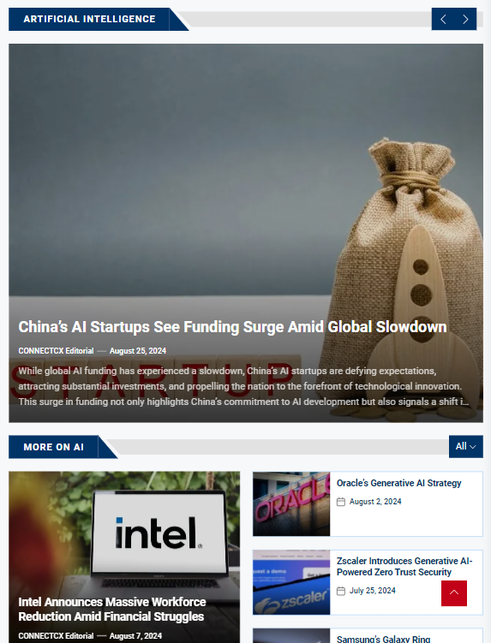
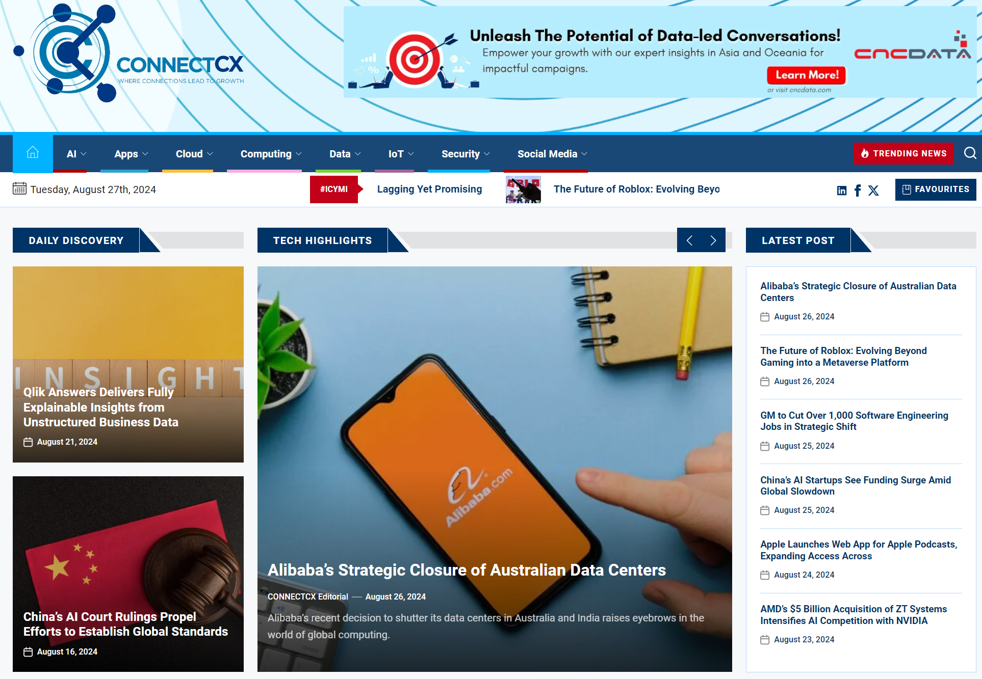
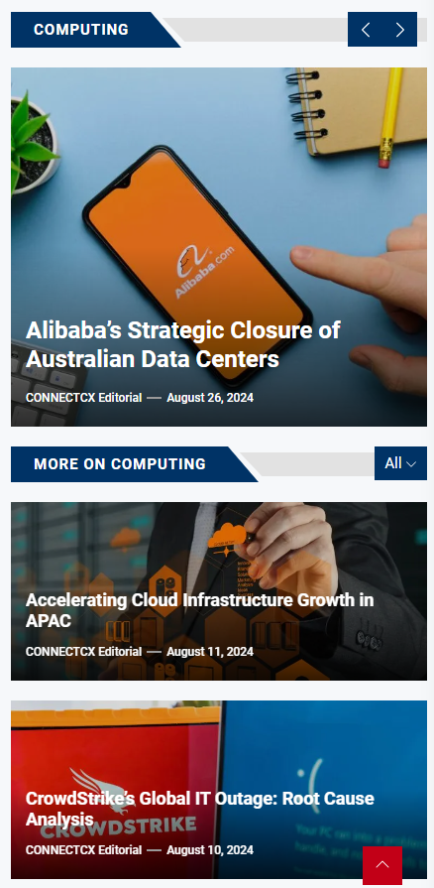
CCX – Responsive Design
Designed for enhanced responsiveness across multiple devices
Optimized for fast loading speeds.

Slide 11
CCX - Awareness & Reach
Connect with your buyers where they are
WHITE PAPERS
CASE STUDIES
PRODUCT SHEETS
MICROSITE
PRODUCT DEMO VIDEOS
PEER-TO-PEER CONTENT
Daily Posting:
Average of 2-3 articles on various topics each day.
Social Media Coverage:
  Article posting on LinkedIn
  Article posting on X
  Article posting on Facebook
Partner Corner :
Featuring partner contents.
Weekly Emails to Subscribers:
Highlighting partner content.
Central Source:
Comprehensive coverage of all tech events in Asia.

Slide 12
CONTACT CENTRE
Leverage our 14 years of expertise with Asia's established and highly connected contact center infrastructure.
With our industry-leading capabilities, elevate customer experience through our robust contact center network.
150
Employees
7
Countries and 8 Locations
25
Countries Covered
15
Languages
14
Years of Experience
Singapore
Kuala Lumpur, Malaysia,
Makati, Philippines
Cebu, Philippines
Bangkok, Thailand
Ho Chi Minh, Vietnam
Kerala. India
Melbourne, Australia
ANZ | Australia, New Zealand
ASEAN | Indonesia, Malaysia Philippines, Singapore Thailand, Vietnam
GREATER CHINA | Hong Kong, Macau, Taiwan
INDIA | India
EAST ASIA | Japan and South Korea
EMERGING | Bangladesh, Sri Lanka Pakistan, Maldives, Nepal, Brunei, Fiji, Laos, Cambodia, Myanmar, Papua New Guinea
English, Chinese (Mandarin and Cantonese), Tagalog, Cebuano, Malay, Bahasa Indonesia, Thai, Vietnamese, Japanese, Korean, Hindi, Urdu, Bengali, Tamil, and other South Asian languages.

Slide 13

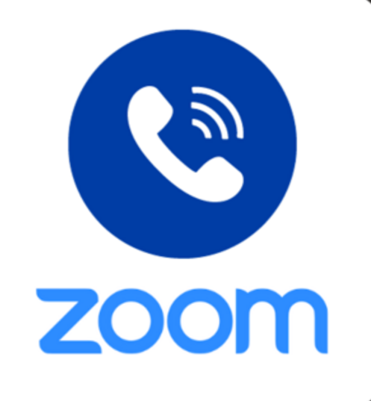



CONTACT CENTRE TECHNOLOGIES
Equipped with right technologies.
Reliable and Reputable Telephony Network Infrastructure
Localised Phone Number
Proprietary Call Center Management System
Work From Home & Remote Agents
Compliance and Security
Our advanced and trusted telephony network infrastructure offers unparalleled reliability and performance, ensuring seamless communication for businesses of all sizes. Built on state-of-the-art technology, our infrastructure supports high-quality voice transmission, robust security measures, and scalable solutions tailored to your specific needs.
Localized phone numbers are essential for businesses looking to establish a strong local presence and build trust with regional customer. These numbers provide the familiarity of a local area code and enhance customer engagement by increasing response rates.
Our call center management system delivers a tailored, comprehensive solution for handling all call interactions efficiently. It provides enhanced control over call management, real-time monitoring, and in-depth analytics. This system enables managers to optimize resource allocation, enhance agent performance, and achieve high levels of customer satisfaction.
Our call center management system is designed to seamlessly support work-from-home and remote agents. It ensures effective communication and collaboration regardless of location, with features that include secure access, real-time monitoring, and performance tracking.
DataConnect is built with a strong focus on compliance and security, integrating advanced features to protect sensitive data and uphold regulatory standards.

Slide 14
CONTACT CENTRE CAPABILITIES
Strategic Demand Generation
  We drive high-quality leads with personalized campaigns, engaging the right audience at the right time to boost conversions and ensure sustained growth across multiple channels.
Event Attendee Acquisition & RSVP Solutions
  We handle attendee acquisition and RSVP management, ensuring seamless event promotion, engagement, and registration to maximize participation and event success.
Comprehensive Data Acquisition, Validation & Account Profiling
  We acquire, update, and validate data to ensure businesses operate with clean, accurate records for better decision-making and operational efficiency. We also execute deep profiling programs into target accounts, helping businesses refine outreach and increase success by identifying key decision-makers, challenges, and opportunities.
Helpdesk & Customer Support Excellence
  Our team delivers reliable, responsive helpdesk and customer support across multiple channels, ensuring customer satisfaction through prompt query resolution and efficient service.
Digital Customer Engagement Strategies
  We enhance digital engagement by building tailored strategies that foster stronger customer relationships, optimizing interactions to boost satisfaction and brand loyalty.
Outsourced Lead Generation & BDR/SDR Services
  Our outsourced BDRs and SDRs deliver qualified leads through targeted outreach, helping businesses maintain a steady sales pipeline and grow revenue.
Efficient Product Recall Management
  We handle product recalls with full compliance, minimizing impact through efficient communication and customer safety management.

Slide 15
DIGITAL CHANNEL
Ad Placement
Email Marketing
We optimize targeted ad placements and increase visibility and engagement while driving traffic and conversions from your ideal B2B audience
Our targeted email campaigns engage decision-makers, delivering personalized content to drive leads and boost conversions.
Content Syndications
SMS Broadcasting
Expand your content’s reach by distributing through our content engine, enhancing visibility, building brand authority, and generating qualified leads efficiently
Reach audiences instantly with our bulk SMS services, offering high engagement rates and timely, direct communication for conversions
LinkedIn Reach
WhatsApp Business API
Our LinkedIn outreach connects you with professionals, generating qualified leads and building meaningful B2B relationships with decision-makers.
Leverage WhatsApp for personalized, real-time communication, enhancing customer engagement and building stronger business relationships efficiently.

Slide 16







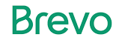

Digital Technologies
Build customer relationships across multiple touchpoints.
WhatsApp
Business
Email
SMS
Add Placement
Social
Our Platforms

Slide 17
B2B Data Acquisition
Data Access
Data is a core area of knowledge and expertise for us. We can effectively guide you through the process of purchasing the right data for your needs. Our own data set for is one of the most comprehensive in the market and can be obtained through a one-time purchase or an annual subscription.
Power your growth and unleash the potential of Data
CNCData has extensive experience in managing customer and prospect data, which can significantly drive your growth. With our expertise in enhancing, connecting, profiling, and cleaning data, we can transform it into a powerful asset for your business. As data specialists, we excel in sourcing the most relevant data and applying it effectively to your campaigns.
PLATFORM
Dataplus is our enterprise business intelligence platform that provides access to high-quality, hard-to-reach B2B prospects. It features a comprehensive dataset with extensive filtering options, giving you ultimate control to target new markets and territories. With DataPlus, you can expand your reach with a vast contacts database while maintaining complete control over your outreach efforts.
CONCIERGE SERVICE
Connect with one of our data experts for a tailored consultation to receive a customized list of high-value contacts, specifically matched to your business needs.

Slide 18
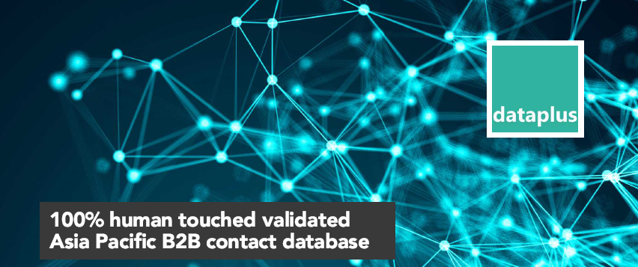
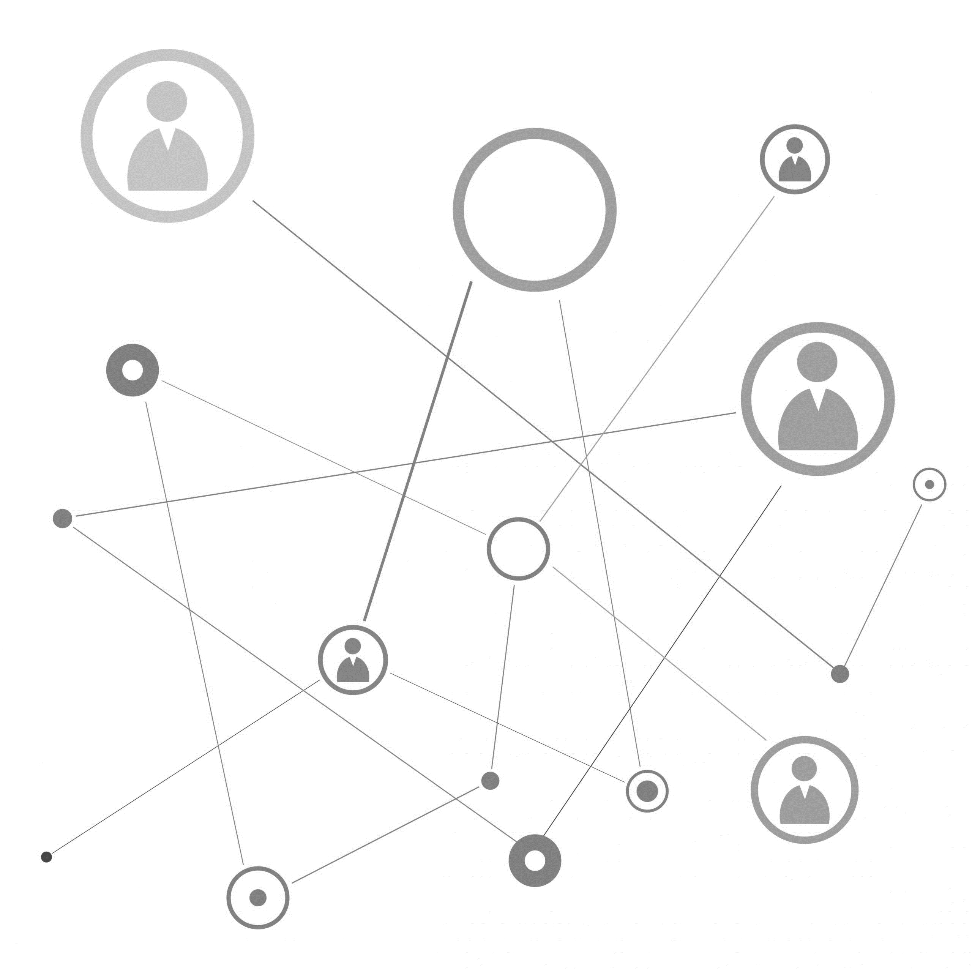
Balanced scorecard slide 2
Dataplus Platform
Asia’s Leading Enterprise B2B Data Platform
An enterprise business intelligence platform that enables organizations to make data-informed business decisions.
An online DaaS (Data as a Service) platform providing access to high-quality, hard-to-reach B2B data across the Asia Pacific region.
The most accurate and comprehensive dataset on enterprise companies in Asia, including firmographics, demographics, and technographics details.
Our sophisticated platform allows users to select the right data from a comprehensive database, which can be filtered by industry, job function, job level, number of employees, and more.
Records are validated for utmost accuracy through our contact centers, ensuring that only qualified and validated records are included in DataPlus.
Data coverage extends to 25 Asia Pacific countries, including ASEAN, ANZ, Greater China, India, Japan, Korea, and emerging markets.

Slide 19
Balanced scorecard slide 2
Why Dataplus?
COMPANY NAME
BUSINESS OVERVIEW
URL
BUSINESS TYPE
CORPORATE COUNTRY
CORPORATE ADDRESS
TELEPHONE
YEAR FOUNDED
REGISTRATION NO
INDUSTRY TYPE
SIC / NAICS CLASSIFICATIONS
SOCIAL LINKS
EMPLOYEE SIZE
REVENUE
LOCAL LANGUAGE PROFILE
Data is the most crucial part for any businesses to succeed.
DATA ATTRIBUTES
One Platform, 25 APAC Countries
  Single Source, multiple country coverage.
Local Asian Language
  Dataplus captures information in both local languages and English.
High Accuracy
  Achieved through digital and human touch validation.
Functional Contacts in Asia Pacific.
  Various functional contact levels available for selection.
Flexible Arrangements
  Options for on-demand purchases or long-term maintenance contracts.
50+ Data Points
  Provides comprehensive insights into Asian businesses and decision-makers
FIRST NAME
LAST NAME
JOB TITLE
DEPARTMENT
CONTACT ADDRESS
JOB FUNCTION
JOB LEVEL
DIRECT PHONE / MOBILE
CONTACT SOCIAL LINKS
BUSINESS EMAIL
LOCAL LANGUAGE PROFILE
VENDOR
PRODUCT
CATEGORY
COUNTRY
# OF PCS
# OF SERVERS

Slide 20
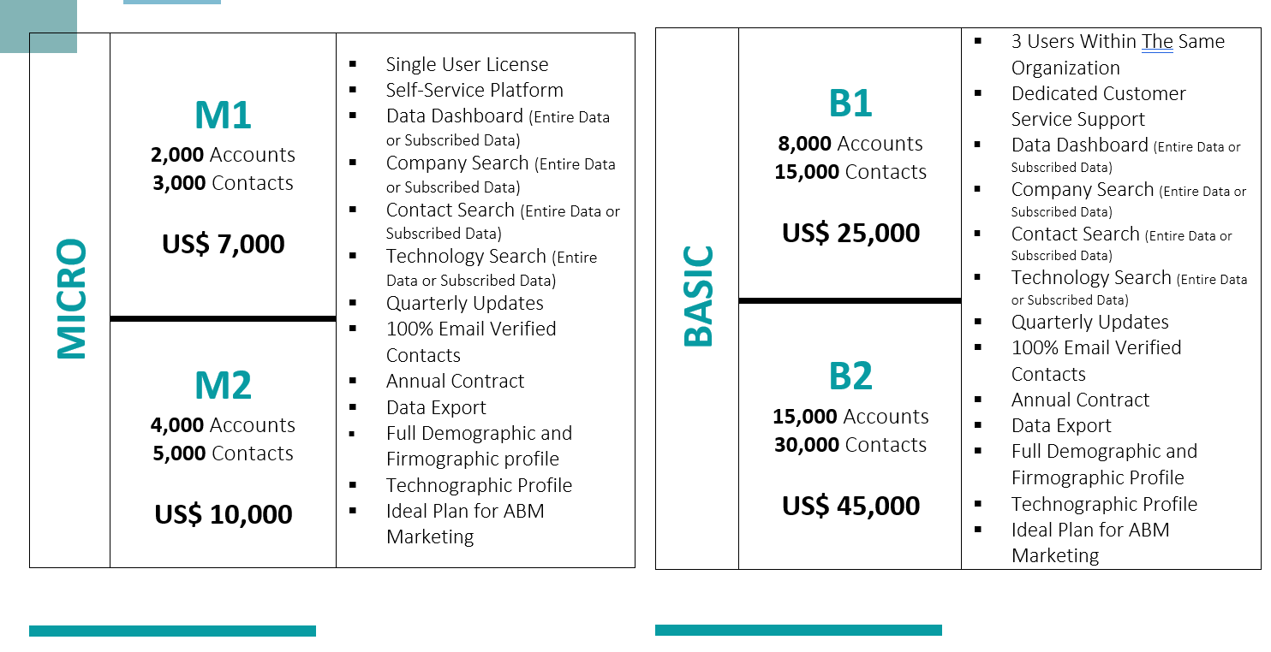
PRICING – TIER 1

Slide 21
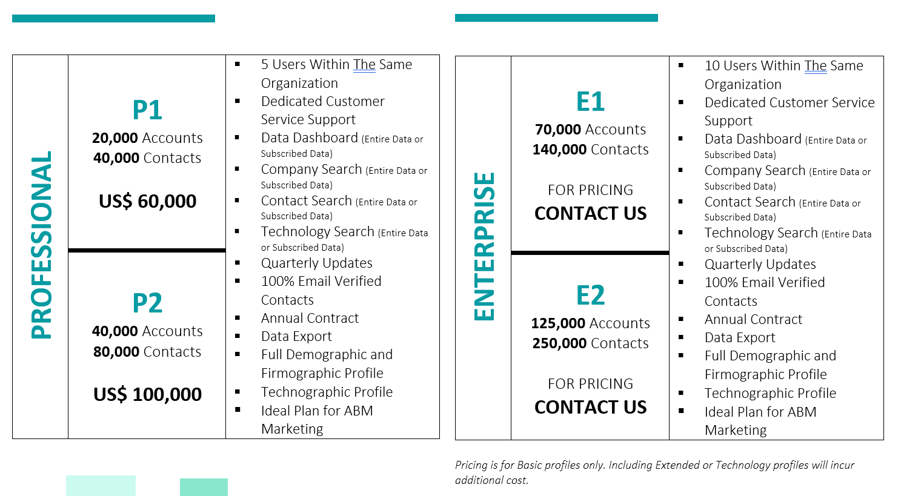
PRICING – TIER 2

Slide 22
Data Management
Leverage CNCData's Data Experts for your organization
DATA
PROCESSING
DATA
CLEANSING
Our experts provide tailored data management services designed to meet your specific needs. We focus on understanding your business objectives and analyzing relevant data to uncover actionable insights and strategic opportunities.
Partner with us to ensure that every decision is backed by precise, high-quality data, empowering you to drive sustainable success with data-driven decision-making.
DATA VALIDATION
DATA APPENDING
DATA
ENTRY
DATA
MATCHING

Slide 23
Harness the Power
of Our Data Expertise
Partner with CNCData to add value to address your data quality challenges immediately.
Fuzzy Matching
Quickly and accurately detect misspellings, abbreviations, and similar variations across diverse datasets using fuzzy matching. Build scalable, reusable configurations that support varying match types, including character-based and phonetic algorithms.
Address Verification
Address validation ensures the accuracy and standardization of postal addresses by verifying correct spelling, formatting, abbreviations, and geocoding, as well as appending precise ZIP codes. This process is vital for ensuring successful deliveries, streamlined shipping, and targeted direct mail campaigns based on customer locations.
We provide solutions to comprehensive Data Quality Management Lifecycle.
Record Linkage
Are you dealing with fragmented data? Our record linkage software effortlessly merges multiple datasets, eliminating the need for manual matching or intricate coding. Enhance your data quality strategy with ease..
Data Deduplication
Our data deduplication solution efficiently removes duplicate entries from your databases. Leveraging advanced data matching algorithms, it automatically identifies and eliminates identical records across systems, ensuring a unified and accurate source of truth.

Slide 24
Solution Overview
DATA
Collection
DATA
Hygiene
On-line System
Off-line System
Legacy System
Other Inhouse System
Data Entry
Data Validation
Data Processing
Data Integration
Data Matching
Data Cleansing
Address Hygiene
Data Standardization
Data Merge/Purge
Hardcopy Source
Data
Acquisition
Name
Cards
Directories
DATA
Maintenance
DATA
Enrichment
Target
Marketing
Direct
Marketing
Email
Marketing
Data maintenance Programs
Consultancy & Advisory
Remote Off-shore Support Services
Data Profiling
Data Augmentation
Data Appending
Data Linkage
Customer
Communications
Market
Research
Interactive
Marketing
$
Telemarketing
Lead
Generation
Other Program
Executions

Slide 25
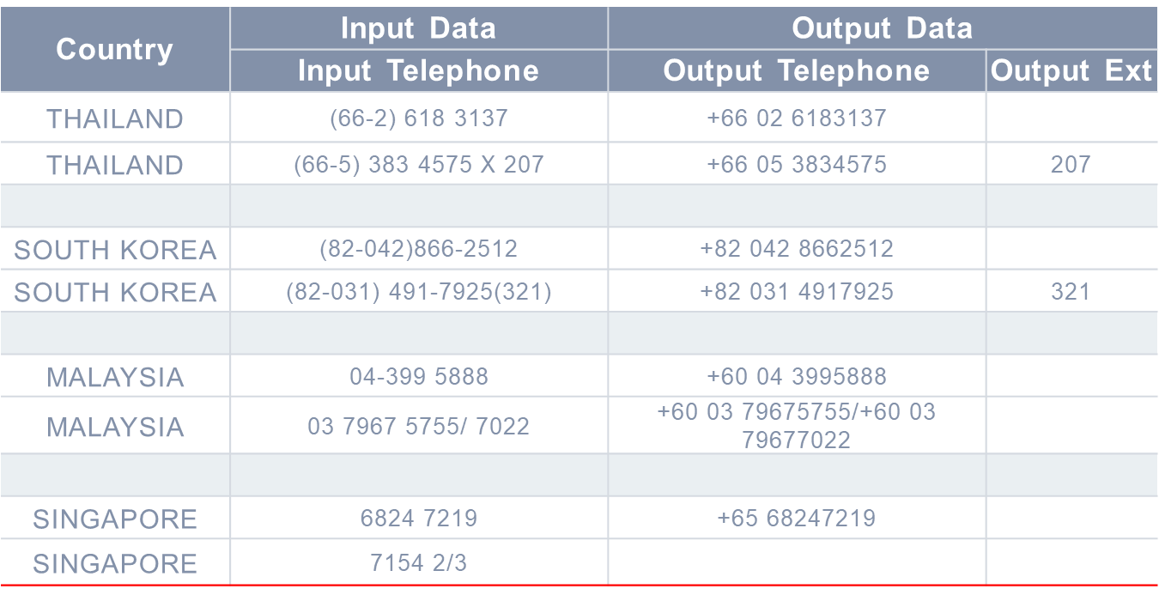
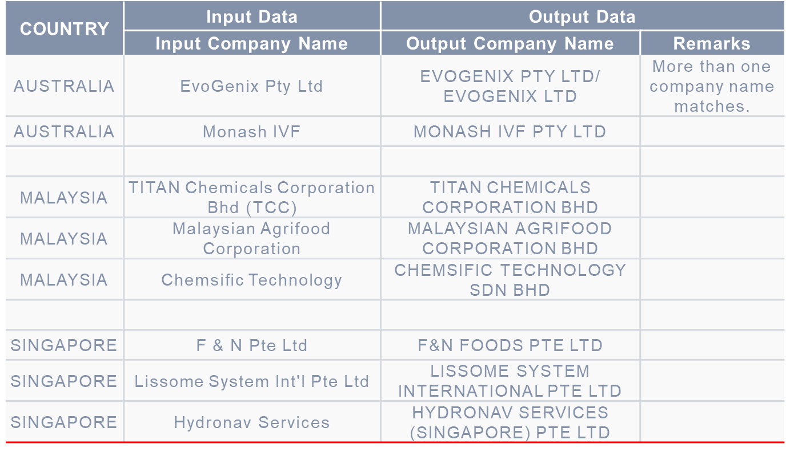
CONTACT NUMBERS
Samples.
LEGAL COMPANY NAME STANDARDIZATION
Data Deduplication
NAME | ADDRESS 1 | ADDRESS 2 | ADDRESS 3 | CITY | COUNTRY
YUKIKO INAGAKI | 1-30 AZABU-CHO, 2 CHOME |  |  | SAPPORO CITY 001 | JAPAN
YUKIKO INAGAKI | 2-1-30, ASABU-CHO, KITAKU | SAPPORO CITY 001-0045 |  | JAPAN
CHARLES LACEY | 221 AITKEN | GLENROTHES | FIFE | KY7 GSQ | SCOTLAND
CHARLES LALEY | 221 AITKEN ROAD | GLENROTHES | KY7 6SQ |  | UK
CUAUHTEMO LUIS | PARMA 36 | RES. ACOXPA,TLALPAN |  | C.P. 14300 | MEXICO
LUIS CUAUNTEMOU | PARMA 36 RES ACOXPA | CP 14300 |  | TLALPAN D.F. | MEXICO
CARLOTA GALVAO | BOX 1152 | CENTRO | 80001-970 CURITIBA PR |  | BRAZIL
CARLOTA GALVAO | CAIXA POSTAL 1152 | CURITIBA, PR 80001-970 |  |  | BRAZIL

Slide 26
Off-Shore Data Management
Cost Efficiency
Our offshore data management services significantly reduce operational costs by leveraging lower labor and infrastructure expenses in different countries. This helps businesses save on data storage, processing, and management costs.
Scalability
Our services offer the ability to quickly scale data management operations up or down based on business needs. This flexibility ensures that resources align with current demands, enhancing overall efficiency.
Access to Expertise
Our offshore data management provides access to a pool of specialized skills and expertise that may not be available locally. This includes advanced analytics, data security, and compliance knowledge..
Enhanced Focus on Core Activities
By outsourcing data management functions, our clients can concentrate on their core activities and strategic initiatives, while we handle all data-related tasks with expert care
Data Quality and Accuracy
Our dedicated teams focus on maintaining high data quality and accuracy through rigorous validation and cleansing processes, ensuring that the information we manage is reliable and up-to-date.
Innovation and Adaptability
Our offshore data management services incorporate advanced solutions like AI-driven analytics, automation, and cloud-based platforms, helping businesses stay competitive by leveraging the latest technological advancements..

Slide 27
Benefits of Our Data Management Solutions
1
Efficient Customer Acquisition:
Attract new customers and enhance cross-selling and up-selling opportunities with cleansed and highly profiled data
6
Enhanced Efficiency:
Boost operational efficiency with better planning and utilization of technology and resources, without compromising quality.
2
Faster Delivery:
Speed up shipping orders and direct mail newsletters by eliminating time spent verifying addresses
7
Self-Service Capabilities:
Utilize rapid self-service fuzzy matching to reduce the burden on IT and Data Operations departments.
3
Data Accuracy:
Gain confidence in the accuracy of your data, assess its current state, and build a deeper understanding of its content and structure.
8
Compliance Assurance:
Ensure your data management strategies adhere to compliance standards such as GDPR, PDPA, and others.
4
Reliable Analysis:
Ensure correct data usage in customer analysis reports, leading to more reliable insights
9
Increased Brand Loyalty:
Foster stronger brand loyalty through improved data management practices.
5
Improved Response Rates:
Achieve higher response rates for mail-outs and reduce returned mail instances due to incorrect addresses
10
Enhanced Customer Satisfaction:
Improve overall customer satisfaction by delivering more accurate and personalized interactions.

Slide 28



Account Profiling
Account Intelligence
Elevate your marketing efforts with precise account insights. Harness the power of our data intelligence and expertise to develop more effective strategies.
Data-Let Insights
Insightful Market Analysis
Installed and Intent Data
Leverage our data intelligence to build targeted accounts
Leverage our expertise and infrastructure to conduct primary and secondary research
Enhance with our Installed and Intent signals to precisely build your target account profiles

Slide 29
How we work with you
1
3
5
We seamlessly combine your data with our own, as well as data from our partner network, to build comprehensive source data points.
We have the necessary infrastructure in the region and can seamlessly integrate as an integral part of your pipeline development.
Our multi-touch and multi-channel approach guarantees the efficient profiles that we build.
Our in-house data combined with an extensive partner network enables us to offer a comprehensive 360-degree of accounts.
We conduct secondary research with our data analysts to enhance the profiles.
2
4

Slide 30
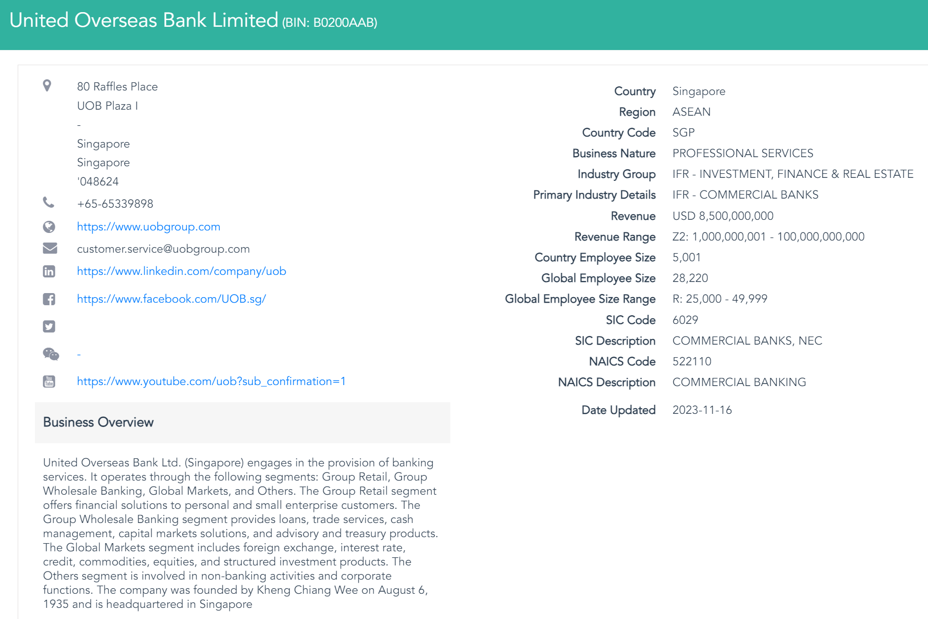

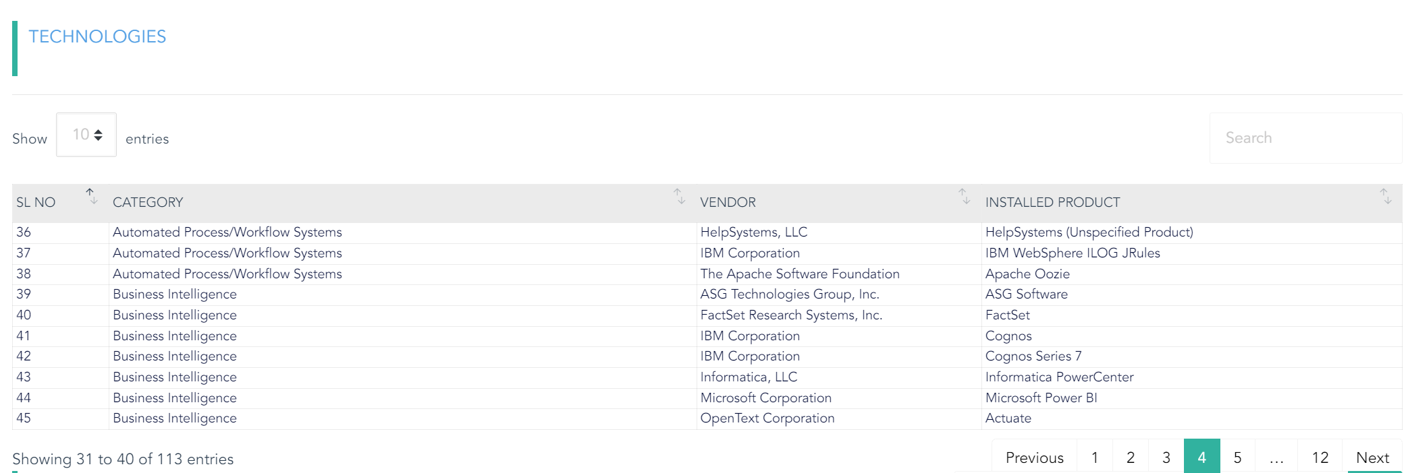
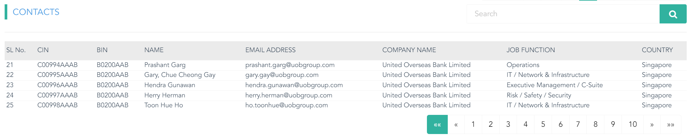
Account 360

Slide 31
Deep Profiling Programme
Define Objectives:
Identify the info needed and the scope of the research.
Identify reputable and reliable sources.
Build the repositories.
Secondary Research:
Build and validate required data points.
Extract relevant information and statistics from these sources.
Summarize key findings and insights from relevant sources.
Quality Control & Validation:
Apply quality control checks to validate the relevance and reliability of the data extracted.
Verify the credibility of the data obtained by cross-referencing information from multiple sources.
Data Delivery:
Platform Setup.
Access rights and prepare for demo/presentation.
Pre-planning
Data build and research
Conclusion
3rd Party/Partner Data Injection:
Establish a data mapping framework to ensure integration of partner/3rd party datasets.
Address any discrepancies in data formats or structures to facilitate smooth integration.
Data Development:
Review of existing list of accounts from CNCData.
Review of partner-led data.
Data merge, cleansing & enrichment.
Data Synthesis:
Organize and synthesize the collected data to create a coherent overview.
Prepare the database with the key findings with proper citations.

Slide 32
Multi-Channel Demand Generation
Lead Offering | Criteria/Output
MQL | Opted-in contact Business card details Confirmed call-back Date and time stamps
SQL | Opted-in contact Business card details Confirmed call-back Date and time stamps Profiled information
HQL | Opted-in contact Business card details Confirmed call-back Date and time stamps Profiled information Requirement confirmed
BANT | Opted-in contact Business card details Confirmed call-back Date and time stamps Profiled information Requirement confirmed Timeframe confirmation Funding availability
MQL
SQL
HQL
BANT

Slide 33



How we work with you
1
3
5
We seamlessly combine your data with our own and our partner network's data to construct a high-profile TAL.
We have the necessary infrastructure in the region and can seamlessly integrate as an integral part of your pipeline development.
Our multi-touch and multi-channel approach guarantees efficient lead conversions.
Our in-house data combined with an extensive partner network enables us to offer a comprehensive 360-degree view of leads.
We handle your TAL and legacy data to effectively convert them into valuable opportunities.
2
4

Slide 34





Multi-Channel Approach
1
Getting Started
2
3
4
5
6
Defining & Building TAL
Targeted Email Campaigns
Micro-site & Content Syndication
LinkedIn Outreach
Phone Prospecting
We understand your audience, and we will identify and build ideal target accounts and contacts. We personalize and enrich the TAL using our in-house and partner-led data sources.
We will deliver the appropriate content via email campaigns and gauge the level of interest through Open and Click Through behaviors.
We create targeted microsites tailored to the content you provide and effectively drive audience engagement.
We supercharge the engagement through our LinkedIn Outreach programs to qualify, validate, and nurture prospects.
Our skilled team engages in personalised conversations to understand the needs and gather meaningful insights about the leads.
Qualified Leads
7

Slide 35
Core Goals
Awareness
Secure
Building Stakeholder Awareness
Secure connection and identify the needs
01
02
03
04
05
Content
Relationship
Adopt
Customised Content based on personas and products
Deepen Stakeholder Relationship
Drive Adaptation

Slide 36










Deployment Plan
Digital
Regular nature emails
ConnectCX Banner Ad Placement
Use the LinkedIn channel to promote content to the target audience
Build a microsite, host the contents and assets
Deliver personalised eDMs to the personas
Personalised communication via WhatsApp Business API
Tele Outreach
Monitor Engagement People viewed/clicked
Not Interested
Gather additional insights and continue nurturing the prospect
Redeliver the message
Qualification
Engage with contacts and qualify them
Reactive Follow up
Engage with contacts who have not responded to eDMs or digital outreach
Conversion
Invite For Event
Register for upcoming events
Meeting Setup
Direct Meeting Setup
Trial Setup
Register for demo access

Slide 37


Outcome
Contactable Universe Prospecting
Profiling and Qualification
Actionable Prospects
Conversion
Positioning
Brand Activation
Demand Generation
80,000
Contacts Contacted
24,000
Successfully Profiled
12,000
Contacts Responded
3,600
Leads with Potential Opportunities
Inhouse Database
2,660
RSVPs
270
Leads/Meetings
2,120
Sign up/Registration
Profiling Questions with BANT criteria:
Budget = Yes, with no specific amount
Authority : Yes, a decision maker
Need : Willing to explore GW
Timeline: Within 12 months
Understand and Identify where the opportunities for Google Workspace.
Partner-Led Database
LinkedIn Channel Reach
Installed Intelligence
Intent Signals
TAL and Prospect Data from GW
TAL and Prospect Data from GW
Prospect Journey

Slide 38
Maximizing Event Success with Targeted Engagement
Precisely Identify Your Event's Target Audience
  We pinpoint the ideal attendees to ensure your event reaches those who matter most.
Craft Compelling Event Landing Pages
  We design comprehensive landing pages featuring the event agenda, speaker profiles, and a streamlined registration process.
Implement Multi-Touchpoint Engagement Strategies
  We create multiple engagement touch points to ensure no key personas are overlooked.
Extend Invitations Through Multiple Channels
  We deliver personalized invitations via email, SMS, WhatsApp, LinkedIn, and through our efficient contact center.
Amplify Event Visibility Through Our Content Platform
  We promote your event on our content platform to maximize reach and engage a broader audience..

Slide 39

Streamlined Attendee Management Solutions
Physical On-site Events
  Boost attendance for physical events with our streamlined RSVP management process. We bring attendees from your existing database and new sources.
Webinars
  We mxaximize webinar participation by managing RSVPs efficiently. We drive registrations through our strategic campaign management process to fill seats.
Virtual Events
  Leverage our contact centers and RSVP management expertise to attract attendees, ensuring maximum online engagement.
Hybrid (Physical and Virtual) Events
  Optimize RSVP processes for hybrid events. We ensure seamless integration of physical and virtual attendee management, maximizing overall event reach and impact.
On-demand Events
  Increase on-demand event viewership with precise RSVP management. We drive interest through customized promotions and ensure easy access for registered viewers.
Tailored Workshops
  Ensure high turnout for tailored workshops with targeted RSVP management. We attract relevant participants through personalized outreach and efficient registration processes

Slide 40



Deployment Plan
Reminders
Emails
WhatsApp
SMS
Event Landing Page Design
ConnectCX Banner Ad Placement
Deliver personalised eDMs to the personas
Personalised communication via WhatsApp Business API
Promote through LinkedIn paid ads
Monitor Engagement People viewed/clicked
Redeliver the message
Reactive Follow up
Engage with contacts who have not responded to eDMs or digital outreach
Reconfirmation
Retouch and re-confirm the attendance
Reminder Calls
Continuous Reminders
Registration
Capture the interest
RSVP
Registration

Slide 41



BPO/CX Solutions
Acquire New Customers
Leverage our 14 years of experience and expertise in various CX solutions to build and manage your customer experience programs.
Foster Customer loyalty
Ensure Regulatory Compliance

Slide 42

BPO Services
At CNCData, we offer a range of comprehensive BPO (Business Process Outsourcing) services that can help businesses of all sizes streamline their operations, reduce costs, and improve their customer service experiences. Our primary focus is on contact center services, including outbound and inbound services, as well as managed services.
We understand that each business has unique needs when it comes to managing their operations. That is why we work closely with our clients to understand their business needs and design customized solutions that meet those needs. Our services are flexible and scalable, which means that we can easily adjust our staffing levels to accommodate fluctuating workloads.

Slide 43
BPO Services
CNCData BPO
Contact Centre
Managed Services
Outbound Services
Inbound Services
- Demand Generation (SDR/MDR services)
- Attendees Acquisition
- Account Profiling
- Market Research
- Customer Service
- Tech Support
- Helpdesk Services
This involves outsourcing the management of a specific business function or process such as Data Entry, Desktop Research, Data Analysts and other management services

Slide 44
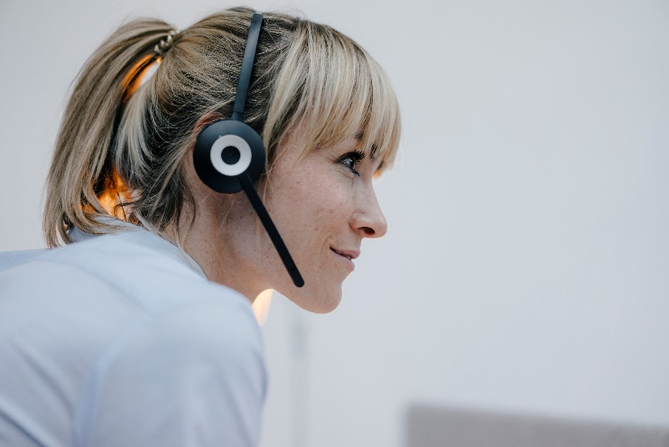

CNCDATA BPO – Contact Center Services
Our Outbound Contact Center services are designed to help businesses increase their sales revenue, improve customer satisfaction, and streamline their customer communication processes. Our team of experienced agents are trained in telemarketing, lead generation, attendee acquisition for the events (physical & virtual), customer profiling and customer surveys or market research, among others.
On the other hand, our Inbound Contact Center services are designed to help businesses provide exceptional customer service experiences by providing prompt and effective support to their customers. Our team of experienced agents are trained to handle a wide range of customer inquiries, including technical support, order processing, and general customer service.

Slide 45
Best in class multilingual calling teams
International Calling Capabilities
B2B technology focus
Covering Europe, USA, APAC and LATAM
Calling Hubs in Ireland, Eastern Europe, The Philippines, network of remote resources to cover all global requirements
Positioning technology solutions
Experienced callers able to identify and engage with senior contacts
Understanding of technology propositions
Native language skills & cultural knowledge
Covering most local languages globally
Programs set up and run based on local culture
Experts in Demand Generation
Callers experienced in engaging with senior contacts
Positioning client’s solutions
Full qualification
Nurture programs
Double opt-in expertise
Channel Programs
Data-driven approach
Our global file covers 56m decision making contacts
Ongoing maintenance
Data privacy compliant (PDPA, GDPR & ePrivacy, etc.)

Slide 46
Languages Supported
We support most languages, including
We support most Asian languages, including
English, German, French, Italian, Spanish, Dutch, Portuguese
Danish, Swedish, Finnish, Norwegian
Polish, Hungarian, Romanian, Bulgarian, Greek, Turkish, Czech, etc.
Russian
Arabic
Chinese (Mandarin and Cantonese)
Japanese
Tagalog
Cebuano
Korean
Thai
English

Slide 47

CNCDATA BPO – Managed Services
CNCData BPO Managed Services are designed to help our clients achieve their business goals by improving their operational efficiency, reducing costs, and allowing them to focus on their core business functions. By outsourcing their managed services needs to CNCData, our clients can benefit from our expertise and experience, while also reducing their operational costs.
Our BPO managed services include a range of activities such as data management, data entry, desktop research, back-office support, and more. Our team of experienced professionals are trained to handle each of these activities with professionalism, accuracy, and efficiency.

Slide 48



Business Process Outsourcing
Resource
Expertise
Time
Having the right resource in the right place at the right time is always a challenge, especially when the demands of the business fluctuate
There will always be times as a business grows and changes that we do not have the right expertise when we need it. especially true when running a business function that sits outside our day to day business
Even when we have the expertise, we don’t always have the time we need to dedicate to certain business areas.

Slide 49
Why CNCData?
We work with you as an
extension of your business.
We have extensive experience working with companies similar to yours.
We gave a strong infrastructure and can rapidly integrate into your organization.
We adhere to your requirements and create a tailored environment to meet your business needs.
We comply with your compliance practices and policies.
We have the expertise ready to be seamlessly applied within your organization.

Slide 50
CX solutions
With extensive experience in data management and validation processes, we specialize in ensuring the highest standards of data quality and consistency across various platforms. Whether you require real-time validation or offline checks for duplications, redundancies, or inconsistencies, our expertise enables us to enhance data accuracy and reliability. By meticulously managing these processes, we help you maintain a robust and trustworthy data environment, tailored to meet the specific needs of your customer ecosystem. Our solutions are designed to support seamless integration and functionality across all platforms, ensuring your data is always aligned with your business objectives.
Data Validation Programs
Our expertise in data management and validation programs ensures top-tier data quality and consistency, whether in real-time or offline data, across all platforms. We enhance data accuracy to align with your business needs to ensue high data reliability in any customer environment

Slide 51





How It Works
We work with your data
We are specialists in data management and contact center management
We follow your process, or one we agree together
We have experienced and pre-trained resource, ready to work for you.
We can work directly into your systems
Spend your time on your core business

Slide 52

Email Programs
Personalized Email Campaigns: We incorporate personalization tokens, such as the recipient’s name, to create a more engaging and relevant experience.
Hyper-Segmentation: We tailor our email content to specific segments based on their interests, behavior, and demographics to ensure relevance and engagement.
Automated Drip Campaigns: We set up a series of automated emails to nurture leads or guide customers through the buyer’s journey.
A/B Testing: We experiment with different subject lines, content, and CTAs to identify the most effective approaches for boosting open rates and click-through rates.
Clear Call-to-Action (CTA): We ensure each email has a single, clear action for recipients to take, whether it's visiting a webpage, signing up for a webinar, or downloading a resource.

Slide 53
Email Programs
Optimize for Mobile: We design our emails to be mobile-friendly, as a significant percentage are opened on smartphones.
Visual Appeal: We include strong visuals, such as infographics, images, or GIFs, to make our emails more engaging and to convey key messages quickly.
Compliance: We adhere to email marketing best practices and legal requirements, including providing an unsubscribe option and complying with GDPR or CAN-SPAM regulations.
Track and Analyze Metrics: We monitor open rates, click-through rates, and conversions to continually refine and optimize our email content and strategy.

Slide 54

SMS Reach
Personalized and Concise Messages: We use personalization to address recipients by name and tailor content based on their preferences and past interactions. We ensure short, clear messages that convey key information quickly and effectively, given the character limit of SMS.
Segmented Campaigns: We send targeted SMS campaigns to specific segments based on demographics, history, and behaviour to ensure relevance and engagement.
Timely Communication: We schedule SMS messages to be sent at optimal times when recipients are most likely to engage, such as during promotions or event reminders.
Compliance and Opt-In: We adhere to SMS marketing regulations, including obtaining proper consent and providing easy opt-out options to respect privacy and preferences.
Track and Analyze Performance: We monitor metrics such as delivery rates, response rates, and conversion rates to continually refine and optimize our SMS campaigns.
Event Reminders and Notifications: We use SMS for timely reminders and updates about events, appointments, or promotions, ensuring recipients are informed and engaged.
Promotional and Exclusive Offers: We use SMS to send exclusive promotions or time-sensitive offers to drive immediate action from recipients.

Slide 55
WhatsApp Business API
Harness the power of conversational experiences to deliver personalized journeys
Create new revenue streams
Maximize campaign effectiveness
Omni-channel solutions
Transform your customer interactions with advanced conversational technologies.
Excellent Customer Service
Deliver actionable insights
Build customer loyalty

Slide 56
WhatsApp Business API
Enhance your WhatsApp business messages on a reliable platform
Create meaningful interactions on WhatsApp with user-friendly automation capabilities and provide customers with always-on support.
Design conversational customer journeys with the WhatsApp Business Platform
Offer secure interactions, always-on customer support and create unique journeys across industries on the world’s most popular chat app.
Implement any use case on a single channel
Conversational marketing, sales or support use cases can be designed and deployed throughout the entire customer journey on WhatsApp over a unified platform
Enhance your communication strategy with WhatsApp features
WhatsApp features will help you develop creative and unique interactions for customers, improving your overall communication strategy.
Craft your communication strategy with multiple integration options
Easily implement the WhatsApp Business Platform into your existing tech stack and add on new integrations to build your B2C communication strategy.

Slide 57
Linked In
Optimized LinkedIn Profiles: Ensure our LinkedIn profiles are fully optimized with professional photos, compelling headlines, and detailed descriptions to attract and engage our target audience.
Targeted Content Sharing: We create and share content tailored to specific industries, job roles, and interests to engage our LinkedIn audience effectively.
Build and Nurture Connections: We actively build and nurture connections by engaging with posts, sending personalized connection requests, and following up with meaningful interactions.
Engage with Industry Groups: We participate in and contribute to LinkedIn groups relevant to our industry to establish thought leadership and connect with potential clients.
Personalized Connection Requests: We send personalized connection requests with a clear value proposition to build a relevant network and foster relationships.
Regular Updates and Insights: We post regular updates, including industry insights, company news, and valuable resources, to maintain visibility and keep our network informed.
Expert LinkedIn strategies to boost engagement, visibility, and lead generation.
We optimize profiles, create targeted content, use sponsored ads, and track performance for maximum impact.

Slide 58
Linked In
Utilize LinkedIn Ads: We leverage LinkedIn’s advertising options, such as Sponsored Content and InMail, to reach a targeted audience with tailored messaging.
Utilize LinkedIn Analytics: We monitor LinkedIn analytics to track engagement metrics, such as post interactions and follower growth, and refine our strategy based on performance insights.
Lead Gen Forms: We utilize LinkedIn’s lead gen forms to capture leads directly within the platform, simplifying the process for potential clients to express interest in our services.
Leverage Recommendations and Endorsements: We actively seek recommendations and endorsements from clients and colleagues to build credibility and showcase our expertise.
Showcase Case Studies and Success Stories: We highlight case studies and success stories to demonstrate our capabilities and provide evidence of our value to potential clients.
Expert LinkedIn strategies to boost engagement, visibility, and lead generation.
We optimize profiles, create targeted content, use sponsored ads, and track performance for maximum impact.

Slide 59




Additional Services
eDM Design
Microsite/Landing Page Setup
Call To Action (CAT) Setup
Banner Ads.
We create impactful eDM campaigns with engaging designs and compelling content. Our service enhances your brand’s visibility and drives better results, ensuring your messages resonate and perform effectively.
We build tailored landing pages and microsites that leverage your existing content to create compelling and effective experiences. Our team will transform your content into a visually appealing and high-converting page, ensuring it aligns with your brand and business goals. From design to deployment, we handle the entire process, allowing you to focus on your core business while we optimize your landing pages for maximum impact and engagement
Our call-to-action forms are crafted to boost engagement and conversions by prompting users to take specific actions, like signing up or making a purchase. Integrated into our platform, these forms feature dynamic, responsive designs and robust backend support for real-time validation, automated follow-ups, and performance analytics.
We design compelling banner ads that stand out and drive action. Our team combines creative visuals with strategic messaging to ensure your ads not only capture attention but also deliver measurable results. Tailored to your brand and audience, our banner ads enhance visibility, boost engagement, and convert viewers into loyal customers.

Slide 60

OUR COVERAGE
ASEAN
SINGAPORE, MALAYSIA, PHILIPPINES, INDONESIA, THAILAND & VIETNAM
INDIA
INDIA & SOUTH ASIA
GREATER CHINA
HONG KONG & TAIWAN
Specialised in the Asia Pacific and Oceania regions with a localised delivery center and over 14 years of experience.
ANZ
AUSTRALIA & NEW ZEALAND

Slide 61

Why CNCData
ESTABLISHED BLUE-CHIP CLIENTELE
ESTABLISHED brand
Our clients are mostly blue chip and include many ‘fortune 500’ companies. Over 60% of our customers have come through referrals from existing customers.
In operation since 2010, with 8 offices across 7 countries and employing over 200 dedicated professionals. Over 85% of our business comes from repeat customers who have worked with us over multiple years.
DATA EXPERTISE
Tailored SOLUTIONS by experts
We have extensive experience in handling customer and prospect data, which can genuinely drive your growth.
With extensive experience and practical knowledge, our team specialises in delivering Data-driven CX solutions tailored to individual customer needs.
Native language skills & cultural knowledge
LOCAL CONTACT CENTRES
Our expertise, along with our local teams, precise language skills, and in-depth local knowledge, facilitates rapid expansion into the Asia Pacific and Oceania regions for your business.
Our dedicated contact centers across 8 locations can serve as an extension to your business, providing prompt activation for any Customer Engagement (CX) programs.
We serve diverse industries and stand as a trusted partner for established and high-growth new-economy enterprises seeking to harness the region’s exponential growth potential by leveraging our local expertise and strong presence in Asia

Slide 62



































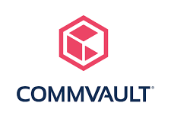










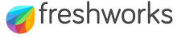



























You will be in Good Company

Slide 63

Strategic offices
UNITED STATES
SINGAPORE
MALAYSIA
PHILIPPINES
AUSTRALIA
Los Angeles,
United States
Harbourfront,
Singapore
Kuala Lumpur
Malaysia
Makati
Philippines 1227
Melbourne
Australia
THAILAND
INDIA
PHILIPPINES
VIETNAM
Cebu
Philippines
Ho Chi Minh
Vietnam
Bangkok
Thailand
Kerala
India
Sales and Execution Office
Execution Office Only

Slide 64
Get In Touch
+65 6530 9015
enquiries@cncdata.com
www.cncdata.com
1 Maritime Square, #10-27 Harbourfront Centre, Singapore 099253

