Slide 1

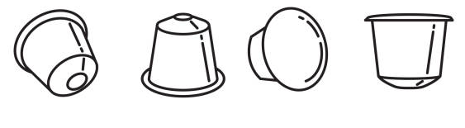
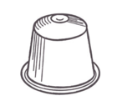




Team Logo
IMAGES NEEDED with text above or below…
Capsule wearing a jetpack – text: “Powered by NABs”
Capsule “flexing” with wifi logo overhead – text: “Powered by NABs and WiFi”
Capsule wearing a gold medal – text: “NABs Retail Champion”
Capsule wearing a cape looking heroic - text: “A NABs Superhero”
(Coffee) Capsule shape
STYLE
Capsule can have arms and legs, or not

